Slide 1
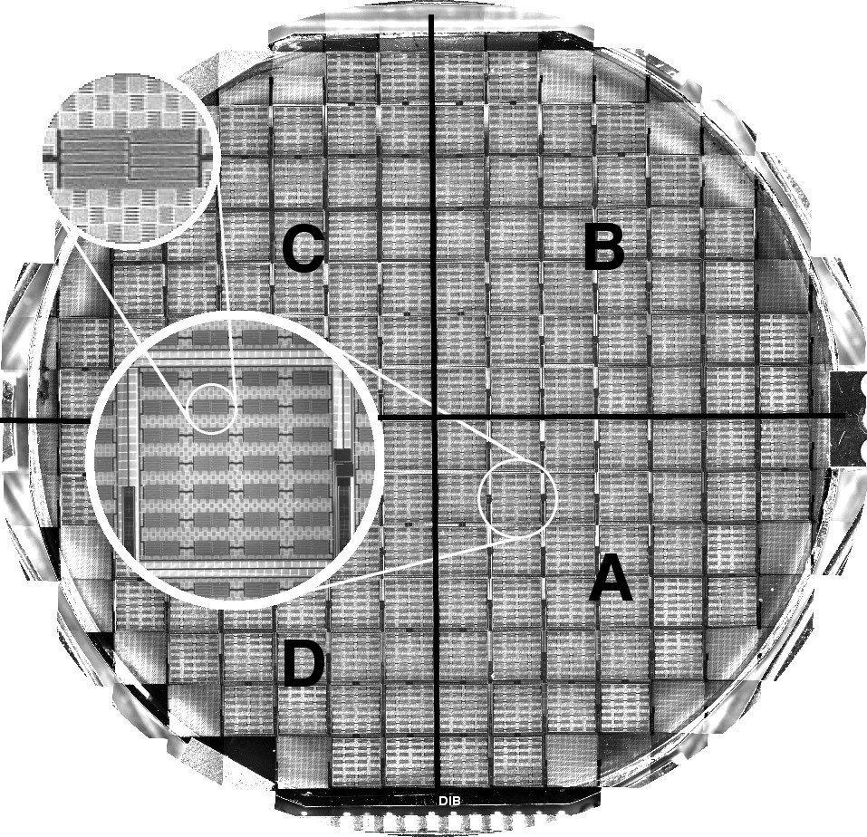
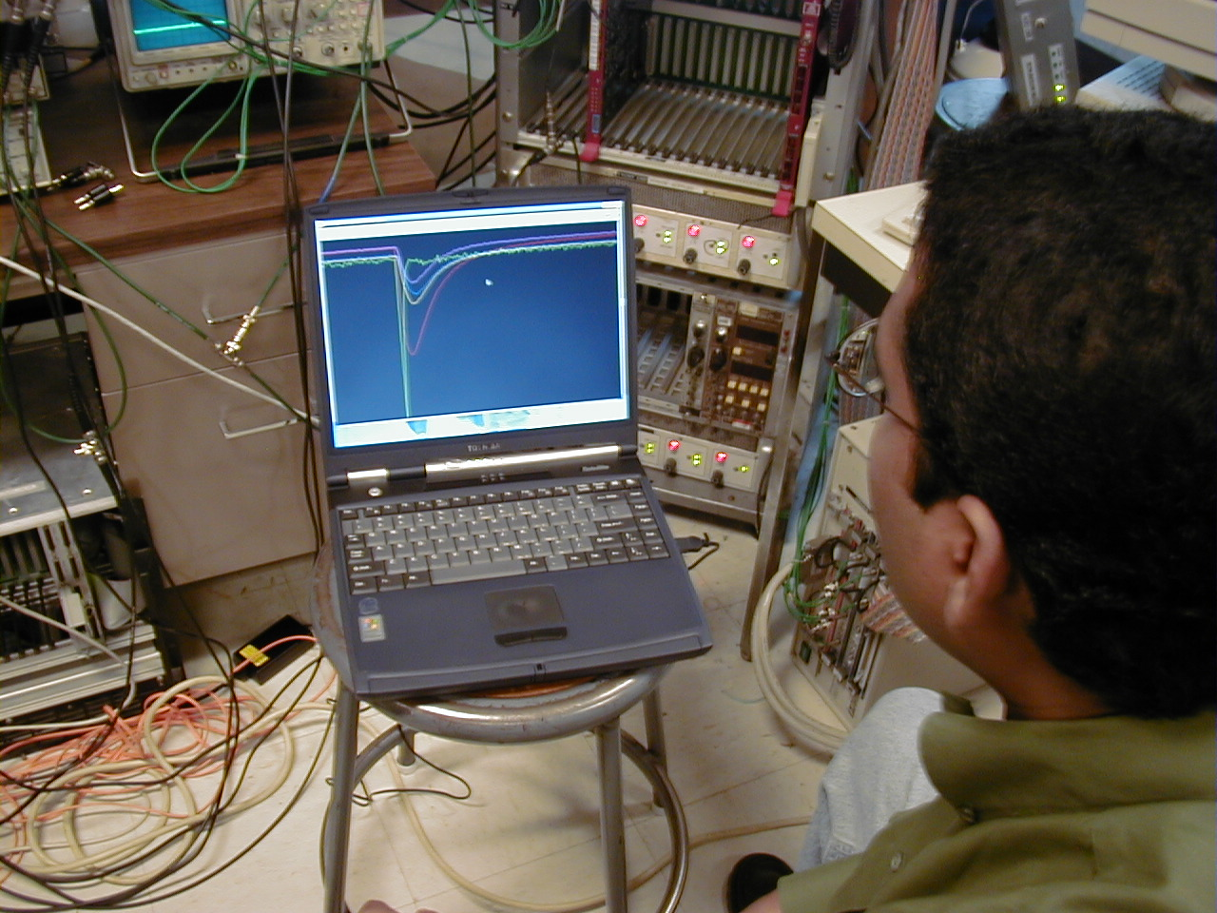
Understanding the CDMS detectors: Choose a power supply for your TES

Slide 2
Outline
Energy deposition in CDMS detectors
Sensing the energy deposition
Transition Edge Sensor (TES)
Making the TES human-readable: the TES circuit I
Keeping the TES working: the TES circuit II
Requirements on circuit stability: the TES circuit III
Using an off-the-shelf current source: the TES circuit IV

Slide 3
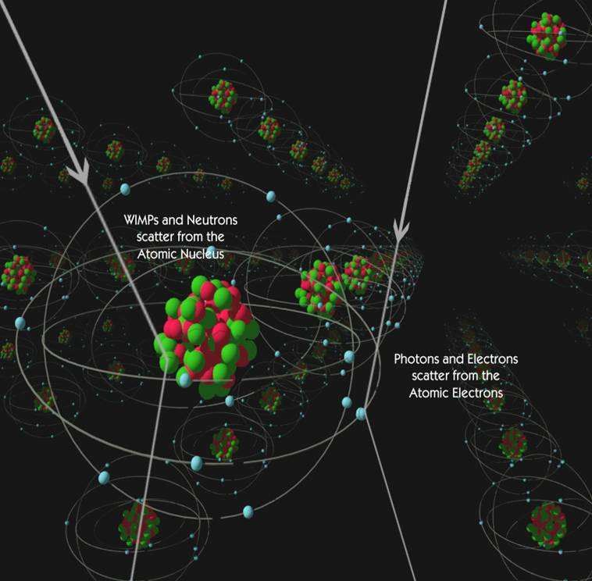
Energy deposition: an energetic particle interacts within the CDMS crystal
At the moment of the interaction
A particle can deposit energy in a CDMS crystal in two ways:
Create phonons (vibrations in the crystal lattice)
Create ionization (electron-hole pairs)
Slightly after the interaction
More phonons: if the electrons and holes feel an electric field, they’ll accelerate and produce more phonons via the Luke-Neganov effect.
A lucky break
A particle interacting with the detector has two options: (1) interact with a nucleus and (2) interact with an electron. When a particle interacts with a nucleus, the energy preferentially goes into phonon creation; with an electron interaction, the energy preferentially goes to ionization.

Slide 4
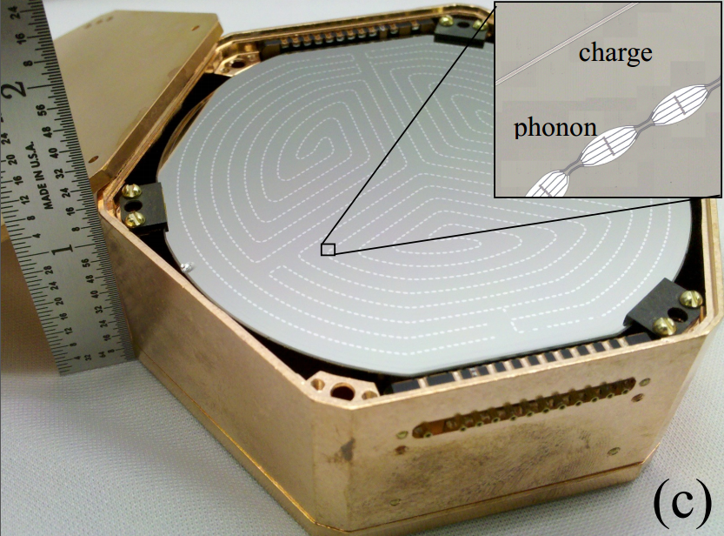
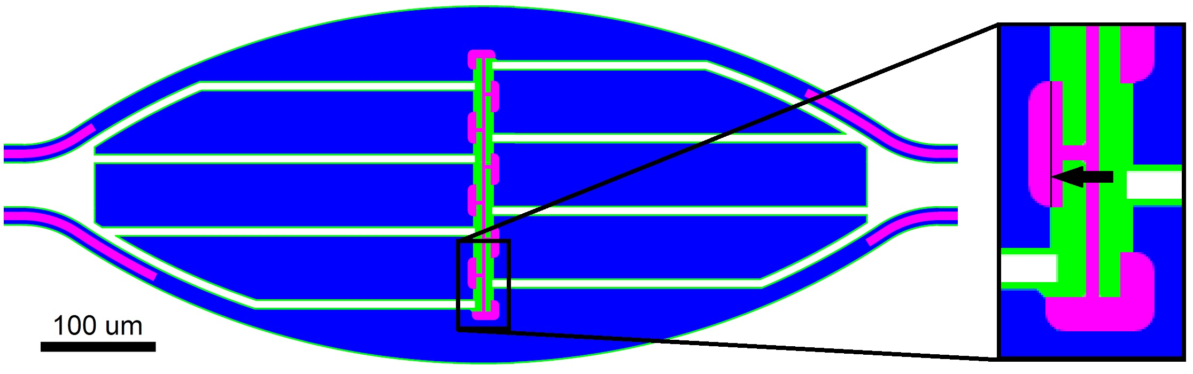
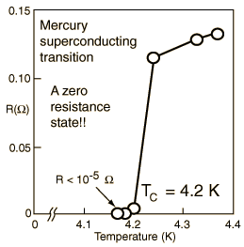
See the energy
Deposit energy
Increase TES temperature
Increase TES resistance

Slide 5
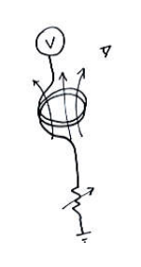
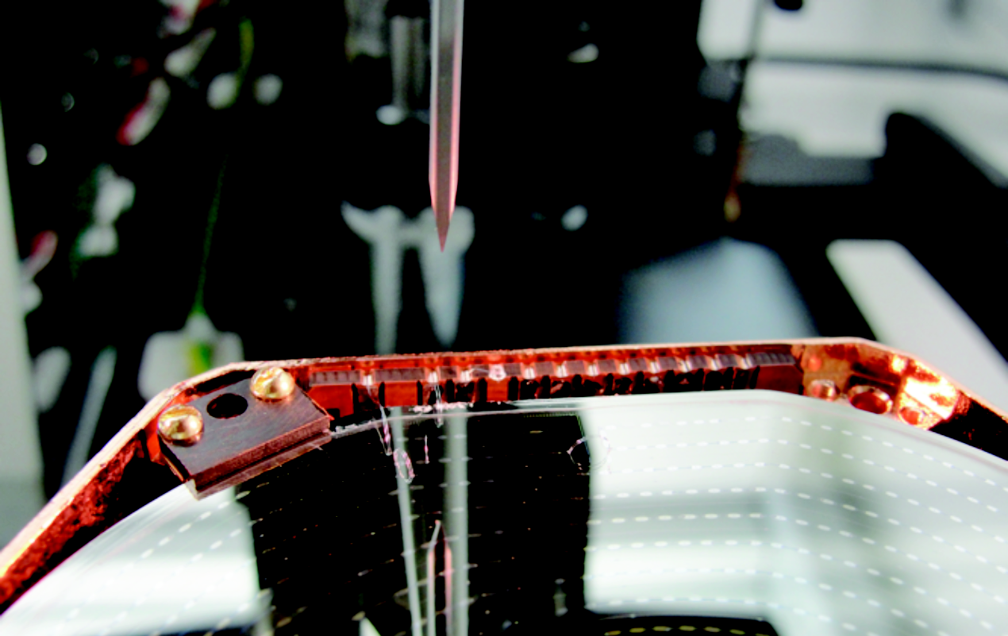
See the energy
We can use SQUIDS to see magnetic fields with very little added noise
The TES is on the crystal

Slide 6
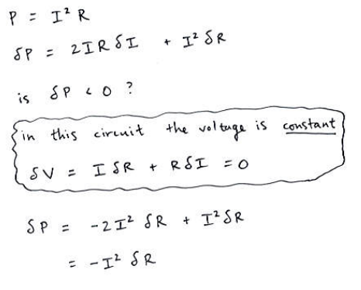
See the energy for multiple events

Slide 7
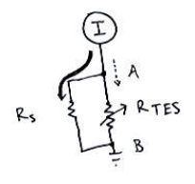
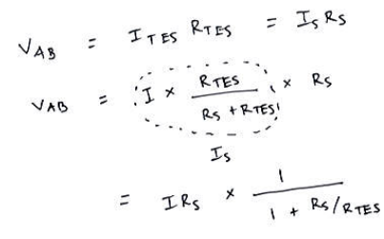
See the energy with existing power-supply technology
The TES (one channel = an array of sensors hooked up in parallel) ends up being ~ 2 Ohms. The shunt resistor is ~ 20 milli Ohms.

Slide 8
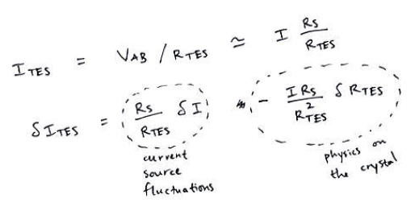
See the energy with existing power supply technology
The TES (one channel = an array of sensors hooked up in parallel) ends up being ~ 2 Ohms. The shunt resistor is ~ 20 milli Ohms.
Heating the TES into its superconducting transition typically requires ~ 20 micro Amps.

