Slide 1

GraphQL
A QUERY LANGUAGE FOR YOUR API

Slide 2
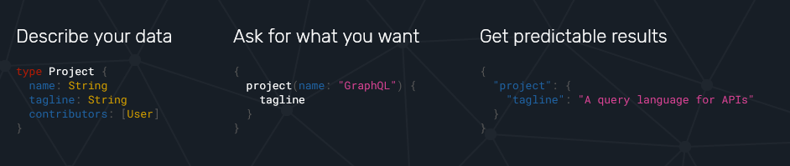

Slide 3
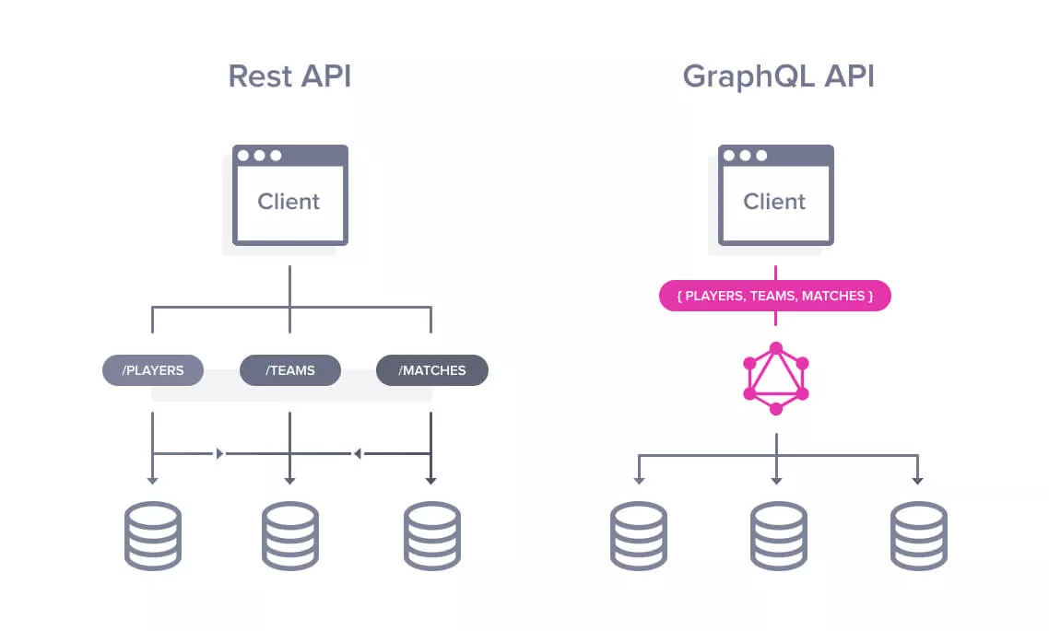

Slide 4
👨‍💻 Warm-up time!

Slide 5
Get all data in a single request! Describe all entities No versioning Better validations No third-party applications for API development

