Slide 1

GraphQL
A QUERY LANGUAGE FOR YOUR API

Slide 2
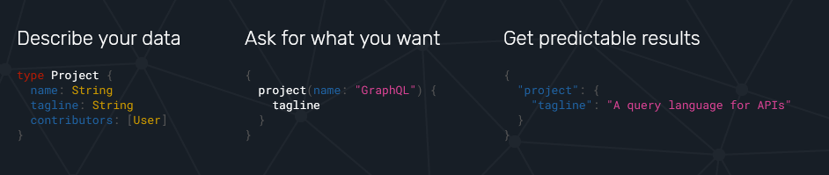

Slide 3
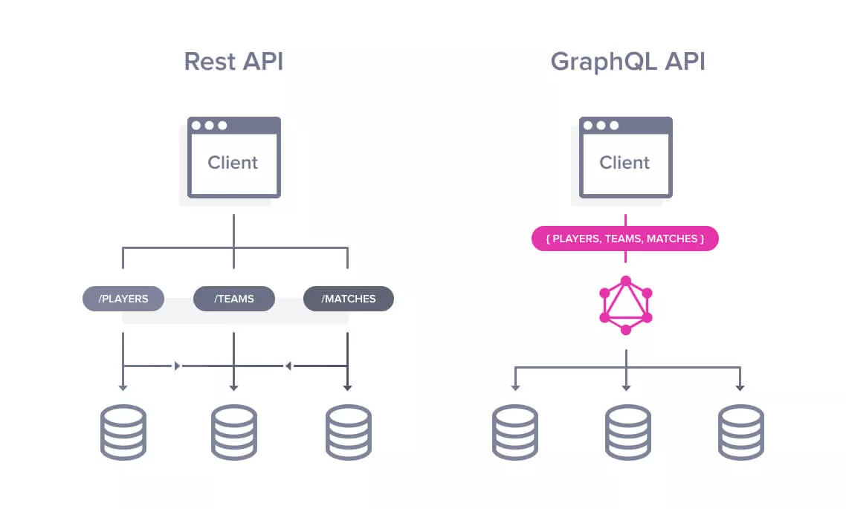

Slide 4
👨‍💻 Warm-up time!

Slide 5
Welcome back! 👍
Get all data in a single request! Describe all entities No versioning Better validations and misspell correction No third-party applications for API development

Slide 6
Some samples: https://github.com/APIs-guru/graphql-apis

