Slide 1
The Database Engines
Oracle9i MS SQL Server 2K
PostGreSQL 7.x MySQL 4.1x

Slide 2
Warmup: The ACID Test
Atomicity:
Suppose you have a transaction comprised of an UPDATE, an INSERT and a DELETE statement. Start the transaction, and yank the plug from the wall. In what state is your data now? Atomicity means that either the three statements changed all your data, or none of it.
Consistency:
When the transaction is complete, both the data and internal structures are correct, and accurately reflects the changes effected by the transaction.
Isolation:
One transaction cannot interfere with the processes of another concurrent transaction.
Durability:
All changes are permanent at the end of the transaction.

Slide 3
Warmup: Enterprise Systems
ALWAYS pass the ACID test with flying colors
Sophisticated Query Optimization
  Extensive indexing, usually supports many kinds of indexes
  Automatic, advantageous use of multiple processors
Support for Multi-Server Implementations (“Clustering”)
Enormous Data Capacity (gigabyte, terabyte, more)
  Can support terabyte (10^12 bytes) or better
  Extensive data partitioning support
Reliable Backup Utilities
  Automated and Schedulable
  Full or Incremental
Data-Replication Tools
Procedural application languages (PL/SQL, T-SQL, 4GL, etc)
  Usually run in the same application space as the server
Detailed transaction management methods
Tools for bulk-loading data
Extensive options for user management and permissions (separate, and/or in conjunction with OS user permissions)
Licensed by User or CPU: EXPEN$IVE

Slide 4
Warmup: “Desktop” Systems
May not pass ACID (until recently, MySQL did not support transactions)
Usually limited support for SQL 92 (“The” standard for SQL syntax)
  80/20 rule: designers implement 20% of the instructions, which are used 80% of the time (again until recently, MySQL did not support nested relationships)
Cannot usually handle very large databases easily, many cannot handle moderate (1GB+)
  Don’t support clustering
  BUT: PostgreSQL has been reported to handle a few 4 TB systems
Lack sophisticated and/or scalable query optimization
  Works well, even stellar on small to medium datasets, and/or simple table joins, but performance degrades with increasing data volume or join count
  Not multi-processor aware
Typically, provide limited or no procedural languages (exception: postgreSQL)
Lack sophisticated, very reliable backup utilities tested on enormous data loads (critical failing)
Do not support multi-server installations
Limited/Lacking support for data partitioning (necessary for effective RAID usage)

Slide 5
Assessing Differences
Architecture
Performance
Maintenance
Application Support (PL/SQL, Java, PHP, etc)
Scalability
Platform Support

Slide 6
A Method
Port (or imagine porting) a richly featured Oracle database to PostGres, MySQL, and SQL Server 2K. What changes must be made to the DDL? To the SQL queries? To the data itself?
The database should feature, at least:
  6-12 tables
  1 table of gigabyte size
  1 table with blobs

Slide 7
Port Oracle to SQL Server?
Common Syntax: very little. This is a big job.
DDL | Some important differences on tablespace distribution. MS uses “Identity” for Oracle “Sequence” Etc.
SQL | Mostly similar – both have robust support of SQL 92. Some changes for “EXCEPT” and “MINUS”.
Procedural Languages | Requires a complete rewrite. Different string and date manipulation functions, procedures and cursors are declared slightly differently. T-SQL != PL/SQL
Architecture | Again some important differences. SQL Server user is not really equivalent to an Oracle user: by default Oracle users have their own schema and tablespace; in SQL everyone is assigned roles, shares a tablespace unless specifically changed.
Note: MS Data Transformation Services does ease the manual work considerably.

Slide 8
Oracle -> PostGreSQL
DDL | PostGreSQL is pretty friendly with Oracle. There will be warnings about syntactical differences. Sequences may fail on you.
SQL | Almost identical
Procedural Languages | Again almost identical. We’ll see some differences in a minute.
Architecture | Be wary of user/schema relationships. PG is more like SQL Server here. Tablespace distributions might need to be changed as well to take advantage/avoid PG’s implementation of large-file support. (older versions supported only 8K rows, by the way – this could be upped to 32 at compile time, but with a speed hit. The new version presumably fixes this).

Slide 9
Oracle -> MySQL
DDL | Views, Triggers, Stored Procedures, some foreign keys will fail. Beyond that most syntax should run.
SQL | Almost identical
Procedural Languages | N/A
Architecture | Be sure to use InnoDB or BerkeleyDB, not Classic. MySQL should be flexible with regard to the Oracle architecture.

Slide 10
Porting Applications
What are the problem points?
The procedural language syntax might be different
The interface drivers (DBI/DBD, JDBC, ODBC) might not be supported as well
Query parsers might be called differently
Parsers may handle large result sets differently

Slide 11
Applications, Oracle -> PostGreSQL
PostGreSQL comes packaged with PL/pgSQL, its own version of Oracle’s PL/SQL. It is ALSO (rather handily) packaged with handlers for C, Perl, Tcl and Python.
Procedural languages on PostGres are executed by handler code, not the database server code itself. pgSQL, for instance, is executed by a handler program written in C. When a procedure is called, the server calls the handler and passes on a pointer to the object to be run.
Here are some important differences from Oracle’s PL/SQL:
No default values for parameters
You can overload function names
No need for cursors, use FOR instead (cursors are supported and though the syntax is slightly different, PG recognizes Oracle syntax too)
Single quotes must be escaped in the procedure body
Use schemas instead of packages to group your functions.

Slide 12
Applications, Oracle -> MySQL
At this time, MySQL supports no procedural SQL-based languages, stored procedures, or triggers. Ad-hoc queries only (via a query tool, Java, C, Tcl,etc application).
MySQL expects to support a form of PL/SQL, procedures and triggers with version 5.1.
You need to write applications in your (supported) language of choice to query MySQL (via DBI/DBD, ODBC, JDBC, etc)

Slide 13
MySQL: SQL92 Compliance and other Issues
Departures from SQL 92 - Sub Queries supported in InnoDB only - Transactions – InnoDB only - Foreign Keys – InnoDB only, not checked during bulk loads - No Views -- comment issues (supported only lately, must have trailing space) | Known Problems that are Likely to Appear: Table corruption during bulk loading – platform dependant Bulk loader is new Multiple LEFT JOIN and RIGHT JOINs in a query can return incorrect results Replication fails Cannot refer to temporary tables within a query more than once. This fails: SELECT * FROM temp_table, temp_table as T2

Slide 14
Performance
Obviously, along with Maintenance and Scalibility, this is the metric we care about most.
MySQL is extremely fast.

Slide 15
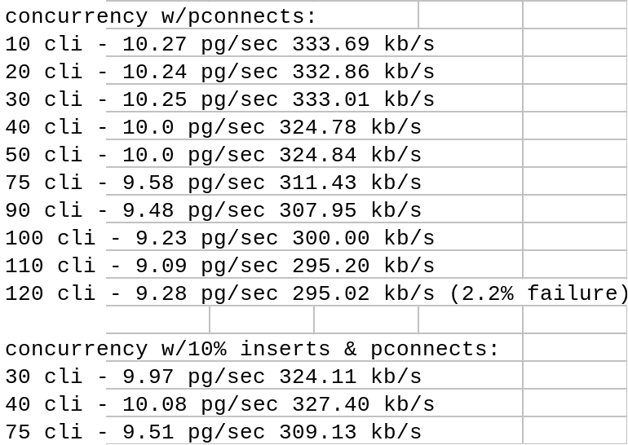
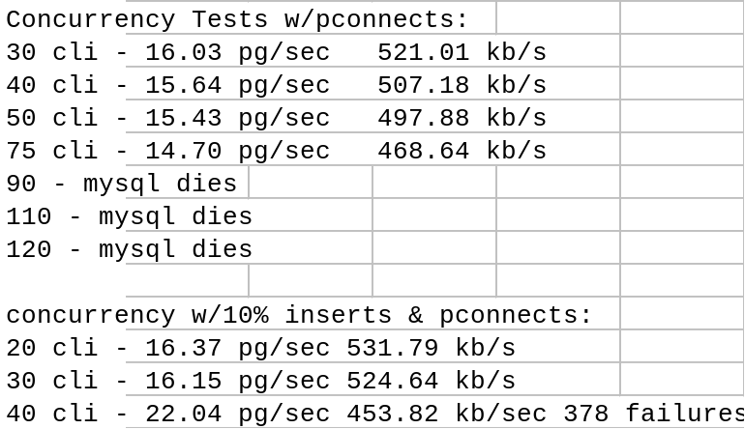
PG vs. MySQL
Tim Perdue’s results:
PostGreSQL 7.0.2
MySQL 3.22.3
Postgres scales roughly 3x’s higher for concurrent connections…
But MySQL is 3xs as fast
Source: http://www.phpbuilder.com/columns/tim20000705.php3?page=2

Slide 16
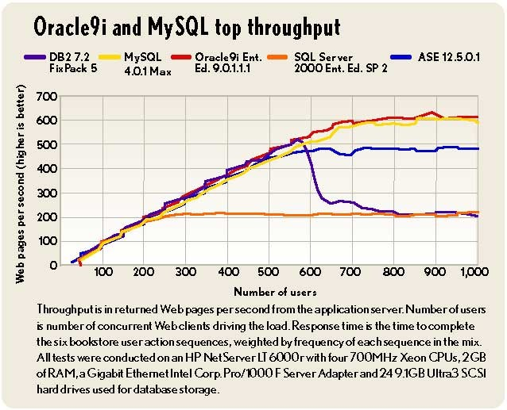
Throughput Benchmark
Source: eWeek (http://www.eweek.com)

Slide 17
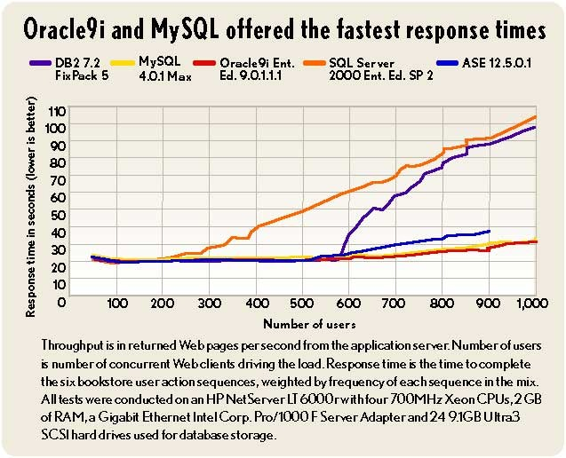
Response Times
Source: eWeek (http://www.eweek.com)

Slide 18
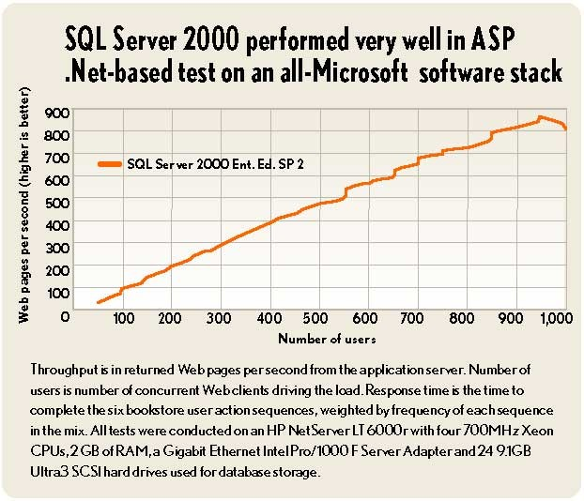
SQL Server on MS
Source: eWeek (http://www.eweek.com)

Slide 19
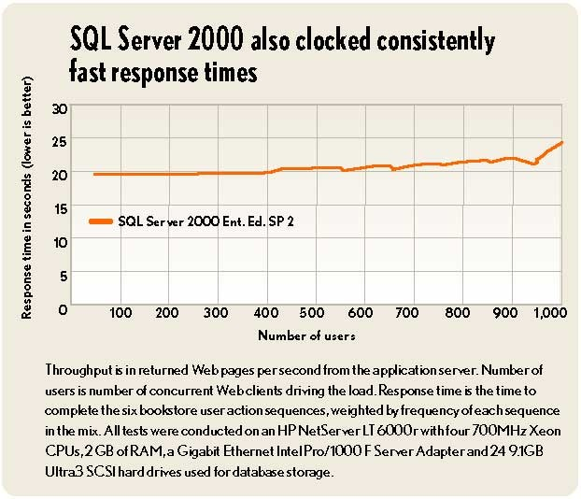
SQL Server Response Times
Source: eWeek (http://www.eweek.com)

Slide 20

MySQL: Pricing
MySQL Pro
MySQL Pro includes the InnoDB transactional storage engine, which provides row-level locking.
Number of licenses
Price per copy
EUR
USD
GBP
1 .. 9
440.00
495.00
290.00
10 .. 49
315.00
360.00
205.00
50 .. 99
255.00
290.00
165.00
100 .. 249
195.00
220.00
127.00
250 .. 499
155.00
175.00
100.00
500 +
ask for quote, sales@mysql.com
Price is given per Server (not per CPU)
Source: http://www.mysql.com/products/pricing.html

Slide 21
PostGreSQL: Pricing
Free.

Slide 22
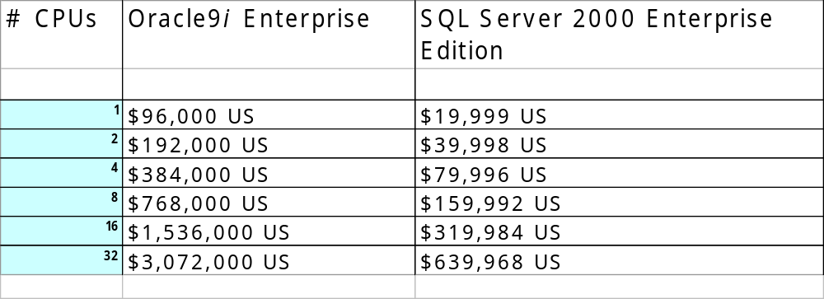
Some Actual Pricing!
(according to Microsoft)
Oracle9i Enterprise Edition and SQL Server 2000 Enterprise Edition
With Management Tools, Advanced Security Features, and Business Intelligence Features (May 2003)
Source: http://www.microsoft.com/sql/evaluation/compare/pricecomparison.asp
Date: 9/25/2003

Slide 23
Some Words on Market Acceptance
Oracle and SQL Server | Pretty much control the Fortune 100 market (Oracle=51%), sharing space with DB2
PostGreSQL | Widely used by experienced DBAs seeking affordable Oracle-like solutions. Enjoys formal and rapid development. Large user base across all platforms.
MySQL | Probably has a larger user base than PostGres. Blinding performance makes it a popular solution for simple databasing needs and high-read-to-write ratio systems. Also enjoys formal development, a large development community, a very large user base (also across all platforms). Is now supported through formal support contracts.

Slide 24
Case for Middleware and Stored Procedures
Because the workers developing Flash and web media code are not typically database experts, its usually desirable (to say the least) to separate functional logic from presentation code.
One way would be to have your front end developers hand the code to the DBA to implement. But this is clearly not a good solution.
Another is to leave your logic in stored procedures. The only calls your developers make to the database are via procedure calls. But this requires them to manipulate data after they get it.
So the method that has become very common is to establish one or more layers of middleware code that separates the presentation layer, from the data formatting layer, from the data retrieval layer, from the database.
This also makes it easier to compartmentalize your application across many machines

Slide 25
Bottom Lines
If your Shop is… | Use…
UNIX, Enormous Enterprise | Oracle
NT, Enormous Enterprise | SQL Server
Unix or NT, transaction-heavy data, or require extensive RI (bank, complicated records, etc) | PostGreSQL
Same as above, but speed is king and you’re doing mostly reads anyway. Or, you just need an easy, well documented DB | MySQL

