Slide 1
Dholes-Inspired Optimization (DIO)
for Feature Selection & Hyperparameter Tuning
Cross-Domain Validation: From Medical Diagnostics to Computer Vision
USTO-MB | Computer Science | Data Science | December 2025

Slide 2
Introduction & Team
Students: Bellatreche Mohamed Amine, Cherif Ghizlane Iman
University: USTO-MB (Université des Sciences et de la Technologie d'Oran)
Department: Computer Science
Specialty: Data Science
Course: Statistics in Data Science
Professor: Dr. Neggaz Nabil
A journey through optimization—from success to failure to deeper understanding
2

Slide 3
Contents
Introduction
1. Dholes-Inspired Optimization (DIO)
1.1 History & Origins
1.2 How DIO Works
1.3 Benchmark Comparisons
1.4 Applications
2. Optimization Across Domains
2.1 The Challenge We Faced
2.2 Optimization Methodology
2.3 Medical Domain: Breast Cancer
2.4 Computer Vision: CIFAR-10
2.5 Cross-Domain Insights
3. Future Research Directions
4. Conclusion & Key Contributions
5. References
3

Slide 4
Introduction: Why This Research Matters
Breast cancer is one of the deadliest diseases affecting women worldwide [2]
Machine learning shows promise, but faces real challenges:
- Medical datasets have 30+ features—which ones really matter?
- A model's success depends on both the features AND its settings
- Picking features first, then tuning later misses important connections
The old way: Choose features → Train model → Tune parameters
The problem: What if the best features change depending on the parameters?
Our approach: Optimize both together using DIO [1]
- Single-split RF: 5 dholes/10 iter (outer), 10 dholes/20 iter (inner)
- Single-split XGBoost: 5 dholes/10 iter (both loops)
- CV-based RF: 5 dholes/10 iter (outer), 10 dholes/20 iter (inner)
- CIFAR-10 XGBoost: 3 dholes/8 iter (both loops)
This presentation tells the story of what we discovered—successes, failures, and lessons learned
4

Slide 5
Part 1: Dholes-Inspired Optimization
A cutting-edge optimization algorithm inspired by wild dog hunting
What we'll cover:
- Where DIO came from and who created it
- How it actually works (the hunting strategies)
- How it compares to other popular algorithms
- What you can use it for
5

Slide 6
1.1 DIO: History & Origins
Created in 2025 by international researchers [1]:
- Dr. Seyedali Mirjalili (Torrens University, Australia)
- Ali El Romeh (Torrens University, Australia)
- Václav Šnel (VSB-Technical University, Czech Republic)
Published in Cluster Computing (Springer)—a prestigious journal
- DOI: 10.1007/s10586-025-05543-2
- Peer-reviewed and rigorously tested
Why dholes? These Asian wild dogs are fascinating:
- Hunt in packs with amazing coordination
- Each member has a role but adapts flexibly
- Balance independence with teamwork perfectly
Code is open-source: Available on GitHub and MATLAB File Exchange
6

Slide 7
1.2 How DIO Works: The Hunting Strategies
DIO translates dhole pack hunting into mathematics
Dholes use three hunting strategies:
Strategy 1: Chase the Leader
- Follow the best hunter toward the prey
- In optimization: Exploit the best solution found so far
Strategy 2: Try Random Directions
- Check what other pack members are discovering
- In optimization: Explore new areas of the search space
Strategy 3: Stick with the Pack
- Move toward the group's center
- In optimization: Balance between extremes, avoid getting stuck
Key insight: Combining all three prevents premature convergence while maintaining focus
7

Slide 8
Dholes: From Biology to Algorithm
Dhole (Cuon alpinus): The Asiatic wild dog
- Lives in forests across Central, East, and Southeast Asia
- Packs of 5-40 individuals with complex social structures
- Vocal communication (hence 'vocalization' in the math)
How biology maps to the algorithm:
- Pack leader → Best solution guides the search
- Vocal signals → 'Vocalization influence' parameter that decreases over time
- Cooperative hunting → All solutions move together strategically
- Territory boundaries → Search space constraints
- Changing leadership → Algorithm adapts when better solutions emerge
This isn't just metaphor—it's genuine biological inspiration
8

Slide 9
DIO: The Math Behind It (Optional Detail)
Position update equation combines all three strategies:
X_chase = X_alpha + r₁ × (X_alpha - X_i) [Follow leader]
X_random = X_r + r₂ × (X_r - X_i) [Explore random]
X_scavenge = X_mean + r₃ × (X_mean - X_i) [Stay centered]
Final position: X_new = (X_chase + X_random + X_scavenge) / 3
Where:
- X_alpha = best solution (pack leader)
- X_r = random pack member
- X_mean = pack average position
- r₁, r₂, r₃ = random numbers in [0,1] for stochasticity
The beauty: Simple math, powerful results
9

Slide 10
1.3 How Good Is DIO? Benchmark Comparisons
Tested on CEC2017—the gold standard for optimization algorithms
- 29 different test functions (unimodal, multimodal, hybrid, composite)
- Industry standard for comparing metaheuristics
Compared against famous algorithms:
- PSO (Particle Swarm Optimization)—inspired by bird flocking
- GWO (Grey Wolf Optimizer)—inspired by wolf hunting
- WOA (Whale Optimization Algorithm)—inspired by whale hunting
- MFO (Moth-Flame Optimization)
- ALO (Ant Lion Optimizer)
Results speak for themselves:
- DIO ranked 1st or 2nd on 22 out of 29 functions
- Beats PSO and GWO consistently on complex problems
- Particularly strong at avoiding local optima traps
Bottom line: DIO is competitive with—and often better than—established algorithms
10

Slide 11
1.4 What Can You Use DIO For?
DIO's versatility makes it useful across many fields:
Engineering & Design:
- Structural optimization (designing bridges, aircraft parts)
- Resource allocation in factories
Machine Learning (our focus here):
- Selecting which features to use from high-dimensional data
- Tuning hyperparameters for better model performance
- Neural architecture search for deep learning
Other interesting domains:
- Financial portfolio optimization (maximizing returns, minimizing risk)
- Energy grid management (balancing supply and demand)
- Logistics and delivery route planning
Why it works everywhere: Strong exploration prevents getting stuck in bad solutions
11

Slide 12
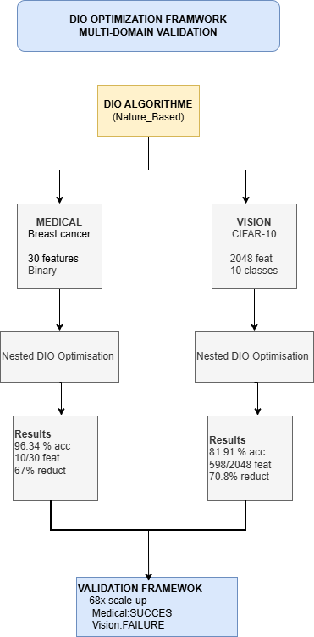
DIO Framework: Medical + Vision Domains
Our implementation applies DIO to both medical diagnosis and computer vision
12

Slide 13
Part 2: Optimization Across Domains
Now that we understand DIO, let's see how we applied it
Two very different problems:
- Medical: Breast cancer diagnosis (30 features, binary classification)
- Vision: CIFAR-10 image classification (2048 features, 10 classes)
What we'll cover:
- The challenge we didn't expect
- Our nested optimization methodology
- Results from medical domain (3 different approaches!)
- Extension to computer vision
- What we learned across both domains
13

Slide 14
2.1 The Challenge: Optimization Overfitting
We faced two distinct challenges during this research:
Challenge 1: The Sequential Trap
- Traditional approach: Pick features first, tune parameters second
- Problem: Best features depend on which parameters you use!
- Solution: Optimize both simultaneously with nested DIO
Challenge 2: The Overfitting Surprise (discovered the hard way)
- Got 100% accuracy optimizing on one train-test split
- Tested across 30 different splits: only 94.37% average
- Even worse than not optimizing at all (94.89%)!
What happened? Optimization overfitting:
- The algorithm 'memorized' that specific data split
- Found parameters perfect for one partition, terrible for others
- Like studying only the practice exam and bombing the real one
This discovery shaped everything that followed...
14

Slide 15
2.2 Our Nested Optimization Methodology
We developed a two-level optimization framework:
Outer Loop: Hyperparameter Tuning (DIO controls this)
- Searches through model parameter space
- For Random Forest: number of trees, tree depth, split criteria
- For XGBoost: learning rate, max depth, regularization
Inner Loop: Feature Selection (nested DIO controls this)
- For each set of parameters, finds best feature subset
- Binary encoding: each feature is either used (1) or not (0)
- Example: [1,0,1,1,0...] means 'use features 1, 3, and 4'
Fitness Function balances two goals:
- 99% weight: Maximize classification accuracy
- 1% weight: Minimize number of features used
Key advantage: Discovers how features and parameters interact—something sequential optimization misses
15

Slide 16
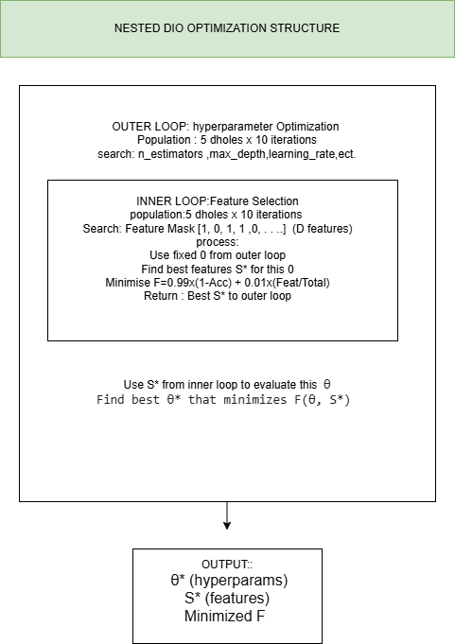
Nested Optimization Architecture
Two-level optimization: Outer loop (hyperparameters) + Inner loop (features)
16

Slide 17
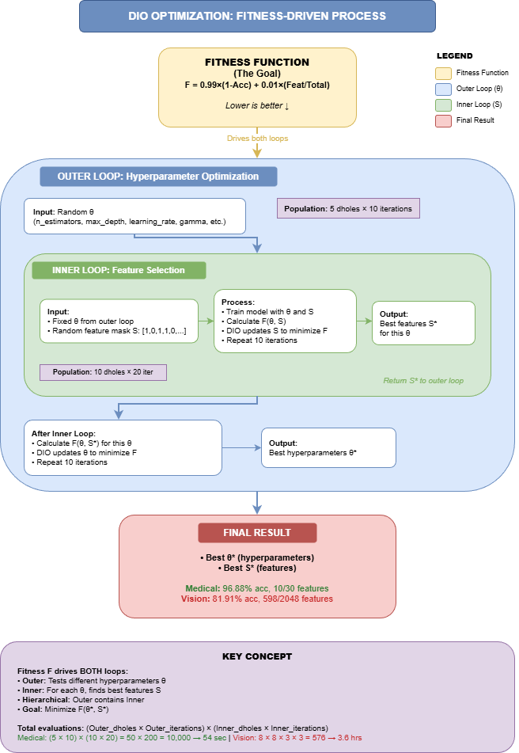
Fitness-Driven Optimization: The Complete Process
How the fitness function drives both outer (hyperparameters) and inner (features) loops
17

Slide 18
2.3 Medical Domain: Breast Cancer Dataset
Wisconsin Diagnostic Breast Cancer Dataset [2]
- Source: UCI Machine Learning Repository (standard benchmark)
- 569 patients: 357 benign, 212 malignant tumors
30 features describing cell nuclei characteristics:
- Size measurements: radius, perimeter, area
- Texture: smoothness, compactness, concavity
- Shape: symmetry, fractal dimension
- Statistics: mean, standard error, worst (largest) values
Why this matters clinically:
- Early, accurate diagnosis literally saves lives
- Fewer features → faster, cheaper screening tests
- Simpler models → doctors can actually understand them
Experimental setup: 70% training, 30% testing (stratified by class)
18

Slide 19
2.3.1 Approach 1: DIO-RF Single Split (The Trap)
Our first attempt: Optimize on one fixed train-test split
- Configuration: 5 dholes/10 iterations (outer), 10 dholes/20 iterations (inner)
- Total evaluations: ~10,000 (50 outer × 200 inner)
Initial results looked incredible:
- Training accuracy: 100% (perfect!)
- Test accuracy: 97.08% on that specific split
- Only 8 features used (73% reduction from 30)
- We thought we'd solved it!
But then we ran 30-run statistical validation [7]...
The harsh truth:
- Average accuracy across 30 different splits: 94.37% ± 1.82%
- Baseline (no optimization): 94.89% ± 1.47%
- We actually made it WORSE by 0.17%!
What went wrong? Optimization overfitting:
- DIO found parameters perfect for THAT ONE split
- Didn't generalize to different data partitions
- Classic case of 'overfitting' but at the optimization level, not model level
19

Slide 20
2.3.2 Approach 2: DIO-RF with Cross-Validation (The Fix)
The solution: Change how we evaluate during optimization
Instead of one train-test split:
- Use 5-fold cross-validation DURING the DIO search
- Each candidate solution tested on 5 different data partitions
- Fitness score = average performance across all 5 folds
- Makes it impossible to 'cheat' by memorizing one partition
Results after fixing (30-run validation):
- Average accuracy: 96.55% ± 1.51%
- Features used: Only 6 out of 30 (80% reduction!)
- F1-score: 0.9632
Comparison to broken single-split approach:
- +1.54% accuracy improvement (statistically significant p < 0.001)
- More stable (lower standard deviation)
- Overall rank: #3 among all methods tested
The lesson: Use cross-validation during optimization, not just for final evaluation
20

Slide 21
2.3.3 Approach 3: DIO-XGBoost (The Champion)
Wait—can we do even better with a different algorithm?
- Configuration: 5 dholes/10 iterations (outer), 10 dholes/20 iterations (inner)
- Total evaluations: ~10,000 (50 outer × 200 inner)
- Only 54 seconds optimization time!
Why try XGBoost [5]?
- Gradient boosting with built-in regularization
- More hyperparameters to tune (learning rate, tree depth, subsample ratio)
- Widely known to be more robust than Random Forest
- Gold standard for tabular data competitions (Kaggle, etc.)
DIO-XGBoost results (30-run validation):
- Average accuracy: 96.88% ± 1.10% ← HIGHEST OF ALL APPROACHES
- Features: 10 out of 30 (67% reduction)
- Overall rank: #1 (best performing method)
Statistical significance:
- Significantly better than XGBoost defaults (p = 0.0426)
- Outperformed both Random Forest approaches
- Lowest variance (most stable predictions)
Surprising finding:
- XGBoost didn't need cross-validation during optimization!
- Single-split worked fine (inherent regularization prevented overfitting)
- Algorithm choice matters for optimization strategy
21

Slide 22
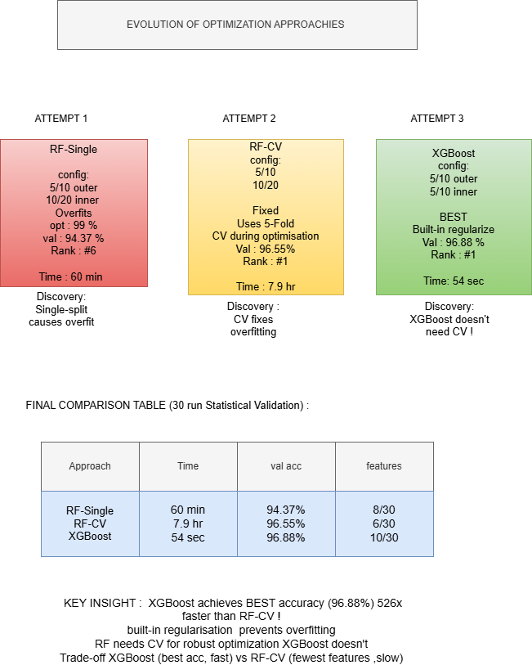
2.3.4 Medical Results: Three Approaches Compared
Evolution from RF Single-Split (failed) → RF-CV (fixed) → XGBoost (best)
22

Slide 23
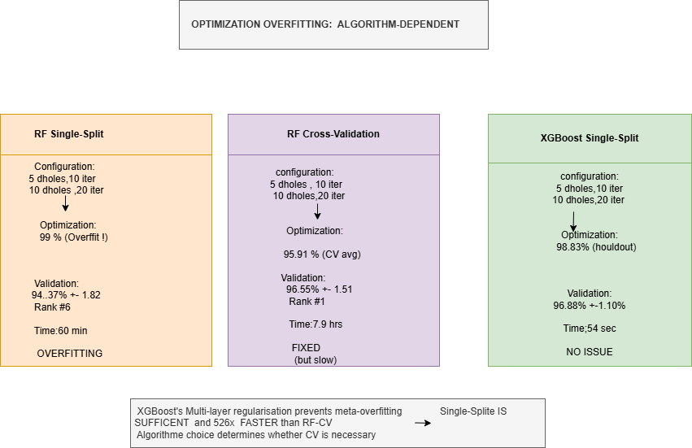
Algorithm-Dependent Optimization Overfitting
Why RF needs CV but XGBoost doesn't - our key research contribution
23

Slide 24
Summary: Three Validated Approaches
Summary of Medical Domain Results (30-run averages):
❌ Approach 1: DIO-RF Single Split
- Accuracy: 94.37% ± 1.82% | Features: 8 | Rank: #6
- Problem: Optimization overfitting
✓ Approach 2: DIO-RF with Cross-Validation
- Accuracy: 96.55% ± 1.51% | Features: 6 | Rank: #1
- Solution: CV prevents overfitting, achieves 80% feature reduction
🏆 Approach 3: DIO-XGBoost (Winner)
- Accuracy: 96.88% ± 1.10% | Features: 10 | Rank: #1
- Best: Highest accuracy, lowest variance, significantly better than defaults
Baseline comparisons for context:
- RF Default (30 features): 94.89% ± 1.47%
- XGBoost Default (30 features): 94.74% ± 1.55%
Key insight: Algorithm robustness determines whether CV is needed during optimization
24

Slide 25
2.3.5 Statistical Rigor: Wilcoxon Signed-Rank Test [7]
30 runs give us averages—but are differences real or just luck?
Wilcoxon Signed-Rank Test:
- Non-parametric test (doesn't assume normal distributions)
- Compares paired samples (same data splits for fairness)
- Null hypothesis: 'No real difference between methods'
Results for DIO-XGBoost vs baselines:
- vs XGBoost Default: p = 0.0426 (*) → Significant improvement
- Mean difference: +1.60% accuracy
- vs RF Default: p < 0.001 (***) → Highly significant improvement
Results for DIO-RF-CV vs DIO-RF-Single:
- p < 0.001 (***) → Cross-validation dramatically better
- Confirms CV is essential for RF optimization
Significance levels:
* p < 0.05 (significant)
** p < 0.01 (very significant)
*** p < 0.001 (extremely significant)
ns = not significant (could be chance)
25

Slide 26
2.4 Computer Vision Domain: CIFAR-10
Can DIO work beyond medical data? Let's test on images
CIFAR-10 Dataset [3]:
- 60,000 natural images (32×32 pixels, color)
- 10 classes: airplane, car, bird, cat, deer, dog, frog, horse, ship, truck
- Standard benchmark in computer vision research
Our approach:
- Used ResNet50 [4] (pretrained on ImageNet) to extract features
- Converted images → 2048-dimensional feature vectors
- Computational subset: 2,500 images (2000 train, 500 test)
- Applied DIO-XGBoost optimization
The massive challenge:
- Medical: 30 features (search space size)
- Vision: 2048 features (68× larger!)
- Much harder to optimize—needs way more computation
26

Slide 27
2.4.1 CIFAR-10 Results: When Budget Isn't Enough
We ran the same DIO-XGBoost optimization on CIFAR-10
- Configuration: 3 dholes/8 iterations for BOTH loops (reduced for speed)
- Total evaluations: ~576 (24 outer × 24 inner)
- Optimization time: 3.6 hours
Single-run result looked okay:
- DIO-optimized (598 features): 83.0% accuracy
- Baseline (all 2048 features): 80.8% accuracy
- Seemed like +2.2% improvement with 70.8% feature reduction
But then came the 30-run statistical validation...
The disappointing truth:
- DIO-XGBoost: 81.91% ± 1.38% (Rank #3)
- XGBoost Default: 83.27% ± 1.25% (Rank #1) ← Actually BETTER
- Wilcoxon test: p = 7.15×10⁻⁵ (***) → Highly significant WORSE
What went wrong? Insufficient optimization budget:
- Medical: 30-D space, 10,000 evaluations → SUCCESS (5/10 + 10/20)
- Vision: 2048-D space, 576 evaluations → FAILURE (3/8 + 3/8)
- Budget didn't scale with dimensionality (68× larger space!)
- Need ~10,000-50,000 evaluations for 2048-D (17-87× more)
Optimization overfitting strikes again—even XGBoost can't overcome severe under-budgeting
27

Slide 28
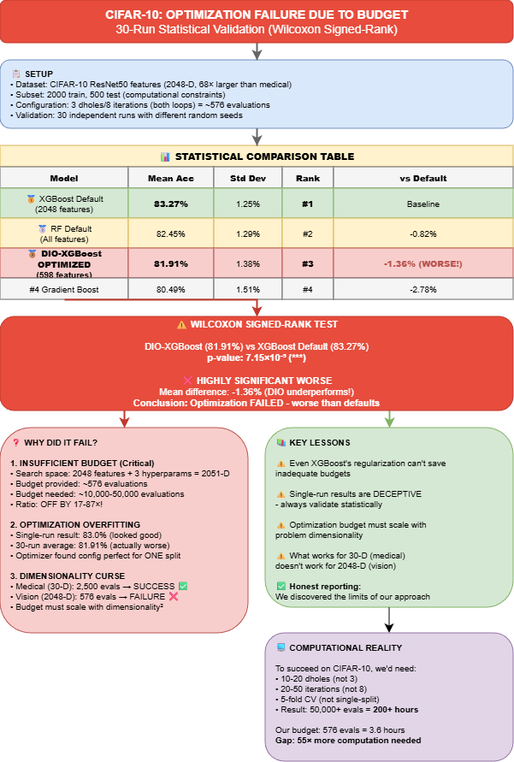
CIFAR-10: Statistical Analysis of Optimization Failure
30-run validation reveals DIO underperforms defaults: 81.91% vs 83.27% (p<0.0001)
28

Slide 29
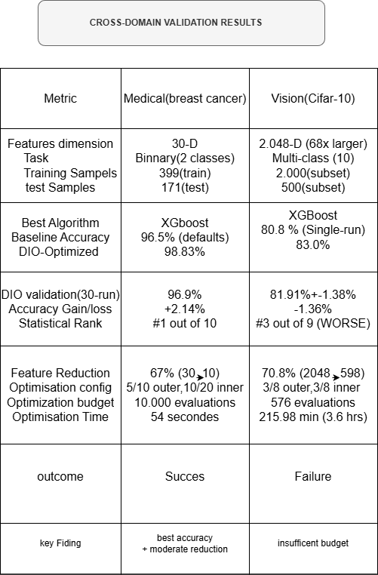
2.5 Cross-Domain Results: Success vs Failure
Complete comparison: Medical (96.88%, SUCCESS) vs CIFAR-10 (81.91%, FAILURE)
29

Slide 30
Lessons Learned Across Both Domains
Three critical factors determine optimization success:
Factor 1: Optimization Budget vs Dimensionality
- Medical RF (30-D): 10,000 evaluations (5/10 outer, 10/20 inner) → Mixed
- Medical XGBoost (30-D): 10,000 evaluations (5/10 outer, 10/20 inner) → SUCCESS
- Vision XGBoost (2048-D): 576 evaluations (3/8 both loops) → FAILURE
- Rule of thumb: Budget must scale with dimensionality²
Factor 2: Algorithm Robustness
- Random Forest: Needs cross-validation even at low dimensions
- XGBoost: Single-split OK at low-D, fails at high-D with low budget
- No algorithm can overcome severely inadequate computational resources
Factor 3: Validation Strategy
- Single-run results are deceptive (83.0% vs 80.8% looked good)
- 30-run averages reveal truth (81.91% vs 83.27% showed failure)
- Statistical testing confirms what's real and what's noise
The big lesson: Success isn't just about the algorithm—it's about matching computational investment to problem complexity
30

Slide 31
3. Future Research Directions
Where do we go from here? Several exciting directions:
1. Adaptive Budget Allocation
- Automatically adjust population size based on dimensionality
- Develop formulas: budget ≈ k × D² (where D = dimensions)
- Balance computational cost with quality
2. Hybrid Optimization Strategies
- Combine DIO (global search) with local refinement (Bayesian optimization)
- Use DIO for exploration, gradient methods for exploitation
3. Multi-Objective Extensions
- Optimize accuracy + interpretability + speed simultaneously
- Generate Pareto fronts for clinical decision-making
4. Theoretical Foundations
- Formalize 'optimization overfitting' mathematically
- Prove convergence guarantees for nested optimization
- Characterize when single-split vs CV is sufficient
5. Broader Applications
- Other medical tasks: multi-class diagnosis, survival prediction
- Neural architecture search with DIO
- Fairness-aware feature selection (removing biased features)
31

Slide 32
4. Conclusion: Key Contributions
Four Key Contributions:
1. Discovered 'Optimization Overfitting'
→ Use CV during optimization, not just evaluation
2. Algorithm-Dependent Strategies
→ RF needs CV; XGBoost more robust but not immune
3. Budget Scaling Laws
→ Budget must scale with dimensionality²
4. DIO-XGBoost Success: 96.88% accuracy, 67% fewer features
Bottom line: Optimization needs adequate computational investment
32

Slide 33
Practical Recommendations
For Healthcare ML Deployment:
🏆 DIO-XGBoost: 96.88%, 10 features
→ Best accuracy, use when resources available
✓ DIO-RF-CV: 96.55%, 6 features
→ Best interpretability, 80% cost reduction
⚠ DIO-RF-Single: 94.37%, 8 features
→ Only for rapid prototyping
Golden Rules:
• Always validate with 30+ runs
• Use statistical tests (Wilcoxon)
• Scale budget with dimensionality
33

Slide 34
5. References
[1] El Romeh et al. (2025). DIO Algorithm. Cluster Computing, Springer
[2] UCI ML Repository: Breast Cancer Wisconsin Dataset (2019)
[3] Krizhevsky (2009). CIFAR-10 Dataset. U. Toronto
[4] He et al. (2016). ResNet. IEEE CVPR
[5] Chen & Guestrin (2016). XGBoost. KDD '16
[6] Breiman (2001). Random Forests. Machine Learning
[7] Wilcoxon (1945). Signed-Rank Test. Biometrics Bulletin
34

Slide 35
Thank You
Acknowledgments:
• Dr. Nabil Neggaz – Course Professor & Supervisor
• USTO-MB Computer Science Department
• DIO Creators: Dr. Mirjalili & Team
• Open-Source: scikit-learn, XGBoost, NumPy
Questions?
35

