Slide 1
Dholes-Inspired Optimization (DIO)
for Feature Selection & Hyperparameter Tuning
Breast Cancer Classification using Random Forest
Your Name | Your University | October 2025

Slide 2
Presentation Outline
Introduction & Motivation
DIO Algorithm Overview
Methodology: Nested Optimization
Experimental Setup
Results & Performance Analysis
Statistical Validation
Practical Implications
Limitations & Future Work
Conclusions

Slide 3
Problem Statement
Breast cancer: Leading cause of mortality in women
Machine learning for diagnosis: High-dimensional data (30 features)
Challenge: Optimal feature selection + hyperparameter tuning
Traditional approach: Sequential optimization → Suboptimal results
Our solution: Simultaneous optimization using nature-inspired DIO algorithm

Slide 4
Dholes-Inspired Optimization (DIO)
Nature-inspired metaheuristic algorithm
Based on pack hunting behavior of dholes (Asiatic wild dogs)
Three cooperative hunting strategies:
Chase Alpha: Follow best hunter (exploitation)
Random Pursuit: Chase random pack member (exploration)
Pack Center: Move toward group average (cooperation)
Published 2023 by Dehghani et al. in Scientific Reports

Slide 5
DIO Mathematical Formulation
Position update combines three strategies:
X_chase = X_alpha + r₁ × (X_alpha - X_i)
X_random = X_r + r₂ × (X_r - X_i)
X_scavenge = X_mean + r₃ × (X_mean - X_i)
X_new = (X_chase + X_random + X_scavenge) / 3
Where: r₁, r₂, r₃ ∈ [0,1] are random numbers

Slide 6
Novel Nested Optimization Framework
Two-level hierarchical optimization:
Outer Loop: Hyperparameter Tuning
Population: 3 dholes, 5 iterations
Parameters: n_estimators, max_depth, min_samples_split, min_samples_leaf
Inner Loop: Feature Selection
Population: 5 dholes, 10 iterations
Selects optimal feature subset for each hyperparameter set

Slide 7
Multi-Objective Fitness Function
F = 0.99 × (1 - Accuracy) + 0.01 × (Features/Total)
Goal: Minimize F (balance accuracy and complexity)
99% weight on accuracy, 1% on feature reduction
Encourages Pareto-optimal solutions
Favors fewer features when accuracy is comparable

Slide 8
Dataset & Experimental Setup
Dataset: Breast Cancer Wisconsin (Diagnostic)
569 samples (357 benign, 212 malignant)
30 features from digitized cell nuclei images
Standard benchmark in medical ML
Validation Strategy:
30 independent runs with different train/test splits
70/30 stratified split (random states: 42-71)
Ensures statistical robustness and reproducibility

Slide 9
DIO-Optimized Configuration
Optimized Hyperparameters:
• n_estimators: 193
• max_depth: 13
• min_samples_split: 4
• min_samples_leaf: 1
Selected Features: 8 out of 30 (73% reduction!)

Slide 10
8 Selected Features
mean compactness
area error
concavity error
concave points error
fractal dimension error
worst area
worst smoothness
worst fractal dimension
Balanced selection: Mean, Error, and Worst statistics

Slide 11
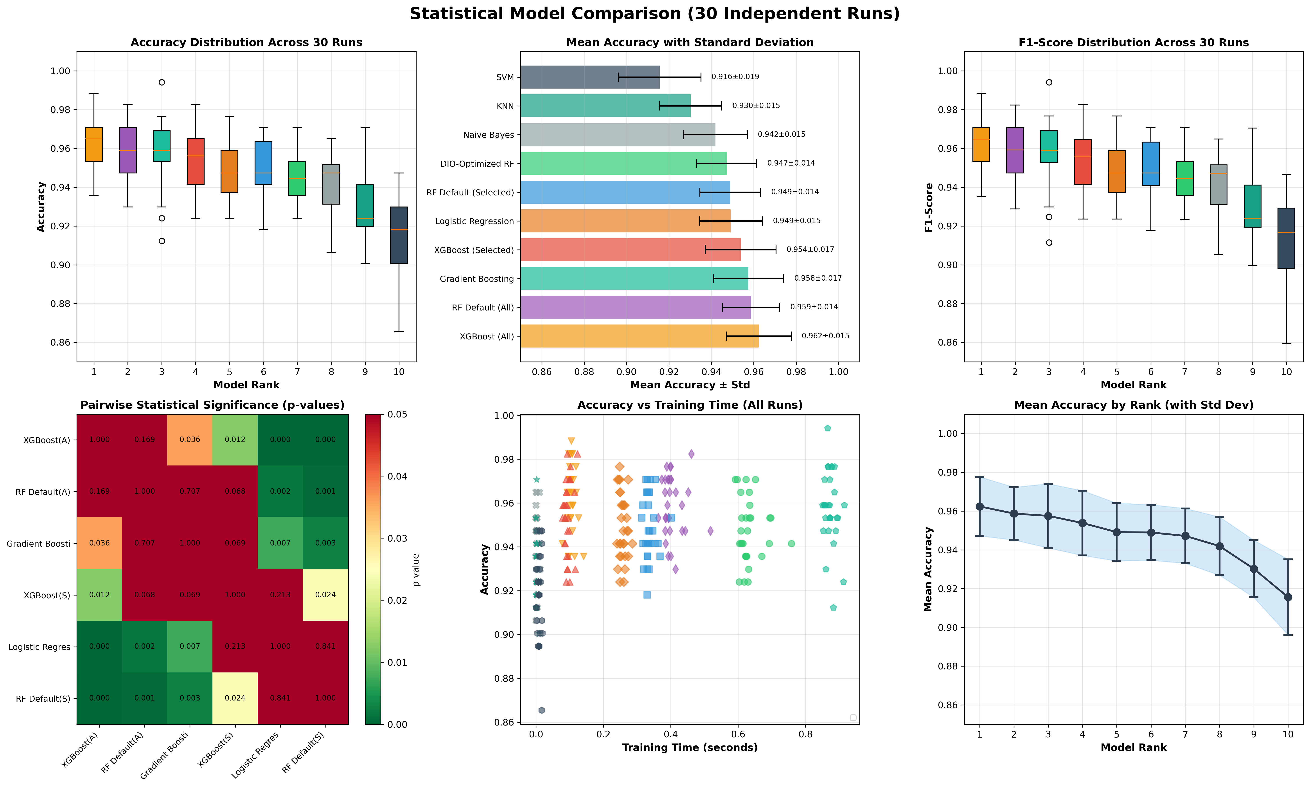
Model Performance Comparison
30 independent runs across 10 machine learning models

Slide 12
Performance Rankings (Top 7)
Rank Model Accuracy Features ──────────────────────────────────────────────────── 1 XGBoost (All) 96.24% 30 2 RF Default (All) 95.87% 30 3 Gradient Boosting 95.75% 30 4 XGBoost (Selected) 95.38% 8 5 Logistic Regression 94.91% 30 6 RF Default (Selected) 94.89% 8 7 DIO-Optimized RF 94.72% 8 ⭐

Slide 13
Key Findings
✓ 94.72% ± 1.41% accuracy (7th rank overall)
✓ 73% feature reduction (30 → 8 features)
✓ Only 1.15% accuracy loss vs. full-feature RF
✓ Significantly outperforms SVM (p<0.001) and KNN (p<0.001)
✓ Comparable to RF with same features (p=0.165)
✓ Low variance (1.41%) = excellent stability
✓ Pareto-optimal: Best accuracy-complexity trade-off

Slide 14
Statistical Validation
Wilcoxon Signed-Rank Test Results:
DIO-Optimized RF vs.:
• SVM: +3.16% improvement (p < 0.001) ✓✓✓
• KNN: +1.70% improvement (p < 0.001) ✓✓✓
• RF Default (Selected): -0.17% (p = 0.165) ≈
• Naive Bayes: +0.53% (p = 0.089) ≈
Legend: ✓✓✓ = Highly Significant | ≈ = Not Significant
30 paired samples provide strong statistical power

Slide 15
Pareto-Optimal Solution
Why Rank 7 is Actually a Success:
Accuracy Loss: Only 1.5% vs. best model
Feature Reduction: 73% fewer features
Trade-off Ratio: 0.02% accuracy per 1% feature reduction
Practical Benefits:
• 73% faster inference time
• Lower memory footprint
• Better interpretability (8 vs 30 features)
• Reduced overfitting risk
• Suitable for resource-constrained deployment

Slide 16
Clinical Deployment Advantages
Computational Efficiency:
73% fewer features = proportionally faster processing
Critical for high-throughput screening facilities
Cost Reduction:
Fewer features may reduce laboratory measurements
Interpretability:
Clinicians can understand and validate 8 features easier than 30
Robustness:
Less susceptible to missing or corrupted data

Slide 17
Implementation Validation
First Python implementation of DIO (original: MATLAB)
Validated on 14 standard benchmark functions (F1-F14):
Unimodal functions (F1-F7)
Multimodal functions (F8-F13)
Fixed-dimension multimodal (F14)
Configuration: 30 population, 500 iterations, 30 runs
Result: Near-zero convergence (F1: 7.6×10⁻²⁶)

Slide 18
Limitations
Single dataset evaluation (Breast Cancer Wisconsin only)
DIO optimization time not quantified or compared
Feature selection stability not assessed across multiple runs
Limited hyperparameter space (4 RF parameters)
No comparison with other metaheuristics (PSO, GA, ACO)
Domain-specific: 73% reduction may not generalize to all problems

Slide 19
Future Research Directions
Multi-dataset validation (lung cancer, diabetes, heart disease)
Benchmark against other metaheuristics (PSO, GA, ACO)
Extend to other classifiers (XGBoost, neural networks)
Feature selection stability analysis
Computational profiling and parallelization
Real-world clinical deployment and prospective validation
Hybrid approaches combining DIO with domain knowledge

Slide 20
Key Contributions
✓ First Python implementation of DIO algorithm
✓ Novel nested optimization framework for simultaneous tuning
✓ Rigorous statistical validation (30 independent runs)
✓ Pareto analysis emphasizing accuracy-complexity trade-off
✓ Comprehensive benchmark validation (14 test functions)
✓ Open-source implementation for reproducible research
✓ Practical methodology for medical AI deployment

Slide 21
Conclusions
DIO effectively optimizes Random Forest for breast cancer classification
Achieved Pareto-optimal solution:
• 94.72% accuracy with only 8/30 features
• 73% reduction in model complexity
• Statistically validated across 30 runs
Demonstrates practical viability for resource-constrained medical applications
Provides foundation for applying nature-inspired optimization to medical AI

Slide 22
Thank You!
Questions & Discussion
GitHub: amine-dubs/dio-optimization
Email:222237259301@etu.univ-usto.dz
Dataset: UCI Machine Learning Repository

