Slide 1
ENVIRONMENTAL DASHBOARD
Comparative Waste Management Analysis
Europe & Africa (1990-2021)
Bellatreche Mohamed Amine
Cherif Ghizlane Imane
Novembre 2025

Slide 2
Context & Project Objectives
🌍 GLOBAL CONTEXT
  • 49 countries analyzed (27 Europe + 22 Africa)
  • North-South divide in waste management infrastructure
  • Europe: 25-35% recycling rates, advanced systems
  • Africa: Rapid waste growth (3-5%/year), limited infrastructure
🎯 OBJECTIVES
  • Comparative analysis: Europe vs. Africa waste practices
  • Machine learning forecasts (ARIMA models)
  • Environmental risk assessment (rule-based scoring)
  • Evidence-based policy recommendations

Slide 3
Data Sources & Methodology
📊 DATA SOURCES
  • Waste generation: UN Environment (132 countries, 2000-2021)
  • Recycling rates: OECD Municipal Waste (38 countries, 1990-2015)
  • Linear interpolation: Biennial data → Annual time series
🎯 KEY INDICATORS
  ✓ Recycling rate (%, Europe only)
  ✓ Waste per capita (kg/year)
  ✓ Waste by sector (households, construction, manufacturing, services)
  ✓ Risk score (0-100, rule-based)
  ✓ 5-year ARIMA forecasts

Slide 4
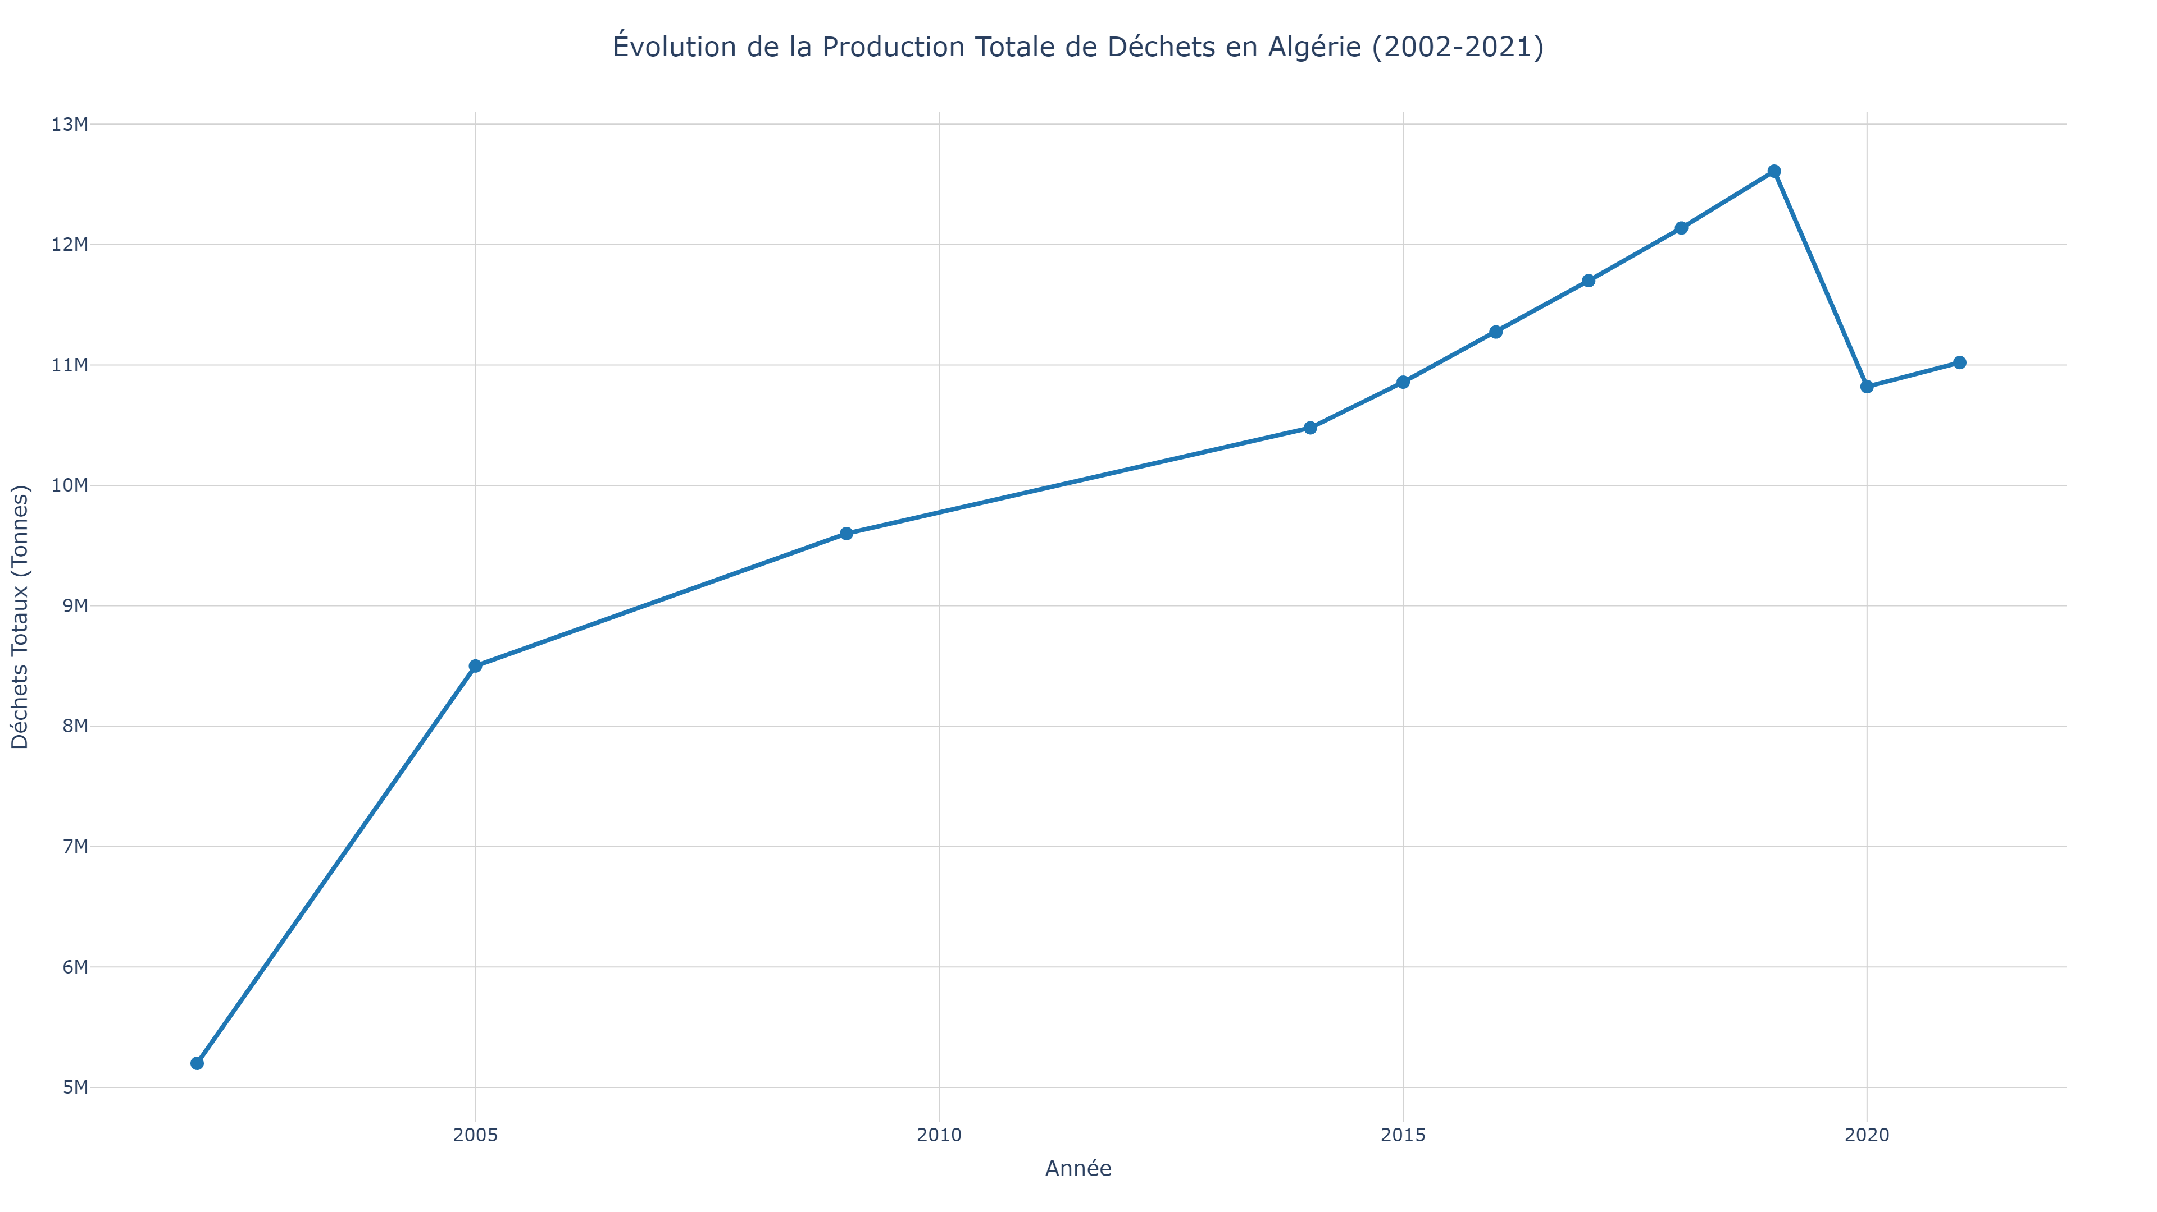
Waste Management: Europe vs. Africa (1990-2021)
🇪🇺 Europe: 500 kg/cap/yr avg, 30% recycling | 🌍 Africa: 250 kg/cap/yr avg, 3-5% growth

Slide 5
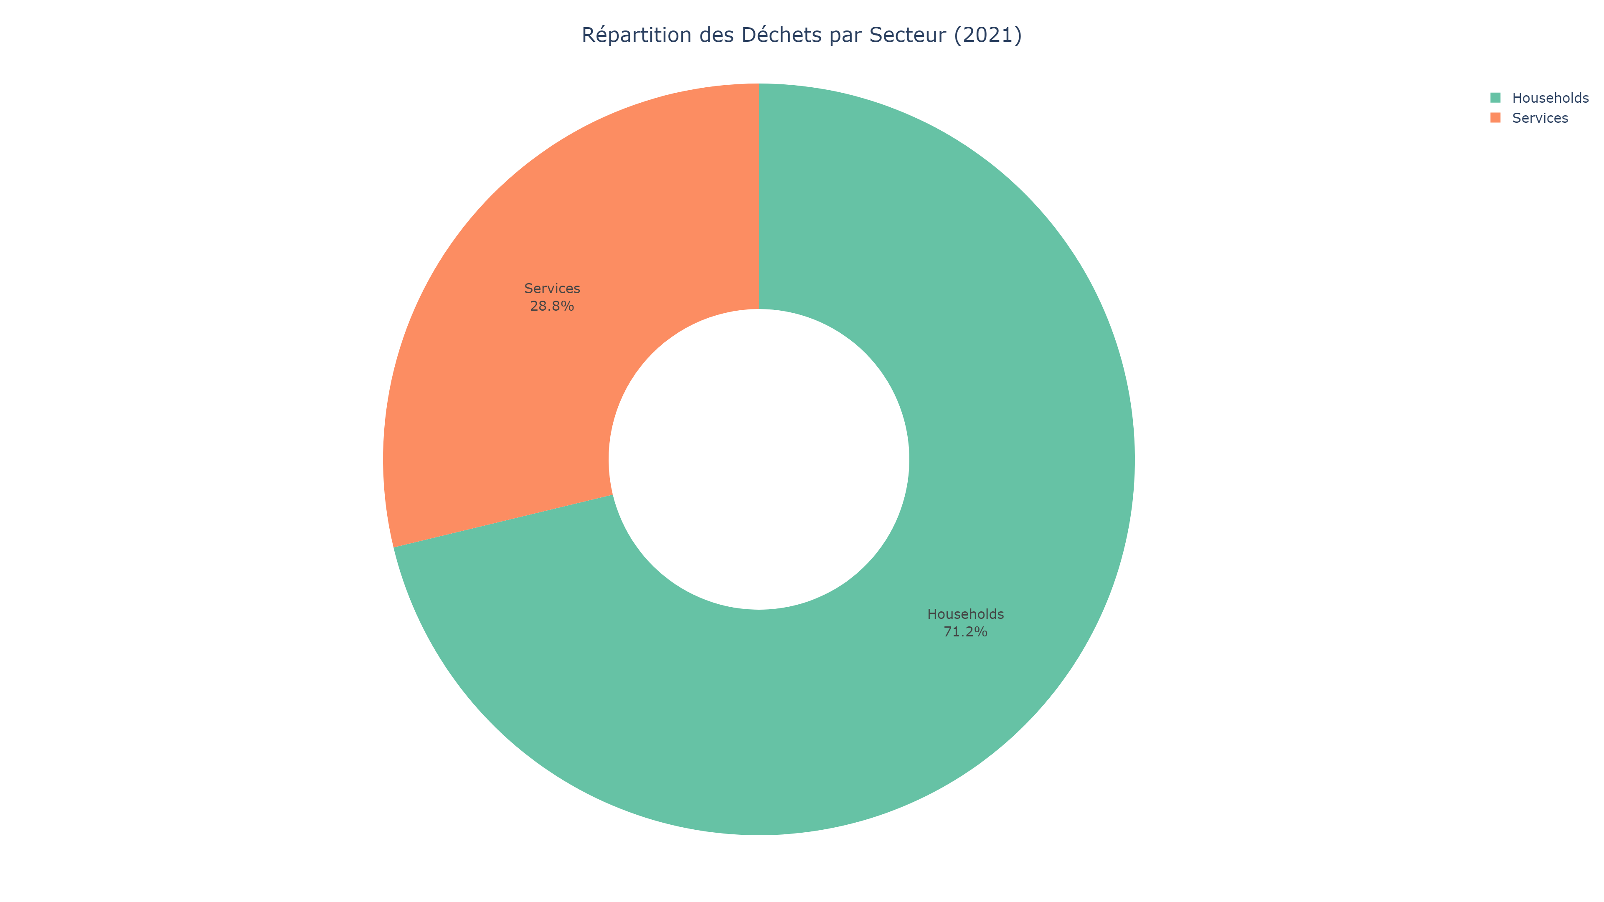
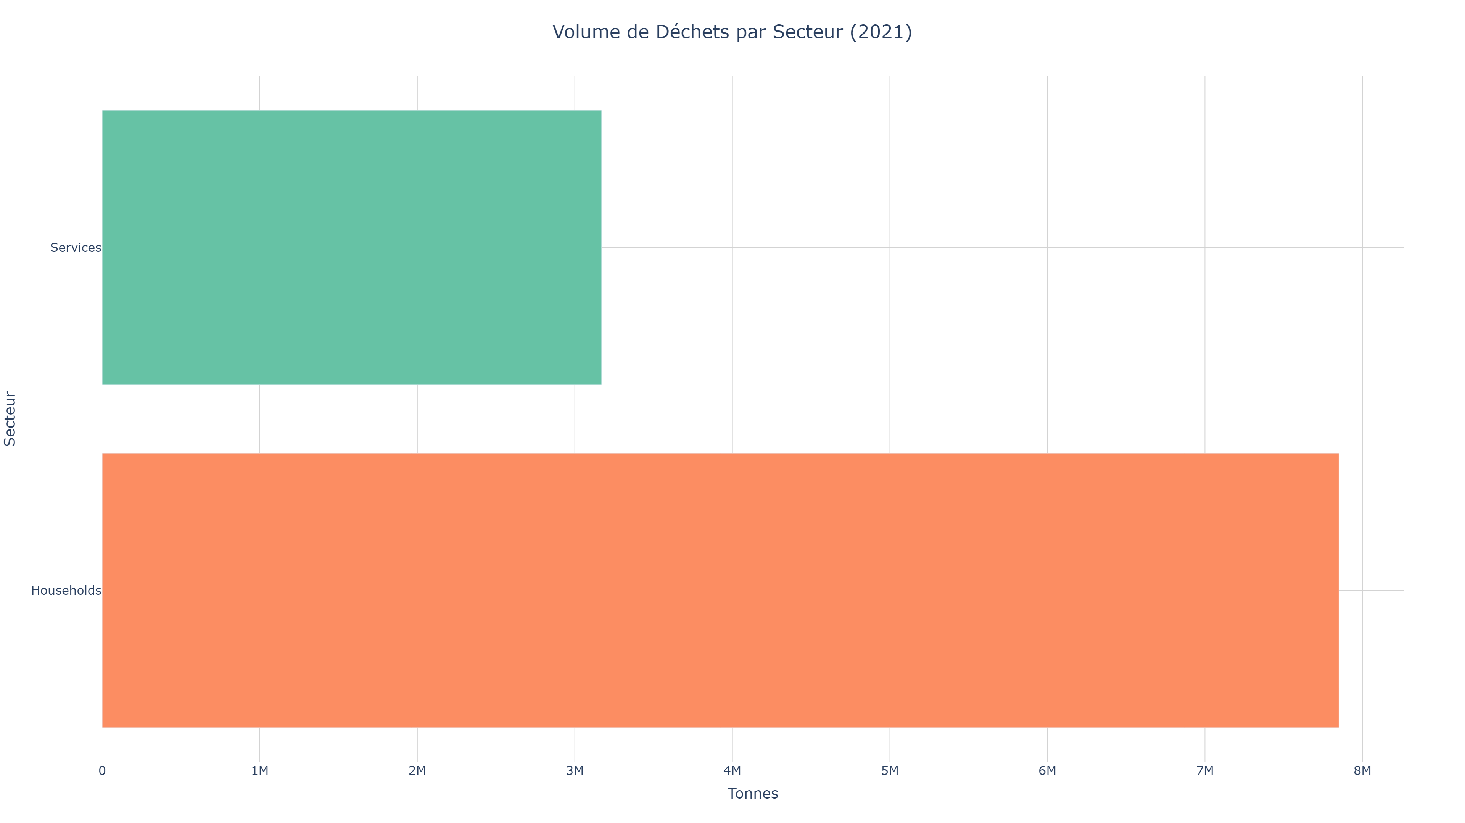
Waste Composition by Economic Sector
✓ Households = largest sector | ✓ Construction waste significant | ✓ Stacked area shows temporal evolution

Slide 6
Strategic Recommendations
🇪🇺 EUROPE (OPTIMIZATION)
  • Circular economy transition
  • Meet 50% recycling targets
  • Extended Producer Responsibility
  • Harmonize data collection
🌍 AFRICA (INFRASTRUCTURE)
  • Basic collection systems
  • Formalize informal sector
  • Regional cooperation
  • Technology transfer from Europe
🤖 ML & ANALYTICS
  • ARIMA forecasting: 5-year trends
  • Risk assessment: Priority countries
  • Scenario modeling: Policy impact
  • Dashboard for evidence-based decisions

Slide 7
❓ QUESTIONS ?
Merci de votre attention
📧 [votre.email@institution.dz]
📊 Dashboard disponible sur demande
─────────────────────────────
Sources: UN Environment (132 countries) | OECD Municipal Waste (38 countries) | World Bank Population

