Slide 1
Spring Basics
2024

Slide 2
Spring Container
userController
myBean
productController
userService
userRepository
Spring Bean (singleton)
productService
productRepository
applicationContext
Spring Container

Slide 3


Spring Layers
userController
myBean
HTTP
productController
DTO
(Data Transfer Object)
userService
userRepository
Controller
Service
Repository
productService
Entity
productRepository
Java DB driver
applicationContext
Spring Container

Slide 4
DTO
@Getter @Setter @ToString @EqualsAndHashCode public class UserDto { private String id; private String firstName; private String lastName; private LocalDate birthDate; }

Slide 5
Entity
@Entity @Getter @Setter @ToString public class User { @Id private String id; private String firstName; private String lastName; private LocalDate birthDate; }

Slide 6
Repository
@Repository public interface UserRepository extends JpaRepository<User, String> { Optional<User> findByFirstNameAndLastNameAndBirthDate(String firstName, String lastName, LocalDate birthDate); Stream<User> findByLastName(String lastName); }

Slide 7
Service
@Service @AllArgsConstructor public class UserService { private final UserRepository userRepository; @Transactional(isolation = Isolation.SERIALIZABLE)
public UserDto createUser(UserDto user) { ... }
}

Slide 8
Controller
@RestController @RequestMapping("users") @AllArgsConstructor public class UserController { private final UserService userService; @PostMapping public UserDto createUser(@RequestBody UserDto user) { return userService.createUser(user); } }

Slide 9
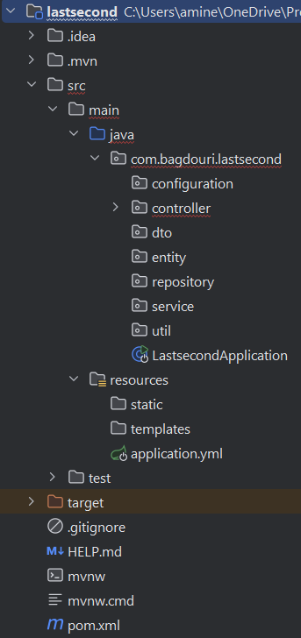
Spring Project Structure

