Slide 1
Distributed Systems
Principles &
Implementation
2024

Slide 2
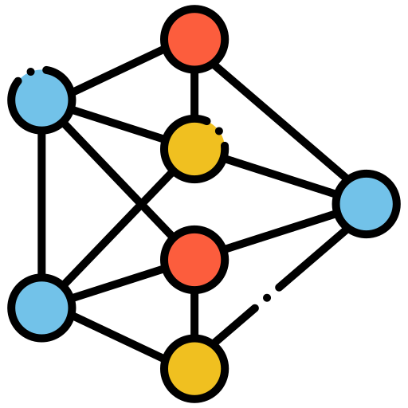

Distributed Systems
Common
Objective
Group of Nodes

Slide 3





Distributed Systems
Communication
Maintainability
Coordination
Resilience
Scalability

Slide 4

Distributed Systems
Communication

Slide 5
Distributed Systems
Coordination

Slide 6




Distributed Systems ➤ Coordination
Two Generals Problem

Slide 7

Distributed Systems ➤ Coordination
Two Generals Problem

Slide 8


Distributed Systems ➤ Coordination
Two Generals Problem

Slide 9

Distributed Systems
Scalability
Vertical
Horizontal

Slide 10


Distributed Systems
Resilience
“Anything that can go
wrong will go wrong”

Slide 11



Distributed Systems
Maintainability
Testing
Delivery
Monitoring

Slide 12
Distributed Systems
Communication

Slide 13

Distributed Systems ➤ Communication
Network Stack
HTTPS
TCP
IP
Ethernet
00:1B:44:11:3A:B7

Slide 14

Distributed Systems ➤ Communication
Network Stack
HTTPS
TCP
IP
Ethernet
67.195.160.76
Link Layer
00:1B:44:11:3A:B7

Slide 15

Distributed Systems ➤ Communication
Network Stack
HTTPS
TCP
IP
Ethernet
443
Internet Layer
67.195.160.76
67.195.160.76
Link Layer
00:1B:44:11:3A:B7

Slide 16

Distributed Systems ➤ Communication
Network Stack
HTTPS
TCP
IP
Ethernet
GET /index.html
Transport Layer
443
443
Internet Layer
67.195.160.76
Link Layer
00:1B:44:11:3A:B7

Slide 17

Distributed Systems ➤ Communication
Network Stack
HTTPS
TCP
IP
Ethernet
GET /index.html
Application Layer
Transport Layer
443
Internet Layer
67.195.160.76
Link Layer
00:1B:44:11:3A:B7

Slide 18
Distributed Systems ➤ Communication
Network Stack
HTTPS
TCP
IP
Ethernet
<html>
Hello World
</html>
Application Layer
Transport Layer
443
Internet Layer
67.195.160.76
Link Layer
00:1B:44:11:3A:B7

Slide 19
Distributed Systems ➤ Communication
Network Stack
HTTPS
TCP
IP
Ethernet
<html>
Hello World
</html>
Application Layer
Transport Layer
443
443
Internet Layer
67.195.160.76
Link Layer
00:1B:44:11:3A:B7

Slide 20
Distributed Systems ➤ Communication
Network Stack
HTTPS
TCP
IP
Ethernet
Application Layer
Transport Layer
443
6789
Internet Layer
67.195.160.76
67.195.160.76
Link Layer
00:1B:44:11:3A:B7

Slide 21
Distributed Systems ➤ Communication
Network Stack
HTTPS
TCP
IP
Ethernet
Application Layer
Transport Layer
443
Internet Layer
67.195.160.76
13.107.18.11
Link Layer
00:1B:44:11:3A:B7

Slide 22
Distributed Systems ➤ Communication
Network Stack
HTTPS
TCP
IP
Ethernet
Application Layer
Transport Layer
443
Internet Layer
67.195.160.76
Link Layer
00:1B:44:11:3A:B7
4B:67:91:55:F6:E3

Slide 23
Distributed Systems ➤ Communication
Network Stack
<html>
Hello World
</html>
HTTPS
TCP
IP
Ethernet
HTTPS
TCP
IP
Ethernet
IP
Ethernet
Ethernet
Host A
Switch
Router
Host B

Slide 24
Distributed Systems ➤ Communication
Network Stack
<html>
Hello World
</html>
HTTPS
TCP
IP
Ethernet
HTTPS
TCP
IP
Ethernet
IP
Ethernet
Ethernet
4B:67
Host A
Switch
Router
Host B

Slide 25
Distributed Systems ➤ Communication
Network Stack
<html>
Hello World
</html>
HTTPS
TCP
IP
Ethernet
HTTPS
TCP
IP
Ethernet
IP
Ethernet
Ethernet
4B:67
4B:67
Host A
Switch
Router
Host B

Slide 26
Distributed Systems ➤ Communication
Network Stack
<html>
Hello World
</html>
HTTPS
TCP
IP
Ethernet
HTTPS
TCP
IP
Ethernet
13.107.
18.11
IP
Ethernet
Ethernet
4B:67
4B:67
Host A
Switch
Router
Host B

Slide 27
Distributed Systems ➤ Communication
Network Stack
<html>
Hello World
</html>
HTTPS
TCP
IP
Ethernet
HTTPS
TCP
IP
Ethernet
13.107.
18.11
IP
Ethernet
Ethernet
4B:67
4B:67
E5:A0
Host A
Switch
Router
Host B

Slide 28
Distributed Systems ➤ Communication
Network Stack
<html>
Hello World
</html>
<html>
Hello World
</html>
HTTPS
TCP
IP
Ethernet
HTTPS
TCP
IP
Ethernet
13.107.
18.11
IP
Ethernet
Ethernet
4B:67
4B:67
E5:A0
Host A
Switch
Router
Host B

Slide 29
Distributed Systems ➤ Communication
Network Security : TLS
HTTP
TLS
TCP
IP
Ethernet
Encryption
Integrity
Authentication

Slide 30

Distributed Systems ➤ Communication ➤ TLS
Encryption
Host A
Host B

Slide 31




Distributed Systems ➤ Communication ➤ TLS
Encryption
Host A
Host B
Private
Public
Public
Private

Slide 32
Distributed Systems ➤ Communication ➤ TLS
Encryption
Host A
Host B
Private
Public
Public
Private

Slide 33
Distributed Systems ➤ Communication ➤ TLS
Encryption
Host A
Host B
Private
Public
Public
Private
Shared Symmetric Key
Shared Symmetric Key

Slide 34

Distributed Systems ➤ Communication ➤ TLS
Encryption
Host A
Host B
Encrypted
Shared Symmetric Key
Shared Symmetric Key

Slide 35

Distributed Systems ➤ Communication ➤ TLS
Encryption
Host A
Host B
Encrypted
Shared Symmetric Key

Slide 36
Distributed Systems ➤ Communication ➤ TLS
Authentication
Host A
Host B
Public
B
Public
B
Public
B
Private
B

Slide 37

Distributed Systems ➤ Communication ➤ TLS
Authentication
Host A
Host B
Signed with private key B
Identity verified with public key B
Public
B
Public
B
Private
B

Slide 38

Distributed Systems ➤ Communication ➤ TLS
Authentication
Host A
Host B
Public
B
Public B is authentic ?
Public
B
Private
B

Slide 39

Distributed Systems ➤ Communication ➤ TLS
Authentication
Host A
Host B
Public B
Signed with Public X
Public
B
Public
B
Certificate Authority X

Slide 40
Distributed Systems ➤ Communication ➤ TLS
Authentication
Host A
Host B
Public B
Signed with Public X
Public
B
X is authentic ?
Certificate Authority X

Slide 41
Distributed Systems ➤ Communication ➤ TLS
Authentication
Certificate Authority X
Host A
Public X
Signed with Public Y
Public
X
Public
Y
Certificate Authority Y

Slide 42
Distributed Systems ➤ Communication ➤ TLS
Authentication
Certificate Authority X
Host A
Public X
Signed with Public Y
Public
X
Y is authentic ?
Certificate Authority Y

Slide 43
Distributed Systems ➤ Communication ➤ TLS
Authentication
Certificate Authority Y
Host A
Public Y Signed with Root Certificate
Public
Y
Public Y
Self-signed Root Certificate pre-installed on the OS
Root Certificate Authority

Slide 44
Distributed Systems ➤ Communication ➤ TLS
Authentication
Host A
Host B
Signed with private key B
Identity verified with public key B
Public
B
Private
B
Certificate Chain

Slide 45
Distributed Systems ➤ Communication ➤ TLS
Authentication
Host A
Host B
Signed with private key B
Identity verified with public key B
Public
B
Private
B

Slide 46

Distributed Systems ➤ Communication ➤ TLS
Integrity
Host A
Host B
Message altered by Middleman
Message
Middleman

Slide 47



Distributed Systems ➤ Communication ➤ TLS
Integrity
Host A
Host B
Middleman can’t generate correct Digest
Message + Message Digest generated with Private B
Middleman
Public
B
Public
B
Private
B

Slide 48
Distributed Systems ➤ Communication ➤ TLS
Integrity
Host A
Host B
Middleman can’t generate correct Digest
Message + Message Digest generated with Private B
Middleman
Public
B
Private
B

Slide 49

Distributed Systems ➤ Communication
Network Discovery : DNS
https://www.google.com

Slide 50
Distributed Systems ➤ Communication
Network Discovery : DNS
https://www.google.com
443 is the default port of HTTPS

Slide 51
Distributed Systems ➤ Communication
Network Discovery : DNS
https://www.google.com
What is the IP Address of Google ?

Slide 52

Distributed Systems ➤ Communication
Network Discovery : DNS
DNS Server
IP of google.com ?
13.107.18.11
Domain Name | IP Address
google.com | 13.107.18.11
microsoft.com | 77.84.181.6
… | …

Slide 53

Distributed Systems ➤ Communication
Network Discovery : DNS
DNS Server
google.com = 13.107.18.11
Domain Name | IP Address
google.com | 13.107.18.11
microsoft.com | 77.84.181.6
… | …

Slide 54
Distributed Systems ➤ Communication
APIs
What’s your name ?
何を言っている ？

Slide 55
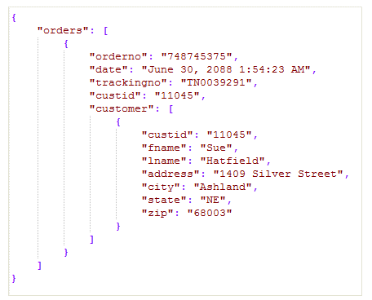
Distributed Systems ➤ Communication ➤ APIs
Data Formats
JSON (textual)
Protobuf (binary)
Self-describing
Human-readable
Verbose
Inefficient parsing
Simple Data Types
Compact
Performant
Rich Data Types
Not human-readable
XML, BSON, YAML, …

Slide 56
Distributed Systems ➤ Communication ➤ APIs
Protocols
REST
gRPC
HTTP Based
Textual (JSON or XML)
Requires extra validation
Request-response communication
No native code generation
Multiple endpoints defined by HTTP methods + resource paths
HTTP Based
Binary (Protobuf)
Automatic native data validation
Bidirectional streaming
Native code generation for many programming languages
Callable functions

Slide 57
Distributed Systems ➤ Communication ➤ APIs ➤ REST
HTTP Methods
HTTP Method | Use | Safe | Idempotent
GET | Retrieve a resource or a list of resources | YES | YES
POST | Create a new resource | NO | NO
PUT | Update a resource | NO | YES
DELETE | Delete a resource | NO | YES

Slide 58
Distributed Systems ➤ Communication ➤ APIs ➤ REST
HTTP Response Status Codes
Codes | Category | Examples
2xx | Success | 200 (OK) 201 (Created)
3xx | Redirection | 301 (Moved Permanently)
4xx | Client Error | 400 (Bad Request) 401 (Unauthorized) 403 (Forbidden) 404 (Not Found)
5xx | Server Error | 500 (Internal Server Error) 502 (Bad Gateway) 503 (Service Unavailable)

Slide 59
Distributed Systems ➤ Communication ➤ APIs
Evolution
Don’t introduce breaking changes, for example :
POST /products ➜ POST /new-products
Optional parameter birthDate ➜ Mandatory parameter
If breaking changes are necessary, version your API :
/v1/products ➜ keep /v1/products and add /v2/products

Slide 60


Distributed Systems ➤ Communication ➤ APIs
Idempotency
A
B
C

Slide 61
Distributed Systems ➤ Communication ➤ APIs
Idempotency
Create product X
Insert X
X created
A
B
C
X
Connection
Error

Slide 62

Distributed Systems ➤ Communication ➤ APIs
Idempotency
Create product X
Insert X
X created
A
B
C
X
X
Connection
Error
Create product X
Insert X
X created
X created twice

Slide 63
Distributed Systems ➤ Communication ➤ APIs
Idempotency
A
B
C

Slide 64
Distributed Systems ➤ Communication ➤ APIs
Idempotency
Create product X,
Request ID 17
Insert X
X created
A
B
C
X
Connection
Error

Slide 65

Distributed Systems ➤ Communication ➤ APIs
Idempotency
Create product X,
Request ID 17
Insert X
X created
A
B
C
X
Connection
Error
Create product X,
Request ID 17
Request ID 17 was
already processed
X created
X created once

