Slide 1
Distributed Systems
Principles &
Implementation
2024

Slide 2
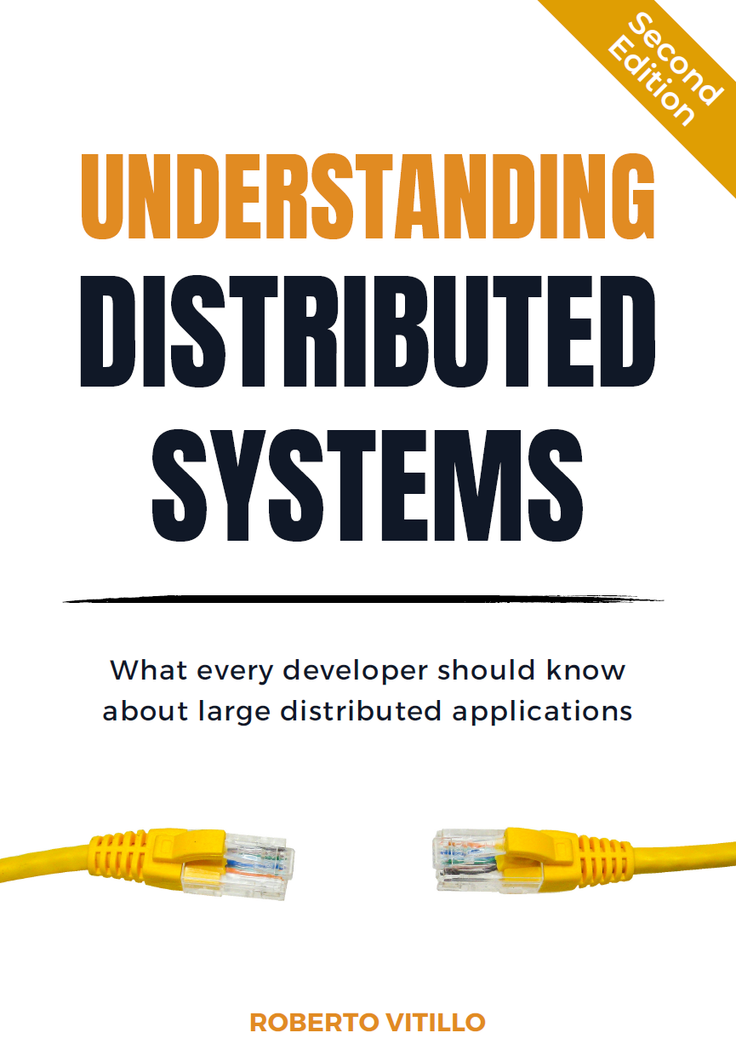
Based on the Book

Slide 3
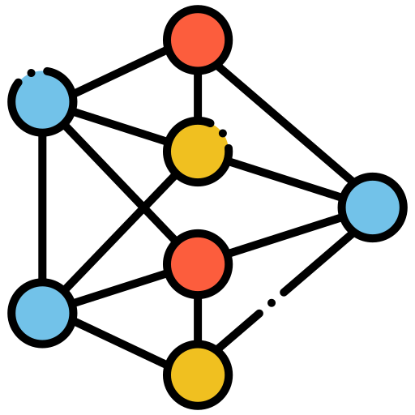

Distributed Systems
Common
Objective
Group of Nodes

Slide 4





Distributed Systems
Communication
Maintainability
Coordination
Resilience
Scalability

Slide 5

Distributed Systems
Communication

Slide 6
Distributed Systems
Coordination

Slide 7




Distributed Systems ➤ Coordination
Two Generals Problem

Slide 8

Distributed Systems ➤ Coordination
Two Generals Problem

Slide 9


Distributed Systems ➤ Coordination
Two Generals Problem

Slide 10

Distributed Systems
Scalability
Vertical
Horizontal

Slide 11


Distributed Systems
Resilience
“Anything that can go
wrong will go wrong”
Murphy's law

Slide 12



Distributed Systems
Maintainability
Testing
Delivery
Monitoring

Slide 13
Distributed Systems
Communication

Slide 14

Distributed Systems ➤ Communication
Network Stack
HTTPS
TCP
IP
Ethernet
00:1B:44:11:3A:B7

Slide 15

Distributed Systems ➤ Communication
Network Stack
HTTPS
TCP
IP
Ethernet
67.195.160.76
Link Layer
00:1B:44:11:3A:B7

Slide 16

Distributed Systems ➤ Communication
Network Stack
HTTPS
TCP
IP
Ethernet
443
Internet Layer
67.195.160.76
67.195.160.76
Link Layer
00:1B:44:11:3A:B7

Slide 17

Distributed Systems ➤ Communication
Network Stack
HTTPS
TCP
IP
Ethernet
GET /index.html
Transport Layer
443
443
Internet Layer
67.195.160.76
Link Layer
00:1B:44:11:3A:B7

Slide 18

Distributed Systems ➤ Communication
Network Stack
HTTPS
TCP
IP
Ethernet
GET /index.html
Application Layer
Transport Layer
443
Internet Layer
67.195.160.76
Link Layer
00:1B:44:11:3A:B7

Slide 19
Distributed Systems ➤ Communication
Network Stack
HTTPS
TCP
IP
Ethernet
<html>
Hello World
</html>
Application Layer
Transport Layer
443
Internet Layer
67.195.160.76
Link Layer
00:1B:44:11:3A:B7

Slide 20
Distributed Systems ➤ Communication
Network Stack
HTTPS
TCP
IP
Ethernet
<html>
Hello World
</html>
Application Layer
Transport Layer
443
443
Internet Layer
67.195.160.76
Link Layer
00:1B:44:11:3A:B7

Slide 21
Distributed Systems ➤ Communication
Network Stack
HTTPS
TCP
IP
Ethernet
Application Layer
Transport Layer
443
6789
Internet Layer
67.195.160.76
67.195.160.76
Link Layer
00:1B:44:11:3A:B7

Slide 22
Distributed Systems ➤ Communication
Network Stack
HTTPS
TCP
IP
Ethernet
Application Layer
Transport Layer
443
Internet Layer
67.195.160.76
13.107.18.11
Link Layer
00:1B:44:11:3A:B7

Slide 23
Distributed Systems ➤ Communication
Network Stack
HTTPS
TCP
IP
Ethernet
Application Layer
Transport Layer
443
Internet Layer
67.195.160.76
Link Layer
00:1B:44:11:3A:B7
4B:67:91:55:F6:E3

Slide 24
Distributed Systems ➤ Communication
Network Stack
<html>
Hello World
</html>
HTTPS
TCP
IP
Ethernet
HTTPS
TCP
IP
Ethernet
IP
Ethernet
Ethernet
Host A
Switch
Router
Host B

Slide 25
Distributed Systems ➤ Communication
Network Stack
<html>
Hello World
</html>
HTTPS
TCP
IP
Ethernet
HTTPS
TCP
IP
Ethernet
IP
Ethernet
Ethernet
4B:67
Host A
Switch
Router
Host B

Slide 26
Distributed Systems ➤ Communication
Network Stack
<html>
Hello World
</html>
HTTPS
TCP
IP
Ethernet
HTTPS
TCP
IP
Ethernet
IP
Ethernet
Ethernet
4B:67
4B:67
Host A
Switch
Router
Host B

Slide 27
Distributed Systems ➤ Communication
Network Stack
<html>
Hello World
</html>
HTTPS
TCP
IP
Ethernet
HTTPS
TCP
IP
Ethernet
13.107.
18.11
IP
Ethernet
Ethernet
4B:67
4B:67
Host A
Switch
Router
Host B

Slide 28
Distributed Systems ➤ Communication
Network Stack
<html>
Hello World
</html>
HTTPS
TCP
IP
Ethernet
HTTPS
TCP
IP
Ethernet
13.107.
18.11
IP
Ethernet
Ethernet
4B:67
4B:67
E5:A0
Host A
Switch
Router
Host B

Slide 29
Distributed Systems ➤ Communication
Network Stack
<html>
Hello World
</html>
<html>
Hello World
</html>
HTTPS
TCP
IP
Ethernet
HTTPS
TCP
IP
Ethernet
13.107.
18.11
IP
Ethernet
Ethernet
4B:67
4B:67
E5:A0
Host A
Switch
Router
Host B

Slide 30
Distributed Systems ➤ Communication
Network Security : TLS
HTTP
TLS
TCP
IP
Ethernet
Encryption
Integrity
Authentication

Slide 31

Distributed Systems ➤ Communication ➤ TLS
Encryption
Host A
Host B

Slide 32




Distributed Systems ➤ Communication ➤ TLS
Encryption
Host A
Host B
Private
Public
Public
Private

Slide 33
Distributed Systems ➤ Communication ➤ TLS
Encryption
Host A
Host B
Private
Public
Public
Private

Slide 34
Distributed Systems ➤ Communication ➤ TLS
Encryption
Host A
Host B
Private
Public
Public
Private
Shared Symmetric Key
Shared Symmetric Key

Slide 35

Distributed Systems ➤ Communication ➤ TLS
Encryption
Host A
Host B
Encrypted
Shared Symmetric Key
Shared Symmetric Key

Slide 36

Distributed Systems ➤ Communication ➤ TLS
Encryption
Host A
Host B
Encrypted
Shared Symmetric Key

Slide 37
Distributed Systems ➤ Communication ➤ TLS
Authentication
Host A
Host B
Public
B
Public
B
Public
B
Private
B

Slide 38

Distributed Systems ➤ Communication ➤ TLS
Authentication
Host A
Host B
Signed with private key B
Identity verified with public key B
Public
B
Public
B
Private
B

Slide 39

Distributed Systems ➤ Communication ➤ TLS
Authentication
Host A
Host B
Public
B
Public B is authentic ?
Public
B
Private
B

Slide 40

Distributed Systems ➤ Communication ➤ TLS
Authentication
Host A
Host B
Public B
Signed with Public X
Public
B
Public
B
Certificate Authority X

Slide 41
Distributed Systems ➤ Communication ➤ TLS
Authentication
Host A
Host B
Public B
Signed with Public X
Public
B
X is authentic ?
Certificate Authority X

Slide 42
Distributed Systems ➤ Communication ➤ TLS
Authentication
Certificate Authority X
Host A
Public X
Signed with Public Y
Public
X
Public
Y
Certificate Authority Y

Slide 43
Distributed Systems ➤ Communication ➤ TLS
Authentication
Certificate Authority X
Host A
Public X
Signed with Public Y
Public
X
Y is authentic ?
Certificate Authority Y

Slide 44
Distributed Systems ➤ Communication ➤ TLS
Authentication
Certificate Authority Y
Host A
Public Y Signed with Root Certificate
Public
Y
Public Y
Self-signed Root Certificate pre-installed on the OS
Root Certificate Authority

Slide 45
Distributed Systems ➤ Communication ➤ TLS
Authentication
Host A
Host B
Signed with private key B
Identity verified with public key B
Public
B
Private
B
Certificate Chain

Slide 46
Distributed Systems ➤ Communication ➤ TLS
Authentication
Host A
Host B
Signed with private key B
Identity verified with public key B
Public
B
Private
B

Slide 47

Distributed Systems ➤ Communication ➤ TLS
Integrity
Host A
Host B
Message altered by Middleman
Message
Middleman

Slide 48



Distributed Systems ➤ Communication ➤ TLS
Integrity
Host A
Host B
Middleman can’t generate correct Digest
Message + Message Digest generated with Private B
Middleman
Public
B
Public
B
Private
B

Slide 49
Distributed Systems ➤ Communication ➤ TLS
Integrity
Host A
Host B
Middleman can’t generate correct Digest
Message + Message Digest generated with Private B
Middleman
Public
B
Private
B

Slide 50

Distributed Systems ➤ Communication
Network Discovery : DNS
https://www.google.com

Slide 51
Distributed Systems ➤ Communication
Network Discovery : DNS
https://www.google.com
443 is the default port of HTTPS

Slide 52
Distributed Systems ➤ Communication
Network Discovery : DNS
https://www.google.com
What is the IP Address of Google ?

Slide 53

Distributed Systems ➤ Communication
Network Discovery : DNS
DNS Server
IP of google.com ?
13.107.18.11
Domain Name | IP Address
google.com | 13.107.18.11
microsoft.com | 77.84.181.6
… | …

Slide 54

Distributed Systems ➤ Communication
Network Discovery : DNS
DNS Server
google.com = 13.107.18.11
Domain Name | IP Address
google.com | 13.107.18.11
microsoft.com | 77.84.181.6
… | …

Slide 55
Distributed Systems ➤ Communication
APIs
What’s your name ?
何を言っている ？

Slide 56
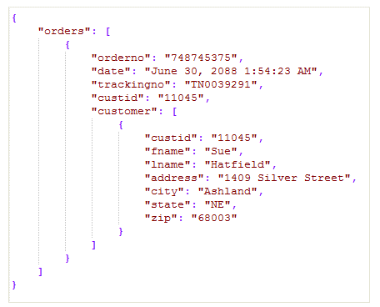
Distributed Systems ➤ Communication ➤ APIs
Data Formats
JSON (textual)
Protobuf (binary)
Self-describing
Human-readable
Verbose
Inefficient parsing
Simple Data Types
Compact
Performant
Rich Data Types
Not human-readable
XML, BSON, YAML, …

Slide 57
Distributed Systems ➤ Communication ➤ APIs
Protocols
REST
gRPC
HTTP Based
Textual (JSON or XML)
Requires extra validation
Request-response communication
No native code generation
Multiple endpoints defined by HTTP methods + resource paths
HTTP Based
Binary (Protobuf)
Automatic native data validation
Bidirectional streaming
Native code generation for many programming languages
Callable functions

Slide 58
Distributed Systems ➤ Communication ➤ APIs ➤ REST
HTTP Methods
HTTP Method | Use | Safe | Idempotent
GET | Retrieve a resource or a list of resources | YES | YES
POST | Create a new resource | NO | NO
PUT | Update a resource | NO | YES
DELETE | Delete a resource | NO | YES

Slide 59
Distributed Systems ➤ Communication ➤ APIs ➤ REST
HTTP Response Status Codes
Codes | Category | Examples
2xx | Success | 200 (OK) 201 (Created)
3xx | Redirection | 301 (Moved Permanently)
4xx | Client Error | 400 (Bad Request) 401 (Unauthorized) 403 (Forbidden) 404 (Not Found)
5xx | Server Error | 500 (Internal Server Error) 502 (Bad Gateway) 503 (Service Unavailable)

Slide 60
Distributed Systems ➤ Communication ➤ APIs
Evolution
Don’t introduce breaking changes, for example :
POST /products ➜ POST /new-products
Optional parameter birthDate ➜ Mandatory parameter
If breaking changes are necessary, version your API :
/v1/products ➜ keep /v1/products and add /v2/products

Slide 61


Distributed Systems ➤ Communication ➤ APIs
Idempotency
A
B
C

Slide 62
Distributed Systems ➤ Communication ➤ APIs
Idempotency
Create product X
Insert X
X created
A
B
C
X
Connection
Error

Slide 63

Distributed Systems ➤ Communication ➤ APIs
Idempotency
Create product X
Insert X
X created
A
B
C
X
X
Connection
Error
Create product X
Insert X
X created
X created twice

Slide 64
Distributed Systems ➤ Communication ➤ APIs
Idempotency
A
B
C

Slide 65
Distributed Systems ➤ Communication ➤ APIs
Idempotency
Create product X,
Request ID 17
Insert X
X created
A
B
C
X
Connection
Error

Slide 66

Distributed Systems ➤ Communication ➤ APIs
Idempotency
Create product X,
Request ID 17
Insert X
X created
A
B
C
X
Connection
Error
Create product X,
Request ID 17
Request ID 17 was
already processed
X created
X created once

Slide 67
Distributed Systems
Coordination

Slide 68
Distributed Systems ➤ Coordination
Failure Detection
Host A
Host B
Request
No Response

Slide 69
Distributed Systems ➤ Coordination
Failure Detection
Host A
Host B
Request
No Response
Is the server slow ?
Has the server crashed ?
Is there a network issue ?

Slide 70

Distributed Systems ➤ Coordination
Failure Detection
Host A
Host B
Ping
Pong

Slide 71
Distributed Systems ➤ Coordination
Failure Detection
Host A
Host B
Ping
Pong
No Pong
➜
B is unavailable

Slide 72
Distributed Systems ➤ Coordination
Failure Detection
Host A
Host B
Heartbeat

Slide 73
Distributed Systems ➤ Coordination
Failure Detection
Host A
Host B
Heartbeat
Long time since last heartbeat
➜
B is unavailable

Slide 74

Distributed Systems ➤ Coordination
Time

Slide 75
Distributed Systems ➤ Coordination ➤ Time
Physical Clock
Clock Drift : rate at which a clock runs faster or slower than others
Clock Skew : difference between two clocks at a specific point in time

Slide 76
Distributed Systems ➤ Coordination ➤ Time
Physical Clock
Quartz Crystal Clock
Cheap
Low accuracy
Atomic Clock
Expensive
High accuracy
(1 second in 3M years)

Slide 77
Distributed Systems ➤ Coordination ➤ Time ➤ Physical Clock
Synchronization
Quartz Crystal Clock
Atomic Clock
Time ?
11:32:17
11:32:15
11:32:17

Slide 78
Distributed Systems ➤ Coordination ➤ Time ➤ Physical Clock
Synchronization
NTP Client
NTP Server
Quartz Crystal Clock
Atomic Clock
Time ?
11:32:17
11:32:15
11:32:18
11:32:17
NTP Protocol
11:32:17 +
1s estimated network latency

Slide 79
Distributed Systems ➤ Coordination ➤ Time ➤ Physical Clock
Synchronization
Quartz Crystal Clock
Atomic Clock
Time ?
11:32:17
11:32:19
11:32:17

Slide 80
Distributed Systems ➤ Coordination ➤ Time ➤ Physical Clock
Synchronization
NTP Client
NTP Server
Time ?
11:32:17
11:32:19
11:32:18
11:32:17

Slide 81

Distributed Systems ➤ Coordination ➤ Time ➤ Physical Clock
Synchronization
NTP Client
Measurement of a duration could be inaccurate and even negative !
11:32:19
11:32:18

Slide 82
Distributed Systems ➤ Coordination ➤ Time ➤ Physical Clock
Monotonic Clock
Measures the amount of time since an arbitrary point
Useful for accurate measurement of a duration
Cannot be used to compare timestamps of two nodes

Slide 83

Distributed Systems ➤ Coordination ➤ Time
Logical Clock
Jimmy
Drink Coffee
Send Email to Ema
Time
Ema
Receive Email from Jimmy
Read Email

Slide 84
Distributed Systems ➤ Coordination ➤ Time
Logical Clock
Jimmy
Drink Coffee
Send Email to Ema
Time
Ema
Receive Email from Jimmy
Read Email
Jimmy’s “Drink Coffee” action
happened-before
Ema’s “Read Email” action

Slide 85
Distributed Systems ➤ Coordination ➤ Time
Logical Clock
Jimmy
Drink Coffee
Send Email to Ema
Time
0
1
2
3
Ema
Receive Email from Jimmy
Read Email
Ema and Jimmy must coordinate their logical clocks

Slide 86
Distributed Systems ➤ Coordination ➤ Time ➤ Logical Clock
Example Implementations
Lamport Clock
Each process has a single local counter
Timestamp(A) < Timestamp(B)
doesn’t imply
A happened-before B
Vector Clock
Each process has a local vector of counters : 1 counter for each process in the system
Timestamp(A) < Timestamp(B) implies A happened-before B

Slide 87
Distributed Systems ➤ Coordination
Leader Election

Slide 88
Distributed Systems ➤ Coordination ➤ Leader Election
Distributed Algorithm Properties
Safety
Nothing Bad happens
Liveness
Something Good eventually happens

Slide 89
Distributed Systems ➤ Coordination
Leader Election
Safety
At Most One Leader at any given time
Liveness
An Election Eventually Completes even in the presence of failures

Slide 90
Distributed Systems ➤ Coordination ➤ Leader Election
Raft Leader Election
Follower
Candidate
Leader

Slide 91
Distributed Systems ➤ Coordination ➤ Leader Election
Raft Leader Election
All Nodes start as Followers

Slide 92
Distributed Systems ➤ Coordination ➤ Leader Election
Raft Leader Election
No Leader was found, they transition to Candidate state and vote for a Leader

Slide 93
Distributed Systems ➤ Coordination ➤ Leader Election
Raft Leader Election
A Leader is elected by the Majority of votes

Slide 94
Distributed Systems ➤ Coordination ➤ Leader Election
Raft Leader Election
The Leader node could fail at anytime

Slide 95
Distributed Systems ➤ Coordination ➤ Leader Election
Raft Leader Election
Nodes transition to Candidate state and vote for a new Leader

Slide 96
Distributed Systems ➤ Coordination ➤ Leader Election
Raft Leader Election
A new Leader was Elected

Slide 97
Distributed Systems ➤ Coordination ➤ Leader Election
Raft Leader Election
If the previous Leader is up again it will
Follow the New Leader

Slide 98
Distributed Systems ➤ Coordination ➤ Leader Election
Compare-And-Swap Election
If there is no leader, then I’m the leader
Data Store
that supports Compare-And-Swap

Slide 99
Distributed Systems ➤ Coordination ➤ Leader Election
Compare-And-Swap Election
First one to request leadership wins !
Data Store
that supports Compare-And-Swap

Slide 100
Distributed Systems ➤ Coordination
Replication
Increase Availability
Increase Scalability
Increase Performance

Slide 101
Distributed Systems ➤ Coordination ➤ Replication
Consistency
x=5
x=5
x=5

Slide 102
Distributed Systems ➤ Coordination ➤ Replication
Consistency
x=17
x=5
x=5
x=5

Slide 103
Distributed Systems ➤ Coordination ➤ Replication
Consistency
x=17
x=17
x=5
x=17

Slide 104
Distributed Systems ➤ Coordination ➤ Replication
Consistency
x=5
x=17
x=5 or x=17
x=17

Slide 105
Distributed Systems ➤ Coordination ➤ Replication
Consistency
Write Visible
Write Request
x = 17
Write Done
x = 5
Time

Slide 106
Distributed Systems ➤ Coordination ➤ Replication ➤ Consistency
Strong Consistency
Client A
Write Visible
Write Request
x = 17
Write Done
x = 5
Time
Read Request
5
Read Request
17
Client B

Slide 107
Distributed Systems ➤ Coordination ➤ Replication ➤ Consistency
Sequential Consistency
Client A
x = 17
x = 20
x = 5
Time
5
5
5
17
20
Client B

Slide 108
Distributed Systems ➤ Coordination ➤ Replication ➤ Consistency
Eventual Consistency
Client A
x = 17
x = 20
x = 5
Time
5
17
5
17
20
Client B

Slide 109
Distributed Systems ➤ Coordination ➤ Replication
Consistency
Strong
Bad
Strong Consistency (Linearizability)
Sequential Consistency
Eventual Consistency
Performance
Consistency
Weak
Good

Slide 110
Distributed Systems ➤ Coordination ➤ Replication
Example Implementations
Paxos
Old & Complex
Strong Consistency
Prioritizes safety over liveness
Raft
Recent & Simple
Strong Consistency
Prioritizes liveness over safety
Can continue operating if minority of nodes fail
Chain
Recent & Simple
Strong Consistency
Prioritizes safety over liveness
Better Performance
Blocks if a node fails

Slide 111
Distributed Systems ➤ Coordination ➤ Replication
Raft Replication
5
5
x = 5
5
5
5
5

Slide 112
Distributed Systems ➤ Coordination ➤ Replication
Raft Replication
5
5
The Client requests to write a new value to the Leader
x = 17
5
5
5
5

Slide 113
Distributed Systems ➤ Coordination ➤ Replication
Raft Replication
5
5
The Leader propagates the write to all nodes
x = 17
5
5
5
5

Slide 114
Distributed Systems ➤ Coordination ➤ Replication
Raft Replication
As soon as the Majority of nodes acknowledge the new value, the Leader updates its local value and confirms the update to the Client
17
17
x = 17
17
5
17
5

Slide 115
Distributed Systems ➤ Coordination ➤ Replication
Raft Replication
17
17
Reads are performed exclusively on the Leader node
17
5
17
17
5

Slide 116
Distributed Systems ➤ Coordination ➤ Replication
Chain Replication
5
5
5
5
5
Head
Tail

Slide 117
Distributed Systems ➤ Coordination ➤ Replication
Chain Replication
x = 17
17
17
17
5
5
Writes are performed exclusively on the Head node.
Each node updates its local value and propagates the value
to the next node until reaching the Tail node.

Slide 118
Distributed Systems ➤ Coordination ➤ Replication
Chain Replication
17
17
17
17
17
The acknowledgment flows back from the Tail node to the Head Node that will confirm the update to the Client

Slide 119
Distributed Systems ➤ Coordination ➤ Replication
Chain Replication
17
17
17
17
17
17
Reads are performed exclusively on the Tail node

Slide 120
Distributed Systems ➤ Coordination
Transactions
A C I D
Atomicity
Isolation
Consistency
Durability

Slide 121
Distributed Systems ➤ Coordination ➤ Transactions
Atomicity
write
x = 7
y = 13
x = 7
y = 13
x = 20
y = 50
x = 20
y = 50
x = 20
y = 13
“ All or Nothing “
Either all the operations in the transaction complete successfully, or none do

Slide 122
Distributed Systems ➤ Coordination ➤ Transactions
Consistency
A transaction can only transition a system from a correct state to another correct state
e.g. the sum of the amounts of both bank accounts before and after a transfer must be the same

Slide 123
Distributed Systems ➤ Coordination ➤ Transactions
Isolation
A transaction appears to run in isolation as if no other transactions are executing

Slide 124
Distributed Systems ➤ Coordination ➤ Transactions ➤ Isolation
Dirty Write
Transaction B
write x = 20
write y = 50
write x = 90
x = 90
y = 13
x = 7
y = 13
Time
Transaction A
A transaction overwrites the value written by another transaction that hasn’t committed yet

Slide 125
Distributed Systems ➤ Coordination ➤ Transactions ➤ Isolation
Dirty Read
Transaction B
write x = 20
write y = 50
read x = 20
x = 20
y = 13
x = 7
y = 13
Time
Transaction A
A transaction observes a write from a transaction that hasn’t completed yet

Slide 126
Distributed Systems ➤ Coordination ➤ Transactions ➤ Isolation
Fuzzy Read
B
read x = 7
write x = 20
read x = 20
x = 7
y = 13
Time
A
A transaction reads an object’s value twice but sees a different value in each read because another transaction updated the value between the two reads

Slide 127
Distributed Systems ➤ Coordination ➤ Transactions ➤ Isolation
Phantom Read
B
write x = 20
write y = 13
delete x
write sum = 33
y = 13
sum = 37
x = 7
y = 13
sum = 20
Time
A
A transaction reads a group of objects matching a specific condition, while another transaction concurrently adds, updates, or deletes objects matching the same condition

Slide 128
Distributed Systems ➤ Coordination ➤ Transactions ➤ Isolation
Isolation Levels
Strict Serializable
Serializable
Repeatable Read
Read Committed
Read Uncommitted
No Guarantees
Strong
Bad
Changes immediately visible after commit
Forbid Phantom Reads
Forbid Fuzzy Reads
Performance
Isolation
Forbid Dirty Reads
Forbid Dirty Writes
Weak
Good

Slide 129
Distributed Systems ➤ Coordination ➤ Transactions
Durability
Committed changes must be persisted and must survive any crashes

Slide 130
Distributed Systems
Scalability
Vertical
Horizontal

Slide 131
Distributed Systems ➤ Scalability
Vertical Scalability
CPU
More CPU cores
Application must be multi-threaded
Network
More NICs
Disk
More disks
SSD instead of HDD
Memory
Increase memory

Slide 132
Distributed Systems ➤ Scalability
HTTP Caching
Client
Cache
Server
GET /api/v1/products/42
Cache Miss
GET /api/v1/products/42
product 42
Cache expiry : 5 min
Version: 1
product 42 v1

Slide 133
Distributed Systems ➤ Scalability
HTTP Caching
Client
Cache
Server
GET /api/v1/products/42
Cache Hit
product 42 v1

Slide 134
Distributed Systems ➤ Scalability
HTTP Caching
Client
Cache
Server
GET /api/v1/products/42
Cache Expired
GET /api/v1/products/42
I have version: 1
product 42 v1

Slide 135
Distributed Systems ➤ Scalability
HTTP Caching
Client
Cache
Server
GET /api/v1/products/42
Cache Expired
GET /api/v1/products/42
I have version: 1
product 42
Cache expiry : 5 min
Version: 2
product 42 v2

Slide 136
Distributed Systems ➤ Scalability ➤ Caching
Client-side Caching
Client (ex: Browser)
Server
Client Application
Cache

Slide 137
Distributed Systems ➤ Scalability ➤ Caching
Reverse Proxy Caching
Client
Server Cluster
Reverse Proxy
Server Application

Slide 138




Distributed Systems ➤ Scalability ➤ Caching
Content Delivery Network (CDN)
PARIS PROXY
NY PROXY
TOKYO PROXY

Slide 139
Distributed Systems ➤ Scalability ➤ Caching
Local Caching
Server
Product
Service
Local
Product
Cache
Product
Database

Slide 140
Distributed Systems ➤ Scalability ➤ Caching
External Caching
External
Cache
Database
Servers

Slide 141
Distributed Systems ➤ Scalability
Load Balancing
Gateway
2
3
4
1
6
5
8
7
9
10
12
11

Slide 142

Distributed Systems ➤ Scalability
Partitioning
Gateway
A - J
Tiger ?
1
K - Q
R - Z

Slide 143
Distributed Systems ➤ Scalability
Partitioning
Gateway
A - J
Tiger ?
2
1
Tiger ?
K - Q
R - Z

Slide 144

Distributed Systems ➤ Scalability
Partitioning
Gateway
A - J
Tiger ?
2
1
Tiger ?
K - Q
R - Z
3

Slide 145
Distributed Systems ➤ Scalability
Partitioning
Gateway
A - J
Tiger ?
2
1
Tiger ?
K - Q
4
R - Z
3

Slide 146

Distributed Systems ➤ Scalability
Messaging
Workers
Task 1
Task 5
Task 15
Task 10
Task 13
Task 12
Task 11
Task 2
Task 3
Task 14
Queue
Task 6
Task 8
Task 4
Task 7
Task 9

Slide 147
Distributed Systems ➤ Scalability
Messaging
Subscribers
Msg 1
Msg 2
Msg 7
Msg 3
Msg 6
Msg 5
Msg 4
Msg 3
Msg 1
Msg 8
Msg 2
Publish / Subscribe
Msg 3
Msg 1
Msg 2

Slide 148
Distributed Systems
Resilience
“Anything that can go
wrong will go wrong”
Murphy's law

Slide 149
Distributed Systems ➤ Resilience
Common Failures
Incorrect Error Handling
Configuration changes
Hardware
Faults
Network Faults
Single Points of Failure (SPOF)
Load Pressure
Resource Leaks

Slide 150
Distributed Systems ➤ Resilience
Managing Risk
Impact
Extensive
Major
Medium
Minor
Low
Probability
Unlikely
Possible
Likely
Very Likely
Highly unlikely

Slide 151
Distributed Systems ➤ Resilience
Redundancy
Replication
Instances must not fail for the same reason

Slide 152
Distributed Systems ➤ Resilience
Redundancy
US instance
China instance

Slide 153
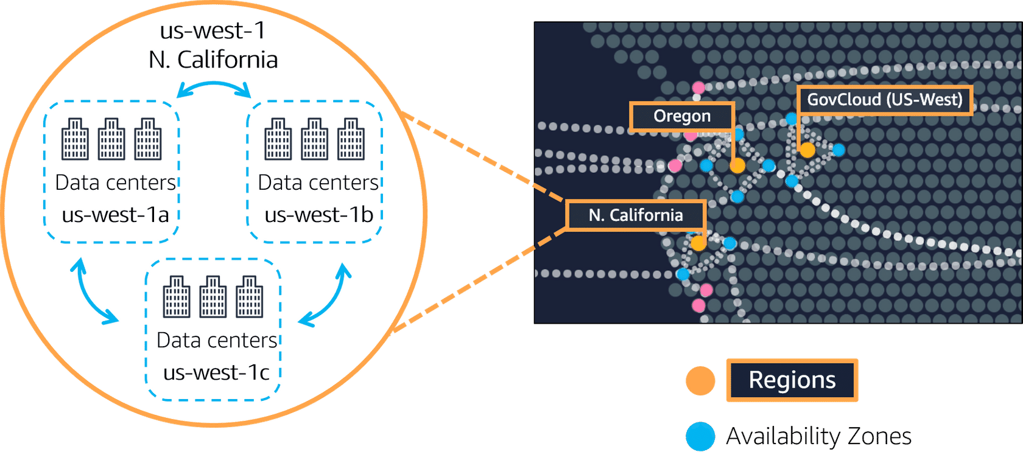
Distributed Systems ➤ Resilience
Redundancy

Slide 154
Distributed Systems ➤ Resilience
Downstream Resilience
GET /products/23
Always configure a timeout on requests
Retry the request if the server replies with a server error
Retries must be delayed exponentially (ex: 1s, 2s, 4s, …)
Limit the number of requests

Slide 155
Distributed Systems ➤ Resilience
Upstream Resilience
GET /products/23

Slide 156
Distributed Systems ➤ Resilience ➤ Upstream Resilience
Load Shedding
GET /products/23
503
Limit the number of concurrent requests
Return 503 (Service Unavailable) if the limit is exceeded

Slide 157
Distributed Systems ➤ Resilience ➤ Upstream Resilience
Load Leveling
GET /products/23
product 23
Use a message a broker between the client and the server
The server will process the requests at its own pace

Slide 158
Distributed Systems ➤ Resilience ➤ Upstream Resilience
Rate Limiting
GET /products/23
API key = 87
429
Each client must have an API key to query the server
For each API key there is one or multiple quotas on the number of requests per period of time (per second, per day, …)
Return 429 (Too Many Requests) if the quota is exceeded

