Slide 1
Spring Basics
2024

Slide 2
Spring Container
userController
myBean
productController
userService
userRepository
Spring Bean (singleton)
productService
productRepository
applicationContext
Spring Container

Slide 3


Spring Layers
userController
myBean
HTTP
productController
DTO
(Data Transfer Object)
userService
userRepository
Controller
Service
Repository
productService
Entity
productRepository
Java DB driver
applicationContext
Spring Container

Slide 4
DTO
@Getter @Setter @ToString @EqualsAndHashCode public class UserDto { private String id; private String firstName; private String lastName; private LocalDate birthDate; }

Slide 5
Entity
@Entity @Getter @Setter @ToString public class User { @Id private String id; private String firstName; private String lastName; private LocalDate birthDate; }

Slide 6
Repository
@Repository public interface UserRepository extends JpaRepository<User, String> { Optional<User> findByFirstNameAndLastNameAndBirthDate(String firstName, String lastName, LocalDate birthDate); Stream<User> findByLastName(String lastName); }

Slide 7
Service
@Service @AllArgsConstructor public class UserService { private final UserRepository userRepository; @Transactional(isolation = Isolation.SERIALIZABLE)
public UserDto createUser(UserDto user) { ... }
}

Slide 8
Controller
@RestController @RequestMapping("users") @AllArgsConstructor public class UserController { private final UserService userService; @PostMapping public UserDto createUser(@RequestBody UserDto user) { return userService.createUser(user); } }

Slide 9
Other Beans creation & injection
@Configuration public class CacheConfiguration { @Bean @Qualifier("userCache") public Cache<String, User> userCache() { return CacheBuilder.newBuilder().build(); } @Bean @Qualifier("imageCache") public Cache<String, Image> imageCache() { return CacheBuilder.newBuilder().build(); } }
@Service public class UserService { private final Cache<String, User> userCache; public UserService(@Qualifier("userCache") Cache<String, User> userCache) { this.userCache = userCache; }
}

Slide 10
Value injection
@Configuration public class CacheConfiguration { @Bean public Cache<String, User> userCache(@Value("my-app.user.cache.size") int cacheSize) { return CacheBuilder.newBuilder().maximumSize(cacheSize).build(); }
}
my-app: user: cache: size: 1000
application.yml

Slide 11
Scheduled task
@Slf4j @Service public class UserService { @Scheduled(fixedRate = 5, timeUnit = TimeUnit.MINUTES) public void logHello() { log.info("Hello !"); }
}

Slide 12
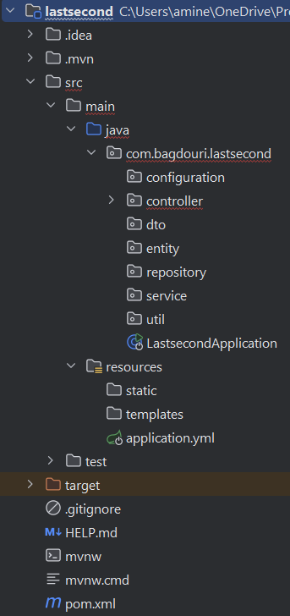
Spring Project Structure

