Slide 1
Spring Basics
2024

Slide 2
Spring Container
userController
myBean
productController
userService
userRepository
Spring Bean (singleton)
productService
productRepository
applicationContext
Spring Container

Slide 3


Spring Layers
userController
myBean
HTTP
productController
DTO
(Data Transfer Object)
userService
userRepository
Controller
Service
Repository
productService
Entity
productRepository
Java DB driver
applicationContext
Spring Container

Slide 4
Service
@Service @AllArgsConstructor public class UserService { private final UserRepository userRepository; public UserDto createUser(UserDto user) { ... } }

Slide 5
Controller
@RestController @RequestMapping("users") @AllArgsConstructor public class UserController { private final UserService userService; @PostMapping public UserDto createUser(@RequestBody UserDto user) { return userService.createUser(user); } }

Slide 6
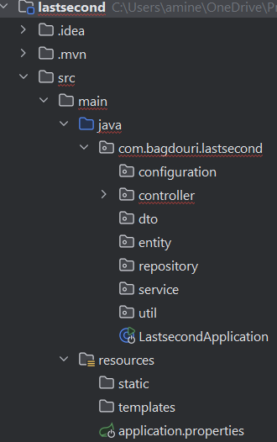
Spring Application Packages

