Slide 1
TEAM VICTORY
PRESENTS

Slide 2

YOUR WAY OUT OF THE LONELINESS

Slide 3
LONELINESS
WAS ASSOCIATED WITH:
HIGHER RATES OF
HEARTH DISEASE
STROKE,
DEPRESSION
& ANXIETY
MILLIONS
OF WORLDWIDE
SENIORS
ARE AFFECTED BY LONELINESS

Slide 4
WHY?

Slide 5
BECAUSE THEY HAVE
NOBODY TO TALK TO.

Slide 6
SO HERE IS
OUR
SOLUTION

Slide 7
YOUR WAY OUT OF THE LONELINESS

Slide 8
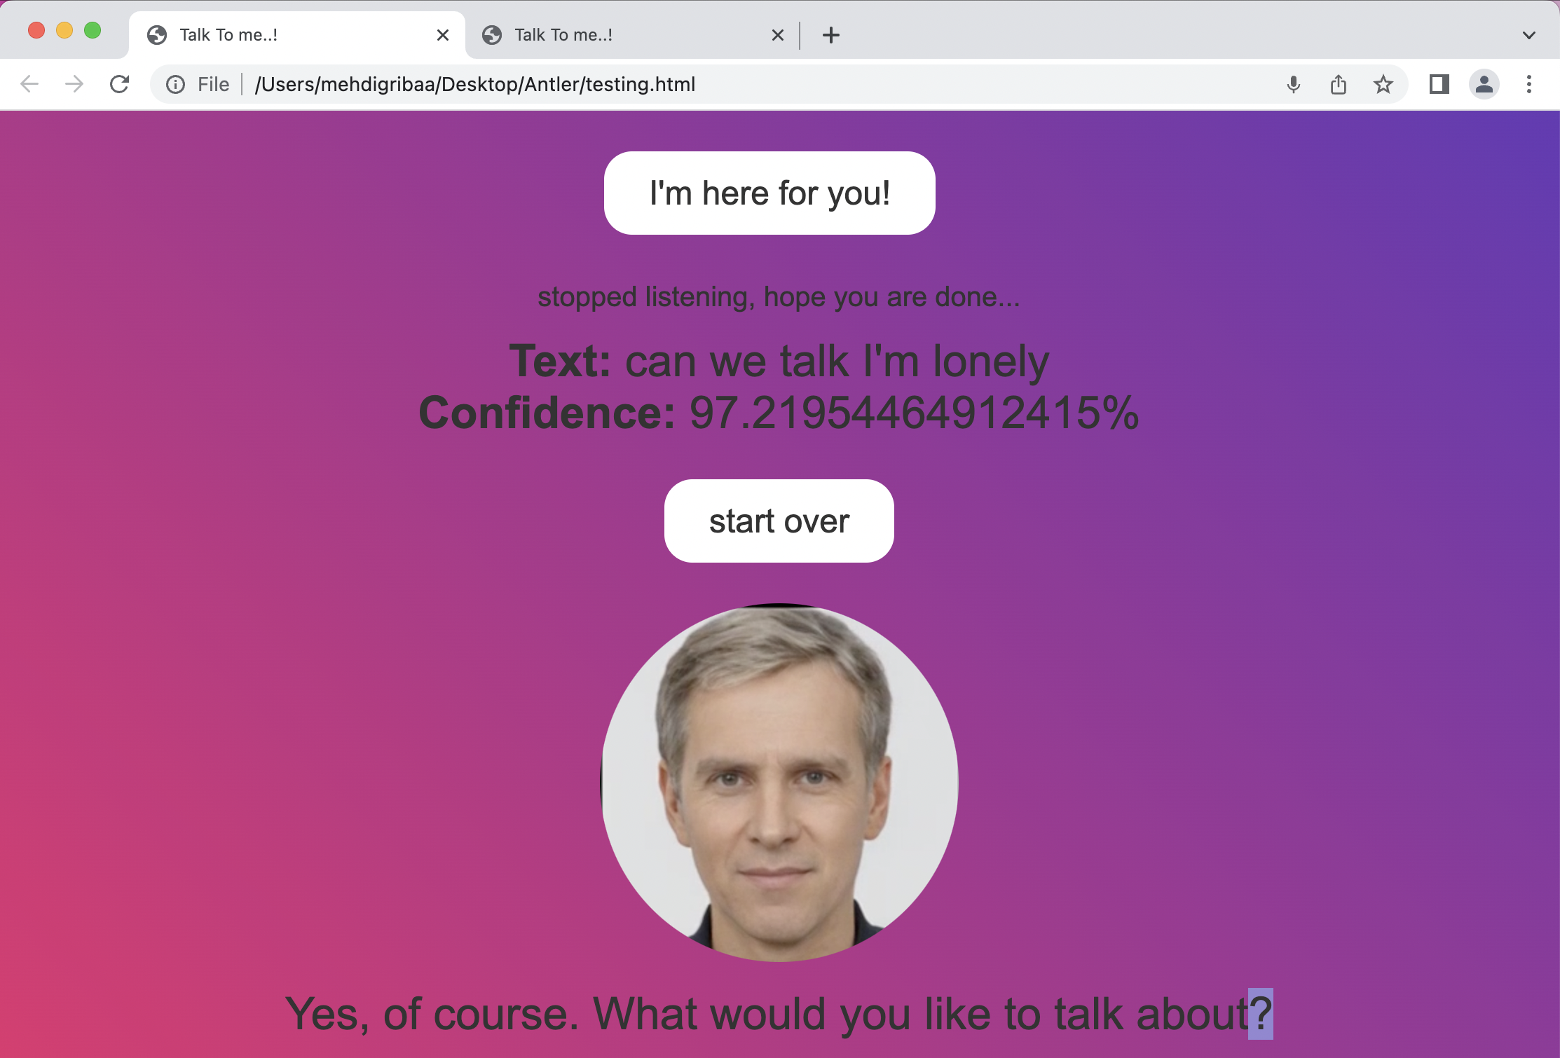
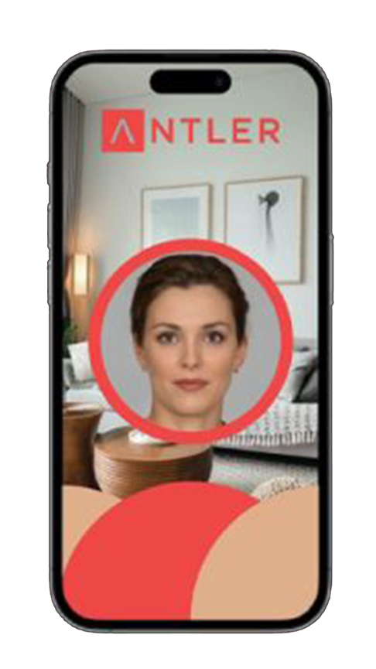


Slide 9
WHAT IS WARMLY?
AN AI POWER COMPANION THAT WORKS WITH SPEECH RECOGNITION

Slide 10
HOW DOES IT WORK?
IT HEARS WHAT ELDERLY HAVE TO SAY
RESPONDS ACCURATELY TO IT
ALLEVIATES LONELINESS

Slide 11
WITH A
BY
HOLDING A CONVERSATION
REASSURING TONALITY

Slide 12
OUR APPROACH
JUST NEED TO PUT THE CARD IN THE READER, NO NEED FOR OTHER PHYSICAL INTERACTION.

Slide 13
OUR APPROACH PT2
CREATE A WEBSITE AND AN APP COMPATIBLE WITH THE FULL REACH SYSTEM.

Slide 14
OUR APPROACH PT3
THE APP WILL USE 3 APIS:
TO CONVERT SPEECH TO TEXT
TO RUN THE TEXT IN A LANGUAGE MODEL AI
TO CONVERT THE TEXT TO SPEECH

Slide 15
OUR APPROACH PT4
MORE FEATURES:
AVATAR IN A REAL HUMAN FORM, BASED ON YEPIC VIDEO API
AVAILABLE ON WEBSITE FORMAT

Slide 16
WHY A HUMAN LOOKING AI AVATAR?
TO MAKE THE ELDERLY MORE COMFORTABLE PSYCHOLOGICALLY

Slide 17
THE NEXT STEPS FOR WARMLY
LEARN FROM CONVERSATIONS
ASK MORE SPECIFIC QUESTIONS
LIMIT THE TIME OF RESPONSE

Slide 18
THE NEXT STEPS FOR WARMLY PT2
SOOTHING MUSIC IN THE BACKGROUND:
PERSON MORE OPEN TO THE AI
THE AI CAN LEARN MORE ABOUT THE PERSON

Slide 19
THANK YOU
FROM TEAM VICTORY
MOHAMED AMINE CHEIKH
MARTING JANG-SOO ALEXANDER ZAHREN
MEHDI GRIBAA NASUH FLORIN ACAR

