Slide 1
P4 Olist

Slide 2
Problematic
Olist is a brazilian e-commerce platform that has provided anonymized data about its customers, sellers, products,…
The aim of this project is to use these data to build a client-based segmentation that can be interpreted easily by the marketing team. This should also help them target their communication so that it becomes more efficient.
The segmentation stability will be investigated as well and a maintenance planning will be provided.

Slide 3
Contents
Exploratory Data Analysis
Feature Engineering
RFM analysis
Model selection
Stability and maintenance
Clusters explanation

Slide 4
EDA
1
Let’s start by exploring the dataset

Slide 5

EDA: data schema
The data schema is compounded of 8 datasets
Keys between each table are helpful to merge them together.

Slide 6
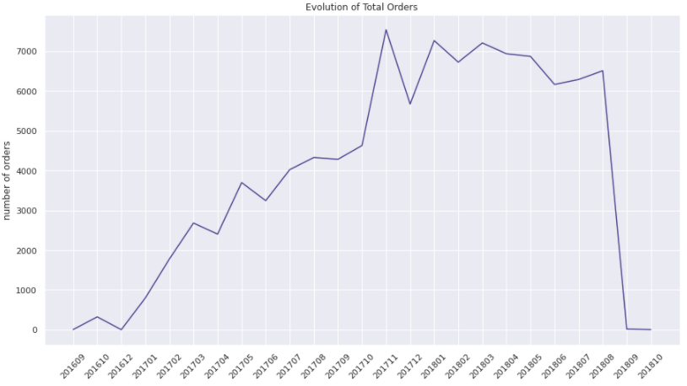
EDA: monthly orders

Slide 7
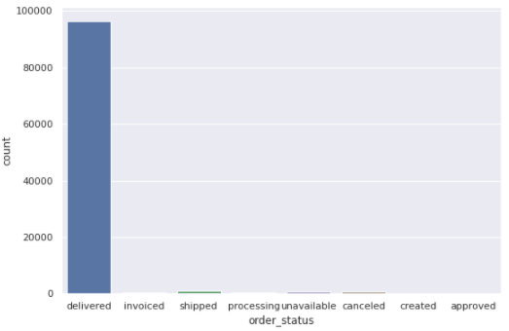
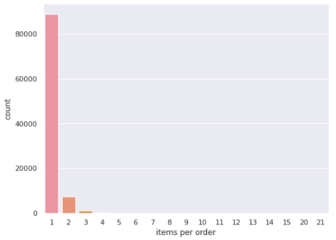
EDA: order status & items

Slide 8
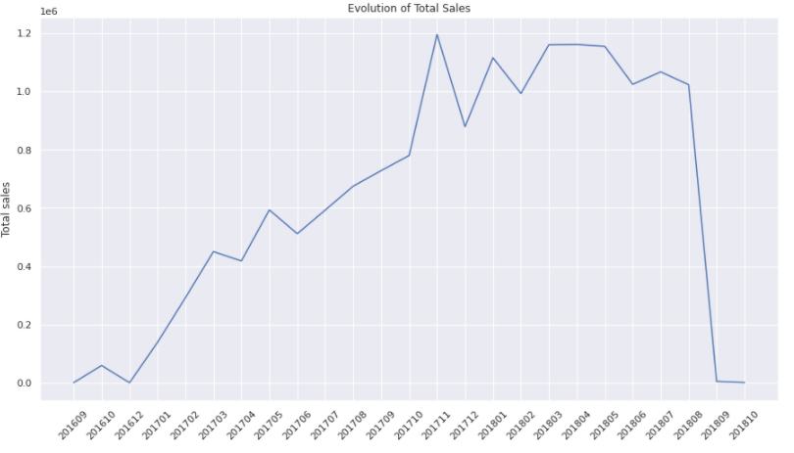
EDA: monthly sales

Slide 9
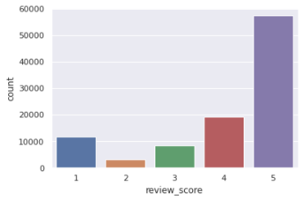
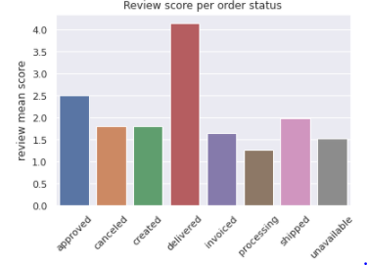
EDA: reviews
Mean review score: 4.07

Slide 10
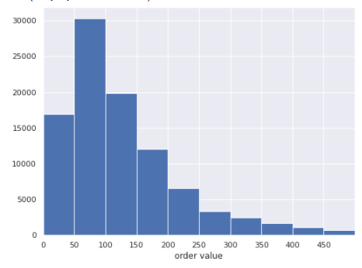
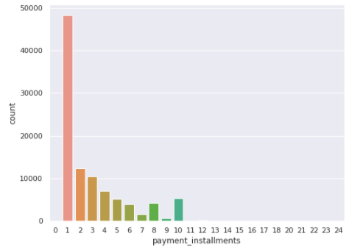
EDA: payments
Most order range between 50-100 R$

Slide 11
Feature Engineering
2
Let’s create new features

Slide 12
FE: delivery
Creation of 2 numerical features to evaluate delivery time:
nb_days_to_deliver
nb_days_ahead_estimate
purchase
delivery
estimate
nb_days_to_deliver
nb_days_ahead_estimate

Slide 13
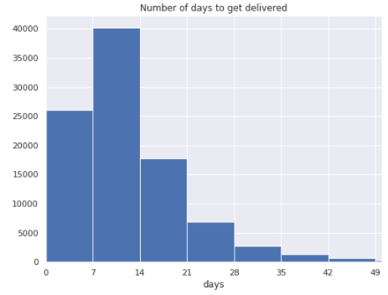
FE: delivery time
Most of the orders are delivered between 1-2 weeks time.
¼ th are delivered in 1 week.
Overall, these are good metrics.
However about 3% of orders are delivered after 4 weeks.

Slide 14
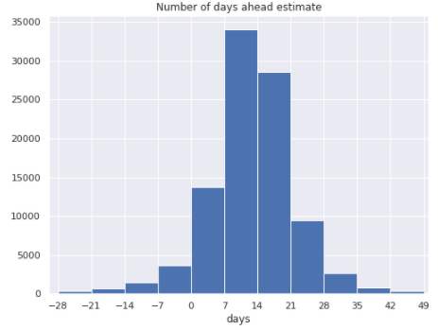
FE: delivery performance
Orders are generally delivered 0-3 weeks before the estimated time.
Nb_days_ahead_estimate is mostly > 0. (delivered on time)
There are around 5% of the orders that did not get delivered by the estimated time.

Slide 15
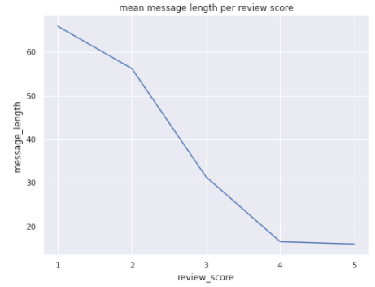
FE: review features
2 features were created to measure the length of message and title reviews:
Title_length
Message_length
When title or message is missing then 0 is attributed.
Unsastified customers tend to give longer reviews.

Slide 16
Merge datasets
Merge datasets on the left excepts sellers and geolocation.
Keep only numerical features.
Group_by ’customer_unique_id ’

Slide 17
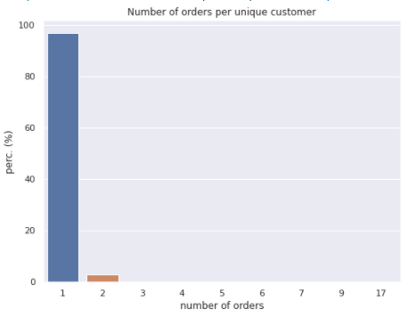
Frequency (unique clients)
Around 96,8% of the customers ordered just once.
2.9 % ordered twice.
0.3% only ordered 3 times or more.

Slide 18
RFM analysis
3

Slide 19
RFM
RFM is a marketing technique used to create a client segmentation. It stands for:
Recency: last purchase date
Frequency: number of purchase
Monetary: amount of money spent
Using this technique with this dataset did not provide a good segmentation. It was not able to cluster the most frequent customers apart. Also it gives the same importance to each of these features.

Slide 20
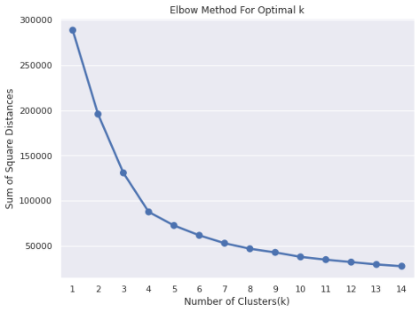
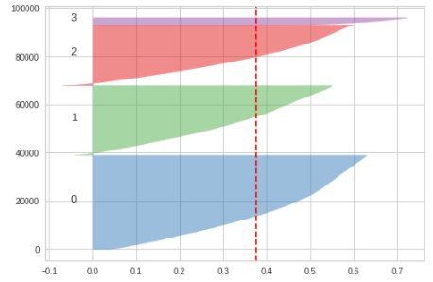
Kmeans on RFM features
I have tried to compare the traditional RFM technique with a clustering algorithm. After transforming the RFM data (log + std scaler) I have run Kmeans with different values of k:

Slide 21
Model selection
3

Slide 22
Split dataframe
I only keep data from 01/01/2017 to 31/08/2018.
I have created 5 dataframes in order to evaluate the stability over time:
DF_2017 (transaction for year 2017)
DF_2017_2m (transactions for year 2017 + 2 months)
DF_2017_4m (transactions for year 2017 + 4 months)
DF_2017_6m (transactions for year 2017 + 6 months)
DF_2017_8m (transactions for year 2017 + 8 months)
I will work on DF_2017 only to perform the iterations to select the best features and related transformations along with the best model.

Slide 23
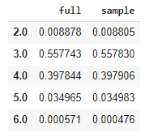
StratifiedShuffleSplit
In order to speed-up the process of selecting the best clustering model, I have decided to work only on a portion of the DF_2017 dataframe.
However, this sample needs to be representative of the whole data.
I have used StratifiedShuffleSplit on « monetary » feature to make sure the distribution is preserved after sampling.

Slide 24
Model selection process
Step 1
Step 2
Step 3
Step 4
Sample data
Kmeans optimization
Select best model
Clustering on all data
Work only with a representative sample in order to speed-up the iterations.
Iterate on sample data to select the best features, transformations and optimal k.
Run 2 other clustering algorithms on the best features from step 2. Compare and select best model.
Run the best model on the full data.

Slide 25

Kmeans - all features
Run Kmeans on all features below:
Iterate on different k values from 2 to 10.
Use following hyperparameters:
Init = ‘k-means++’
I have tried to tune other parameters such as n_init, max_iter and tol but no improvement. Only k param will be tuned from now.

Slide 26
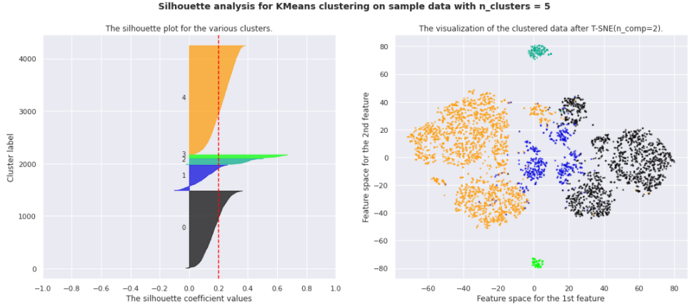
Kmeans - all features
The maximum average silhouette obtained is 0.2 with k=5.

Slide 27
Kmeans – best features
In order to improve these results I have tested different:
feature selection
feature transformations (Log, QuantileTransformer)
scaling (StrandardScaler, MinMaxScaler)
Best results were obtained with 5 features:
Features | Transformations
Recency | QuantileTransformer + StrandardScaler
Frequency
Monetary
Nb_items_ordered
Review_score | MinMaxScaler

Slide 28
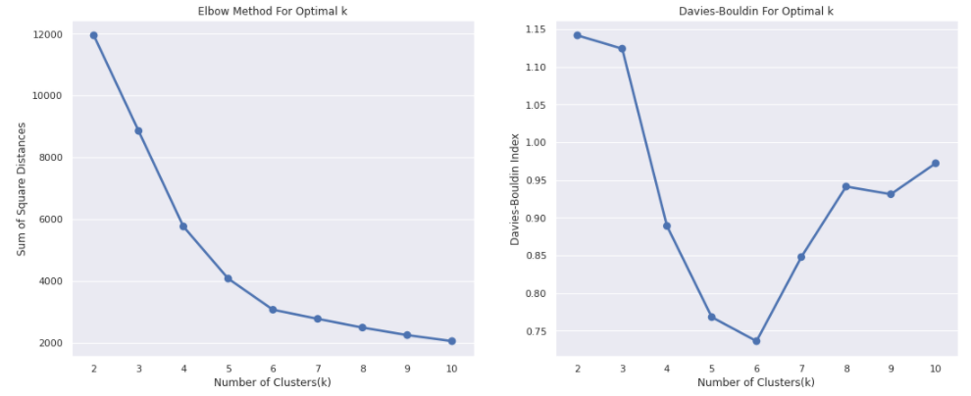
Kmeans – optimal k
I

Slide 29
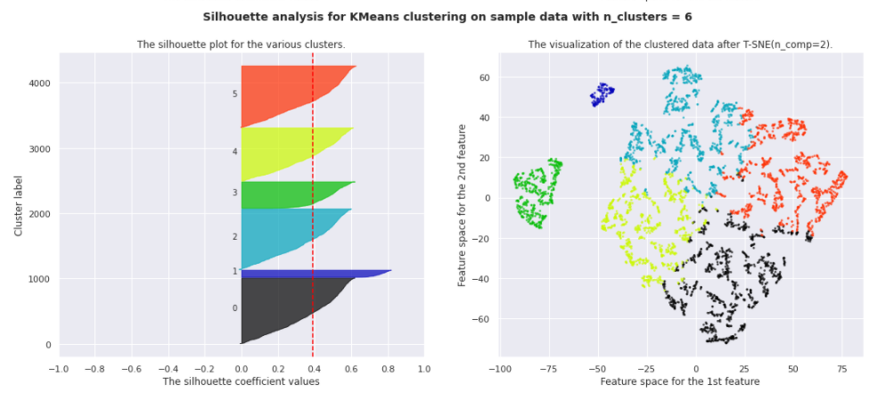
Kmeans – silhouette + cluster
I

Slide 30
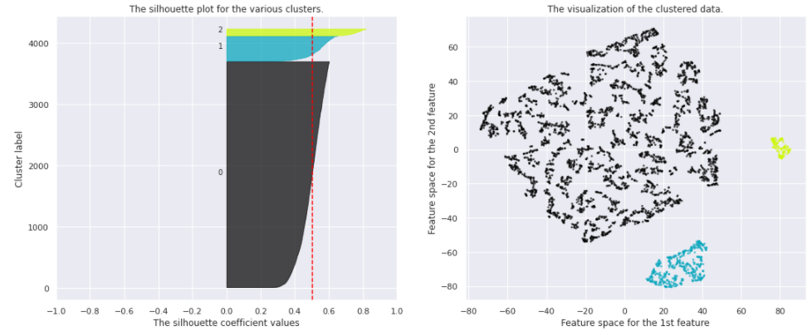
DBSCAN – silhouette + viz
I

Slide 31
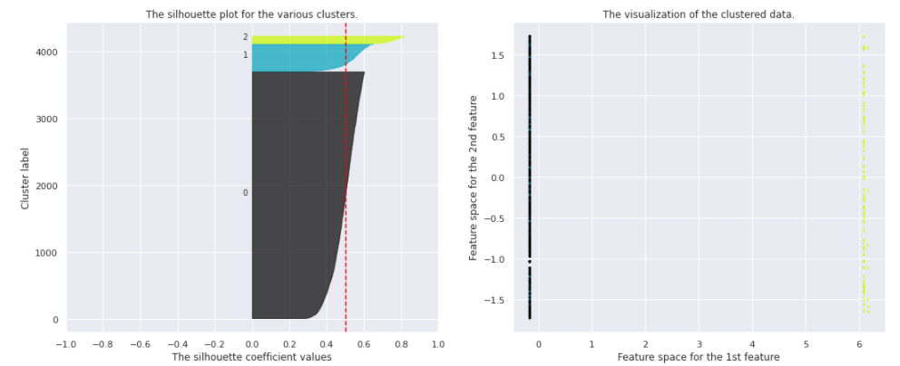
AgglomerativeClustering
I

Slide 32
Best model ?
DBSCAN and AgglomerativeClustering have a higher average silhouette value than Kmeans.
However, the optimal number of clusters for these 2 models is k=3. They both have a really dense cluster.
Kmeans is able to create 4 well defined clusters from it. Even after tuning the parameters of DBSCAN, it fails to separate the dense cluster into more well-defined clusters. This is due to:
DBSCAN being a density-based clustering algorithm
And customers within this dense cluster being close
Kmeans is for that reason the best model because it gives 6 well defined clusters, which is more interesting for marketing purposes.

Slide 33
Stability
4

Slide 34
Stability
I have run Kmeans on the other 4 dataframes:
DF-2017 + 2 months
DF-2017 + 4 months
DF-2017 + 6 months
DF-2017 + 8 months
Everytime, 6 is the optimal cluster number.
Now it would be interesting to check if the customers within each cluster remain in the same cluster over time or not.
To answer that question, I am using the Adjusted Rand Index (ARI).

Slide 35
Stability + Maintenance
ARI compares two partitions and return a score between -1 and 1.
We can clearly see than after 2 months, the ARI score goes down which means the clusters are less stable.
I would advise to update the segment every 2 months .
ARI | 2017 | 2017 + 2m | 2017 + 4m | 2017 + 6m | 2017 + 8m
Customers 2017 | - | 0.67 | 0.53 | 0.52 | 0.53
Customers 2017 + 2m | - | - | 0.74 | 0.58 | 0.52
Customers 2017 + 4m | - | - | - | 0.79 | 0.64
Customers 2017 + 6m | - | - | - | - | 0.82
Customers 2017 + 8m | - | - | - | - | -

Slide 36
Clusters explanation
5

Slide 37
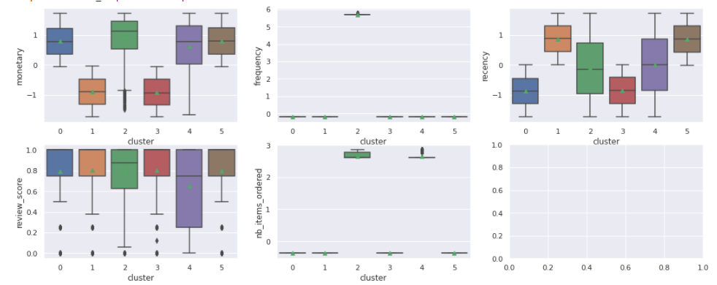
Cluster interpretation

Slide 38
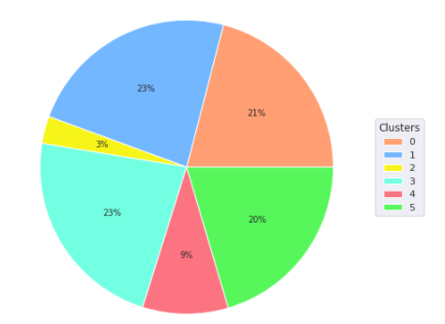
Cluster interpretation
Cluster 2: Top clients (frequent, spend more)
Cluster 5: Good clients (satisfied, spend more than avg., recent)
Cluster 0: Good clients but old buyers
Cluster 4: Unsatisfied clients (purchase multiple items at once)
Cluster 1: Low value (purchase recently)
Cluster 3: Lost customers (low value, purchased long ago)

Slide 39
THANKS!
Any questions?

