Slide 1
P2 Openfoodfacts - 03/11/2020
Amine FATMI

Slide 2
Contents
Application proposal
Data cleaning
Exploratory data analysis
Feasibility
Q/A

Slide 3
Application proposal
The aim of this project is to use the openfoodfacts dataset to build a simplified app to compute the nutriscore.
I would like the app to comply with a few requirements:
Easy to use with minimum inputs requested to the user
Good level of accuracy in computing the nutriscore
Increase awareness about food quality

Slide 4

Data cleaning
Data overview
Nan values
Outliers & Duplicate
Filtering
Checks

Slide 5
Data cleaning
Read csv into a pandas dataframe using following parameters:
Delimiter = ‘t’
Encoding = ’utf-8’
Low_memory = False
df.shape
1 481 112 rows
182 columns
df.describe()
125 numerical columns (out of 182)
Many missing values
Outliers
Most of the numerical variables can be split into 7 different groups:
Fat, Carbohydrates, Fibers, Proteins, Salt / Sodium, Vitamins and Minerals.
→ These groups will be checked separately as this is not easy to visualize too many variables simultaneously.
Data overview
Nan values
Outliers & Duplicate
Filtering
Checks

Slide 6
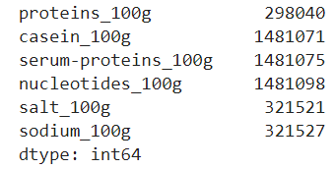
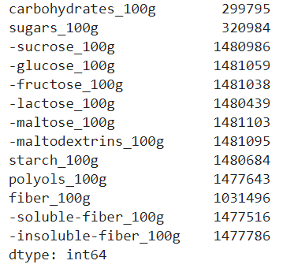
Data cleaning
Let’s have a look at the nan values among few macro-nutrients groups.
Proteins & Salt / Sodium
There are many missing values for composants of proteins.
Carbohydrates & Fibers
Similarly, many missing values for components of carbohydrates and fibers.
Data overview
Nan values
Outliers & Duplicate
Filtering
Checks

Slide 7
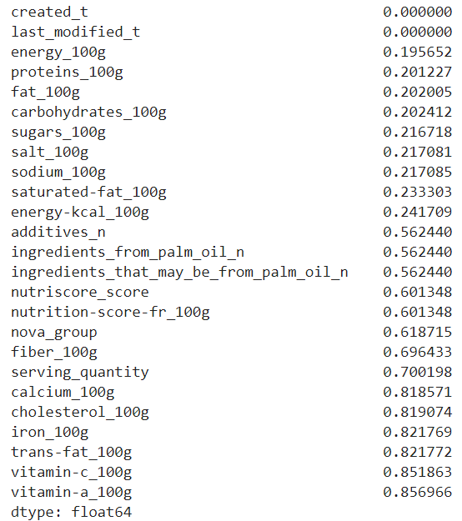
Data cleaning
In the exact same way, components of fats, minerals and vitamins have more than 70% of missing values.
See below the percentage of missing values in ascending order for the first 25 numerical columns:
I drop all columns with more than 70% nan values so that I keep the most relevant variables only.
Data overview
Nan values
Outliers & Duplicate
Filtering
Checks

Slide 8
Data cleaning
I have decided to drop also categorical columns based on the same threshold (more than 70% of nan values).
Additionally, I removed few other columns that have little interest for the nutriscore.
df.shape is now:
1 481 112 rows
22 columns
We will now reduce the number of rows by checking the outliers, duplicates,…
Data overview
Nan values
Outliers & Duplicate
Filtering
Checks

Slide 9
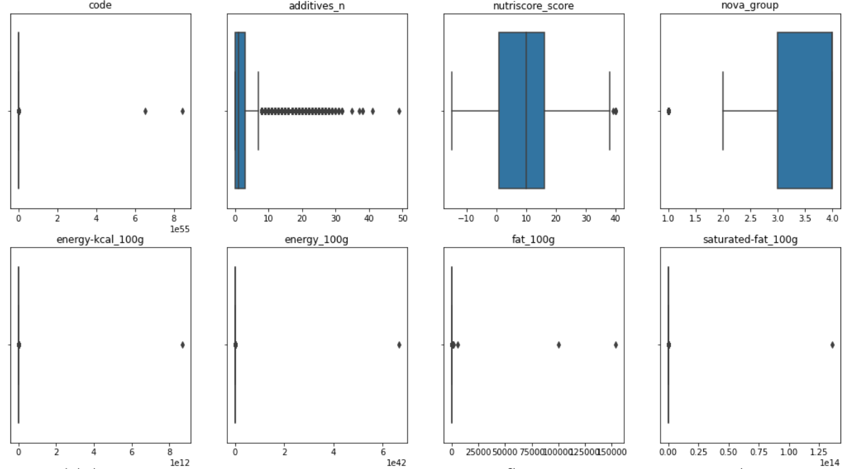
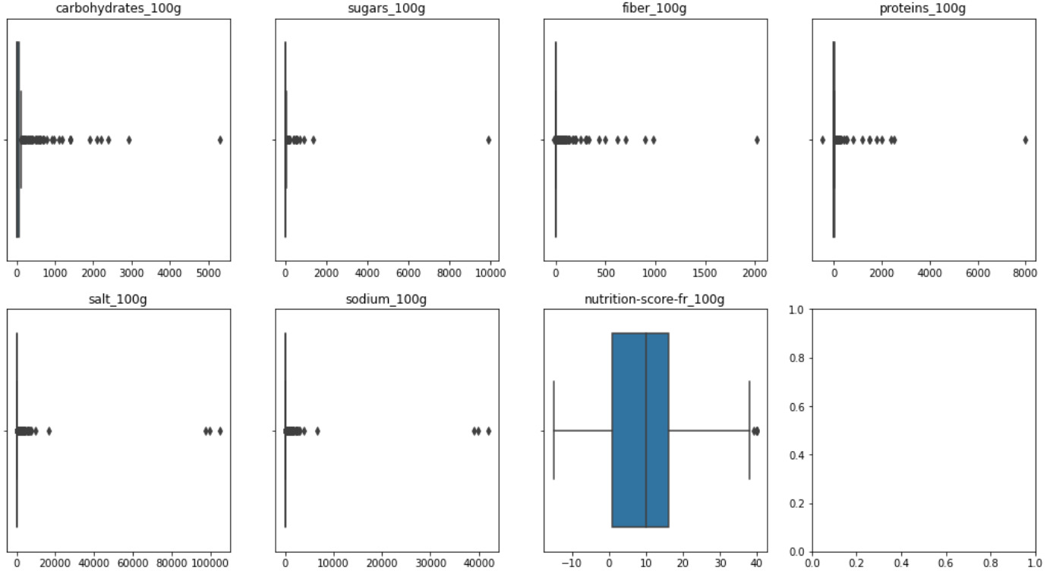
Data cleaning
Boxplots visualization of quantitative columns.
Data overview
Nan values
Outliers & Duplicate
Filtering
Checks

Slide 10
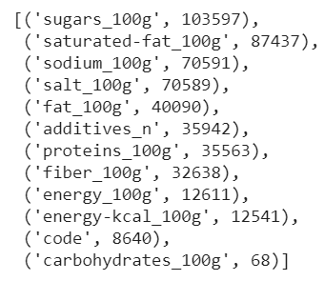
Data cleaning
The list below highlights the number of outliers detected for each column where the IQR was applied:
I have decided to remove the row if at least one value within the row is an outlier.
I end up removing 355044 rows from the dataset.
After removing the duplicated rows (42) the shape of my dataset is now (1 126 026, 20). In other words, I removed around 24% of the observations.
Data overview
Nan values
Outliers & Duplicate
Filtering
Checks

Slide 11
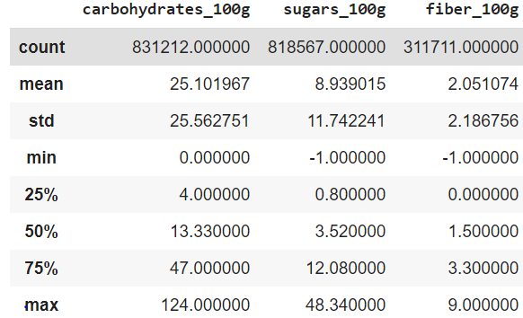
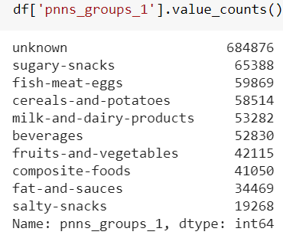
Data cleaning
The dataset was filtered based on the statements:
Sugars and Fiber quantity can’t be negative
Carb quantity can’t be higher than 100
Sum of fat, carb, protein and fiber can’t be higher than 100 for a portion of 100g.
I will later analyse subsets of ‘pnns_groups_1’ variable. So I have dropped the observations where
pnns_groups_1 is ‘Nan’ or ‘Unknown’
Data overview
Nan values
Outliers & Duplicate
Filtering
Checks

Slide 12
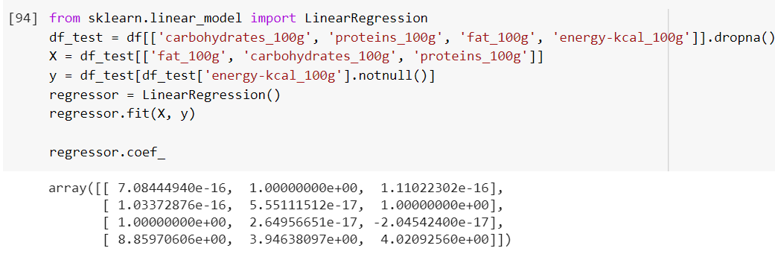
Data cleaning
I wanted to check the consistency of the data within the same row. More precisely that the energy value is consistent with the macro nutrients data:
→ Keep only the rows where:
(fat & carb & protein & fiber) not null
AND (energy_kcal or energy_kj) not null
We know that energy on one hand and fat, carbohydrate and protein on the other hand are closely related.
In fact, we can approximate the energy using the formula:
Energy (kcal) = Fat(g) * 9 + Carb(g) * 4 + Protein(g) * 4
I have used a simple linear regression model to check the formula above.
Data overview
Nan values
Outliers & Duplicate
Filtering
Checks

Slide 13

Exploratory data analysis
Following the data cleaning process, our dataset shape is now (204840, 20).
I will now use this cleaned dataset to perform exploratory data analysis (EDA).
Univariate Analysis
Distribution plots
Normality tests
Multivariate analysis
Nutriscore per product type
Pairplots
Correlation matrix
NaN values imputation

Slide 14
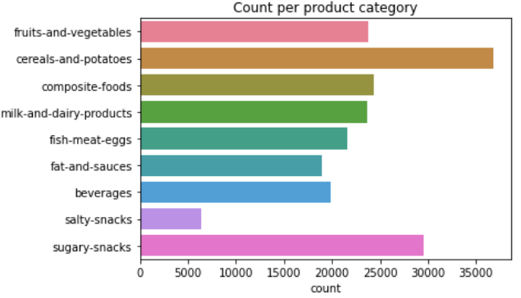
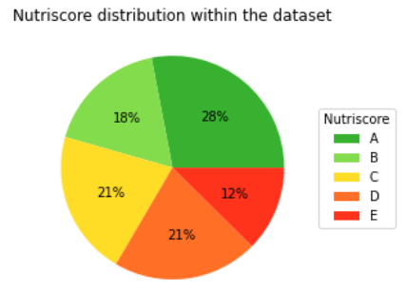
Exploratory data analysis
As shown in the figure below, the dataset is quite evenly distributed across each product category.
The pie chart shows that:
A grade products are
The most represented
E grade product the least
B, C and D grade products
represents each around 1/5 of
the dataset.
Univariate Analysis
Distribution plots
Normality tests
Multivariate analysis
Nutriscore per product type
Pairplots
Correlation matrix
NaN values imputation

Slide 15
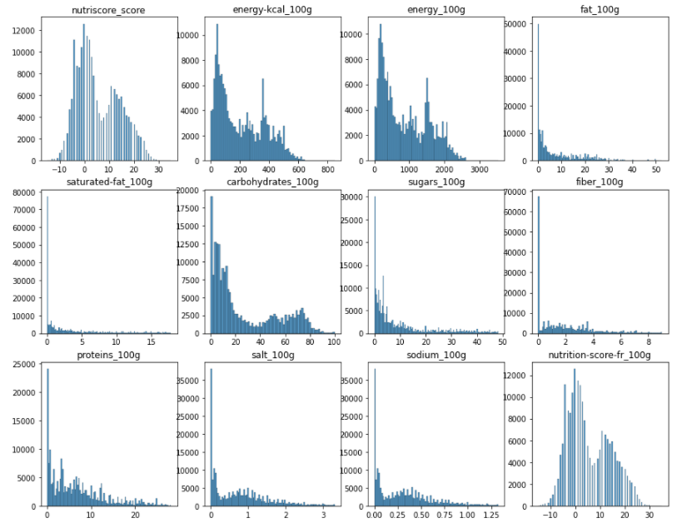
Exploratory data analysis
These figures highlight distributions of the quantitative variables of interest.
Few observations:
Distributions do not look normal
Nutriscore and energy distributions are bi or multi-modal.
Other distributions are badly skewed (right skewed)
Univariate Analysis
Distribution plots
Normality tests
Multivariate analysis
Nutriscore per product type
Pairplots
Correlation matrix
NaN values imputation

Slide 16
Exploratory data analysis
It is a good practice to use statistical tests along with visualizations. Here, I will be using a normality test to corroborate the observations from the previous slide.
There are multiple normality tests out there. The tests listed below are among the most popular:
Shapiro-Wilk (N < 5000)
D’Agostino K^2
Anderson-Darling
The Shapiro-Wilk test is usually not robust for large samples (N > 5000). Hence, I have used both D’Agostino K^2 and Anderson-Darling normality tests. Even though they aim both at checking the normality they have a different approach.
Not surprisingly, they do both reject the null hypothesis:
H0: “distribution is Gaussian-like or normal
None of the distributions are normal.
This will influence the method used to compute the correlation matrix.
Univariate Analysis
Distribution plots
Normality tests
Multivariate analysis
Nutriscore per product type
Pairplots
Correlation matrix
NaN values imputation

Slide 17
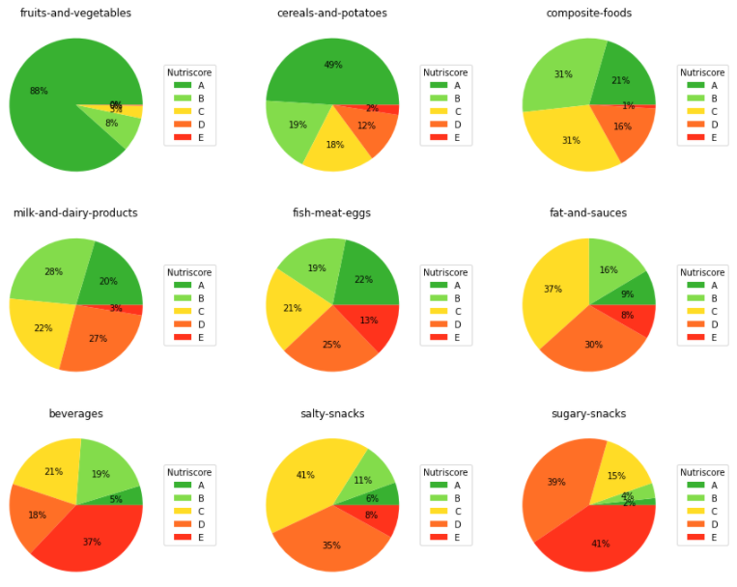
Exploratory data analysis
Pie-charts below underline the nutriscore grade per category as defined in ‘pnns_groups_1’ variable
As expected, fruits-vegetables and cereals-potatoes categories contain a high proportion of healthy products.
Conversely, snacks, fat-sauces and beverages categories are mostly compounded of unhealthy products.
Univariate Analysis
Distribution plots
Normality tests
Multivariate analysis
Nutriscore per product type
Pairplots
Correlation matrix
NaN values imputation

Slide 18
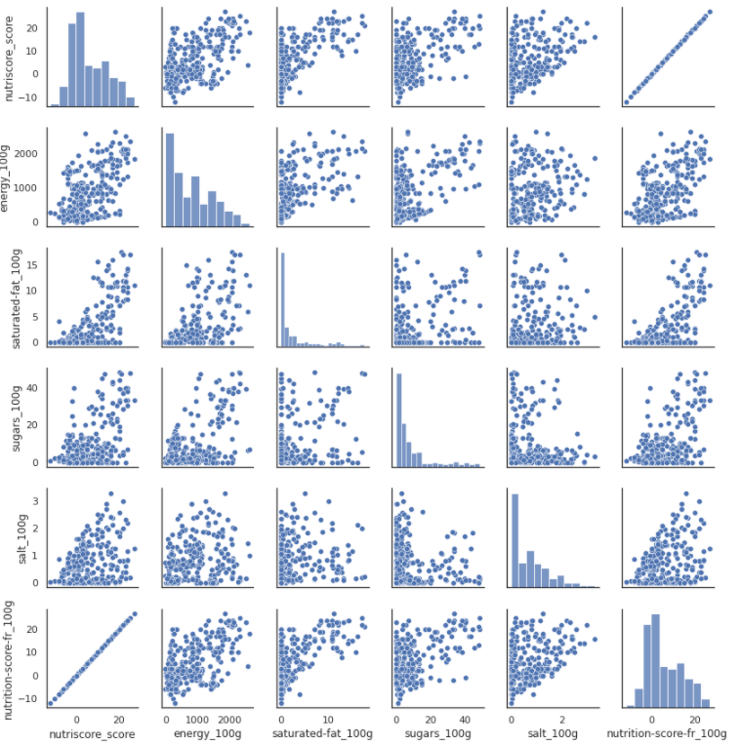
Exploratory data analysis
Multiple scatter plots are drawn with a random sample size N= 300.
Univariate Analysis
Distribution plots
Normality tests
Multivariate analysis
Nutriscore per product type
Pairplots
Correlation matrix
NaN values imputation

Slide 19
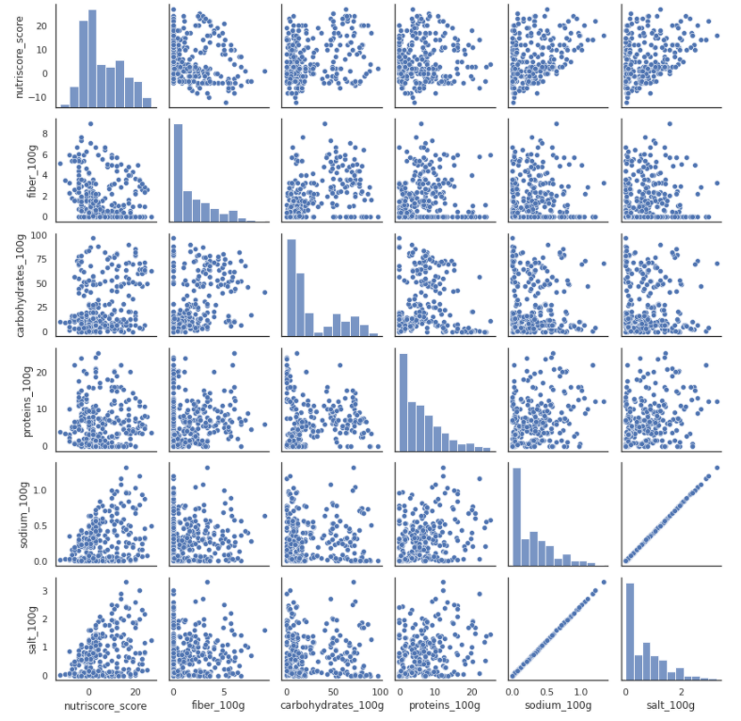
Exploratory data analysis
Same as previous slide but different varaibles.
Univariate Analysis
Distribution plots
Normality tests
Multivariate analysis
Nutriscore per product type
Pairplots
Correlation matrix
NaN values imputation

Slide 20
Exploratory data analysis
There are different correlation methods to compute the relationship between variables. Pearson and Spearman correlation methods are widely used.
Pearson’s correlation works well if the relationship between variables is linear and if the variables are roughly normal. But it is not robust in the presence of outliers.
Spearman’s rank correlation is an alternative that mitigates the effect of outliers and skewed distributions.
We have removed outliers from the dataset during the cleaning process. However, the quantitative variables are far from being normally distributed. In this context, Spearman’s rank correlation method will be used to calculate the correlation matrix.
Univariate Analysis
Distribution plots
Normality tests
Multivariate analysis
Nutriscore per product type
Pairplots
Correlation matrix
NaN values imputation

Slide 21
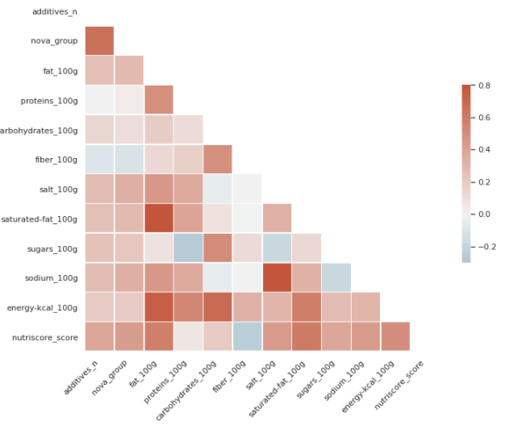
Exploratory data analysis
The heatmap below shows up the strength of correlation between variables.
Univariate Analysis
Distribution plots
Normality tests
Multivariate analysis
Nutriscore per product type
Pairplots
Correlation matrix
NaN values imputation

Slide 22
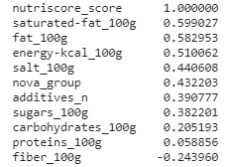
Exploratory data analysis
The correlation factors between each variable and the nutriscore are given below:
Main observations about the nutriscore:
Moderately correlated with saturated fat and fat,
energy, salt, sugars, nova group and additives_n.
Low correlation with proteins and carbohydrates
Moderately anti-correlated with fiber
Based on that, we can select the most relevant features to approximate the nutriscore. For our app, we would keep all the variables above except:
Proteins and carbohydrates as they are not much correlated to our target
Nova_group and additives_n as there are not easy piece of information to find.
In the last section of this presentation, we will build a model to compute a simplified nutriscore but before that we need to address the remaining null values within our dataset.
Univariate Analysis
Distribution plots
Normality tests
Multivariate analysis
Nutriscore per product type
Pairplots
Correlation matrix
NaN values imputation

Slide 23
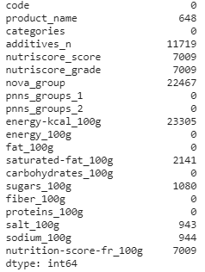
Exploratory data analysis
It is better to address NaN at the end of the EDA step to avoid altering the dataset.
Hereunder, a screenshot that summarizes the null values for each remaining variables.
Strategy for imputation:
Use energy(kj) to replace null values in energy-kcal variable (1kcal = 4.184 kj)
Drop code, product_name, categories variables, pnns_groups_2,
energy_100g (kj), sodium and nutriscore-fr variables from the dataset.
Use KNN Imputer on all remaining variables to replace NaN.
Univariate Analysis
Distribution plots
Normality tests
Multivariate analysis
Nutriscore per product type
Pairplots
Correlation matrix
NaN values imputation

Slide 24

Feasibility
Linear Regression Model
Training and Testing
Improve score
Way forward to build the app
Strategy
Pros & Cons

Slide 25
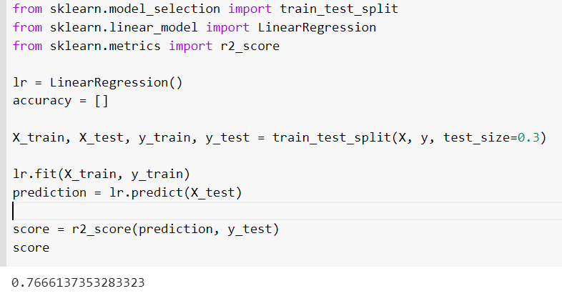
feasibility
Following the EDA, I choose to keep the features that are best correlated with the nutriscore:
Energy
Fat & saturated fat
Sugar
Fiber
Salt
The dataset is split into a training and a test set (test size = 0.3)
R2 score = 0.76
Linear Regression Model
Training and Testing
Improve score
Way forward to build the app
Strategy
Pros & Cons

Slide 26
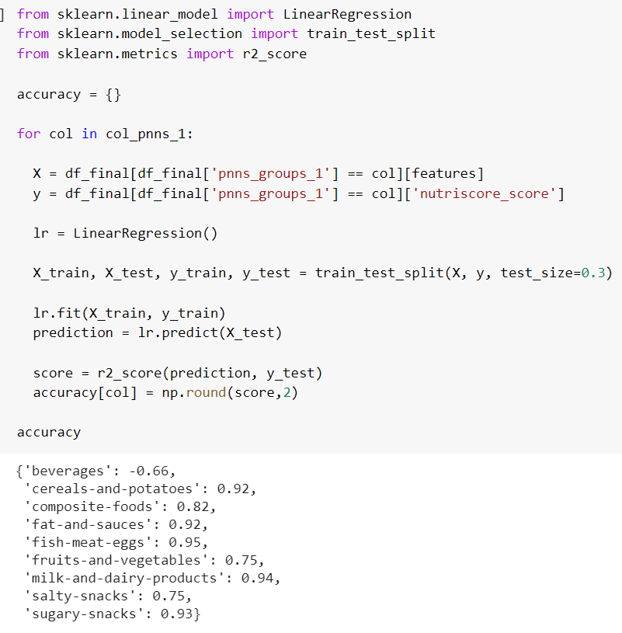
feasibility
R2 score comparison per product category:
R2 score for beverages is negative which means the model is not performing well
R2 score of fruits-vegetables category is lower than other categories
Linear Regression Model
Training and Testing
Improve score
Way forward to build the app
Strategy
Pros & Cons

Slide 27
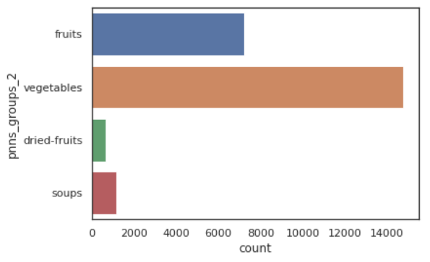
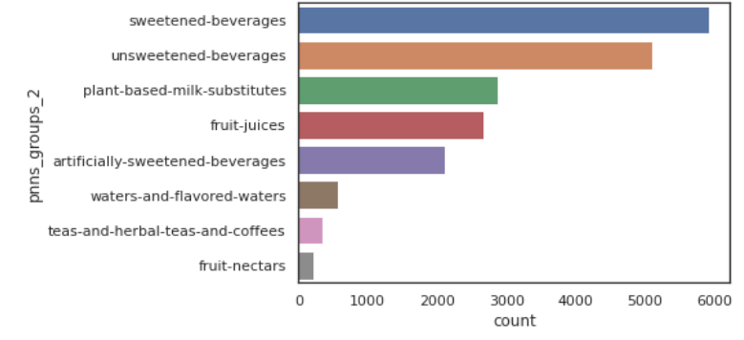
feasibility
The reason is that we are missing an important feature:
% fruits, vegetables, pulses, nuts, rapeseed, walnut and olive oils
This feature is important for ‘fruits-vegetables’ and ‘beverages’ category:
Soups are not 100% made from vegetables so it would be beneficial to have the % of vegetables to better approximate the nutriscore. R2 score for this category is not so bad because soups represent a small proportion within this category.
Fruit juices have also a % of fruits. There is a high proportion of fruit bases juices in ‘beverages’ category which explains the bad approximation of the nutriscore (R2 score < 0).
Based on these observations, I have tried to improve the results by excluding all beverage products from our dataset and run another regression.
The results for this new linear regression analysis is an R2 = 0.93.
Linear Regression Model
Training and Testing
Improve score
Way forward to build the app
Strategy
Pros & Cons

Slide 28
Feasibility
The app would require the following inputs for each product in order to calculate the nutriscore:
Energy (kcal)
Fat
Saturated fat
Sugar
Fiber
Salt
These data must be provided for a portion of 100g.
It is hard to approximate the nutriscore of beverage products using the openfoodfacts dataset because there are more too many missing values in the variable: %fruits, vegetables,…
Linear Regression Model
Training and Testing
Improve score
Way forward to build the app
Strategy
Pros & Cons

Slide 29
feasibility
This app aims at providing a simplified model to get the nutriscore of food products. The simplification has few advantages but limitations too:
Pros:
Need only few data
Nutrition facts required easily found on product packaging
Simple and quick measure of the nutriscore
Cons:
Simplification implies a loss in accuracy
Beverage products could not be computed
Linear Regression Model
Training and Testing
Improve score
Way forward to build the app
Strategy
Pros & Cons

Slide 30
Q & A

Slide 31
Principal Component Analysis (Annex)
I have run a PCA to reduce the dimensionality. However it does not seem to be a requirement for this project anymore.
Besides, I think there is not much interest in using this technique here. In fact, there are only few variables left after the cleaning process.
In the next slides, I will present few plots about the PCA.

Slide 32
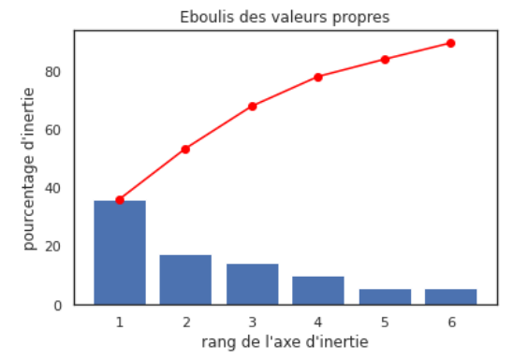
Principal Component Analysis (Annex)

Slide 33
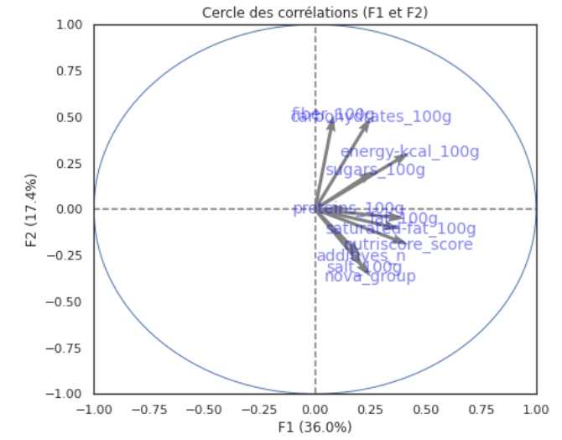
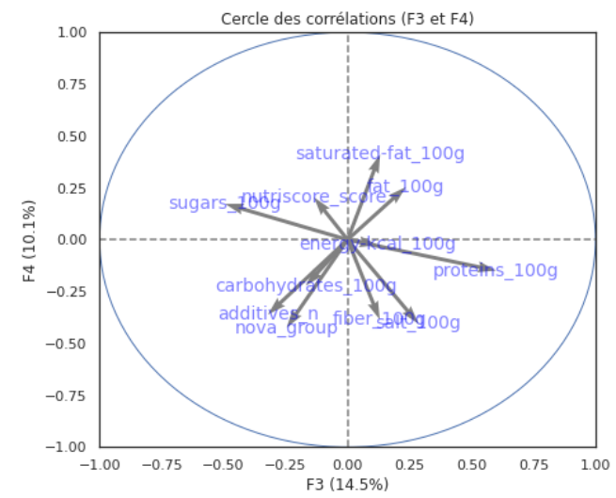
Principal Component Analysis (Annex)

