Slide 1


P3 Seattle
Amine Fatmi, 25/11/2020

Slide 2
Problematic
The aim of this project is to build a ML model to predict both gas emissions and energy consumption of buildings.
The key part here is to avoid energy readings which are costly to obtain.
Instead, the main focus should be on building attributes such as type, size, year built, …

Slide 3
Contents
Exploratory Data Analysis & Cleaning
Feature Engineering
Model selection
Final validation
Conclusions

Slide 4
EDA
1
Let’s start by exploring the dataset

Slide 5
EDA: dataset
Dataset of year 2016 only.
Shape of data (3376, 46)
Type of data:
Building type, location, size, energy star score, energy type and consumption for 2016.
EnergyStarScore: measure of energy efficiency for a given building → between 0 and 100.

Slide 6
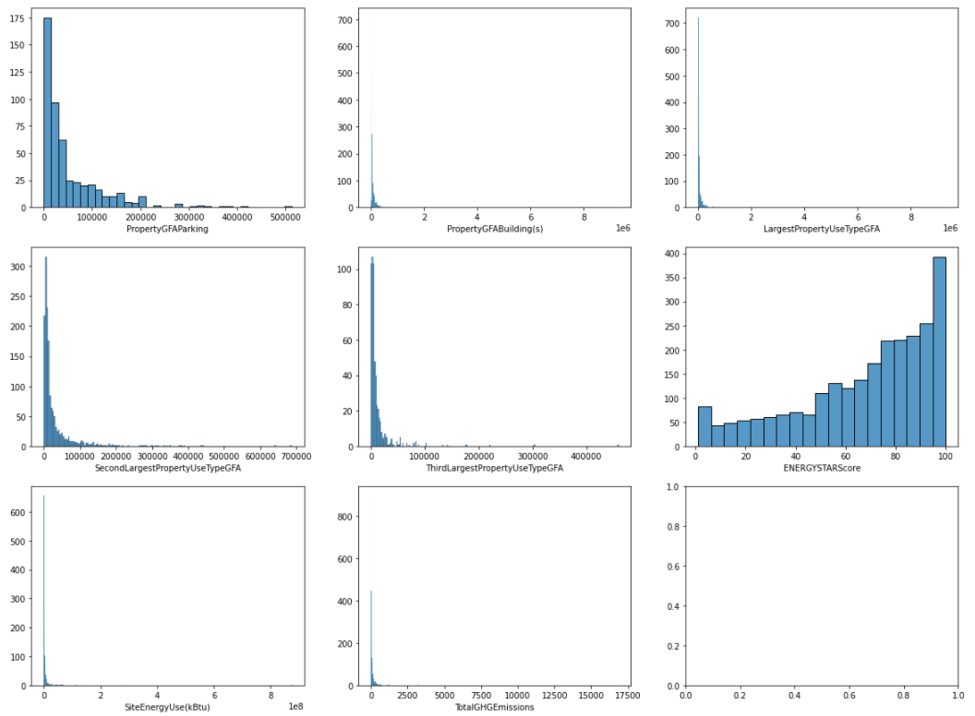
EDA: distributions
Apart from EnergyStarScore, the continuous variables are badly right skewed.
→ Variables will be transformed in the FE section.

Slide 7
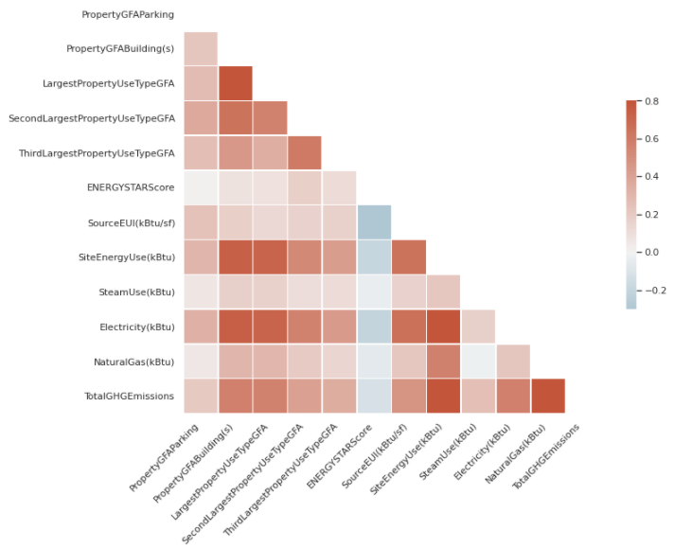
EDA: correlation heatmap
Spearman correlation.
Targets are highly correlated.
SiteEnerguUse (SEU) with Electricity and Largest GFA.
GHGE with Gas.
ESS anti correlated to both targets.

Slide 8
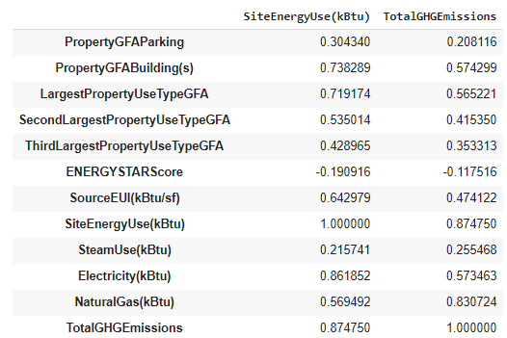
EDA: correlation coefficients
Electricity most correlated to SEU.
Gas most correlated to GHGE.
GFA attributes are much correlated to both targets:
Probably good predictors.

Slide 9
EDA: cleaning
Filter « CompliantStatus » column to keep only « compliant » values then drop it.
Drop « Outlier » column.
Drop other columns with:
Low variability
Little interest for this analysis
Measurement data (Electricity, Gas, …)
(3376, 46) → (3211, 21)

Slide 10
EDA: cleaning
Fill (1) and (2) nan values respectively with « None » and « 0 »
Second/Third LargestPropertyUseType (1)
Second/Third LargestPropertyUseTypeGFA (2)
Drop samples not compliant with statement above (~800 rows)
GFATotal >= Sum of 3 LargestPropertyUseTypeGFA
Remove observations where variables have negative values (ex. GHGEmissions)

Slide 11
Feature Engineering
2

Slide 12
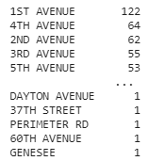
FE: address
Transform « Address » column to extract:
Building Number
Street Name
Drop « Address » and « BuildingNumber » and keep only the StreetName:
1st Avenue is the most common street name
in our cleaned dataset.

Slide 13
FE: year built
Group « YearBuilt » values every 10 years (sometimes 15 or 20 when there are fewer data).
Create a new variable « YearBuilt_binned » and use OrdinalEncoder class from sklearn.preprocessing to encode the data in order to preserve the ordinality.
The use of either « YearBuilt » or « YearBuilt_binned » was investigated:
The latter gives better results
Any model presented here will include « YearBuilt_binned »

Slide 14
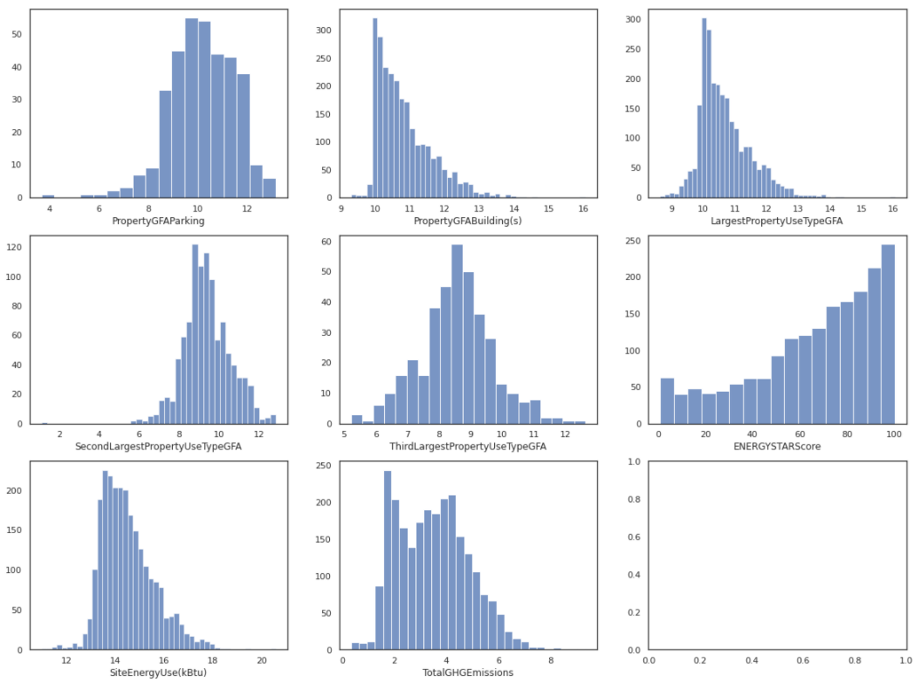
FE: log transformation
Log (x + 1) applied to all continuous variables except ESS.
Reduced right skewness.
Easier to interpret than a skewed distributions.

Slide 15
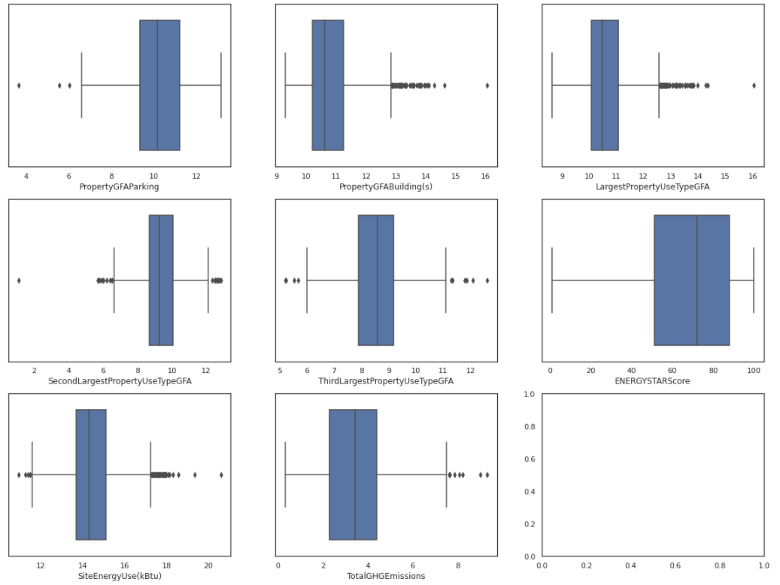
FE: outliers
Boxplots to visualize data distributions and outliers.
No treatment made to remove outliers from the dataset.

Slide 16
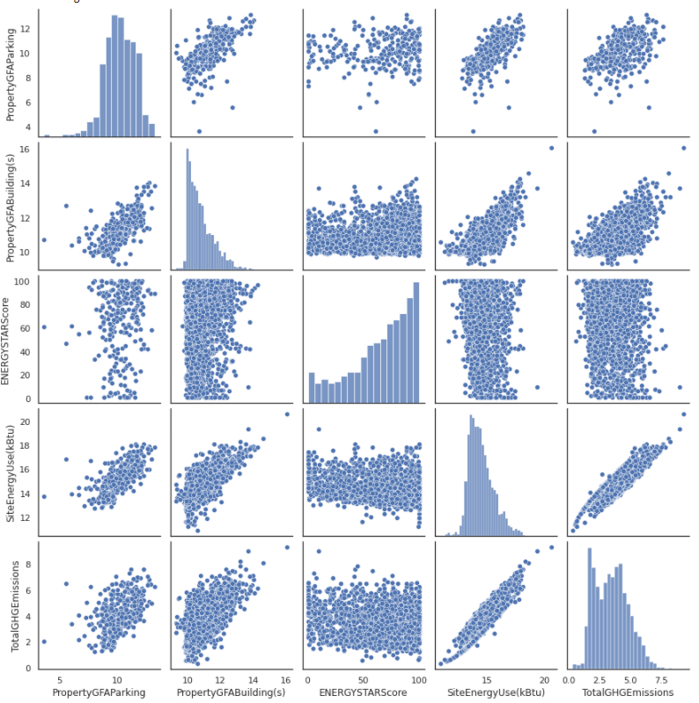
FE: outliers
Pairplots to visualize correlations.
Strong linear correlation between SEU and GHGE.
High correlation between SEU – GHGE and PropertyGFAParking.
Cleaned dataset does not seem to include much ouliers.

Slide 17
FE: energy encoding
Electricity, Steam and Gas variables were used to detect that a given buiding was connected to this type of energy.
I have created binary variables:
If electricity value > 0 → cat_elec = 1, else cat_elec = 0
If steam value > 0 → cat_steam= 1, else cat_elec = 0
If gas value > 0 → cat_gas = 1, else cat_elec = 0
Unsurprisingly, most of the buildings were equipped with electricity.
However, not all of them were connected to gas and steam so these new cat variables might be helpful here.

Slide 18
FE: categorical encoding
Machine Learning algorithms can deal with numerical data only, so we need to encode categorical variables before we train models.
I will use « get_dummies » from pandas to transform categorical data.
It is important to perform this step before we split our dataset into training/testing sets so that we can have the same number of variables in both sets.
After encoding, dataset shape is now:
(2467, 720)

Slide 19
Train/Test split strategy
3

Slide 20
Train/Test split
I will be comparing two ways of splitting the dataset:
Random split
Stratified split
« PropertyGFABuilding » is an important attribute for both targets so I want to make sure the test set is representative of the various categories of GFABuilding in the whole dataset.
Since this attribute is continuous, I need first to create a GFABuilding category attribute.

Slide 21
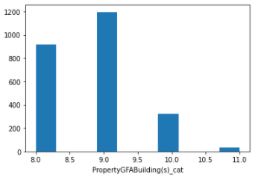
Train/Test split
The aim is to have a train set and a test set that is representative of the whole dataset regarding this attribute.

Slide 22
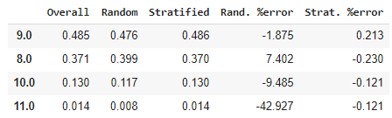
Train/Test split
The table below summarizes the propotion of each GFABuilding category:
Overall: whole dataset
Random: test set proportion using train_test_split
Stratified: test set using Stratified_Shuffle_Split

Slide 23
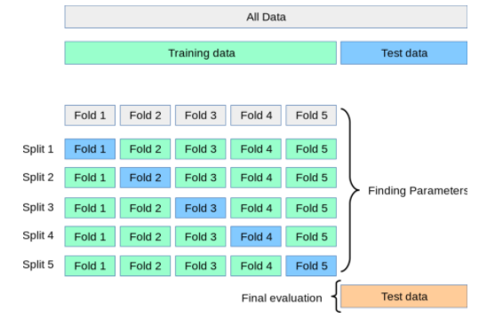
Train/Test split
The stratified method is used to train/test split the dataset.
Transformations such as standardization and imputation are performed on the training set after splitting.

Slide 24
Model selection
4

Slide 25
Model selection process
Step 1
Step 2
Step 3
Step 4
Baseline models
Find best parameters
Select best model
Final evaluation
Cross-validation on training set and model scores comparison (R2, MAE, MSE and RMSE).
Cross-validation on training set to fine-tune model hyperparameters.
Determine the best model based on both performance and speed.
Evaluate the best model on testing set.

Slide 26
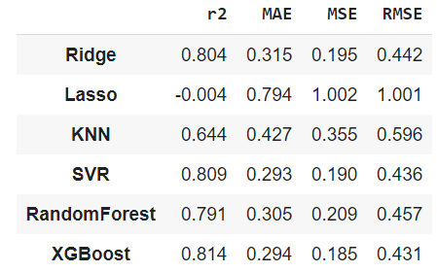
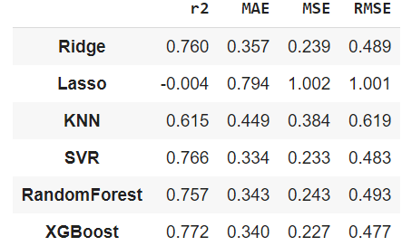
Baseline models - SEU
Cross-validation for models with default parameters to predict SiteEnergyUse.
Evaluate the influence of the EnergyStarScore feature.
with EnergyStarScore
w/o EnergyStarScore

Slide 27
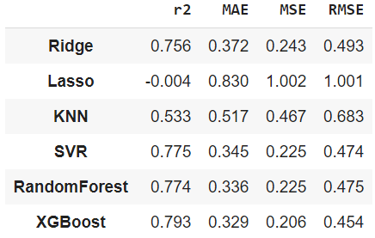
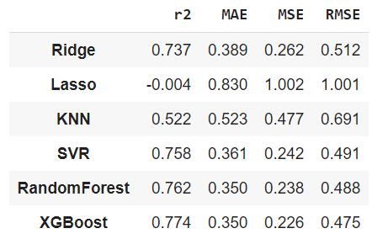
Baseline models - GHGE
Cross-validation for models with default parameters to predict GHGEmissions.
Evaluate the influence of the EnergyStarScore feature.
with EnergyStarScore
w/o EnergyStarScore

Slide 28
Find best parameters
Strategy used to find the optimal parameters for each model:
SiteEnergyUse target only
All features (including ESS)
GridSearch and cross-validation to try different combinations.
Evaluate models using R2 score metric

Slide 29
Best model ?
SEU | R2 score (No-tuned) | R2 score (Tuned) | Rank
Ridge | 0.804 | 0.820 | 4
Lasso | -0.004 | 0.822 | 2
KNN | 0.644 | 0.657 | 6
SVR | 0.809 | 0.821 | 3
RandomForest | 0.791 | 0.792 | 5
XGBoost | 0.814 | 0.830 | 1
XGBoost is still the best model after tuning.
Next step: feature selection and check how this impacts run time and model performance (R2score)

Slide 30
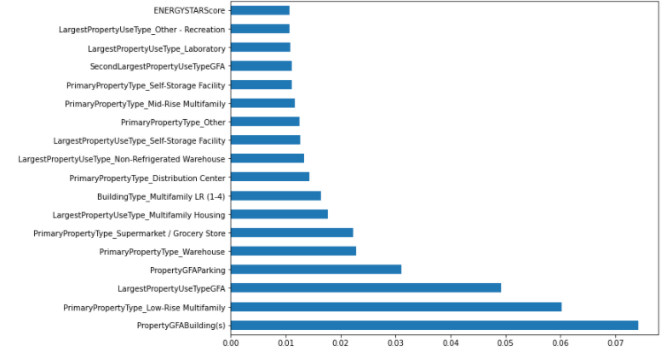
Features importance XGBoost

Slide 31
Features importance XGBoost
I will keep only features with a coefficient over a threshold = 0.005.
This reduces the feature space from 714 to 48.
I have trained again XGB model after dimensionality reduction:
SEU | R2 score (Tuned) | Running time (s)
XGBoost_baseline | 0.814 | -
XGBoost_tuned | 0.830 | 42
XGBoost_tuned (features selection) | 0.828 | 6
Final model

Slide 32
Final validation
4

Slide 33
Final validation on test set
XGBoost model results with optimal parameters and FS
 | R2 score
 | with ESS | w/o ESS
SiteEnergyUse | 0.781 | 0.740
TotalGHGEmissions | 0.761 | 0.748

Slide 34
Conclusion
PropertyType and GFA are really important features to predict both targets.
ENERGYSTARScore does help to improve the performance of our model. However, it is not among most important predictors. Not much effort should be allocated to get the ESS (fastidious to compute).
Knowing if a bulding is connected to Gas is really important to predict GHGE. R2 score without this piece of information was around 0.4 on test set…
XGBoost was the best performing model

Slide 35
THANKS!
Any questions?

