Slide 1


P5 Stackoverflow
Amine Fatmi, 17/01/2021

Slide 2
Scope of work
Stackoverflow is a famous question and answer website for professional and enthusiast programmers. When asking a question, you need to enter some tags so that it can be found more easily.
Focus: Question – Body - Tag
Goal: Build a ML model to predict tags based on question asked.
Use of Natural Language Processing techniques and tools.

Slide 3
Contents
Data collection
EDA and cleaning
Document-Term Matrix
Topic Modeling
Supervised Learning
Model deployment

Slide 4
EDA
1
Let’s start by exploring the dataset

Slide 5
Data collection
Stackexchange explorer: tools provided by stackoverflow to extract data using SQL queries.
Focus on popular questions: ( view count > 500 and score > 75 )
Limitation of 50 000 questions per query.
Dataset:
100 428 questions
Title, Body and Tags columns

Slide 6
EDA: example

Slide 7
EDA: title & body
Average body length: 200 characters
Average title length: 40 characters

Slide 8
EDA: tags
Between one and five tags.
Questions with 3 tags most represented.
Top 400 tags:
1-gram | 78%
2-gram | 20%
3-gram | 2%

Slide 9
EDA: tags wordcloud

Slide 10
Data cleaning process
Text preprocessing steps:
Remove HTML tags
Make text all lower case
Remove numerical characters
Tokenize text
Remove stop words
Lemmatization

Slide 11
Document-Term Matrix
2

Slide 12
Document-Term Matrix
Let us first define a corpus, document and term in NLP:
Corpus = collection of texts (all our questions)
Document = text (single question)
Term = word (or n-gram) within a document
The vocabulary is the list of all unique words accross the corpus.

Slide 13
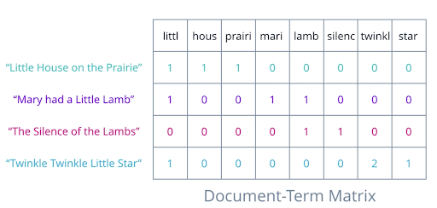
DTM - example

Slide 14
Feature extraction
There are two widely used feature extraction techniques:
TF (or Count Vectorizer)
TF-IDF
TF is a scoring word frequency → highly frequent words dominate but might not contain as much informational content.
TF-IDF:
Rescale the frequency of words by how often they appear in the corpus.
Penalized score of frequent words that appear in a high proportion of documents.

Slide 15
Topic modeling
3

Slide 16
Topic modeling
A topic model is a type of statistical model for discovering topics from a collection of documents. A document is generally about multiple topics in different proportions. Every topic is a distribution of words.
Latent Dirichlet Allocation (LDA)
Non-Negative Matrix Factorization (NMF)

Slide 17
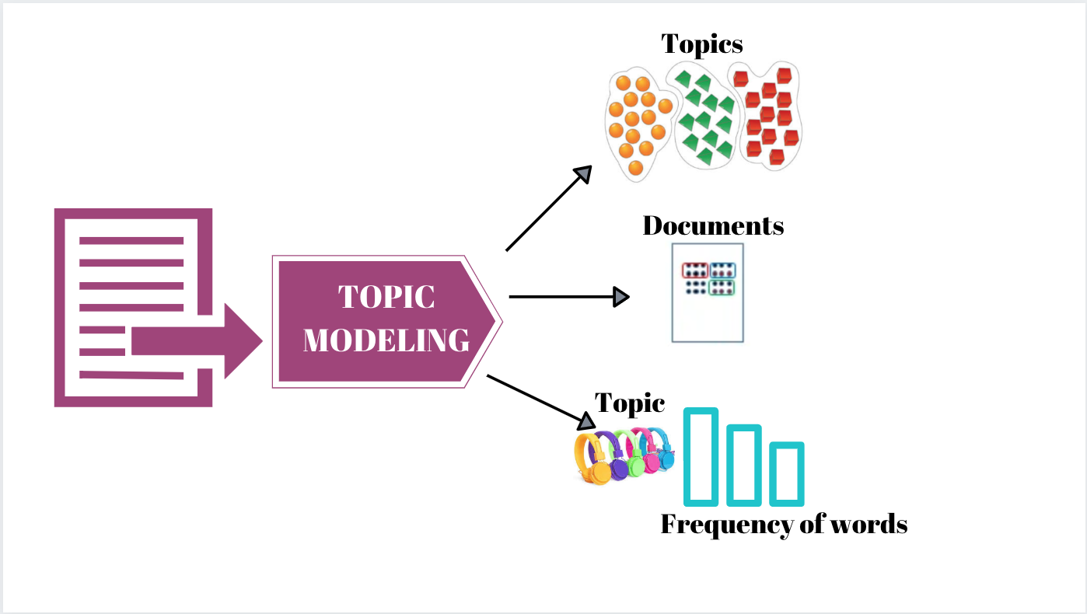
Topic modeling

Slide 18
Topic modeling
These two algorithms are unsupervised techniques; best number of topics not defined a priori.
Find the best number of topics for:
TF + LDA
TF-IDF + NMF
Topic modeling metrics:
Coherence measure (c_v)
Check topics found make sense

Slide 19
LDA: coherence score
N_topics = 20
high coherence score
Topics are interpretable and make sense
However some topics are not well defined.

Slide 20
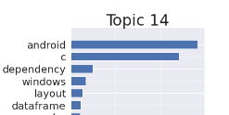
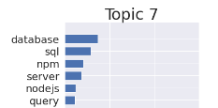
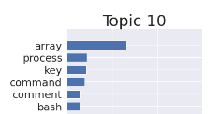
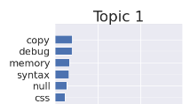
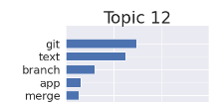
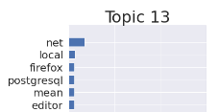
LDA: topic coherence

Slide 21
LDA: document-topic matrix

Slide 22
LDA – tag extraction
I have used the following strategy to extract tags from the LDA results:
Check the dominant topic(s) for each document
Identify the top 50 words for each dominant topic
Intersect the top words from step 2 with the remaining words in the cleaned document
Set results of intersection = tags
If #tags found > 5, keep only the first five tags.
Similarity measure to evaluate the performance of the model: Jaccard.

Slide 23
LDA – key metrics
Key metrics for LDA model:
Average Jaccard score = 0.21
At least one tag correctly predicted in 63% of questions.
2% of questions perfectly predicted.

Slide 24
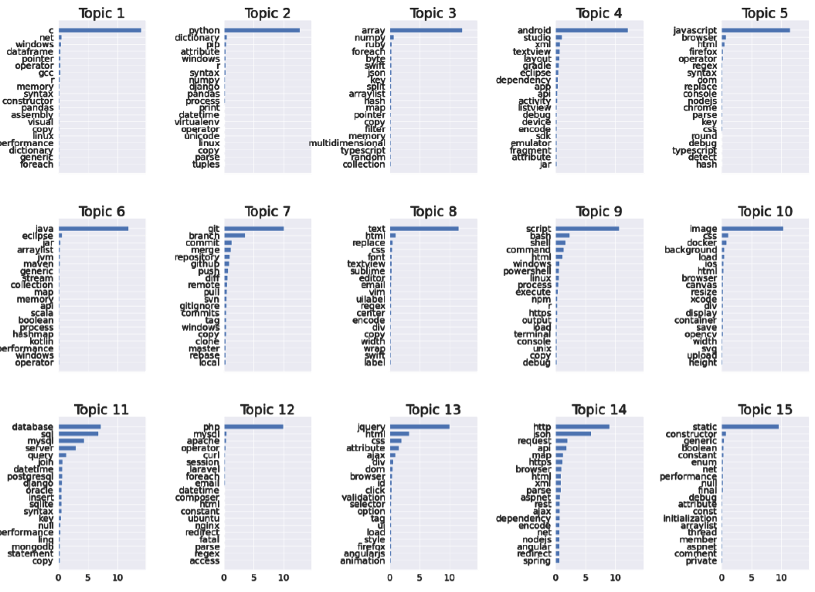
NMF – topic coherence
Topics well defined.
Top word in each topic is dominant.
Top words are mainly leading programming language:
C,
Python,
Android,
javascript,
…

Slide 25
NMF – key metrics
Key metrics for NMF model:
Average Jaccard score = 0.22
At least one tag correctly predicted in 66% of questions.
2.5% of questions perfectly predicted.
These numbers confirm NMF results are better than LDA.

Slide 26
Supervised Learning
4

Slide 27
Supervised approach
The target variables to predict are tags:
More than 2 tags → multi-class
One question can have more than 1 tag → multi-label
Preprocessing to transform target variables (see next slide)
Feature extraction
Train / Test split
OneVersusRest + classifier

Slide 28
Preprocessing
Multi-label binarzer
Keep only top 402 tags (>100 occurrences)
Target variables:
2D matrix where indices [i, j] = 1 if tag i is present in document i.
N_rows = #documents
N_columns = 402
TF-IDF vectorizer for feature extraction.
Train / Test split with 80 / 20 ratio.

Slide 29
Results
 | Mean Jaccard | % questions at least 1 tag | % questions perfect match | Run time (s)
OVR + Linear SVC | 0.45 | 69 % | 25.8 % | 46
OVR + Multinomial NB | 0.21 | 32 % | 12.5 % | 9
OVR + Logistic Regression | 0.39 | 61 % | 22 % | 126
OVR + Decision Tree | 0.43 | 74 % | 25.5 % | 1123
Linear SVC is the best model: highest accuracy and fast running time.
Hyperparameter tuning on regularization parameter → Linear SVC mean Jaccard score = 0.46.

Slide 30
Model improvement
Further text preprocessing to improve the results:
I had previously removed the punctuation and special characters from all words of the corpus.
However, several programming languages are made from this:
C#, C++, asp.net, .net,…
Also tried to include bi-grams such as ‘android studio’ (without success)
Increased the number of questions: 100k to 140k
By applying these changes, Linear SVC Jaccard score improved to 0.55, more than 10% increase.

Slide 31
Model deployment
5

Slide 32
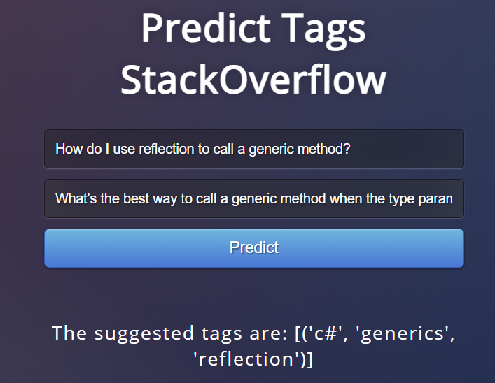
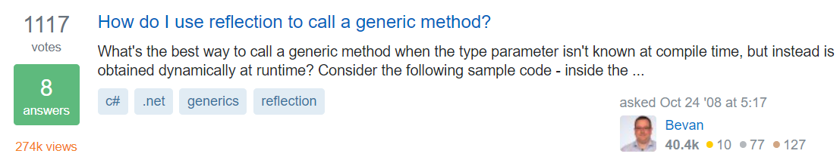
Model deployment
The improved Linear SVC model was succesfully deployed on the cloud:
App using Flask framework
Web server: Gunicorn
Could platform: Heroku

Slide 33
THANKS!
Any questions?

