Slide 1
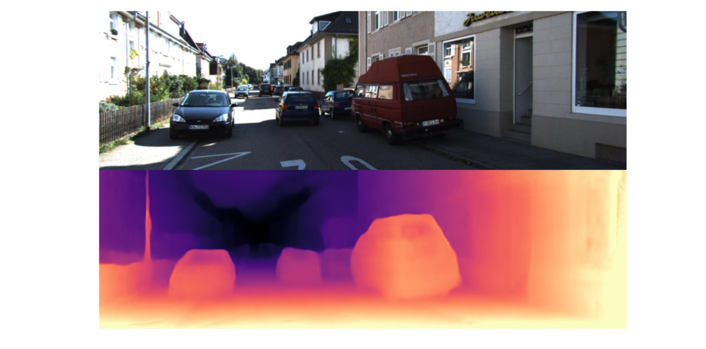
Single-Image Depth Estimation Based on Fourier Domain Analysis
Dani Bouch/ Amine Khelif
Sorbonne University
Master ISI

Slide 2
Introduction | 03
Existing Methods | 04
Critical Analysis of existing methods | 05
Suggested method | 06
Development of the Algorithm | 7-10
Implementation on a dataset | 11
Performance analysis | 12
Final Inference | 13
Conclusion | 14
References | 15
Presentation Outline

Slide 3
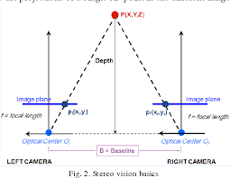
Introduction
01
What is Depth Estimation?
Depth estimation is the process of predicting the depth map of a scene using one or more images. The depth information serves as an important cue for understanding geometric relationship in scene
This can be used in: 3D model reconstruction
Scene recognition, Human pose estimation.
02
The challenges of Single-Image Depth estimation
Lack of Stereo Information
Ambiguity and Scale issues
The perspective Distortion

Slide 4
Literature review
Theory 01
Saxena, M. Sun, and A. Y. Ng. 3-D depth reconstruction from a single still image. Int. J. Comput. Vis., 76(1):53–69, Oct. 2008: Using Markov Random Field (MRF) to divide an image into homogeneous patches to obtain 3D parameters at each patch, and reconstructed a 3D structure.
Theory 02
M. Liu, M. Salzmann, and X. He. Discrete-continuous depth estimation from a single image. In Proc. IEEE CVPR, pages 716–723, Jun. 2014. Using Discrete-Continuous Depth Estimation with a CRF (Conditional Random Field)
Theory 03
E. I. Laina, C. Rupprecht, V. Belagiannis, F. Tombari, and N. Navab. Deeper depth prediction with fully convolutional residual networks. In Proc. IEEE 3DV, pages 239–248, Oct. 2016. Using Residuel CNNs for single image depth estimation
Theory 04
F. Xu, E. Ricci, W. Ouyang, X. Wang, and N. Sebe. Multiscale continuous CRFs as sequential deep networks for monocular depth estimation. In Proc. IEEE CVPR, pages 5354–5362, Jun. 2017. Fusioning information from CNN side outputs using CRFs

Slide 5
Critical Analysis
Method | Advantages | Disadvantages | Strengths | Weaknesses
MRF-based 3D Reconstruction | Utilizes local image features, good at handling texture variations | Requires manual tuning, computationally intensive | Effective in structured environments, good at patch-level depth estimation | Struggles with occlusions and complex geometries
Discrete-Continuous CRF | Balances global and local context, robust to noise | Optimization can be complex, sensitive to initial conditions | Provides a smooth depth map, handles depth discontinuities well | May not generalize well across different scenes
Residual CNNs for Depth Prediction | Leverages deep learning for feature extraction, high accuracy on standard benchmarks | Requires large datasets for training, high computational cost | Effective in diverse environments, learns hierarchical features automatically | Limited by the resolution of input data
Multiscale CRFs as Sequential Networks | Integrates information across scales, effective at capturing contextual relationships | Complex training procedure, requires careful parameter tuning | Robust across different scales, adapts well to scene variations | Potentially high latency in processing

Slide 6
Suggested Method
Single-Image Depth Estimation Based on Fourier Domain Analysis
Phase 1: Developing a new CNN structure
Phase 2: Defining a new loss function
Phase 3: Generating multiple depth maps for each Image
Phase 4: Combing the depth maps in the Fourier Domain
Taking an existent CNN architecture (Res-Net 152)
Modifying its structure to include additional paths for intermediate feature extraction
2 phase training process:
1. Finetuning Original Res-Net 152 on depth maps
2. Feature Extraction training
Defining a new loss function: Depth-Balanced Euclidean Loss based on Euclidean loss
The use of a balancing function to ensure accurate estimation of shallow and deep depths
First we crop the input image with a cropping ratio r
Then we process each cropped image to get the corresponding depth map (With scaling to compensate zooming)
Estimating discrete Fourier Transform of each depth candidate
Using DFT vectors to estimate weight and bias parameters
Combining the DFT vectors into a final estimate
Taking the inverse Fourier transform to generate final Depth Map

Slide 7
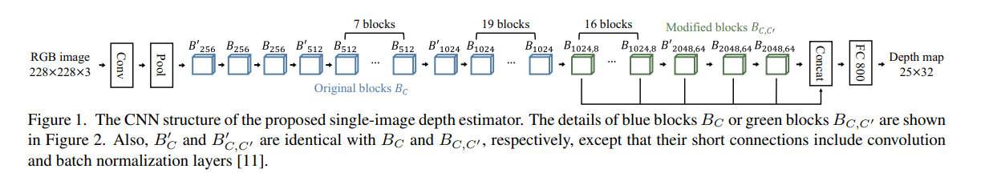
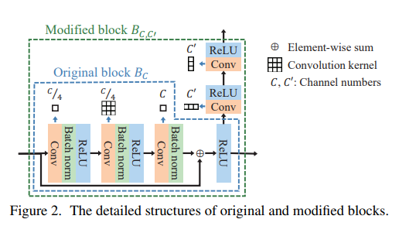
Algorithm Development:
Single-Image Depth Estimation Based on Fourier Domain Analysis
Phase 1: Developing a new CNN structure
Taking an existent CNN architecture (Res-Net 152)
Modifying its structure to include additional paths for intermediate feature extraction
2 phase training process:
1. Finetuning Original Res-Net 152 on depth maps
2. Feature Extraction training
ResNet-152: Contains 50 blocks each which 3 Convolutional layers, followed by batch normalization and ReLU layers as well as shortcut connections
Our modified structure: Like shown in the figure above. We modify the last 19 blocks while maintaining the original 31 blocks
Modified Block: Adds an additional path for intermediate feature extraction by adding 2 extra convolutional layers with 1x3 and 3x1 kernels giving the model a better ability to discern fine grained details that effect the depth prediction

Slide 8




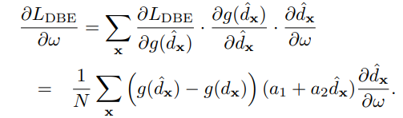
Algorithm Development:
Single-Image Depth Estimation Based on Fourier Domain Analysis
Phase 2: Defining a new loss function
Where x denotes the coordinate of a pixel in a depth map and dx^ is the estimated depth and dx is he ground truth depth
Euclidean Loss:
Defining a new loss function: Depth-Balanced Euclidean Loss based on Euclidean loss
The use of a balancing function to ensure accurate estimation of shallow and deep depths
Updating w:
In practice: The absolute estimation error tends to be bigger for further objects. Therefore the partial derivative is effected by errors of distantly located objects more than near objects. How to overcome this?
Depth-Balanced Euclidean loss (DBE):
Choosing the balancing function:
Gradient of DBE Loss:
a1 relatively large and a2 negative reduces the effect of larger errors at greater depths hance balancing the loss

Slide 9
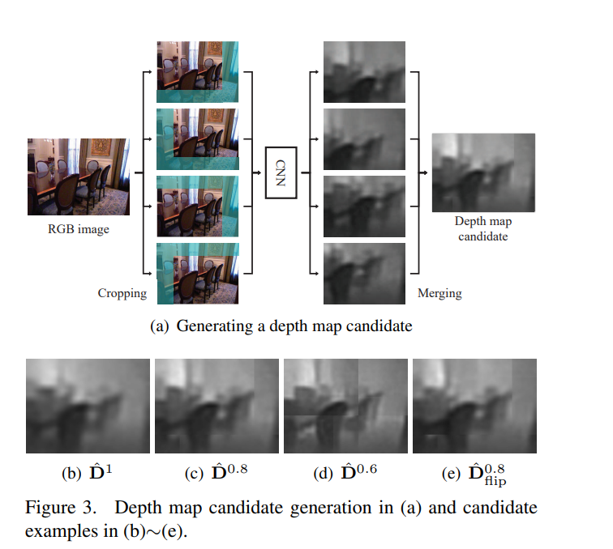
Algorithm Development:
Single-Image Depth Estimation Based on Fourier Domain Analysis
Phase 3: Generating multiple depth maps for each Image
Note: CNN parameters are not symmetric therefore a flipped image will give another depth map
First we crop the input image with a cropping ratio r
Then we process each cropped image to get the corresponding depth map (With scaling to compensate zooming)
Cropping: Taking the original image of size WxH and transforming it into an image of size r W x r H with 0<r<1
Depth map estimation: Each cropped image would give us a “Zoomed in” version of the full depth map
Scaling: To compensate the effect of zooming. The estimated depth values are scaled by 1/r

Slide 10







Algorithm Development:
Single-Image Depth Estimation Based on Fourier Domain Analysis
Phase 4: Combing the depth maps in the Fourier Domain
1. Why pass by the frequency domain? Depth maps with large r-> Overall depth distribution (low frequencies)
Smaller r-> Estimating local details (high frequencies)
2. Estimating Discrete Fourier Transform :
Estimating discrete Fourier Transform of each depth candidate
Using DFT vectors to estimate weight and bias parameters
Combining the DFT vectors into a final estimate
Taking the inverse Fourier transform to generate final Depth Map
3. DFT vectors:
4. Bias Estimation: The goal is to compensate for the average deviation of fk^m from the ground truth fk
5. Weight Estimation: The goal is to minimize the MSE between fk^ and fk which results in an optimization problem
T_k is a matrix where each element corresponds to fk,t^m –bk^m for each depth map candidate
T_k is a vector of the k-th frequency of the ground truth’s DFT
Solution by Pseudo-Inverse
6. Inverse Fourier Transform: After combing the DFT vectors of the depth map candidates into a final estimate. An inverse Fourier transform is applied to get the final depth map.

Slide 11
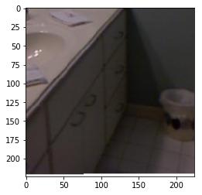
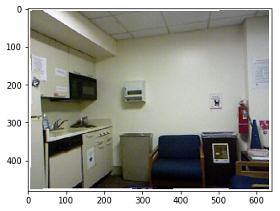
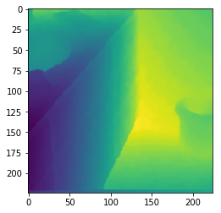
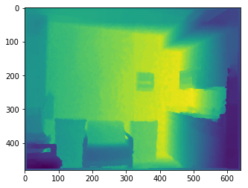
Implementation on a dataset:
Dataset Used:
01
We used The NYU-Depth V2 data set that is comprised of video sequences from a variety of indoor scenes as recorded by both the RGB and Depth cameras from the Microsoft Kinect which contains 280,000 training images
Performing data augmentation with scale, rotation and horizontal flip transformations
Using 654 test images in the dataset
We only extract the central area of size 427x561 for each image which contains a valid depth projection
Image Examples
02
Training setup:
Phase 1: Use a pre-trained network and train for 50 batches and a learning rate of 0.0001
Phase 2: Reduce the learning rate by a factor of 10^-3
for the existing parts of the model while initializing new feature extraction parts with the Xavier initialization method,
Corresponding Depth Maps

Slide 12
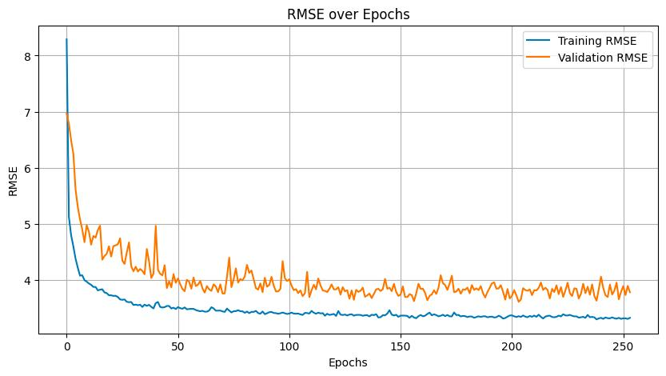

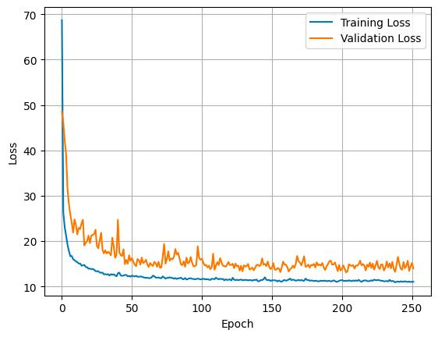
Performance Analysis
Metric used to evaluate results:
Root Mean Squared Error:
Root Mean Squared Error in linear scale is a measure of the differences between values predicted by a model and the values observed (the ground truths).
Training and Validation Losses:
-We trained for 500 epochs with an early stopping option that stopped at us around 250 epochs (8 hours) on Macbook Pro M1 Max (64gb GPU)

Slide 13
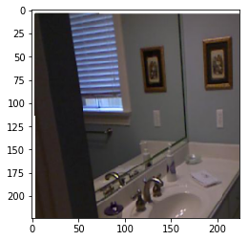
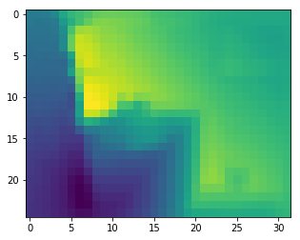
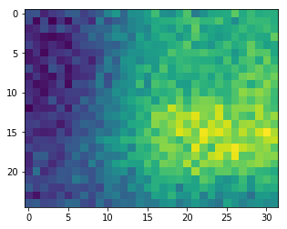
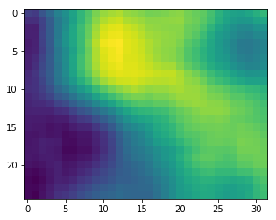
Inference and comparisons:
Model Prediction:
01
Ground-Truth Depth Map
Predicted Depth map
With Resnet-152
Predicted Depth map
With Resnet-152 + Fourier Analysis
Test Image

Slide 14
Conclusion:
The results we reached and what we learned from this:
Modifying a pre-existant CNN architecture: We were able to develop a CNN based on the ResNet architecture, enhancing it with paths for intermediate feature extraction which was critical for capturing detailed depth nuances.
Defining our own loss function: Instead of using a pre-defined loss function. We had to define our own loss function for this use case “Depth Balanced Euclidean Loss”
Fourier Domain Analysis: Balancing overall distribution with fine details by leveraging Fourier domain analysis of Images
Experimental Validation: Demonstrated state-of-the-art performance on the NYUv2 depth dataset, significantly outperforming conventional algorithms and validating the effectiveness of the Fourier analysis and DBE loss in improving depth estimation accuracy.

Slide 15
References
References
1
Single-Image Depth Estimation Based on Fourier Domain Analysis https://ieeexplore.ieee.org/document/8578140
5
Multiscale continuous CRFs as sequential deep networks for monocular depth estimation https://arxiv.org/abs/1704.02157
2
3-D depth reconstruction from a single still image https://www.researchgate.net/publication/220659394_3-D_Depth_Reconstruction_from_a_Single_Still_Image
6
Deep Residual Learning for Image Recognition https://arxiv.org/abs/1512.03385
3
Deeper depth prediction with fully convolutional residual networks https://arxiv.org/abs/1606.00373
7
Discrete-Time Signal Processing https://research.iaun.ac.ir/pd/naghsh/pdfs/UploadFile_2230.pdf
4
Discrete-continuous depth estimation from a single image. https://ieeexplore.ieee.org/document/6909492
8
Understanding the difficulty of training deep feedforward neural networks https://proceedings.mlr.press/v9/glorot10a/glorot10a.pdf

