Slide 1
MOVESENSE · TIER A · 4 SENSORS
SPEC V1.0 · CONFIG 2026.1
Double-Poling Trainer
Mobile app design for ergometer double poling — three signals live, an honest report, one grounded cue.
14 screens & states
English · Swedish to follow
Dev handoff reference
Notes:
One product aim, one spec, one design language. This deck walks the athlete's path through the app and shows where the honesty rules become pixels.

Slide 2
01 · THE AIM
A four-sensor system that measures double poling well enough to show three trustworthy signals live, produce an honest report , and deliver one grounded cue per session.
Four sensors
Three signals
Honest
One cue
Donning time is the retention constraint. Three minutes to dressed.
The attention ceiling at threshold — not a UI preference.
Every number defensible or visibly absent, with its gate named.
An athlete given five cues adopts zero.
Notes:
Every clause is load-bearing. Four sensors because donning time is the retention constraint. Three signals because that is the attention ceiling at threshold. Honest because a greyed metric builds more trust than a confident wrong one. One cue because an athlete given five adopts zero.

Slide 3
02 · SCREEN FLOW
Six screens from cold start to cue
→
→
→
→
→
A1
A2
A3
A4
A7
A8
Home
Setup
Calibration
Live
Report card
Full report
Last session · battery
Sites · L/R swap · sync tap
5 steps · 60–90 s
Three signals
Well · focus · drill
Eight sections
Designed states hanging off the flow:
A3f calibration failed
A4d sensor dropped
A4s slip detected
A7e escalation
A8q suppressed metric
Notes:
The session flow is modal: no tab bar between setup and report. Home, History and Settings are the only tabbed screens. Five degraded states hang off the flow and are designed, not improvised.

Slide 4
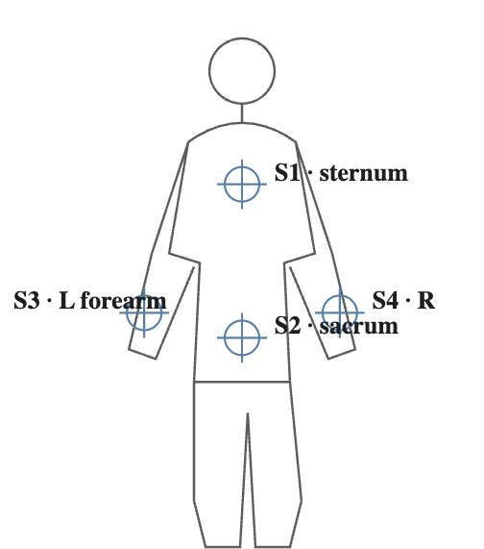
‹
SENSOR SETUP
Tier A · 4
03 · A2 SENSOR SETUP
Straps and batteries kill wearables, not algorithms
01
One-tap L/R swap
Sternum · chest belt
Wrong-limb mounting is the second most common placement fault. Fixing it in software costs one control; fixing it by re-strapping costs users.
86%
174823 · streaming 52 Hz
Sacrum · waist belt, midline
72%
174911 · streaming 52 Hz
Left forearm · strap, arrow up
Swap L/R
02
Sync tap as UI, not tooltip
175002 · streaming 52 Hz
Right forearm · strap, arrow up
Swap L/R
Left–right timing lives in the 20–50 ms range — the same order as BLE jitter. The tap is what turns sync from an assumption into a measurement.
175118 · connecting…
SYNC TAP · WHEN ALL FOUR ARE GREEN
Tap the ergometer frame firmly 3 times with both hands to sync clocks.
03
State never rides on colour alone
CONTINUE TO CALIBRATION
Every status dot has a text partner: “streaming 52 Hz”, “connecting…”.
Notes:
Two details carry disproportionate weight: the one-tap software L/R swap, and the sync-tap instruction as a first-class block. Wrong-limb mounting is common; without the swap the athlete re-straps and some fraction stops using the product.

Slide 5
‹
CALIBRATION
STEP 3 OF 5
BIAS
UPRIGHT
AXES
READY
VERIFY
04 · A3 CALIBRATION
STEP 3 FAILED · FUNCTIONAL AXES
A near-miss, not a rejection
Right forearm — try again
The movement wasn't quite planar, or the strap may have rotated. Check the arrow points up the arm, then repeat with slower, fuller cycles.
Calibration failure is the highest-frequency friction point in the product, so its screen shows the gate it is measuring against — 74% against a gate of 80% — names the sensor rather than the abstraction, and offers the placement clip for that exact site.
SLOW CYCLES RECORDED
6/ 6
Gyro bias
0.4 dps
PASS
Upright pose
6.2°
PASS
Axis variance (PC1)
74% · gate 80%
FAIL
STEP 3 PASS CRITERIA
Perpendicularity
34° · gate 30°
FAIL
PC1 explains > 80% of angular-velocity variance and the medio-lateral axis lies within 30° of perpendicular to the segment's long axis.
REPEAT STEP 3
Watch placement video · right forearm
Notes:
Showing the variance percentage while measuring rather than a spinner is deliberate: it makes the pass criterion legible, so a repeat feels like a near-miss rather than an arbitrary rejection. Failure names the sensor and the likely cause.

Slide 6
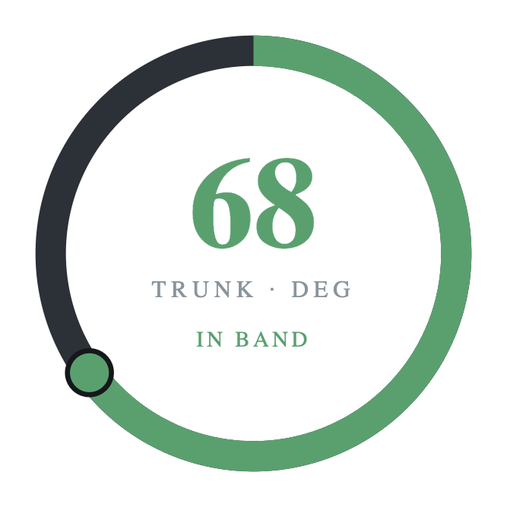
05 · A4 LIVE SESSION
18:24
ZONE 3
Three signals. Nothing else.
Posture ring · primary
Trunk-to-vertical against the personalised band. Turns red on over-flexion or any lumbar extension episode — the safety signal overrides everything.
LEFT
PLANT OFFSET 14 MS
RIGHT
Symmetry bar · secondary
CYCLE RATE
55
Dead-band set to the measurement uncertainty of the current sampling mode. A bar that twitches on noise gets ignored, and an ignored signal is worse than an absent one.
target 52–56 · min⁻¹
Cycle rate · tertiary
Only when a cadence is prescribed. Amber when rate rises as arm ROM falls — degradation masquerading as effort.
audio cues on · fading 60% · svank tone armed
Glass-to-glass budget for the ring: ≤ 100 ms · svank tone within 150 ms of episode onset
END SESSION
Notes:
Three signals maximum, all pre-attentively decodable — colour and position, no reading. The screen budget is fixed: any proposal to add a live element must displace an existing one. This is the rule that erodes first, so it is in the spec.

Slide 7
‹
SESSION REPORT
Fri 17 Aug · 40:12
✓ WENT WELL
06 · A7 REPORT CARD
Poling time held at 53.1% of the cycle for the whole session — inside the ergometer band, and steadier than your last four sessions.
Numbers in code, language in the model
▲ ONE FOCUS · SVANK
Lumbar extension appeared 2.4 times per 100 cycles against a reference of 0–1, and rose through the session as your trunk lean fell away. That is your pelvis tipping forward once the deep core tires, not your arms giving out.
The deterministic layer measures, ranks, suppresses and escalates. The model only phrases. It never computes, never chooses a threshold, and never even sees a number that failed a quality gate.
“Ribs down, tail tucked — brace before every push.”
NEXT DRILL
3 × 2 min at low resistance, holding a braced trunk with a deliberate pause at the end of each push.
GENERATED · VALIDATED
config 2026.1 · sync 3.2 ms
Same shape, either source
One cue, set apart
2 more items in full report
›
With coaching off, the deterministic template fills the identical card. The product runs with the model switched off.
Italic quotation inside the focus block — the single line worth retaining.
Notes:
Fixed order: went well, one focus, next drill. The cue is set apart in italic quotation because it is the one line the athlete should be able to retain. Suppressed faults are never expanded here — that restraint is the whole point.

Slide 8
‹
SESSION REPORT
Fri 17 Aug · 38:40
07 · A7E ESCALATION
The hierarchy is the safety mechanism
■ WORTH GETTING CHECKED
Lumbar extension episodes have risen across your last three sessions and stayed high through this one. That pattern is worth showing to a physiotherapist. This app measures movement — it can't assess your back.
Share session data
Log pain
Referral first. Fixed, human-written text — never generated, never rewritten. “This app measures movement — it can't assess your back.”
WHAT WE SAW
Drill replaced, not softened. A dashed neutral block: no training prescribed on top of a referral.
4.1 lumbar extension episodes per 100 cycles, against a reference of 0–1, and rising within the session: 2.2 in the first third, 5.6 in the last. No cue this session.
Focus becomes observation. Coaching scope drops to conservative, so cue and drill leave the required schema entirely.
NO DRILL THIS WEEK
Train easy and keep sessions short until you've been assessed.
Went-well is retained. An athlete being told to see a physio still deserves to know what they did well.
✓ WENT WELL
Timing symmetry was your best yet: 9 ms mean offset at 2.8 ms sync error.
Moving the referral block below the coaching content is a regression in a safety behaviour — flag it in review, not in backlog.
Fixed template · coaching scope: conservative · not generated
Notes:
The visual hierarchy is the safety mechanism. If a future design change moves the referral card below the coaching content, that is a regression in a safety behaviour, not a layout preference — flag it in review.

Slide 9
08 · A8Q SUPPRESSED METRIC
Absence is a feature
Any metric whose supporting data failed a quality gate is removed and named — never estimated. This is what makes the numbers that do appear worth believing.
IN THE REPORT — GREYED IN PLACE
IN THE DESCRIPTOR — STRUCTURALLY OMITTED
Plant timing offset
— — —
"data_quality": {
Drive-velocity SI
— — —
"sync_error_ms": 11.0,
"calibration_ok": true },
Sync error 11 ms — timing symmetry not reportable this session. The end-of-session tap was skipped, so drift could not be bounded.
"suppressed_due_to_quality": [
"timing_symmetry"
]
Names only. The model is told a family was unreliable, never what its value might have been.
Notes:
A greyed metric with a stated reason builds more trust than a confident wrong one. The same metric is structurally omitted from the descriptor, so the coaching layer cannot mention it — a constraint the model can violate is weaker than a number it never receives.

Slide 10
09 · DEGRADED & EDGE STATES
Designed, not improvised
STATE
WHAT THE ATHLETE SEES
WHAT THE SYSTEM DOES
Calibration step failed
Sensor named, cause in one clause, gate value shown as a near-miss
Repeat that step only; placement clip offered for the site
Sensor dropped mid-session
Affected signal greys with an icon; session continues
Logbook backfills; dropout recomputed as the residual
Slip detected
Posture ring pauses, one non-blocking line
Absolute angles marked from the slip timestamp onward
Sync error over gate
Timing symmetry greyed in place with the reason
Metric family omitted from the descriptor entirely
Escalation rule fires
Fixed referral card above everything; no drill
Coaching scope drops to conservative
A silently degraded live signal teaches the athlete the wrong movement — so every degradation carries text, not just a colour change.
Notes:
Degradation is always visible and labelled. A silently degraded live signal teaches the athlete the wrong movement. Five states are designed, not improvised at implementation time.

Slide 11
10 · NEXT
What the design needs before pilot
Swedish at real length
Real placement footage
Cadence default
Every card re-checked with Swedish strings — the focus block and the fixed referral text are the tight ones.
Four clips keyed to the silhouette. Currently placeholders on A11.
The tertiary signal is hidden unless prescribed. Decide whether first-session mode prescribes one.
Out of v1, plumbing preserved: coach tablet view · on-device inference · Tier B/C sensors
Spec v1.0 · §15
Notes:
What the design still needs before pilot: Swedish strings at final length, real placement footage, and a decision on whether cadence is prescribed by default. Coach tablet view stays out of v1.

