Slide 1
School Management
User Guide

Slide 2
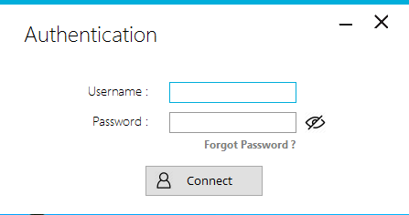
Connect Form
Type your username
Put the mouse on the eye to see password you entered
Type your password
Recover password
Connect to your account

Slide 3
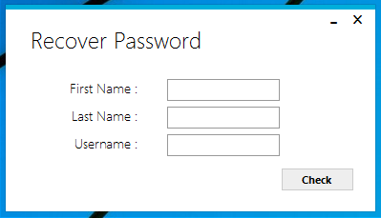
Recover Password - Step 1
Type your first name
Type your last name
Type your username
Check the informations you entered

Slide 4
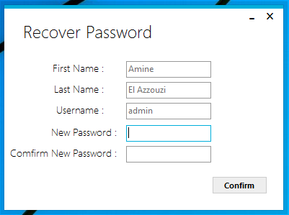
Recover Password - Step 2
After checking your informations
Type your new password
Confirm your new password
Save Changes

Slide 5
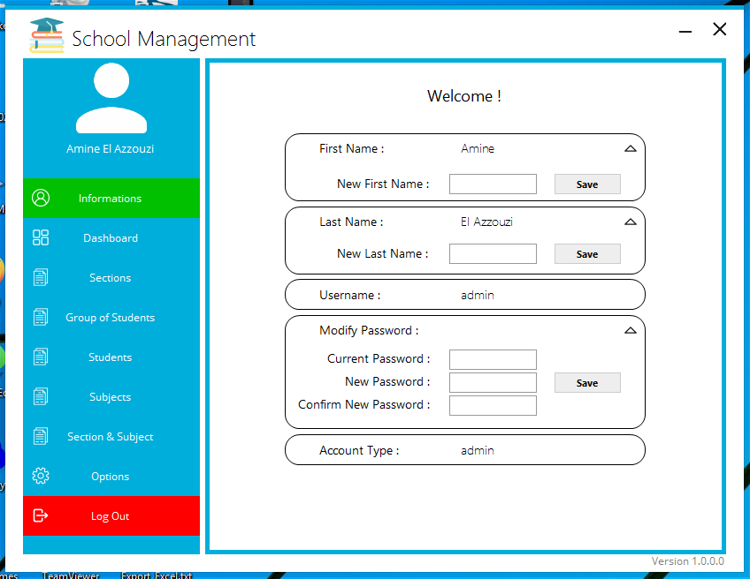
Main Form
Your name here
Go to “Informations”
Go to “Dashboard”
Go to “Sections”
Go to “Group of Students”
Go to “Students”
Go to “Subjects”
Go to “Section & Subject”
Go to “Options”
Log out of your account

Slide 6
Informations of you account
Change your first name
Change your last name
Change your password

Slide 7
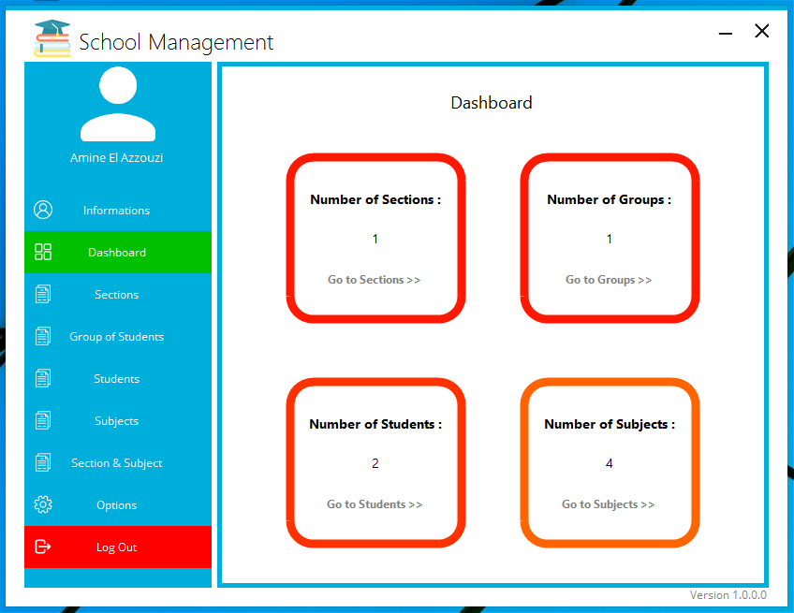
Dashboard
Shows the number of values in each table

Slide 8
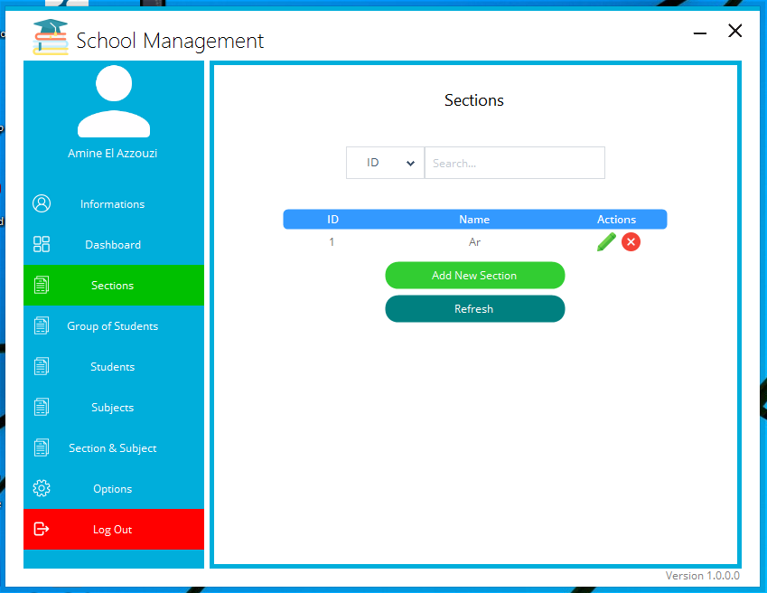
Sections
Search Section
Modify Section
“Only for Administrator”
Delete Section
“Only for Administrator”
Add Section
“Only for Administrator”

Slide 9
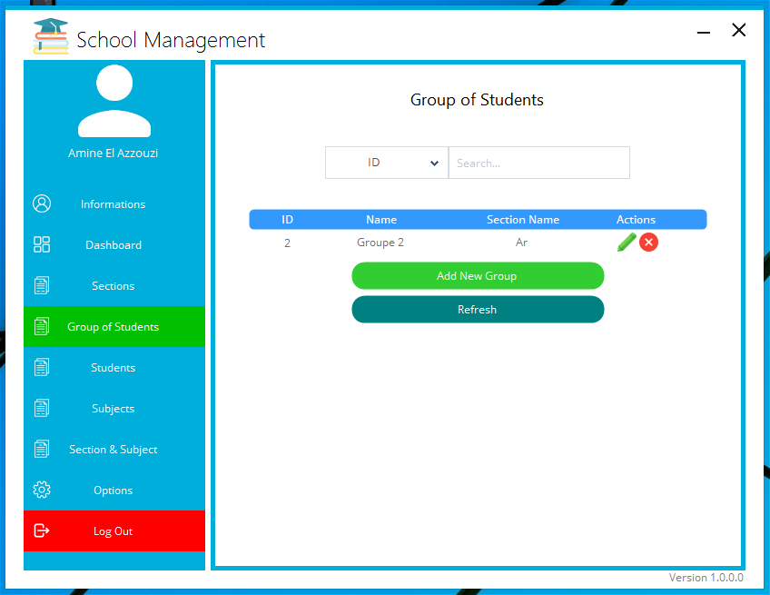
Group of Students
Search Group
Modify Group
“Only for Administrator”
Delete Group
“Only for Administrator”
Add Group
“Only for Administrator”

Slide 10
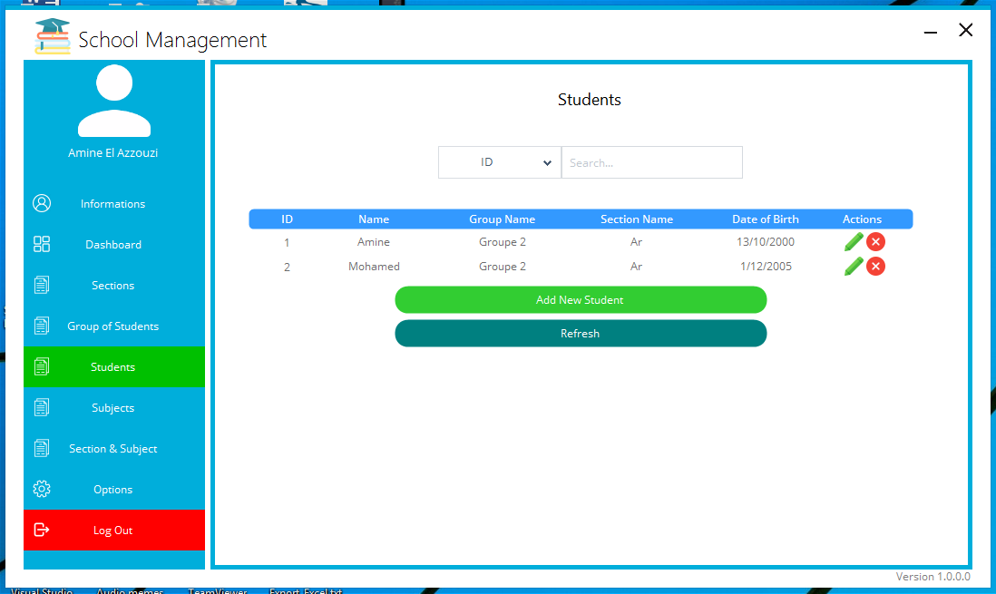
Students
Search Student
Modify Student
“Only for Administrator”
Delete Student
“Only for Administrator”
Add Student
“Only for Administrator”

Slide 11
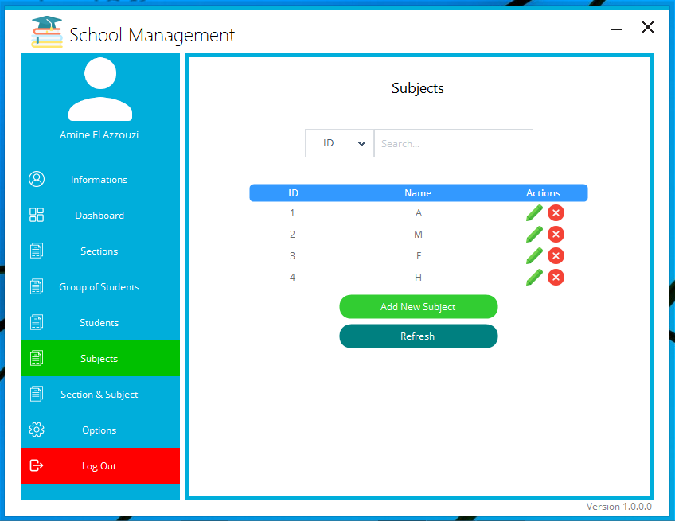
Subjects
Search Subject
Modify Subject
“Only for Administrator”
Delete Subject
“Only for Administrator”
Add Subject
“Only for Administrator”

Slide 12
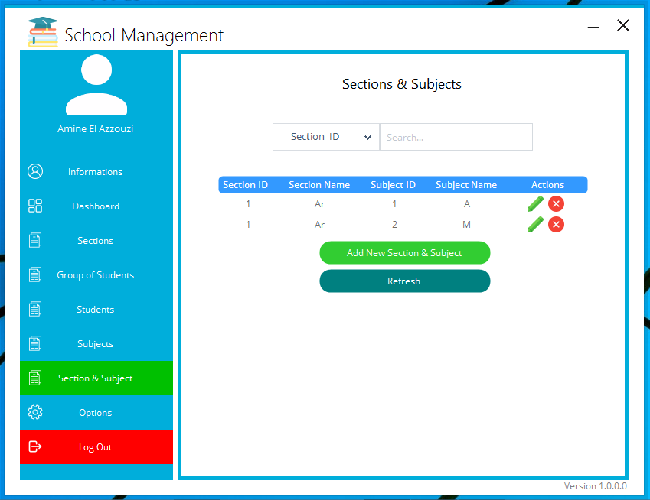
Search Section & Subject
Section & Subjects
Modify Section & Subject
“Only for Administrator”
Delete Section & Subject
“Only for Administrator”
Add Section & Subject
“Only for Administrator”

Slide 13
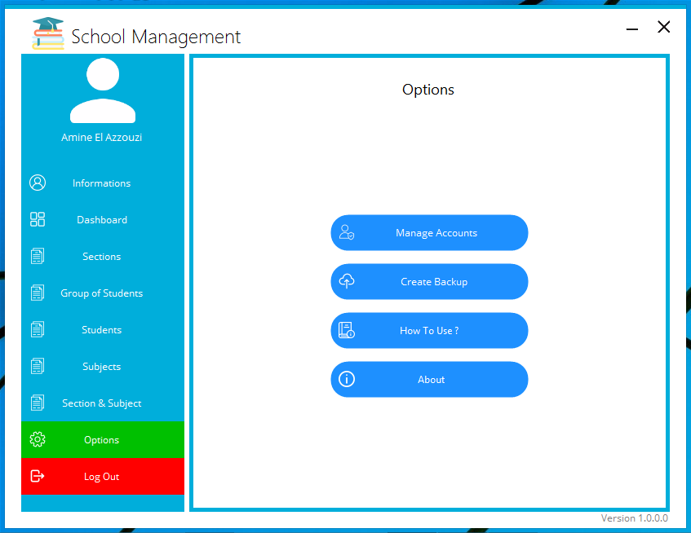
Options
Go to “Manage Accounts”
Only for Administrator
Go to “Create Backup”
Only for Administrator
Open this “User Guide”
Open “About” Form

Slide 14
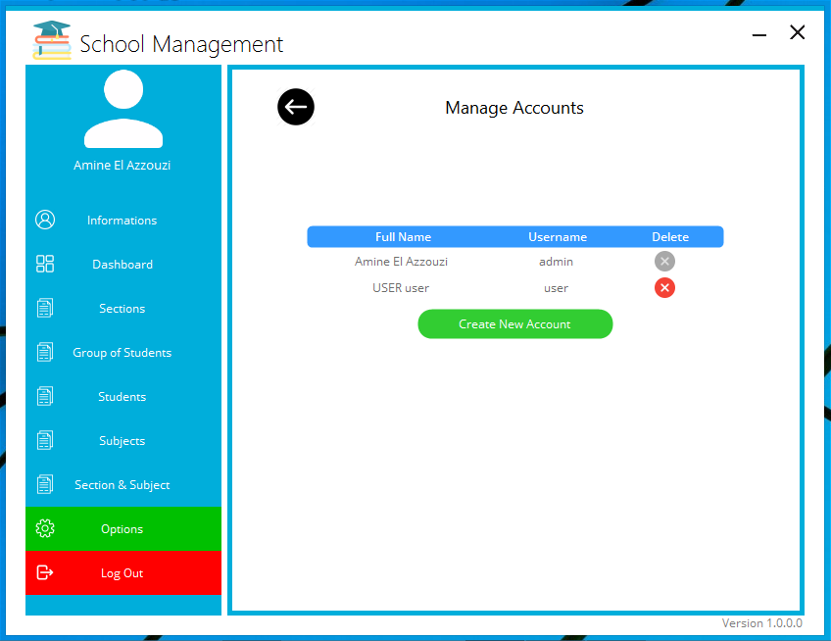
Manage Accounts
“Only for Administrator”
Delete Account
Go back to “Options”
Create New Account

Slide 15
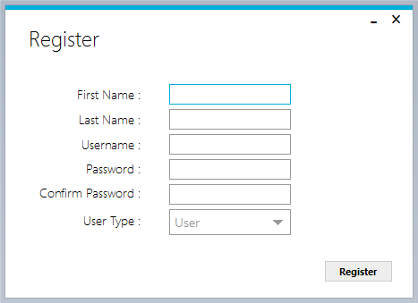
Create New Account
“Only for Administrator”
First Name
Password
Last Name
Confirm Password
Username
Choose “User Type”
Register

Slide 16
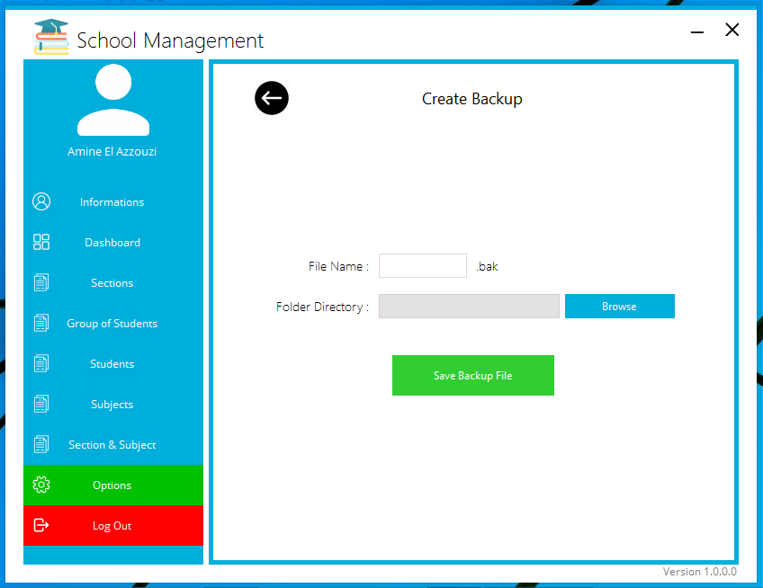
Create Backup
“Only for Administrator”
Type a file name of your choice
Go back to “Options”
Browse for a locate to save the backup file
Save the backup file

Slide 17
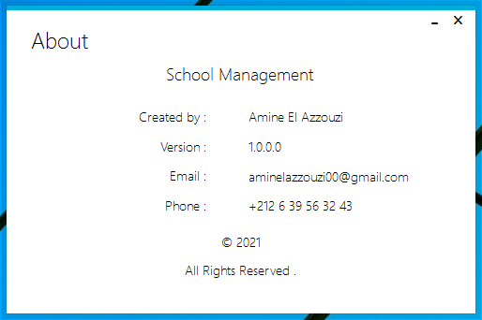
“About” Form

