Slide 1


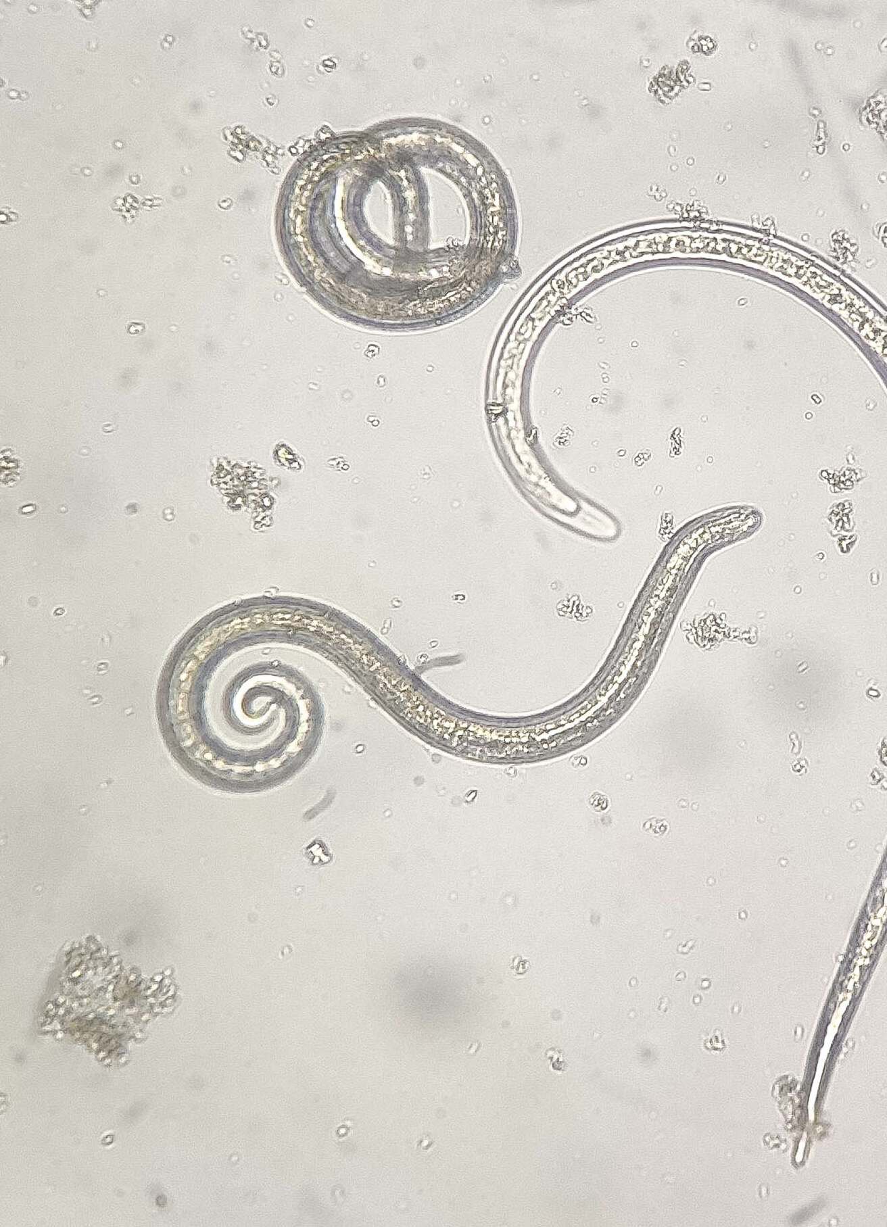



Comparative Analysis of Retrotransposon
Percent Insertion in Trichinella spiralis and Trichinella papuae
Course: BINF*6210 – BIOINFORMATICS Software Tools
Team Members (Group 8):
Kristian Gonzales
Matthew Perry
Mohammadamin Emamimeybodi
IVRANDEEP KOUR

Slide 2

Retrotransposons are mobile genetic elements that copy themselves through an RNA intermediate
Retrotransposons are a subclass of transposable elements (TEs) (Wicker et al., 2007).
They move through a copy-and-paste mechanism.
The original copy remains while a new copy is inserted elsewhere in the genome.
Their activity can contribute to genome expansion, variation, and changes in gene regulation.
Major types:
1. LTR retrotransposons (Long Terminal Repeat elements)
2. LINEs (Long Interspersed Nuclear Elements)
3. SINEs (Short Interspersed Nuclear Elements)
(Wicker et al., 2007).
Illustration of retrotransposon activity in the genome

Slide 3
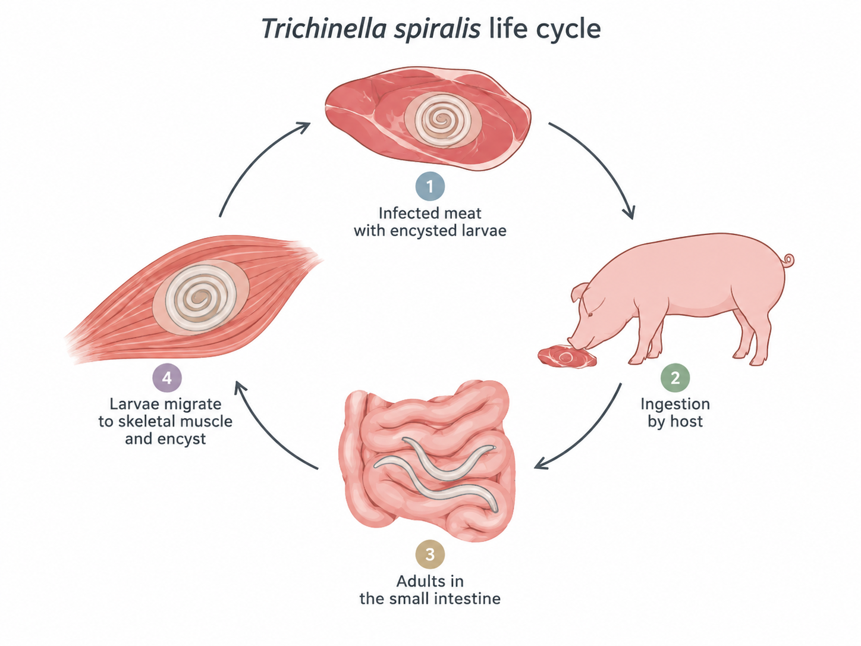
Trichinella spiralis is a zoonotic parasitic nematode with a well-characterized genome that supports comparative retrotransposon analysis.
Causes Trichinellosis, a food-borne disease transmitted through infected meat.
Infects a broad range of mammalian hosts, including pigs, wildlife, and humans.
Adults live in the intestine, while larvae encyst in skeletal muscle cells.
Its sequenced and annotated genome provides resources for studying repetitive DNA and retrotransposon content (Mitreva et al., 2011).
Why it is relevant
A well-studied reference species within the genus Trichinella.
Useful for comparing retrotransposon characteristics with other Trichinella species (Mitreva et al., 2011).
Simplified life cycle of Trichinella spiralis

Slide 4
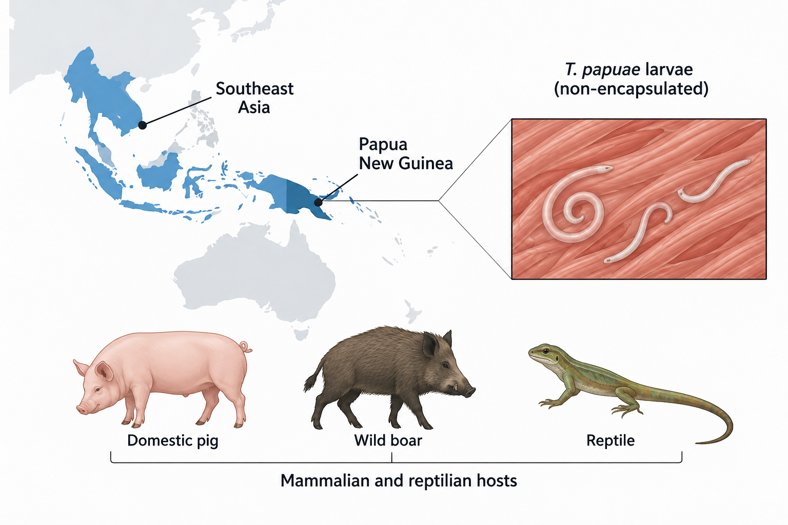
Trichinella papuae is a non-encapsulated parasitic nematode whose distinct biology makes it useful for comparative retrotransposon analysis
Causes Trichinellosis and is transmitted through consumption of infected meat.
Belongs to the non-encapsulated clade, so larvae do not form collagen capsules in host muscle (Pozio et al., 1999).
Infects both mammalian and reptilian hosts, giving it a broader host range.
Found mainly in Papua New Guinea and Southeast Asia.
Why it is relevant
Represents a distinct evolutionary lineage within Trichinella (Korhonen et al., 2016).
Useful for comparing how biology and evolutionary history may relate to retrotransposon patterns.
Trichinella papuae: distribution and hosts

Slide 5
Trichinella spiralis and Trichinella papuae represent distinct evolutionary lineages, making them useful for comparing retrotransposon patterns.
Why Compare Their Retrotransposons?
Retrotransposons are important components of genome evolution and can vary among related species (Wicker et al., 2007).
Comparing retrotransposon percent insertion between these two lineages may help reveal whether differences in evolutionary history are associated with differences in repetitive DNA composition.
Feature | T. spiralis | T. papuae
Lineage | Encapsulated | Non-encapsulated
Hosts | Mainly mammals | Mammals + reptiles
Geographic distribution | Widespread globally | Primarily Papua New Guinea and Southeast Asia
(Pozio et al., 1999)

Slide 6
Percent insertion (perc_insert) is the percentage of bases in a repeat copy that are inserted relative to its repeat consensus sequence.
perc_insert is calculated from the alignment between a genomic repeat copy and its reference consensus (Tarailo-Graovac & Chen, 2009).
A higher perc_insert means that the repeat copy contains more inserted sequence relative to that consensus.
Why it is useful for our comparison:
Differences in perc_insert can reflect how much individual retrotransposon copies have accumulated insertion-related sequence changes relative to their family consensus (Wicker et al., 2007).
Comparing these values between T. spiralis and T. papuae therefore provides a way to examine whether retrotransposon copies show different patterns of sequence modification between the two species.
Consensus: ATGCTA---CGTAA​
​
Repeat copy: ATGCTAGGGCGTAA​
↑ Inserted bases​
perc_insert = (inserted bases / aligned repeat length) × 100

Slide 7
Comparing percent insertion may reveal differences in retrotransposon sequence characteristics between the two Trichinella species
Research Question:
Do retrotransposon percent insertion (perc_insert) values differ between Trichinella spiralis and Trichinella papuae?
Why ask this question?
T. spiralis and T. papuae represent distinct evolutionary lineages, and comparing perc_insert allows us to examine whether their retrotransposon copies differ in sequence-level insertion variation (Korhonen et al., 2016)
Study focus:
Compare the distribution of perc_insert values between the two species using retrotransposon records from each genome.

Slide 8
Code Overview
Step 1: Read in the .csv data for Trichinella spiralis and Trichinella papuae.
Step 2: Filtered out the non-transposable elements and the DNA transposons leaving us with just the retrotransposon categories in the data frame.
Step 3: With the retrotransposon data frame we used mutate to add a species column and format and filter the rest of the data frame so downstream figures would be compatible without error.
Step 4: We used ggplot to create a distribution plot for the T.spirallis data frame and the T.papuae data frame.
Step 5: Combined the two Trichinella data frames to create a frequency plot overlaying both using ggplot and dplyr.
Step 6: We used summary, linear models and t-test for our novel numerical data.

Slide 9
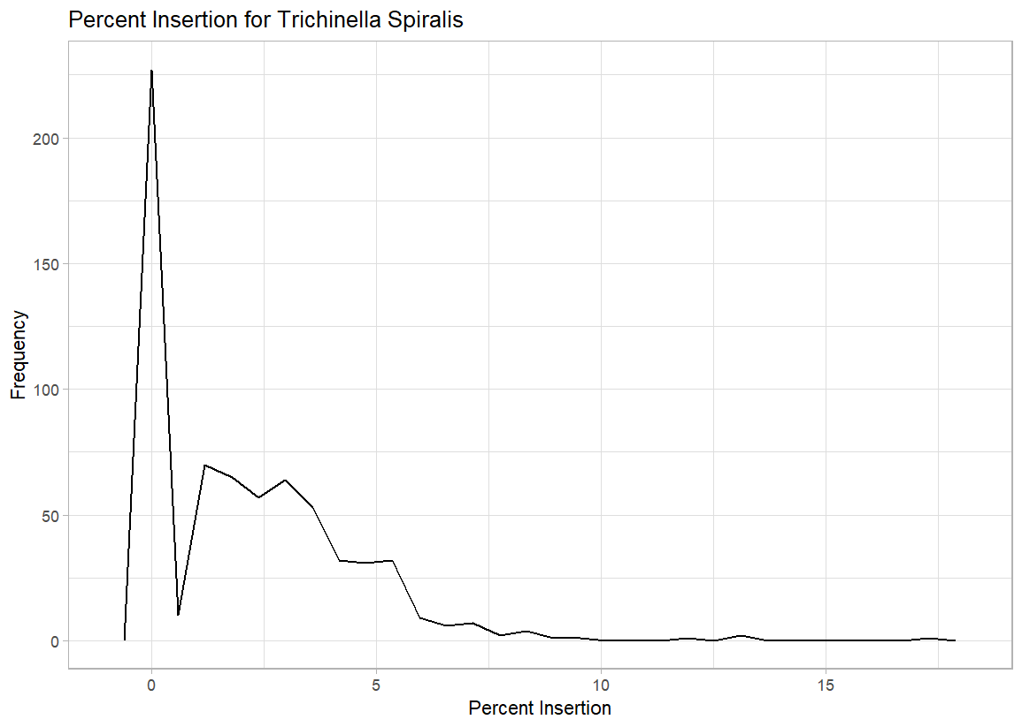
Most T. spiralis retrotransposon records have low perc_insert values.
The distribution is concentrated near 0, with fewer records at higher perc_insert values.
Figure: Distribution of perc_insert in T. spiralis

Slide 10
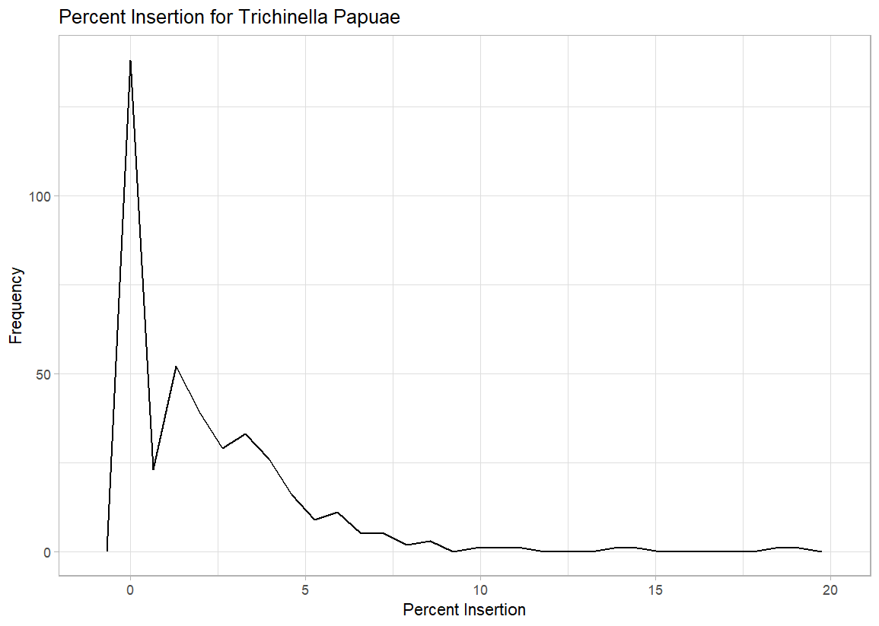
Most T. papuae retrotransposon records have low perc_insert values.
The distribution is concentrated near 0, with fewer records at higher perc_insert values.
Figure: Distribution of perc_insert in T. papuae​

Slide 11
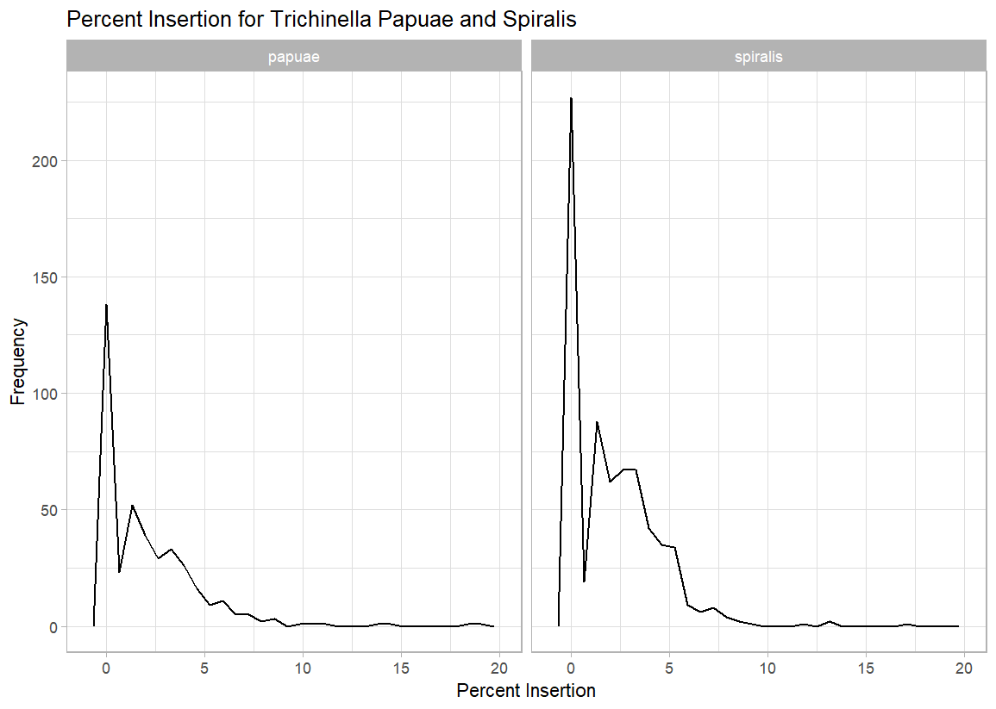
Both T. spiralis and T. papuae show perc_insert distributions concentrated at low values.
The combined figure allows the two species’ perc_insert distributions to be compared directly.
Figure: Percent Insertion for Trichinella Spiralis and Trichinella Papuae

Slide 12
Results
Species | Min Percent Insertion | Max Percent Insertion | Mean Percent Insertion | Median Percent Insertion
T. spiralis | 0 | 17.3 | 2.111 | 1.7
T. papuae | 0 | 19.1 | 2.131 | 1.5
Individual frequency plots appear similar, but the scale on the y-axis is much smaller for Trichinella papuae.
There appears to be significantly more zeros in the percent insertion column for Trichinella spiralis than for Trichinella papuae.
The plot also seems to flatten more quickly for Trichinella spiralis, suggesting that T. papuae may have more records with higher percent insertion values.

Slide 13
Although the plots appear different, statistical testing shows no significant difference in perc_insert between T. spiralis and T. papuae.
Plots appear to show a difference in percent insertion for Trichinella spiralis vs Trichinella papuae.
Linear model of percent insertion separating by species contradicts the plots
Obtaining a p-value of 0.895 for the species coefficient in the linear model means that there is no statistically significant relationship for percent insertion between the two Trichinella species.

Slide 14
Despite different evolutionary lineages, the two species show similar average insertion-related sequence variation.
Similar Mean Values: Both species showed nearly identical mean percent insertion values (2.111% for T. spiralis and 2.131% for T. papuae).
Visual vs. Statistical Differences: Although the frequency plots suggested differences in distribution, the linear model (p = 0.895) found no statistically significant difference in mean percent insertion between species.
Biological Interpretation: Despite belonging to different evolutionary lineages, the two species showed similar average insertion-related sequence variation relative to their retrotransposon consensus sequences.
Study Limitations: Differences in the number of retrotransposon records may influence the frequency plots. Additionally, comparing overall means may overlook differences among individual retrotransposon families.
Future Directions: Comparing normalized distributions and analyzing specific retrotransposon families could reveal differences not captured by the current statistical analysis.

Slide 15
Novel Component
Separate from the linear model, we also conducted a t-test.
Trichinella spiralis perc_insert sample mean = 2.111
Trichinella papuae perc_insert sample mean = 2.131
H₀ : true difference in means is equal to 0.
H_{A} : true difference in means is not equal to 0.
t= 0.12597, df = 726, p-value = 0.8998 (large)
No evidence against the null hypothesis, meaning there seems to be negligible difference for percent insertion between Trichinella spiralis and Trichinella papuae.

Slide 16
References
Korhonen, P. K., Pozio, E., La Rosa, G., Chang, B. C. H., Koehler, A. V., Hoberg, E. P., Boag, P. R., Tan, P., Jex, A. R., Hofmann, A., Sternberg, P. W., Young, N. D., & Gasser, R. B. (2016). Phylogenomic and biogeographic reconstruction of the Trichinella complex. Nature Communications, 7, 10513. https://doi.org/10.1038/ncomms10513 PubMed
Mitreva, M., Jasmer, D. P., Zarlenga, D. S., Wang, Z., Abubucker, S., Martin, J., Taylor, C. M., Yin, Y., Fulton, L., Minx, P., Yang, S.-P., Warren, W. C., Fulton, R. S., Bhonagiri, V., Zhang, X., Hallsworth-Pepin, K., Clifton, S. W., McCarter, J. P., Appleton, J., Mardis, E. R., & Wilson, R. K. (2011). The draft genome of the parasitic nematode Trichinella spiralis. Nature Genetics, 43(3), 228–235. https://doi.org/10.1038/ng.769 PubMed
Pozio, E., Owen, I. L., La Rosa, G., Sacchi, L., Rossi, P., & Corona, S. (1999). Trichinella papuae n. sp. (Nematoda), a new non-encapsulated species from domestic and sylvatic swine of Papua New Guinea. International Journal for Parasitology, 29(11), 1825–1839. https://doi.org/10.1016/S0020-7519(99)00135-6 PubMed

Slide 17
References
Wicker, T., Sabot, F., Hua-Van, A., Bennetzen, J. L., Capy, P., Chalhoub, B., Flavell, A., Leroy, P., Morgante, M., Panaud, O., Paux, E., SanMiguel, P., & Schulman, A. H. (2007). A unified classification system for eukaryotic transposable elements. Nature Reviews Genetics, 8(12), 973–982. https://doi.org/10.1038/nrg2165 DOI​
Tarailo-Graovac, M., & Chen, N. (2009). Using RepeatMasker to identify repetitive elements in genomic sequences. Current Protocols in Bioinformatics, 25(1), 4.10.1–4.10.14. https://doi.org/10.1002/0471250953.bi0410s25 PubMed​

Slide 18
Copilot Prompts
Briefly explain what retrotransposons are, how they move, their major types, and why they matter. Include 1–2 references.
Briefly introduce Trichinella spiralis, its biology, host range, genome relevance, and why it is useful for retrotransposon comparison. Include references.
Briefly introduce Trichinella papuae, its biology, host range, non-encapsulated lineage, geographic distribution, and genomic relevance. Include references.
Explain why T. spiralis and T. papuae are biologically meaningful to compare, including lineage, host, and evolutionary differences. Include references.
Explain what perc_insert means, what a higher value indicates, what it does not measure, and why it is useful for comparing the two species. Include references.
Could differences in retrotransposon insertion patterns reflect evolutionary differences between Trichinella species?
Help me present the research question: Do retrotransposon percent insertion (perc_insert) values differ between Trichinella spiralis and Trichinella papuae? Briefly explain why this question is biologically relevant.

