Slide 1
Social Listening Architecture

Slide 2


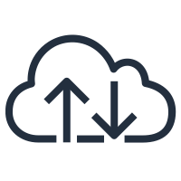

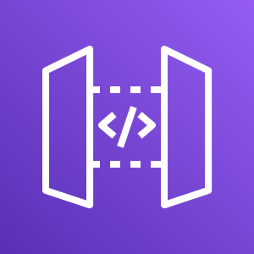


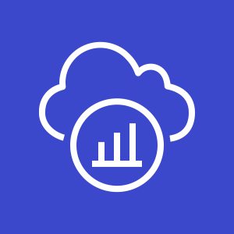










AWS Cloud
API Gateway
Amazon Cognito
CloudWatch
Availability Zone 1 (ap-southeast-1a)
Availability Zone 2 (ap-southeast-1b)
VPC (10.10.0.0/18)
AWS X-Ray
Public-DMZ1 subnet (10.10.0.0/24)
Public-DMZ2 subnet (10.10.1.0/24)
Job4U-Serverless Architecture
Cloud9
NAT Gateway
ALB / NLB
NAT Gateway
Private-Services1 subnet (10.10.10.0/24)
Private-Services2 subnet (10.10.11.0/24)
Micro-Services
S3
Internet Gateway

Slide 3

AWS Cloud
Amazon Cognito
API Gateway
AWS X-Ray
CloudWatch
Availability Zone 1
Availability Zone 2
VPC
Public subnet1
Public subnet2
API-Gateway Architecture
NAT Gateway
Cloud9
NAT Gateway
Network Load Balancing
Private subnet1
Private subnet2
Backend
Internet Gateway

Slide 4




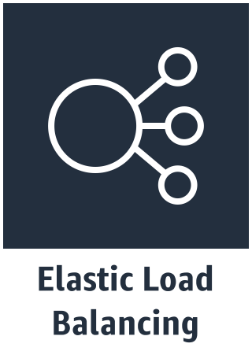


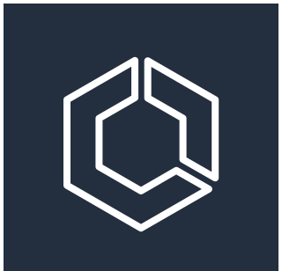

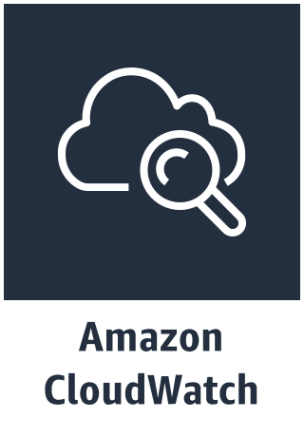
AWS container web architecture
VPC
Internet Gateway
Availability Zone A
Availability Zone B
Public Subnet
Public Subnet
NAT Gateway
NAT Gateway
Private Subnet
Private Subnet
EKS Cluster
Auto Scaling Group
Instances
Instances

Slide 5



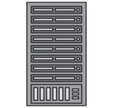


Firehose transformations add robust delivery
Data transformation function
Inline calls to Lambda for free-form changes to the underlying data
Failed transforms tracked and delivered to S3
data source
transformed
records
source records
Firehose
delivery stream
Amazon Elasticsearch
Service
S3 bucket
delivery failure
transformation failure
source records

