Slide 1
POWER BI PROJECT
E-Commerce Analysis
(Amazon)
Project by
Aminesh Kumar Singh

Slide 2

PROBLEM STATEMENT
You are working as a business analyst at Amazon, a company currently performing well. The stakeholders wish to maintain this level of performance and seek improvement. For this purpose, they want to devise new strategies. You are part of a team exploring new ways to benefit customers, such as offering more discounts and Prime membership perks. Could you suggest additional methods to identify and reward customers and enhance their shopping experience?

Slide 3
APPROACH
Understanding Problem Statement
Identifying the key questions ,the goals of the analysis, and the data available to address them.
Data Modelling & Transformation
Data understanding and defining relationship between tables using power pivot , data cleaning
and transformation using power query editor.
Analysis
Finding insights, KPIs, time series analysis, trend and pattern identification by creating Measures and calculated columns using DAX functions.
Data Visualization
Visualization of key metrics such as Revenue, Customers, Return rate, Logistics, product rating etc, by choose most suitable charts and graphs.
Strategic Recommendations
Suggestion to boost profit & revenue, improve shopping experience and identifying & awarding
loyal customer.

Slide 4

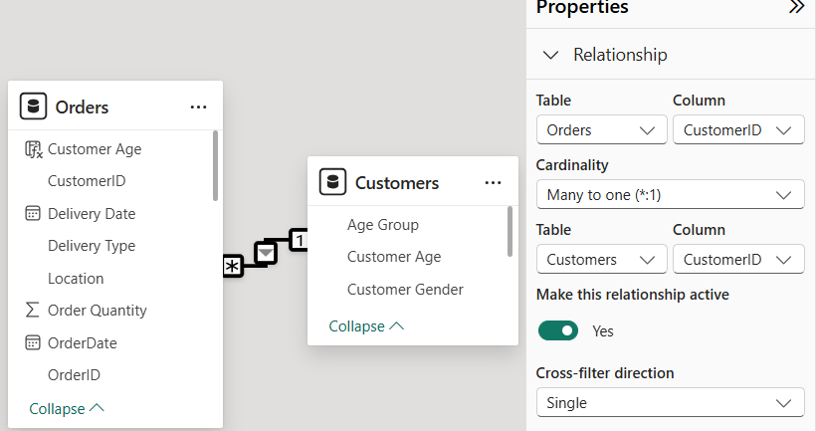
DATA DESCRIPTION
Dataset consists of two tables -
Orders: Fact table containing transactional data related to orders placed by customers.
Customers: Dimension table with descriptive data like age & gender.
Orders table has a many-to-one relationship with the Customers table, joined on CustomerID.

Slide 5
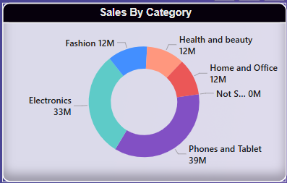
PRODUCT CATEGORY ANALYSIS
INSIGHTS
Phones and Tablets lead sales with ₹39M, making it the highest-selling category.
Electronics follows closely at ₹33M, indicating strong demand for tech-related products.
Fashion, Health & Beauty, and Home & Office each contribute ₹12M, showing balanced sales distribution among lifestyle categories.

Slide 6
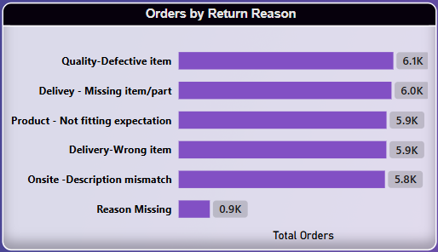
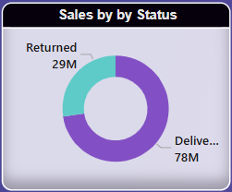
RETURNS ANALYSIS
INSIGHTS
78M sales were successfully delivered, showing a strong fulfillment process but room for improvement in reducing returns.
29M worth of sales were returned, indicating potential issues with product quality, delivery, or customer expectations.
RECOMMENDATIONS
Implement stricter quality control, improve product descriptions & images, and offer better return policies to minimize returns.

Slide 7
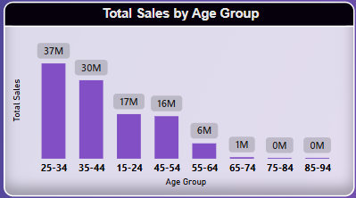
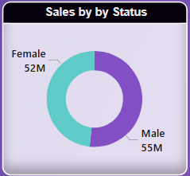
SALES BY AGE GROUP & GENDER
INSIGHTS
The 25-34 age group has the highest sales, followed by 35-44 (30M).
Sales decline drastically after 45+, with 55-64 (6M) and 65+ barely contributing.
The gender distribution is nearly equal, suggesting that both male and female-centric marketing strategies can be equally effective.
RECOMMENDATIONS
Focus on engaging the younger (15-24) and older (45+) demographics with personalized offers, loyalty programs, and products that cater to their preferences.

Slide 8
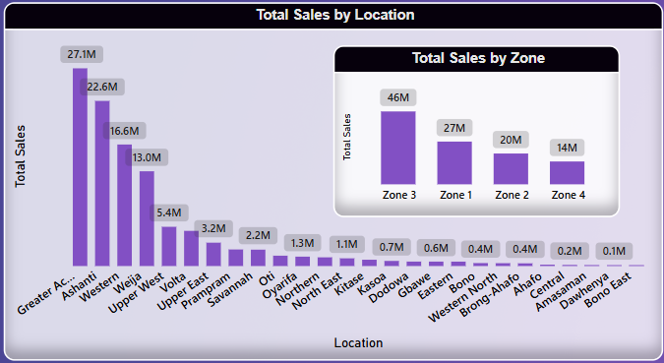
REGION WISE SALES
INSIGHTS
Greater Accra (27.1M) and Ashanti (22.6M) Lead in Sales.
Locations like Oti (2.2M), North East (1.1M), and Bono East (0.1M) have minimal sales, indicating either low demand or untapped market potential.
Zone 3 significantly outperforms other zones, highlighting a strong customer base while
Zone 4 (14M) shows the lowest sales.
RECOMMENDATIONS
Locations like Dawhenya, Central, and Bono East show extremely low sales, indicating a need for awareness campaigns, better distribution, or localized offers.

Slide 9
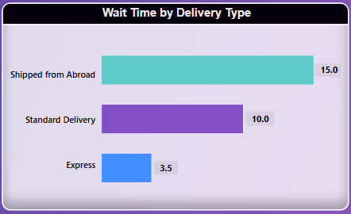
DELIVERY TYPE ANALYSIS
INSIGHTS
Express Delivery is the fastest (3.5 Days), ideal for urgent orders.
Standard Delivery takes 10 Days, a balance between cost and speed.
International Shipments take the longest (15 Days).
Customers ordering from abroad face the highest wait times, which could impact purchasing decisions.
RECOMMENDATIONS
Improving logistics, optimizing inventory management, and offering alternative shipping methods can help lower delays, enhancing customer satisfaction.

Slide 10
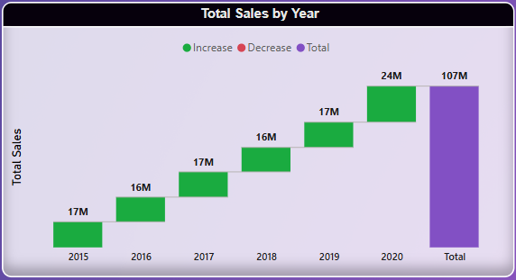
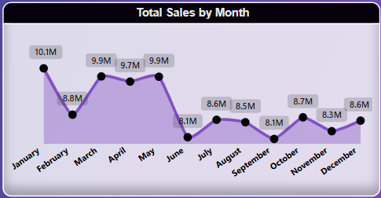
TIME SERIES ANALYSIS
INSIGHTS
Sales have steadily increased from 17M in 2015 to 24M in 2020, reaching a total of 107M.
January (10.1M) and June (9.9M) recorded the highest monthly sales.
Sales dip in July (8.1M) and September (8.1M), suggesting slower periods.
RECOMMENDATIONS
Continue leveraging high-performing months for major campaigns.
Introduce mid-year incentives (discounts, new product launches) to boost low-performing months.

Slide 11
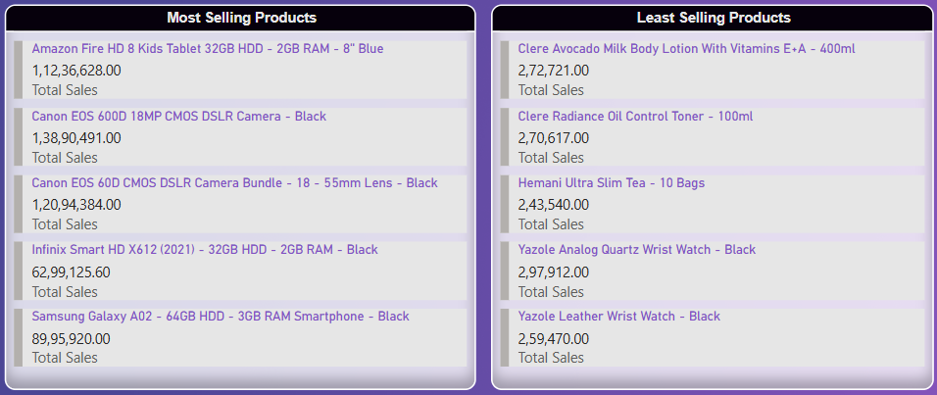

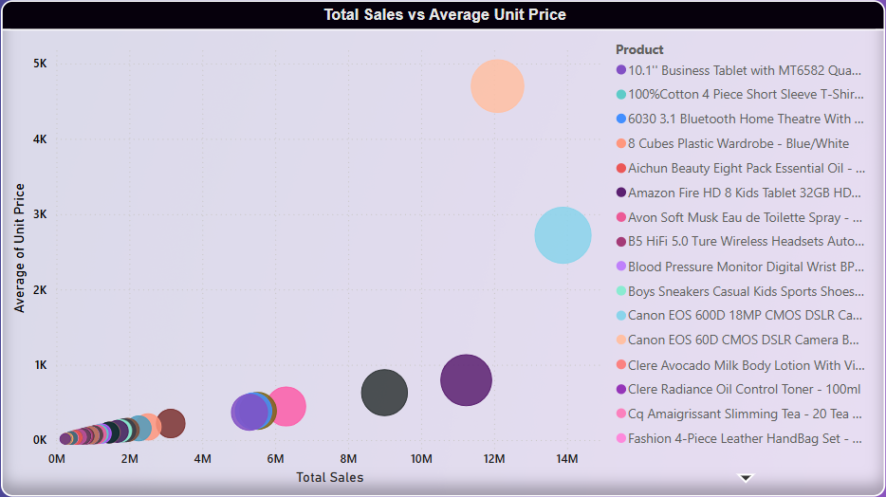
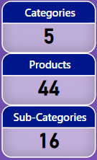
PRODUCT ANALYSIS
INSIGHTS
Total 44 unique products are sold under 16 categories and sub-categories.
Top 7 products contribute to ~65% of overall sales amount.
High-priced, low-sales items:
-Canon EOS 60D CMOS DSLR Camera Bundle - 18-55mm Lens - Black
-Canon EOS 600D 18MP CMOS DSLR Camera - Black
RECOMMENDATIONS
Discounts or rewards on specific products can increase visibility and sales for items that are not selling well.

Slide 12
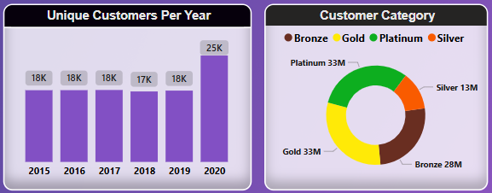
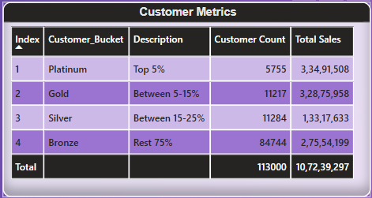
CUSTOMER ANALYSIS
INSIGHTS
The number of unique customers remained stable from 2015 to 2019 (~17K-18K annually).
A significant jump to 25K in 2020, indicating strong recent growth.
Platinum and Gold customers contribute the highest revenue per person.
Bronze customers form the majority (75%) but contribute less per capita sales.
RECOMMENDATIONS
Provide exclusive discounts, early access to sales, or premium support for high-spending customers.
Use targeted marketing for cross-selling and upselling premium products.

Slide 13
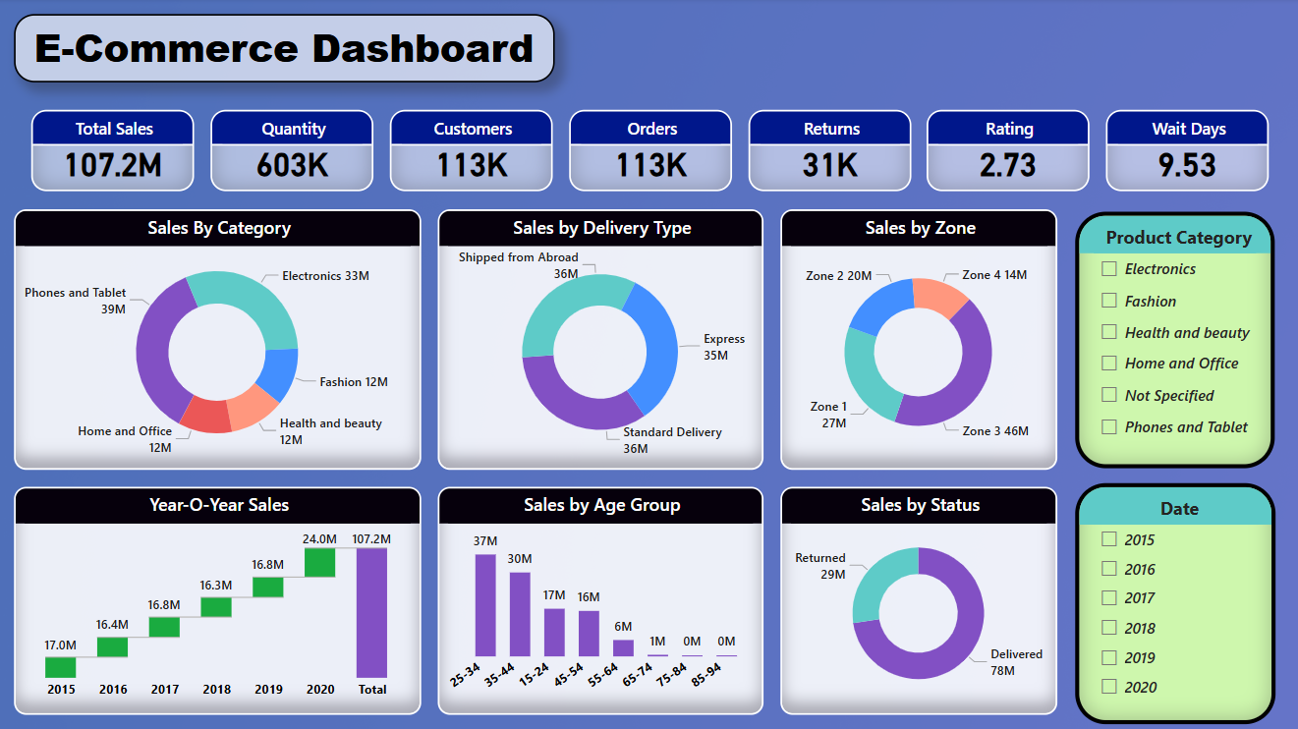
DASHBOARD : SUMMARY TAB

Slide 14
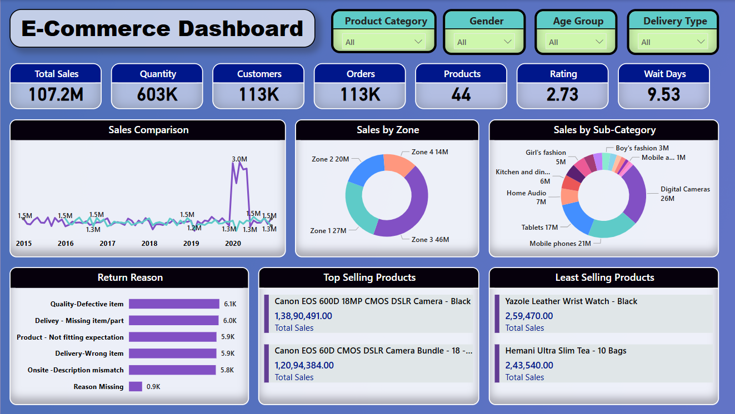
DASHBOARD : PRODUCT CATEGORY TAB

Slide 15
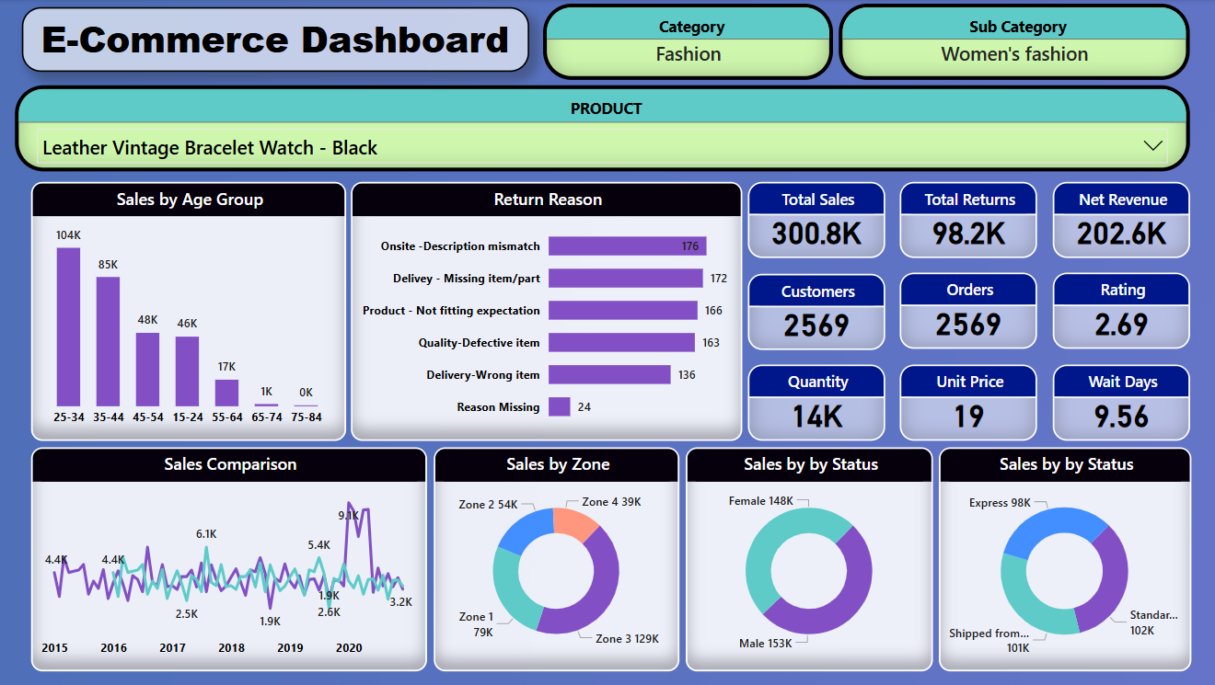
DASHBOARD : PRODUCT TAB

Slide 16

CONCLUSION
Stable customer base growth between 2015-2019, accompanied by surge in 2020 indicating strong recent growth.
Steady Yearly Growth: Sales increased from 17M in 2015 to 24M in 2020, totaling 107M.
44 unique products are sold across 6 categories & 16 sub-categories.
Top 7 products contribute ~65% of total sales, making them key revenue drivers.
Top 15% customers contributes to 60% of the total sales.
The 25-34 age group has the highest sales, followed by 35-44 (30M), Lower sales in older age groups.
Reason like missing parts, wrong description, wrong item, defective item delivered caused returns worth 29M (i.e. 27% of total sales).
Products shipped from abroad takes 15 day in average, negatively affecting users shopping experience and product rating.

Slide 17
THANK YOU

