Slide 1
SQL PROJECT
Social Media Analysis
(META)
Project by
Aminesh Kumar Singh

Slide 2

PROBLEM STATEMENT
You are hired as a data analyst at Meta and asked to collaborate with Marketing team. Marketing teams wants to leverage Instagram's user data to develop targeted marketing strategies that will increase user engagement, retention, and acquisition. Provide insights and recommendations to address the following objectives

Slide 3
OBJECTIVE
Understanding Problem Statement
Identifying the key questions ,the goals of the analysis, and the data available to address them.
Analysis
Utilized SQL functions like CTE ,Aggregate Functions , Subqueries , Group by clause, Rank functions and etc. for analysis.
Data Visualization
Visualized key metrics such as total posts, likes, and comments Created charts and graphs to rank users based on engagement rates and to highlight the most influential hashtags.
Strategy Making
Prepared plans and strategies for increasing user retention and increasing engagement activities.
Implementation
Implementation of the plans and strategy are also discussed for optimised and better results.

Slide 4
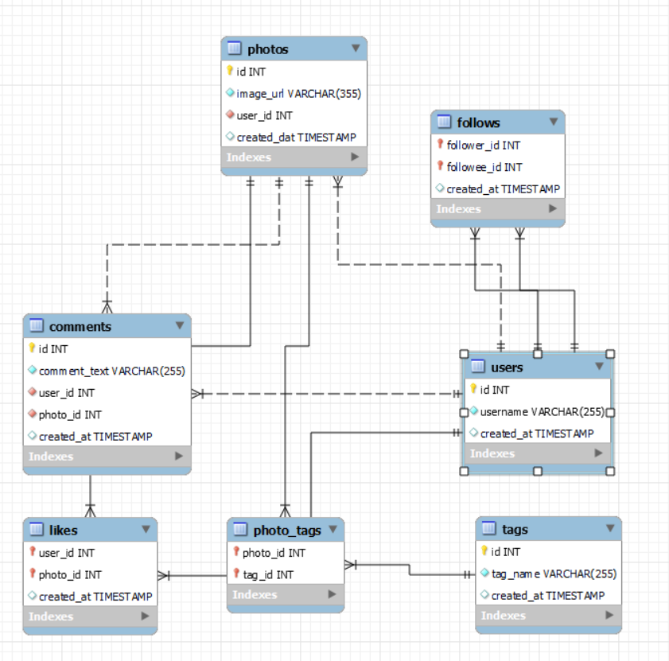
SCHEMA

Slide 5

DATA DESCRIPTION
comments_id : unique identifier for each comment
comment_text : text content of a given comment
user_id : unique identifier for each user
photo_id : unique identifier for each photo
created_at : date of interaction in the form like, photos, tags
follower_id : user_id of the follower for a certain user
followee_id : user_id of followee for a certain user
tag_id : unique identifier for each tag
image_url : link to the image posted on the platform
username : username chosen by the user

Slide 6
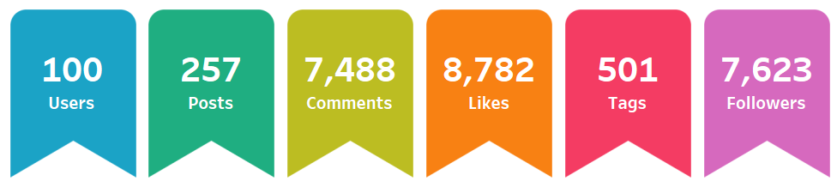
KEY PERFORMANCE INDICATORS (KPIs)
I) OVERALL ACTIVITY SUMMARY
100 Users have generated 257 Posts, averaging ~2.57 posts per user.
7,488 Comments and 8,782 Likes indicate strong interaction, Averaging ~63 interactions per post.
7,623 Followers with 100 active users suggests ~7.6 followers per active user, indicating potential for higher user conversion from passive followers.
501 Tags reflect an effort in content categorization and engagement through tagging.

Slide 7
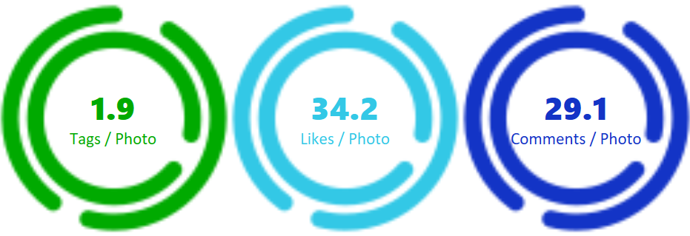
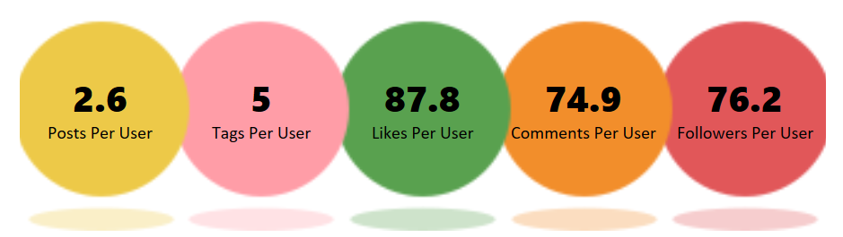
II) PHOTO ENGAGEMENT RATE
III) USER ENGAGEMENT RATE

Slide 8
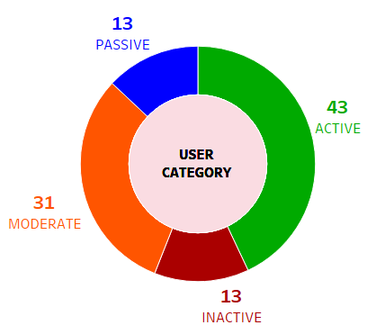
USER CATEGORY
Active Users (43%)
These users contribute significantly to engagement, surpassing the average in photos, likes, and comments.
They are key content creators and influencers in the platform.
-----------------------
Moderate Users (31%)
They engage but at a lower-than-average rate.
There is potential to convert them into highly active users with proper incentives.
-----------------------
Passive Users (13%)
These users do not post but engage by following and reacting to posts.
They prefer consuming content rather than creating it.
-----------------------
Inactive Users (13%)
They neither post nor engage, indicating low platform retention or lack of interest.
A re-engagement strategy is necessary to activate them.

Slide 9
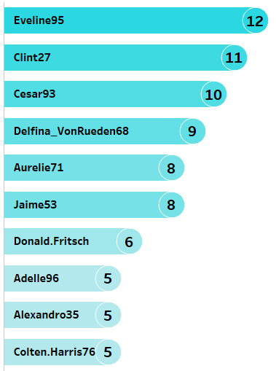
USERS ACTIVELY POSTING
Top Contributors:
Users like Eveline95, Clint27, and Cesar93 are the most active, with 12, 11, and 10 posts, respectively.
Potential Influencers:
The top 3–5 users are highly engaged and can serve as community influencers or ambassadors.
Engagement Drop-off:
There's a noticeable gap after the top 6 users, suggesting that some users might need encouragement to post more.
Suggestions:
Recognize Top Posters: Highlight the top 3 users in a leaderboard, newsletter, or featured post to encourage continued engagement.
Gamify Posting Activity: Introduce badges, levels, or challenges to encourage more participation.

Slide 10
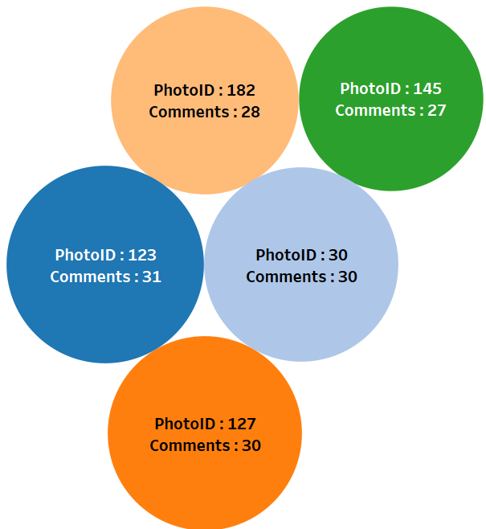
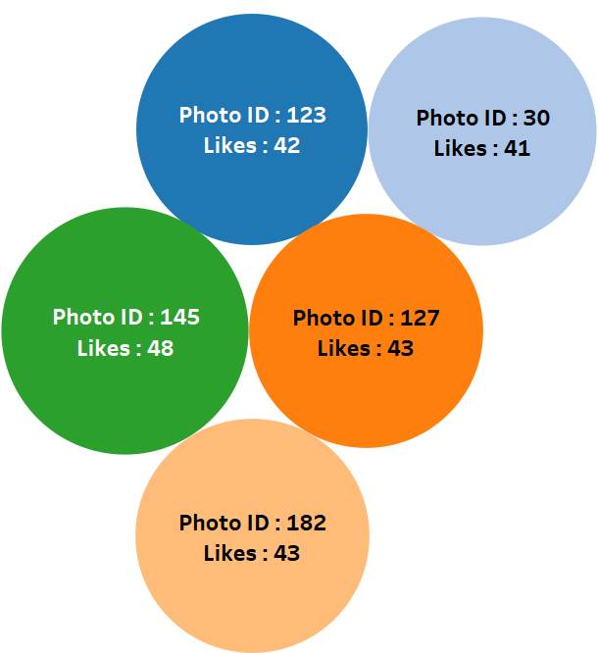
MOST LIKED & COMMENTED
Most Commented Posts:
Photo ID: 123, 30, 127, 182 and 185 have the highest number of Comments among all posts.
Most Liked Posts:
Photo ID: 145, 182, 127, 123 and 30 have the highest number of Likes among all posts.
Suggestion:
Identify the themes, topics, and visuals of these posts to understand why they received high engagement.
If they feature trending topics, emotional appeal, or user-generated content, consider replicating those elements in future posts.
Use questions, polls, or call-to-action captions to drive discussions.Use questions, polls, or call-to-action captions to drive discussions.

Slide 11
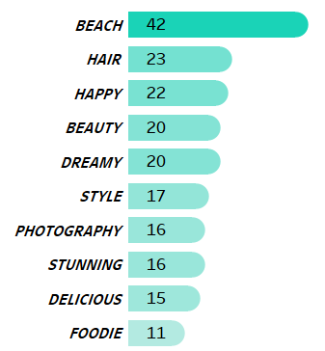
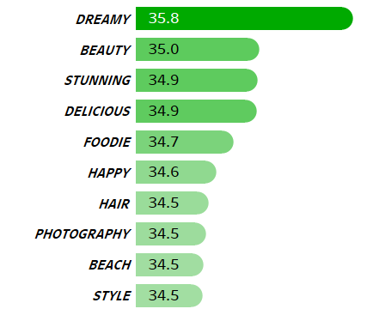
POPULAR HASHTAGS
Most Used Hashtags-
#Beach is the most frequently used hashtag (42 times), followers by (#Hair - 23 times) & (#Happy - 22 times)
This suggests that beach-related content is highly popular among users.
High Engagement Hashtags-
#Dreamy has the highest engagement rate (35.8), despite being used only 20 times.
#Beauty, #Stunning, #Delicious, and #Foodie also have high engagement rates, meaning they resonate well with the audience.
Underutilized but High-Performing Hashtags-
#Dreamy (35.8), #Stunning (34.9), and #Delicious (34.9) have high engagement but are not the most frequently used.
Increasing the use of these hashtags could boost engagement levels further.

Slide 12
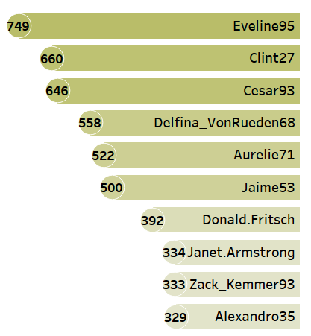
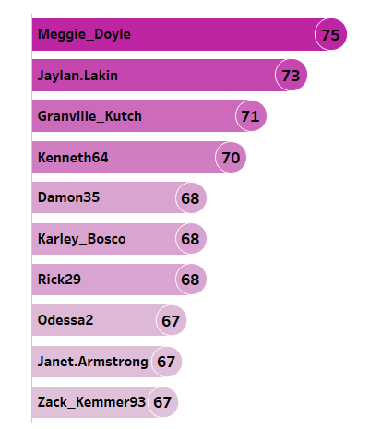
MOST POPULAR VS MOST LOVED
Most Popular
Eveline95 (749), Clint27 (660) & Cesar93 (646) are Strong performers with highest engagement score.
Delfina_VonRueden68 (558), Aurelie71 (522), Donald.Fritsch (392) & Zack_Kemmer93 (333) can be considered as Mid-tier influencers.
These users can be leveraged for community-building or influencer marketing.
--------------------------------------------
Most Loved
Meggie_Doyle (75) & Jaylan.Lakin (73) & Granville_Kutch (71) are most loved users having highest average engagement rates
They could be ideal for brand partnerships or community-driven content efforts.
Encouraging them to post more frequently could drive higher overall platform engagement.

Slide 13

STRATEGIES TO RE-ENGAGE INACTIVE USERS
1. Personalized Email
We Miss You! , Here’s What You’ve Missed!”
Including an easy "One-Click Login" CTA.
Engage users through surveys to understand why they became inactive and address their concerns.
2. Push Notifications
Showcase trending posts, popular discussions, and top users they might know.
Send notifications about friends’ recent activities or anniversaries of their account creation.
3.Related Content
Suggest content, groups, or hashtags they might be interested in based on their past behaviour.
2. Exclusive Incentives & Rewards
Bonus points, badges, or exclusive features for logging in and interacting.
A streak-based reward system for continued activity (e.g., post for 3 days & unlock a reward).

Slide 14
USER EXPANSION & RETENTION STRATEGIES
1. Referral & Incentive Programs
Introduce a “Invite & Earn” program where users get rewards for bringing in new members.
Offer bonus points, badges, exclusive content, or discounts for successful referrals.
2. Targeted Promotions
Run Facebook, Instagram, and Google ads targeting relevant audiences.
Use lookalike audiences (people similar to your active users).
3. Community & Social Incentives
Showcase Top Contributors in newsletters, blogs, or social media.
Achievement badges for consistent engagement (e.g., “Super Contributor,” “Top Commenter”).
Invite to Special Events like webinars, Access to VIP events or networking opportunities.
Early access to new features for top contributors.
4. Monetary Rewards
Cash Rewards or Gift Cards for top contributors or frequent users.
Swag & Merchandise – Branded gifts, T-shirts, stickers, or personalized items.

Slide 15
STRATEGIES TO BOOST ENGAGEMENT AND INTERACTIONS
1. Gamification & Incentives
Gamify Activity: Introduce badges, levels, or challenges to encourage participation.
Point-based rewards (points for likes/comments that can be redeemed for perks).
Achievement badges for consistent engagement ( “Super Contributor,” “Top Commenter”).
2. Community Engagement & Interaction
Community Interaction: Encourage top users to start discussions, reply to others, or moderate content.
Create question-based captions, discussion threads, or comment contests to foster interaction.
Use questions, polls, or call-to-action captions to drive discussions.
Encouraging users to tag friends in posts to further drive visibility and engagement.
3. Content Strategy & Trend Utilization
Identify Trends: Analyze topics, hashtags, or content types to understand what drives engagement.
Encourage more use of high-engagement hashtags to maximize reach.
Offer exclusive content, Q&A sessions or giveaways through influencers.
Promote collaborations with influencers to expand reach.

Slide 16

CONCLUSION
Meggie_Doyle & Jaylan.Lakin & Granville_Kutch are the most loved users having the highest average engagement rates.
Eveline95 , Clint27 & Cesar93 are Strong performers with highest engagement scores. Encouraging such users to post more frequently could drive higher overall platform engagement.
These users can be leveraged for community-building or influencer marketing.
And they could be ideal for brand partnerships or community-driven content efforts.
#Dreamy, #Beauty, #Stunning, #Delicious, and #Foodie are the most popular hashtags. Increasing the use of these hashtags could boost engagement levels.
13% users are inactive, they neither post nor engage, indicating low platform retention or lack of interest. A re-engagement strategy is necessary to activate them.
Introduce “Invite & Earn” program where users get rewards for bringing in new members.
Gamifying activity & community Engagement programs can boost user engagement.
Rewards and Incentives will help in user retention and loyalty.
Utilizing trends and viral topics will help in expanding the meta community.

Slide 17
THANK YOU

