Slide 1
From App Parts and classic web parts to modern SharePoint Framework web parts
Paolo Pialorsi – @PaoloPia
Solution Architect @ PiaSys.com

Slide 2
Upgrading App Parts to modern Web Parts
SharePoint Add-in model App Parts
JavaScript + JavaScript Object Model + jQuery
HTML + CSS
Client-side Web Part with SPFx
TypeScript (+ React)
Fluent UI
Microsoft Graph Toolkit

Slide 3
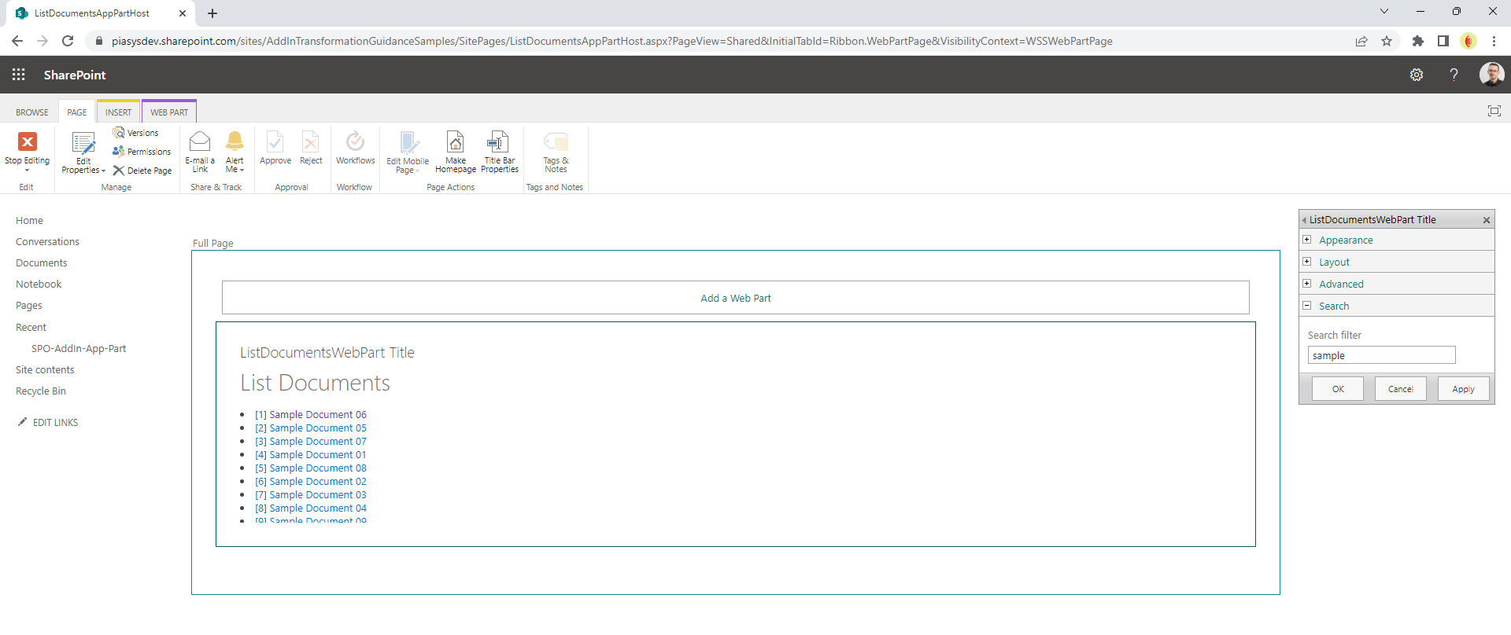
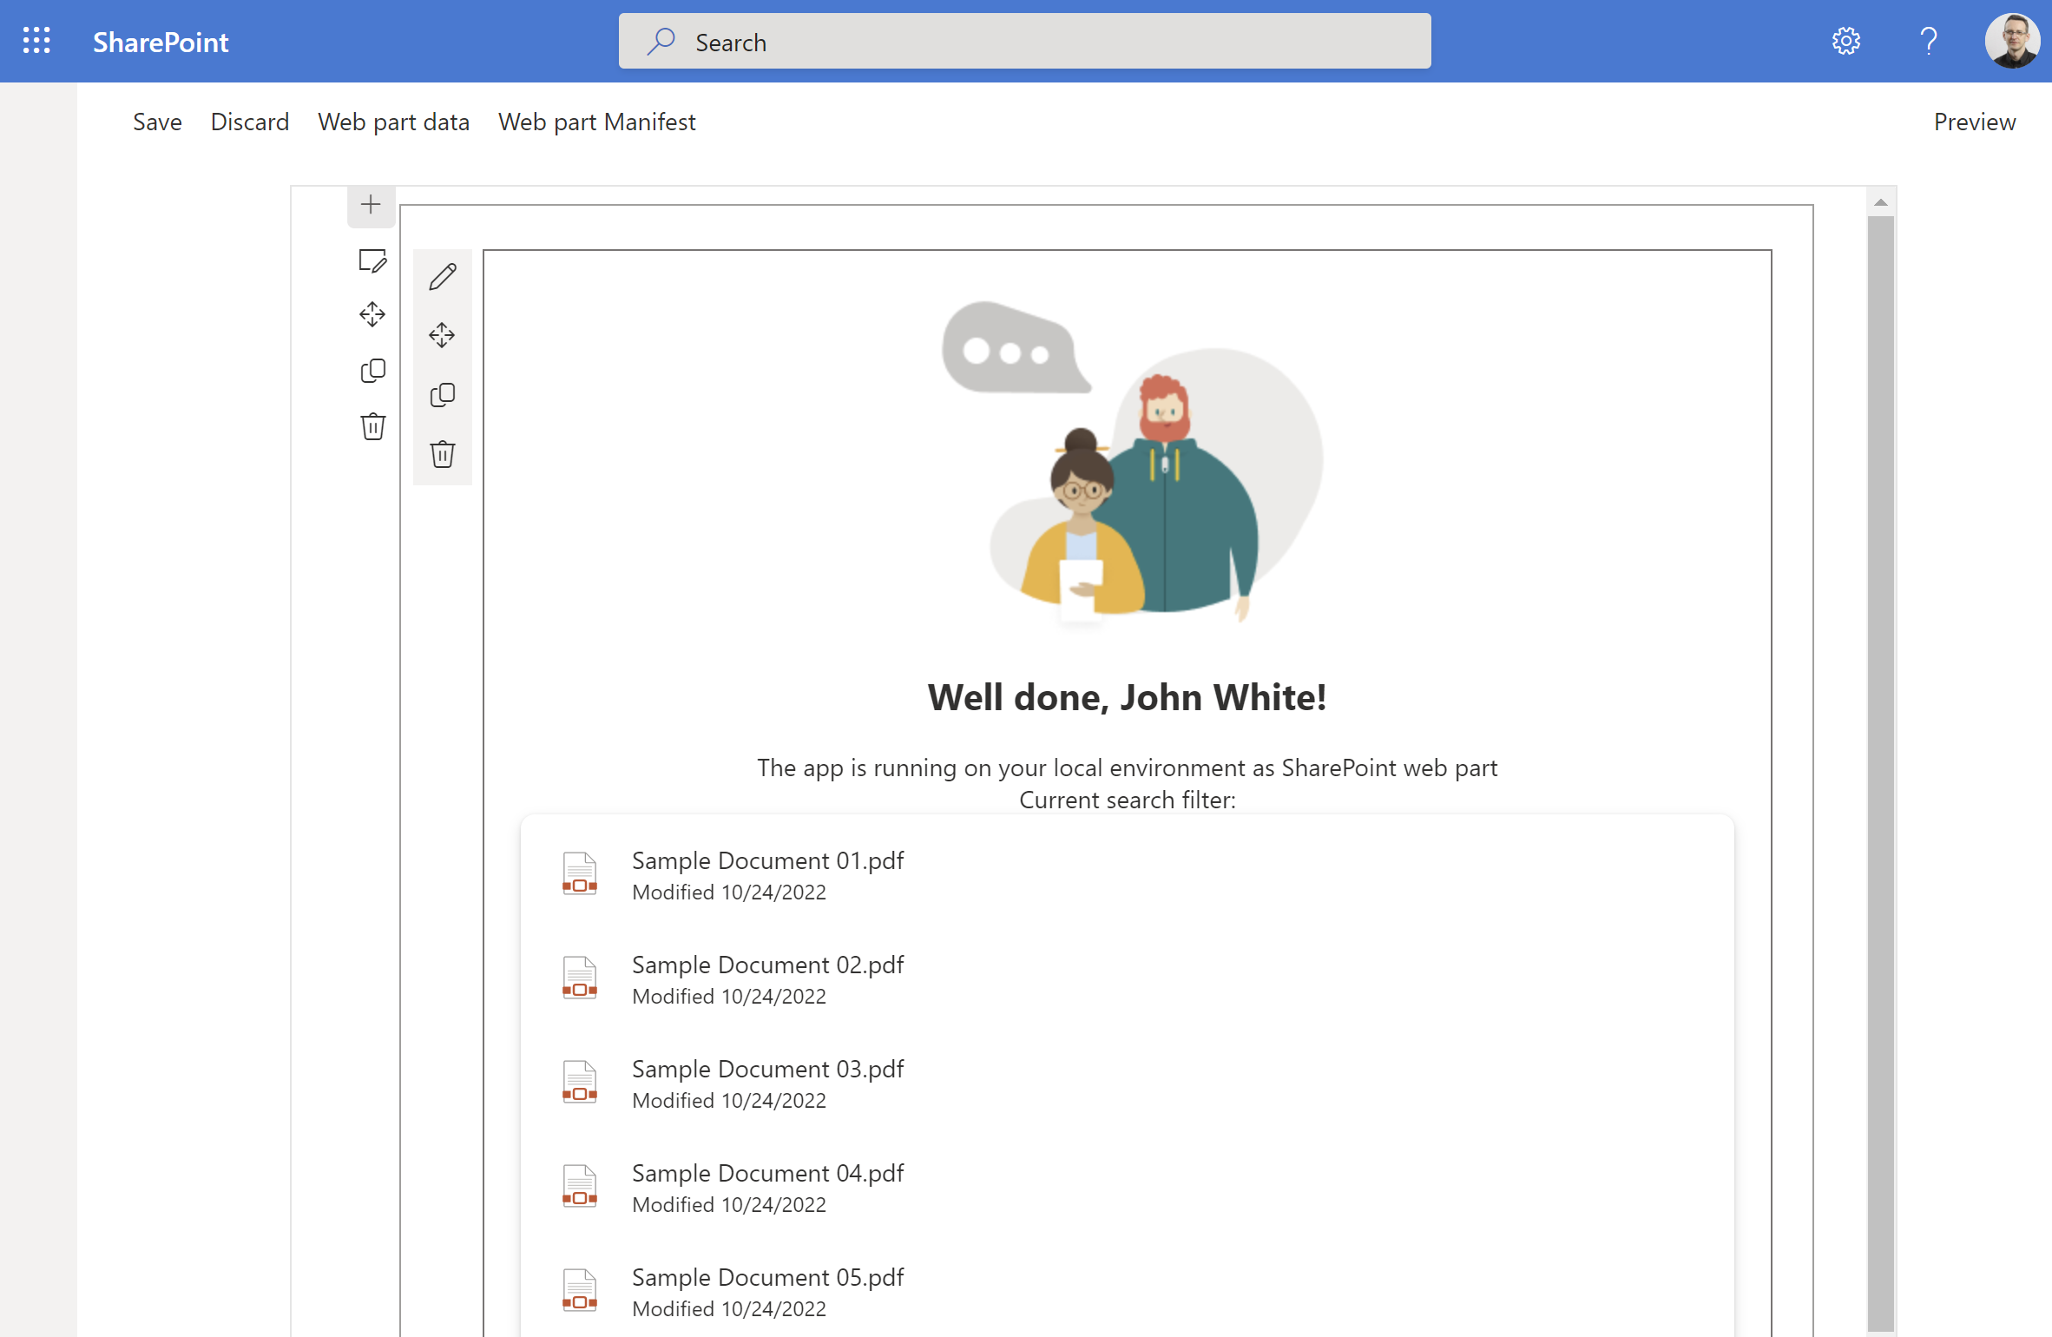
Use case: listing documents in a library

Slide 4
From App Parts to modern Web Parts
There is no conversion tool
Technologies are different
Languages are different
The modern world is more powerful
Create a new SPFx Web Part
Choose to use React for better UI and reusable components
Rely on Microsoft Graph Toolkit to speed up development and maintenance

Slide 5
DEMO
From App Parts and classic web parts to modern SharePoint Framework web parts

Slide 6
Useful links
https://learn.microsoft.com/en-us/sharepoint/dev/spfx/set-up-your-development-environment
https://learn.microsoft.com/en-us/sharepoint/dev/spfx/web-parts/get-started/build-a-hello-world-web-part
https://learn.microsoft.com/en-us/graph/toolkit/overview
https://learn.microsoft.com/en-us/graph/toolkit/components/file-list

Slide 7
Thank you!

