Slide 1
From App Parts and classic web parts to modern SharePoint Framework web parts
Paolo Pialorsi – @PaoloPia
Solution Architect @ PiaSys.com

Slide 2
Upgrading App Parts to modern Web Parts
SharePoint Add-in model App Parts
JavaScript + JavaScript Object Model + jQuery
HTML + CSS
Client-side Web Part with SPFx
TypeScript (+ React)
Fluent UI
Microsoft Graph Toolkit
You better upgrade from ACS to AAD
AAD registered applications are modern and more secure
Can target multiple tenants with just one registration
You can also leverage Resource Specific Consent (RSC) for better granularity of permissions

Slide 3
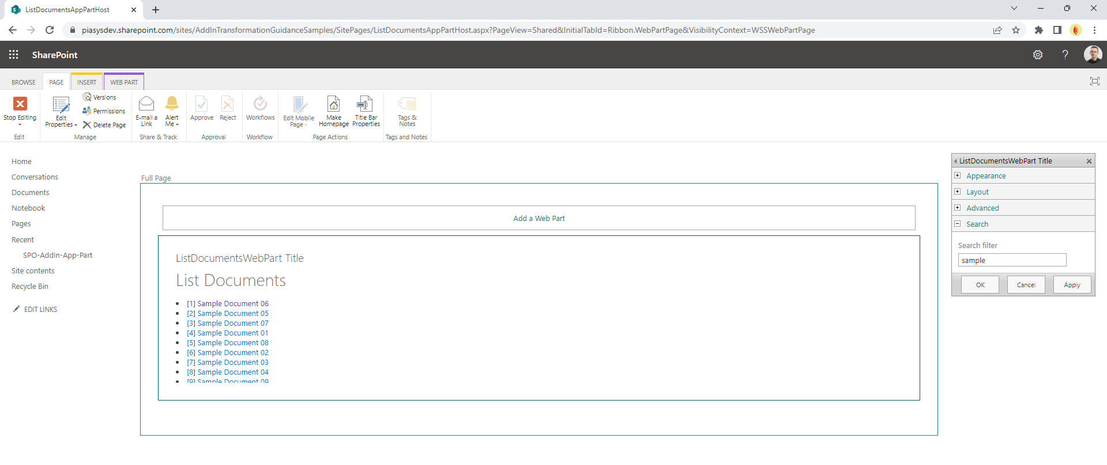
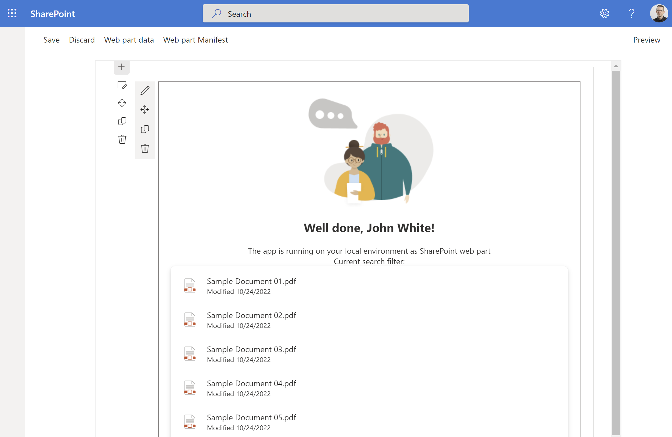
Use case: listing documents in a library

Slide 4
From App Parts to modern Web Parts
There is no conversion tool
Technologies are different
Languages are different
The modern world is more powerful
Create a new SPFx Web Part
Choose to use React for better UI and reusable components
Rely on Microsoft Graph Toolkit to speed up development and maintenance

Slide 5
DEMO
From App Parts and classic web parts to modern SharePoint Framework web parts

Slide 6
Useful links
https://learn.microsoft.com/en-us/sharepoint/dev/spfx/set-up-your-development-environment
https://learn.microsoft.com/en-us/sharepoint/dev/spfx/web-parts/get-started/build-a-hello-world-web-part
https://learn.microsoft.com/en-us/graph/toolkit/overview
https://learn.microsoft.com/en-us/graph/toolkit/components/file-list

Slide 7
Thank you!

