Slide 1
From UI Extensions to SharePoint Framework List View Command Sets
Paolo Pialorsi – @PaoloPia
Solution Architect @ PiaSys.com

Slide 2
Converting an UI Extension to SPFx
SharePoint Add-in model UI Extensions
Command bar buttons
ECB (Edit Control Block) menu items
SharePoint Framework Extensions
ListView Command Set
You can rely on additional components
React
Fluent UI
Microsoft Graph Toolkit

Slide 3
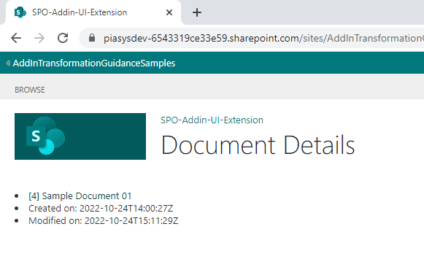
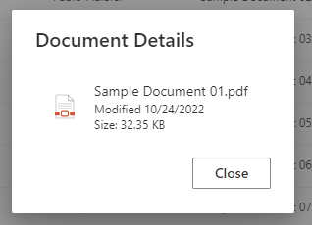
Use case: show document details

Slide 4
How to transform the solution?
Create an SPFx solution
Extension
ListView Command Set
Replace client-side JavaScript
With TypeScript + SPFx dialog window
Use Microsoft Graph Toolkit in the dialog window

Slide 5
DEMO
From UI Extensions to SharePoint Framework List View Command Sets

Slide 6
Useful links
https://learn.microsoft.com/en-us/sharepoint/dev/spfx/extensions/get-started/building-simple-cmdset-with-dialog-api
https://learn.microsoft.com/en-us/sharepoint/dev/spfx/extensions/guidance/using-custom-dialogs-with-spfx

Slide 7
Thank you!

