Slide 1
A Survey on SGX Enclave Privileged Side-Channel Attacks
Amin Fallahi
Ph.D. Student
MAY 14, 2018
Department of Electrical Engineering and Computer Science

Slide 2
Contents
Introduction
Attacks
Defenses
Analysis
Conclusion
Department of Electrical Engineering and Computer Science

Slide 3
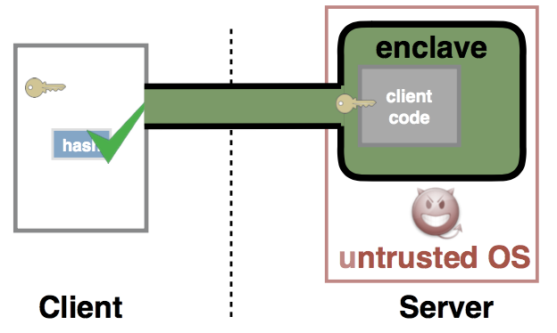
Introduction
Computing environment
Shared resources executing user programs
Security inside the cloud
A hardware solution needed
Intel SGX
Secure user code and data in the public cloud
Protecting data inside the enclave
Privileged Operating System
Kernel space, hardware control
Department of Electrical Engineering and Computer Science

Slide 4
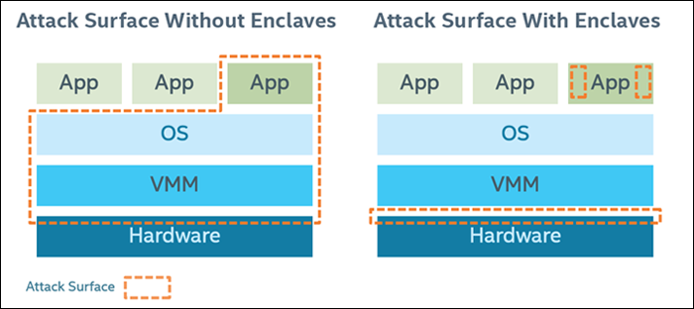
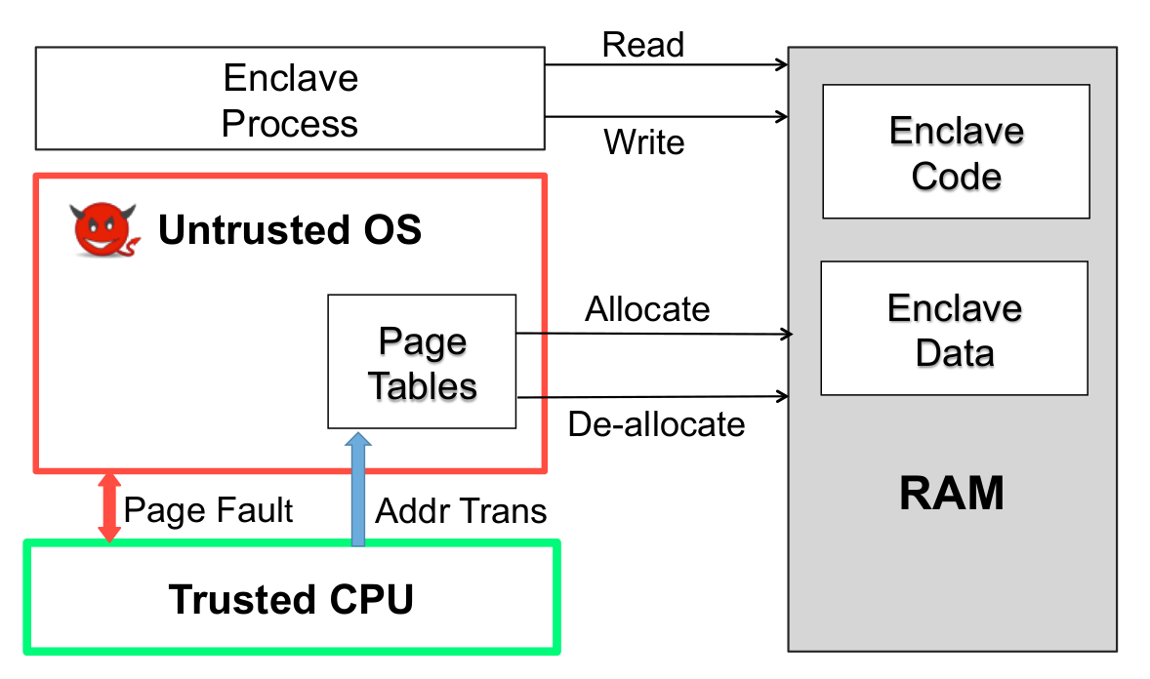
Introduction
Side-Channels
Attacks by analyzing system behavior
Cache attacks: Monitoring cache accesses
Timing attacks: Measuring time between computations
Page-fault attack: Monitoring page-faults and analyzing the pattern
Department of Electrical Engineering and Computer Science

Slide 5
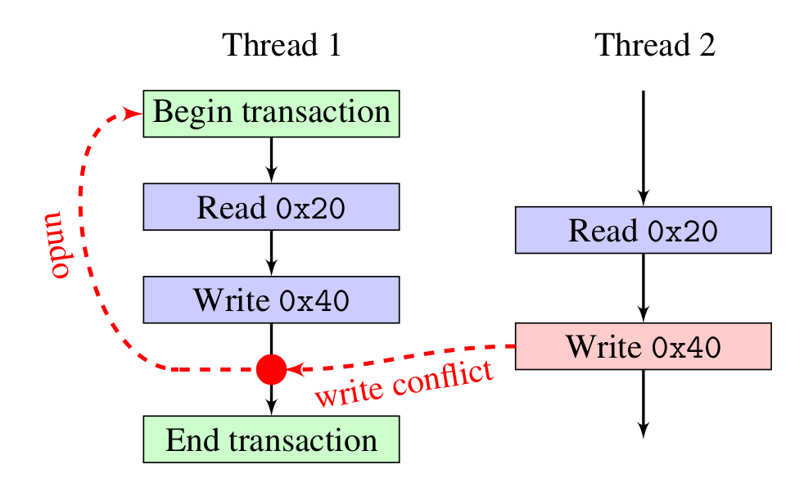
Introduction
Intel TSX
Introduced with Haswell
Critical sections management
Monitoring serialization
Restricted Transactional Memory
New Instruction set interface
Department of Electrical Engineering and Computer Science

Slide 6
Attacks
Attack Model
Enclave protected by SGX
No stranger has the key
Operating System can manage task queues, interrupts, and exceptions
Viewing data transfer between memories and caches
Program pinned to one core, no excessive interrupts, isolated
Department of Electrical Engineering and Computer Science

Slide 7
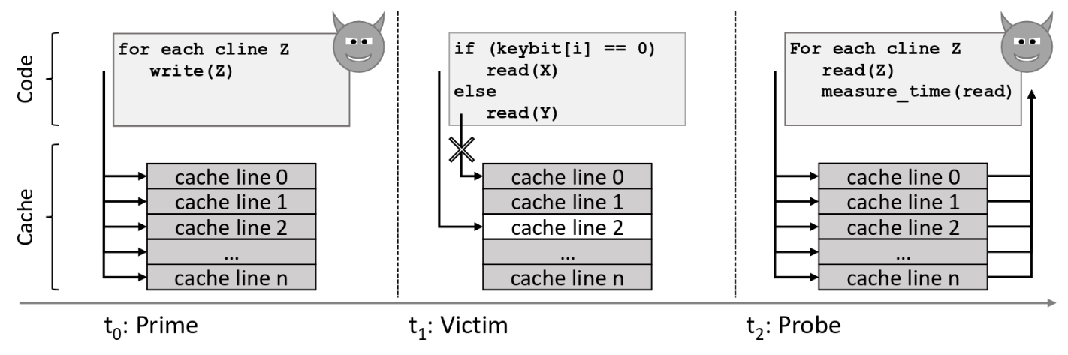
Attacks
Cache-Based Attacks
Intentional Cache-Misses ⇨ Make program access memory
Time, trace, access patterns
Prime+Probe
Prime: attacker executes conflicting cache lines ⇨ cache miss
Probe: executing all the cache lines and measuring execution time
Department of Electrical Engineering and Computer Science

Slide 8
Attacks
Cache-Based Attacks
Intentional Cache-Misses ⇨ Make program access memory
Time, trace, access patterns
Prime+Probe
Prime: attacker executes conflicting cache lines ⇨ cache miss
Probe: executing all the cache lines and measuring execution time
Department of Electrical Engineering and Computer Science

Slide 9
Attacks
Points of attack
TLB: shared between enclave and non-enclave programs ⇨ with hyperthreading enabled it creates side-channels
Page faults: visible to OS
TLB flushes: on context switch
Page table entry flags
Enclave memory address beginning and offset are known
Enclave exits (AEX)
Department of Electrical Engineering and Computer Science

Slide 10
Attacks
Prime+Probe
Department of Electrical Engineering and Computer Science

Slide 11
Attacks
Flush+Reload
Flush target memory line
Wait for the victim to access
Request to access target memory line ⇨ access time
Based on the access time, access by the victim will be revealed
if (secret) {
;
} else {
;
}
Department of Electrical Engineering and Computer Science

Slide 12
Attacks
Stealthy page table based attacks
Introduced by Van Bulck et al.
Basic page-fault attack:
OS controls page tables
Sets trap by making pages inaccessible
Observe page-fault patterns
Or simply monitor certain pages and cause page-faults
Page table entry flags
Accessed and dirty flags
Department of Electrical Engineering and Computer Science

Slide 13
Attacks
Sneaky page monitoring attacks
Introduced by Wang et al.
Accessed flags monitoring
Flags in TLB are not updated
Flush the TLB (by IPI)
Timing enhancement
Only one interrupt ⇨ better performance
Measure the time between two repeatedly accessed entries
TLB flushing through hyperthreading
TLB is shared between hyperthreads
Invalidate TLB entries without IPI
Department of Electrical Engineering and Computer Science

Slide 14
Attacks
DRAMA
Disable caching
Prevent cache based side channel attacks
Attacker allocates two memory lines inside one bank
Regularly access one of the memory lines
Victim accesses the other memory line ⇨ conflict ⇨ attacker’s next fetch will take more time
Cache-DRAM attack: Prime+Probe and DRAMA
Department of Electrical Engineering and Computer Science

Slide 15
Attacks
Flush+Flush
clflush instruction: flush a cache line, if empty ⇨ abort
Abort takes less time than flush
Use the delay ⇨ which memory address is accessed
Department of Electrical Engineering and Computer Science

Slide 16
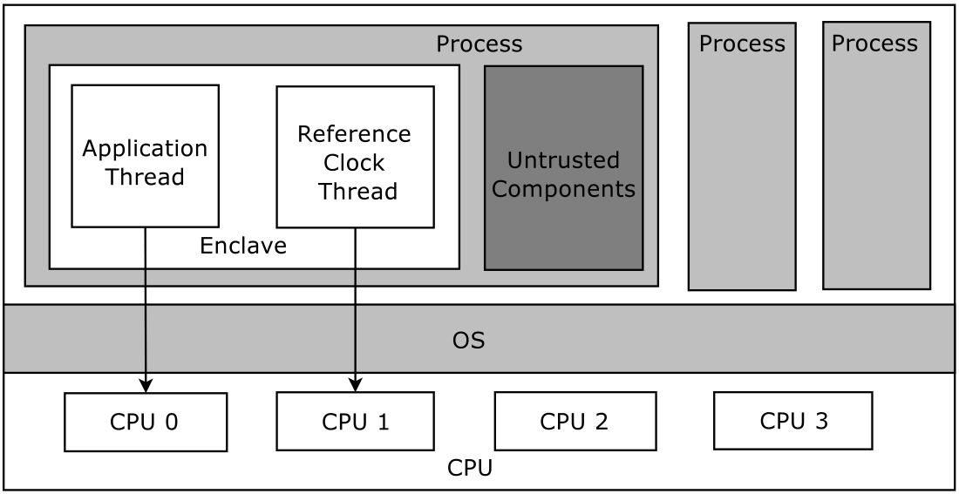
Defenses
Déjà vu
Embed a clock inside enclave
Protect the clock inside TSX transaction
Record regular execution time
Time runs out ⇨ AEX instability ⇨ attack detected
Shinde et al.
Deterministic page access profile
Fake accesses
Department of Electrical Engineering and Computer Science

Slide 17
Defenses
T-SGX
CPU does not deliver page-fault to the OS
Abort transaction and run the fallback code
Lots of aborts
Break into execution blocks
Cloak
Pin data in cache: Not supported by hardware
Preload code/data in transaction and run the algorithm
SGX-Shield
Address space layout randomization (ASLR)
Secure in enclave loading
Limited memory ⇨ small randomization entropy ⇨ brute force attacks
Department of Electrical Engineering and Computer Science

Slide 18
Analysis
Cloak
Makes cache-pinning possible to some extent
Execution time can leak
Aborts do not cancel concurrent memory accesses
Execution behavior and branch prediction uncertainties
T-SGX
Attacks based on monitoring flags are possible
Department of Electrical Engineering and Computer Science

Slide 19
Analysis
Déjà vu
Sneaky page monitoring attacks still effective
Only works on AEX based attacks
Bottom line
Transaction based defenses usually come with high overload and low utilization
Department of Electrical Engineering and Computer Science

Slide 20
Analysis
SGX-Shield
No live randomization ⇨ observe and monitor random patterns
Shinde et al.
Cache and TLB based attacks possible
Department of Electrical Engineering and Computer Science

Slide 21
Analysis
Other methods
Attack detection methods ⇨ Unreliable
Shuffling memory ⇨ expensive
ORAM (make addresses input-independent) ⇨ expensive
The perfect solution?
Remove all branches and conditional code
Pin data/code to cache and TLB
Department of Electrical Engineering and Computer Science

Slide 22
Conclusion
We studied multiple attacks and defenses
Still no robust defense
Attack are emerging
Open to research
Department of Electrical Engineering and Computer Science

Slide 23
References
[1] Ferdinand Brasser, Srdjan Capkun, Alexandra Dmitrienko, Tommaso Frassetto, Kari Kostiainen, Urs Mu¨ller, and Ahmad-Reza Sadeghi. 2017. DR. SGX: Hardening SGX Enclaves against Cache Attacks with Data Location Randomization. arXiv preprint arXiv:1709.09917 (2017). [2] Ferdinand Brasser, Urs Mu¨ller, Alexandra Dmitrienko, Kari Kostiainen, Srdjan Capkun, and AhmadReza Sadeghi. 2017. Software grand exposure: SGX cache attacks are practical. arXiv preprint arXiv:1702.07521 (2017), 33. [3] Sanchuan Chen, Xiaokuan Zhang, Michael K Reiter, and Yinqian Zhang. 2017. Detecting privileged side-channel attacks in shielded execution with D´ej´a Vu. In Proceedings of the 2017 ACM on Asia Conference on Computer and Communications Security. ACM, 7–18. [4] Oded Goldreich. 1987. Towards a theory of software protection and simulation by oblivious RAMs. In Proceedings of the nineteenth annual ACM symposium on Theory of computing. ACM, 182–194. [5] Oded Goldreich and Rafail Ostrovsky. 1996. Software protection and simulation on oblivious RAMs. Journal of the ACM (JACM) 43, 3 (1996), 431–473. [6] Daniel Gruss, Julian Lettner, Felix Schuster, Olya Ohrimenko, Istvan Haller, and Manuel Costa. 2017. Strong and efficient cache side-channel protection using hardware transactional memory. In USENIX Security Symposium. [7] Daniel Gruss, Cl´ementine Maurice, Klaus Wagner, and Stefan Mangard. 2016. Flush+ Flush: a fast and stealthy cache attack. In International Conference on Detection of Intrusions and Malware, and Vulnerability Assessment. Springer, 279–299. [8] Mehmet Kayaalp, Nael Abu-Ghazaleh, Dmitry Ponomarev, and Aamer Jaleel. 2016. A high-resolution side-channel attack on last-level cache. In Proceedings of the 53rd Annual Design Automation Conference. ACM, 72. [9] Rafail Ostrovsky. 1990. Efficient computation on oblivious RAMs. In Proceedings of the twenty-second annual ACM symposium on Theory of computing. ACM, 514–523. [10] Dag Arne Osvik, Adi Shamir, and Eran Tromer. 2006. Cache attacks and countermeasures: the case of AES. In Cryptographers’ Track at the RSA Conference. Springer, 1–20. [11] Peter Pessl, Daniel Gruss, Cl´ementine Maurice, Michael Schwarz, and Stefan Mangard. 2016. DRAMA: Exploiting DRAM Addressing for Cross-CPU Attacks.. In USENIX Security Symposium. 565–581. [12] Sajin Sasy, Sergey Gorbunov, and Christopher Fletcher. 2017. ZeroTrace: Oblivious memory primitives from Intel SGX. In Symposium on Network and Distributed System Security (NDSS). [13] Jaebaek Seo, Byounyoung Lee, Seongmin Kim, Ming-Wei Shih, Insik Shin, Dongsu Han, and Taesoo Kim. 2017. SGX-Shield: Enabling address space layout randomization for SGX programs. In Proceedings of the 2017 Annual Network and Distributed System Security Symposium (NDSS), San Diego, CA. [14] Ming-Wei Shih, Sangho Lee, Taesoo Kim, and Marcus Peinado. 2017. T-SGX: Eradicating controlledchannel attacks against enclave programs. In Proceedings of the 2017 Annual Network and Distributed System Security Symposium (NDSS), San Diego, CA. [15] Shweta Shinde, Zheng Leong Chua, Viswesh Narayanan, and Prateek Saxena. 2015. Preventing your faults from telling your secrets: Defenses against pigeonhole attacks. arXiv preprint arXiv:1506.04832 (2015). [16] Eran Tromer, Dag Arne Osvik, and Adi Shamir. 2010. Efficient cache attacks on AES, and countermeasures. Journal of Cryptology 23, 1 (2010), 37–71. [17] Jo Van Bulck, Nico Weichbrodt, Ru¨diger Kapitza, Frank Piessens, and Raoul Strackx. 2017. Telling your secrets without page faults: Stealthy page table-based attacks on enclaved execution. In Proceedings of the 26th USENIX Security Symposium. USENIX Association. [18] Wenhao Wang, Guoxing Chen, Xiaorui Pan, Yinqian Zhang, Xiaofeng Wang, Vincent Bindschaedler, Haixu Tang, and Carl A. Gunter. 2017. Leaky Cauldron on the Dark Land: Understanding Memory Side-Channel Hazards in SGX. 2421–2434. [19] Yuval Yarom and Katrina Falkner. 2014. FLUSH+ RELOAD: A High Resolution, Low Noise, L3 Cache Side-Channel Attack.. In USENIX Security Symposium
Department of Electrical Engineering and Computer Science

Slide 24
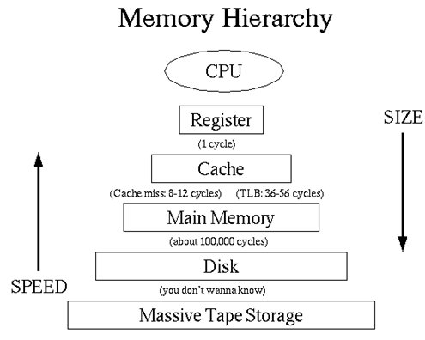
Introduction

Slide 25
Defenses
SGX-Shield
Address space layout randomization
ORAM+SGX
Data shuffling

