Slide 1
A Survey on SGX Enclave Privileged Side-Channel Attacks
Amin Fallahi
Ph.D. Student
MAY 14, 2018
Department of Electrical Engineering and Computer Science

Slide 2
Contents
Introduction
Attacks
Defenses
Analysis
Conclusion
Department of Electrical Engineering and Computer Science

Slide 3
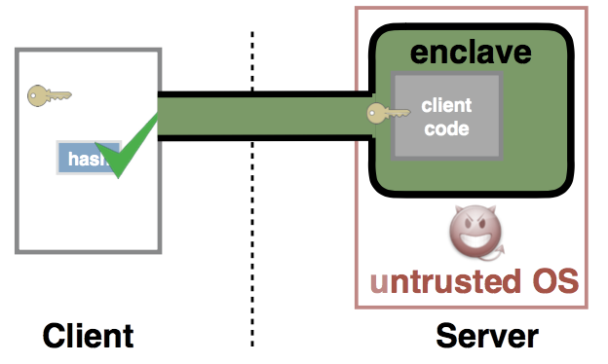
Introduction
Computing environment
Shared resources executing user programs
Security inside the cloud
A hardware solution needed
Intel SGX
Secure user code and data in the public cloud
Protecting data inside the enclave
Privileged Operating System
Kernel space, hardware control
Department of Electrical Engineering and Computer Science

Slide 4
Introduction
Intel SGX
17 new instructions
Enclave created by OS
Contiguous physical memory
Base address randomly assigned from EPC
Hardware level memory encryption engine
Virtual to physical address translation done by OS
Interrupt ⇨ context switch – AEX
ECALLs & OCALLs
Department of Electrical Engineering and Computer Science

Slide 5
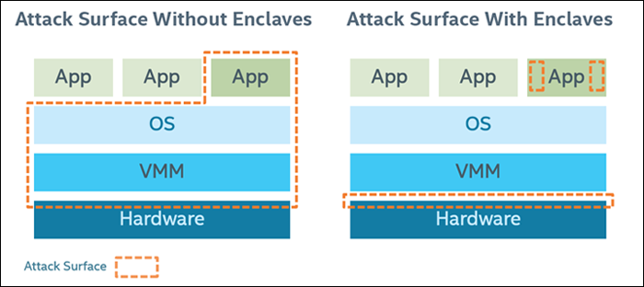
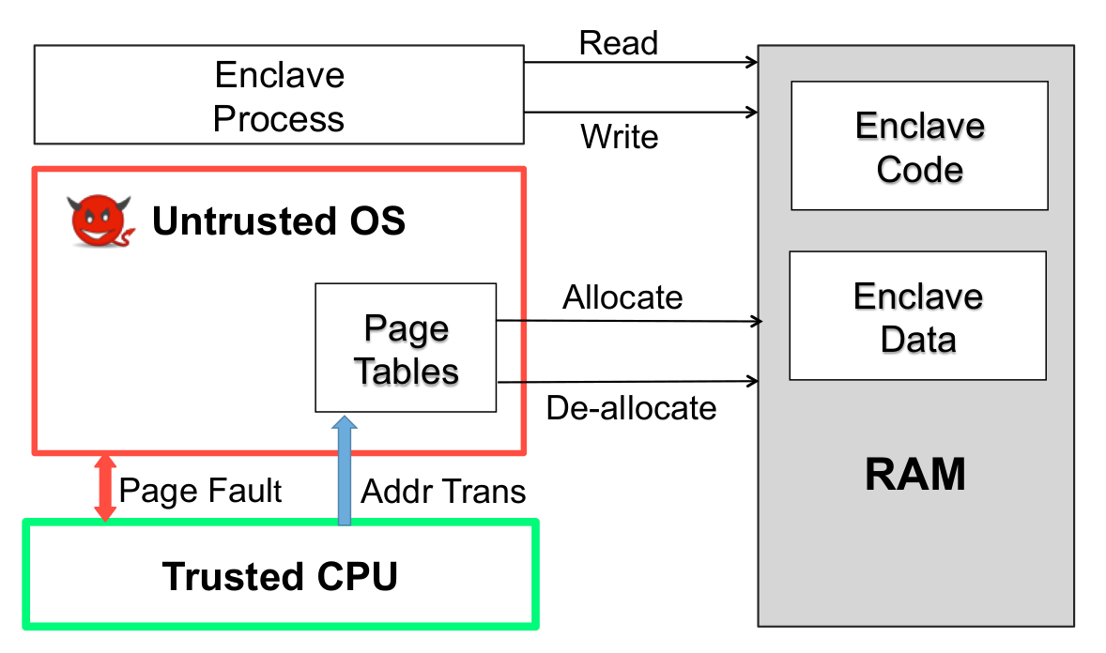
Introduction
Side-Channels
Attacks by analyzing system behavior
Cache attacks: Monitoring cache accesses
Timing attacks: Measuring time between computations
Page-fault attack: Monitoring page-faults and analyzing the pattern
Attack Model
Enclave protected by SGX
No stranger has the key
Operating System can manage task queues, interrupts, and exceptions
Viewing data transfer between memories
Program pinned to one core, no excessive interrupts, isolated
Department of Electrical Engineering and Computer Science

Slide 6
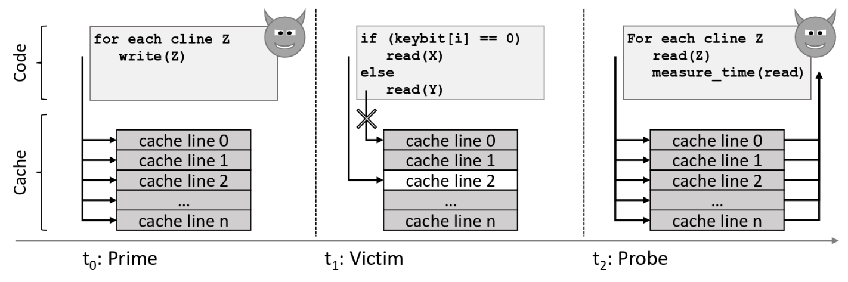
Attacks
Cache-Based Attacks
Intentional Cache-Misses ⇨ Make program access memory
Time, trace, access patterns
Prime+Probe
Prime: attacker executes conflicting cache lines ⇨ cache miss
Probe: executing all the cache lines and measuring execution time
Department of Electrical Engineering and Computer Science

Slide 7
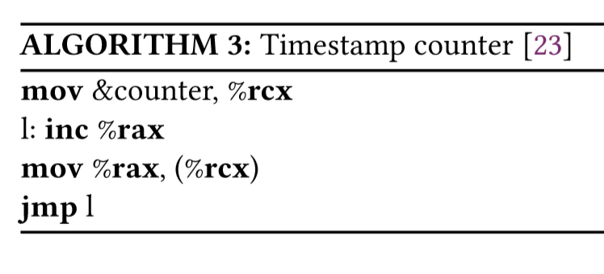
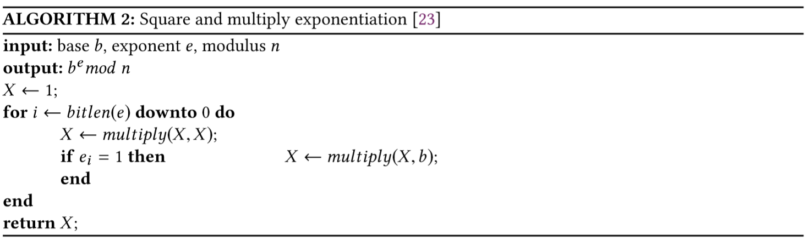
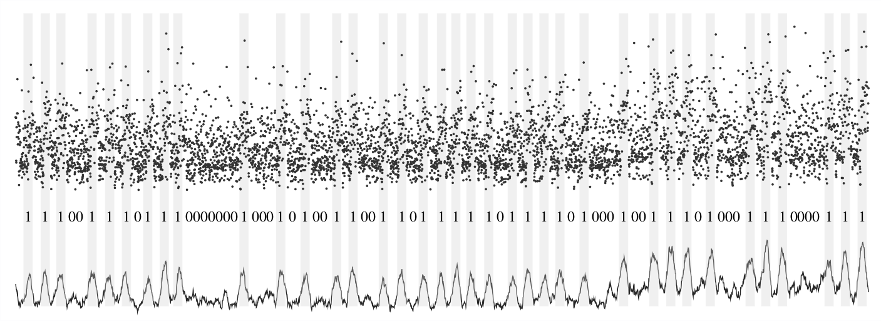
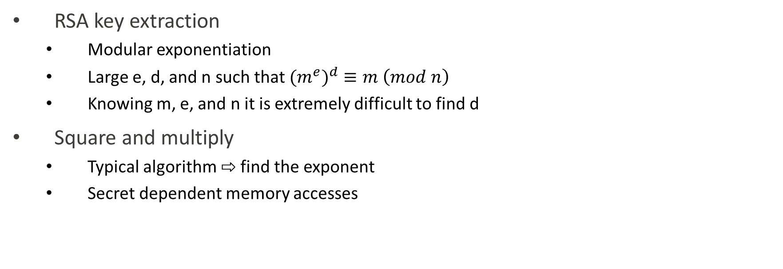
Attacks
Cache-Based Attacks
RSA key extraction
Modular exponentiation
Large e, d, and n such that ${{(m}^{e})}^{d}≡m \left(mod n\right)$
Knowing m, e, and n it is extremely difficult to find d
Square and multiply
Typical algorithm ⇨ find the exponent
Secret dependent memory accesses
Department of Electrical Engineering and Computer Science

Slide 8
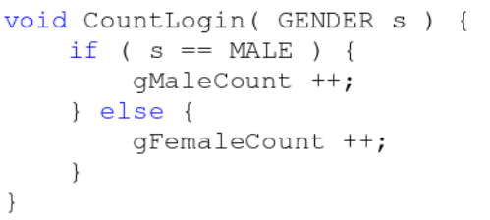
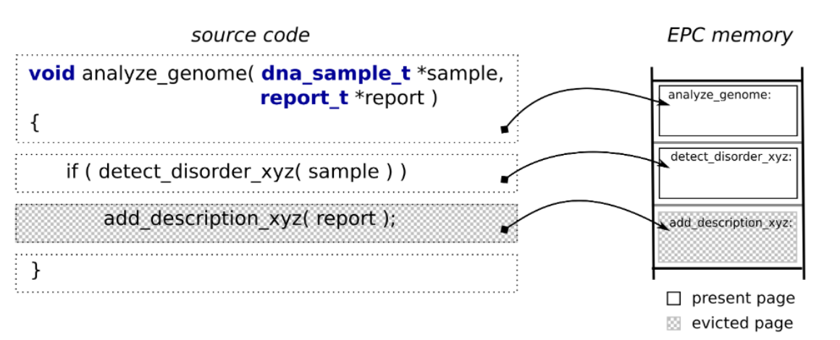
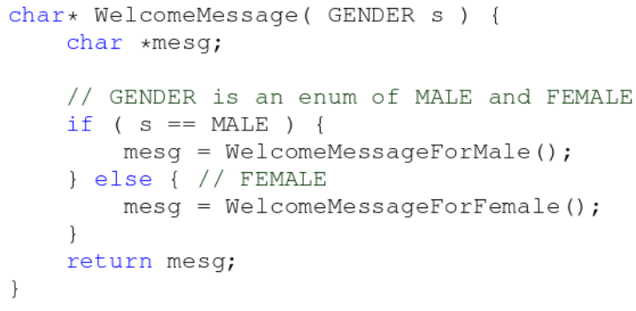
Attacks
Page Table Based Attacks
Basic page-fault attack
AEX on fault ⇨ base address of faulting page revealed
Cause intentional page faults ⇨ obtain page level trace
Monitor a specific page
Department of Electrical Engineering and Computer Science

Slide 9
Attacks
Page Table Based Attacks
Problem: page-faults cause a high overhead => attack detection
Solution: Use page-table access and dirty bits
Problem: TLB caches PTEs and flags are not updated in PT
Solution: Flush TLB using an IPI
Problem: Lots of IPIs
Solution: Time difference between two repeatedly accessed pages ⇨ different input dependent paths between pages ⇨ no interrupts between two pages
Problem: Still interrupts!
Solution: TLB is shared between two hyperthreads on same core ⇨ invalidate TLB entries ⇨ no IPIs
Department of Electrical Engineering and Computer Science

Slide 10
Attacks
Other Attacks
Flush+Reload
Flush a memory line and wait for victim to access it
Flush+Flush
Flush a cache line using clflush instruction
DRAMA
Caching disabled
Allocate two memory lines with different virtual addresses but same physical address
Regularly access one of the memory lines
Cache-DRAM
Prime+Probe + DRAMA
Department of Electrical Engineering and Computer Science

Slide 11
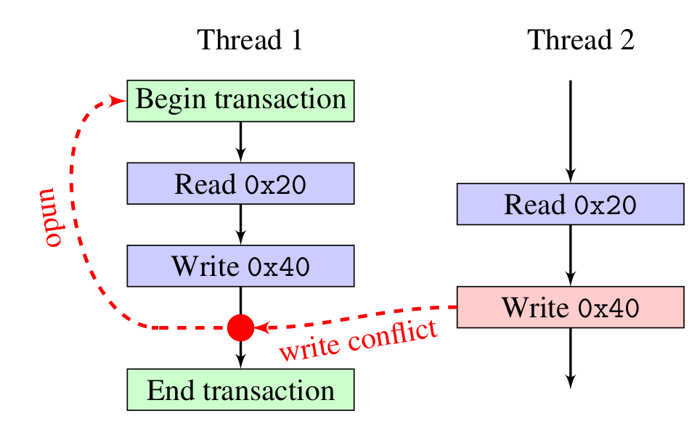
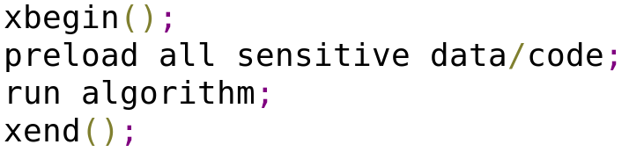
Defenses
Defense against cache-based attacks
Basic approach: Pin code/data to cache
Using Intel TSX
Introduced with Haswell
Critical sections management
Monitoring serialization
Restricted Transactional Memory
New Instruction set interface
Cloak
Preload code/data
Execute algorithm inside transaction
Department of Electrical Engineering and Computer Science

Slide 12
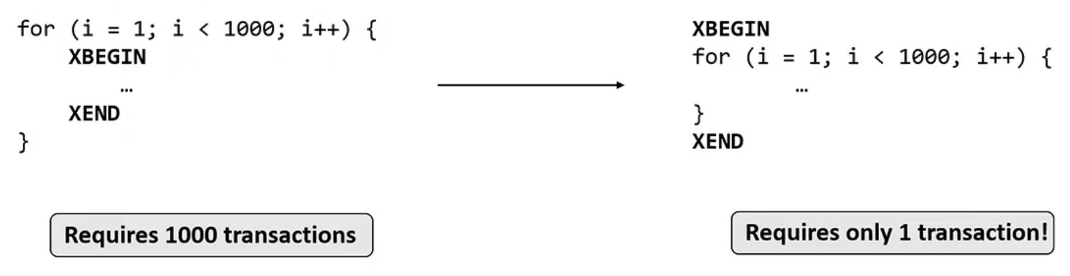
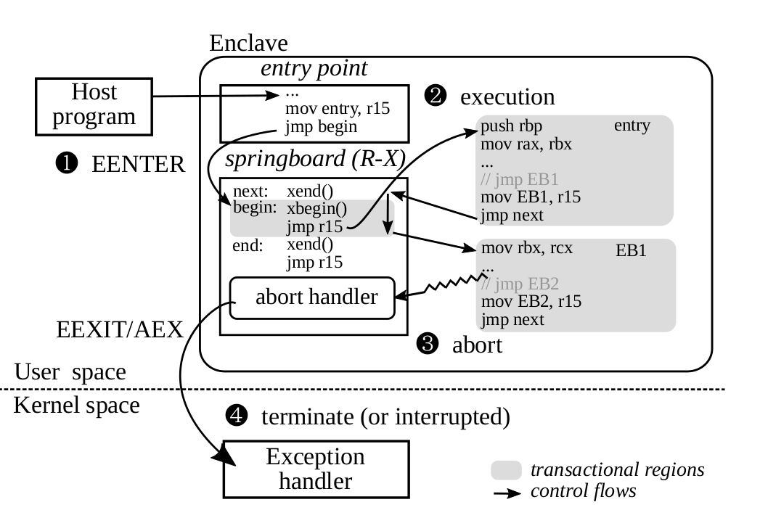
Defenses
Defense against page table based attacks
T-SGX: run code inside transaction => page fault => attack detection => program termination
Problem: Frequent timer interrupt
Program take too long => exception => never terminate
Problem: TSX buffers all memory changes inside cache
single transaction, lots of accesses => cache conflict => transaction abort
Break program into tiny blocks
Problem: transaction setup has cost => performance
Merge continuous blocks
Problem: boundaries leak
Solution: springboard
Department of Electrical Engineering and Computer Science

Slide 13
Defenses
Other defense methods
Déjà vu
Reference clock thread inside a transaction
Shinde et al.
Deterministic page access profile
Introducing fake acceses
SGX-Shield
ASLR
ZeroTrace
Use of ORAM + SGX
Dr. SGX
Data location randomization
Department of Electrical Engineering and Computer Science

Slide 14
Analysis
Cloak
Makes cache-pinning possible to some extent
Execution time can leak
Aborts do not cancel concurrent memory accesses
Execution behavior and branch prediction uncertainties
T-SGX
Attacks based on monitoring flags are possible
Bottom line
Transaction based defenses usually come with high overload and low utilization, and need isolation
Other methods
Attack detection methods ⇨ Unreliable
Shuffling memory ⇨ expensive
ORAM (make addresses input-independent) ⇨ expensive
Department of Electrical Engineering and Computer Science

Slide 15
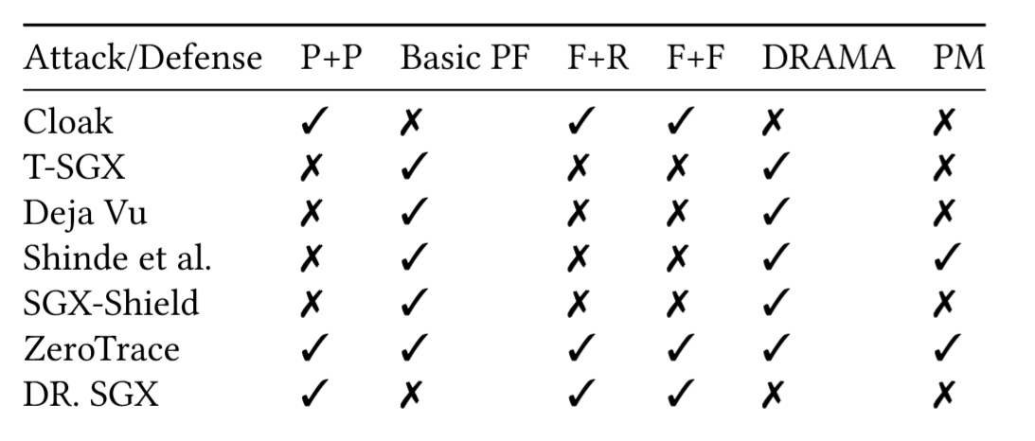
Analysis
The perfect solution?
Remove all branches and conditional code
Pin data/code to cache and TLB
CAT+SGX
Non-shared non-cached secure memory element
Most of defenses either work on page table based attacks or cache-based attacks
ORAM performance optimization
Page table flags monitoring attacks
Department of Electrical Engineering and Computer Science

Slide 16
Conclusion
We studied multiple attacks and defenses
Still no robust defense
Attack are emerging
Open to research
Department of Electrical Engineering and Computer Science

Slide 17
References
Michael Schwarz, Samuel Weiser, Daniel Gruss, Clémentine Maurice, and Stefan Mangard. 2017. Malware guard extension:UsingSGXtoconcealcacheattacks.InInternational Conference on Detection of Intrusions and Malware, and Vulnerability Assessment.Springer,3–24.
Ferdinand Brasser, Urs Mu¨ller, Alexandra Dmitrienko, Kari Kostiainen, Srdjan Capkun, and AhmadReza Sadeghi. 2017. Software grand exposure: SGX cache attacks are practical. arXiv preprint arXiv:1702.07521 (2017), 33.
Daniel Gruss, Julian Lettner, Felix Schuster, Olya Ohrimenko, Istvan Haller, and Manuel Costa. 2017. Strong and efficient cache side-channel protection using hardware transactional memory. In USENIX Security Symposium.
Ming-Wei Shih, Sangho Lee, Taesoo Kim, and Marcus Peinado. 2017. T-SGX: Eradicating controlled channel attacks against enclave programs. In Proceedings of the 2017 Annual Network and Distributed System Security Symposium (NDSS), San Diego, CA.
Jo Van Bulck, Nico Weichbrodt, Ru¨diger Kapitza, Frank Piessens, and Raoul Strackx. 2017. Telling your secrets without page faults: Stealthy page table-based attacks on enclaved execution. In Proceedings of the 26th USENIX Security Symposium. USENIX Association.
Wenhao Wang, Guoxing Chen, Xiaorui Pan, Yinqian Zhang, Xiaofeng Wang, Vincent Bindschaedler, Haixu Tang, and Carl A. Gunter. 2017. Leaky Cauldron on the Dark Land: Understanding Memory Side-Channel Hazards in SGX. 2421–2434.
Department of Electrical Engineering and Computer Science

Slide 18
References
[1] Ferdinand Brasser, Srdjan Capkun, Alexandra Dmitrienko, Tommaso Frassetto, Kari Kostiainen, Urs Mu¨ller, and Ahmad-Reza Sadeghi. 2017. DR. SGX: Hardening SGX Enclaves against Cache Attacks with Data Location Randomization. arXiv preprint arXiv:1709.09917 (2017). [2] Ferdinand Brasser, Urs Mu¨ller, Alexandra Dmitrienko, Kari Kostiainen, Srdjan Capkun, and AhmadReza Sadeghi. 2017. Software grand exposure: SGX cache attacks are practical. arXiv preprint arXiv:1702.07521 (2017), 33. [3] Sanchuan Chen, Xiaokuan Zhang, Michael K Reiter, and Yinqian Zhang. 2017. Detecting privileged side-channel attacks in shielded execution with D´ej´a Vu. In Proceedings of the 2017 ACM on Asia Conference on Computer and Communications Security. ACM, 7–18. [4] Oded Goldreich. 1987. Towards a theory of software protection and simulation by oblivious RAMs. In Proceedings of the nineteenth annual ACM symposium on Theory of computing. ACM, 182–194. [5] Oded Goldreich and Rafail Ostrovsky. 1996. Software protection and simulation on oblivious RAMs. Journal of the ACM (JACM) 43, 3 (1996), 431–473. [6] Daniel Gruss, Julian Lettner, Felix Schuster, Olya Ohrimenko, Istvan Haller, and Manuel Costa. 2017. Strong and efficient cache side-channel protection using hardware transactional memory. In USENIX Security Symposium. [7] Daniel Gruss, Cl´ementine Maurice, Klaus Wagner, and Stefan Mangard. 2016. Flush+ Flush: a fast and stealthy cache attack. In International Conference on Detection of Intrusions and Malware, and Vulnerability Assessment. Springer, 279–299. [8] Mehmet Kayaalp, Nael Abu-Ghazaleh, Dmitry Ponomarev, and Aamer Jaleel. 2016. A high-resolution side-channel attack on last-level cache. In Proceedings of the 53rd Annual Design Automation Conference. ACM, 72. [9] Rafail Ostrovsky. 1990. Efficient computation on oblivious RAMs. In Proceedings of the twenty-second annual ACM symposium on Theory of computing. ACM, 514–523. [10] Dag Arne Osvik, Adi Shamir, and Eran Tromer. 2006. Cache attacks and countermeasures: the case of AES. In Cryptographers’ Track at the RSA Conference. Springer, 1–20. [11] Peter Pessl, Daniel Gruss, Cl´ementine Maurice, Michael Schwarz, and Stefan Mangard. 2016. DRAMA: Exploiting DRAM Addressing for Cross-CPU Attacks.. In USENIX Security Symposium. 565–581. [12] Sajin Sasy, Sergey Gorbunov, and Christopher Fletcher. 2017. ZeroTrace: Oblivious memory primitives from Intel SGX. In Symposium on Network and Distributed System Security (NDSS). [13] Jaebaek Seo, Byounyoung Lee, Seongmin Kim, Ming-Wei Shih, Insik Shin, Dongsu Han, and Taesoo Kim. 2017. SGX-Shield: Enabling address space layout randomization for SGX programs. In Proceedings of the 2017 Annual Network and Distributed System Security Symposium (NDSS), San Diego, CA. [14] Ming-Wei Shih, Sangho Lee, Taesoo Kim, and Marcus Peinado. 2017. T-SGX: Eradicating controlledchannel attacks against enclave programs. In Proceedings of the 2017 Annual Network and Distributed System Security Symposium (NDSS), San Diego, CA. [15] Shweta Shinde, Zheng Leong Chua, Viswesh Narayanan, and Prateek Saxena. 2015. Preventing your faults from telling your secrets: Defenses against pigeonhole attacks. arXiv preprint arXiv:1506.04832 (2015). [16] Eran Tromer, Dag Arne Osvik, and Adi Shamir. 2010. Efficient cache attacks on AES, and countermeasures. Journal of Cryptology 23, 1 (2010), 37–71. [17] Jo Van Bulck, Nico Weichbrodt, Ru¨diger Kapitza, Frank Piessens, and Raoul Strackx. 2017. Telling your secrets without page faults: Stealthy page table-based attacks on enclaved execution. In Proceedings of the 26th USENIX Security Symposium. USENIX Association. [18] Wenhao Wang, Guoxing Chen, Xiaorui Pan, Yinqian Zhang, Xiaofeng Wang, Vincent Bindschaedler, Haixu Tang, and Carl A. Gunter. 2017. Leaky Cauldron on the Dark Land: Understanding Memory Side-Channel Hazards in SGX. 2421–2434. [19] Yuval Yarom and Katrina Falkner. 2014. FLUSH+ RELOAD: A High Resolution, Low Noise, L3 Cache Side-Channel Attack.. In USENIX Security Symposium
Department of Electrical Engineering and Computer Science

