Slide 1
A Reliability-Aware Decision Framework for Cost-Sensitive Selective Prediction in Credit Risk under Distribution Shift
Amin Feli (11038701)
Supervisors: Prof. Dr. Mehrdad Jalali
Prof. Dr. Binh Vu
SRH Hochschule Heidelberg

Slide 2
Introduction
What is Credit Risk?
Credit risk is a fundamental task in finance and banking, designed to estimate the likelihood that a borrower will default on a loan or fail to meet contractual debt obligations.
Why is Credit Risk Prediction Important?
Banks make decisions based on information about applicants, such as their occupation_status , credit history, and credit_score . Machine Learning (ML) models can learn patterns from historical data and estimate the probability that an applicant will default. refine it in the simple way.
A reliable prediction system can help to:
Reduce losses from unpaid loans.
Make better lending decisions.
Manage money and capital more efficiently.

Slide 3
Problem Statement:
Static decision thresholds: many systems rely on a fixed decision threshold, commonly 0.5, which does not adequately reflect the changing financial trade-offs between false positives and false negatives.
Fixed cost-sensitive learning: Although cost-sensitive learning is widely used to account for the unequal consequences of classification errors, penalty structures are generally predefined and fixed.
Lack of selective prediction: Conventional credit risk models typically provide deterministic binary predictions without explicitly quantifying prediction uncertainty. Consequently, they may automatically make decisions for ambiguous cases where the model is insufficiently confident and human intervention would be more appropriate.
distribution shift: Most credit risk models are developed and evaluated under the assumption that the underlying data distribution remains relatively stable. In real banking environments, however, economic conditions, customer behavior, and credit patterns continuously change, resulting in data distribution shifts that can reduce model performance and reliability over time.
Lack of continuous reliability monitoring: Existing approaches often evaluate model performance periodically rather than continuously after deployment.

Slide 4
Table of Content
  Introduction
  Problem Statement
  Methodology
  Data Preprocessing
  Exploratory Data Analysis (EDA)
  Model Explainability
  Selective Prediction / Risk-Based Decision System
  Model Monitoring
  Results & Key Findings

Slide 5
Dataset & Data Description
Dataset Overview
This dataset contains 50,000 loan application records with 20 features describing applicants' demographic characteristics, employment and financial status, credit history, and loan information. It is designed for credit risk assessment and loan outcome prediction using machine learning methods.
The dataset includes information such as age, occupation status, employment history, annual income, credit score, savings, debt, previous defaults, delinquencies, loan amount, interest rate, and several financial ratios.
The dataset also contains categorical variables describing the applicant's employment status, product type, and loan intent, together with numerical variables representing the applicant's financial and credit characteristics.
The target variable, loan_status, represents the loan outcome:
0 = Rejected
1 = Approved

Slide 6
Data Processing
Checking Corrupted Rows
The purpose of this step was to identify invalid, corrupted, or logically inconsistent records before applying machine learning models.
The code performed the following validation processes:
Range Validation: Checked realistic ranges for age, credit score, employment, and credit history.
Negative Values: Detected invalid negative values in financial and credit variables.
Ratio Validation: Verified Debt-to-Income Ratio, Loan-to-Income Ratio, and payment-to-income ratios.
Text Validation: Used Regex to identify malformed categorical values and validated loan_status.

Slide 7
Data Type Standardization
Ensured all key numerical variables use consistent data types.
Missing Value Analysis
Identified missing values that could affect model performance.
Categorical Data Consistency
Examined categorical variables for inconsistent labels.
Identified potential duplicates such as “Male” and “male.”
Duplicate Records
The dataset was checked for duplicated observations.

Slide 8
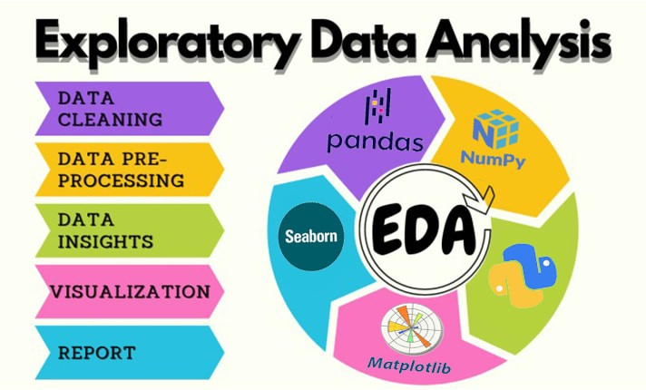

Slide 9
Exploratory Data Analysis (EDA)
Statistical Overview
The study uses a real-world dataset containing loan application records. This includes:
👤 Applicant Characteristics
Age: 18–70 years, with a mean of 35.0 years
Years employed: 0–39.9 years, with a mean of 7.45 years
Annual income: €15,000–€250,000, with a mean of approximately €50,063
Credit score: 348–850, with a mean of 643.6
Key features:
Numerical: income, debt-to-income ratio, credit history length
Categorical: job type, education, residence status
Derived: risk score, monthly debt obligations

Slide 10
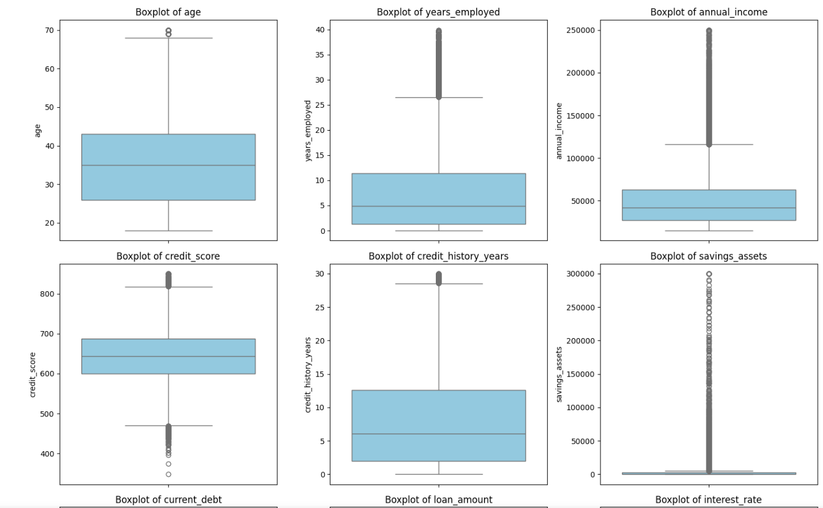
Outlier Analysis
Most variables contained normal-range observations with some outliers.
The highest number of normal outliers was found in:
Savings assets: 6,508
Current debt: 2,932
Annual income: 2,355
Years employed: 1,373
Extreme outliers were mainly observed in:
Savings assets: 4,353
Current debt: 859
Annual income: 515
No extreme outliers were detected in age, credit score, loan amount, interest rate, or the ratio variables.

Slide 11
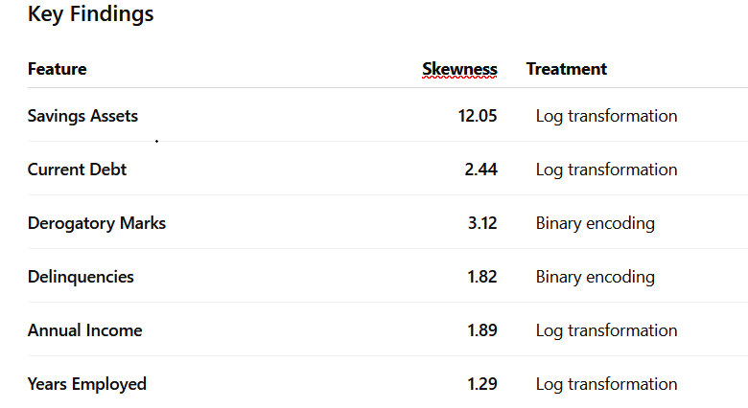
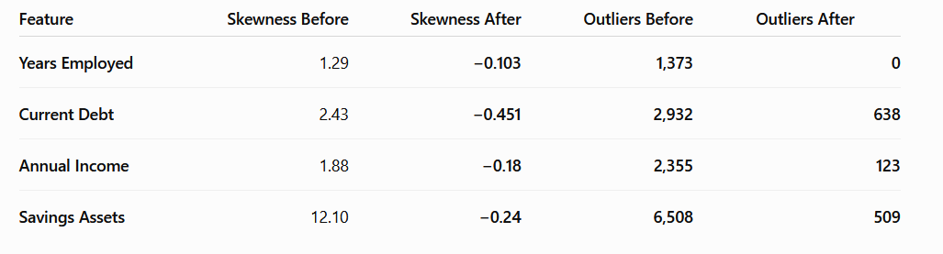
Distribution & Skewness
Transformation Strategy
Highly Skewed Features → Log Transformation
Compresses extreme values
Reduces right-skewness
Produces more stable distributions
Continuous Features → StandardScaler
Centers features around zero
Normalizes the scale
Prevents large-scale variables from dominating model training

Slide 12
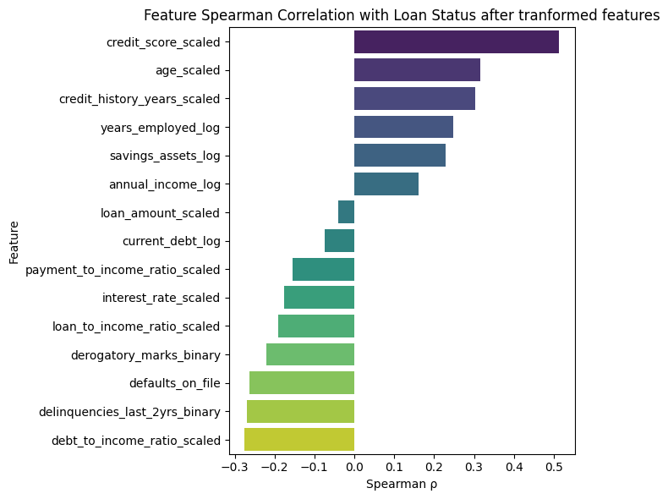
Correlation Analysis
Spearman rank correlation (ρ) was used to examine relationships between the engineered numerical features and the target variable.
Important Feature Relationships
Some predictors also show relatively strong correlations with each other:
Loan-to-Income ↔ Payment-to-Income: ρ = 0.815
Loan Amount ↔ Loan-to-Income: ρ = 0.755
Current Debt ↔ Debt-to-Income: ρ = 0.716
Age ↔ Credit History: ρ = 0.664
Annual Income ↔ Current Debt: ρ = 0.657

Slide 13
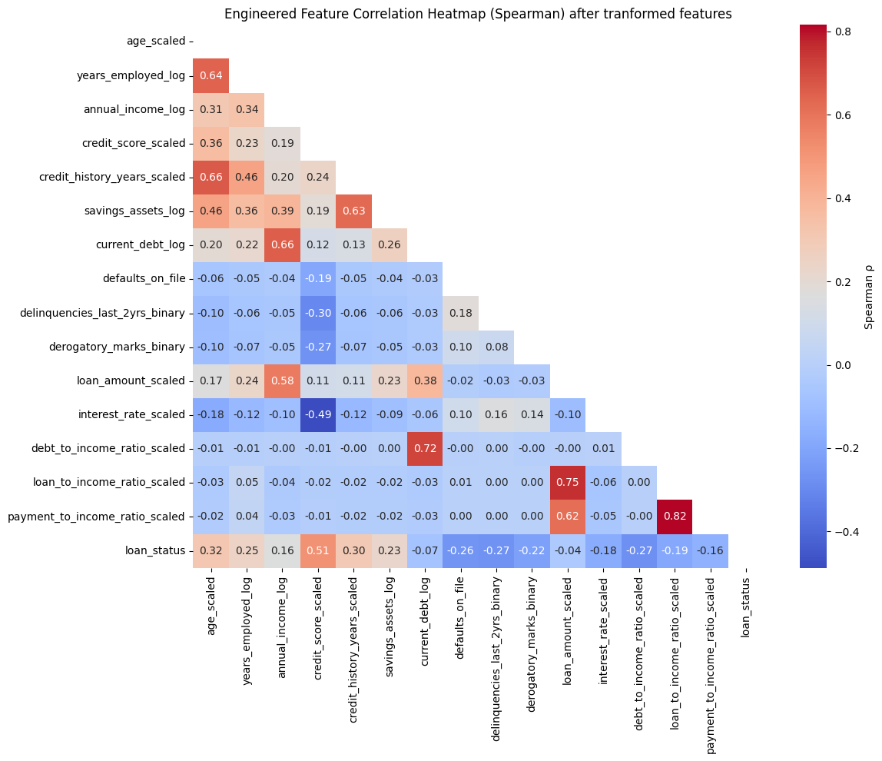
Correlation Analysis

Slide 14
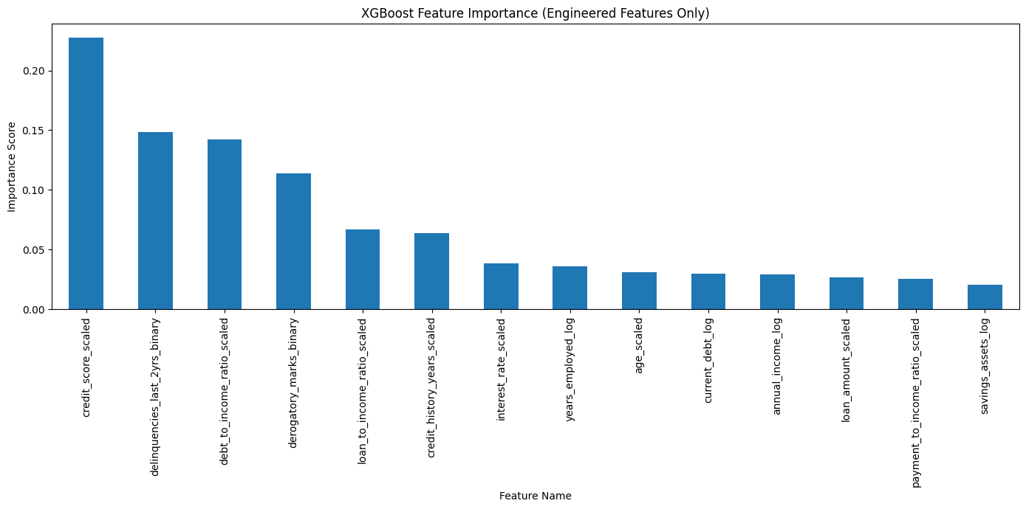
Feature Importance — XGBoost
XGBoost was used to identify the most influential features for credit-risk prediction.
The most important features were:
Credit score: 22.8%
Delinquencies: 14.9%
Debt-to-income ratio: 14.2%
No features had importance below 0.02,
so no feature was removed based on this criterion.

Slide 15
Permutation Feature Importance
A method to measure the importance of each feature in a machine learning model.
Idea: Randomly shuffle a feature’s values and see how the model performance changes.
How it works:
Train the model on the data and calculate baseline performance (e.g., accuracy, R²).
For each feature:
  Shuffle its values randomly.
  Re-evaluate the model performance.
Compare performance:
  Big drop in performance → feature is very important
  Little or no change → feature is less important

Slide 16
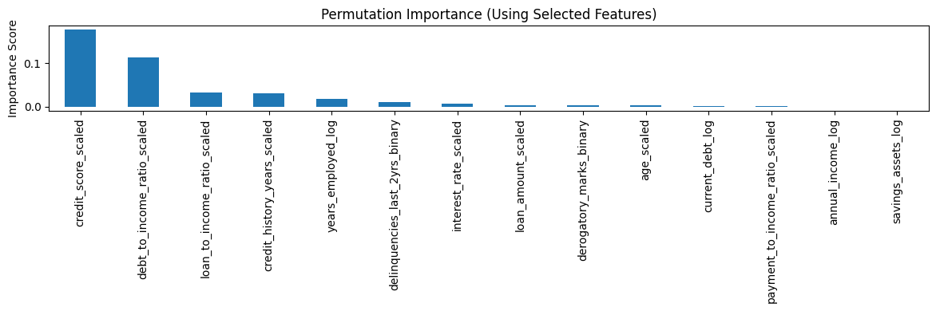
Permutation Importance Analysis
Permutation importance was used to measure the actual impact of each feature on model performance.
The most influential features were:
Credit score: 0.177
Debt-to-income ratio: 0.112
Loan-to-income ratio: 0.033
Features such as annual income and savings assets showed almost no impact.
Negative or near-zero importance indicates that shuffling these features did not improve or slightly improved—model performance.

Slide 17
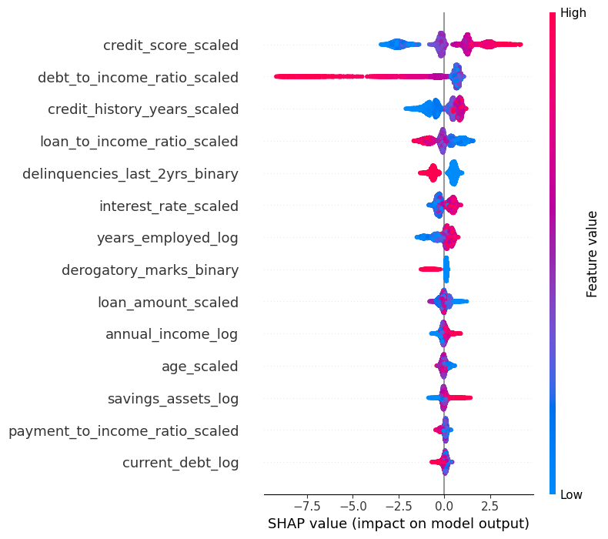
SHAP-Based Feature Importance
SHAP was used to measure how strongly each feature contributes to the model's predictions.
The most influential features were:
Credit score: 1.477
Debt-to-income ratio: 1.294
Credit history: 0.676
Loan-to-income ratio: 0.566
Delinquencies: 0.557
Savings assets, payment-to-income ratio, and current debt had relatively low contributions.
Based on the SHAP results, low-impact features were considered for removal to simplify the model.

Slide 18
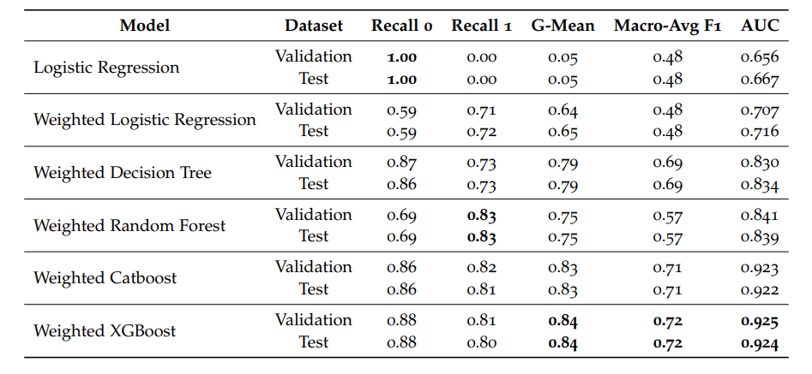
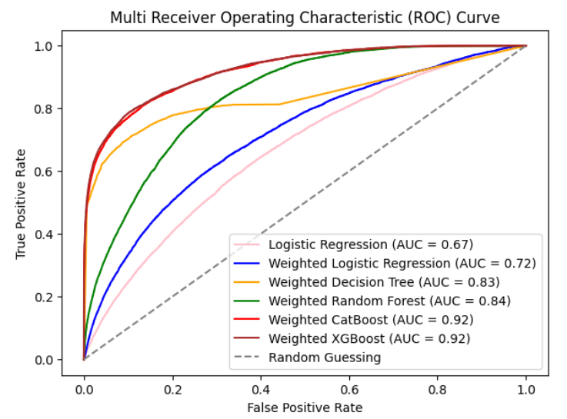
Related Articles

Slide 19
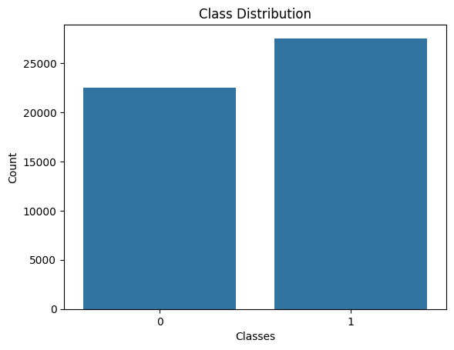
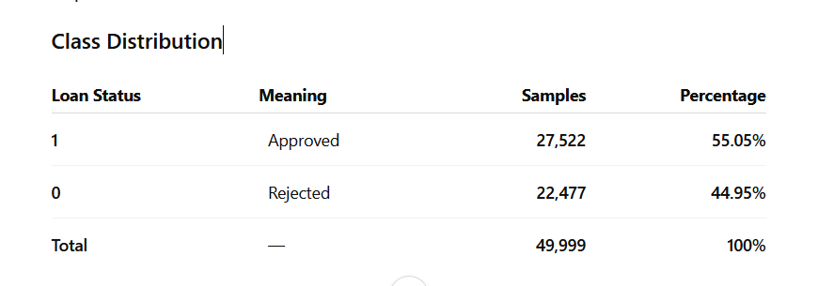
Class Imbalance
The distribution of the target variable was examined to determine whether the dataset contains a significant class imbalance and whether imbalance-handling techniques are required.

Slide 20

Methods for Handling Class Imbalance
Random Oversampling
Duplicates minority-class samples to increase their representation.
SMOTE
Generates synthetic minority-class samples instead of simply duplicating them.
Cost-Sensitive Learning (CSL)
Assigns higher importance/cost to minority-class errors during model training.

Slide 21
Machine Learning Model Development
Algorithm: XGBoost (Extreme Gradient Boosting)
Data Split: 80% Training | 10% Validation | 10% Test
Class Imbalance: Class weights applied during training
Hyperparameter Optimization: Grid Search
n_estimators: [200, 300, 400, 500,600,700]
learning_rate: [0.03, 0.05, 0.07, 0.1 ,0.2, 0.3]
max_depth: [3, 4, 5, 6,7,8]
min_child_weight: [1, 3, 5, 7, 9]
Total: 1080 XGBoost configurations evaluated

Slide 22
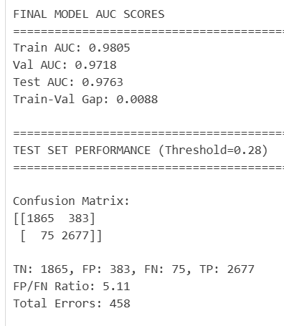
Find optimal threshold:
Standard approach → Fixed threshold = 0.50
Proposed approach → Optimize the decision threshold
Tested thresholds: (0.15, 0.6, 0.01)
Business cost function: prioritize low FN, penalize FP
Cost = 2.5 × FN + FP
p(default)< 0.50-→ Approved
p(default)> 0.50-→ Rejected
Each model was evaluated using:
AUC
False Negatives (FN)
False Positives (FP)
Error balance:FP/FN Ratio
Minimum Business Cost

Slide 23
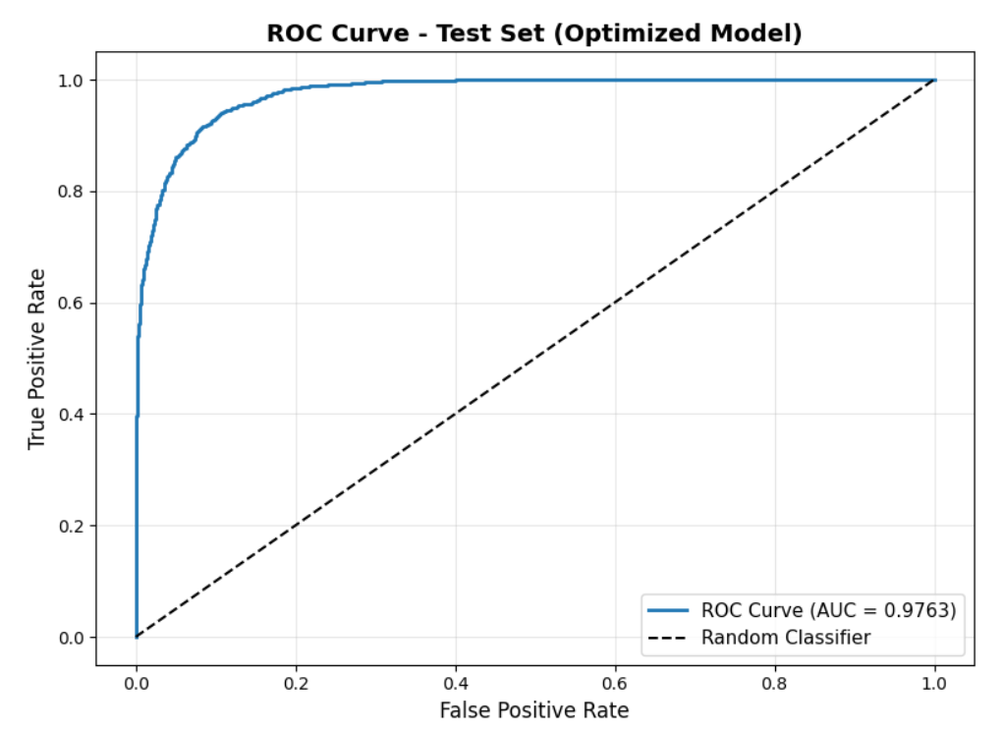

Slide 24
Explainable AI: SHAP-Based Model Interpretation
Objective:
Interpret how the XGBoost model makes credit-risk predictions and identify the features that drive its decisions.
SHAP Framework
TreeExplainer applied to the final XGBoost model
2,000 test observations analyzed
Global feature importance based on mean |SHAP value|
SHAP dependence plots used to examine feature effects
Key Findings:
Credit Score: 19.42% of total SHAP importance
Debt-to-Income Ratio: 15.95%
Credit History: 9.65%
Loan-to-Income Ratio: 8.42%
Education Loan Intent: 8.15%

Slide 25
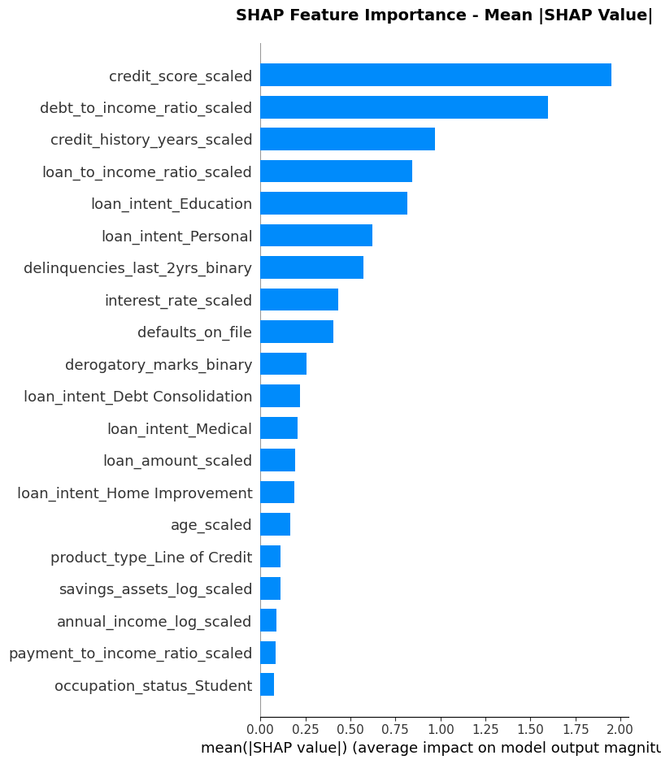
Explainable AI: SHAP-Based Model Interpretation
Cumulative importance of top 10 features: 84.39%
Cumulative importance of top 20 features: 98.83%

Slide 26
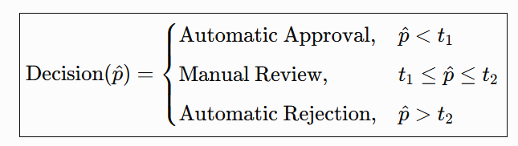
Selective Prediction Framework
Traditional classification forces an automatic decision for every applicant.
My approach: allow the model to abstain from uncertain cases and refer them to human loan officers.
Two-Threshold Decision Policy:
Probability of Default < thresholds t₁ 🟢 AUTO APPROVE ( low-risk )
thresholds t₁ ≤ Probability of Default ≤ thresholds t₂ 🟠 MANUAL REVIEW ( uncertain )
Probability of Default > thresholds t₂ 🔴 AUTO REJECT( high-risk )

Slide 27
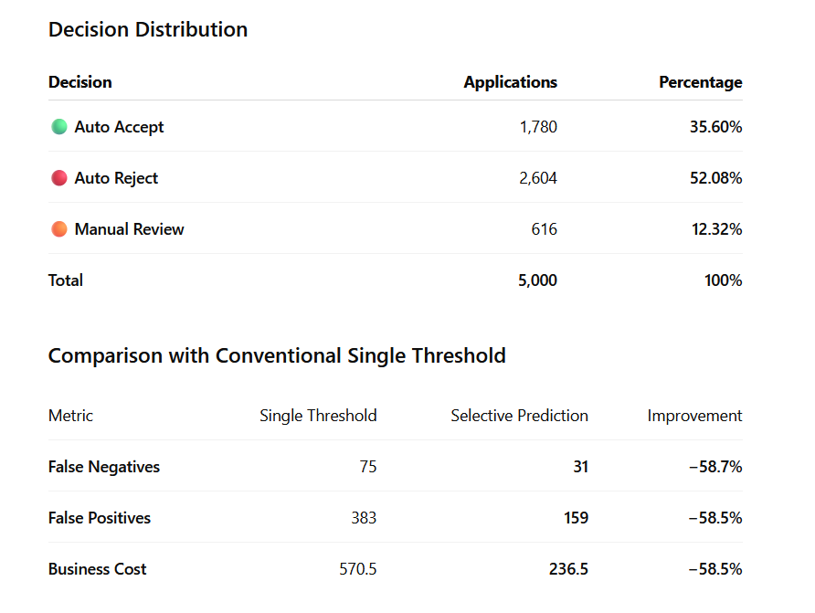
Selective Prediction — Test Set Results
Test-Set Decision Distribution
Auto Accept: 1,780 (35.60%)
Auto Reject: 2,604 (52.08%)
Manual Review: 616 (12.32%)

Slide 28
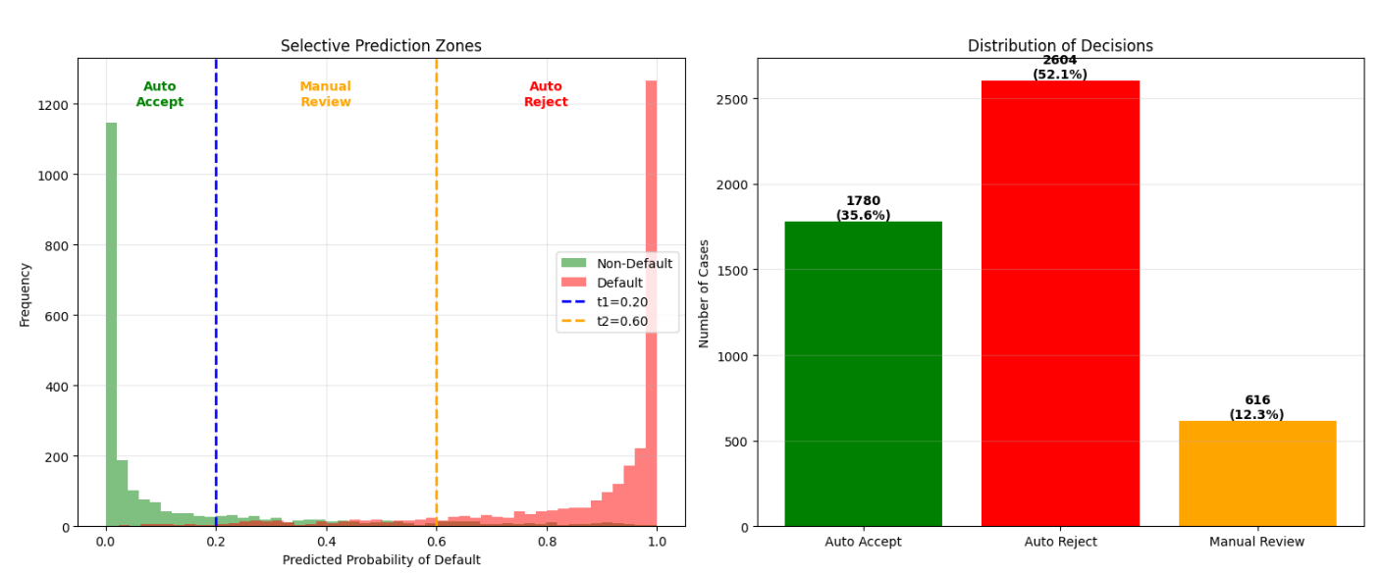
Selective Prediction — Test Set Results

Slide 29
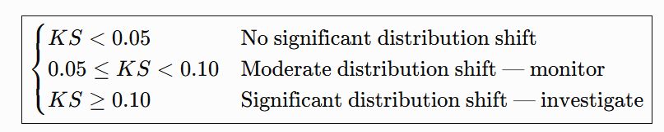
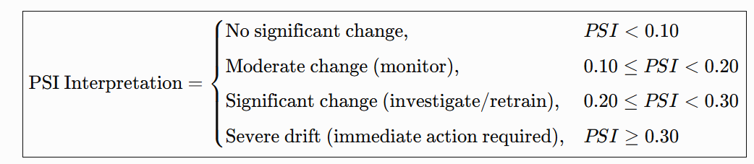
Reliability Monitoring Framework
Ensure that the credit-risk model remains reliable after deployment when customer populations and data distributions change.
Automated Monitoring Pipeline
1. DATA DRIFT
Monitor changes in customer characteristics
PSI → measures changes in feature distributions
PSI Interpretation:
KS Test → compares reference and new distributions
KS Interpretation:
2. PREDICTION / MODEL MONITORING
Monitor changes in model behavior and performance
AUC
Accuracy
False Negatives
False Positives

Slide 30
Reliability Monitoring Framework
3. RELIABILITY ACTION
Detect degradation → Generate alert → Investigate / Retrain
Drift Classification
🟢 Stable
🟠 Moderate Drift
🔴 Significant Drift
Reference Population
The validation dataset was used as the baseline because it represents unseen customers.
Key Contribution
The model is not treated as a static predictor.
Reliability is continuously monitored under distribution shift.

Slide 31
Nightly Automated Model Monitoring
Purpose: Continuously monitor the deployed credit-risk model for data and prediction changes.
Monitoring Pipeline
Collect new data
→ Latest scored loan applications
Data Drift Detection
→ Compare current features with reference data
→ Identify MODERATE / SEVERE drift
Prediction Drift
→ Monitor predicted probabilities
→ Calculate Population Stability Index (PSI)
Performance Monitoring
→ AUC, False Negatives (FN), False Positives (FP)
→ Cost-sensitive performance
Automated Alerting
→ Trigger alert when severe drift, prediction drift, or performance degradation is detected
Schedule: Daily at 02:00 AM

Slide 32
Further Improvements
  1. Alternative Models
  Evaluate LSTM and other Deep Learning models
  Compare performance, reliability, and computational cost with XGBoost
  2. Business-Cost Optimization
  Current: Cost = 2.5 × FN + FP
  Future: optimize λ in Cost = λ × FN + FP
  Use grid search over a predefined λ range
  Re-optimize t₁ and t₂ for each λ
  Challenge: high computational cost due to repeated XGBoost training

