Slide 1
PYTHON PROGRAMMING
MODULE 1

Slide 2
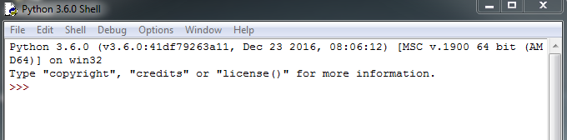
Introduction
Before learning, check every student’s computer whether the python 3.6.0 is already installed or not.
Launch python IDLE.

Slide 3
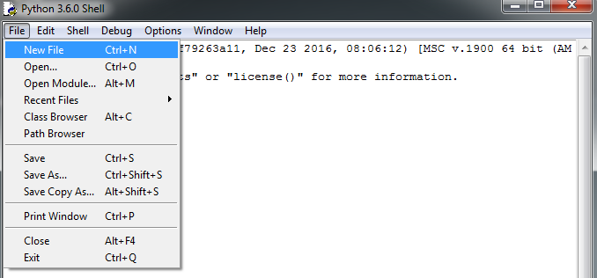
Steps before learning
Click file>New file

Slide 4
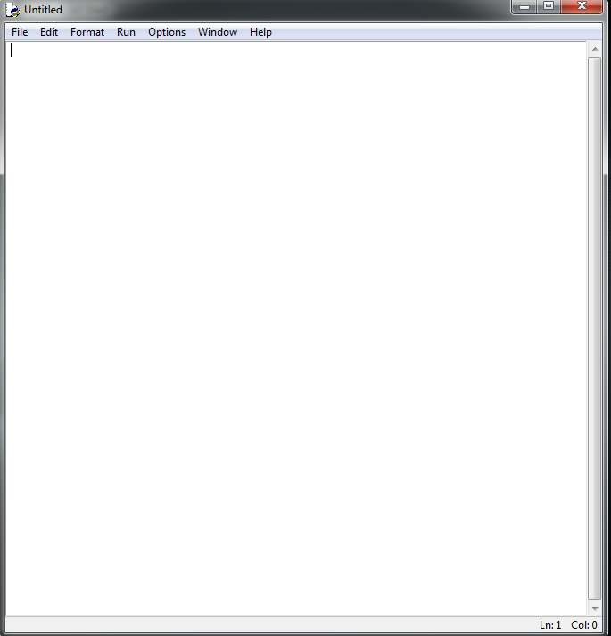
First blank file is opened.

Slide 5

Start writing codes!
In the blank file, write your first code.

Slide 6
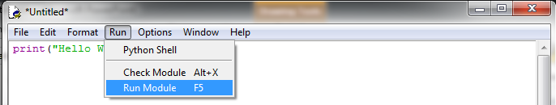
Click ‘Run’

Slide 7
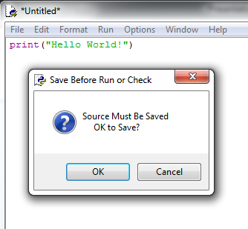
Save the blank file

Slide 8
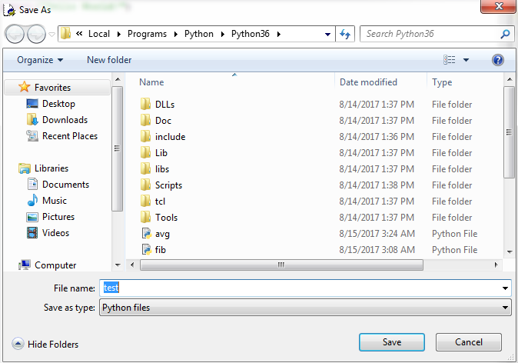
Save the blank file

Slide 9
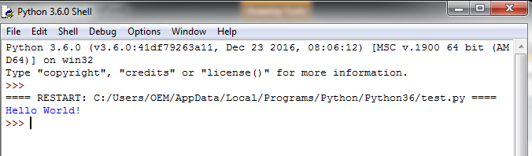
The Output will be generated in other window
This is the output

Slide 10
Exercise
Now, try to print your own name.
print (“My name is ________”)

