Slide 1
Bash Programming
TOSAN TECH TALKS
by Amin Hejazi

Slide 2
CLI vs GUI
In CLI we must memorize all commands
Cannot multi task
Is more flexible
CLI is programmable
GUI is easy to learn
Multitasking
Is not very flexible when it comes to command combinations
GUI is not

Slide 3
Typing over Drag and Drop
Advanced HTML or CSS designers use more coding
Advanced .net developers do not use Designers
Why should it be any different for Admins
But also most of today's daily tasks can only be done with GUI
  Web browsing
  Slides
  Video and multimedia

Slide 4
Deferent CLIs
Microsoft
  Power Shell
  CMD
Unix
  KSH (Korn shell in bell labs)
  SH (Bourne Shell was written in bell labs)
  Bash* (Bourne Again Shell is GNU)
  csh(C shell c like syntax for prog)
  Pysh (python shell kind of ipython)

Slide 5
Bash History
Is a GNU copy of Bourne Shell
Released in 1989
Default GNU Linux and Mac OS Shell and ported to windows as Cygwin
Is SH compatible and has some ideas from ksh and csh
  History
  $RANDOM and $PPID variables
  POSIX command substitution syntax $(…)

Slide 6
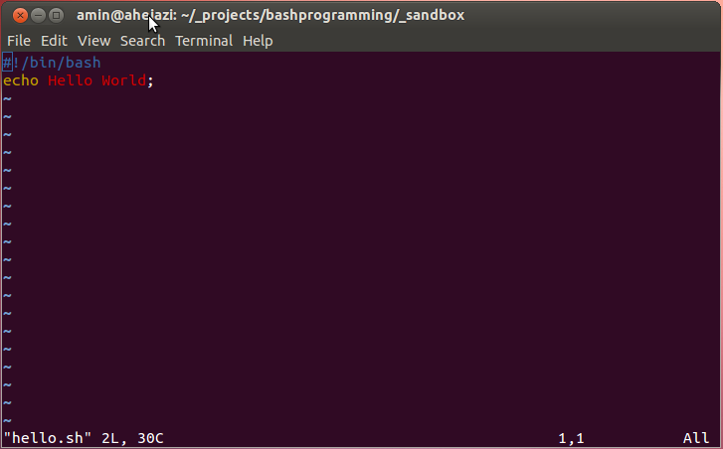
Bash Programming
Hello World
#! (sha bang)
Is used at start of scripts in unix systems
When System sees the string after #! it start that command with an argument to current script file instead of running the script directly.

Slide 7
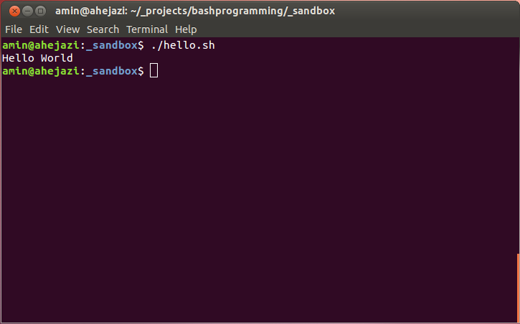
Bash Programming
Hello World
./ current folder
../ previews folder
~/ user home folder
Linux needs complete path for execution

Slide 8
Bash Programming
Program Output Redirection
Outputs in linux : $> ls -l > ls-l.txt
  Stdout : 1
  Stderr : 2
Stderr to file : grep da * 2> grep-errors.txt
Stdout to StdErr : grep da * 1>&2
Stderr to Stdout : grep * 2>&1
Stderr and Stdout to file :
  rm -f $(find / -name core) &> /dev/null
  rm -f * 1>&2 2> /dev/null

Slide 9
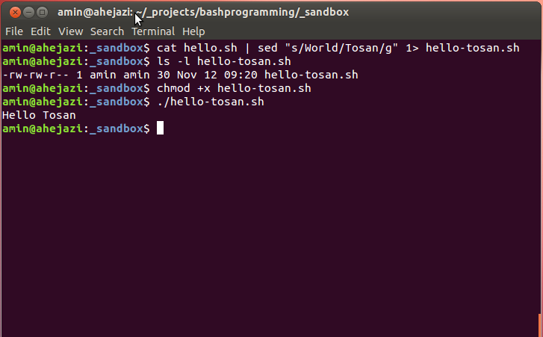
Bash Programming
Pipes
Pipes let you use the output of a program as the input of another one
SED is a stream editor its precursor is ED
SED uses regular expression to perform stream editing

Slide 10
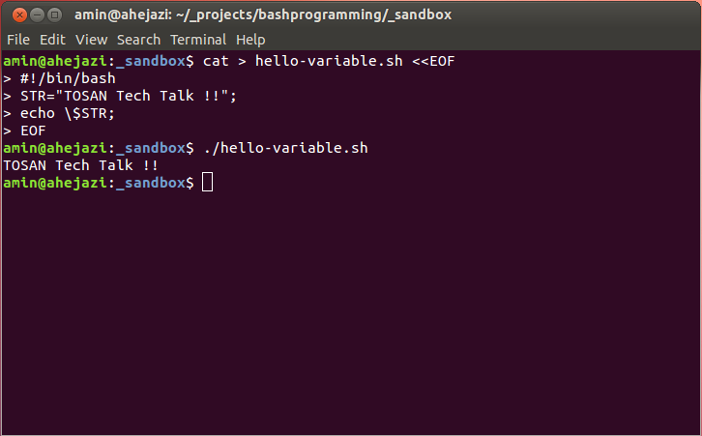
Bash Programming
Variables
You can use variables as in any programming languages
As we have stdout we also have stdin
We can use bashes input redirection and CAT to write files directly in bash
Find out why do we need \ before $STR in here !!! (drop \ once and test then export STR=”Surprise !!!” and try again)

Slide 11
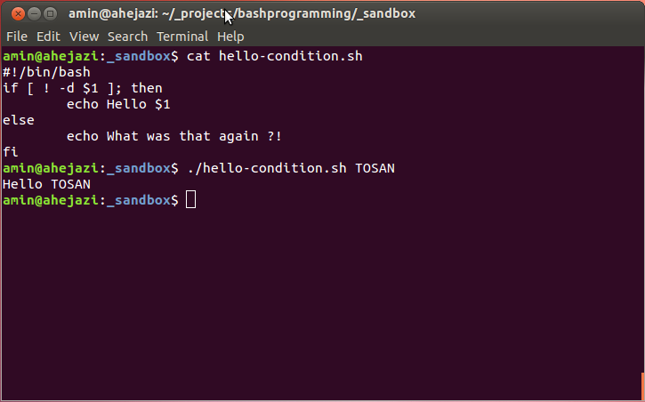
Bash Programming
Conditions
There is nothing really to it

Slide 12
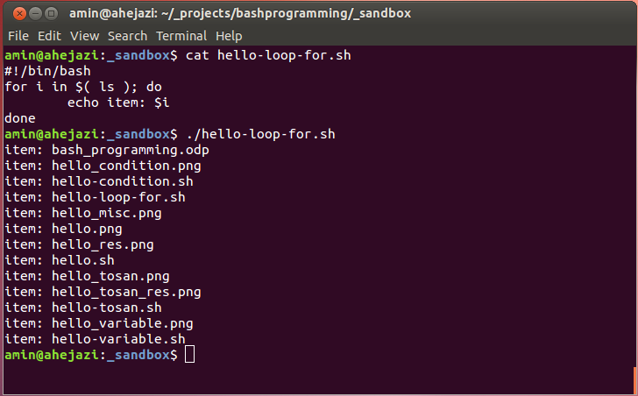
Bash Programming
Loops
Some thing interesting in here is the usage of $() this executes the command in () and insert its content is the script

Slide 13
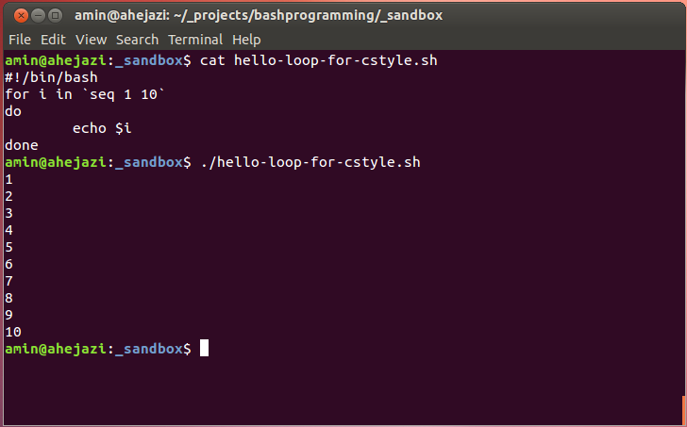
Bash Programming
Loops
Here we use `` instead of $()
What happened to ; ?
  What could that mean?

Slide 14
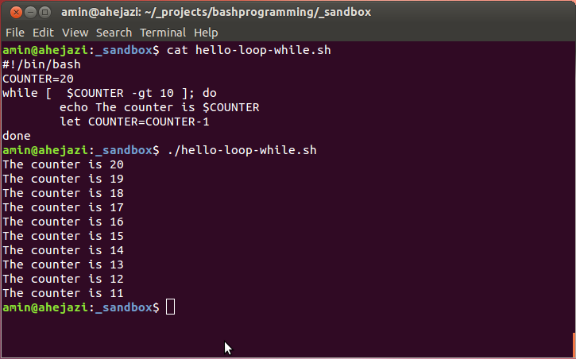
Bash Programming
Loops
Here let key word lets you operate on the var if we do not use let the result of Counter would be exact text of “COUNTER-1” instead of decreasing it .

Slide 15
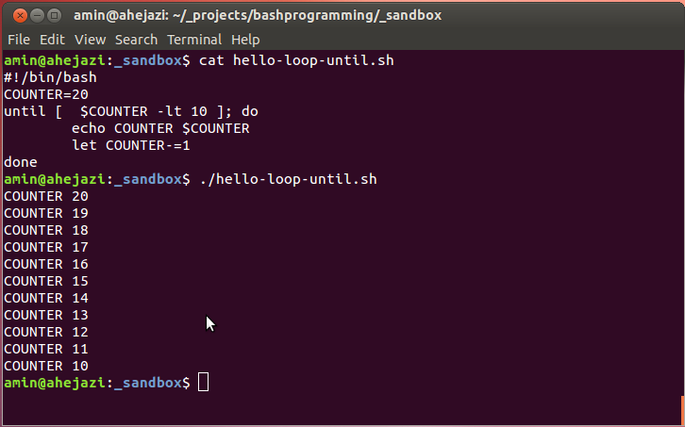
Bash Programming
Loops
There are two command separators in bash one is ; and the other is new line character

Slide 16
Bash Programming
Combinations
In bash we have two command separator one is ; and the other is newline character
  we can execute multiple command in one line separating them by ; .
  Mkdir test ; cp test.tar.gz test ; cd test ; tar -xvf test.tar.gz ; ./run.sh

Slide 17
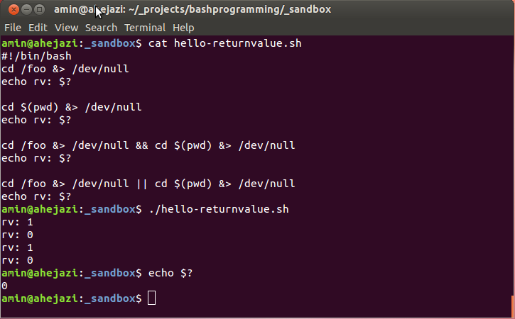
Bash Programming
Return Value of a Program
Each process that exits returns a value which indicates how it is exiting
Exit Value | Exit Status
0 (Zero) | Success
Non-zero | Failure
2 | Incorrect usage
127 | Command Not found

Slide 18
Bash Programming
Combinations
We can run command with short circuit conditionally by separating them with && and ||
  [ -z "$DISTDIR" ] && do-some-thing
  If DISTDIR is null then the first part is null and we do-some-thing
  && continues until it gets to a false result or exits successfully
  || continues until first occurrence of true return value

Slide 19
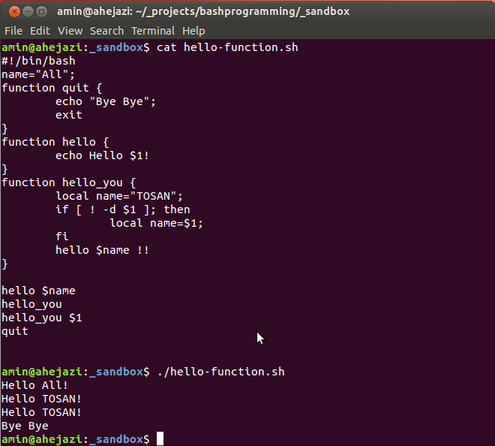
Bash Programming
Functions

Slide 20
Bash Programming
Functions
As any other programming language we have functions here too
In functions we can have local variables with local keyword
Each function accepts it own argument

Slide 21
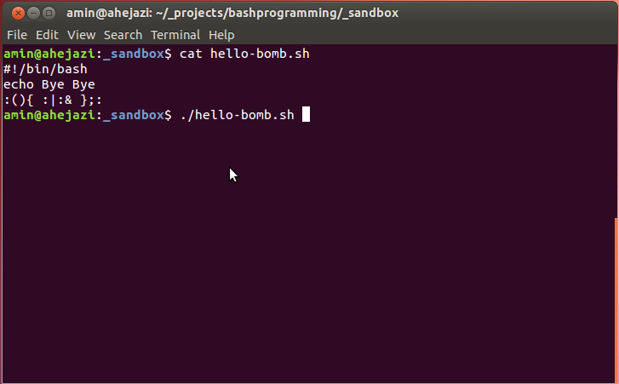
Bash Programming
Fork Bomb
: is a function
: calls it self recursively
: pips to and instance of it self which is going to run in the back ground
We end the function with ;
And set the bomb :
:)

Slide 22
Bash Programming
Resources
  http://www.wikipedia.org/
  http://tldp.org/
Get this content at :
  https://github.com/aminhjz/bashprogramming.git

Slide 23
Bash Programming
End
Thank You

