Slide 1
TOSAN tech talk
Learn git the hard way
By amin Hejazi

Slide 2
Concepts
Simple design
Is designed around its DATA structure
Takes Snapshot instead of Storing differences
Project structre
Integrity by design

Slide 3
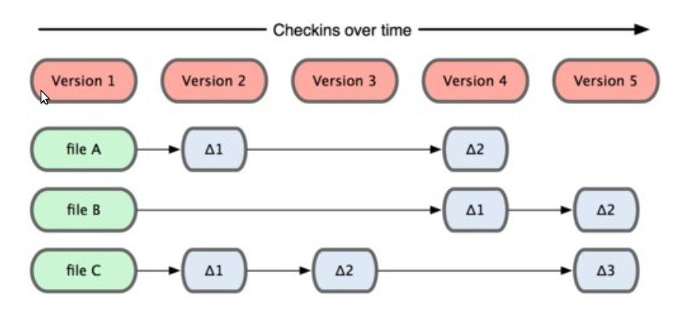
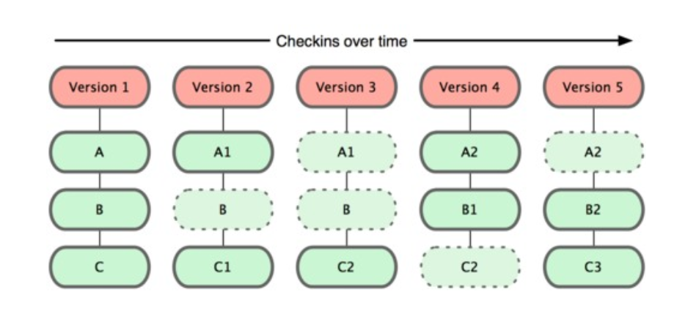
Git Data Storage Difference

Slide 4
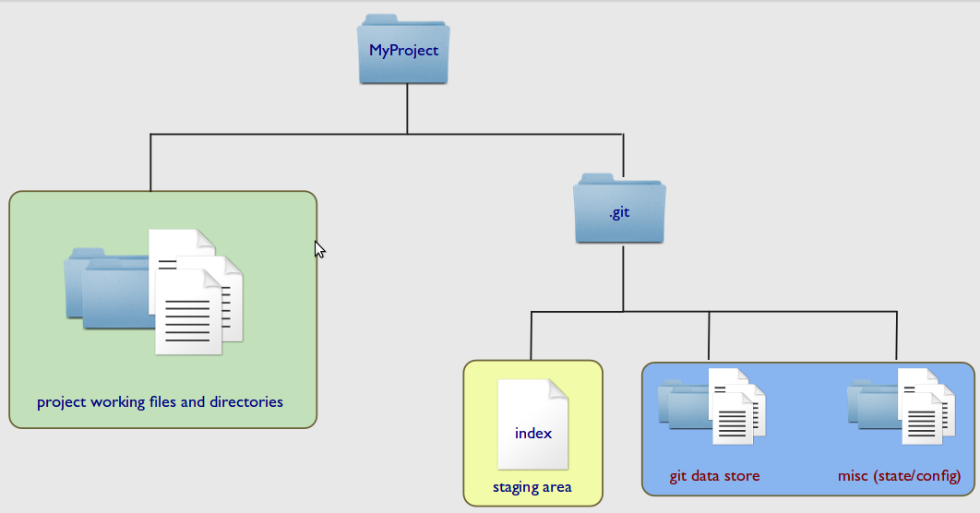
Project Structure

Slide 5
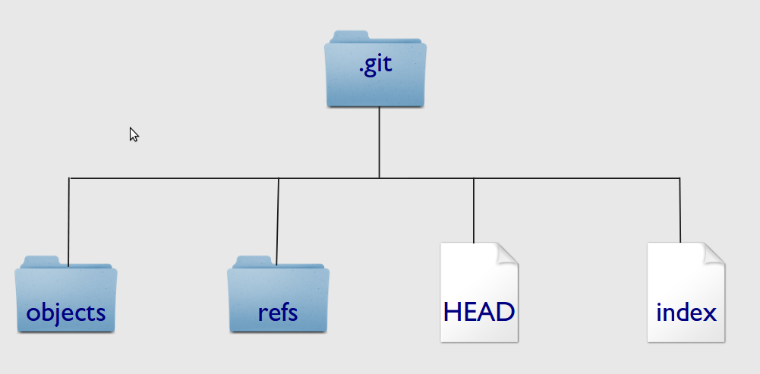
.git Folder

Slide 6
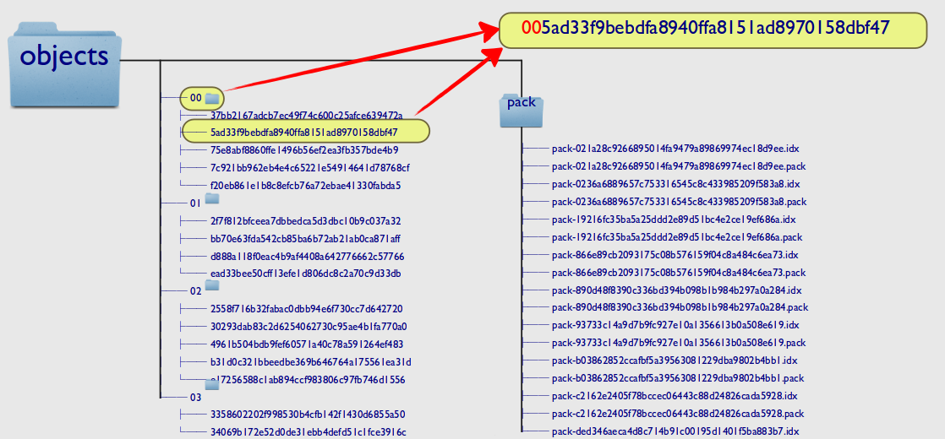
.git objects folder

Slide 7
Objects
Blob
Tree
Commit
tag

Slide 8
Git blob object
The git “blob” type is just a bunch of bytes that could be anything, like a text file, source code, or a picture, etc.

Slide 9
Git tree object
A git tree is like a filesystem directory. A git tree can point to, or include:
  Git “blob” objects (similar to a filesystem directory includes filesystem files).
  Other git trees (similar to a filesystem directory can have subdirectories).

Slide 10
Git commit object
A git commit object includes:
  Information about who commited
  A pointer to the git tree
  The parent commit to this commit

Slide 11
Git tag object
A git tag object points to any git commit object.

Slide 12
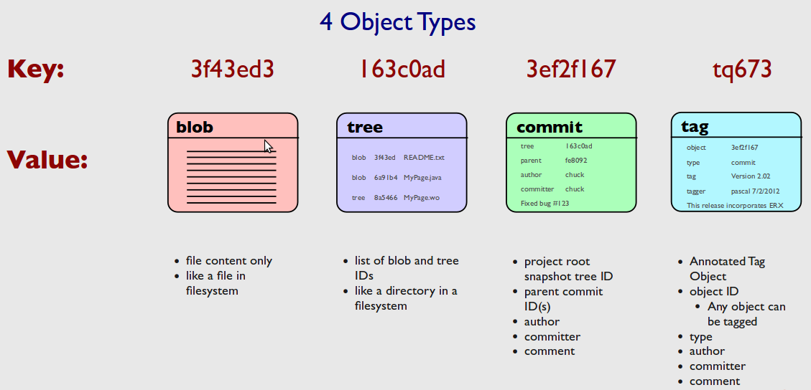
How do they work together

Slide 13
Integrity by Design
Meaning
  Having internal consistency and lack of corruption
  The condition of being unified
Its done by the means of Git Object
  Immutable
  Bind to its content by sha1 hashing

Slide 14
Commands
git init (initialize the working directory)
git add (add files to staging area {PROJECT}/.git/index)
git commit (create object and add to git repository)
git cat-file (investigate your self)
  -t :shows objects type
  -p:prints object content

Slide 15
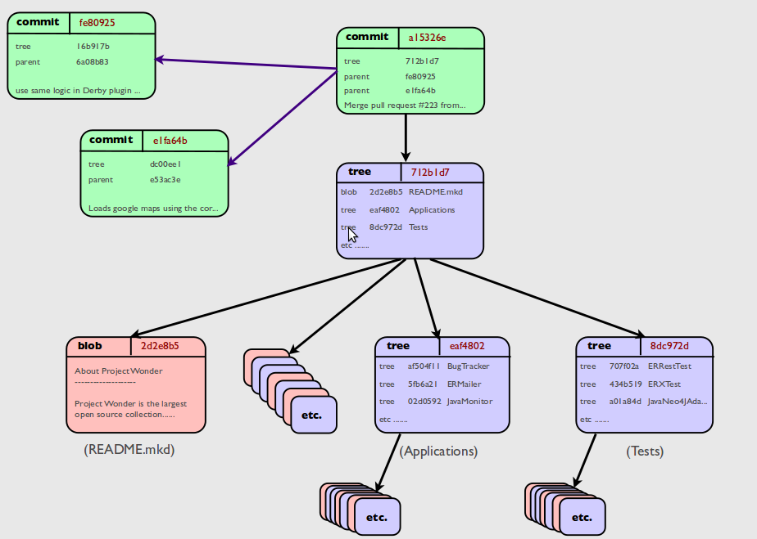
Under the hood

Slide 16
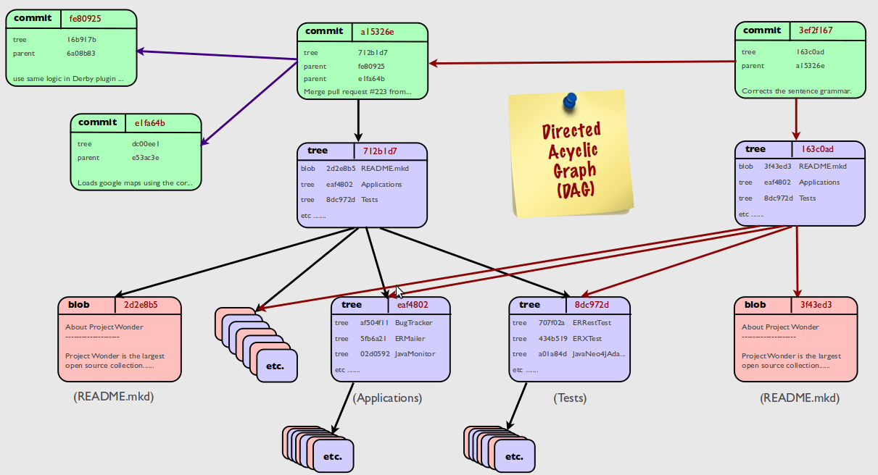
Directed Acyclic Graph

Slide 17
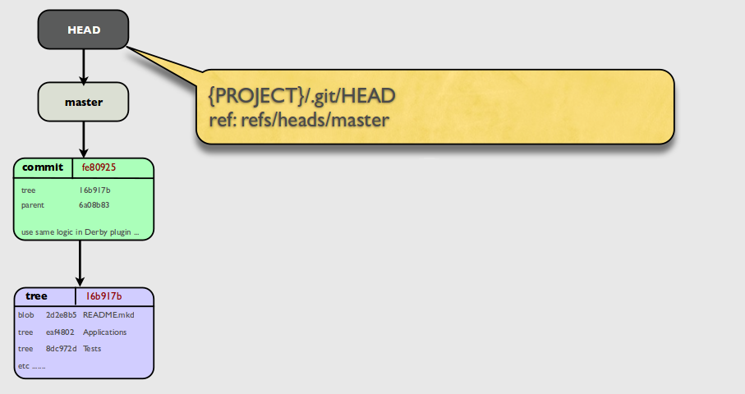
References

Slide 18
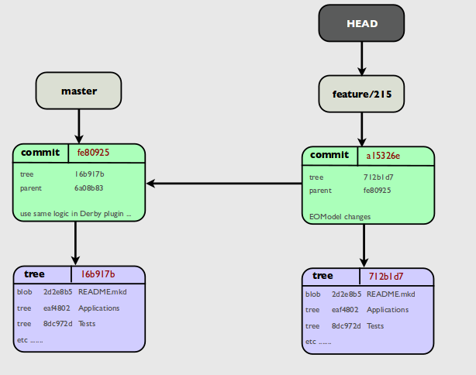
Branch References

Slide 19
Its Distributed
Your commits are all local so you should have the full repository to be able to work on git (clone)
Git can integrate all of its local objects to remote repositories (push) , or fetch all remote object and integrate them locally (pull)
If remote object do not match local branch object hashes a conflict happened and we can resolve it by the means of merge or rebase.
In git every clone repository can effectively be a different branch

Slide 20
Distribution benefits
Collaboration Is easer
Branches have low cast
You can commit every change and keep track without corrupting main release repository
Merging can be done to release branch by a network of trust
Branching is not the issue merging is

Slide 21
Work flows
Centralized
Feature Branch
Git flow
Forking

Slide 22
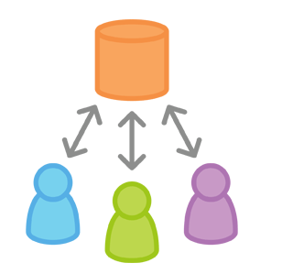
Centralized

Slide 23
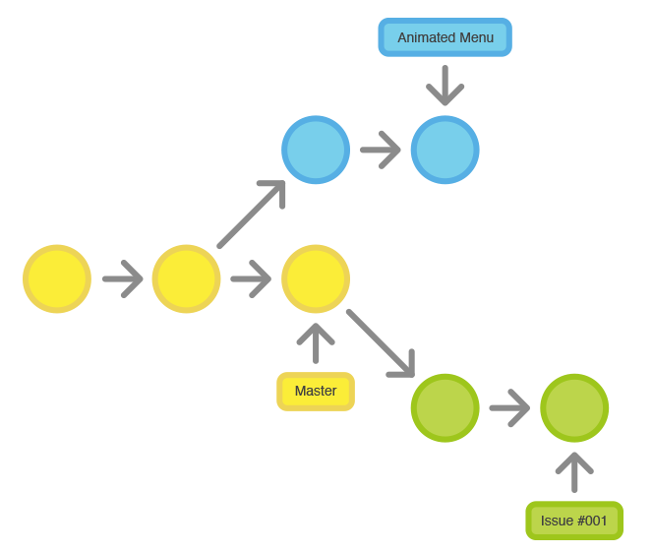
Feature Branch

Slide 24
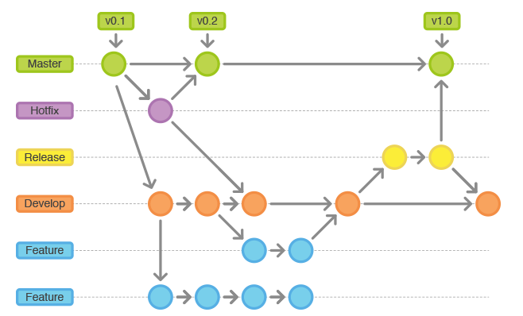
Git flow

Slide 25
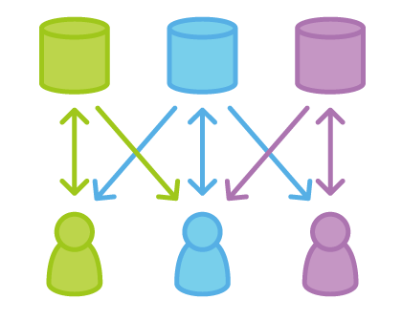
Forking

Slide 26
Code review and audit
Code review is systematic examination (often known as peer review) of computer source code. It is intended to find and fix mistakes overlooked in the initial development phase, improving both the overall quality of software and the developers' skills. Reviews are done in various forms such as pair programming, informal walkthroughs, and formal inspections.

Slide 27
Audit vs Review
Audit
  After code integration
Review
  Before code integration

Slide 28
Gerrit

Slide 29
Reference
understanding and using git kieran kelleher
  http://www.wocommunity.org/podcasts/wowodc/2012/slides/UsingGit.pdf
Tech Talk: Linus Torvalds on git
  http://www.youtube.com/watch?v=4XpnKHJAok8
https://www.atlassian.com/git/workflows

