Slide 1
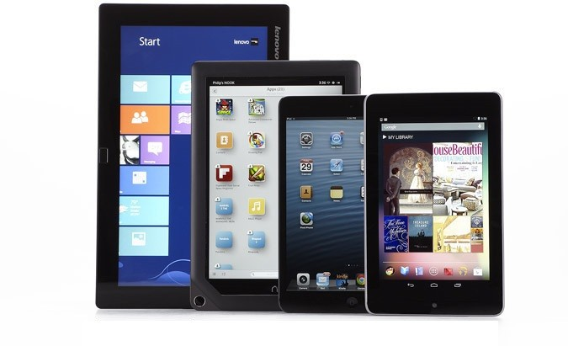
Android Mobile Development
Instructor: NGUYEN ANH MINH (M. Sc.)

Slide 2
Module 02
Android UI Tour
Android Framework
Our first Android app
Resources
Android UI Design

Slide 3
Android UI Tour

Slide 4
Android UI Tour
Android UI has many standard components that developers can reuse
Next: Review app screens and usage of UI components in popular apps
Why? These components will also be mentioned in developing Android apps

Slide 5
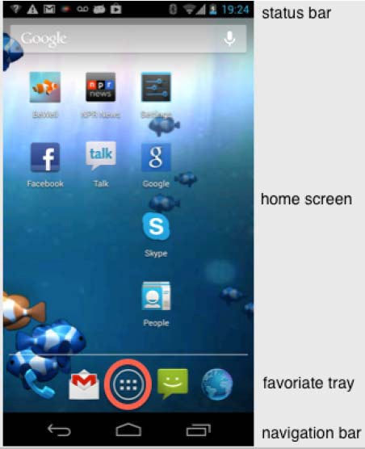
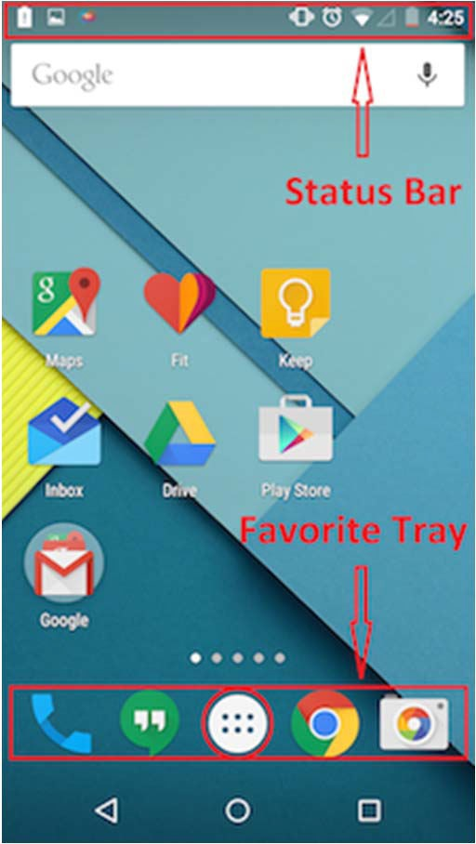
Home Screen
First screen after unlocking phone or hitting home button
Includes favorites tray (e.g phone, mail, messaging, web, etc)
Android 4.0
Android 5.0

Slide 6
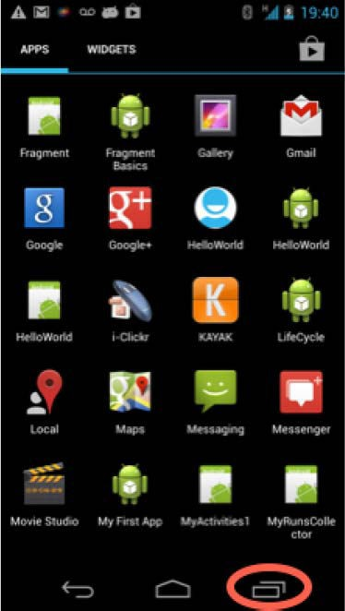
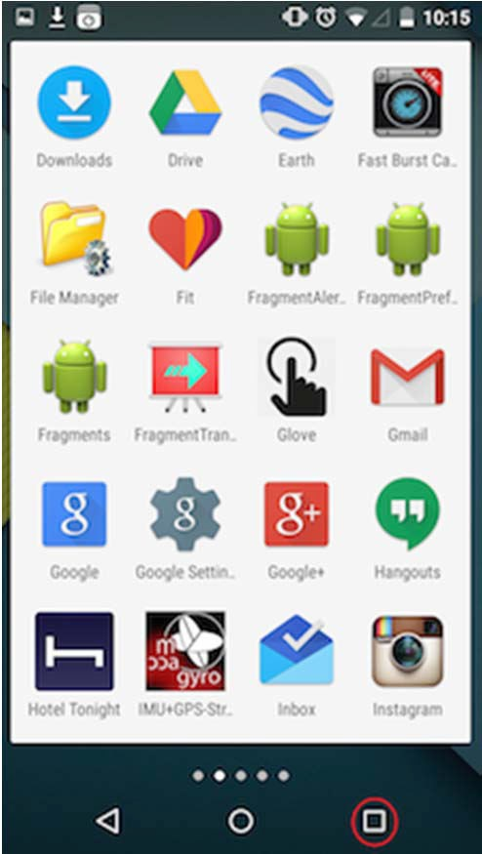
All Apps Screen
Accessed by touching all apps button in favorites tray
Users can swipe through multiple app and widget screens
Can be customized by dragging and dropping items
Android 4.0
Android 5.0

Slide 7
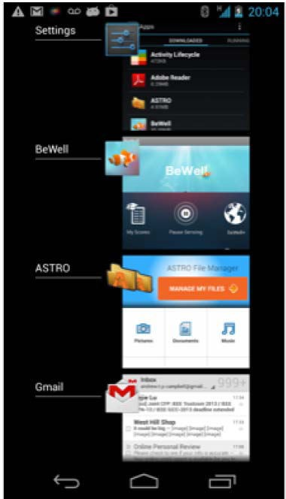
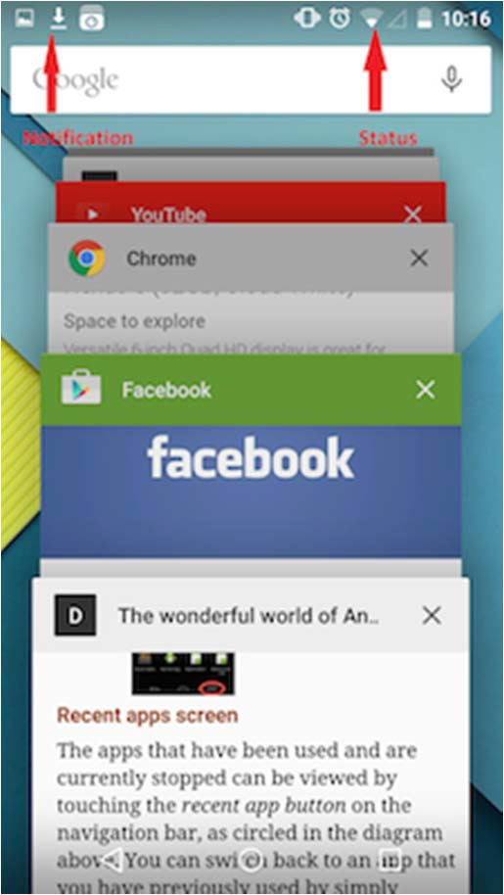
Recent Apps Screen
Accessed by touching the recent apps button
Shows recently used and currently stopped apps
Can switch to a recently used app by touching it in list
Android 4.0
Android 5.0

Slide 8
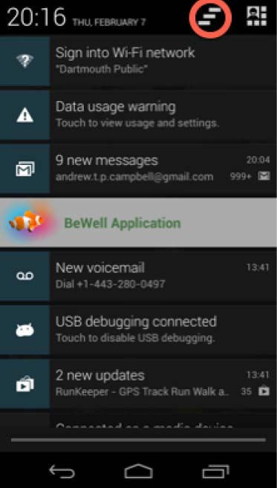
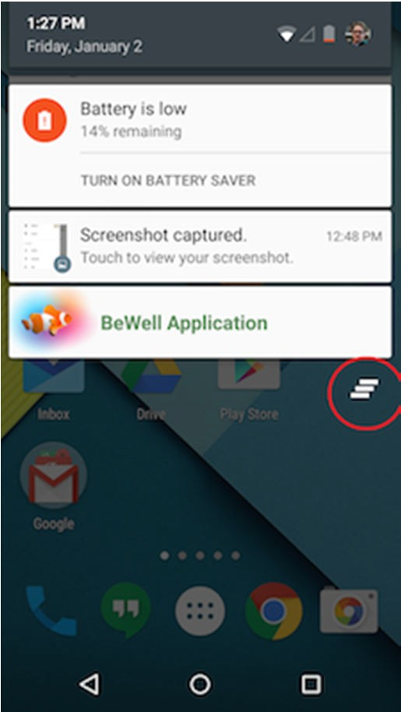
Status Bar and Notification Screen
Displays notifications (on left) and status (on right)
Status: time, battery, cell signal strength, bluetooth enabled, etc
Notification: wifi, mail, bewell, voicemail, usb active, music, etc
Android 4.0
Android 5.0

Slide 9
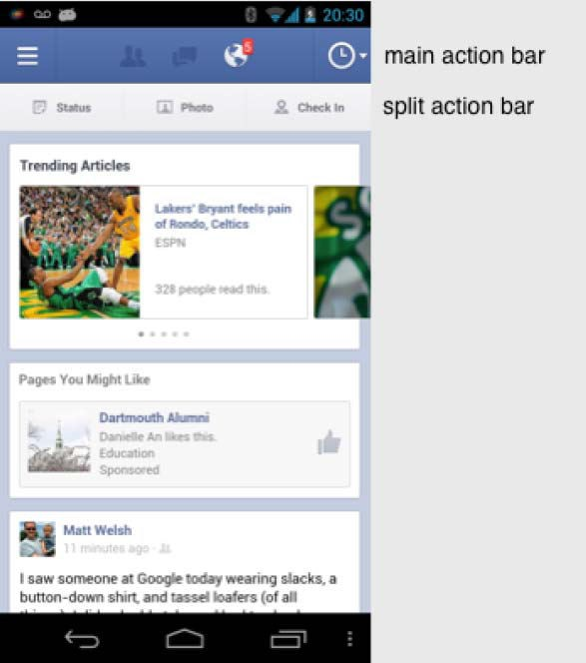
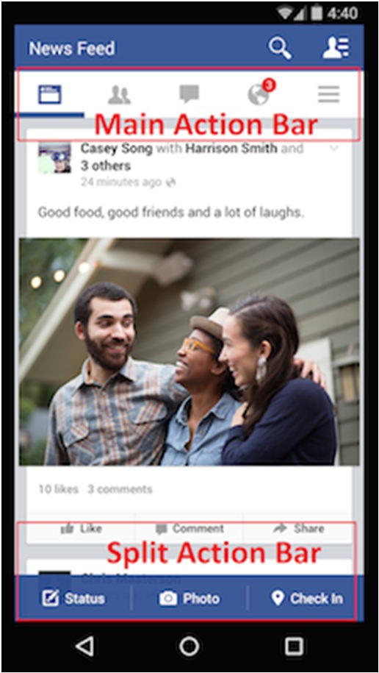
Facebook UI
Uses many standard Android UI components
Shows main action bar and split action bar
Action bar: configurable, handles user action and app navigation
Android 4.0
Android 5.0

Slide 10
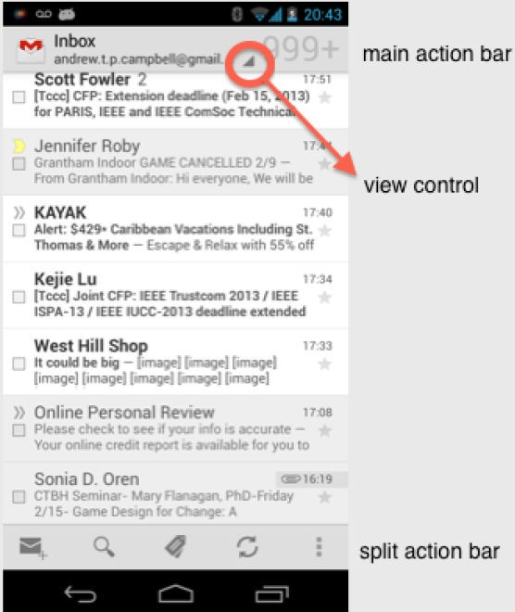
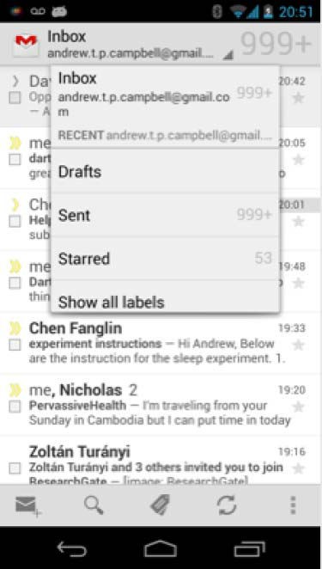
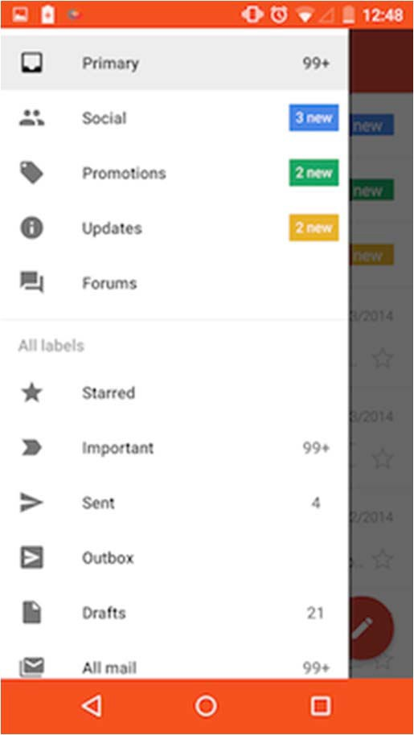
Gmail
Split action bar at bottom of screen
View control: allows users switch between different views (inbox, recent, drafts, sent)
Android 4.0
Android 4.0
Android 5.0

Slide 11
Android Software Framework

Slide 12
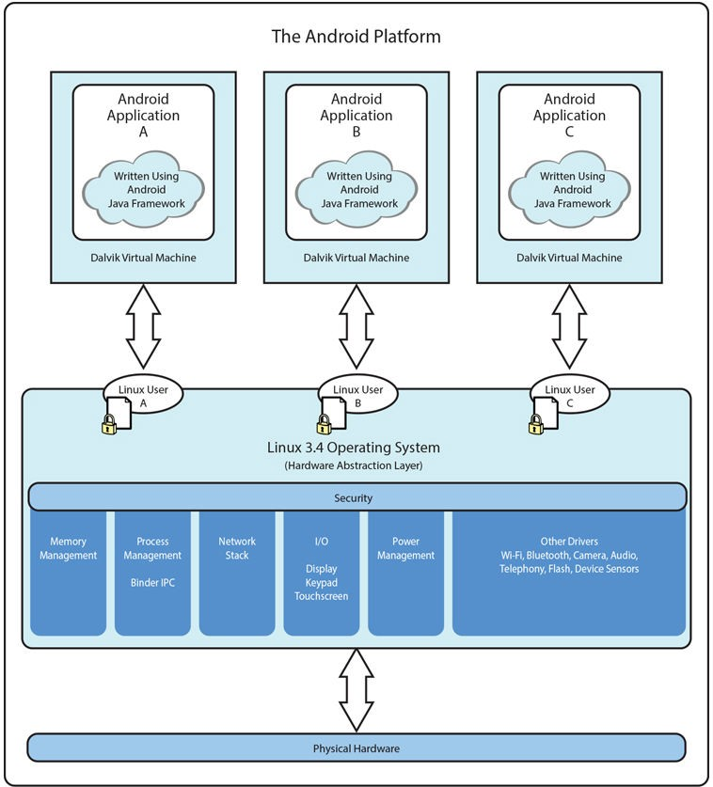
Android Software Framework
Each Android app runs in its own security sandbox (VM, minimizes complete system crashes)
Android OS multi‐user Linux system
Each app is a different user
Application’s files are private
Android starts app’s process when its components need to be executed, shuts down the process when no longer needed
Ref: Introduction to Android Programming, Annuzzi, Darcey & Conder

Slide 13
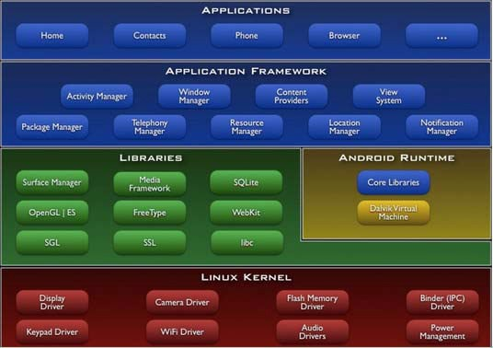
Android Software Framework
Android system assigns each app a unique Linux user ID
ID is unknown to the application
Android system sets permissions for all an app’s files so that only the process with the app’s user ID can access them

Slide 14
Our First Android App

Slide 15
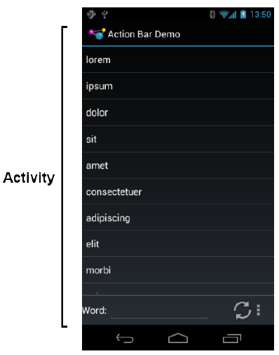
Activities
Activity: main building block of Android UI
Analogous to a window or dialog box in a desktop application
Apps
have at least 1 activity that deals with UI
Entry point of app similar to main( ) in C
Typically have multiple activities
Example: A camera app
Activity 1: to focus, take photo, start activity 2
Activity 2: to present photo for viewing, save it

Slide 16
Activities
Each activity controls 1 or more screens
Activities independent of each other
Can be coupled by control or data
App Activities are sub‐class of Activity class

Slide 17
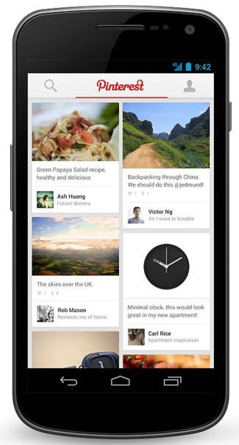
Recall: Files Hello World Android Project
3 Files:
Activity_my.xml: XML file specifying screen layout
MainActivity.Java: Java code to define behavior, actions taken when button clicked (intelligence)
AndroidManifest.xml:
Lists all screens, components of app
How these components attach themselves to overall Android system
Analogous to a table of contents for a book
E.g. Hello world program has 1 screen, so AndroidManifest.xml has 1 item listed
App starts running here (a bit like main( ) in C), launches activity with a tag “LAUNCHER”

Slide 18
Execution Order
Start in AndroidManifest.xml Read list of activities (screens) Start execution from Activity tagged Launcher
Create/execute activities (declared in java files)
E.g. MainActivity.Java
Format each activity using layout In XML file (e.g. Activity_my.xml)

Slide 19
Recall: Files Hello World Android Project
3 Files:
Activity_my.xml: XML file specifying screen layout
MainActivity.Java: Java code to define behavior, actions taken when button clicked (intelligence)
AndroidManifest.xml:
Lists all screens, components of app
How these components attach themselves to overall Android system
Analogous to a table of contents for a book
E.g. Hello world program has 1 screen, so AndroidManifest.xml has 1 item listed
App starts running here (a bit like main( ) in C), launching activity with a tag “LAUNCHER”
Next: Let’s look at AndroidManifest.XML

Slide 20
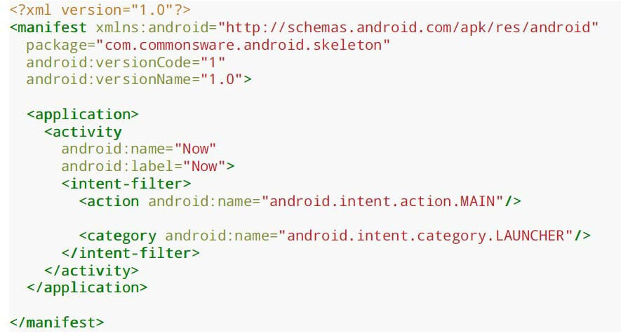
Recall: Inside “Hello World” AndroidManifest.xml
Your package name
Android version
List of activities (screens) in your app
One activity (screen) designated LAUNCHER. The app starts running here

Slide 21
Recall: Files Hello World Android Project
3 Files:
Next: Let’s look at
Simple java file
Activity_my.xml: XML file specifying screen layout
MainActivity.Java: Java code to define behavior, actions taken when button clicked (intelligence)
AndroidManifest.xml:
Lists all screens, components of app
How these components attach themselves to overall Android system
Analogous to a table of contents for a book
E.g. Hello world program has 1 screen, so AndroidManifest.xml has 1 item listed
App starts running here (a bit like main( ) in C), launching activity with a tag “LAUNCHER”

Slide 22
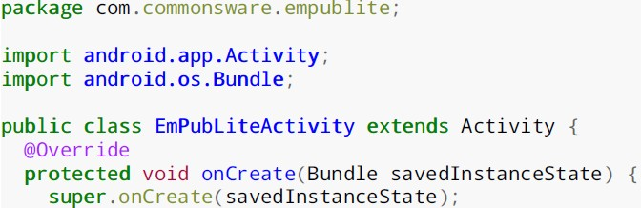

Example Activity Java file (E.g. MainActivity.java)
Package declaration (Same as chosen initially)
Import needed classes
My class inherits from Android activity class
Initialize by calling onCreate( ) method of base Activity class
Use screen layout (design) declared in file main.xml stored in folder res/layout
Note: onCreate Method is called once your Activity is created

Slide 23
Recall: Files Hello World Android Project
XML file used to design Android UI
3 Files:
Activity_my.xml: XML file specifying screen layout
MainActivity.Java: Java code to define behavior, actions taken when button clicked (intelligence)
AndroidManifest.xml:
Lists all screens, components of app
How these components attach themselves to overall Android system
Analogous to a table of contents for a book
E.g. Hello world program has 1 screen, so AndroidManifest.xml has 1 item listed
App starts running here (a bit like main( ) in C), launching activity with a tag “LAUNCHER”

Slide 24
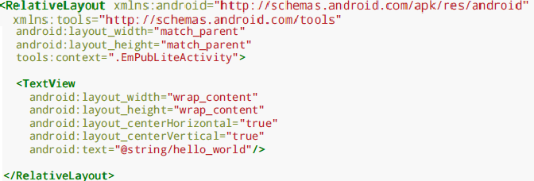
Simple XML file Designing UI
After choosing the layout, then widgets added to design UI
This file is written using xml namespace and tags and rules for android
Declare Layout
Add widgets
Widget properties (e.g. center contents
horizontally and vertically)

Slide 25
Resources

Slide 26
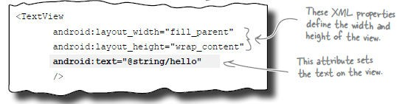
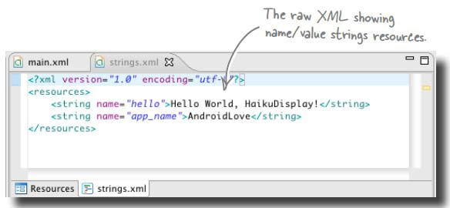
View Properties and String Resources
Views are declared with attributes for configuring them
Consider the following TextView example
@string/hello is a variable declared in another file, strings.xml

Slide 27
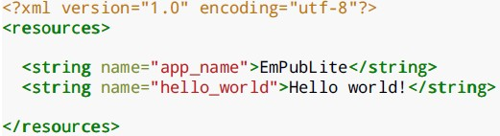
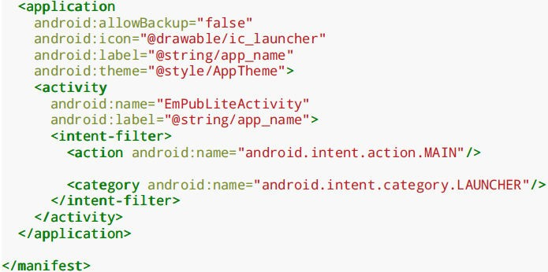
Strings in AndroidManifest.xml
Strings declared in strings.xml can be referenced by all other XML files (activity_my.xml, AndroidManifest.xml)
String declaration in strings.xml
String usage in AndroidManifest.xml

Slide 28
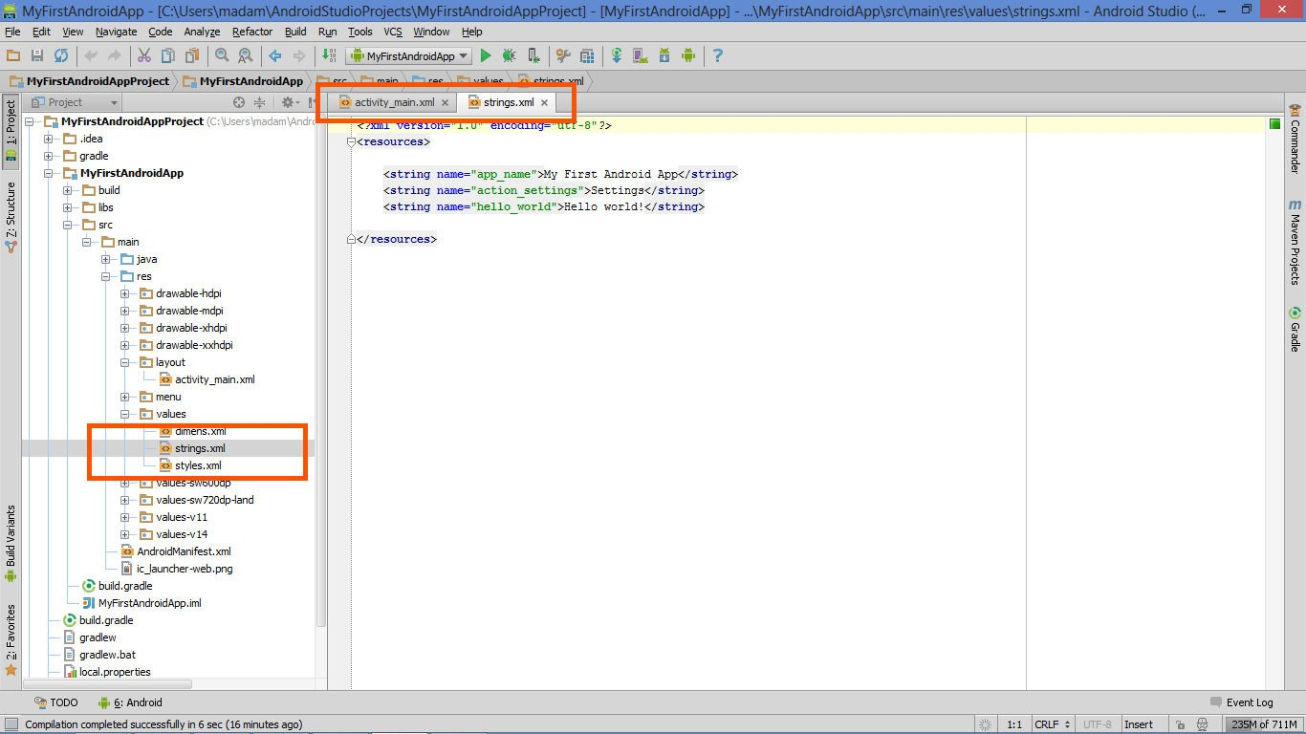
Where is strings.xml in Android Studio?
Editting any string here changes it wherever it is displayed

Slide 29

Styled Text
In HTML, tags can be used for italics, bold, etc
E.g. <i> Hello </i> makes text Hello
<b> Hello <b> makes text Hello
Can use the same HTML tags to add style (italics, bold, etc) to your Android strings

Slide 30
Recall: Example: Files in an Android Project
res/layout: The width, height, layout of screen cells are specified in XML file here
res/drawable‐xyz/: The images stored in jpg or other format here
java/: App’s behavior when user clicks on screen (e.g. button) specified in java file here
AndroidManifext.XML: Contains app name (Pinterest), list of app screens, etc

Slide 31
Resource Files in an Android Project
Resources (stored in /res folder) are static bits of information outside java code (e.g. layout, images, etc). E.g.
res/drawable‐xyz/
res/layout:
Can have multiple resource definitions, used under different conditions. E.g internalization (text in different languages)
In Android Studio, the res/ folder is
app/src/main/

Slide 32
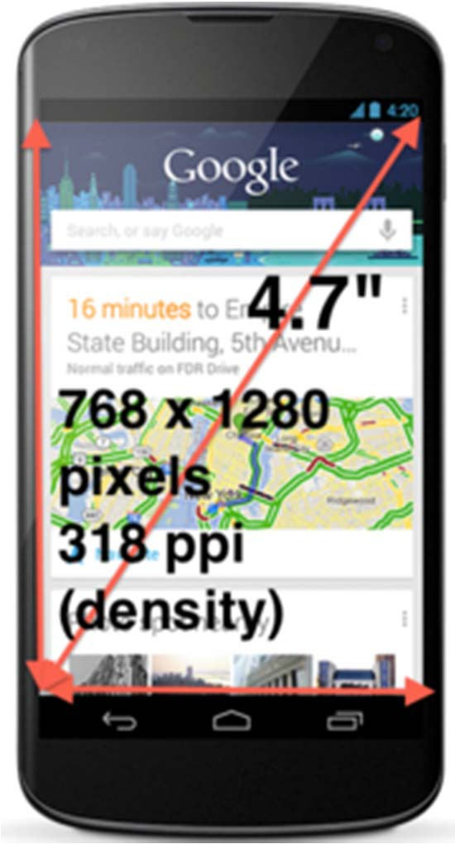
Phone Dimensions Used in Android UI
Physical dimensions measured diagonally
E.g. Nexus 4 is 4.7 inches diagonally
Resolution in pixels
E.g. Nexus 4 resolution 768 x 1280 pixels
Pixels per inch (PPI) =
● Sqrt[(768 x 768) + (1280 x 1280) ] = 318
Dots per inch (DPI) is number of pixels in a physical area
Low density (ldpi) = 120 dpi
Medium density (mdpi) = 160 dpi
High density (hdpi) = 240 dpi
Extra High Density (xhdpi) = 320 dpi

Slide 33
Adding Pictures
Android supports images in PNG, JPEG and GIF formats
GIF officially discouraged, PNG preferred format
Default directory for images (drawables) is res/drawable‐xyz
Images in res/drawable‐xyz can be referenced by XML and java files
res/drawable‐ldpi: low dpi images (~ 120 dpi of dots per inch)
res/drawable‐mdpi: medium dpi images (~ 160 dpi)
res/drawable‐hdpi: high dpi images (~ 240 dpi)
res/drawable‐xhdpi: extra high dpi images (~ 320 dpi)
res/drawable‐xxhdpi: extra extra high dpi images (~ 480 dpi)
res/drawable‐xxxhdpi: high dpi images (~ 640 dpi)
Images in these directories are same size, different resolutions

Slide 34
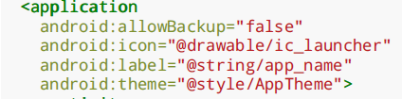
Adding Pictures
Just the generic picture name is used
No format e.g. .png,
No specification of what resolution to use
E.g. to reference an image ic_launcher.png
Android chooses which directory (e.g. –mdpi) based on actual device
Android studio tools for generating icons
Icon wizard or Android asset studio: generates icons in various densities from starter image
Cannot edit images (e.g. dimensions) with these tools

Slide 35

Editting Pictures
Image dimensions:
px: hardware pixels, varies from device to device
in and mm: inches or millimeters based on actual screen size
pt: 1/72nd of an inch
dip (or dp): density‐independent pixels
1 dip = 1 hardware pixel on ~160 dpi screen
1 dip = 2 hardware pixels on ~ 320 dpi screen
sp (or scaled pixels): scaled pixels
Dimensions declared in dimens.xml
Can reference “thin” declared above
In XML layout files as @dimen/thin
In Java using Resources.getDimension(R.dimen.thin)

Slide 36
Styles
Styles specify rules for look of Android screen
Similar to Cascaded Style Sheets (CSS) in HTML
E.g CSS enables setting look of certain types of tags.
E.g. font and size of all <h1> and <h2> elements
Android widgets have properties
E.g. Foreground color = red
Styles in Android: collection of values for properties
Styles can be specified one by one or themes (e.g. Theme, Theme.holo and Theme.material) can be used

Slide 37
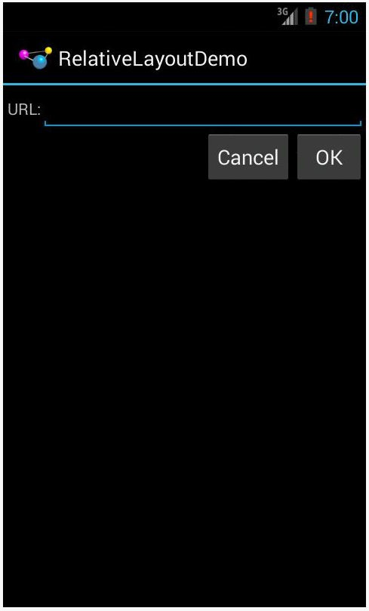
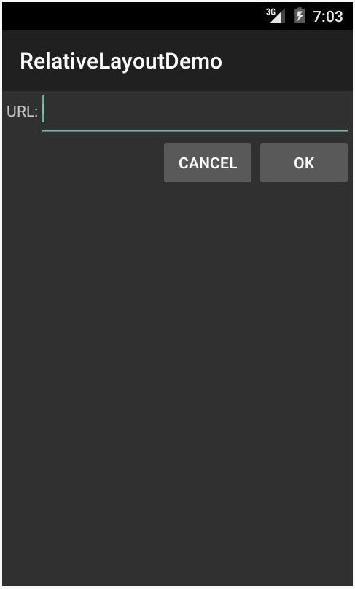
Default Themes
Android chooses a default theme if you specify none
Also many stock themes to choose from
Theme.Holo: default theme in Android 3.0
Theme.Material: default theme in Android 5.0

Slide 38
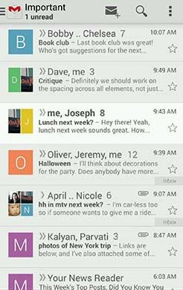
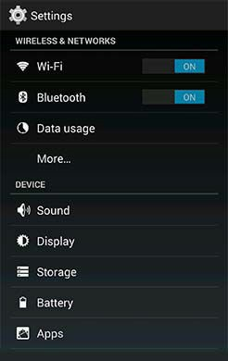
Examples of Themes in Use
GMAIL in Holo Light
Settings in Holo Dark

Slide 39
Android UI Design in XML

Slide 40
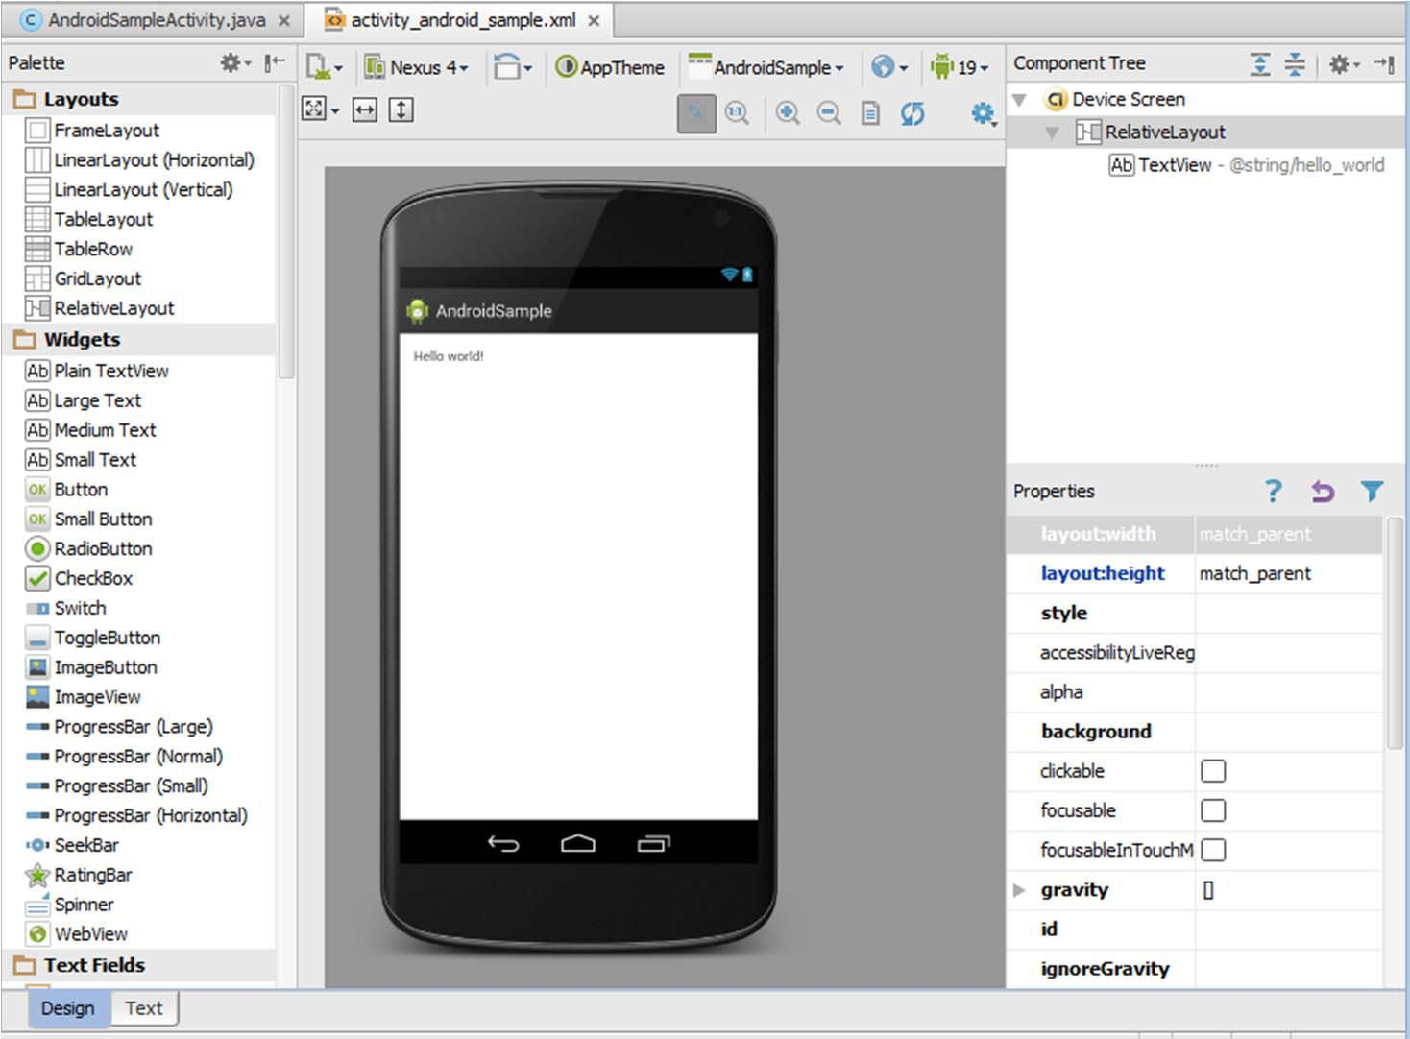
Recall: Edit XML Layouts using Graphical IDE
Can drag and drop widgets, layouts in Android Studio
Can also edit their properties (e.g. height, width, color, etc)
Drag and drop layout
Edit layout properties
Drag and drop button or any other widget or view

Slide 41
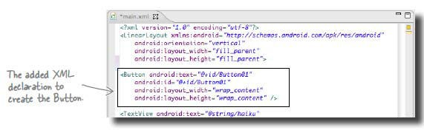
XML Generated
Clicking and dragging button or widget adds corresponding XML to appropriate XML file (e.g. main.xml)

Slide 42
Recall: Files Hello World Android Project
XML file used to design Android UI
3 Files:
Activity_my.xml: XML file specifying screen layout
MainActivity.Java: Java code to define behavior, actions taken when button clicked (intelligence)
AndroidManifest.xml:
Lists all screens, components of app
How these components attach themselves to overall Android system
Analogous to a table of contents for a book
E.g. Hello world program has 1 screen, so AndroidManifest.xml has 1 item listed
App starts running here (a bit like main( ) in C), launching activity with a tag “LAUNCHER”

Slide 43
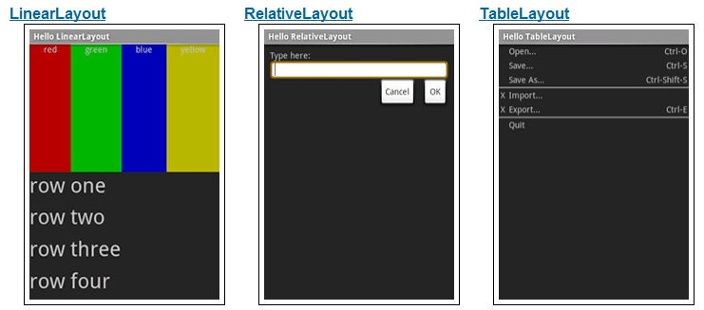
Android UI using XML Layouts
Android UI are usually designed in XML
Note: Android UI can also be designed in Java (more later)
In the XML file, we have to choose a layout to use
http://developer.android.com/resources/tutorials/views/index.html

Slide 44
Layouts
Layouts can contain UI elements (provided and custom)
Stored in res/layout
Useful Layouts:
FrameLayout,
LinearLayout,
TableLayout,
GridLayout,
RelativeLayout,
ListView,
GridView,
ScrollView,
DrawerLayout,
ViewPager
More on layouts next

Slide 45
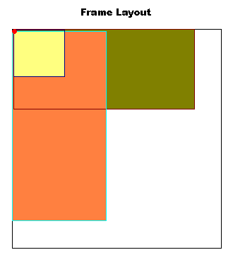
FrameLayout
FrameLayout
simplest type of layout object
fill with single object (e.g a picture)
child elements pinned to top left corner of screen, cannot be moved
adding a new element / child draws over the last one

Slide 46
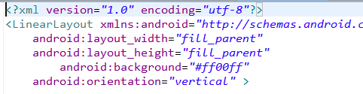
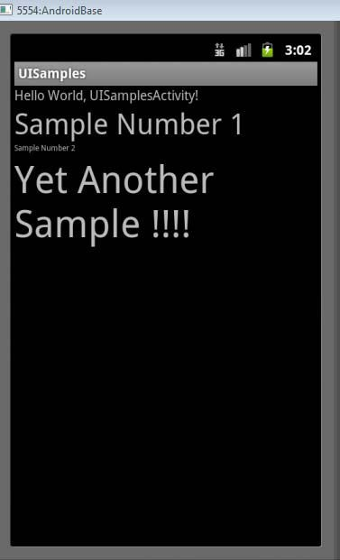
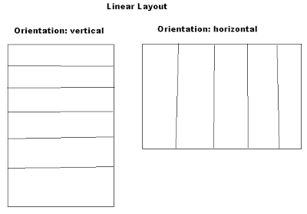
LinearLayout
aligns child elements (e.g. buttons, text boxes, pictures, etc.) in single direction
Example:
orientation attribute defines direction (vertical or horizontal):
android:orientation="vertical"

Slide 47
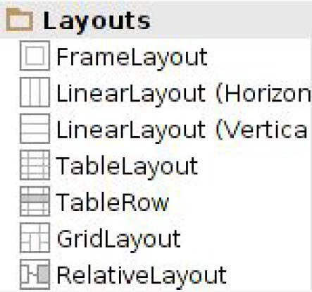
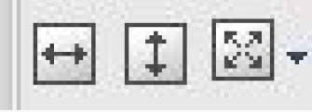
LinearLayout in Android Studio
LinearLayout can be found in palette of Android Studio Graphical Layout Editor
After selecting LinearLayout, toolbars buttons to set parameters
Toggle width, height between match_parent and wrap_content
Change gravity of LinearLayout

Slide 48
Attributes
Layouts have attributes (e.g. width, height, orientation)
Statements to set attribute values appears in XML file.
E.g. android:orientation="vertical"
Attributes can be set:
In xml file
Using IDE (e.g. Android Studio)
In Java program
Lots of attributes!

Slide 49
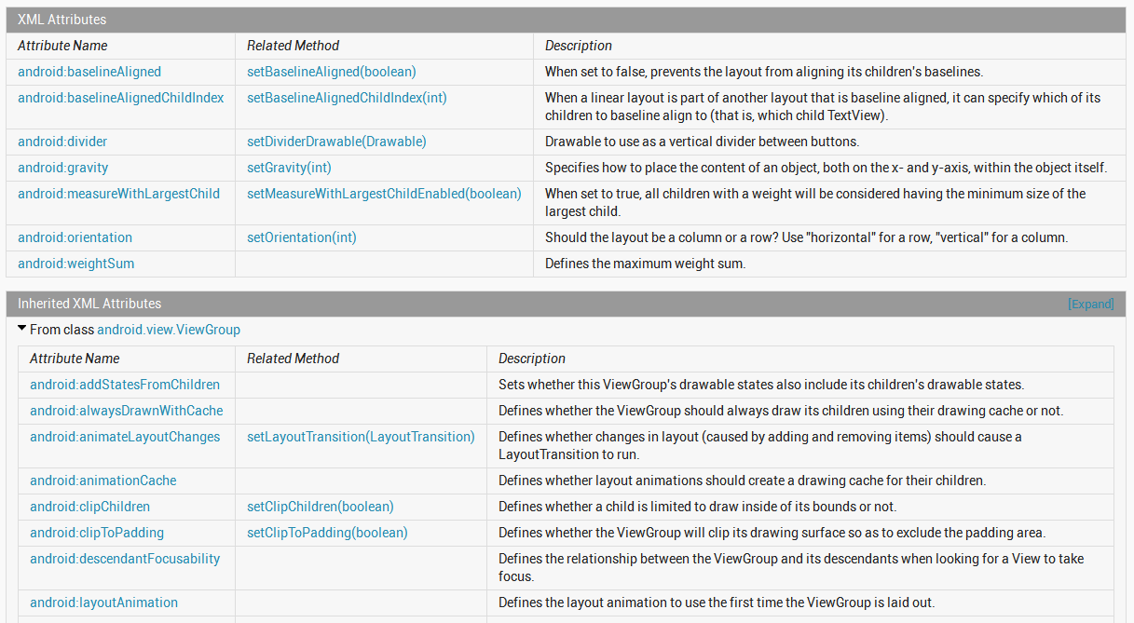
Attributes
Can find complete list of attributes, possible values on Android Developer website

Slide 50
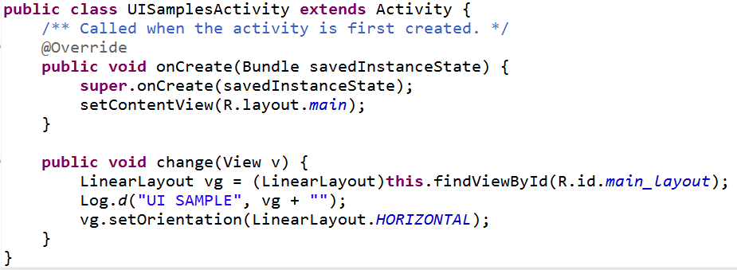
Setting Attributes
in layout xml file
in Java program (More later)

