Slide 1
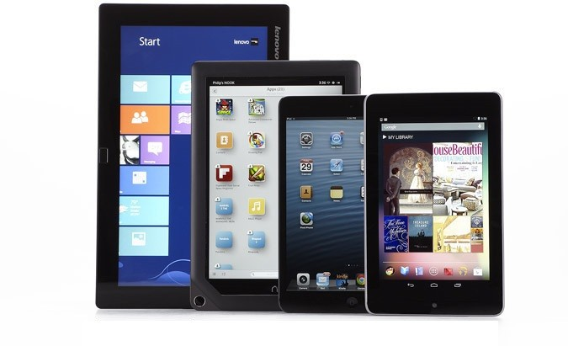
Android Mobile Development
Instructor: NGUYEN ANH MINH (M. Sc.)

Slide 2
Module 03
Android UI Design
Android Framework
Android UI Controls
Web View widget
Android components

Slide 3
Android UI Design Example

Slide 4
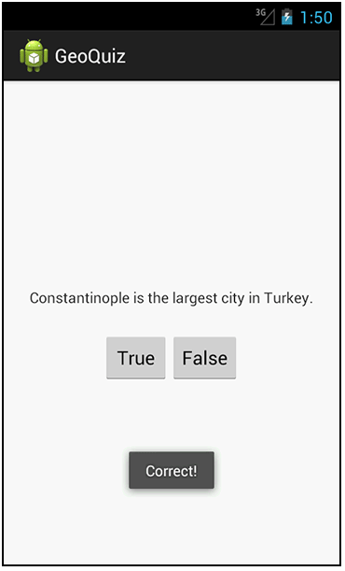
GeoQuiz App
Reference: Android Nerd Ranch, pgs 1‐30
App presents questions to test user’s knowledge of geography
User answers by pressing True or False
buttons
Question
How to get this book?
User responds by clicking True or False

Slide 5
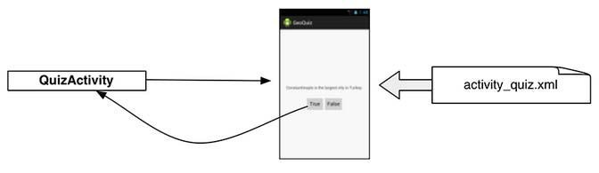
GeoQuiz App
2 main files:
activity_quiz.xml: to format app screen
QuizActivity.java: To present question, accept True/False response
AndroidManifest.xml also auto‐generated

Slide 6
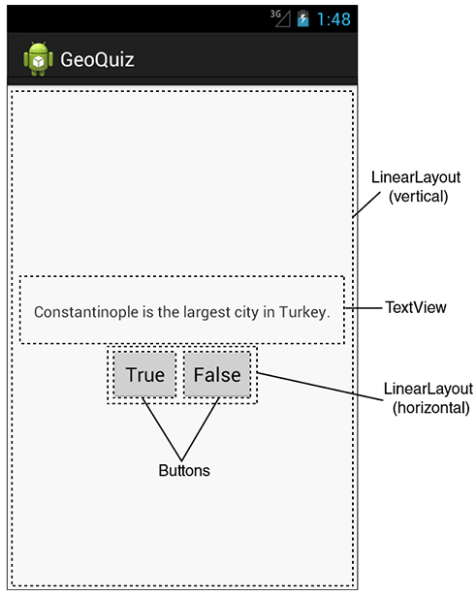
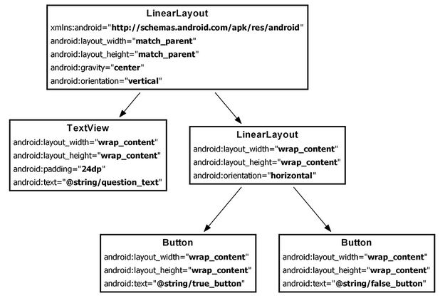
GeoQuiz: Plan Out App Widgets
5 Widgets arranged hierarchically

Slide 7
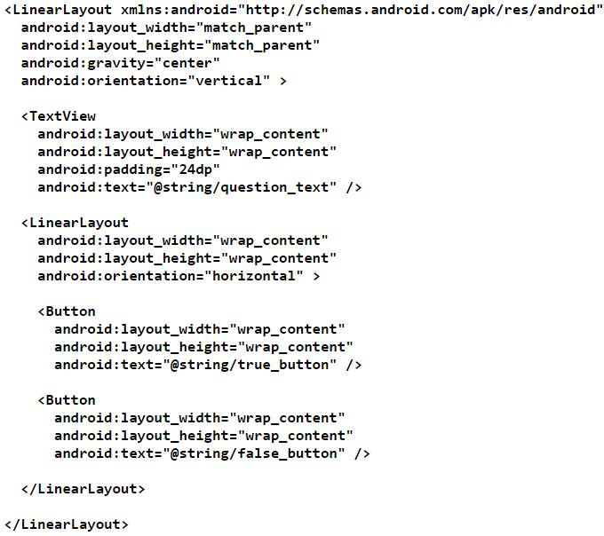
GeoQuiz: activity_quiz.xml File listing

Slide 8
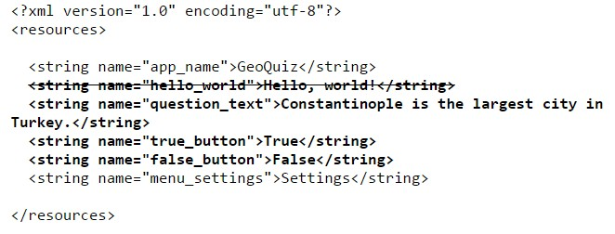
GeoQuiz: strings.xml File listing

Slide 9
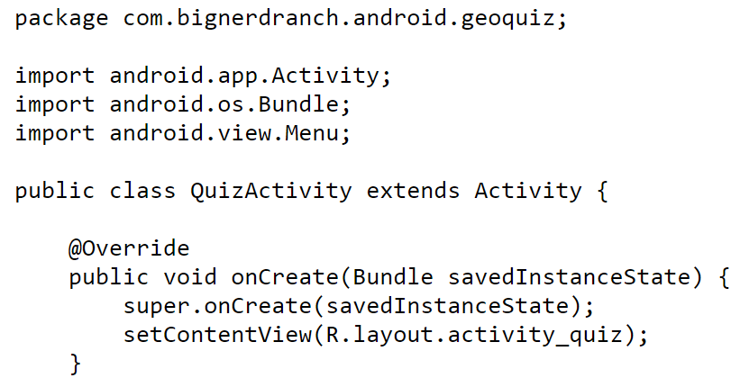
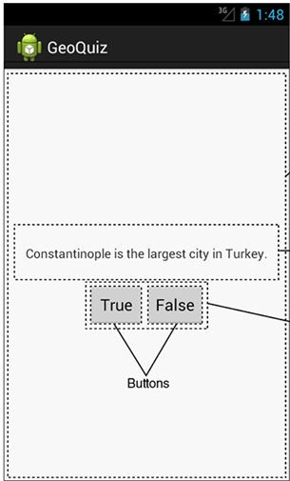
QuizActivity.java
Initial QuizActivity.java code
onCreate Method is called once Activity is created
specify layout XML file
Would like java code to respond to True/False buttons being clicked

Slide 10
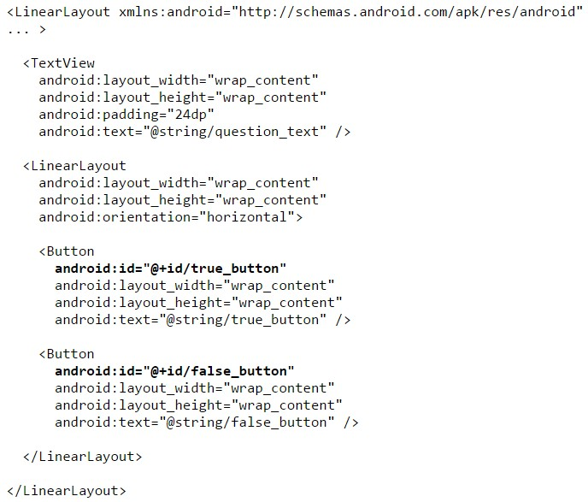
Responding to True/False Buttons in Java
Write code in Java file to specify app’s response when True/False buttons are clicked

Slide 11
2 Ways to Respond to Button Clicks
In XML: set android:onClick attribute
In java create a ClickListener object, override onClick method
typically done with anonymous inner class

Slide 12
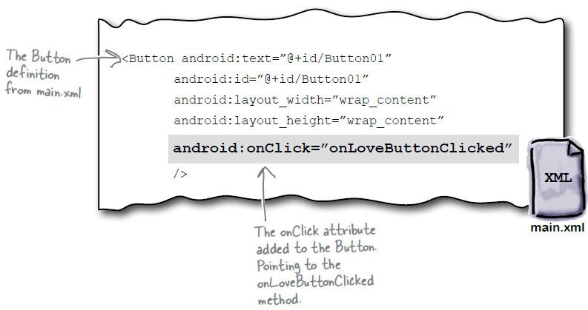
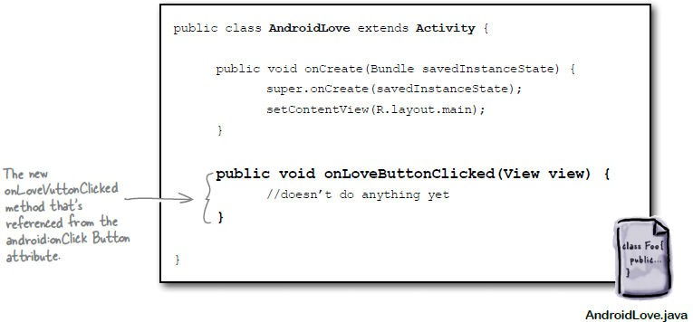
Approach 1: Button that responds to Clicks Reference: Head First Android
1. In XML file (e.g. main.xml), set android:onClick attribute to specify (onLoveButtonClicked) to be invoked
2. In Java file (e.g. AndroidLove.java) declare and implement method/handler to take desired action

Slide 13
Background: User Interface Elements
When views (buttons, widgets, etc) are declared in XML are actually Java classes within Android
Using XML declarations, Android actually creates corresponding Java objects (called inflating a view)
View
basic building block for Android UI
Android class that represents a rectangular area on the screen
Responsible for drawing and event handling
View is the super class for:
Textview, Imageview
Controls such as buttons, spinners, seek bars, etc.
ViewGroups which in turn is the super class for layouts

Slide 14
ViewGroups ‐ Layouts
Layouts:
invisible containers that store other Views
Subclasses of ViewGroup
Still a view but doesn't actually draw anything
A container for other views
Specifies options on how sub views (and view groups) are arranged

Slide 15
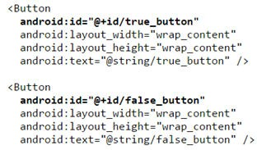
Approach 2: Create a ClickListener object, override onClick
First, get reference to Button in our Java file. How?
Need reference to Buttons

Slide 16
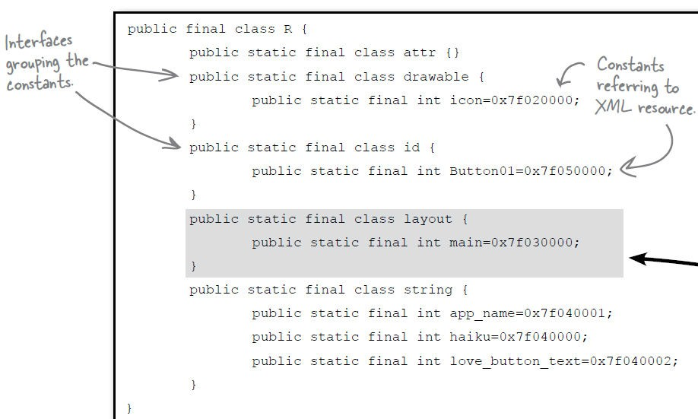
R.Java Constants
During compilation, XML resources (drawables, layouts, strings, views with IDs, etc) are assigned constants
Sample R.Java file

Slide 17

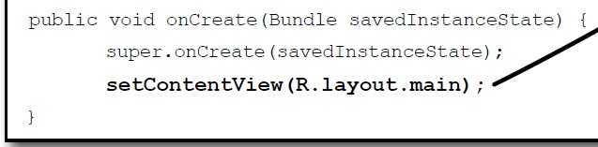
Referring to Resources in Java File
Can refer to resources in Java file using these constants
Example
Constant assigned to R.layout.main at runtime
In java file, R.java the constant corresponding to main.xml is argument of setContentView
Pass in layout file as constant assigned to R.layout.main

Slide 18

Referencing Widgets by ID
Many widgets and containers appear only in XML. E.g. TextView
No need to be referenced in Java code
To reference a widget in Java code, you need its android:id
In java file, to reference/manipulate view/widget use its ID to find it (call findviewbyID( ) )
In XML file, give the widget/view an ID
i.e. assign android:id

Slide 19
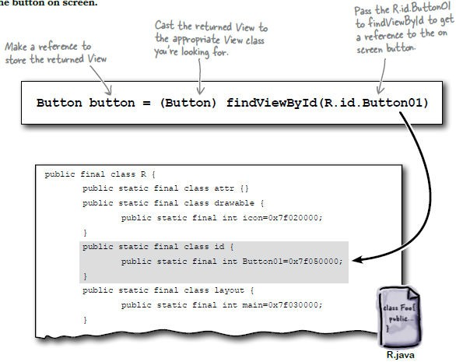
Getting View References
findViewById is implemented in base Activity class so it can be called in our java file (e.g. MainActivity.java)
Argument of findViewById is constant of resource
A generic view is returned (not subclasses e.g. buttons, TextView), so needs to cast

Slide 20
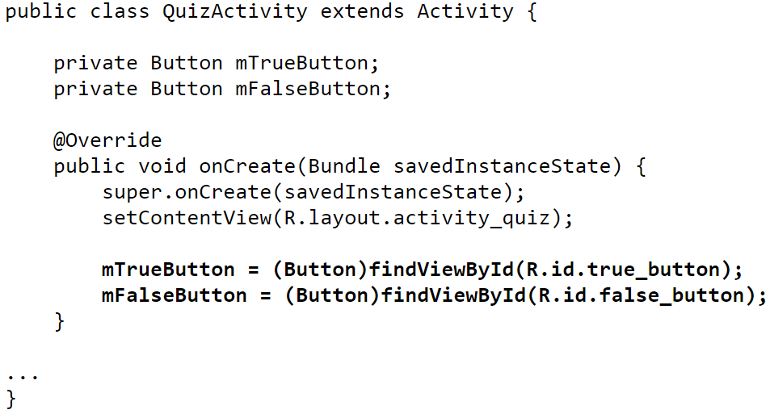
QuizActivity.java: Getting References to Buttons
To get reference to buttons in java code
Declaration in XML

Slide 21
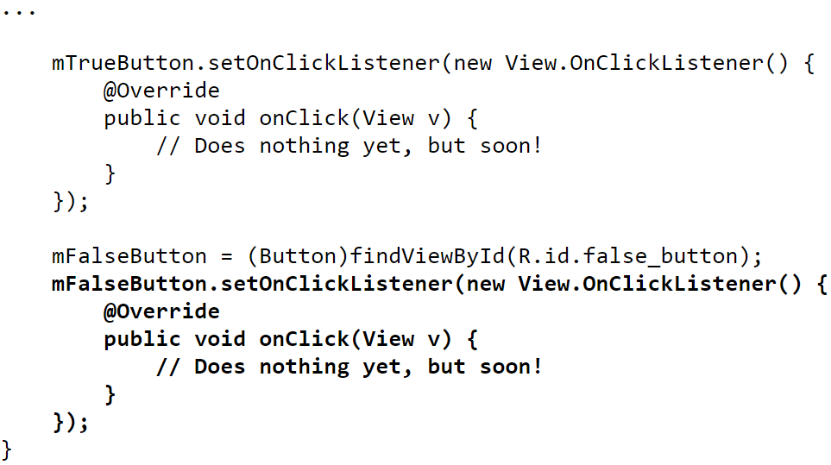
QuizActivity.java: Setting Listeners
Set listeners for True and False button
1.Set Listener Object For mTrueButton
3. Overide onClick method (insert your code to do whatever you want as mouse response here)
2. Create listener object as anonymous (unnamed) inner object

Slide 22
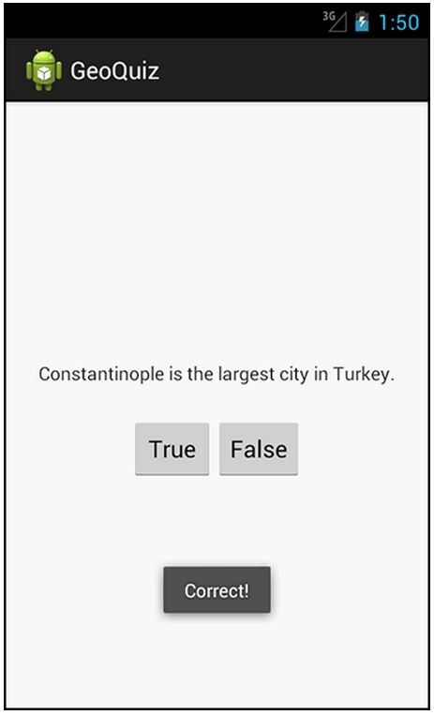
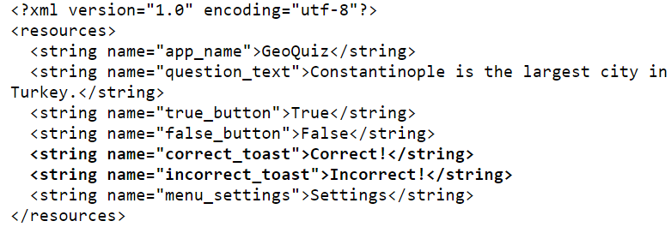
QuizActivity.java: Adding a Toast
A toast is a short pop‐up message
Does not require any input or action
After user clicks True or False button, our app will pop‐up a toast to inform the user if they were right or wrong
First, we need to add toast strings (Correct, Incorrect) to strings.xml
A toast

Slide 23
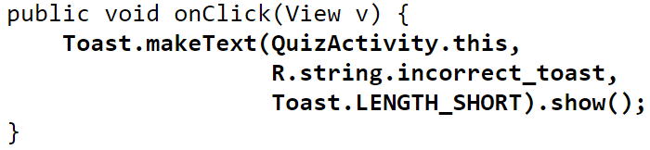
QuizActivity.java: Adding a Toast
To create a toast, call the method:
Instance of Activity (Activity is a subclass of context)
Resouce ID of the string that toast should display
Constant to specifiy how long toast should be visible
After creating toast, call toast.show( )
to display it
For example to add a toast to our onClick( ) method:

Slide 24
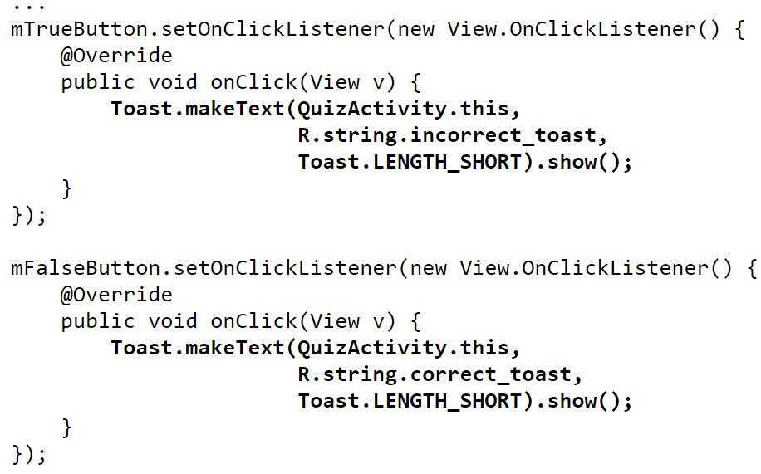
QuizActivity.java: Adding a Toast
Code for adding a toast
1.Set Listener Object For mTrueButton
3. Overide onClick method Make a toast
2. Create listener object as anonymous innner object

Slide 25
package com.bignerdranch.android.geoquiz;
import android.app.Activity; import android.os.Bundle; import android.view.Menu; import android.view.View; import android.widget.Button; import android.widget.Toast;
QuizActivity.java: Complete Listing
public class QuizActivity extends Activity {
Button mTrueButton; Button mFalseButton;
@Override
protected void onCreate(Bundle savedInstanceState) { super.onCreate(savedInstanceState); setContentView(R.layout.activity_quiz);
mTrueButton = (Button)findViewById(R.id.true_button); mTrueButton.setOnClickListener(new View.OnClickListener() {
@Override
public void onClick(View v) { Toast.makeText(QuizActivity.this,
R.string.incorrect_toast, Toast.LENGTH_SHORT)
.show();
}
});

Slide 26
mFalseButton = (Button)findViewById(R.id.false_button); mFalseButton.setOnClickListener(new View.OnClickListener() {
@Override
public void onClick(View v) { Toast.makeText(QuizActivity.this,
R.string.correct_toast, Toast.LENGTH_SHORT)
.show();
}
QuizActivity.java: Complete Listing (Contd)
});
}
@Override
public boolean onCreateOptionsMenu(Menu menu) {
// Inflate the menu;
// this adds items to the action bar if it is present.
getMenuInflater().inflate(R.menu.activity_quiz, menu); return true;
}
}
Used if app has an Action bar menu

Slide 27
Android UI Controls

Slide 28
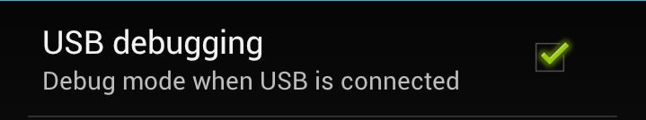
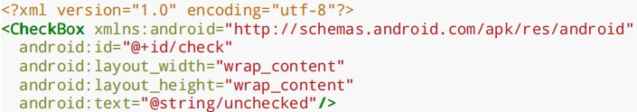
Recall: Checkbox
Has 2 states: checked and unchecked
Clicking on checkbox toggles between these 2 states
Used to indicate a choice (e.g. Add rush delivery)
Since Checkbox widget inherits from TextView, its properties (e.g. android:textColor) can be used to format checkbox
XML code to create Checkbox:

Slide 29
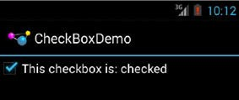
Making Checkbox Responsive
2 ways to make Checkbox responsive:
Set android:onClick attribute or
Create a ClickListener object, override onClick method, and register it with the checkbox
In Java code, the following commands may be used
isChecked( ): to determine if checkbox has been checked
setChecked( ): to force checkbox into checked or unchecked state
toggle( ): to toggle current checkbox setting

Slide 30
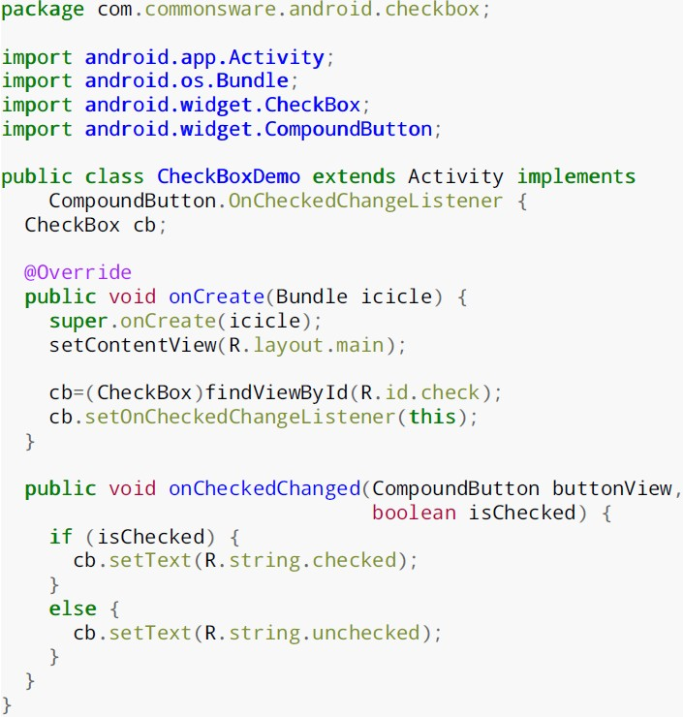
Checkbox Example Java Code
Checkbox inherits from CompoundButton
Register listener OnCheckedChangeListener to be notified when checkbox state changes
Callback, called When checkbox state changes

Slide 31
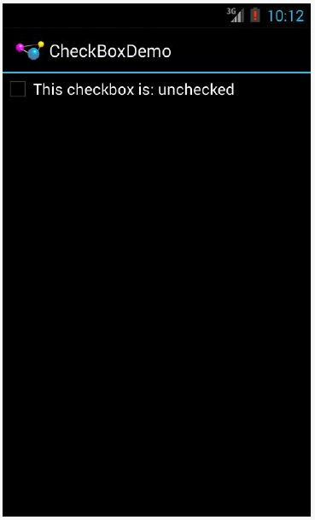
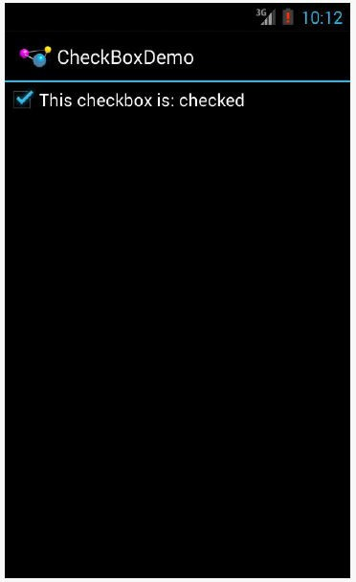
Checkbox Example Result

Slide 32
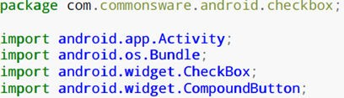
Important Android Packages
Android programs usually import packages at top. E.g.
Important packages
android*
dalvik*
java.*
Android application
Dalvik virtual machine support classes
Core classes and generic utilities (networking, security, math, etc)
HTTP protocol support
Ref: Introduction to Android Programming, Annuzzi, Darcey & Conder
org.apache.http:

Slide 33
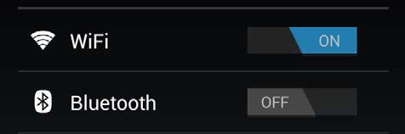

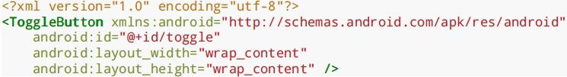
Toggle Button
ToggleButton and Switches
Like CheckBox has 2 states
However, visually shows states on and off text
XML code to create ToggleButton
Can also set up an onCheckedChangeListener to be notified when user changes ToggleButton state

Slide 34
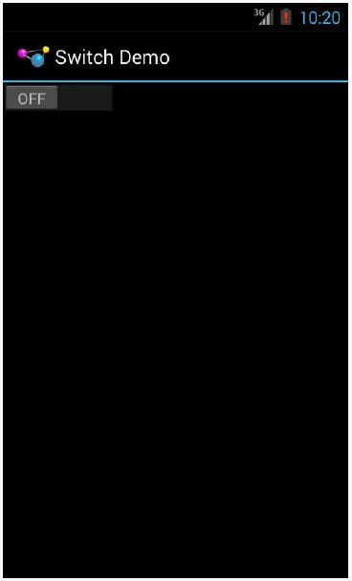
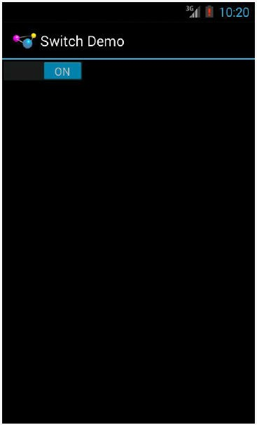
Switch Widget
Android Switch widget shows state via small ON/OFF slider
Added in API level 14

Slide 35
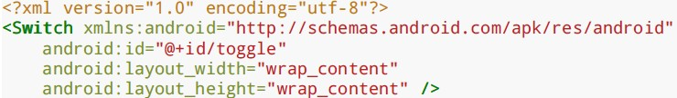
Switch Widget
XML code for creating Switch
Checkbox, ToggleButton and Switch inherit from
CompoundButton
Common API for
toggle( )
isChecked( )
setChecked( )

Slide 36
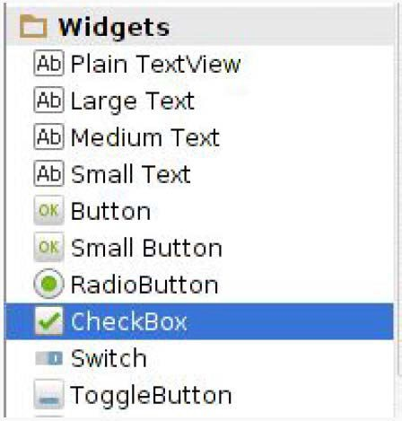
Creating Checkbox, ToggleButton or Switch in Android Studio
Checkbox, Togglebutton and Switch widgets are in Android Studio palette
Can drag and drop them unto app screen then configure properties

Slide 37
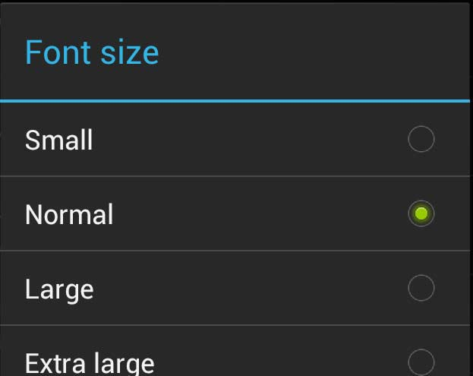
RadioButton and RadioGroup
Select only 1 option from a set
set onClick method for each button
generally same method
Inherits from CompoundButton which inherits from TextView
Format using TextView properties (font, style, color, etc)
Can use methods isChecked( ), toggle( )
Collected in RadioGroup
sub class of LinearLayout
Can have vertical or horizontal orientation

Slide 38

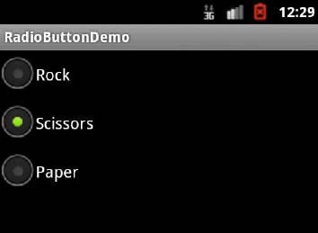
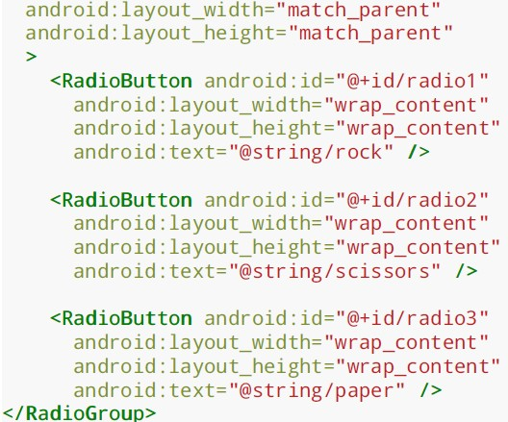
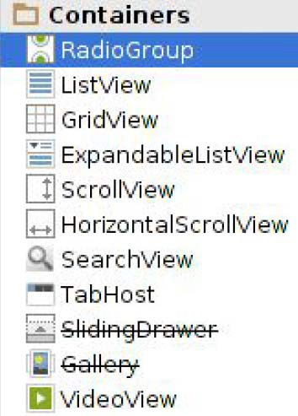
RadioButton and RadioGroup
XML code to create Radio Button
Available in Android Studio palette

Slide 39
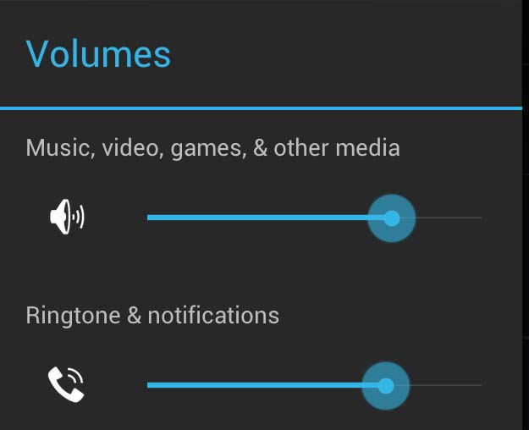
SeekBar
a slider
Subclass of progress bar
implement a SeekBar.OnSeekBarChangeListener to respond to changes in setting

Slide 40
WebView Widget

Slide 41

WebView Widget
A View that display web pages
Can be used for creating your own web browser
OR just display some online content inside your app
Uses WebKit rendering engine (lots of memory)
http://www.webkit.org/
Webkit used in many web browsers including Safari
Web pages in WebView same look same as in Safari
40

Slide 42


WebView
Android 4.4, API level 19 added Chromium as alternative to WebKit
Chromium: http://www.chromium.org/Home
"Chromium WebView provides broad support for HTML5, CSS3, and JavaScript.
Supports most HTML5 features available in Chrome.
Also has updated JavaScript Engine (V8) with vastly improved JavaScript performance. "
https://developer.android.com/about/versions/kitkat.html
41

Slide 43
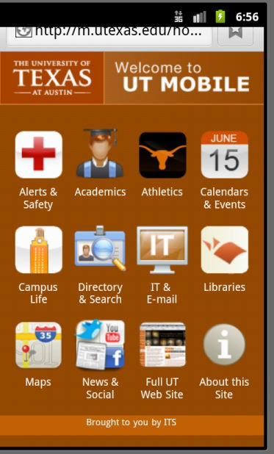
WebView Widget Functionality
Display Web page containing HTML, CSS, Javascript
Navigation history of URLs to support forward and backwards
zoom in and out
perform searches
Additional functionality:
capture images of page
Search page for string
Deal with cookies on a per application basis

Slide 44
Scenarios for Using Webview NOT Browser
Provide info requiring periodic updates.
Example: end user agreement or user guide (no need to update app)
OR display documents hosted online
OR access application data available on Internet
OR display ads
http://developer.android.com/guide/webapps/webview.html

Slide 45
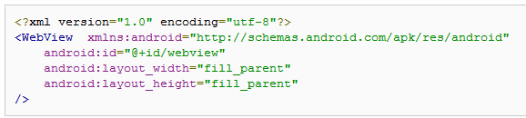
WebView Example
Simple app to view and navigate web pages
XML code (e.g in res/layout/main.xml)

Slide 46
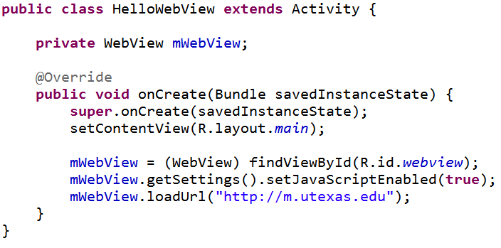
WebView Activity
In onCreate, use loadURL to load website
If website contains Javascript, enable Javascript

Slide 47
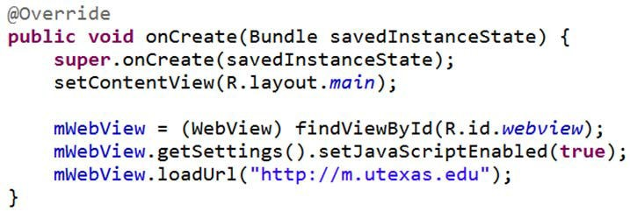
loadUrl( )
loadUrl( ) Works with
http:// and https:// URLs
file// URLs pointing to local filesystem
file:/// android_asset/ URLs pointing to app’s assets (later)
content:// URLs pointing to content provider that is streaming published content

Slide 48
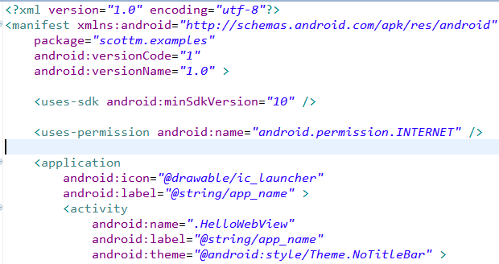
WebView Example
Add permission to AndroidManifest.xml for app to use Internet
Also change style so no title bar
47

Slide 49
Android App Components

Slide 50
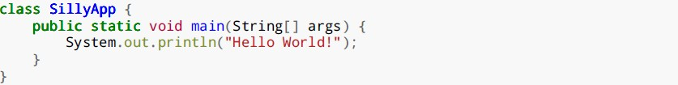
Android App Components
Typical Java program starts from main( )
Android app: No need to write a main
Just define app components by creating sub‐classes of base classes already defined in Android
4 main types of Android app components:
Activities (already seen this)
Services
Content providers
Broadcast receivers

Slide 51
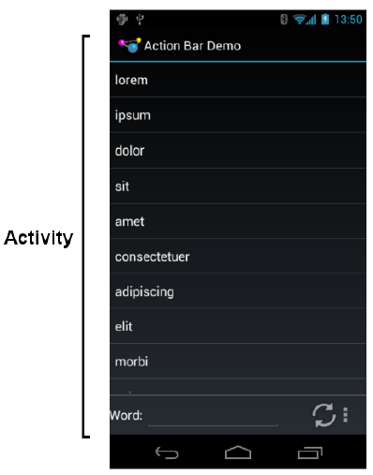
Recall: Activities
Activity: main building block of Android UI
Analogous to a window or dialog box in a desktop application
Apps
have at least 1 activity that deals with UI
Entry point of app similar to main( ) in C
typically have multiple activities
Example: A camera app
Activity 1: to focus, take photo, start activity 2
Activity 2: to present photo for viewing, save it

