Slide 1
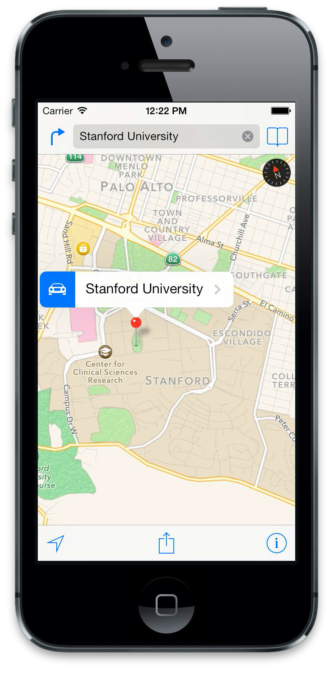
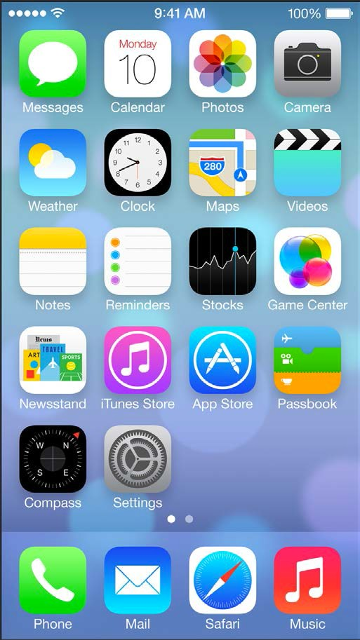
iOS Mobile Development
Instructor: NGUYEN ANH MINH (M. Sc.)

Slide 2
Module 03
TableView
CoreData
ViewController

Slide 3
Table View

Slide 4
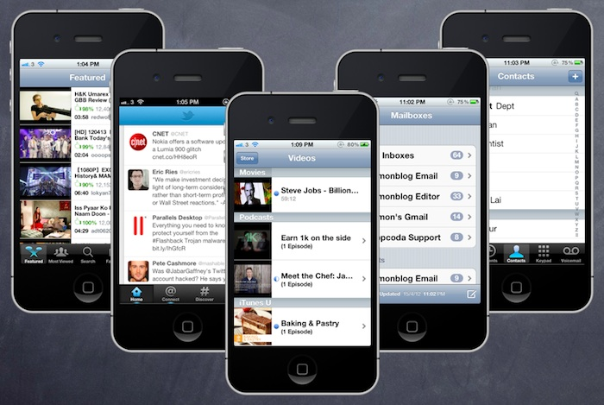

Slide 5
Table View is one of the common UI elements in iOS apps. Most apps, in some ways, make use of Table View to display list of data. The best example is the built-in Phone app.
Your contacts are displayed in a Table View. Another example is the Mail app. It uses Table View to display your mail boxes and emails.
Not only designed for showing textual data, Table View allows you to present the data in the form of images. The built-in Video and YouTube app are great examples for the usage.

