Slide 1
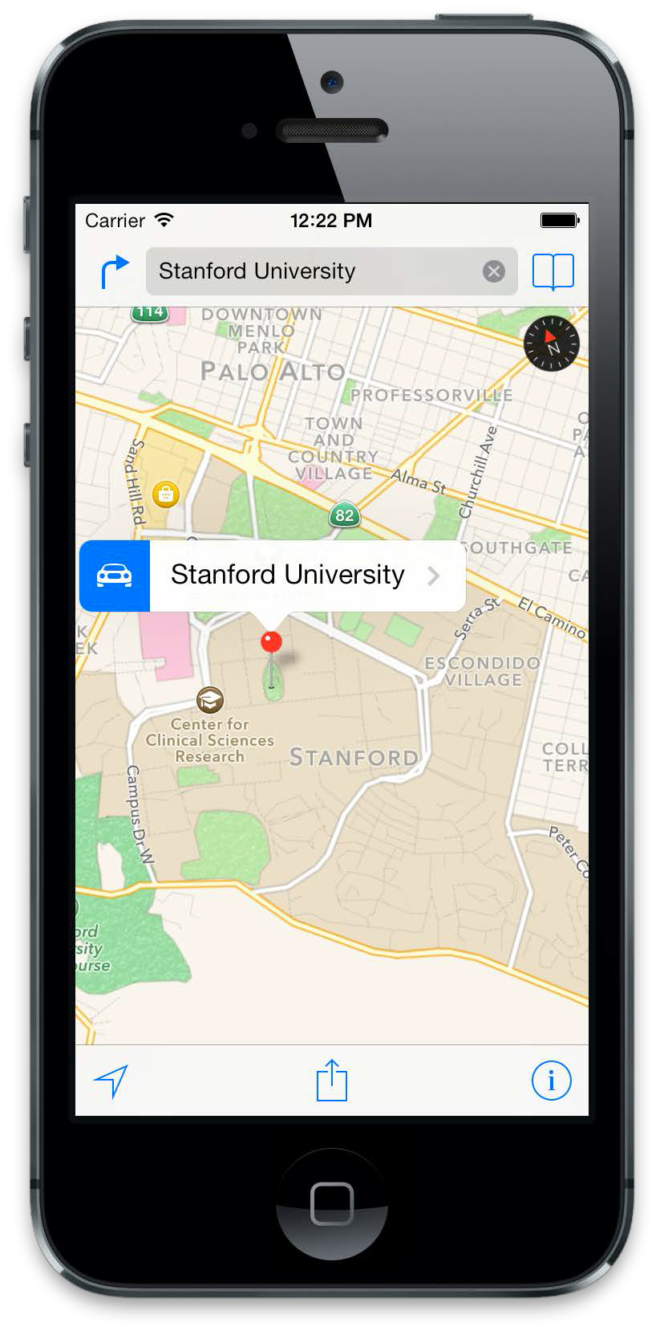
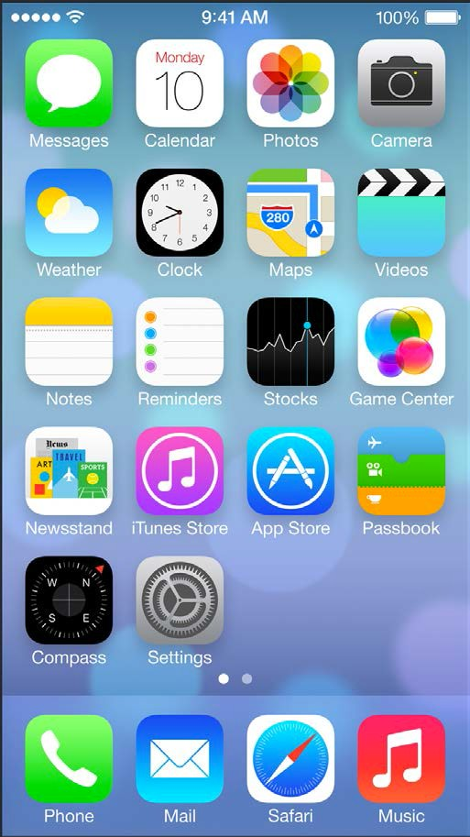
iOS Mobile Development
Instructor: NGUYEN ANH MINH (M. Sc.)

Slide 2
Module 03
Table View
Core Data

Slide 3
Table View

Slide 4
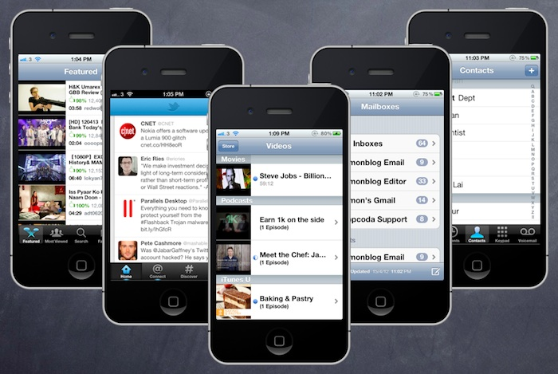

Slide 5
Table View is one of the common UI elements in iOS apps. Most apps, in some ways, make use of Table View to display list of data. The best example is the built-in Phone app.
Your contacts are displayed in a Table View. Another example is the Mail app. It uses Table View to display your mail boxes and emails.
Not only designed for showing textual data, Table View allows you to present the data in the form of images. The built-in Video and YouTube app are great examples for the usage.

Slide 6
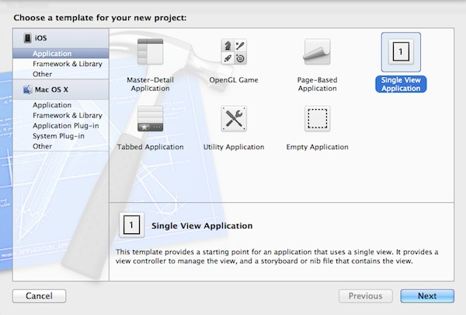
Create Simple Table Project

Slide 7
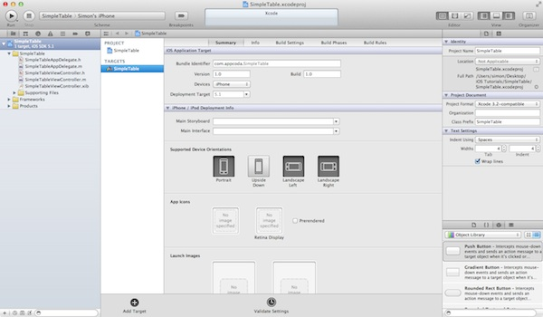
As you confirm, Xcode automatically creates the “SimpleTable” project based on the options you’ve provided. The resulting screen looks like this:

Slide 8
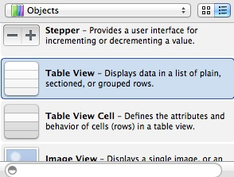
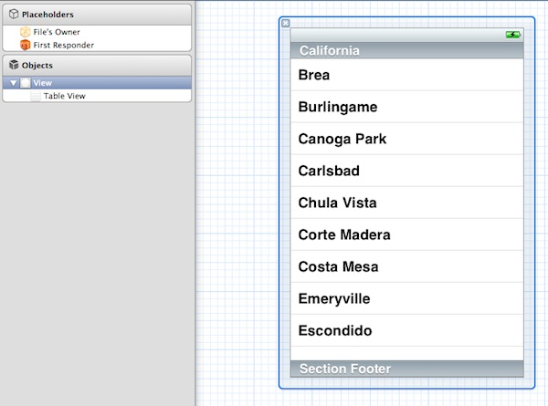
Designing the View → First, we’ll create the user interface and add the table view. Select “SimpleTableViewController.xib” to switch to the Interface Builder.
Your screen should look like below after inserting the “Table View”.

Slide 9
Adding Table Data
Go back to the Project Navigator and select “SimpleTableViewController.h”. Append “<UITableViewDelegate, UITableViewDataSource>” after “UIViewController”. Your code should look like below:
#import <UIKit/UIKit.h> @interface SimpleTableViewController : UIViewController <UITableViewDelegate, UITableViewDataSource> @end
Next, select “SimpleTableViewController.m” and define an instance variable for holding the table data.
@implementation SimpleTableViewController { NSArray *tableData; }

Slide 10
In the “viewDidLoad” method, add the following code to initialize the “tableData” array. We initialize an array with a list of recipes.
- (void)viewDidLoad { [super viewDidLoad]; // Initialize table data tableData = [NSArray arrayWithObjects:@"Egg Benedict", @"Mushroom Risotto", @"Full Breakfast", @"Hamburger", @"Ham and Egg Sandwich", @"Creme Brelee", @"White Chocolate Donut", @"Starbucks Coffee", @"Vegetable Curry", @"Instant Noodle with Egg", @"Noodle with BBQ Pork", @"Japanese Noodle with Pork", @"Green Tea", @"Thai Shrimp Cake", @"Angry Birds Cake", @"Ham and Cheese Panini", nil]; }
Finally, we have to add two datasource methods: “tableView:numberOfRowsInSection” and “tableView:cellForRowAtIndexPath”. These two methods are part of the UITableViewDataSource protocol. It’s mandatory to implement the methods when configuring a UITableView
- (NSInteger)tableView:(UITableView *)tableView numberOfRowsInSection:(NSInteger)section { return [tableData count]; }

Slide 11
Next, we implement the other required methods.
- (UITableViewCell *)tableView:(UITableView *)tableView cellForRowAtIndexPath:(NSIndexPath *)indexPath { static NSString *simpleTableIdentifier = @"SimpleTableItem"; UITableViewCell *cell = [tableView dequeueReusableCellWithIdentifier:simpleTableIdentifier]; if (cell == nil) { cell = [[UITableViewCell alloc] initWithStyle:UITableViewCellStyleDefault reuseIdentifier:simpleTableIdentifier]; } cell.textLabel.text = [tableData objectAtIndex:indexPath.row]; return cell; }

Slide 12
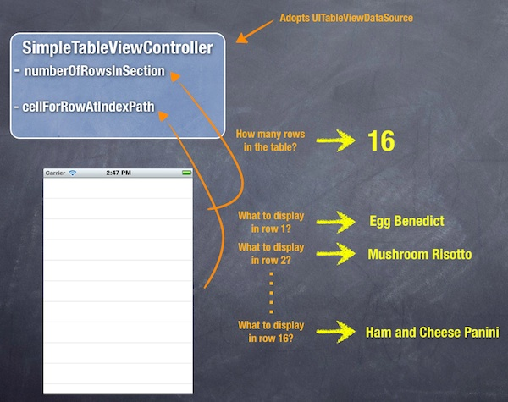
The “cellForRowAtIndexPath” is called every time when a table row is displayed. The below illustration will give you a better understanding about how UITableView and UITableDataSource work.

Slide 13
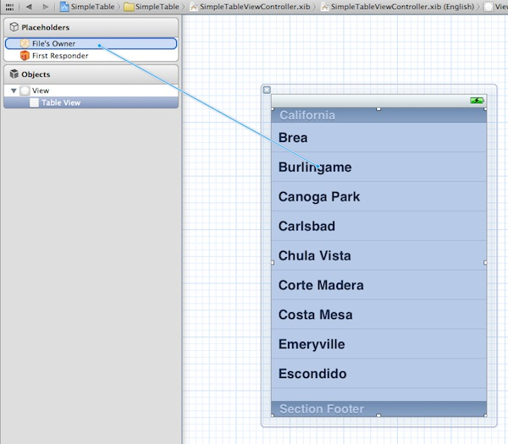
Connecting the Data Source and Delegate
Like the “Hello World” button in the first tutorial, we have to establish the connection between the Table View and the two methods we just created.
Go back to the “SimpleTableViewController.xib”. Press and hold the Control key on your keyboard, select the Table View and drag to the “File’s Owner”. Your screen should look like this:

Slide 14
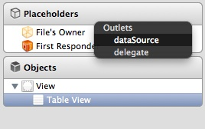
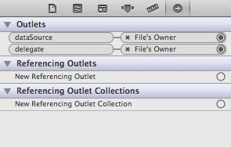
Release both buttons and a pop-up shows both “dataSource” & “delegate”. Select “dataSource” to make a connection between the Table View and its data source. Repeat the above steps and make a connection with the delegate.
Connect data Source and delegate
That’s it. To ensure the connections are linked properly, you can select the Table View again. In the upper part of the Utility area, you can reveal the existing connections in the “Connection Inspector” (i.e. the rightmost tab).
Show the Connections Inspector

Slide 15
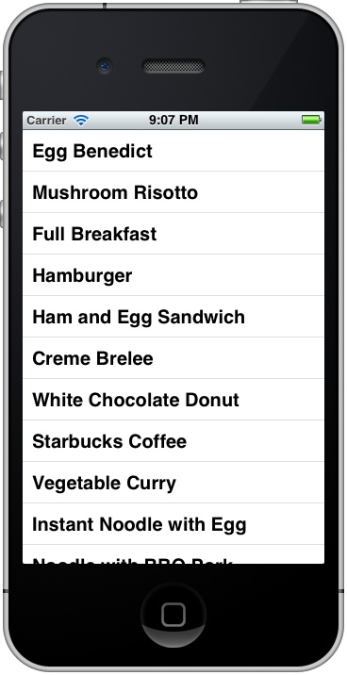
Test Your App
Finally, it’s ready to test your app. Simply hit the “Run” button and let the Simulator load your app:

Slide 16
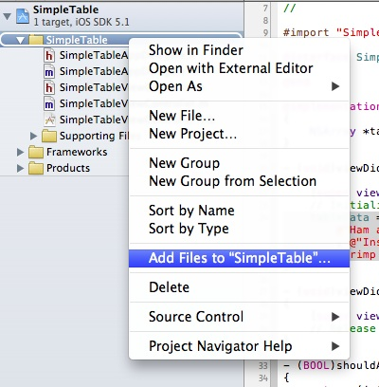
Add Thumbnail to Your Table View
In Project Navigator, right-click the “SimplyTable” folder and select “Add Files to SimpleTable…”.
Add Image to Your Project

Slide 17
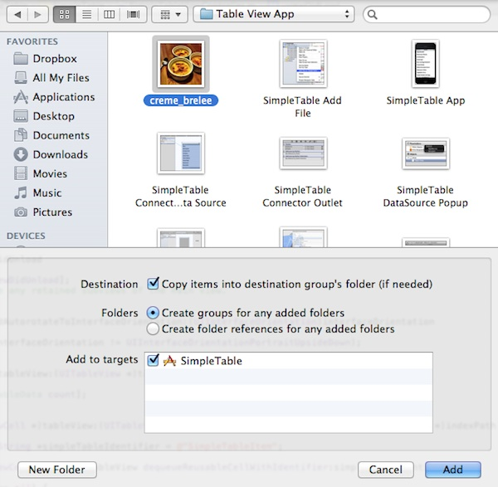
Select the image file and check “Copy items to destination group’s folder” checkbox. Click “OK” to add the file.
Pick your image file and add to the project

Slide 18
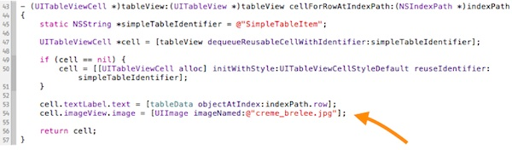
Now edit the “SimpleTableViewController.m” and add the following line of code in “tableView:cellForRowAtIndexPath” method:
cell.imageView.image = [UIImage imageNamed:@"creme_brelee.jpg"];
Your code should look like this after editing:

Slide 19
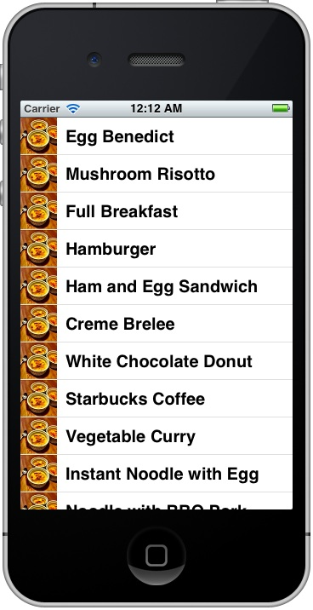
The line of code loads the image and saves in the image area of the table cell. Now, hit the “Run” button again and your Simple Table app should display the image in each row:

Slide 20
Core Data

Slide 21
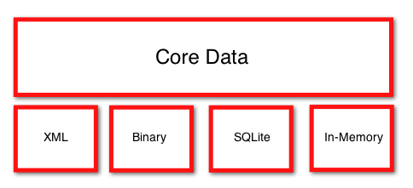
What is Core Data?
An Objective-C API and modeling tool that is used to manage object-graphs.
Available for free with Xcode.
Typically sits on top of SQLite, though other data stores can be used.
Allows you to treat persistence in an object oriented manner (similar to ORM frameworks).

Slide 22
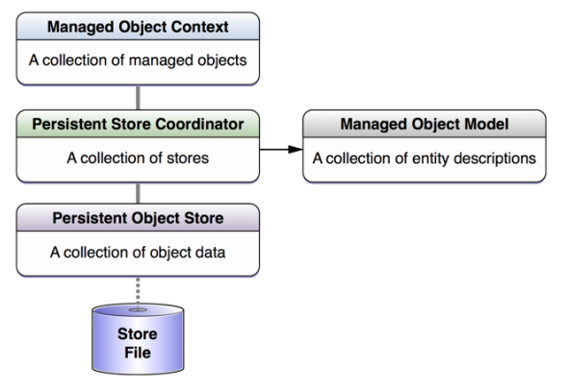
Core Data Architecture
Why Core Data?
There are 5 core classes that are used in most operations with Core Data.
Data structured as Objects Memory Efficient and Fast High Abstraction level
Saving
Undo
Redo
Data Validation
Merging and Migration
Searching, Filtering, Grouping
iOS Interface Integration

Slide 23
Core Data interacts with a persistent store at a lower level that is not visible to the programmer. iOS decides how the low-level data management is implemented. All the
programmer must know is the high-level API she is provided with. But understanding
the structure of Core Data and how it works internally is very important. Let’s create a
Core Data application to understand this
Persistent store
The object that represents the actual data base on disk. We never use this object directly.
Persistent store coordinator
The object that coordinates reading and writing of information from and to the persistent store. The coordinator is the bridge between the managed object context and the persistent store.
Managed object model (MOM)
This is a simple file on disk that will represent our data model. Think about it as your database schema.

Slide 24
Managed object
This class represents an entity that we want to store in Core Data. Traditional da‐
abase programmers would know such entities as tables. A managed object is of
type NSManagedObject, and its instances are placed on managed object contexts.
They adhere to the schema dictated by the managed object model, and they get
saved to a persistent store through a persistent store coordinator.
Managed object context (MOC)
This is a virtual board. We create Core Data objects in memory and set their properties and play with them. All this playing is done on a managed object context.
That table is your managed object context, and you can save its state when you are ready. When you save the state of the managed object context, this save operation will be communicated to the persistent store coordinator to which the context is connected, upon which the persistent store coordinator will store the information to the persistent store and subsequently to
disk.

Slide 25
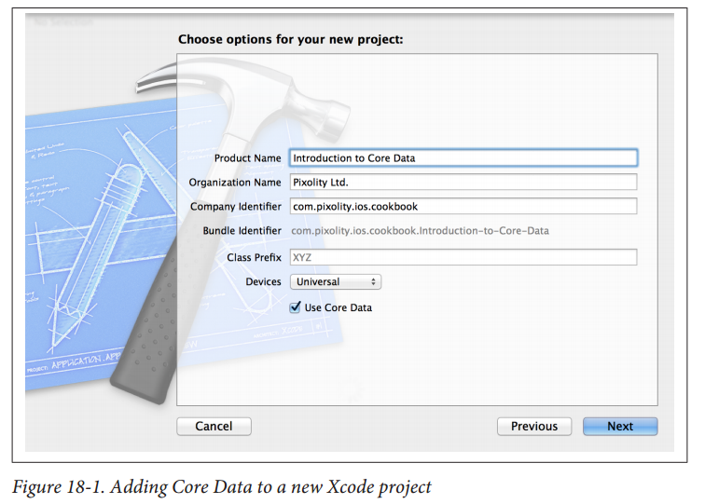
To add Core Data to your project and start using all the cool features that it has to offer, simply create a project and when asked whether to add Core Data to it or not, check the relevant box, as shown in
You should already know these from the description earlier in this chapter.
The context is our playing table, the model is the schema of our data base and the coordinator is the object that will help us save our context to disk.

Slide 26
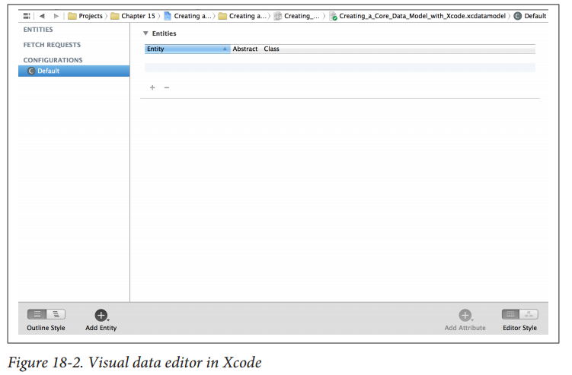
Creating a Core Data Model with Xcode

Slide 27
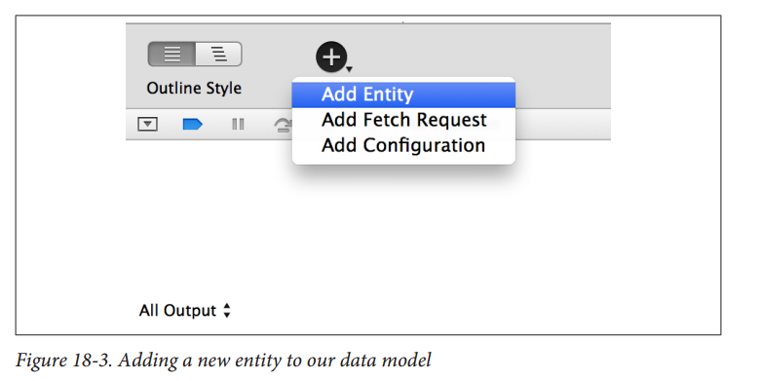
There are two important definitions you need to learn before you can work with this tool:
Entity → Corresponds to a table in a database
Attribute → Corresponds to a column in a table
In the editor, find the + button at the bottom. Click and hold on this button and then
select Add Entity from the menu that will appear, as shown in Figure 18-3.
Your new entity will be created and will be in a state where you can immediately rename
it after creation. Change the name of this entity to Person, as shown in Figure 18-4.

Slide 28
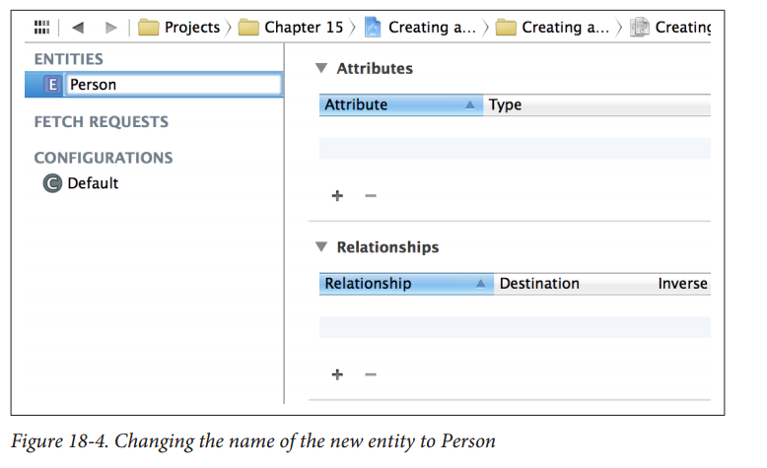

Slide 29
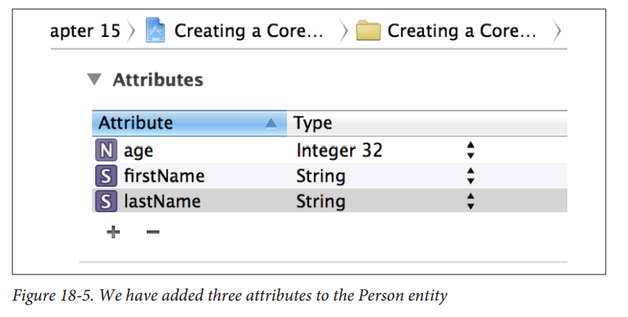
Select the Person entity, then select the + button in the Attributes pane and create the
following three attributes for it (the results are shown in Figure 18-5).
• firstName(of type String).
• lastName(of type String).
• age(of type Integer 32).

Slide 30
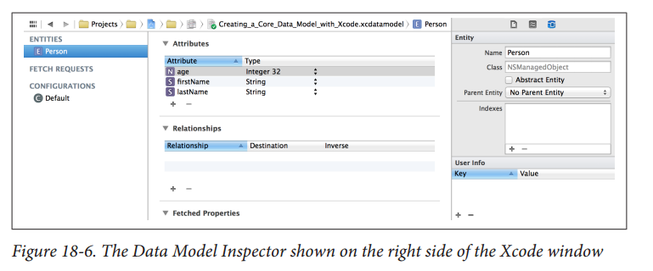
While you are in the data model editor, from the View menu in Xcode, choose Utilit‐
ies → Show Utilities. The utilities pane will open on the right-hand side of Xcode. On
top, choose the Data Model Inspector button and make sure that you have clicked on
the Person entity that we just created.

Slide 31
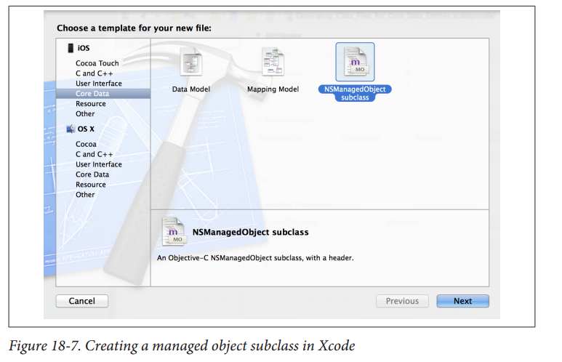
Generating Class Files for Core Data Entities
Follow these steps:
1. In Xcode, find the file with the xcdatamodelextension that was created for your application when you created the application itself in Xcode. Click the file, and you should see the editor on the righthand side of the Xcode window.
2. Select the Person entity that we created earlier (see Recipe 18.1).
3. Select File →New File in Xcode.
4. In the New File dialog, make sure you have selected iOS as the main category and Core Data as the subcategory. Then choose the NSManagedObject subclass item from the righ thand side of the dialog and press Next, as shown in Figure 18-7

Slide 32
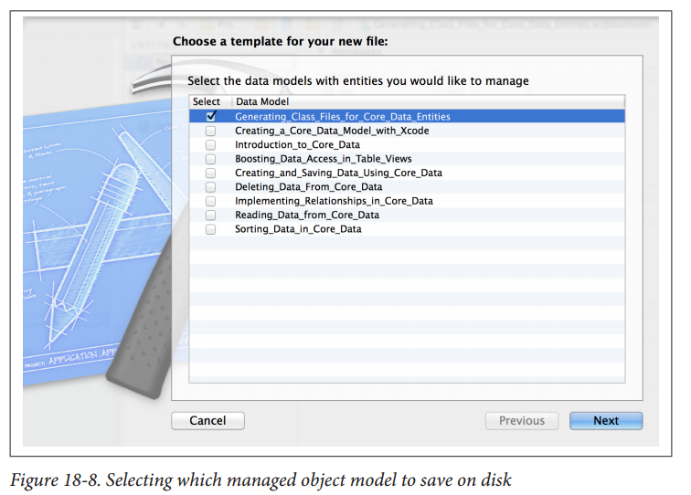
On the next screen, choose the managed object model that you want to save to disk and ensure it is ticked. Once you are done, press the Next button (see Figure 18-8)

Slide 33
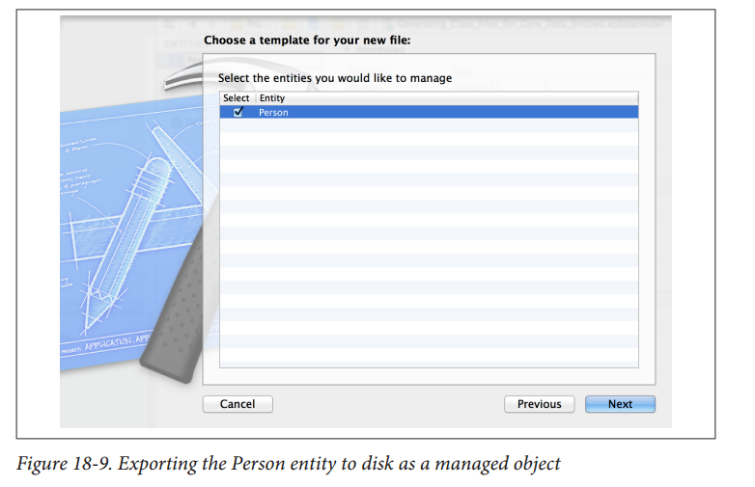
Now you will be asked to pick the entities that you want to export from your model
on disk as Objective-C files. Since we have created only one entity, the Person entity,
your list will look similar to that shown in Figure 18-9. Make sure the Person entity
is ticked, and then press the Next button.
At the last stage, you will be asked to save your entity on disk. Ensure that in the
Targets box, your project is ticked (see Figure 18-10); otherwise, the entity will not
be available to different source files in your code. Once you are happy, press the
Create button.

Slide 34
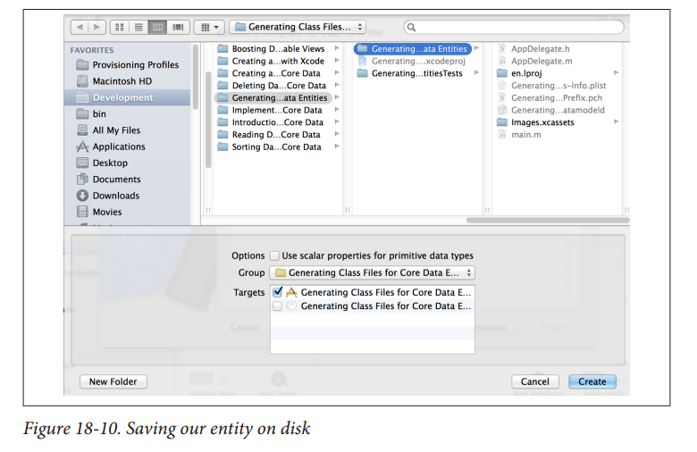

Slide 35
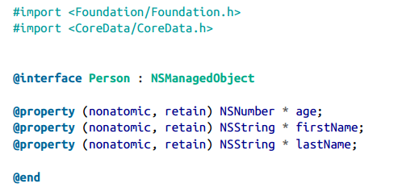
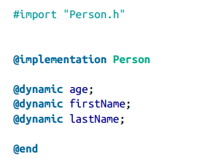
Now you will see two new files in your project, called Person.h and Person.m. Open the contents of the Person.h file. It will look like the following:
The Person.m file is implemented for you in this way

Slide 36
Creating and Saving Data Using Core Data
You have already created a managed object, and you want to instantiate it and insert that instance into your app’s Core Data context.
Follow the instructions in Recipe 18.1and Recipe 18.2. Now you can use the insertNewObjectForEntityForName:inManagedObjectContext:class method of NSEntityDescription to create a new object of a type specified by the first parameter of this method. Once the new entity (the managed object) is created, you can modify it by changing its properties. After you are done, save your managed object context using the save: instance method of the managed object context. I’ll assume that you have created a universal application in Xcode with the name Creating and Saving Data Using Core Data; now, follow these steps to insert a new managed object into the context:
1. Find the implementation file of your app delegate.
2. Import the Person.hfile into the app delegate’s implementation file:

Slide 37
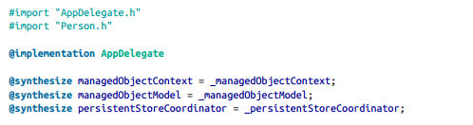

In the application:didFinishLaunchingWithOptions:method of your shared
application delegate, write this code

Slide 38
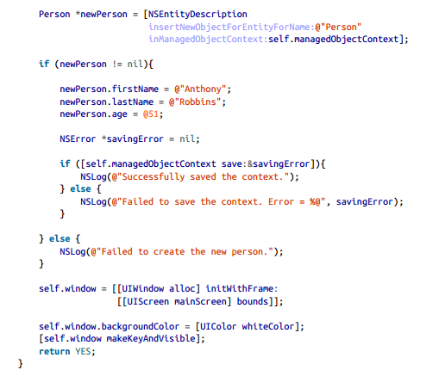

Slide 39
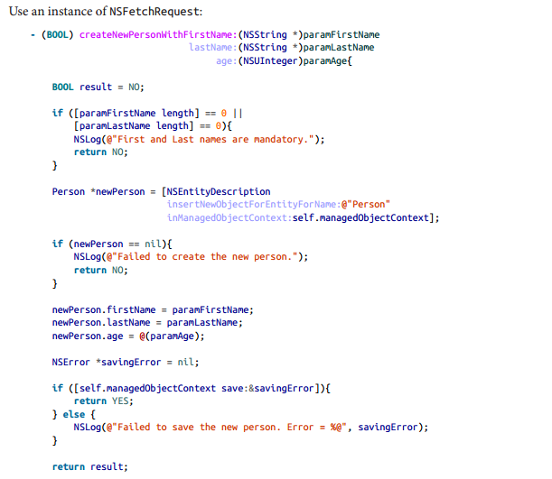
Reading Data from Core Data
You want to be able to read the contents of your entities (tables) using Core Data →Use an instance of NSFetchRequest

Slide 40
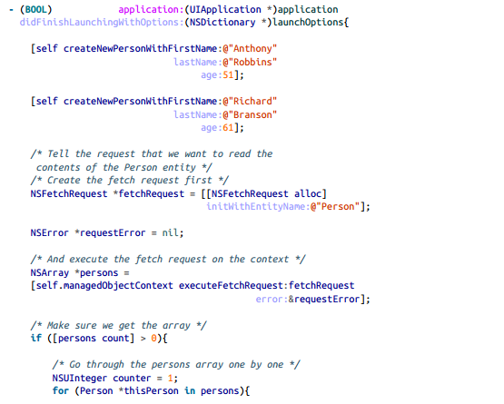

Slide 41
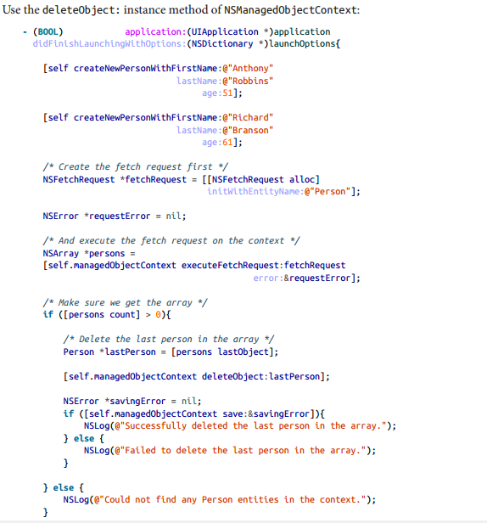
Deleting Data from Core Data

Slide 42
Boosting Data Access in Table Views
In an application that uses table views to present managed objects to the user, you want
to be able to fetch and present the data in a more fluid and natural way than managing
your data manually.
Use fetched results controllers, which are instances of NSFetchedResultsController.
In the previously described application, you would declare your table view controller
that lists all the user’s contacts in this way

Slide 43
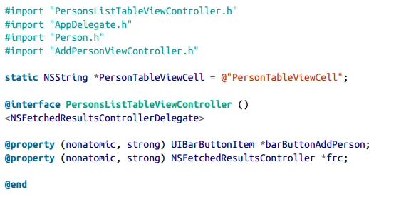
In the previously described application, you would declare your table view controller
that lists all the user’s contacts in this way

Slide 44
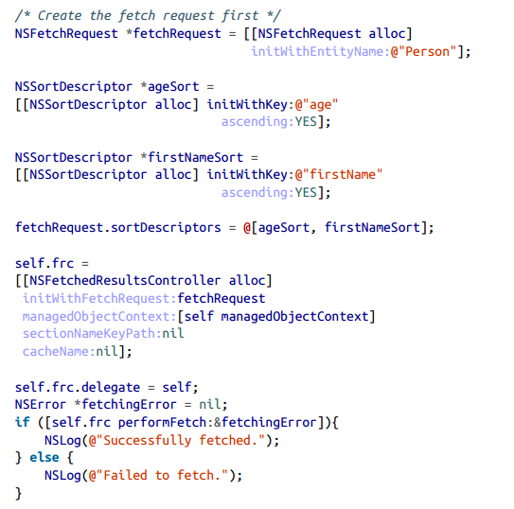
This is how we construct our fetched results controller:

Slide 45
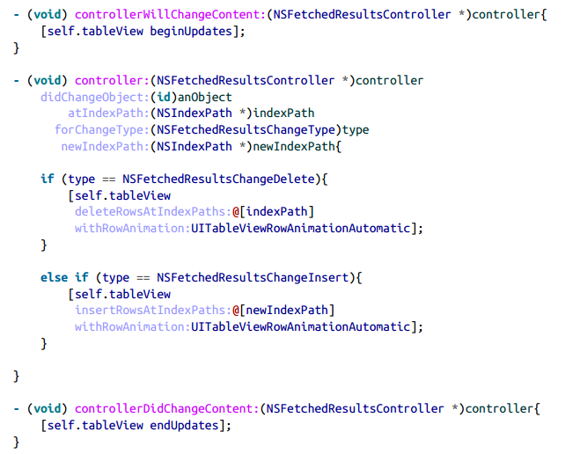

Slide 46
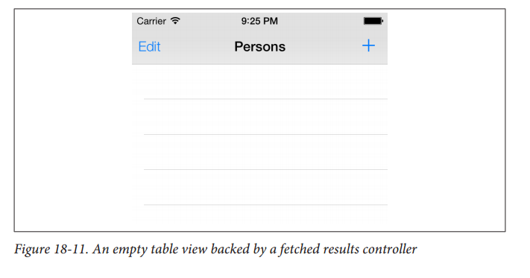

Slide 47
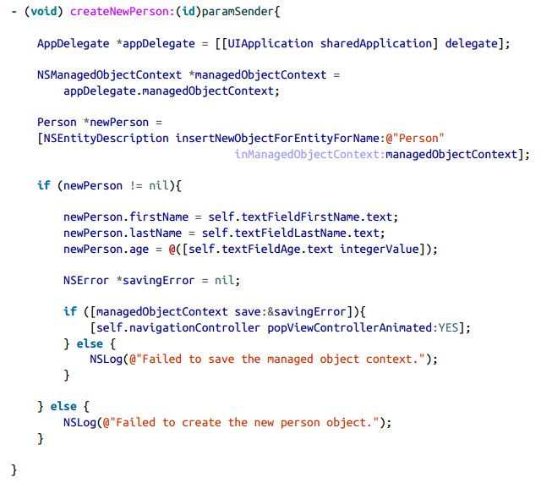
Now in the second view controller, where the user is allowed to add a new Person instance to the managed object context, we will use the following method:

Slide 48
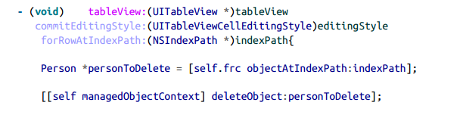
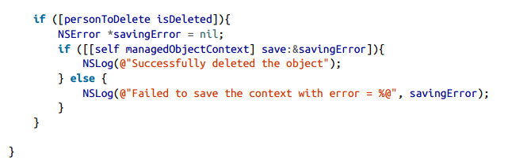
One last thing is how we can allow the user to delete items on the first table
view controller:

Slide 49
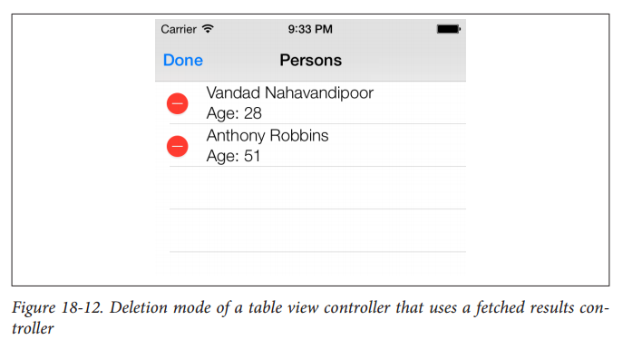
This code won’t even touch the fetched results controller directly, but it deletes the
selected person from the managed object context, which will refresh the fetched results
controller, that in turn refreshing the table view. To learn more about table views, please
refer to Chapter 4. The interface of our table view controller in deletion mode could
look like that shown in Figure 18-12.

