Slide 1
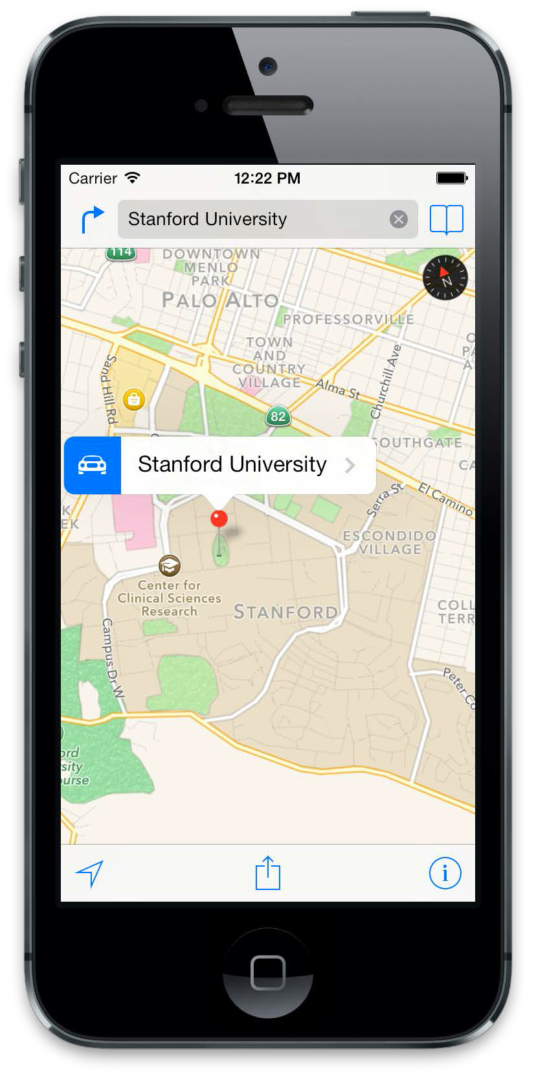
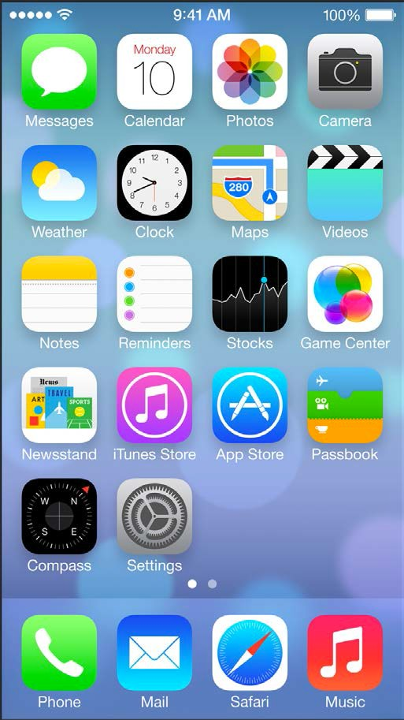
Instructor: NGUYEN ANH MINH (M. Sc.)
iOS Mobile Development

Slide 2
Agenda
•
Blocks
Queues and Threads
•
Grand Central Dispatch
•
NSOperationQueue & NSOperation
•
Quality of Service (QoS) Classes

Slide 3
Blocks
11/11/2013
Networking

Slide 4
Blocks
“Block objects are a C-level syntactic and runtime feature that allow you to compose function expressions that can be passed as arguments, optionally stored, and used by multiple threads. The function expression can reference and can preserve access to local variables.” [2]
11/11/2013
Networking

Slide 5
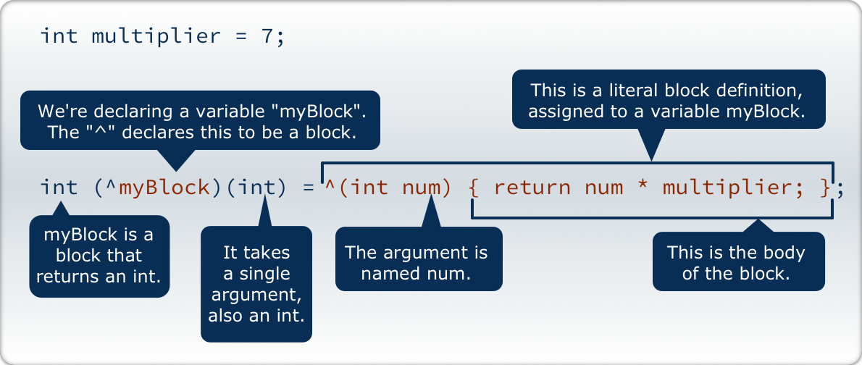
Blocks
The structure of a Block adapted from [3]
11/11/2013
Networking

Slide 6
Blocks
treated as objects
can be assigned to variables and properties
if a property is a block, always use the copy
property-attribute
in other languages referred to as closure or lambda
used to…
…write callbacks
…perform an operation on all items of a collection
create pieces of work for asynchronous execution
11/11/2013
Networking

Slide 7
Queues and Threads

Slide 8
Threads
sequential execution of code
multiple threads of a process execute their code in parallel
belongs to a process (subunit)
provided by the OS
share their process’ address space
available via NSThread (Foundation.framework)
direct access to POSIX-Threads (<pthread.h> available

Slide 9
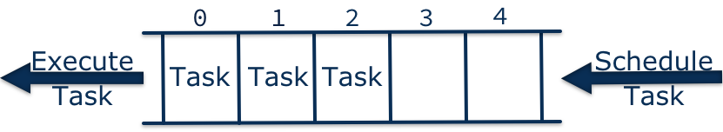
Queues
do not create threads manually
create execution queues or use default queues provided by the system
pieces of codes are scheduled on queues for execution
by default all operations are scheduled on the main queue

Slide 10
Queues
the execution of tasks of a given queue is scheduled according to the available system resources and is handled by the system
a queue and a thread are not necessarily the same unit
tasks scheduled on the same queue may not necessarily be executed on the same thread

Slide 11
Queues
•Main Queue
created when the application launches
always available
all UI operations are scheduled to the main queue
e.g. changing a UILabel’s text property
if you’re working with multiple queues, make sure the property change is scheduled to the main queue

Slide 12
Queues
•Serial Queue
all tasks are executed sequentially as according to the schedule
•Main Queue
long running operations block all consecutive operations
e.g. the UI would not react to user interactions
•Concurrent Queue
tasks are taken sequentially from the queue according to the schedule
tasks can be executed in parallel
execution of different tasks of a queue on different threads in parallel

Slide 13
Grand Central Dispatch

Slide 14
Grand Central Dispatch
introduced in iOS 4 and Mac OS X 10.6
low level C-API
runs on the OS level and is intended to match system resources to all running applications according to their needs [2]
manages a pool of threads of each application based on available and required system resources

Slide 15
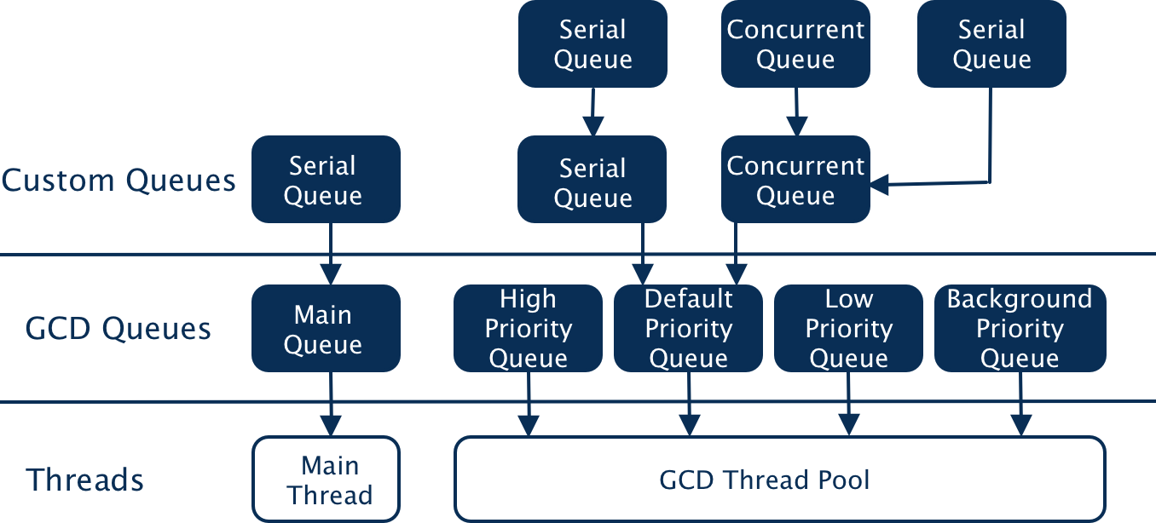
Grand Central Dispatch
Queue schema according to [1]

Slide 16

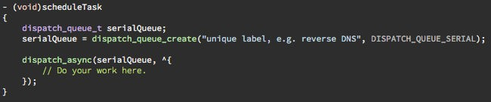
Grand Central Dispatch
•Asynchronous Execution of Tasks
create a new default queue, which is serial
dispatch your code on that queue for async execution
Alternatively:
you could use a concurrent queue for parallel execution DISPATCH_QUEUE_CONCURRENT
dispatch directly to the main queue
dispatch_get_main_queue

Slide 17

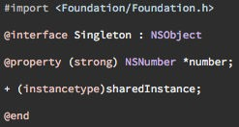

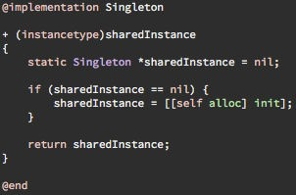
GCD – Thread-safe Singletons
Singleton
only one instance of this class is allowed to exist in the entire application
sharedInstance
method that returns the single instance of the class
NOT thread-safe

Slide 18

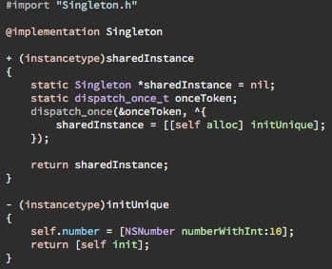
GCD – Thread-save Singletons
dispatch_once
code block is executed only once in the entire applications lifetime
dispatch_once_t
pointer to predicate that tests if the code has already been executed
What about alloc, init and new?

Slide 19

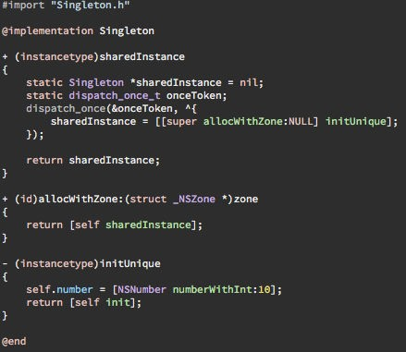
GCD – Thread-safe Singleton
allocWithZone
overriding this method with a method forwarding to sharedInstance allows the user of the class to use alloc, init and new as well

Slide 20
Grand Central Dispatch
Tasks once dispatched cannot be cancelled
No status and progress information of tasks available
only blocks can be dispatched with GCD

Slide 21
NSOperationQueue & NSOperation

Slide 22
NSOperationQueue & NSOperation
•NSOperationQueue
manages the execution of a set of NSOperation objects
operations cannot be removed from a queue, but they can be cancelled
execution of objects is scheduled according priority- levels and inter-operation dependencies
inter-operation dependencies provide an absolut order of execution even if operations are added to different queues

Slide 23
NSOperationQueue & NSOperation
•NSOperation
represents a single task incl. data and code to be executed
abstract class, but contains built-in logic to safely execute the task
task can only be executed once within this object
•NSOperation Dependencies
operation is considered ready for execution if all dependencies have finished
addDependency, removeDependency
dependencies are considered finished regardless of execution result
valid for successful execution as well as cancelation

Slide 24

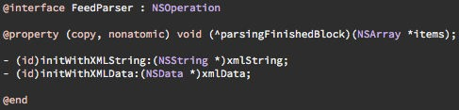

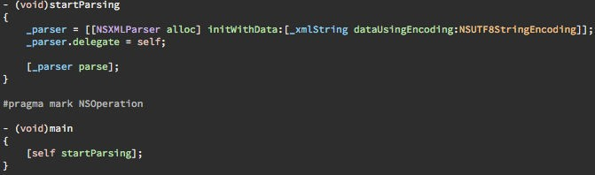
NSOperationQueue & NSOperation
Subclass NSOperation
parsingFinishedBlock
will be invoked, when
the operation finished executing
FeedParser.h
main
for serial execution of operations only the main method
needs to be overridden
11/17/2014
Concurrency
FeedParser.m
24

Slide 25
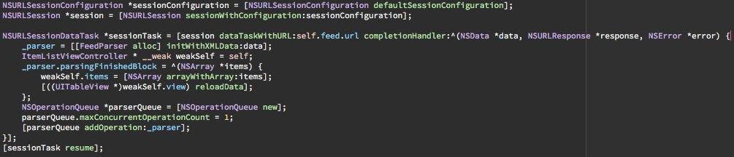
NSOperationQueue & NSOperation
Example: ItemListViewController viewDidLoad
fetch RSS data
create a new FeedParser NSOperation instance
set the parsingFinishedBlock
Create a new NSOperationQueue (concurrent and background by default)
make the queue serial
add the FeedParser operation to the queue, will be launched automatically

Slide 26
Quality of Service Classes

Slide 27
Intention
no sound priority support for queues and threads of the framework
QoS Classes intended to define default priority setups for different use cases
priority inversion not prevented by the QoS classes

Slide 28
Quality of Service Classes
•User-Interactive
UI thread
automatic setup
event handling / UI drawing
•User-Initiated
asynchronous UI, but directly UI initiated
user waits for immediate results which are required to proceed
•Utility
long running task with user-visible progress
energy efficient
•Background
work that the user is not aware of, e.g. prefetching
deferrable
Default (Default Priority Concurrent)

Slide 29
Classes ↔ Queues
Quality of Service Class | Dispatch Queue
User‐Interactive | Main
User‐Initiated | High priority concurrent
Utility | Low priority concurrent
Backround | Background priority concurrent
Default | Default priority concurrent

Slide 30
Quality of Service Classes
applicable to threads, dispatch queues & blocks, NSOperations and processes
GCD runs on QOS_CLASS_DEFAULT (default QoS Class)

Slide 31
Dispatch Block Objects
Extension to blocks that can be scheduled with GCD
wait for completion (synchronization)
completion notification
cancellation (no preemption)
integrates with existing APIs
Dispatch Block Objects are heap objects
call Block_release() on the return object

Slide 32
References
[1] http://www.objc.io/issue-2/concurrency-apis- and-pitfalls.html
[2] https://developer.apple.com/library/Mac/ DOCUMENTATION/Performance/Reference/ GCD_libdispatch_Ref/Reference/reference.html

