Slide 1
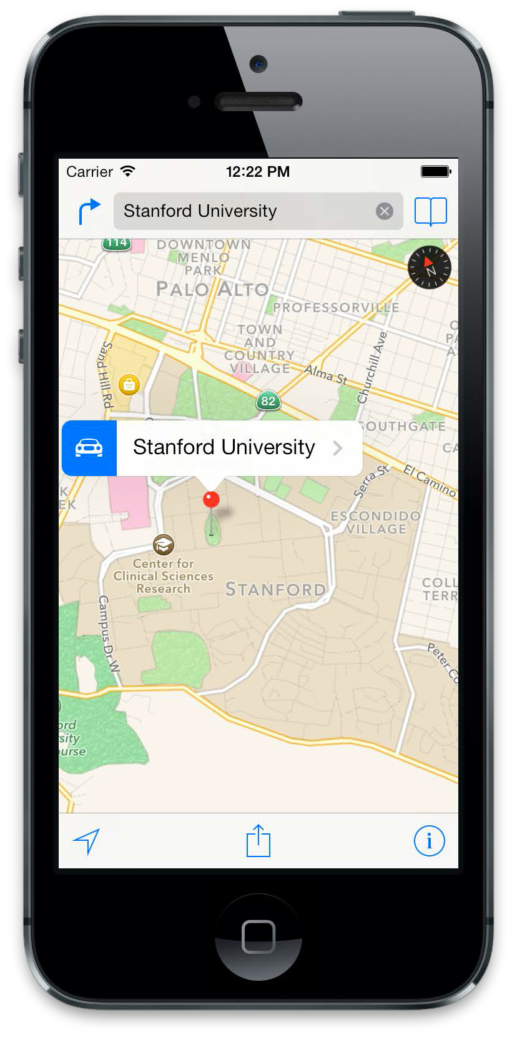
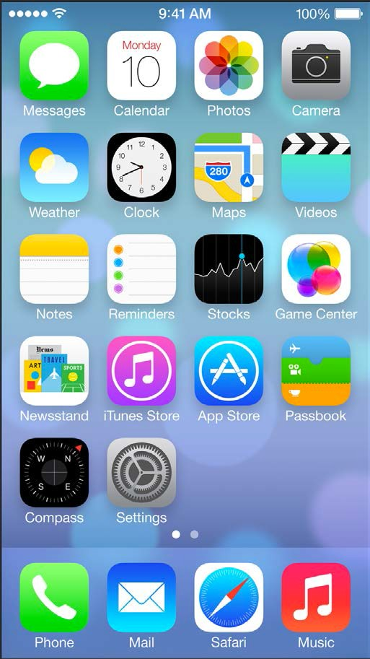
Instructor: NGUYEN ANH MINH (M. Sc.)
iOS Mobile Development

Slide 2
Agenda
•
Networking
Task Indication and non-blocking User Interfaces

Slide 3
Networking

Slide 4
Networking
new APIs since iOS7
NSURLSession API
allows consecutive requests in a single session
each session contains its own configuration and cache
support for background execution built in
APIs for iOS6 and earlier are still available and not deprecated

Slide 5
One of the iOS6 ways
NSURLConnection
• + (void)sendAsynchronousRequest:(NSURLRequest
*)request
queue:(NSOperationQueue *)queue
completionHandler:(void (^)(NSURLResponse*, NSData*, NSError*))handler
request is automatically sent and dispatched on another thread so that the UI is not blocked
request
contains the request data, e.g. url to fetch data from
queue
Operation queue on which the handler is dispatched
•handler
code that is executed when the request finished

Slide 6
One of the iOS7 ways
NSURLSession Stack
1.(create a delegate adopting the
NSURLSessionDelegate)
set up a configuration for the session (NSURLSessionConfiguration)
• +defaultSessionConfiguration gives us the same set of configurations as NSURLConnection inherently had
create the NSURLSession
create a NSURL object
create a NSURLSessionTask to actually create the request to be made via this session

Slide 7
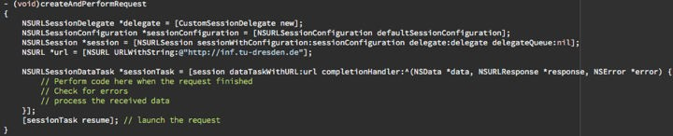
One of the IOS7 ways
replacement of the sendAsynchronousRequest: queue:completionHandler: presented previously
when the DataTask ist created with the dataTaskWithURL:completionHandler: method, it is not necessary to declare a delegate as well
the NSURLSessionDelegate and it’s subclasses provide a more advanced interface to handle network requests

Slide 8
Main Classes & Protocols of the NSURLSession stack

Slide 9
NSURLSessionTask
base class for tasks in an NSURLSession
created by the session in form of a subclass
NSURLSessionDataTask, NSURLSessionUploadTask, NSURLSessionDownloadTask
actual replacement of iOS6’ NSURLConnection class
status and progress properties
cancel, suspend, resume
data and upload tasks provided (subclasses)

Slide 10
Tasks
•Data Task
“intended for short, often interactive requests” [1]
return of data piecemeal or all at once
no data stored to a file → not supported in background sessions
•Download Task
data retrieval in form of a file
support background download while the app is not running
•Upload Task
send data (usually as a file) to a server
support background upload while the app is not running

Slide 11
NSURLSessionDelegate
base protocol for all delegates of NSURLSession
subprotocols following the principle of
NSURLSessionTask subclasses
session keeps strong reference
connection level authentication
URLSession:didBecomeInvalidWithError:
error will be nil when session was successful
gets always called before the delegate is released

Slide 12
NSURLSessionTaskDelegate
protocol to handle task-level events in a
NSURLSession
Delegate adopting the NSURLSessionDelegate is recommended to implement this protocol as well
task:didCompleteWithError:
error will be nil for successful requests
connection and transmission errors only
e.g. 404 will not be detected by this method

Slide 13
NSURLSession
default session shares NSURLConnection stack
custom sessions with private configuration
invalidation required for session
creates data, upload & download tasks
async convenience APIs
cancelable
can share delegate for authentication

Slide 14
Sessions
•Default Session
persistent disk-based cache
stores credentials in the user’s keychain
•Ephemeral Session
caches, credential stores etc. kept in RAM and are tied to the session
all data is purged when application invalidates the cache
•Background Session
similar to default session
separate process handles all data transfer
additional limitations

Slide 15
Background Session
Additional Limitations are:
session must provide a delegate for delivery callbacks
supports only HTTP(S)
supports only upload and download tasks
redirects are always followed

Slide 16





Background Session [2]
NSURLSession Identifier: “DownloadSession”
Create Download
NSURLSession Background Daemon
⥁
Progress
Progress

Slide 17

Background Session [2]
NSURLSession Identifier: “DownloadSession”
Create Download
NSURLSession Background Daemon
⥁
Progress
Progress

Slide 18
Background Session [2]
NSURLSession Identifier: “DownloadSession”
NSURLSession Background Daemon
⥁

Slide 19





Background Session [2]
NSURLSession Identifier: “DownloadSession”
NSURLSession Background Daemon
NSURLSession Identifier: “DownloadSession”
⥁
Relaunched
Reconnect
Completed

Slide 20
Task Indication and non-blocking User Interfaces

Slide 21
Background Tasks
Three kinds of background Tasks
tasks which deliver content
UI not blocked, but user cannot interact due to missing content
tasks that perform a user relevant action
UI not blocked, interaction possible, i.e. progress indicator for sending a message
tasks that are not user relevant
UI not blocked, i.e. prefetching of data to display on user scrolling ➟ user not necessarily needs to be informed on this
Networking

Slide 22


1. Tasks delivering content
synchronous request that loads data
asynchronous at application level to prevent UI from being blocked
yet user sees a white or empty screen
graphical mean to depict load of content in progress
Networking

Slide 23
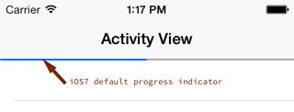
2. Tasks performing relevant task
application is not waiting for data to be loaded
i.e. sending a message, uploading data
it might just be of interest that the message was transmitted successfully to the server
usually indicated by a progress indicator
Networking

Slide 24
3. Pure background Tasks
usually not relevant for depiction of user interface
progress or activity indication not necessarily required
Yet, an application might inform the user when the network is accessed in the background
Networking

Slide 25

Network Tasks
Tasks that require network access
good practice to always indicate them using an activity spinner in the status bar
not displayed automatically when the network is accessed by an application
[UIApplication sharedApplication]. networkActivityIndicatorVisible
= YES;
Networking

Slide 26
References
[1] https://developer.apple.com/library/ios/ documentation/Cocoa/Conceptual/ URLLoadingSystem/Articles/ UsingNSURLSession.html#//apple_ref/doc/uid/ TP40013509-SW1
[2] What’s new in Foundation Networking (Session 705, WWDC13) — https://developer.apple.com/ videos/wwdc/2013/

