Slide 1
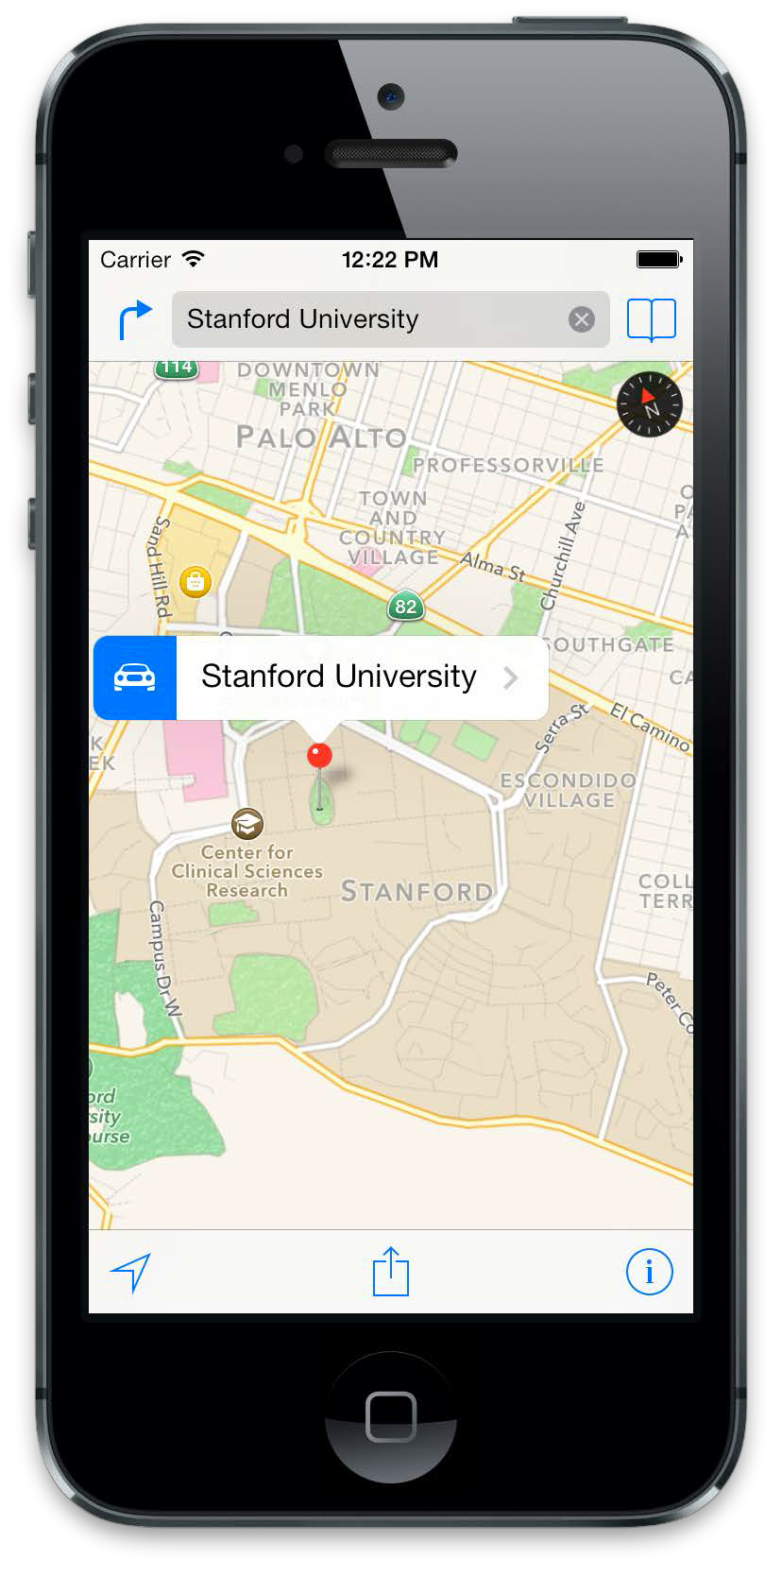
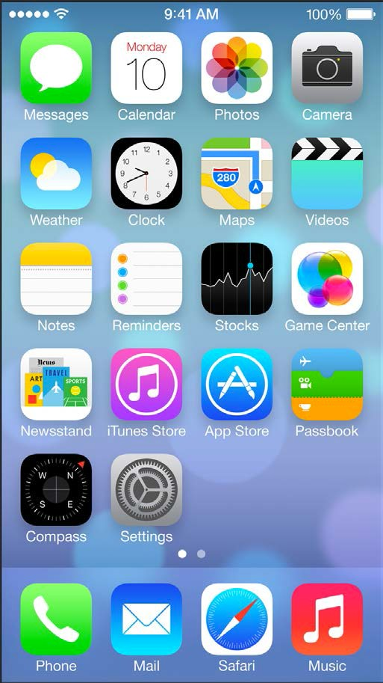
iOS Mobile Development
Instructor: NGUYEN ANH MINH (M. Sc.)

Slide 2
Module 03
TableView
CoreData
ViewController

Slide 3
Table View

Slide 4
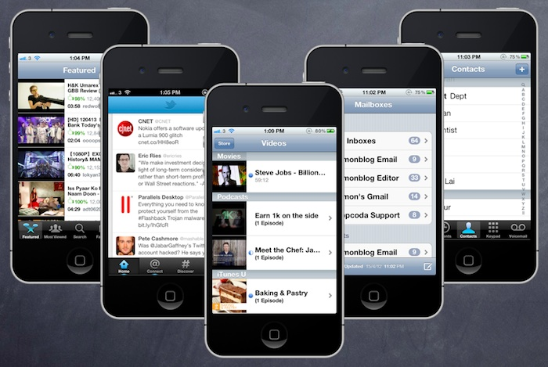

Slide 5
Table View is one of the common UI elements in iOS apps. Most apps, in some ways, make use of Table View to display list of data. The best example is the built-in Phone app.
Your contacts are displayed in a Table View. Another example is the Mail app. It uses Table View to display your mail boxes and emails.
Not only designed for showing textual data, Table View allows you to present the data in the form of images. The built-in Video and YouTube app are great examples for the usage.

Slide 6
Core Data

Slide 7
Core Data interacts with a persistent store at a lower level that is not visible to the
programmer. iOS decides how the low-level data management is implemented. All the
programmer must know is the high-level API she is provided with. But understanding
the structure of Core Data and how it works internally is very important. Let’s create a
Core Data application to understand this
Persistent store
The object that represents the actual data base on disk. We never use this object
directly.
Persistent store coordinator
The object that coordinates reading and writing of information from and to the
persistent store. The coordinator is the bridge between the managed object context
and the persistent store.
Managed object model (MOM)
This is a simple file on disk that will represent our data model. Think about it as
your database schema.

Slide 8
Managed object
This class represents an entity that we want to store in Core Data. Traditional da‐
tabase programmers would know such entities as tables. A managed object is of
type NSManagedObject, and its instances are placed on managed object contexts.
They adhere to the schema dictated by the managed object model, and they get
saved to a persistent store through a persistent store coordinator.
Managed object context (MOC)
Thisis a virtual board. That sounds strange, right? But let me explain. We create
Core Data objects in memory and set their properties and play with them. All this
playing is done on a managed object context. The context keeps track of all the
things that we are doing with our managed objects and even allows us to undo those
actions. Think of your managed objects on a context as toys that you have brought
on a table to play with. You can move them around, break them, move them out of
the table, and bring new toys in. That table is your managed object context, and
you can save its state when you are ready. When you save the state of the managed
object context, this save operation will be communicated to the persistent store
coordinator to which the context is connected, upon which the persistent store
coordinator will store the information to the persistent store and subsequently to
disk.

Slide 9
To add Core Data to your project and start using all the cool features that it has to offer,
simply create a project and when asked whether to add Core Data to it or not, check the
relevant box, as shown in
You should already know these from the description earlier in this chapter. The context
is our playing table, the model is the schema of our data base and the coordinator is the
object that will help us save our context to disk. Plain and easy. OK then, let’s get started
with the rest of this chapter now

Slide 10
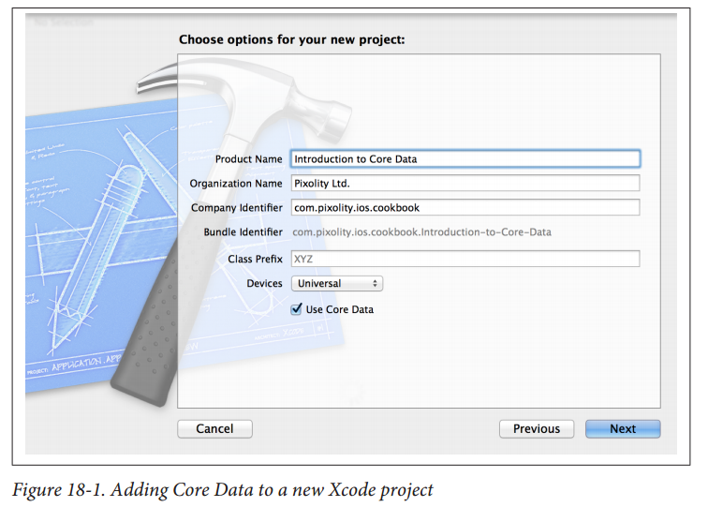

Slide 11
Creating a Core Data Model with Xcode

Slide 12
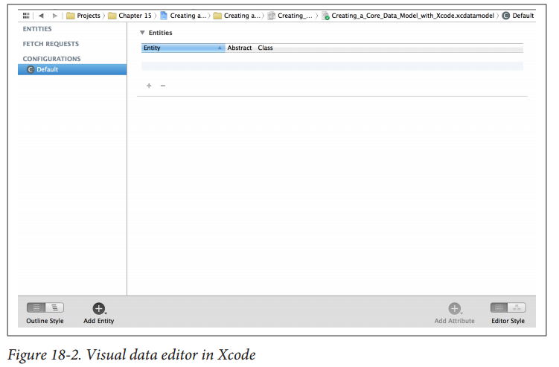

Slide 13
There are two important definitions you need to
learn before you can work with this tool:
Entity
Corresponds to a table in a database
Attribute
Corresponds to a column in a table
In the editor, find the + button at the bottom. Click and hold on this button and then
select Add Entity from the menu that will appear, as shown in Figure 18-3.
Your new entity will be created and will be in a state where you can immediately rename
it after creation. Change the name of this entity to Person, as shown in Figure 18-4.

Slide 14
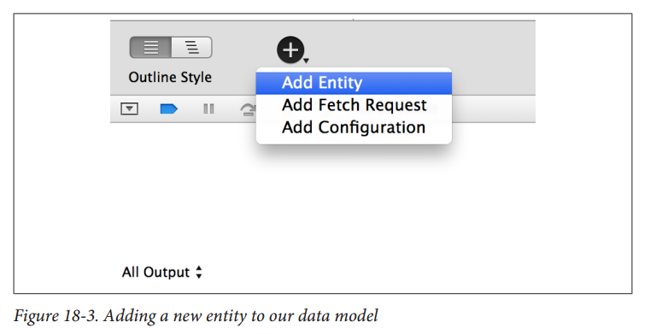

Slide 15
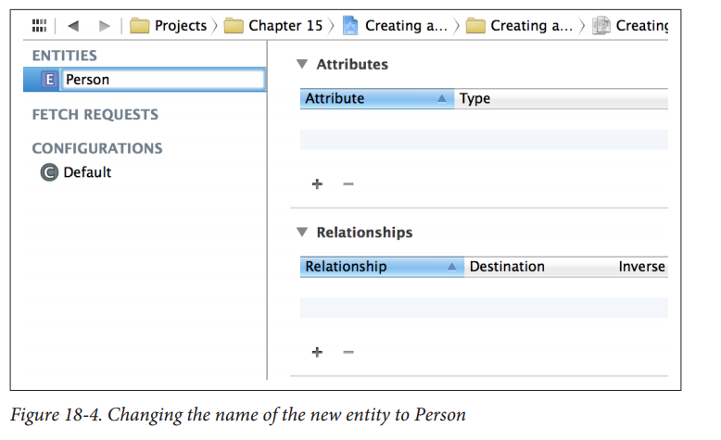

Slide 16
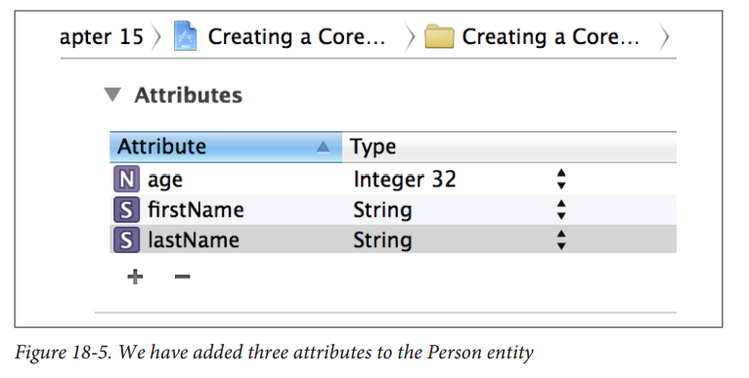
Select the Person entity, then select the + button in the Attributes pane and create the
following three attributes for it (the results are shown in Figure 18-5).
• firstName(of type String).
• lastName(of type String).
• age(of type Integer 32).

Slide 17
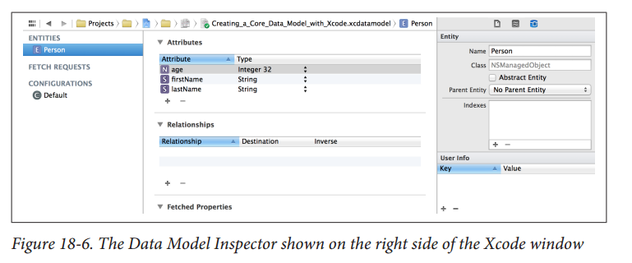
While you are in the data model editor, from the View menu in Xcode, choose Utilit‐
ies →Show Utilities. The utilities pane will open on the righthand side of Xcode. On
top, choose the Data Model Inspector button and make sure that you have clicked on
the Personentity that we just created. At this point, the Data Model inspector will be
populated with items relevant to the Personentity, as shown in Figure 18-6.

Slide 18
Now click the firstName, lastName, and age attributes of the Person entity. Make sure
the firstNameand the lastNameattributes are not optionalby unticking the Option
al checkbox and make sure the age field is optional by ticking the Optionalcheckbox.
OK, we are done creating the model. Choose File →Save to make sure your changes are
saved. To learn how to generate code based on the managed object you just created,
refer to

Slide 19
Generating Class Files for Core Data Entities
Follow these steps:
1. InXcode, find the file with the xcdatamodelextension that was created for your
application when you created the application itself in Xcode. Click the file, and you
should see the editor on the righthand side of the Xcode window.
2. Select the Personentity that we created earlier (see Recipe 18.1).
3. Select File →New File in Xcode.
4. In the New File dialog, make sure you have selected iOS as the main category and
Core Data as the subcategory. Then choose the NSManagedObject subclassitem
from the righthand side of the dialog and press Next, as shown in Figure 18-7

Slide 20
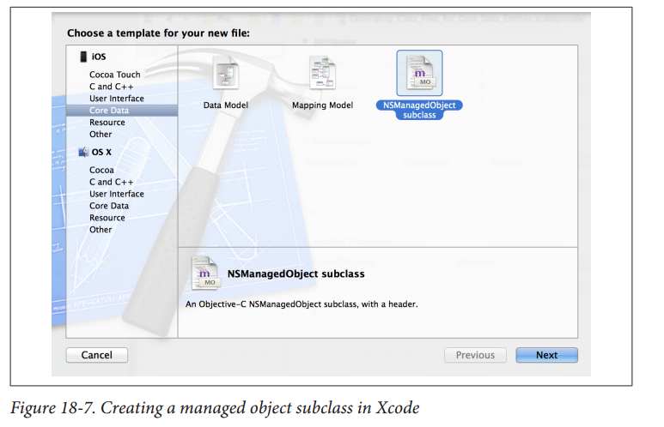

Slide 21
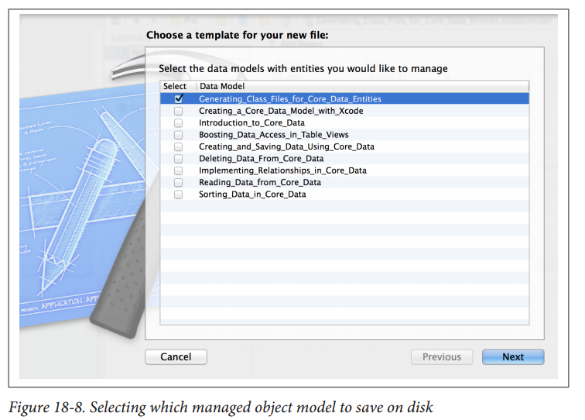
On the next screen, choose the managed object model that you want to save to disk
and ensure it is ticked. Once you are done, press the Next button (see Figure 18-8)

Slide 22
Now you will be asked to pick the entities that you want to export from your model
on disk as Objective-C files. Since we have created only one entity, the Person entity,
your list will look similar to that shown in Figure 18-9. Make sure the Person entity
is ticked, and then press the Next button.
At the last stage, you will be asked to save your entity on disk. Ensure that in the
Targets box, your project is ticked (see Figure 18-10); otherwise, the entity will not
be available to different source files in your code. Once you are happy, press the
Create button.

Slide 23
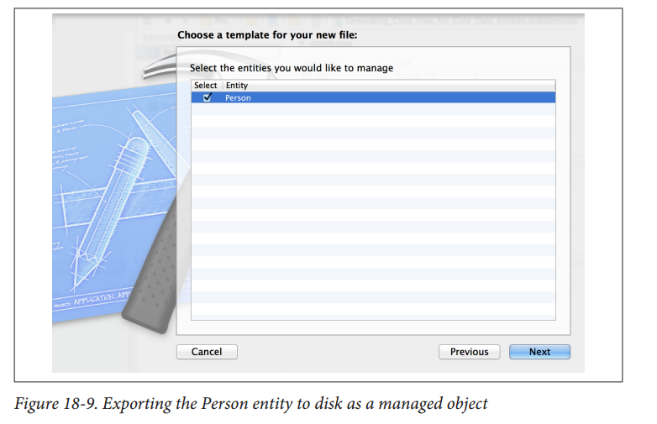

Slide 24
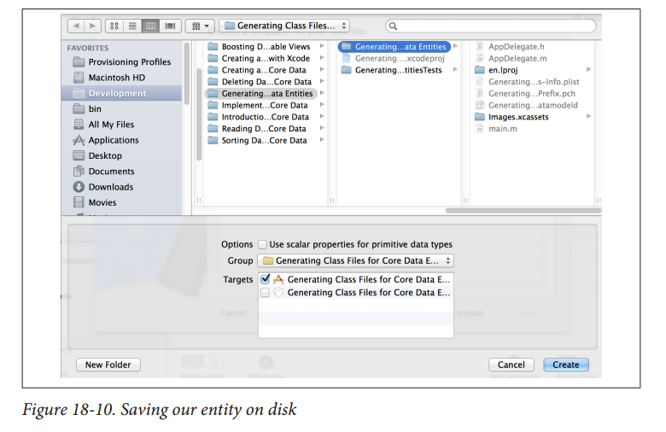

Slide 25
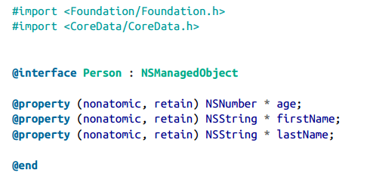
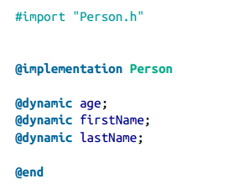
Now you will see two new files in your project, called Person.hand Person.m. Open the
contents of the Person.hfile. It will look like the following:
The Person.mfile is implemented for you in this way

Slide 26
Creating and Saving Data Using Core Data
You have already created a managed object, and you want to instantiate it and insert
that instance into your app’s Core Data context.
Follow the instructions in Recipe 18.1and Recipe 18.2. Now you can use the insertNe
wObjectForEntityForName:inManagedObjectContext:class method of NSEntityDe
scriptionto create a new object of a type specified by the first parameter of this method.
Once the new entity (the managed object) is created, you can modify it by changing its
properties. After you are done, save your managed object context using the save:
instance method of the managed object context.
I’ll assume that you have created a universal application in Xcode with the name Creating
and Saving Data Using Core Data; now, follow these steps to insert a new managed
object into the context:
1. Find the implementation file of your app delegate.
2. Import the Person.hfile into the app delegate’s implementation file:

Slide 27
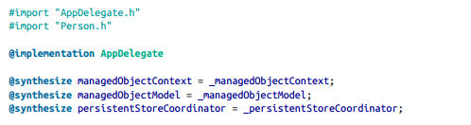

In the application:didFinishLaunchingWithOptions:method of your shared
application delegate, write this code

Slide 28
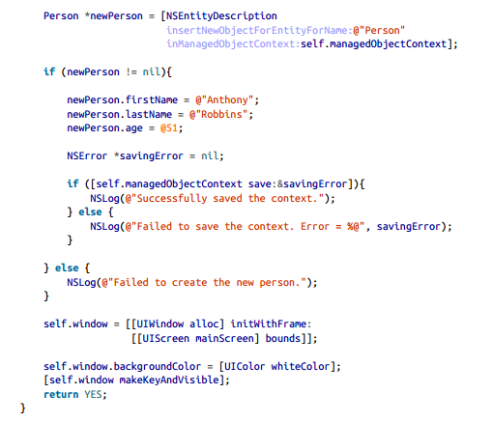

Slide 29
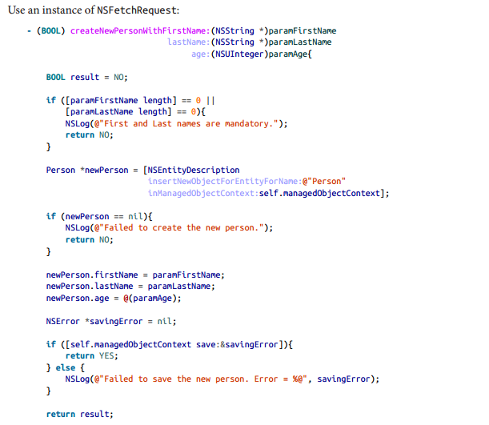
Reading Data from Core Data
You want to be able to read the contents of your entities (tables) using Core Data
Use an instance of NSFetchRequest

Slide 30
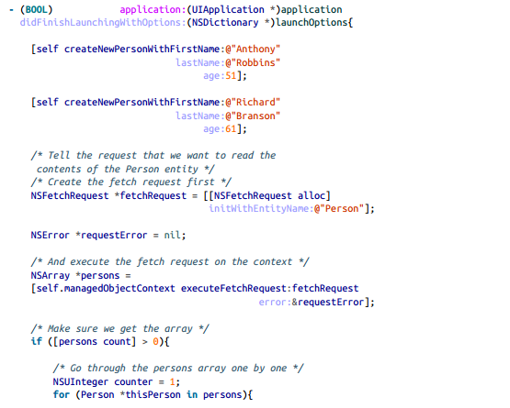

Slide 31
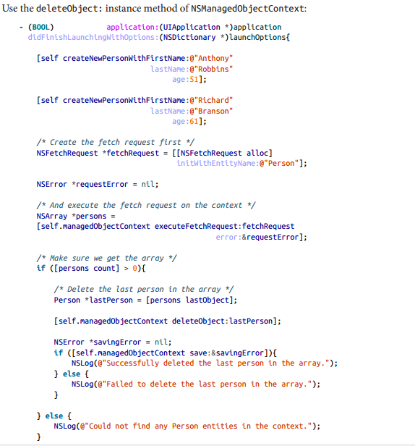
Deleting Data from Core Data

