Slide 1

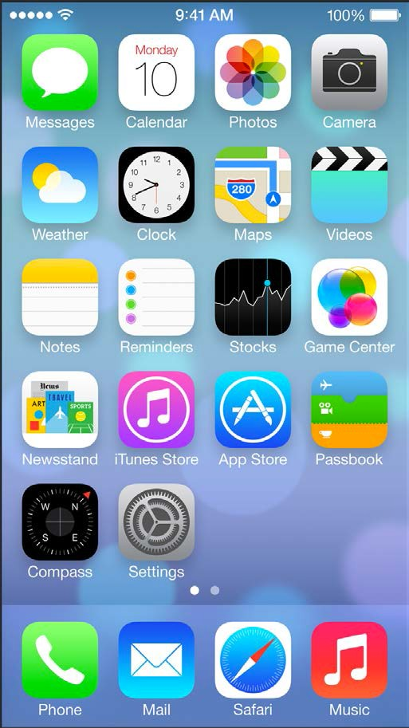
Instructor: NGUYEN ANH MINH (M. Sc.)
iOS Mobile Development

Slide 2
Introduction to Swift

Slide 3
Introduction to Swift
•
Announced and presented at WWDC’14 current version is 1.1
programming language influenced by expressivity of scripting languages
•
•
•
not to be confused with the Swift parallel scripting language (http://swift-lang.org/main/)

Slide 4
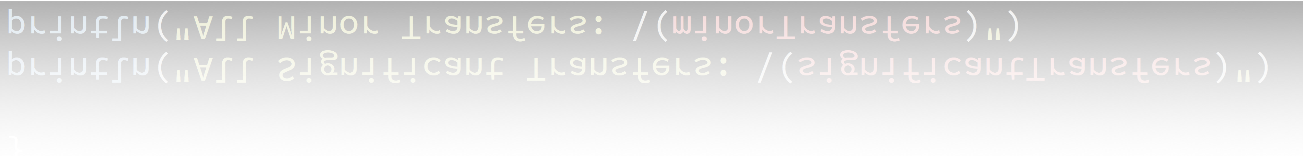
Introduction to Swift
13, 450,
99, 214]
var | minorTransfers = 0
var | significantTransfers | = | [Int]()
for transfer
{
in cashTransfers
if transfer > 100
{
significantTransfers.append(transfer)
}
else
{
minorTransfers
}
+= transfer
}
println("All println("All
Significant
Transfers:
\(significantTransfers)")
Minor
Transfers:
\(minorTransfers)")

Slide 5
Introduction to Swift
•
mutable (var) and immutable (let) variables or constants,
respectively
no explicit type declaration required no semicolon at line end required
•
•
•
only needed, if multiple commands are written on the same line

Slide 6
Classes & Structures

Slide 7
Commonalities
•
no distinction of interface and implementation files
•
values stored in properties methods provide functionality initializers to setup initial state can be extended
can conform to protocols
subscripts can be added to access values using subscript syntax
•
•
•
•
•

Slide 8
Classes
•
Structures lack capabilities that classes offer:
•
inheritance type casting
deinitializers (free up memory) reference counting
→ as a consequence, structures are value type that always get copied when passed around
•
•
•

Slide 9
Classes
•
Identity Operator checks, whether to variables refer to the same instance of an instance of a class
•
=== is identical
•
!== is not identical
•
Semantic equality is expressed by (==)

Slide 10
Structures
•
Can be used, when one or more conditions apply:
•
primary purpose is data encapsulation no inheritance is required
an instance is not required to be accessed from multiple other objects simultaneously
properties are itself value types that are expected to be copies as well
•
•
•
10

Slide 11
Functions / Methods

Slide 12
Functions / Methods
•
Functions
•
self-contained pieces of code each function has
•
•
a name, used to identify and “call” the function
a type, that consists of the function’s parameter types and return type
•
•
Methods
•
is function, that is only within the scope of a given, i.e. classes, structures or enumerations

Slide 13
Functions
•
func
fSig(p1:
String,
p2: Int)
0) returns
-> (ret1:
Int, 0, ret2:
ret2: String) “A String”)
•
fSig(“A
String”,
(ret1:
•
func
noParam()
-> Int
•
noParam()
returns 5
func | noReturnV(param: | String) | -> | ()
func | noReturnV(param: | String)
•
noReturnV(“Another
String”)
returns
Void
which
is ()

Slide 14
External Parameter Names
•
func
ex1(externalParamName
localParamName)
•
func incrementBy(inc: Int,
numberOfTimes
times:
Int)
-> Int
•
incrementBy(5, numberOfTimes: 3)
returns
an Int value
•
func
pow(#basis: Int,
#exponent:
Int) -> Int
•
pow(basis:
5, exponent:
3) returns 125

Slide 15
Methods
•
functions bound to types and instances of types, respectively
func
exampleMethod()
-> String
class
func
exampleMethod()
-> String
static
func
exampleMethod()
-> String
15

Slide 16
Methods
•
functions bound to types and instances of types, respectively
func exampleMethod() -> String
•
for instances of both value and reference types
class func exampleMethod() -> String
•
type method for reference types
static func exampleMethod()
-> String
•
type method for value types
15

Slide 17
Properties
values for classes, structures, or enumerations

Slide 18
Stored Properties
variable stored properties (var keyword) constant stored properties (let keyword)
set a default value for either of them as part of the definition modification of initial value during initialization
→ this is also true for constant stored properties
value types assigned to a constant stored property are completely immutable
•
•
•
•
•
•
it is not possible to change the properties of the assigned value type

Slide 19
Lazy Stored Properties
a constant property’s value must always be known before initialization completes
a lazy stored properties might not be evaluated when initialization finishes
•
value not calculated until it is used for the first time must not be declared as constant
•
•
•
•
useful when complex computation is required to evaluate the property or when value depends on outside factors that might not be known during initialization

Slide 20

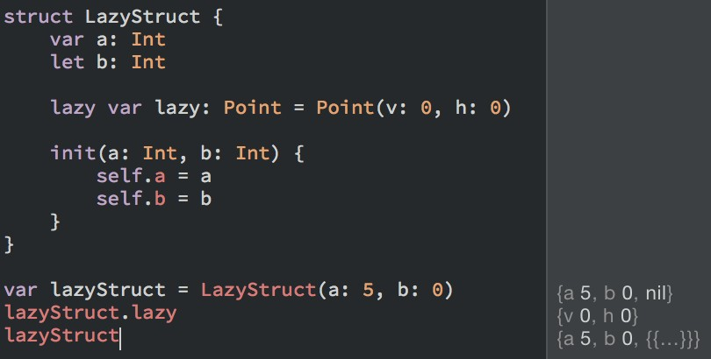
(Lazy) Stored Properties
•
lazily stored property lazy gets evaluated first, when it is accessed

Slide 21
Computed Properties
do not store a certain value
used to set and get other properties indirectly
must not be declared as constants because their value is inherently not fixed
•
•
•
20

Slide 22

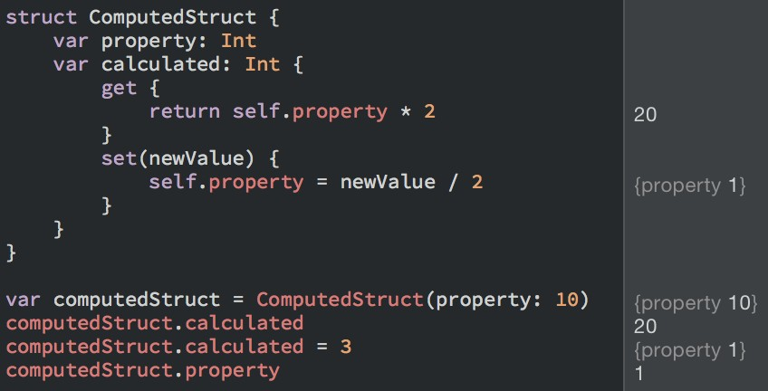
Computed Properties

Slide 23
Type Properties
•
Previously, only instance properties where shown
their values are always associated with a single instance of a type
type properties belong to the type instead of the instance
•
•
at runtime, there will be only one copy of that property independent of the number of created instances
value types allow for stored and computed type properties reference types allow for computed type properties only
•
•
•

Slide 24

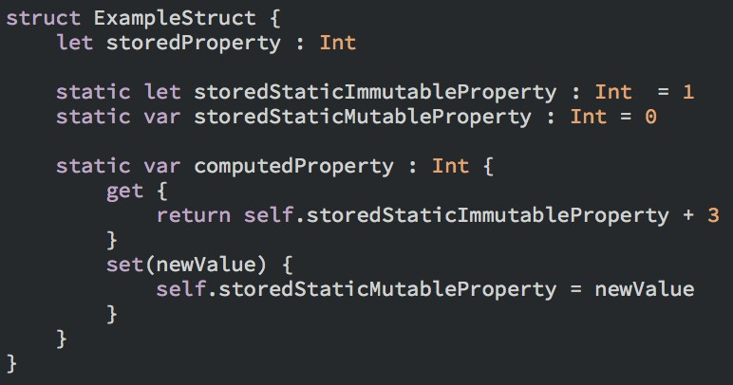

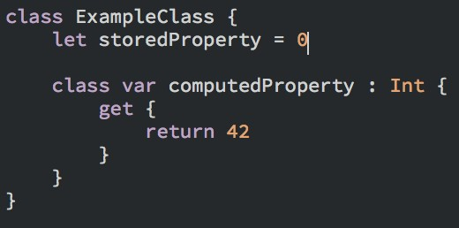
Type Properties

Slide 25
Instance Initialization

Slide 26
Instance Initialization
•
Core concepts apply to both classes and structures
•
Today: Common initialization procedure Next Week: A closer look on Classes
•

Slide 27

Instance Initialization
Initializers are used to create new instance of a particular type
unlike Objective-C, Swift Initializers do not have a return value
when initialization is completed, all stored properties of a type must be initialized with a sound value
•
•
•
init() {
// Initialization
Task
performed
here
}

Slide 28
Generated Initializers
•
Default Initializers
•
generated for structures or classes that do not provide any initializers themselves
does nothing but set properties to their default values
•
•
Memberwise Initializers for Structure Types
•
generated when structures do not provide any initializers themselves
also holds, if properties do not have any default values assigned within the declaration
•

Slide 29
Default Initializer
class ToDoItem
{
var | name | = | “New Item”
var | due | = | NSDate.date()
var | done | = | false
}
28

Slide 30
Default Initializer
class ToDoItem
{
var
generate at compile time
name
= “New
Item”
init() {}
var | due | = | NSDate.date()
var | done | = | false
}
28

Slide 31
Default Initializer
class ToDoItem
{
var
generate at compile time
name
= “New
Item”
init() {}
var | due | = | NSDate.date()
var | done | = | false
}
use directly as runtime
var item
= ToDoItem()
28

Slide 32
Memberwise Initializer
struct Point
{
var x = 0 var y = 0
}
29

Slide 33
Memberwise Initializer
generate at compile time
struct Point
{
init(x:
{
self.x = x self.y = y
}
Int,
y: Int)
var x = 0 var y = 0
}
29

Slide 34
Memberwise Initializer
generate at compile time
struct Point
{
init(x:
{
self.x = x self.y = y
}
Int,
y: Int)
var x = 0 var y = 0
}
use directly as runtime
var point
= Point(x:
5, y: 7)
29

Slide 35
Memberwise Initializer
generate at compile time
struct Point
{
init(x:
{
self.x = x self.y = y
}
Int,
y: Int)
var x = 0 var y = 0
}
use directly as runtime
var point
= Point(x:
5, y: 7)
Default Initializer is generated as well, but omitted for simplicity reasons.
29

Slide 36
Initializer Delegation for Value Types
•
have other initializers to perform initialization tasks to avoid code duplication
because value types do not support inheritance, structures and enumerations can only call initializers they provide themselves
use self.<initializer> to delegate the initialization
•
•
task
remember, that delegation to default or memberwise initializer is not possible from custom initializer
•
30

Slide 37
Optionals
Schrödinger’s Cat in terms of Values

Slide 38
Optionals
•
used for situations where the value of a property, the return value of a function etc. may be absent (nil)
•
an Optional states
•
that there is value that equals x OR that there is no value at all
•

Slide 39
Optionals
•
var surveyAnswer: String?
•
set to nil automatically
if that would be a property, it would not have been explicitly given a value during initialization
•
•
static func toInt(string: String) -> Int?
•
returns either nil or the integer representation of the string

Slide 40

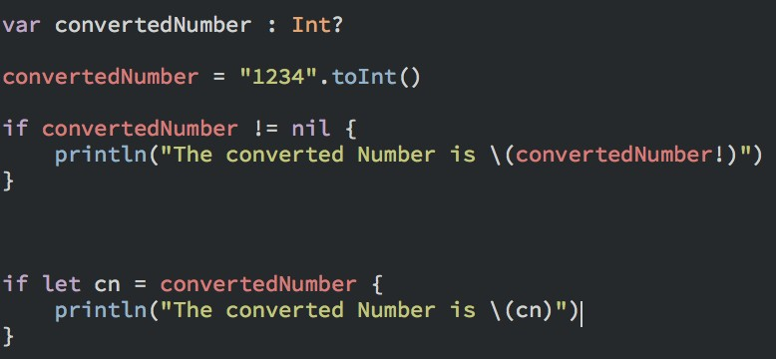
Accessing Optional Values
•
1st If: forced unwrapping
•
exclamation mark added to optional explicitly unwraps the optional causes runtime error if the optional’s value is nil
•
•
2nd If: optional binding
•
bind the optional’s value to a temporary variable to work with, if the optional’s value is not nil

Slide 41
Implicitly Unwrapped Optionals
Exclamation mark required to explicitly unwrap the optional value
let optionalInteger let forcedInteger :
: Int? = 1234
Int =
optionalInteger!
let implicitInteger let
: Int! = 1234
integer =
implicitInteger
no exclamation mark required, because it is already implicitly unwrapped

Slide 42
Implicitly Unwrapped Optionals
•
behave like Optionals, but do not need to be explicitly unwrapped when the underlying value is read
•
used when the Optional can never be nil anytime again
during runtime based on the program structure
(according to Apple’s documentation [1])
•
a runtime error will be raised, when an implicitly unwrapped Optional will be read when the value is nil

Slide 43
Xcode: Playground

Slide 44
Xcode: Playground
•
Just-In-Time evaluation of code
chronologic depiction variables, executed command incl. loops etc.
•
•
Useful for:
•
algorithm development (each step performed is easily visible)
test of Tests
gaining familiarity with new APIs
•
•

Slide 45

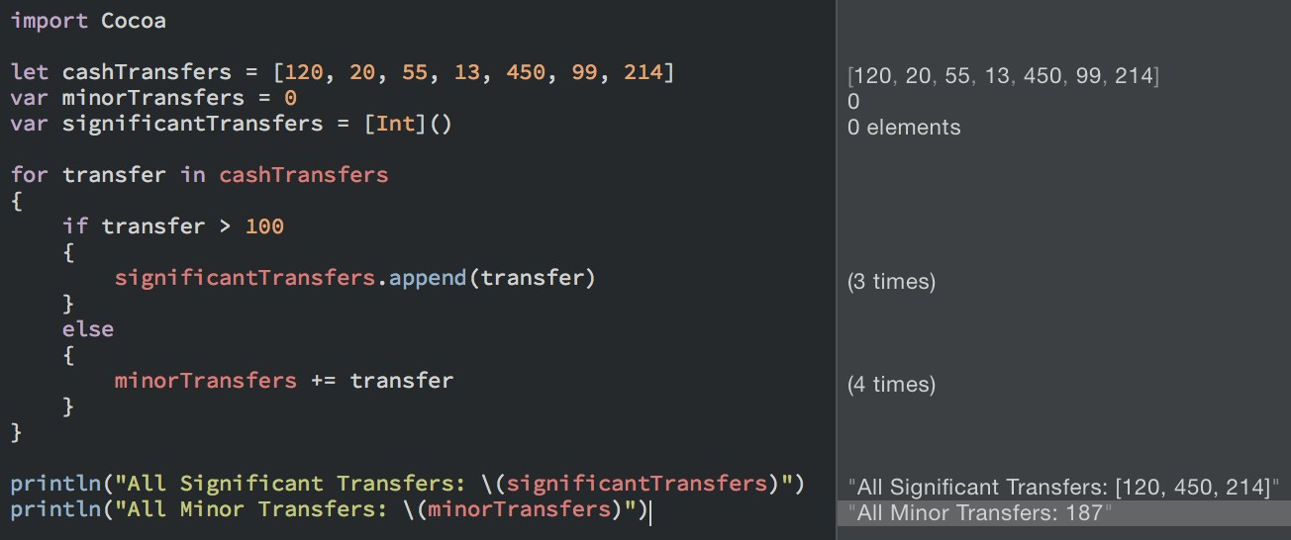
Xcode: Playground
•
left: code editor
right: live evaluation of code written on the left
•

