Slide 1

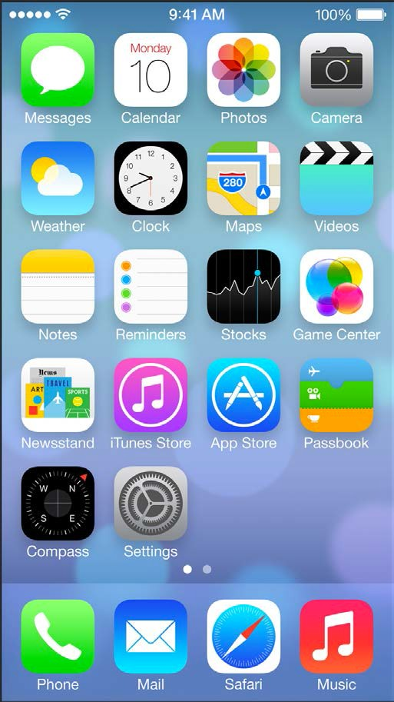
Instructor: NGUYEN ANH MINH (M. Sc.)
iOS Mobile Development

Slide 2
Instance Initialization

Slide 3
Initialization of Classes
•
stored properties must be assigned an initial value during initialization
•
that includes inherited properties, too
•
own properties must be initialized before inherited properties
•
designated and convenience initializers available

Slide 4
Designated Initializers
•
primary initializers of a class
fully initialize the properties provided by the class
•
forwards initialization of inherited properties to one of the superclass’ designated initializer
each class must have at least one designated initializer
•
•
•
inherit the designated initializers from the superclass
might be sufficient
init(/*parameters*/) {
// Initialization
}

Slide 5
Convenience Initializers
secondary, supporting initializers
can only forward initialization to designated initializers of the same class as the convenience initializer
used to provide shortcut or use-case specific initialization
•
•
•
processes of a class
convenience
init(/*parameters*/) {
// Initialization
}

Slide 6
Designated / Convenience
•
3 rules apply:
•
designated initializers must call designated initializers from their immediate superclass
convenience initializers must call another initializer from the same class
convenience initializers must ultimately call a designated initializer
•
•

Slide 7
Two-Phase Initialization
•
Phase 1:
stored properties are assigned initial values by the class that introduces it
Phase 2:
•
•
•
commences as soon as all properties are in their default configuration
each class can modify the default values of their stored properties
•

Slide 8
Compiler Support
•
Swift’s compiler performs sanity checks to ensure two- phase initialization performs without error

Slide 9
Compiler Support
all introduced properties of a class must be initialized before initialization is delegated to the superclass’ initializer
Check 2:
•
Check 1:
•
•
•
designated initializer must forward to the superclass’ designated initializer before values of inherited properties can be changed

Slide 10
Compiler Support
•
Check 3:
convenience initializers must delegate the process to designated initializers before values of any properties (inherited or self) can be modified
Check 4:
•
•
•
initializers cannot call instance methods, read values of instance properties or refer to self as a value until the
first phase of the Two-Phase Initialization is completed
10

Slide 11
Two Phase Initialization: Overview
Phase 1
Phase 2
Root Class
Memory Uninitialized
…
Memory Initialized
self now usable
Properties Customized
…
modify properties
Immediate Superclass
Memory Uninitialized
…
Memory Initialized
Properties Customized
designated initializer hands oﬀ to superclass
modify properties
Class
designated initializer conﬁrms that all stored properties have a value
Memory Allocated
Memory Initialized
Properties Customized
modify properties
Class
Instance
initializer called
ready for usage

Slide 12
Automatic Initializer Inheritance
Initializers are not bequeathed to subclasses by default inheriting initializers is still possible under certain conditions:
if subclass defines no own designated initializers, all the superclass’ initializers are inherited
if subclass provides all designated initializers of the superclass, it inherits all convenience initializers of the superclass
•
•
•
can be achieved through 1 or by providing a custom implementation according to definition of the initializer

Slide 13
Functions / Methods / Closures

Slide 14
Inout Parameter
•
used, when a function needs to modify variables outside of the function’s scope
only variables can be passed as inout parameters
•
•
constants and literals are not
func swapInts(inout let tmpA = a
a = b
b = tmpA
a: Int, inout b: Int){
allowed, because they cannot be modified
}
var a = 5 var b = 10
swapInts(&a,&b)

Slide 15
Excursion: Generics
•
although method overloading is possible with Swift, defining a method for each input parameter type would be cumbersome
func swapValues<T>(inout let tmpA = a
a: T, inout
b: T){
a | = | b
b | = | tmpA
}
var a = 5 var b = 10
swapValues(&a,&b)
•
Generics are used to address this issue
Generics can also be used to ensure, that only instances of a certain type are added to collections
•

Slide 16
Mutating Methods
With Value Types, properties cannot be modified from within instance methods
declare a method as mutating to write the changes back
•
•
to the original structure it is possible to assign a completely new instance to self from within a
struct ValueType { var propA: Int var propB: Int
•
mutating func setPropB(propB: self.propB = propB
}
Int) {
mutating method
}

Slide 17
Closures
•
similar to Objective-C’s blocks and other languages’ lambdas
•
capture and store references of any constant or variable from the context in which Closures are defined
•
global and nested functions are special cases of closures

Slide 18
Forms of Closures
•
global functions
•
have a name and do not capture anything
•
nested functions
have a name and capture variables from their enclosing function
closure expressions
•
•
•
unnamed and capture values from their surrounding context

Slide 19
Syntax of Closures
General Declaration Syntax:
func example(source: Int, closure: (parameters) -> returnValue) -> Int
Deﬁnition of function expecting a closure as 2nd parameter:
func own_filter<T: SequenceType>(source: T, element: (T.Generator.Element)
-> Bool) -> [T.Generator.Element]
{ (parameters) -> returnType in
// statements here
General Expression Syntax:
}
{ (array: T, (element: Int) -> Bool in return element == 42
Example Implementation:
}

Slide 20
Memory Management
20

Slide 21
Memory Management
•
Automatic Reference Counting (ARC) used to manage the memory consumption of an application
Rules only apply to Classes, because Structures and Enumerations are stored by value
relationships between classes is the trouble spot where ARC needs additional information
•
•

Slide 22
Memory Management
whenever a reference type is assigned to a constant or variable a strong reference is established
ARC does not free up class instances that have strong references of other classes pointing to them
•
•
•
have a look at Session 4 “Memory Management” to gain an overview on how ARC worked with Objective-C
Memory Management issues cannot be examined using Playground
•

Slide 23
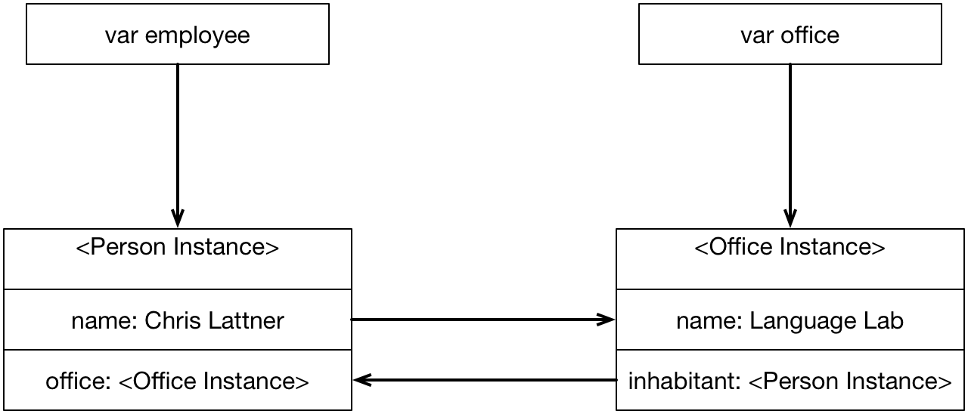
Strong Reference Cycle
23

Slide 24
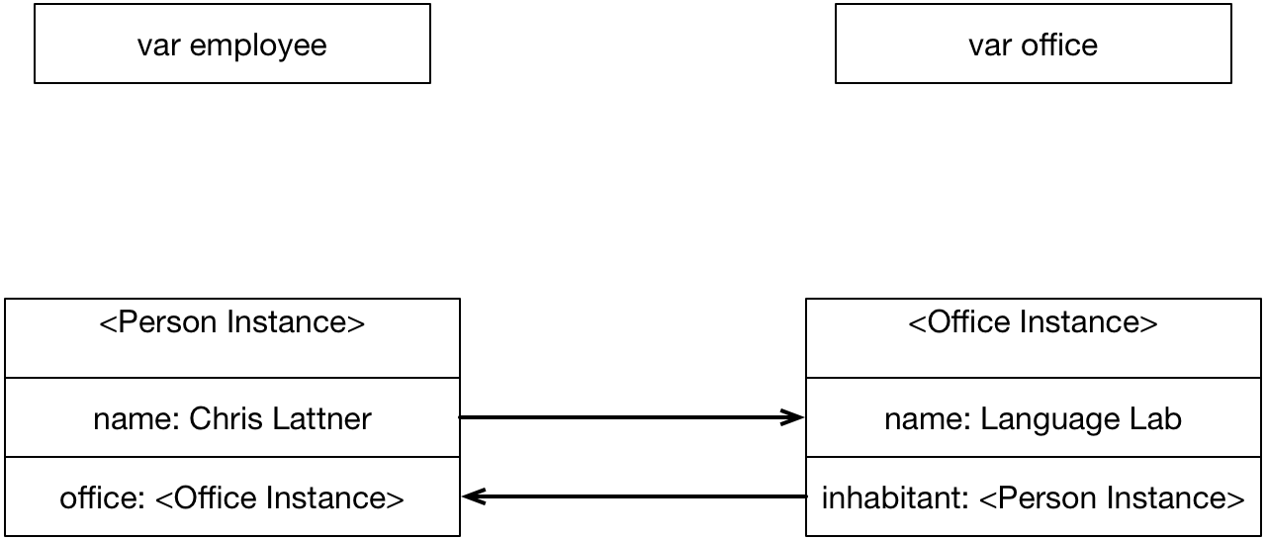
Strong Reference Cycle
23

Slide 25
Weak and Unowned References
•
ARC will not establish a strong reference to classes assigned to weak or unowned properties
weak
•
•
used when the property might be nil during lifetime cannot be a constant
•
•
unowned
•
used for non-Optional properties
because ARC cannot nil-ify the property, it must be ensured, that the assigned reference will not become nil during runtime runtime error, if reference is accessed after deallocation
•
•

Slide 26
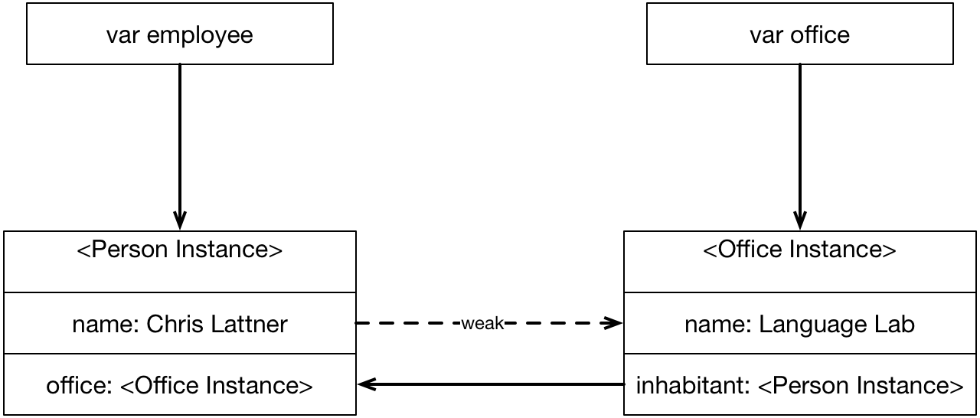
Weak and Unowned References
25

Slide 27
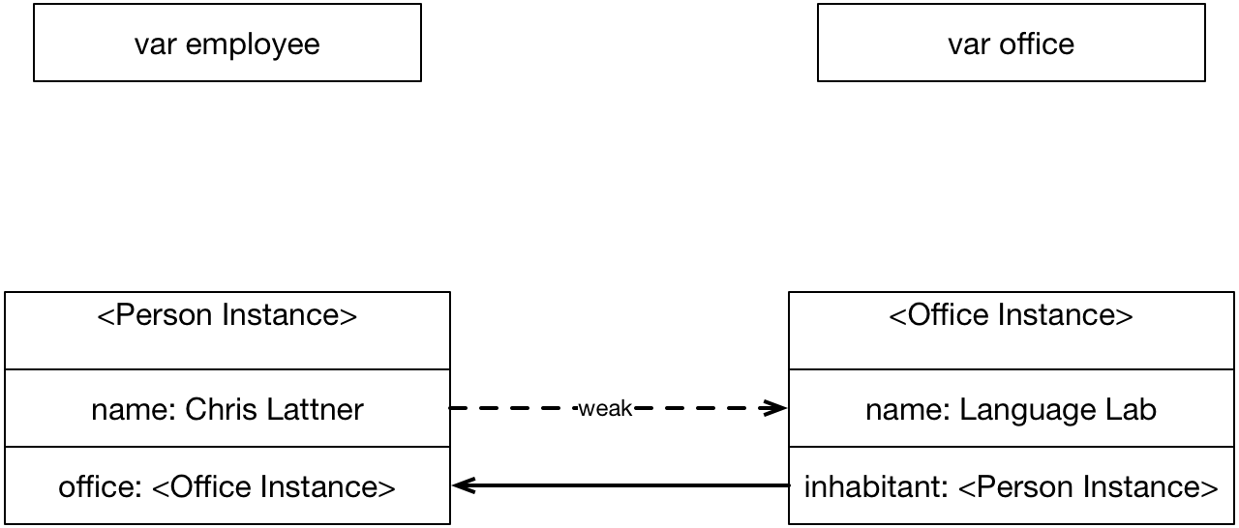
Weak and Unowned References
25

Slide 28
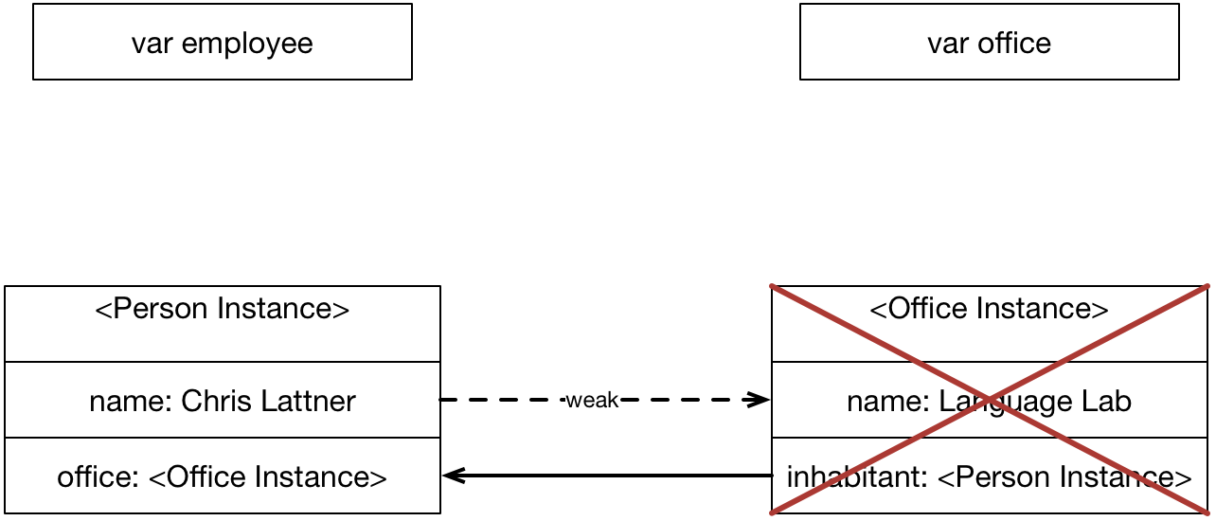
Weak and Unowned References
25

Slide 29
Strong Reference Cycles in Closures
•
closures are reference types as well
•
variables, captured inside a closure, is therefore also held as a strong reference of the closure
as well as the closure is hold as a strong reference
•
•
Solution: define a capture list for every variable that is captured by the block

Slide 30

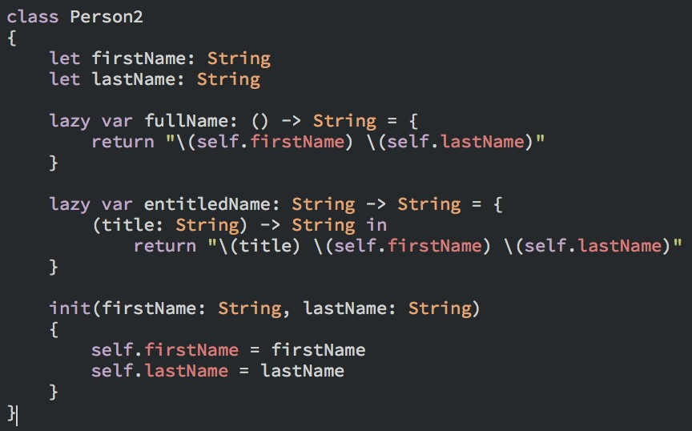

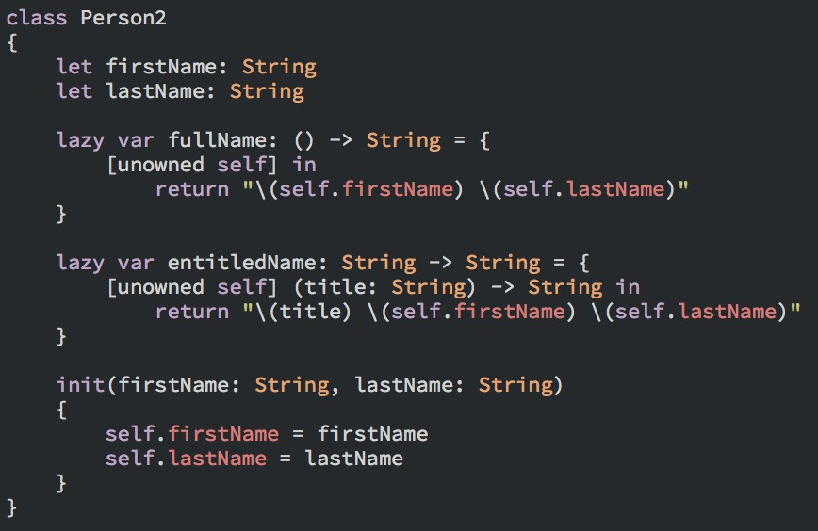
Syntax Example: Capture List
[unowned self, weak someInstance]
capture list is a comma-separated list of (unowned,weak) and class instance reference pairs, separated by commas

Slide 31
Protocols & Extensions

Slide 32

Protocols
similar to Objective-C protocols
allows the definition of a set of methods that a class that adopts the protocol must implement
allows the definition of properties
•
•
•
•
optional properties can be realized as Optionals
protocol ExampleProtocol {
var aProperty: Int { get, set } var bProperty: String { get }
mutating
func
change(newString:
String);
}

Slide 33
Extensions
similar to Objective-C categories
types can be extended with new functionality, but cannot override existing functionality
source code of the extended type not required to extend it
•
•
•
30

Slide 34
Extensions
•
add new initializers
define instance variables and type methods add (static) computed properties
define subscripts
define and use new nested types
add protocol conformance to an existing type
•
•
•
•
•

Slide 35

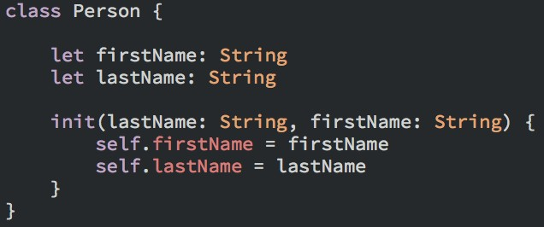

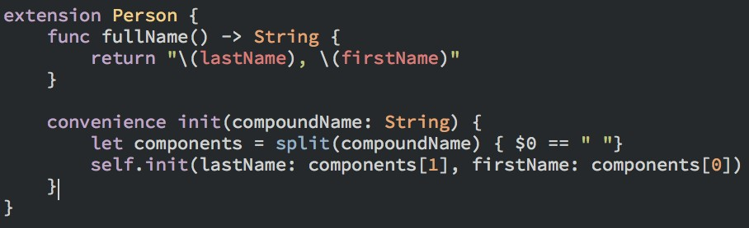
Syntax Example: Extensions
Base class
(or structure or enumeration)
extension of base class

