Slide 1
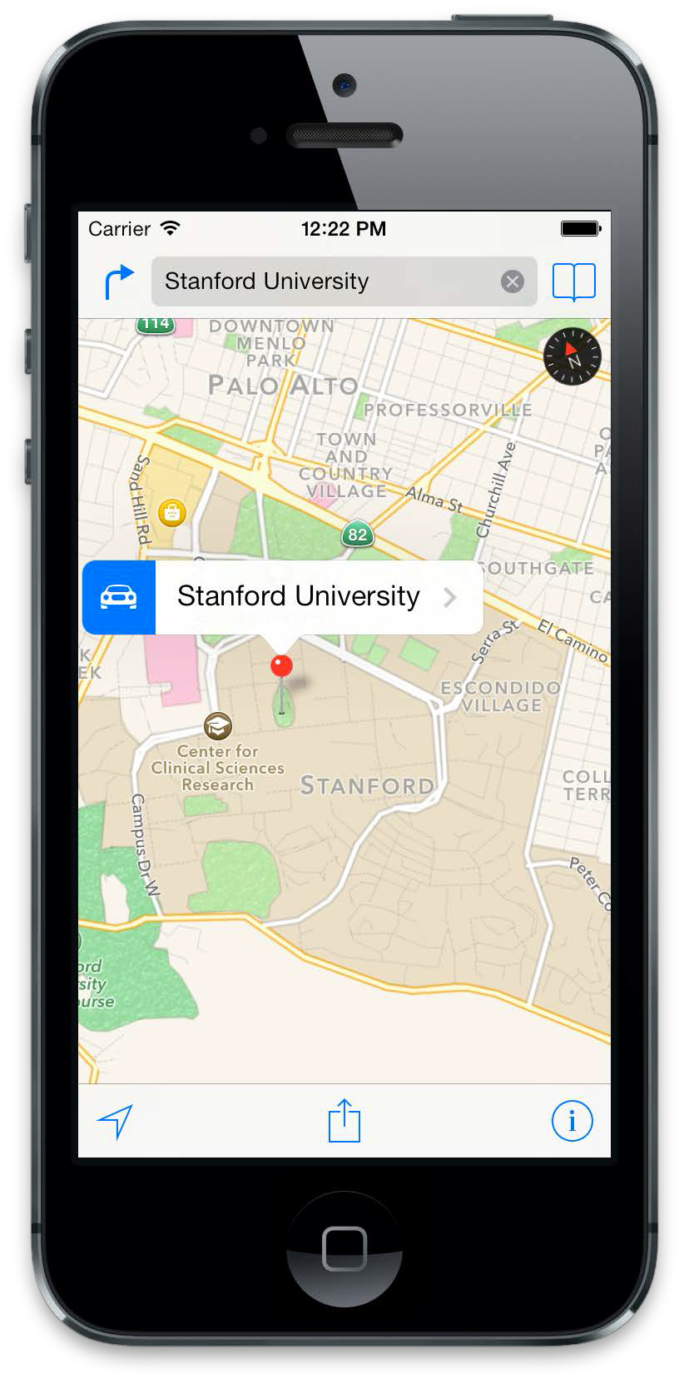
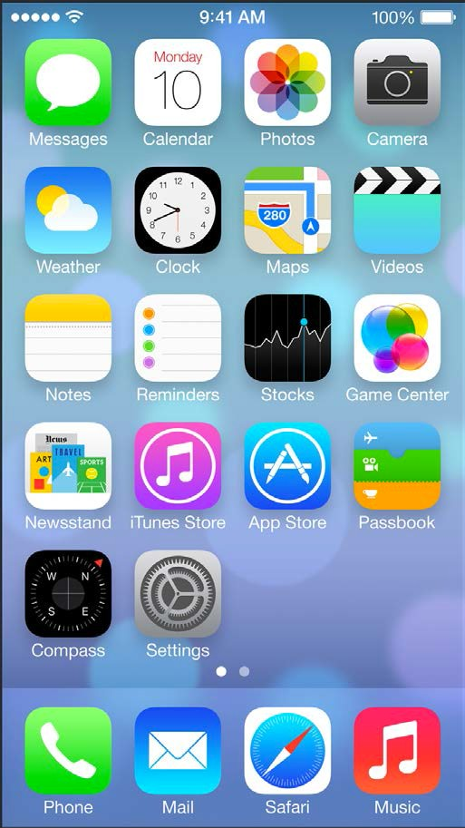
IOS Mobile Development
Instructor: NGUYEN ANH MINH (M. Sc.)

Slide 2
Module 01
IOS Overview
Introduction to Objective-C
Understand of Model-View-Controller
Managing Memory with ARC
X Code Environment

Slide 3
IOS Overview

Slide 4
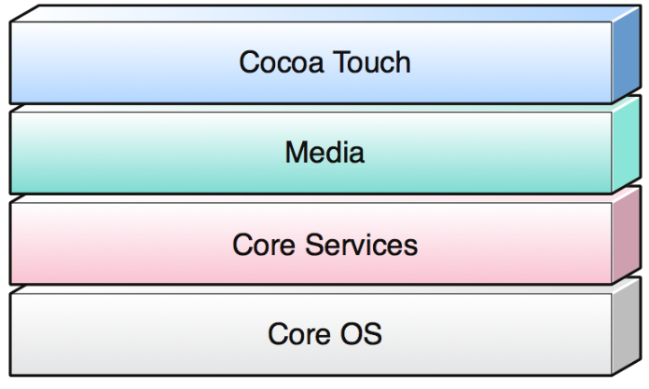
iOS Architecture
Implemented as a number of layers
Lower layers provide fundamental services and technologies
Higher layers provide more sophisticated services
Builds upon the functionality provided by the lower layers
Provides object-oriented abstractions for lower layer constructs
Each layer has a number of frameworks (packages of system interfaces)
Each framework contains dynamically shared libraries and associated resources (header files, images, etc)
When a framework is used, they need to be linked into the project
Standard frameworks such as Foundation and UIKit are linked by default, when a template project is started

Slide 5
iOS Overview: CoreOS
System Framework (based on Mach)
Threading (POSIX)
Networking (BSD sockets)
File system
Service discovery (Bonjour & DNS)
Memory management
Math computations
Core Bluetooth Framework and External Accessory Framework
Support for communicating with hardware accessories
Accelerate Framework
DSP, linear algebra and image processing optimized for hardware
Security Framework
Crypto library and keychain Services (secure storage of passwords, keys, for one or more users)

Slide 6
iOS Overview: Core Services
High level features
iCloud storage
Automatic reference counting
SQLite: lightweight SQL database
Grand Central Dispatch (GCD): manage concurrent execution of tasks
Thread management code moved to the system level
Tasks specified are added to an appropriate dispatch queue
Block objects: a C-level language construct; an anonymous function and the data (a closure or lambda)
In-App purchase: process financial transactions from iTune account
XML support
Notes:
Bonjour is Apple’s proposal for zero-configuration networking over IP. Bonjour comes out of the work of the ZEROCONF Working Group, part of the Internet Engineering Task Force (IETF). The ZEROCONF Working Group’s requirements and proposed solutions for zero-configuration networking over IP essentially cover three areas:
addressing (allocating IP addresses to hosts)
naming (using names to refer to hosts instead of IP addresses)
service discovery (finding services on the network automatically)
Bonjour has a zero-configuration solution for all three of these areas, as described in the following four sections.
Bonjour allows service providers, hardware manufacturers, and application programmers to support a single network protocol—IP—while breaking new ground in ease of use.
Network users no longer have to assign IP addresses, assign host names, or even type in names to access services on the network. Users simply ask to see what network services are available, and choose from the list.
In many ways, this kind of browsing is even more powerful for applications than for users. Applications can automatically detect services they need or other applications they can interact with, allowing automatic connection, communication, and data exchange, without requiring user intervention.

Slide 7
iOS Overview: Core Services (Cont’d)
CFNetwork Framework
Object-oriented abstractions for working with network protocols (DNS, http, Bonjour services)
Core Telephony Framework
System Configuration Framework
Determine network configuration
Social Framework
Post status updates and images to social networks
Foundation Framework: objective-C wrapper
Address Book Framework
Core Data Framework
Core Foundation Framework
Core Media Framework: C interface for media
Core Location Framework
Newsstand Kit Framework
Store Kit Framework: in app purchase
Notes:
Bonjour is Apple’s proposal for zero-configuration networking over IP. Bonjour comes out of the work of the ZEROCONF Working Group, part of the Internet Engineering Task Force (IETF). The ZEROCONF Working Group’s requirements and proposed solutions for zero-configuration networking over IP essentially cover three areas:
addressing (allocating IP addresses to hosts)
naming (using names to refer to hosts instead of IP addresses)
service discovery (finding services on the network automatically)
Bonjour has a zero-configuration solution for all three of these areas, as described in the following four sections.
Bonjour allows service providers, hardware manufacturers, and application programmers to support a single network protocol—IP—while breaking new ground in ease of use.
Network users no longer have to assign IP addresses, assign host names, or even type in names to access services on the network. Users simply ask to see what network services are available, and choose from the list.
In many ways, this kind of browsing is even more powerful for applications than for users. Applications can automatically detect services they need or other applications they can interact with, allowing automatic connection, communication, and data exchange, without requiring user intervention.

Slide 8
iOS Overview: Media
Graphics
Core graphics framework
Core animation framework
Core image framework
OpenGL ES and GLKit framework
Core text framework
Audio/video
Media player framework: access to iTunes
OpenAL framework: positional audio playback
Core audio framework: Airplay, recording audio
Core video framework: buffer support for core media framework
AV Foundation framework (Objective-C interface): playback, recording, Airplay
Asset Library Framework: retrieving photos and videos from user’s device
Notes:
Bonjour is Apple’s proposal for zero-configuration networking over IP. Bonjour comes out of the work of the ZEROCONF Working Group, part of the Internet Engineering Task Force (IETF). The ZEROCONF Working Group’s requirements and proposed solutions for zero-configuration networking over IP essentially cover three areas:
addressing (allocating IP addresses to hosts)
naming (using names to refer to hosts instead of IP addresses)
service discovery (finding services on the network automatically)
Bonjour has a zero-configuration solution for all three of these areas, as described in the following four sections.
Bonjour allows service providers, hardware manufacturers, and application programmers to support a single network protocol—IP—while breaking new ground in ease of use.
Network users no longer have to assign IP addresses, assign host names, or even type in names to access services on the network. Users simply ask to see what network services are available, and choose from the list.
In many ways, this kind of browsing is even more powerful for applications than for users. Applications can automatically detect services they need or other applications they can interact with, allowing automatic connection, communication, and data exchange, without requiring user intervention.

Slide 9
iOS Overview: Cocoa Touch
UI Kit Framework
Apple push notification service
Storyboards: supplant nib files as the recommended way to design your application’s user interface
Document Support: UIDocument class for managing the data associated with user documents
Multitasking
Printing: support allows applications to send content wirelessly to nearby printers
Local push notification
Gesture recognizers
Accelerometer data, built-in camera, battery state information, proximity sensor information
Notes:
Bonjour is Apple’s proposal for zero-configuration networking over IP. Bonjour comes out of the work of the ZEROCONF Working Group, part of the Internet Engineering Task Force (IETF). The ZEROCONF Working Group’s requirements and proposed solutions for zero-configuration networking over IP essentially cover three areas:
addressing (allocating IP addresses to hosts)
naming (using names to refer to hosts instead of IP addresses)
service discovery (finding services on the network automatically)
Bonjour has a zero-configuration solution for all three of these areas, as described in the following four sections.
Bonjour allows service providers, hardware manufacturers, and application programmers to support a single network protocol—IP—while breaking new ground in ease of use.
Network users no longer have to assign IP addresses, assign host names, or even type in names to access services on the network. Users simply ask to see what network services are available, and choose from the list.
In many ways, this kind of browsing is even more powerful for applications than for users. Applications can automatically detect services they need or other applications they can interact with, allowing automatic connection, communication, and data exchange, without requiring user intervention.

Slide 10
iOS Overview: Cocoa Touch (Cont’d)
Game Kit Framework
Peer-to-peer services: over Bluetooth, e.g. multi-player games
Address Book UI Framework: contact management
iAd Framework: deliver banner-based advertisements from your application
Map Kit Framework: a scrollable map interface
Message UI Framework: support for composing and queuing email messages in the user’s outbox
Notes:
Bonjour is Apple’s proposal for zero-configuration networking over IP. Bonjour comes out of the work of the ZEROCONF Working Group, part of the Internet Engineering Task Force (IETF). The ZEROCONF Working Group’s requirements and proposed solutions for zero-configuration networking over IP essentially cover three areas:
addressing (allocating IP addresses to hosts)
naming (using names to refer to hosts instead of IP addresses)
service discovery (finding services on the network automatically)
Bonjour has a zero-configuration solution for all three of these areas, as described in the following four sections.
Bonjour allows service providers, hardware manufacturers, and application programmers to support a single network protocol—IP—while breaking new ground in ease of use.
Network users no longer have to assign IP addresses, assign host names, or even type in names to access services on the network. Users simply ask to see what network services are available, and choose from the list.
In many ways, this kind of browsing is even more powerful for applications than for users. Applications can automatically detect services they need or other applications they can interact with, allowing automatic connection, communication, and data exchange, without requiring user intervention.

Slide 11
Objective-C

Slide 12
Objective-C
A strict superset of ANSI C
Originally used within NeXT’s NEXTSTEP OS (precursor of Mac OS X)
Single inheritance
Dynamic runtime: everything is looked up and dispatched at run time
No garbage collection on iPhone, iTouch and iPad
New types
id type: dynamic type to refer to any object
Selectors: a message and arguments that will (at some point) trigger the execution of a method
Notes:
How can C++ achieve dynamic binding yet also static typing?
When you have a pointer to an object, the object may actually be of a class that is derived from the class of the pointer (e.g., a Vehicle* that is actually pointing to a Car object; this is called "polymorphism"). Thus there are two types: the (static) type of the pointer (Vehicle, in this case), and the (dynamic) type of the pointed-to object (Car, in this case).
Static typing means that the legality of a member function invocation is checked at the earliest possible moment: by the compiler at compile time. The compiler uses the static type of the pointer to determine whether the member function invocation is legal. If the type of the pointer can handle the member function, certainly the pointed-to object can handle it as well. E.g., if Vehicle has a certain member function, certainly Car also has that member function since Car is a kind-of Vehicle.
Dynamic binding means that the address of the code in a member function invocation is determined at the last possible moment: based on the dynamic type of the object at run time. It is called "dynamic binding" because the binding to the code that actually gets called is accomplished dynamically (at run time). Dynamic binding is a result of virtual functions.

Slide 13
Objective-C
Introspection
An object (class, instance, etc) can be asked at runtime what type it is
Can pass anonymous objects to a method, and let it determine what to do based on the object’s actual type
isKindOfClass: returns whether an object is that kind of class (inheritance included)
isMemberOfClass: returns whether an object is that kind of class (no inheritance)
respondsToSelector:returns whether an object responds to a given method
Notes:
Class: defines the grouping of data and code, the “type” of an object
Instance: a specific allocation of a class
Method: a “function” that an object knows how to perform
Selector: a message and arguments that will (at some point) trigger the execution of a method
• Design Patterns
Instance Variable (or “ivar”): a specific piece of data belonging to an object
Static typing means that the legality of a member function invocation is checked at the earliest possible moment: by the compiler at compile time. The compiler uses the static type of the pointer to determine whether the member function invocation is legal. If the type of the pointer can handle the member function, certainly the pointed-to object can handle it as well. E.g., if Vehicle has a certain member function, certainly Car also has that member function since Car is a kind-of Vehicle.
Dynamic binding means that the address of the code in a member function invocation is determined at the last possible moment: based on the dynamic type of the object at run time. It is called "dynamic binding" because the binding to the code that actually gets called is accomplished dynamically (at run time). Dynamic binding is a result of virtual functions.

Slide 14
Objective-C header file and interface
Objective-C stack.h header file
instance variables
are declared as
properties
“-” denotes instance methods
#import <Foundation/Foundation.h>
@interface Stack : NSObject
@property (nonatomic, strong) NSMutableArray *numStack;
-(void) push: (double) num;
-(double) pop;
@end
define STACKSIZE 10
Class Stack {
private:
double num[STACKSIZE+1];
int top;
public:
Stack();
void push(double x);
double pop();
};
C++ header file
Notes:
@private
The instance variable is accessible only within the class that declares it.
@protected
The instance variable is accessible within the class that declares it and within classes that inherit it. All instance variables without an explicit scope directive have @protected scope.
@public
The instance variable is accessible everywhere.
@package
Using the modern runtime, an @package instance variable has @public scope inside the executable image that implements the class, but acts like @private outside.
The @package scope for Objective-C instance variables is analogous to private_extern for C variables and functions. Any code outside the class implementation’s image that tries to use the instance variable gets a link error.
This scope is most useful for instance variables in framework classes, where @private may be too restrictive but @protected or @public too permissive.

Slide 15
Objective-C Properties
Provide access to object attributes
Shortcut to implementing getter/setter methods
Instead of declaring “boilerplate” code, have it generated automatically
Also allow you to specify:
readonly versus readwrite access memory management policy
Memory management: weak and strong
Specify @property in the header (*.h) file
Create the accessor methods by @synthesize the properties in the implementation (*.m) file

Slide 16
Objective-C Method Declaration
Each method declaration consists of:
A name
A return type
An optional list of arguments (and their data or object types)
An indicator to determine if the method is a class or instance method
-(void) setHeight:(double)h Width:(double)w;
Method type:
+ class
- instance
Argument 1 type and name
Argument 2 type and name
Method name: setHeight:Width:

Slide 17
Objective-C Implementation
#import "Stack.h"
@implementation Stack
@synthesize numStack = _numStack;
- (NSMutableArray *) numStack {
if (_numStack==nil)
_numStack = [[NSMutableArray alloc] init];
return _numStack;
}
- (void) push:(double)num {
[self.numStack addObject:[NSNumber numberWithDouble:num]];
}
- (double) pop {
NSNumber *numObject = [self.numStack lastObject];
if(numObject) [self.numStack removeLastObject];
NSLog(@"poped %@",numObject);
return [numObject doubleValue];
}
@end
Objective-C stack.m file
@synthesize creates getter and setter methods
alloc: a class method
Method syntax
self: the instance itself
dot notation to access
setter and getter method
Notes:
@private
The instance variable is accessible only within the class that declares it.
@protected
The instance variable is accessible within the class that declares it and within classes that inherit it. All instance variables without an explicit scope directive have @protected scope.
@public
The instance variable is accessible everywhere.
@package
Using the modern runtime, an @package instance variable has @public scope inside the executable image that implements the class, but acts like @private outside.
The @package scope for Objective-C instance variables is analogous to private_extern for C variables and functions. Any code outside the class implementation’s image that tries to use the instance variable gets a link error.
This scope is most useful for instance variables in framework classes, where @private may be too restrictive but @protected or @public too permissive.

Slide 18
Objective-C Message Syntax
A square brace syntax
[receiver message]
[receiver message:argument]
[receiver message:arg1 :anonymousArg2]
[receiver message:arg1 andArg:arg2]
Main argument
Subsequent named argument
Object receiving
the message
Message itself

Slide 19
C++ Implementation
#include "stack.h"
Stack::Stack()
{
index = top;
}
void Stack::push(double x)
{
if(!is_full())
num[top++] = x;
}
double Stack::pop()
{
if(!is_empty())
return num[--top];
else
return -1;
}
Method syntax
Notes:
@private
The instance variable is accessible only within the class that declares it.
@protected
The instance variable is accessible within the class that declares it and within classes that inherit it. All instance variables without an explicit scope directive have @protected scope.
@public
The instance variable is accessible everywhere.
@package
Using the modern runtime, an @package instance variable has @public scope inside the executable image that implements the class, but acts like @private outside.
The @package scope for Objective-C instance variables is analogous to private_extern for C variables and functions. Any code outside the class implementation’s image that tries to use the instance variable gets a link error.
This scope is most useful for instance variables in framework classes, where @private may be too restrictive but @protected or @public too permissive.

Slide 20
Objective-C Categories and Extensions
Categories allows new methods to be added to existing class without using subclass
category name is listed within parentheses after the class name and the superclass isn’t mentioned
Class extensions are like anonymous categories
@interface MyClass ()
Methods must be implemented in the main @implementation block for the corresponding class
#import <Foundation/Foundation.h>
#import "Stack.h"
@interface Stack (emptyFull)
-(BOOL) isEmpty;
-(BOOL) isFull;
@end
#import "StackExt.h"
#define STACK_CAP 100
@implementation Stack(emptyFull)
- (BOOL) isEmpty{
return ([self.numStack count]==0);
}
- (BOOL) isFull{
return ([self.numStack count]==STACK_CAP);
}
@end
StackExt.h
StackExt.m

Slide 21
Objective-C Protocols
Class and category interfaces declare methods that are associated with a particular class
protocols declare methods that are independent of any specific class
Protocols declare methods that can be implemented by any class. Protocols are useful in at least three situations:
To declare methods that others are expected to implement
To declare the interface to an object while concealing its class
To capture similarities among classes that are not hierarchically related
@protocol MyXMLSupport
@required
- (void) initFromXMLRepresentation:(NSXMLElement *)XMLElement;
- (NSXMLElement *)XMLRepresentation;
@optional
- (void)anOptionalMethod;
@end
@interface aClass <MyXMLSupport>
@end
@interface aClass(categName)<MyXMLSupport>
@end
@implementation className
…
if (![receiver conformsToProtocol:@protocol(MyXMLSupport)])
…
@end

Slide 22
Objective-C Protocols (Cont’d)
#import <UIKit/UIKit.h>
@interface CalculatorAppDelegate : UIResponder <UIApplicationDelegate>
@property (strong, nonatomic) UIWindow *window;
@end
CalculatorAppDelegate.h
@interface UIApplication (UINewsstand)
- (void)setNewsstandIconImage:(UIImage *)image;
@end
@protocol UIApplicationDelegate<NSObject>
@optional
- (void)applicationDidFinishLaunching:(UIApplication *)application;
- (BOOL)application:(UIApplication *)application didFinishLaunchingWithOptions:(NSDictionary *)launchOptions __OSX_AVAILABLE_STARTING(__MAC_NA,__IPHONE_3_0);
(void)applicationDidBecomeActive:(UIApplication *)application;
@end
UIApplication.h

Slide 23
Objective-C: Associative References
@implementation CalculatorBrain(ArithmeticExpressionAdditions)
@dynamic arithExp;
-(NSMutableString*)arithExp { if(objc_getAssociatedObject(self,arithExpKey)==nil){
NSMutableString *str= [[NSMutableString alloc]
initWithFormat:@"%@", @"RPN arith expression: "];
objc_setAssociatedObject(self, arithExpKey, str, OBJC_ASSOCIATION_RETAIN);
}
return objc_getAssociatedObject(self, arithExpKey);
}
- (void)setArithExp:(NSString*)newExpression {
objc_setAssociatedObject(self, arithExpKey, newExpression, OBJC_ASSOCIATION_RETAIN);
}
- (void) appendOp:(NSString*)str {
[self.arithExp appendString:str];
@end
Associative references
Simulate the addition of object instance variables to an existing class
#import "CalculatorBrain.h"
static const char* const arithExpKey = "myexpkey";
@interface CalculatorBrain(ArithmeticExpressionAdditions)
@property (nonatomic, readwrite, strong) NSMutableString* arithExp;
-(void) appendOp:(NSString*)s;
@end

Slide 24
Objective-C: Fast Enumeration
The enumeration is considerably more efficient than, for example, using NSEnumerator directly.
The syntax is concise.
Enumeration is “safe”—the enumerator has a mutation guard so that if you attempt to modify the collection during enumeration, an exception is raised
NSArray *array = [NSArray arrayWithObjects:
@"one", @"two", @"three", @"four", nil];
for (NSString *element in array) {
NSLog(@"element: %@", element);
}
NSEnumerator *enumerator = [array objectEnumerator];
NSString *next;
while ((next=[enumerator nextObject])!=nil) {
//dome something
}

Slide 25
Objective-C: Foundation Framework
Root class: allocation, initialization and duplication of objects, introspection, object encoding and decoding (for archiving / serialization), message forwarding and message dispatching
NSObject
Value objects: encapsulate values of various primitive types
NSNumber
NSDate
NSString
NSData
Collections: collections are objects that store other objects
NSArray, NSMutableArray
NSDictionary, NSMutableDictionary
NSSet, NSMutableSet

Slide 26
Model-View-Controller

Slide 27
Model View Controller (MVC)
Controllers configure the views
that the user sees and make sure
that the view and model objects
keep in sync
Controller
Model objects hold data and know
nothing about the user interface
View
Model
Model
Model
View
View objects are visible to the user. Examples of view objects are buttons, text fields, and
sliders
In MVC, every object is either a model object, a view object, or a controller object

Slide 28
Model View Controller (MVC)
Controller
Model
Model
Model
View
View
Model = What your application is (but not how it is displayed)

Slide 29
Model View Controller (MVC)
Controller
Model
Model
Model
View
View
Controller = How your Model is presented to the user (UI logic)

Slide 30
Model View Controller (MVC)
Controller
Model
Model
Model
View
View
View = Your Controller’s minions

Slide 31
Model View Controller (MVC)
Controller
Model
Model
Model
View
View
Controller’s can always talk directly to their Model.

Slide 32
Model View Controller (MVC)
Controller
Outlet
Model
Model
Model
View
View
Controller’s can also talk directly to their View.

Slide 33
Model View Controller (MVC)
Controller
Outlet
Model
Model
Model
View
View
The Model and View should never speak to each other.

Slide 34
Model View Controller (MVC)
Controller
Outlet
?
Model
Model
Model
View
View
Can the View speak to its Controller?

Slide 35
Model View Controller (MVC)
Controller
Outlet
Model
Model
Model
View
View
Sort of. Communication is “blind” and structured.

Slide 36
Model View Controller (MVC)
Target
Controller
Outlet
Model
Model
Model
View
View
The Controller can drop a target on itself.

Slide 37
Model View Controller (MVC)
Target
Controller
Outlet
Action
Model
Model
Model
View
View
Then hand out an action to the View.

Slide 38
Model View Controller (MVC)
Target
Controller
Outlet
Action
Model
Model
Model
View
View
The View sends the action when things happen in the UI.

Slide 39
Model View Controller (MVC)
Target
Controller
Outlet
Action
will
did
Model
Model
Model
View
View
Sometimes the View needs to synchronize with the Controller.

Slide 40
Model View Controller (MVC)
Target
will
did
Controller
Outlet
Action
Model
Model
Model
View
View
The Controller sets itself as the View’s delegate.

Slide 41
Model View Controller (MVC)
Target
will
did
Controller
Outlet
Delegate
Action
Model
Model
Model
View
View
The Controller sets itself as the View’s delegate.
The delegate is set via a protocol (i.e. it’s “blind” to class).

Slide 42
Model View Controller (MVC)
Target
will
did
Controller
Outlet
Delegate
Action
Model
Model
Model
View
View
Views do not own the data they display.

Slide 43
Model View Controller (MVC)
Target
will
did
Controller
Outlet
Delegate
Action
Data
at
count
Model
Model
Model
View
View
So, if needed, they have a protocol to acquire it.

Slide 44
Model View Controller (MVC)
Target
will
did
Controller
Outlet
Data
at
count
Delegate
Action
Data source
Model
Model
Model
View
View
Controller are almost always that data source (not Model!).

Slide 45
Model View Controller (MVC)
Target
will
did
Controller
Outlet
Data
at
count
Delegate
Action
Data source
Model
Model
Model
View
View
Controllers interpret/format Model information for the View.

Slide 46
Model View Controller (MVC)
Target
will
did
Controller
Outlet
?
count
Data
at
Delegate
Action
Data source
Model
Model
Model
View
View
Can the Model talk directly to the Controller?

Slide 47
Model View Controller (MVC)
Target
will
did
Controller
Outlet
Data
at
count
Delegate
Action
Data source
Model
Model
Model
View
View
No. The Model is (should be) UI independent.

Slide 48
Model View Controller (MVC)
Target
will
did
Controller
Outlet
Data
at
count
Delegate
Action
Data source
Model
Model
Model
View
View
So what if the Model has information to update or something?

Slide 49
Model View Controller (MVC)
Target
will
did
Controller
Outlet
Notification and KVO
Data
at
count
Delegate
Action
Data source
Model
Model
Model
View
View
It uses a “radio station”-like broadcast mechanism.

Slide 50
Model View Controller (MVC)
Target
will
did
Controller
Outlet
Notification and KVO
Data
at
count
Delegate
Action
Data source
Model
Model
Model
View
View
Controllers (or other Model) “tune in” to interesting stuff.

Slide 51
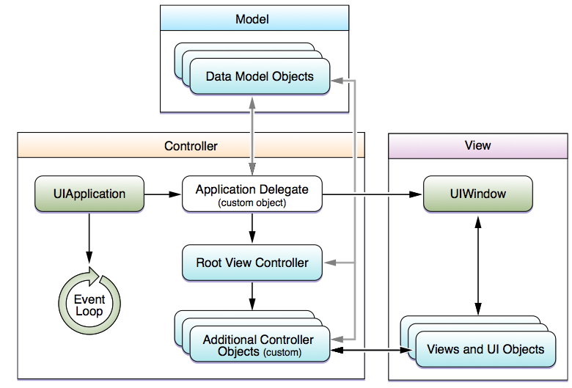
Model View Controller (MVC)
Key objects in iOS apps
UIApplication controller object:
manages the app event loop
coordinates other high-level app behaviors
custom app-level logic resides in your app delegate object
AppDelegate custom object: created at app launch time, usually by the UIApplicationMain function
handle state transitions within the app

Slide 52
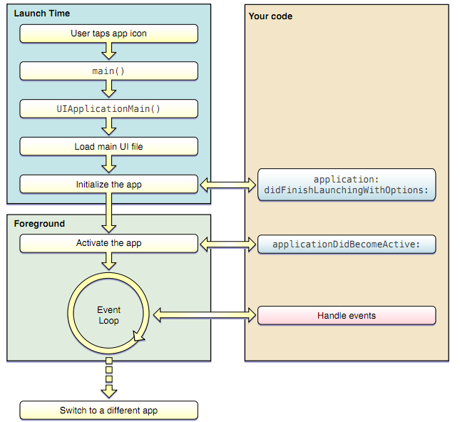
Model View Controller (MVC)
App launch cycle

Slide 53
Model View Controller (MVC)
Controller
Knows both model and view
Acts as a middleman
When model changes, inform the view
When data manipulated by view, update the model
Build-in iOS controllers
UIViewController: managing apps with generic views
UITabBarController: for tabbed applications (e.g. clock)
UINavigationController: managing hierarchical data (e.g. email folders)
UITableController: for lists of data etc (e.g. iTunes tracks)

Slide 54
Managing Memory with ARC

Slide 55
Managing Memory with ARC
Stack: When a method (or function) is executed, a chunk of memory is allocated from a part of memory called the stack.
Heap: There is another part of memory called the heap that is separate from the stack. The heap, on the other hand, is where all Objective-C objects live.
When you send the alloc message to a class, a chunk of memory is allocated from the heap.
You use pointers to keep track of where those objects are stored in the heap

Slide 56
The reference counter
Every instance has a reference counter. It counts how many references are retaining the object. The counter is 1 after allocation. It does not count how many references exist to the object
Sending the retain message to the object increases the reference counter by 1.
Sending the release message decreases the reference counter by 1.
No need to do either if using ARC.

Slide 57
reference counter = retain counter
When the reference counter reaches zero, the object is automatically de-allocated. The programmer does not de-allocate.
The programmer only does:
alloc
retain
release

Slide 58
Rules for memory management
Without ARC: The method that does an alloc or a retain must also do a release, it must maintain the balance between:
(alloc or retain) and (release)
If a method does alloc and returns a pointer to the created object then the method must do an autorelease instead of release.

Slide 59
Autorelease pool
Without ARC: For auto release to work the programmer must create an auto release pool, using:
NSAutoreleasePool *pool
= [[NSAutoreleasePool alloc] init];
When Cocoa is used then the auto release pool is created automatically – the programmer does not need to do it.
To release the pool and all objects in it, do:
[pool release];

Slide 60
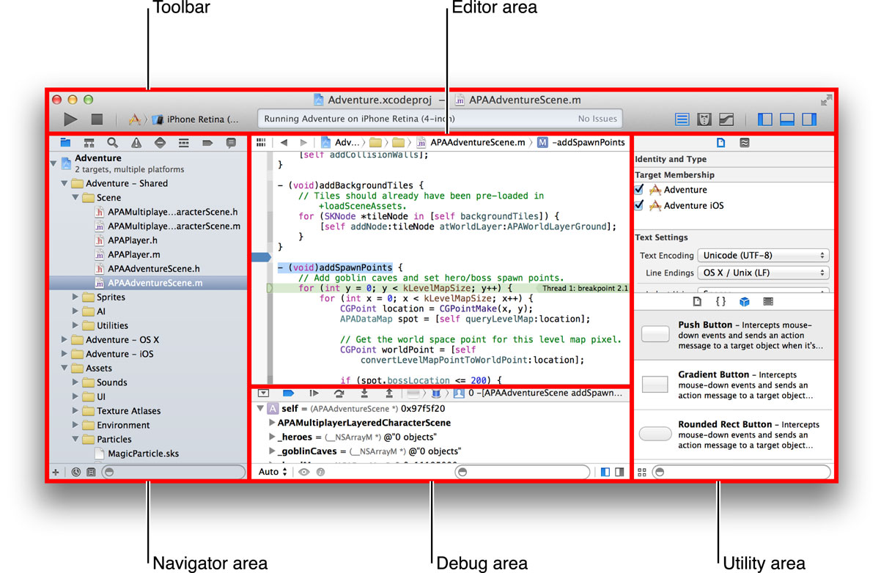
Xcode6
The latest IDE for developing MacOSX and iOS applications
Single window, supporting multiple workspace
Integrated Interface Builder
Assistant Editor (split pane that loads related files, such as header files etc)
Dynamic syntax checking and alert
Version editor with Git or Subversion integration
LLVM 2.0 editor with support for C, C++ and Objective-C
LLDB debugger

Slide 61
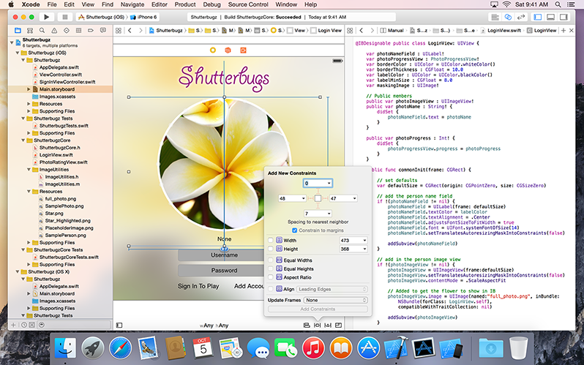
XCode6

