Slide 1

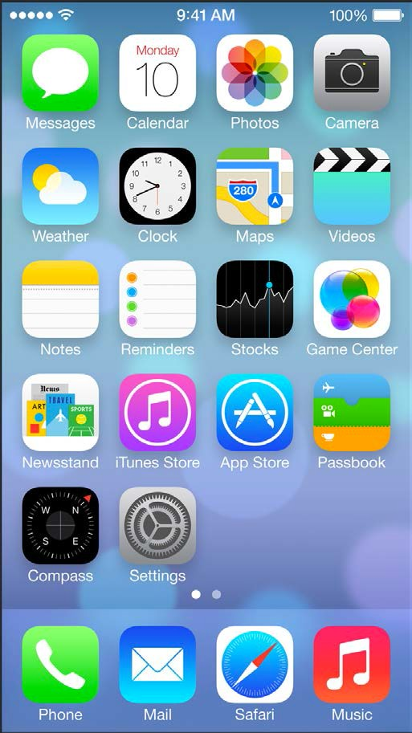
Instructor: NGUYEN ANH MINH (M. Sc.)
iOS Mobile Development

Slide 2
Module 06
Exception vs. Errors
Breakpoints
Xcode Debug Tools & Instruments

Slide 3
Exceptions vs. Errors
exceptions are used for Fatal Errors
that should cause the application to exit
ARC is not exception safe by default (enabled by -fobjc-arc-exceptions compiler flag)
returning nil / 0 is used to indicate Nonfatal Errors
e.g. nil is returned when object creation fails
e.g. 0 is returned when a method did not finish successfully

Slide 4
Throwing Exceptions
NSException *exception = [NSException exceptionWithName:@“InvalidArgument”
reason:@“Parameter must not userInfo:nil];
be nil”
@throw exception
//[exception
raise]; // equivalent
to method
above

Slide 5
Catching Exceptions
@try {
// definition
of exception handling domain
// code can potentially throw an exception
}
@catch(NSException *exception) {
// handling the exception thrown
in the try-block
}
@finally {
// code is executed or not
}
whether
exception
was thrown

Slide 6
NSError
used to provide additional information about nonfatal errors
•NSError
Error domain (String)
usually a global variabel that uniquely defines the source of the error
Error code (Integer)
define the error uniquely within the given error domain
User info (Dictionary)
contains additional info on the error

Slide 7
NSError
NSError
*error
= nil;
BOOL ret = if ( error
// Error
//
}
[object
doSomething:&error];
) {
occurred
Do something
to handle
the situation

Slide 8
NSError
- (BOOL)doSomething:(NSError * autoreleasing
{
*)error
// cause error
if ( internalError ) {
if ( error ) {
// Pass *error through output parameter
*error
= [NSError errorWithDomain:domain
code:code userInfo:userInfo];
}
return
} else {
return
}
NO; // Failure indicated
YES; // Success indicated
}

Slide 9
Breakpoints
General Purpose Breakpoint
can be used to inspect variable allocation during runtime
Exception Breakpoint
used to halt at the specific position where an exception was either caught or thrown
Symbol Breakpoint
used to halt whenever a specific method or function is going to be executed

Slide 10
Breakpoint
Click on the left vertical bar of the editor area of Xcode to create a breakpoint at the specific line
To edit the breakpoint → right click “Edit Breakpoint”
specify a Condition that must be met in order to trigger the code to halt at the breakpoint
specify the amount of hits the breakpoint ignores before becoming active
trigger an action that will be executed each time the breakpoint is hit
e.g. print debug / log message

Slide 11
Exception Breakpoint
Click the ‘Add’ button in the bottom left corner of the breakpoints navigator in Xcode
Choose Add Exception Breakpoint
Choose the type of exception
All. Stops on all exceptions
Objective-C. For Obj-C exceptions only
C++. For C++ exceptions only
Choose when to stop the programm in the handling process.
On Throw.
On Catch.

Slide 12
Symbolic Breakpoint
Click the ‘Add’ button in the bottom left corner of breakpoints navigator in Xcode
Choose Add Symbolic Breakpoint
Enter the symbol name in the Symbol field
if the symbol is declared in multiple modules, provide the appropriate library in the module field
Specify a condition in the Condition field, if a condition has to be met to stop at the breakpoint

Slide 13
Symbols
symbols can be specified as:
method name
e.g. -passwordStringWithLength:
method of a particular class
e.g [PasswordCreator
passwordWithLength:]
e.g security::PasswordCreator::password(int)
function name
e.g.
rand

Slide 14
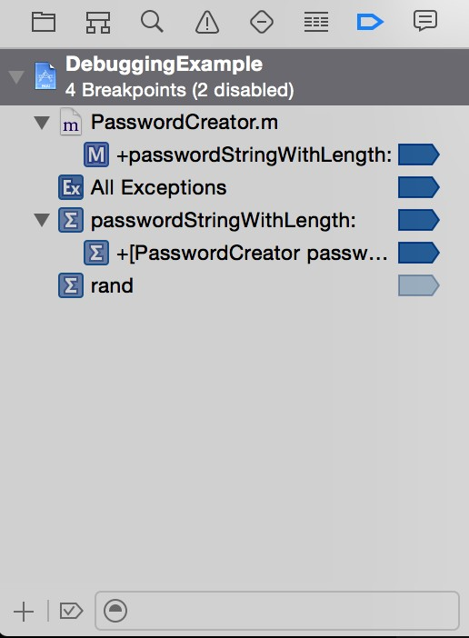
Xcode’s Breakpoints Navigator
List of all currently set breakpoints
enabled and
disabled
Breakpoints can be added via the bottom left button

Slide 15

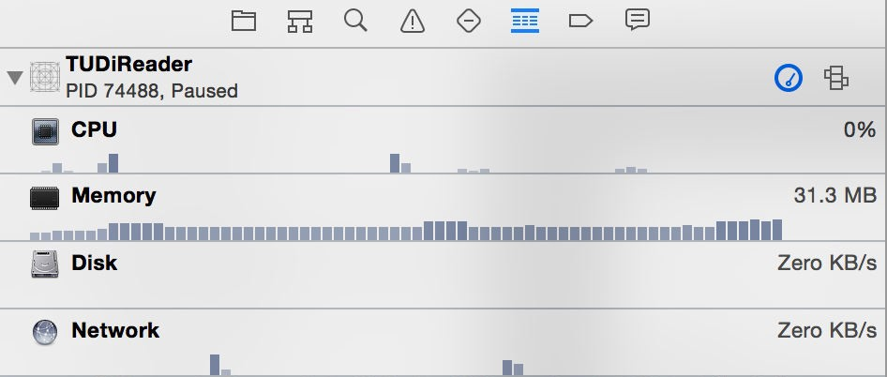
Xcode Debug Tools
Xcode provides a comprehensive view on
CPU utilization
Memory consumption
I/O operations
Network transmissions during runtime
Information available via the Debug Navigator

Slide 16


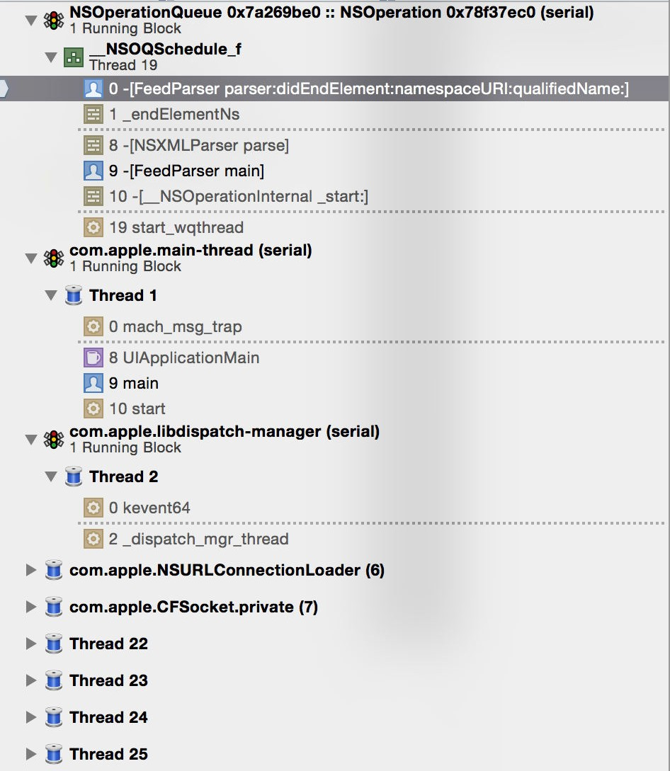
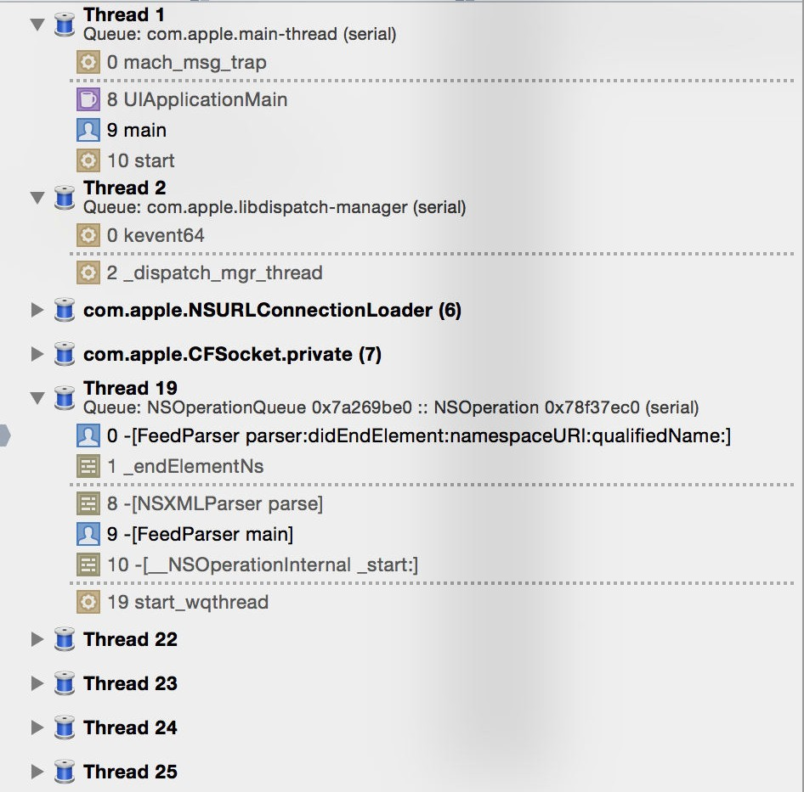
Xcode Debug Tools
stack traces can be grouped via Queue or Thread in the Debug Navigator

Slide 17
Instruments
Performance-analysis and testing tool
Description of all functionalities would far exceed the scope of this lectures
includes the underlying system in the analysis processes, so that the interplay of application and system can be better understood as well

Slide 18
Instruments
Instruments enables:
performance analysis
e.g. determine process time of single methods
find memory issues
e.g. retain cycles or zombie objects
automate UI testing on iOS
stress-test for part of the application
• …

