Slide 1
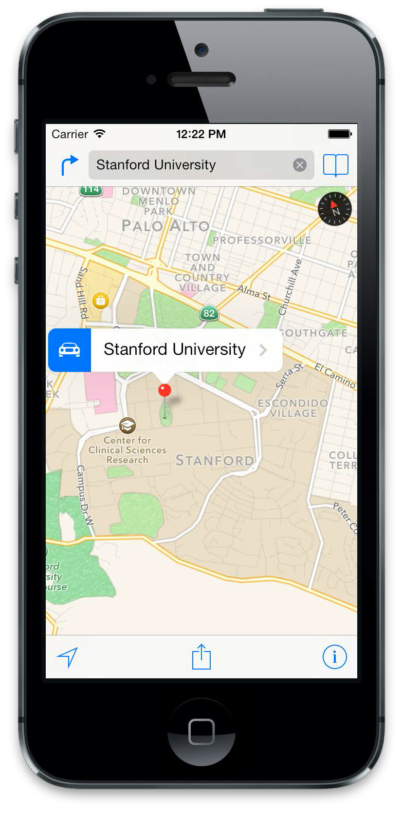
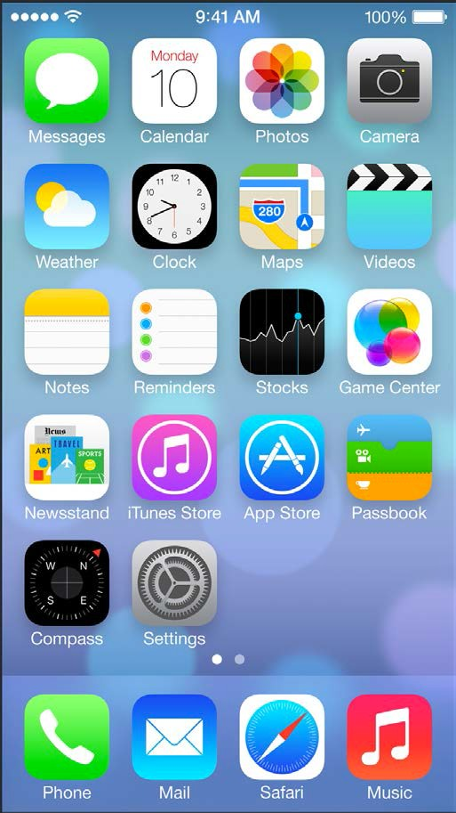
iOS Mobile Development
Instructor: NGUYEN ANH MINH (M. Sc.)

Slide 2
Module 02
Interface Builder
Story Board
UI Design
Auto Layout

Slide 3
Interface Builder

Slide 4
Interface builder
The Interface Builder editor within Xcode makes it simple to design a full user interface without writing any code. Simply drag and drop windows, buttons, text fields, and other objects onto the design canvas to create a functioning Mac, iPhone, or iPad user interface.
Because Cocoa and Cocoa Touch are built using the Model-View-Controller pattern
It is easy to independently design your interfaces, separate from their implementations.

Slide 5
Using Interface builder
Creating Hello World App Using Xcode 6 and Interface Builder
The list goes on and on. Xcode 6 promotes the use of Storyboard instead of Interface Builder. When you create a new Xcode project using the Single View template, it defaults to Storyboard. There is no XIB file generated.
It doesn’t mean we prefer Interface Builder over Storyboard, which is great. We just want you to learn both
Using Interface builder

Slide 6
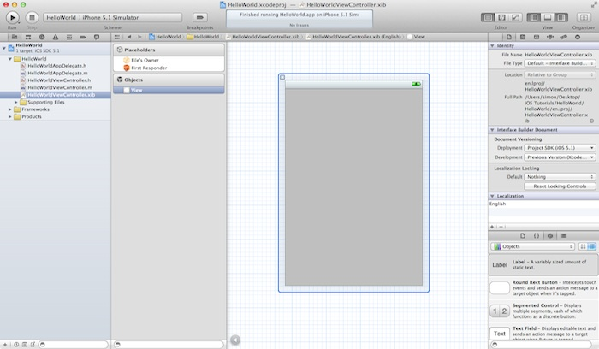
Using Interface builder
.xib – For files with .xib extension, they’re Interface Builder files that store the application’s user interface (UI). As you click on the .xib file, Xcode automatically switches to the Interface Builder for you to edit the UI of the app via drag-and-drop.

Slide 7
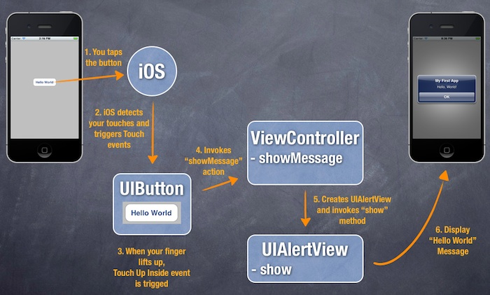
Using Interface builder
Builder HelloWorld Mobile Apps
using Interface Builder

Slide 8
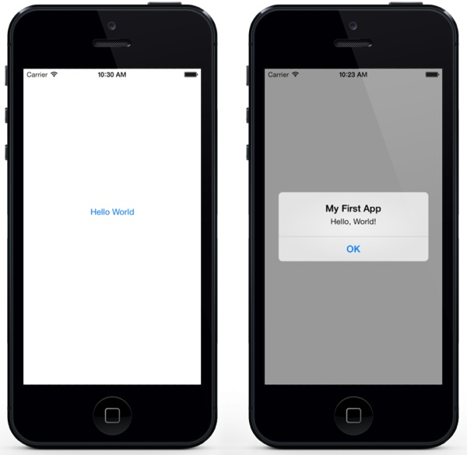
Using Interface builder
It’s very simple and shows
only a “Hello World” button.
When tapped, the app prompts
you a message.
That’s it. Nothing complex but
it helps you kick off your iOS programming journey

Slide 9
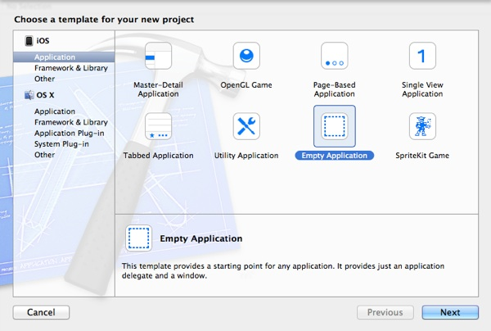
Using Interface builder

Slide 10
Using Interface builder
You can simply fill in the options as follows:
Product Name: HelloWorld – This is the name of your app.
Company Identifier: com.ibsv – It’s actually the domain name written the other way round. If you have a domain, you can use your own domain name.
Class Prefix: HelloWorld – Xcode uses the class prefix to name the class automatically. In future, you may choose your own prefix or even leave it blank. But for this tutorial, let’s keep it simple and use “HelloWorld”.
Device Family: iPhone – Just use “iPhone” for this project.
Use Core Data: [unchecked] – Do not select this option. You do not need Core Data for this simple project.

Slide 11
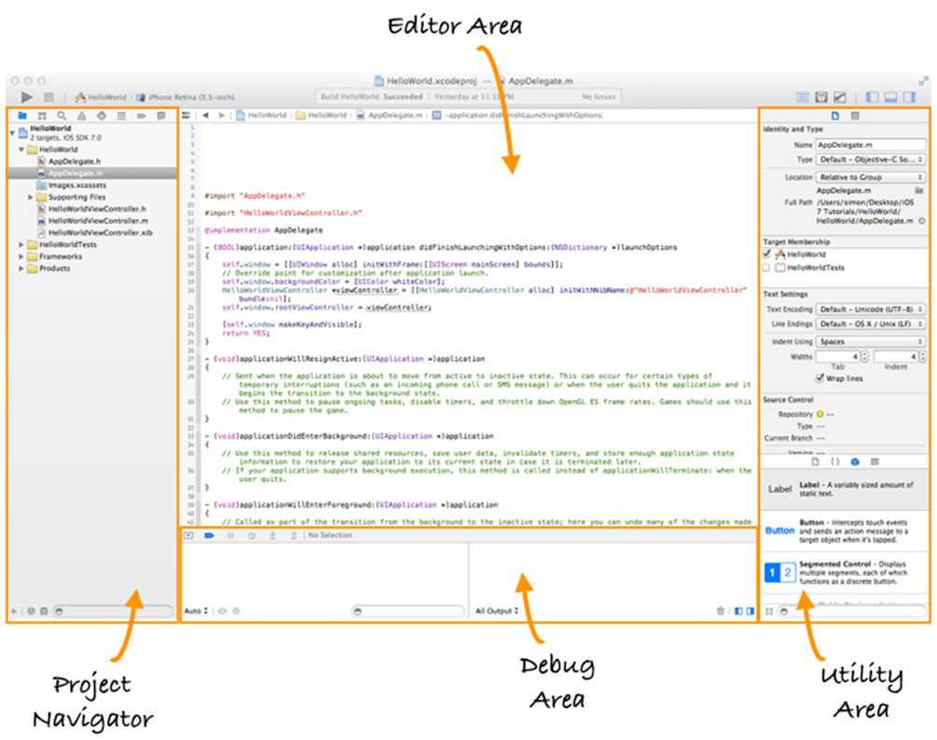
.h and .m – Files with .h extension refers to the header files while those with .m extension are the implementation files. Like most of the programming languages, the source code of Objective-C is divided into two parts: interface and implementation.

Slide 12
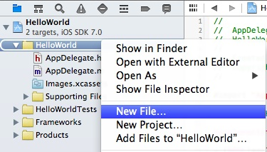
Before we can put a button, we first need to create a view and its corresponding controller. You can think of a view as a container that holds other UI items such as button. Go back to the Project Navigator. Right-click on the HelloWorld folder and select “New File”.

Slide 13
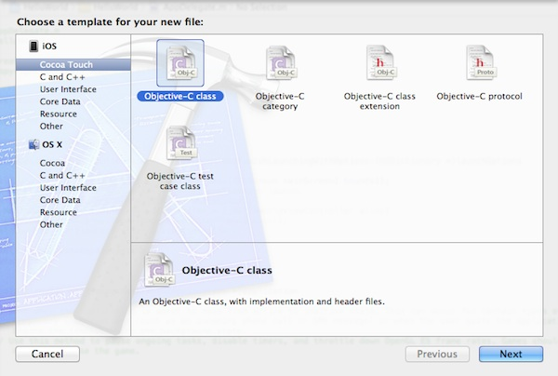
Under the Cocoa Touch category, select the Objective-C class template and click Next.

Slide 14
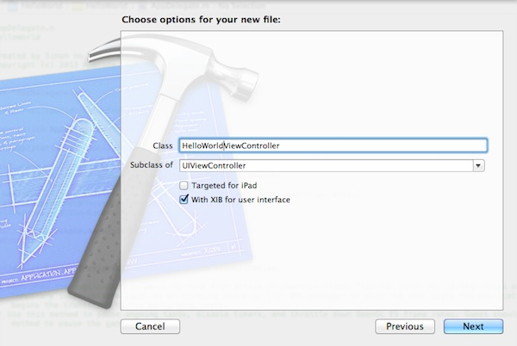
Name the new class as HelloWorldViewController and the subclass as UIViewController. Make sure you check the “With XIB for user interface” option. By selecting this option, Xcode automatically generates a Interface Builder file for the view controller.

Slide 15
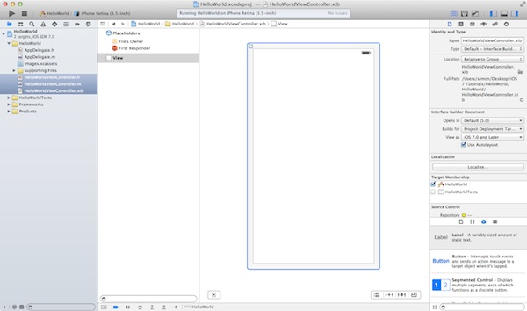
You’ll be prompted with a file dialog. Simply click the Create button to create the class and XIB. Once done, Xcode generates three new files including HelloWorldViewController.h, HelloWorldViewController.m and HelloWorldViewController.xib. If you select the HelloWorldViewController.xib file, you’ll find a empty view similar to the below image:

Slide 16
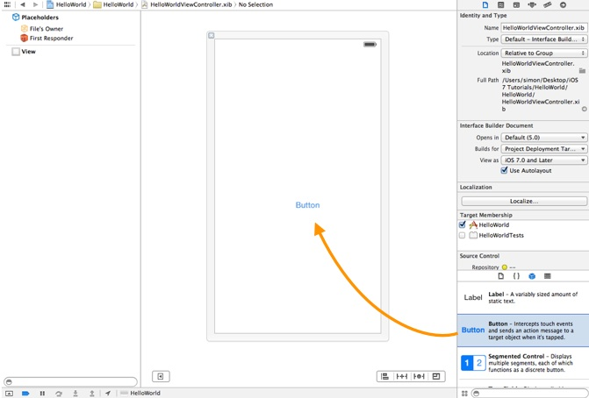
Now we’ll add a Hello World button to the view. In the lower part of the utility area, it shows the Object library. From here, you can choose any of the UI Controls, drag-and-drop it into the view. For the Hello World app, let’s pick the button and drag it into the view. Try to place the button at the center of the view.

Slide 17

Next, let’s rename the button. To edit the label of the button, double-click it and name it “Hello World”.
Select the AppDelegate.m in Project Navigator. Add the following import statement at the very beginning of the file:
#import "HelloWorldViewController.h"
In the didFinishLaunchingWithOptions: method, add the following lines of code right after “self.window.backgroundColor = [UIColor whiteColor]”.
HelloWorldViewController *viewController = [[HelloWorldViewController alloc] initWithNibName:@"HelloWorldViewController" bundle:nil]; self.window.rootViewController = viewController;

Slide 18
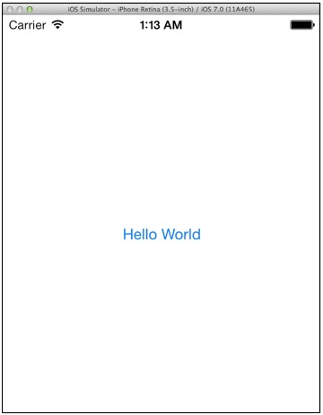
What you have just done is to load the HelloWorldViewController.xib and set it as the root view controller. Now try to run the app again and you should have an app like this:

Slide 19
In the Project Navigator, select the “HelloWorldViewController.h”. The editor area now displays the source code of the selected file. Add the following line of code before the “@end” line:
-(IBAction)showMessage;
Your complete code should look like this after editing:
#import <UIKit/UIKit.h> @interface HelloWorldViewController : UIViewController -(IBAction)showMessage; @end

Slide 20
Next, select the “HelloWorldViewController.m” and insert the following code before the “@end” line:
- (IBAction)showMessage { UIAlertView *helloWorldAlert = [[UIAlertView alloc] initWithTitle:@"My First App" message:@"Hello, World!" delegate:nil cancelButtonTitle:@"OK" otherButtonTitles:nil]; // Display the Hello World Message [helloWorldAlert show]; }

Slide 21
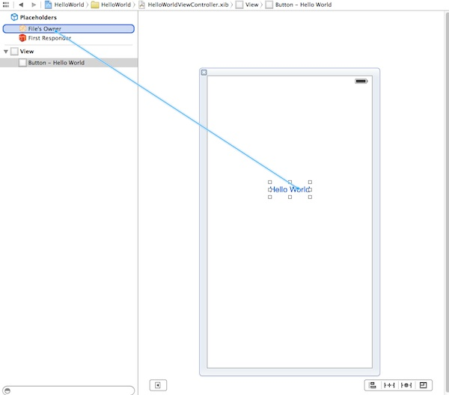
Next up, you’ll need to establish a connection between the “Hello World” button and the “showMessage” action you’ve just added. Select the “” file to go back to the Interface Builder. Press and hold thHelloWorldViewController.xibe Control key on your keyboard, click the “Hello World” button and drag to the “File’s Owner”. Your screen should look like this:

Slide 22
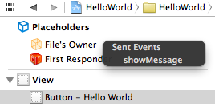
Release both buttons and a pop-up shows the “showMessage” action. Select it to make a connection between the button and “showMessage” action.

Slide 23
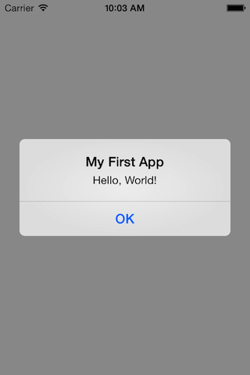
Test Your App ☺
That’s it! You’re now ready to test your first app. Just hit the “Run” button. If everything is correct, your app should run properly in the Simulator.

Slide 24
When to use nibs interface builder?
☺ Simple login and registration views.
☺ Settings and popup windows.
☺Reusable view templates.
☺ Reusable cell templates

Slide 25
When NOT to use nibs?
☹ Views with dynamic content, where the layout changes significantly depending on content.
☹Views that by nature are not easily designable in the Interface Builder.
☹View controllers with complicated transitions that could be simplified with Storyboarding.

Slide 26
UI Design

Slide 27
A user needs to interact with an app interface in the simplest way possible. Design the interface with the user in mind, and make it efficient, clear, and straightforward → MVC
View → (an object whose class is UIView or a subclass of UIView) knows how to draw itself into a rectangular area of the interface.
View Controller → In iOS, this management of the dynamic interface is performed through view control‐lers. A view controller is an instance of UIViewController. Actually, a view controller is most likely to be an instance of a UIViewController subclass; the UIViewController class is designed to be subclassed, and you are very unlikely to use a plain vanilla UIViewController object without subclassing it.

Slide 28
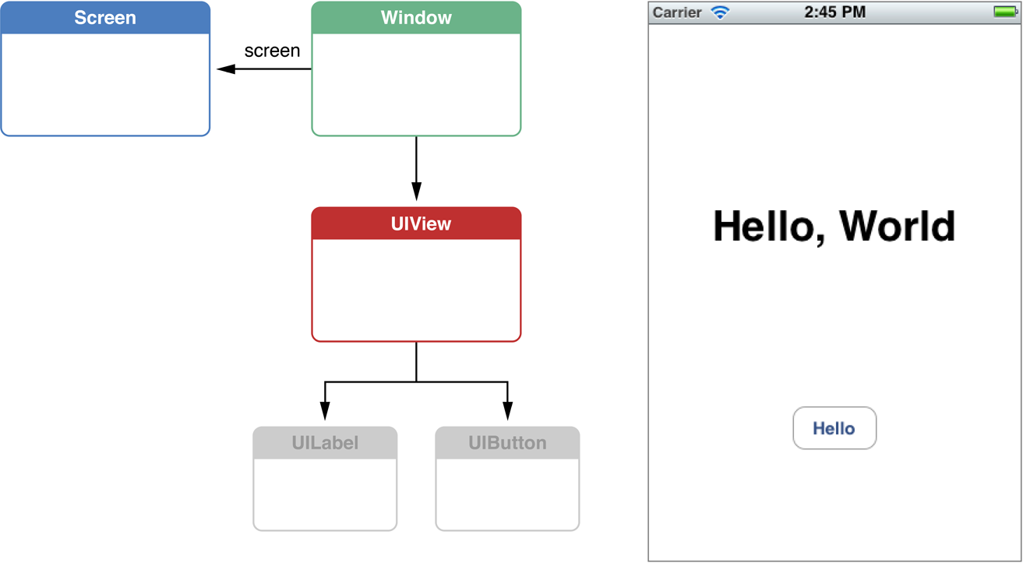

Slide 29
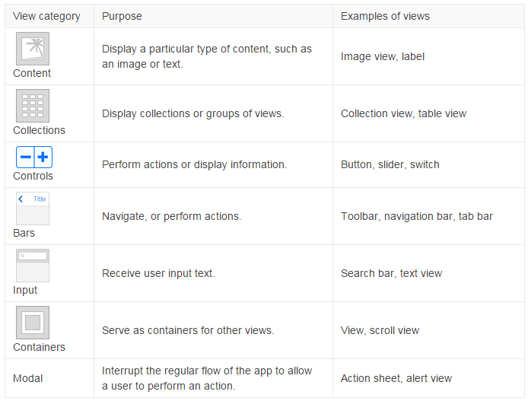

Slide 30
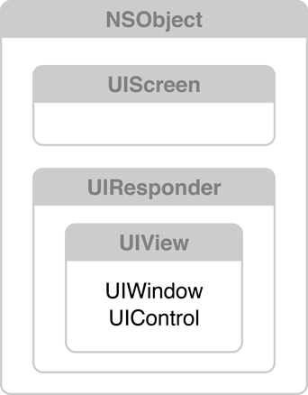
Classes in the View system
There are three major objects at work here:
A UIScreen object that identifies a physical screen connected to the device.
A UIWindow object that provides drawing support for the screen.
A set of UIView objects to perform the drawing

Slide 31
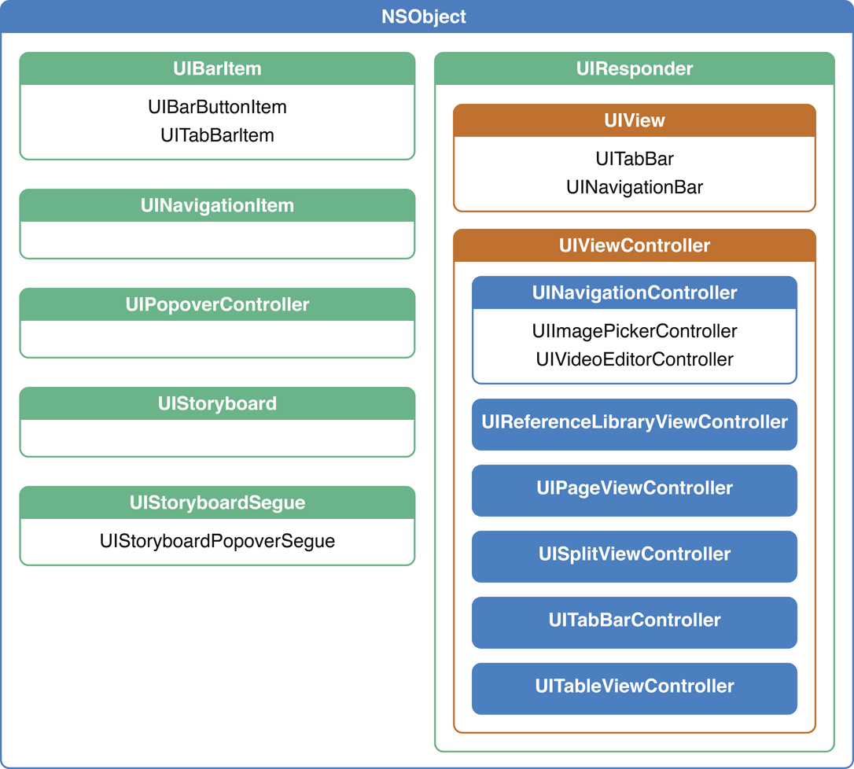
Taxonomy of View Controllers
View controllers are a vital link between an app’s data and its visual appearance. Whenever an iOS app displays a user interface, the displayed content is managed by a view controller or a group of view controllers coordinating with each other. Therefore, view controllers provide the skeletal framework on which you build your apps.
iOS provides many built-in view controller classes to support standard user interface pieces, such as navigation and tab bars. As part of developing an app, you also implement one or more custom controllers to display the content specific to your app.

Slide 32
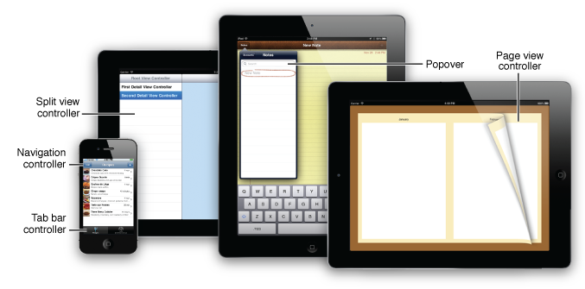
View controllers present and manage a hierarchy of views. The UIKit framework includes classes for view controllers you can use to set up many of the common user interaction idioms in iOS. You use these view controllers with any custom view controllers you may need to build your app’s user interface. This document describes how to use the view controllers that are provided by the UIKit framework.
Parentage (containment)
A view controller can contain another view controller. The containing view con‐troller is the parent of the contained view controller; the contained view controller
is a child of the containing view controller.
Presentation (modal views) A view controller can present another view controller. The first view controller is the presenting view controller (not the parent) of the second; the second view con‐

Slide 33
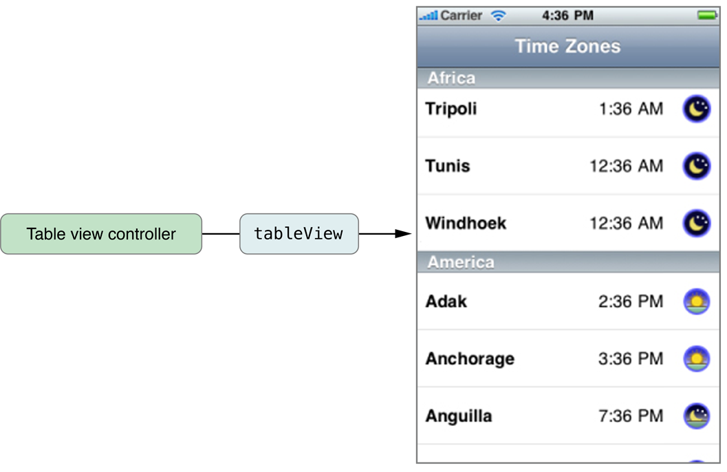
UITableViewController, manages a table view and adds support for many standard table-related behaviors such as selection management, row editing, and table configuration. This additional support is there to minimize the amount of code you must write to create and initialize a table-based interface. You can also subclass UITableViewController to add other custom behaviors

Slide 34
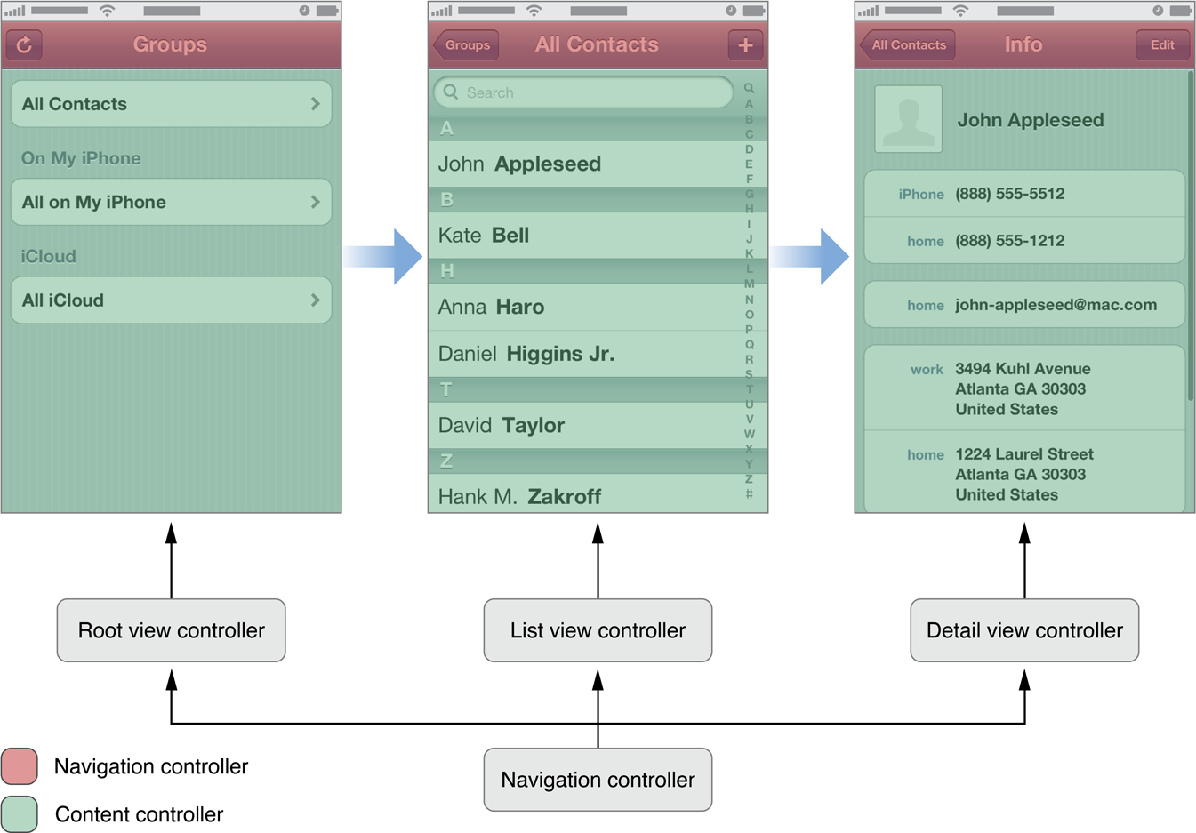
Navigation Controllers
A navigation controller presents data that is organized hierarchically and is an instance of the UINavigationController class. The methods of this class provide support for managing a stack-based collection of content view controllers. This stack represents the path taken by the user through the hierarchical data, with the bottom of the stack reflecting the starting point and the top of the stack reflecting the user’s current position in the data.

Slide 35
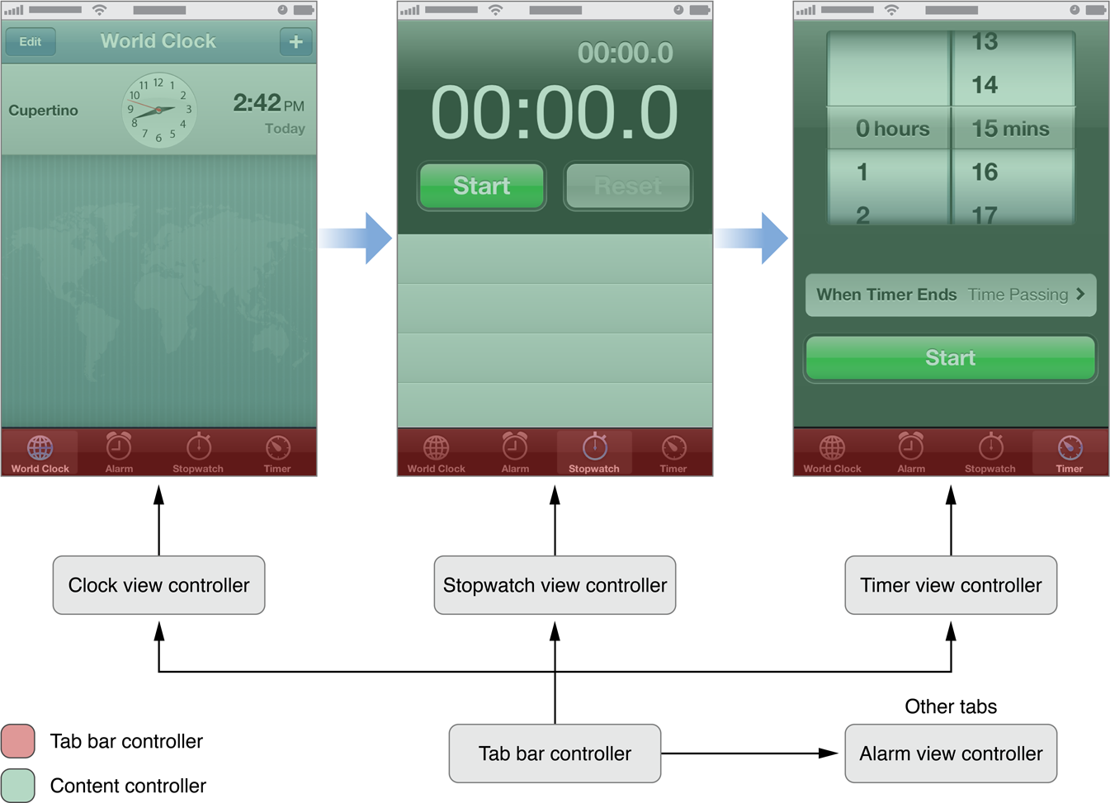
Tab Bar Controllers
A tab bar controller is an instance of the UITabBarController class. The tab bar has multiple tabs, each represented by a child view controller. Selecting a tab causes the tab bar controller to display the associated view controller’s view on the screen.

Slide 36
Story board

Slide 37
Using story board
Storyboards are introduced in iOS 5 and when we use storyboards our deployment target should be 5.0 or higher.
Storyboards helps us visual create all the screens of the application along with their flow of screens under one interface MainStoryboard.storyboard.
It also helps in reducing coding of pushing/presenting view controllers.

Slide 38
Using story board
Like table view, navigation controller is another UI element you commonly find in iOS app.
It provides a drill-down interface for hierarchical content. Take a look at the built-in Photos app, YouTube, and Contacts

Slide 39
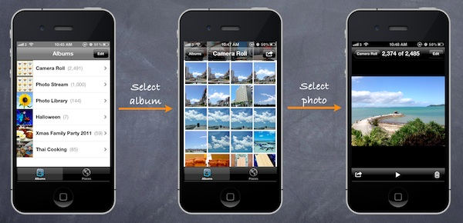
Design of our app

Slide 40
Using story board
X code provides a built-in editor to layout the Story boards
You can define the transition (known as segues) between various screens simply using point and click. This doesn’t mean you do not need to write code for the user interface. But Storyboards significantly reduce the amount of code you need to write

Slide 41
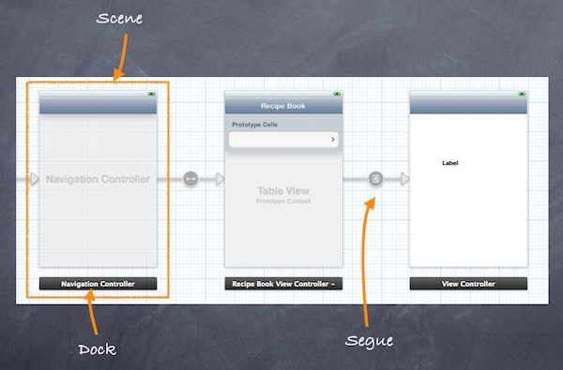
Using story board

Slide 42
Using story board
Scene and Segues
When working with Storyboards, Scene and Segues are two terms you always come across.
Within a Storyboard, a scene refers to a single view controller and its view. Each scene has a dock, which is used primarily to make action and outlet connections between the view controller and its views.
Segue sits between two scenes and manages the transition between two scenes. Push and Modal are two common types of transition.

Slide 43
Steps:
1.Creating Navigation Controller in Storyboards
2.create a new project using “Single View application” template
3.we’ll build a simple app that makes use of both UITableView and UINavigationController.
4.We use the table view to display a list of recipes. When users select any of the recipe, the app navigates to the next screen showing the details. It’ll be easy.
5.create a new project using “Single View application” template.

Slide 44
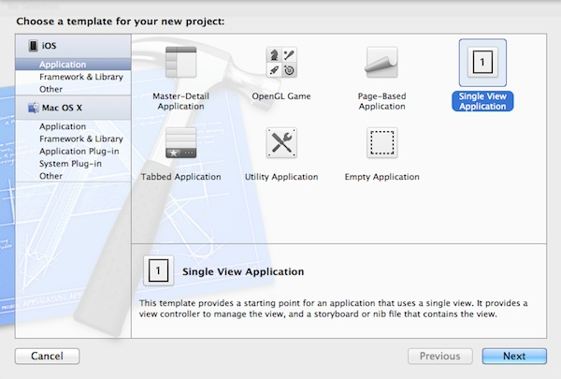

Slide 45
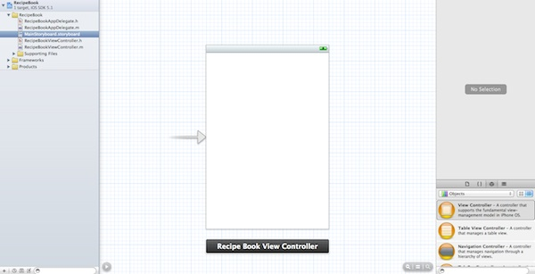

Slide 46
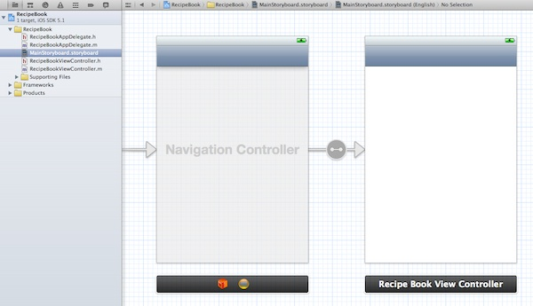

Slide 47
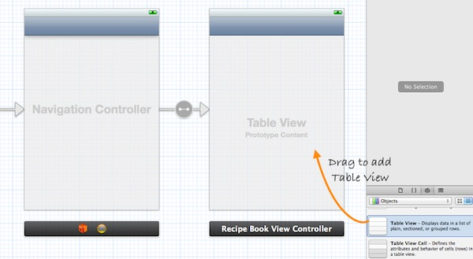
Adding Table View for Your Data

Slide 48
The next thing we have to do is to write code to populate the table data (i.e. recipes). In Project Navigator, select “RecipeBookViewController.h”. Append “” after “UIViewController”. Your code should look like below
#import <UIKit/UIKit.h> @interface RecipeBookViewController : UIViewController <UITableViewDelegate, UITableViewDataSource> @end
Next, select “RecipeBookViewController.m” and define an instance variable (i.e. recipes array) for holding the table data.
@implementation RecipeBookViewController { NSArray *recipes; }
In the “viewDidLoad” method, add the following code to initialize the “recipes” array:
- (void)viewDidLoad { [super viewDidLoad]; // Initialize table data recipes = [NSArray arrayWithObjects:@"Egg Benedict", @"Mushroom Risotto", @"Full Breakfast", @"Hamburger", @"Ham and Egg Sandwich", @"Creme Brelee", @"White Chocolate Donut", @"Starbucks Coffee", @"Vegetable Curry", @"Instant Noodle with Egg", @"Noodle with BBQ Pork", @"Japanese Noodle with Pork", @"Green Tea", @"Thai Shrimp Cake", @"Angry Birds Cake", @"Ham and Cheese Panini", nil]; }

Slide 49
For your reference, this is the complete source code of “RecipeBookViewController.m”.
- (NSInteger)tableView:(UITableView *)tableView numberOfRowsInSection:(NSInteger)section { return [recipes count]; } - (UITableViewCell *)tableView:(UITableView *)tableView cellForRowAtIndexPath:(NSIndexPath *)indexPath { static NSString *simpleTableIdentifier = @"RecipeCell"; UITableViewCell *cell = [tableView dequeueReusableCellWithIdentifier:simpleTableIdentifier]; if (cell == nil) { cell = [[UITableViewCell alloc] initWithStyle:UITableViewCellStyleDefault reuseIdentifier:simpleTableIdentifier]; } cell.textLabel.text = [recipes objectAtIndex:indexPath.row]; return cell; }

Slide 50
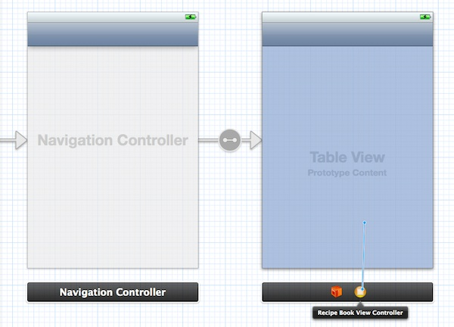
Lastly, we have to establish the connection between the Table View and the two methods we just created. Go back to the Storyboard. Press and hold the Control key on your keyboard, select the “Table View” and drag to the View Controller icon. Your screen should look like this:

Slide 51
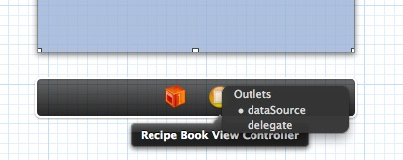
Release both buttons and a pop-up shows both “dataSource” & “delegate”. Select “dataSource” to make a connection between the Table View and its data source. Repeat the above steps and make a connection with the delegate.

Slide 52
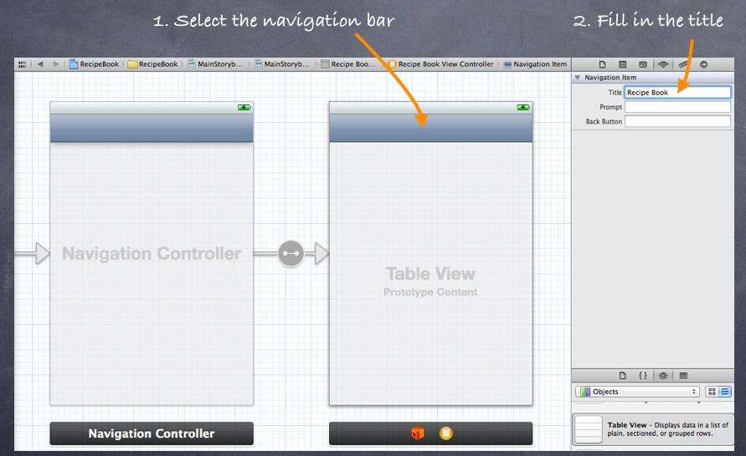
Before we test out the app, one last thing to do is add a title for the navigation bar. Simply select the navigation bar of “Recipe Book View Controller” and fill in the “Title” under “Attributes Inspector”. Remember to hit ENTER after keying in the title to effectuate the change

Slide 53
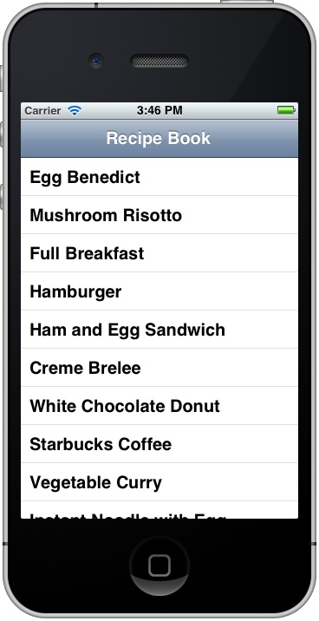
Voila ☺
Now, it’s time to execute your code. Hit the Run button and test out your app. If your code is correct, you should end up with an app displaying a list of recipes.
Notes:
53

Slide 54
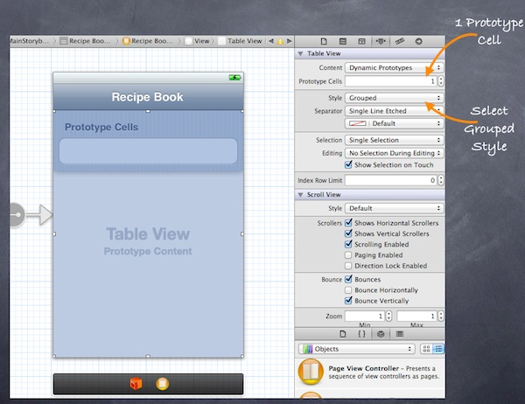
Introducing Prototype Cell
With the introduction of Prototype Cell in Storyboard, it’s much simpler to create a custom cell. Prototype cell allows you to easily design the layout of a table cell right in the Storyboard editor.
To add a prototype cell, select the Table View. Under “Attributes Inspector”, change the “Prototype Cells” value from “0” to “1”. As soon as you change the value, Xcode automatically shows you a prototype cell. In order to show you another table style, let’s also change the “Style” option from “Plain” to “Group”.

Slide 55
Why should we use story board?
Easing navigation flow
Eliminate boilerplate code needed to pop, push, present, and dismiss view controllers. Moreover, view controllers are automatically allocated, so there’s no need to manually alloc and init
Storyboards are best used with multiple interconnected view controllers, as their major simplification is in transitioning between view controllers.

Slide 56
When should we use story board?
For example, it makes sense to use Storyboards when handling:
A set of views for authentication and registration.
A multi-step order entry flow.
A wizard-like (i.e., tutorial) flow.
A master-detail set of views (e.g., profiles lists, profile details).
Meanwhile, large Storyboards should be avoided, including single app-wide Storyboards (unless the app is relatively simple)

Slide 57
Auto Layout

Slide 58
What is Auto Layout?
Auto Layout provides a ﬂexible and powerful system that describes how
views and their content relate to each other and to the super views
they occupy.
The fundamental building block in Auto Layout is the constraint. Constraints
express rules for the layout of elements in your interface; for example, you
can create a constraint that specifies an element’s width, or its horizontal
distance from another element. You add and remove constraints, or
change the properties of constraints, to affect the layout of your interface

Slide 59
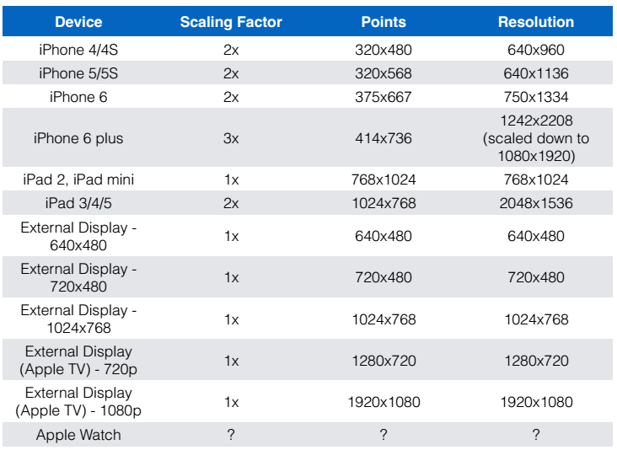
Why do we need Auto Layout?

Slide 60
Positioning Views without Auto Layout
view.frame = CGRectMake(10, 20, 50, 100 );
• frame is in superview coordinates
• X Offset (i.e. 10)
• Y Offset (i.e. 20)
• Width (i.e. 50)
• Height (i.e. 100)

Slide 61
Positioning Views with Auto Layout
Uses Constraints
• Examples:
• “View 1’s X coordinate is positioned 20 points to the
right of its superview’s left coordinate”
• “View 1’s Y coordinate is positioned 20 points below it’s
superviews top coordinate”
• “View 1’s Width is equal to 1/2 of it’s superview’s width”
• “View 1’s Height is equal to 1/2 of it’s superview’s height”

Slide 62
Constraints
Define relationships between one or two views
• Stored in a third view which should be the nearest common ancestor of both views.

Slide 63
Parts of a Constraint
View 1
• View 1 attribute
• View 2
• View 2 attribute
• Relationship (==, <, >, <=, >=)
• Constant
• Priority
• Multiplier

Slide 64
Ambiguous / Incomplete Constraints
Can cause views to disappear, because
unspecified constraints default to 0. For example,
width or height would be set to 0, making the view
not appear.
• Ambiguous constraints will generate warnings on
the Xcode console

Slide 65
Unambiguous Layout
Usually requires a minimum of 4 constraints. One for
each of the below:
• X
• Y
• Width
• Height
• If a view has an intrinsic size, this satisfies width & height
constraints so only need 2 constraints: X & Y constraints

Slide 66
Intrinsic Size
Minimum size (width & height) needed to display the view’s full content
without squeezing or clipping content
• Some system controls automatically provide this
• UIButton
• UILabel
• UISegmentControl
• UISwitch
• etc.
• Can define this in custom views using intrinsicContentSize() method
• If intrinsic content size in a custom view changes, call
invalidateIntrinsicContentSize()

Slide 67
X Constraint Attributes
Left - Left side of the view’s alignment rectangle
• Right - Right side of the views alignment rectangle
• Leading - Leading edge of the view’s alignment
rectangle
• Trailing - Trailing edge of the view’s alignment
rectangle
• Center X - Center along the X-axis of the view’s
alignment rectangle

Slide 68
Y Constraint Attributes
Top - Top of view’s alignment rectangle
• Bottom - Bottom of view’s alignment rectangle
• Center Y - Center along the Y-Axis of the view’s
alignment rectangle
• Baseline - The view’s baseline

Slide 69
Width / Height Constraint Attributes
Width - Width of the view
• Height - Height of the view

Slide 70
Constraint Priorities
Range from 1 (lowest priority) to 1000 (required
priority)
• Used to resolve conflicts in constraints

Slide 71
How to apply Auto Layout
Interface Builder
• In code
• Using Visual Format Language

Slide 72
Visual Format Language
Text based format to create constraints in code
• Described in Auto Layout Guide in Visual Format Language
Appendix A
var viewDict = ["view1": view1, "view2": view2]
view1.setTranslatesAutoresizingMaskIntoConstraints(false)
var constraints: NSArray =
NSLayoutConstraint.constraintsWithVisualFormat(
“ H : | - 5 0 - [ v i e w 1 ] - 5 0 - | ",
options: NSLayoutFormatOptions.allZeros,
metrics: nil,
views: viewDict )
self.view.addConstraints(constraints)
• Note that constraintsWithVisualFormat() returns an array of
constraints, not a single constraint

Slide 73
Adding Constraints in Code
Example:
self.view.addConstraint(
NSLayoutConstraint(
item: self.view1!,
attribute: NSLayoutAttribute.Leading,
relatedBy: NSLayoutRelation.Equal,
toItem: self.view,
attribute: NSLayoutAttribute.Leading,
multiplier: 1.0,
constant: 0
)
)

