Slide 1

Project Integration Management
Prabudh Dhingra
Emmanuel Munet-Quiñones
Deepthi Ranganathan
Henrietta Mengue
Hitesh Parmar
Renjei Mei
Sagnik Saha
Presented to:
Prof. William García
IT Project Management
The George Washington University Washington D.C.

Slide 2
Agenda
Project Integration Management Framework
Activity
Strategic Planning Process
Common Techniques for Selecting Projects
Project Integration Management Process
Project Integration Management Tools
Closing

Slide 3
What is Project Integration Management?
The coordination of all the other project management knowledge areas throughout a project’s life cycle.
According to PMBOK®, it involves six processes:
Developing the project charter
Developing the project management plan
Directing and managing project work
Monitoring and controlling project work
Performing integrated change control
Closing the project of phase

Slide 4

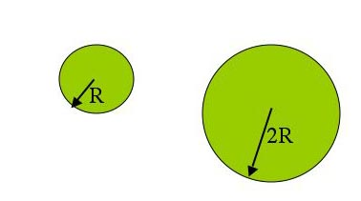
Activity
Big Picture Game
Objective: Participants are required to form a picture that is two times bigger than the original picture given to them.

Slide 5
Strategic Planning and Project Selection
What is strategic planning?
Strategic plan of the organization to determine what types of projects will provide the most value
Determining long-term objectives by analyzing the strengths and weaknesses of an organization, studying opportunities and threats in the business environment, predicting future trends, and projecting the need for new products and services

Slide 6
Strategic Planning
Why do you need a strategic plan?
Why should managers be a part of the strategic planning process?
To help an organization do a better job
To ensure that members of the organization are working toward the same goals
To adjust to a changing environment
Because project managers can provide valuable insight into the project selection process

Slide 7
Strategic Planning [Continued]
In short, strategic planning is a disciplined effort to produce fundamental decisions and actions that shape and guide:
What an organization is
What it does
Why it does it, with a focus on the future
Strategic planning involves determining long-term objectives by analyzing the strengths and weaknesses of an organization, studying opportunities and threats in the business environment, predicting future trends, and projecting the need for new products and services.

Slide 8
SWOT Analysis
S
Strengths
W
Weaknesses
O
Opportunities
T
Threats

Slide 9
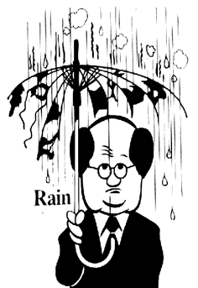
SWOT Analysis: Bald Guy
Strengths
You’re the first to know when it’s raining or snowing

Slide 10

SWOT Analysis: Bald Guy [Continued]
You always stand out from the crowd

Slide 11

SWOT Analysis: Bald Guy [Continued]
Weaknesses
A bald pate serves as a sort of “advertising board for emotions”. When it turns RED, it means a wordless but very clear statement of “Don't mess with me!"

Slide 12
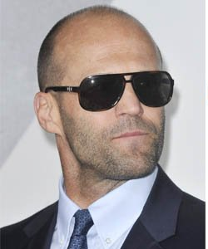
SWOT Analysis: Bald Guy [Continued]
Opportunities
You make sunglasses look cool any time of the day throughout the year

Slide 13

SWOT Analysis: Bald Guy [Continued]
Threats
Your close friends and family members like to touch your head. And it brings out:

Slide 14
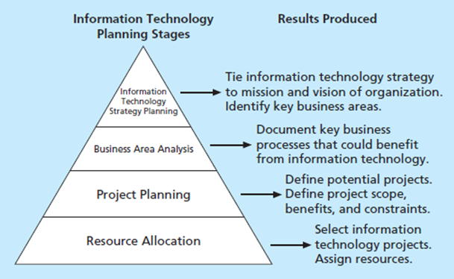
Planning Process for IT Projects

Slide 15

Methods For Selecting Projects
Focusing on broad organizational needs
Categorizing IT Projects
Performing Financial Analysis
Developing Weighted Score Models
Balanced Score Cards

Slide 16
Methods For Selecting Projects
Focusing on Broad Organization Needs
Need: Do people in the organization agree that the project needs to be done?
Funding: Does the organization have the desire and capacity to provide adequate funds to perform the project?
Will: Is there a strong will to make the project succeed?
Should be reevaluated to determine should we continue ?

Slide 17
Methods For Selecting Projects
Categorizing IT Projects
Problems
Opportunities
Directive

Slide 18


Methods For Selecting Projects
Performing Financial Analysis
NPV (Net Present Value) :
ROI: In a recent Information Week study, more than 82 percent of IT decisions required an ROI analysis
Payback Analysis

Slide 19
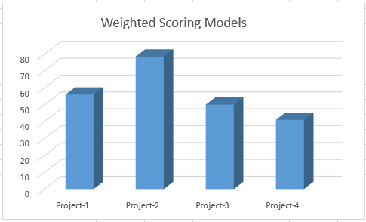
Methods For Selecting Projects
Weighted Scoring Models

Slide 20
Methods For Selecting Projects
Balanced scored :
Converts value drivers to series of defined metrics
Customer Service
Innovation
Operational Efficiency
Financial Performance

Slide 21
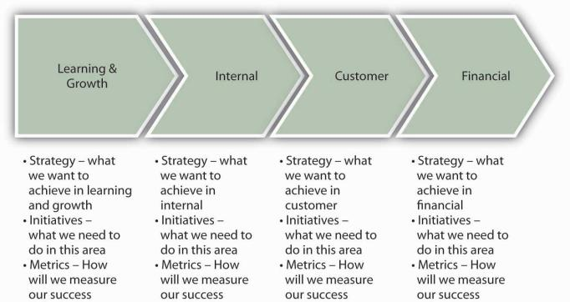
Methods For Selecting Projects
Balanced scored :

Slide 22

Video Skydiving

Slide 23
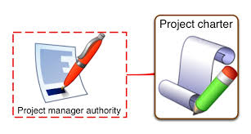
Project Integration Management Processes
Developing the project Charter
It is a document that formally recognizes the existence of a project and provides direction on the project’s objectives and management.
Also called letter of agreement or formal contracts

Slide 24
Project Integration Management Processes
Project Charter for a Class Presentation
Project Title: Chapter Four Presentation
Date of Authorization: August 25
Project Start Date: August 25 | Project Finish Date: September 16
Key Schedule Milestones: Read the chapter by September 11 Have the presentation ready by September 9 Practice the presentation on September 15 Deliver the presentation on September 16
Budget Information: Group members will use their own laptops and money to buy foods

Slide 25
Project Integration Management Processes
Project Charter for a Class Presentation
Project Manager: Emmanuel
Project objectives: Create a presentation that will help students understand the main points of chapter 4.
Project success Criteria: The presentation must be interesting, relevant, entertaining, and funny.
Approach: Hold weekly progress review meeting Make an outline of the chapter Divide the different section between team members Then integrate all the sections in one document

Slide 26
Project Integration Management Processes
Project Charter for a Class Presentation
Roles and Responsibilities
Name | Role | Responsibilities | Contact Information
William García | Sponsor | Make finals
Emmanuel | Project Manager | Manage the project
Henriette | Team member | Section 1 | hmengue@gwu.edu
Sagnik | Team member | Section2
Hitesh | Team member | Section3
Sign –off (signature of key stakeholders) William García Emmanuel Munet
Comments: “If anyone has questions, do not hesitate to contact me.” Emmanuel

Slide 27
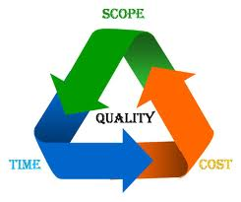
Project Integration Management Processes
Developing the project management plan
The project management plan is a document used to coordinate all project planning documents
It helps guide a project’s execution and control

Slide 28

Project Integration Management Processes
An introduction
Project name: Information Technology Project Management class plan
Description of project and issue addressed: get an A and learn something
Sponsor name: William García
Project Manager and Key Team Members: Emmanuel, Henriette, Sagnik, Hitesh, Deepthi
Deliverable of the project: daily quizzes, two group presentations and one paper
Reference materials: Textbook, syllabus

Slide 29

Project Integration Management Processes
A description of how the project is organized
Project responsibilities: each student is responsible for his/her own success or failure
Strategy that will be followed: Don’t fall behind and read assigned chapters
The management and technical processes used on the project
Management objectives: Professor García’s expectations
Project control: daily quizzes, grades
Risk management: being late, being distracted during presentation
Project staffing: students

Slide 30

Project Integration Management Processes
Sections describing the work to be performed
Work breakdown structure: read chapter, make daily bank words, study for daily quizzes,
Key deliverable: Quizzes, presentation, exams and one paper
Assumptions made: Professor is nice but hard with grade, need to study a lot
Sections describing the schedule
Summary schedule: Presentation chapter four
September 15, midterm exam on October 13
Detailed schedule: read one a day one week prior to the midterm exam

Slide 31

Project Integration Management Processes
Sections describing the budget
Summary budget: $6,000 for the overall project
Detailed budget: tuition + book + presentation spending, salary increase

Slide 32

Project Integration Management Processes
Directing and Managing Project Work
PM needs to be flexible and creative in dealing risk, communication stakeholder and team management
Coordinating Planning and Execution
Project planning and execution go hand in hand
A good plan →good work results
PM collects inputs from his team members in each knowledge area

Slide 33
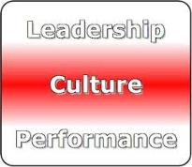
Project Integration Management Processes
Providing Strong Leadership and a Supportive Culture
create and follow plan to motivate team
supportive organizational culture Good project execution
simple and good templates easy to understand and follow

Slide 34
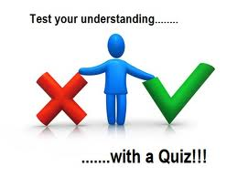
Pop Quiz
Which of the following processes is not part of project integration management?
developing the project business case
developing the project charter
developing the project management plan
closing the project or phase

Slide 35

Pop Quiz
What is the last step in the four-stage planning process for selecting IT projects?
IT strategy planning
business area analysis
mind mapping
resource allocation

Slide 36

Pop Quiz
Which of the following is not a best practice for new product development projects?
aligning projects and resources with business strategy
selecting projects that will take less than two years to provide payback
focusing on customer needs in identifying projects
assigning project managers to lead projects

Slide 37
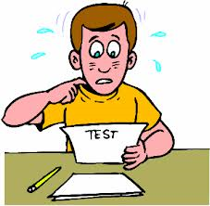
Pop Quiz
A new government law requires an organization to report data in a new way. Which of the following categories would include a new information system project to provide this data?
problem
opportunity
directive
regulation

Slide 38

Project Integration Management Processes
A _____________ is a document that formally recognizes the existence of a project and provides direction on the project’s objectives and management.
project charter
contract
business case
project management plan

Slide 39

STRONG LEADERSHIP
COMMUNICATION
POLITICAL SKILLS

Slide 40
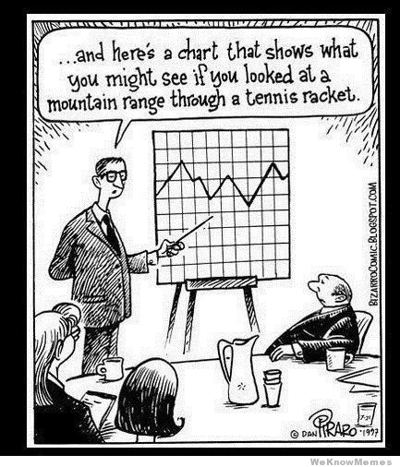
Project Integration Management Processes

Slide 41
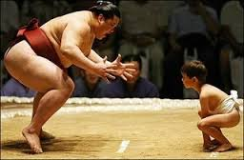
Project Integration Management Processes
Small Projects
Technical work
Mentoring
Large Projects
No time for technical work
Lead the team
Communicate with key stake holders
Enough if he understands Business and application area

Slide 42
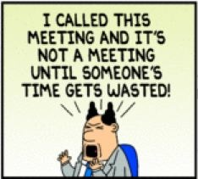
Project Integration Management Processes
Project execution Tools
1. Expert Judgment
2. Meetings
3. Project Management Tools

Slide 43
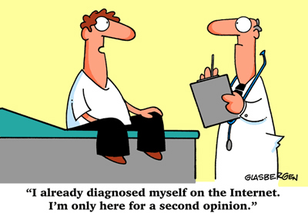
Project Integration Management Processes
Expert Judgment

Slide 44
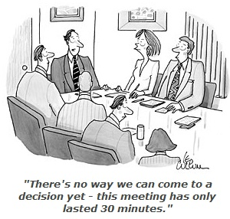
Meetings
Project Integration Management Processes
Face to face meetings
Online and over the phone meetings
In Scrum …
1. Sprint planning
2. Stand up meeting
3. Estimation
4. Sprint Review
5. Retrospective

Slide 45

Project Integration Management Processes
Project Management
Keep track of expenses and milestones completed
Integrate the different functional units
Use of Analytics Software to analyze data and support decision making process
Budgeted Cost of Work vs Actual Cost of Work line graphs

Slide 46
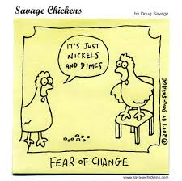
Project Integration Management Processes
Monitoring and Controlling Project Work
Handle changes
Monitoring project health and make improvements when required
Continuous Monitoring to take corrective and preventive actions
Key deliverables and planned dates
Change requests and Work performance reports
Defect repair

Slide 47

Project Integration Management Processes
Performing Integrated Change Control
Influencing the factors that create changes to ensure that changes are beneficial
Determining that a change has occurred
Managing actual changes as they occur

Slide 48
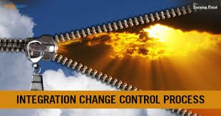
Project Integration Management Processes
Change Control on IT Projects
Change Control System
Change Control Board (CCB)
Configuration management
A process for communicating changes

Slide 49


Project Integration Management Processes
Closing the project or phase
Final product, service, or result transition
Organizational process asset updates

Slide 50
References
https://new.edu/resources/crafting-your-balanced-scorecard
http://www.financeformulas.net/Net_Present_Value.html

Slide 51

Questions?

