Slide 1
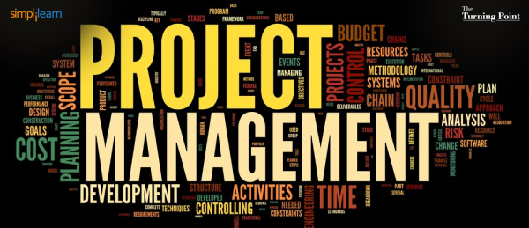
Instructor: NGUYEN ANH MINH, MSc, PMP

Slide 2
Project Integration Management

Slide 3
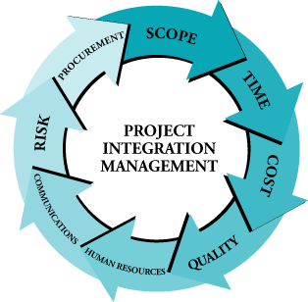
Integration … is What?
Its best described as putting all other management processes of the project into a cohesive whole.

Slide 4
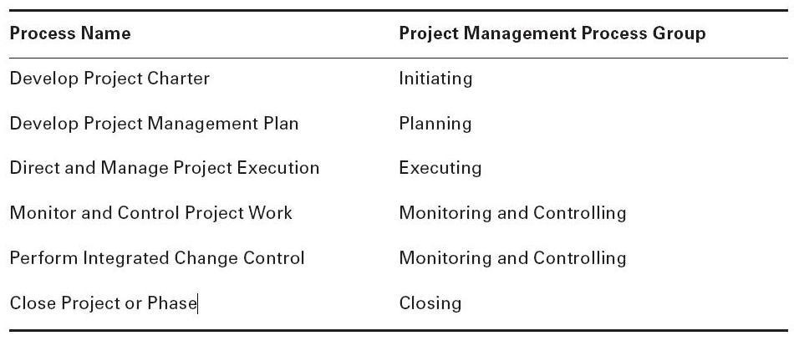
Project Integration management Processes

Slide 5
Project Selection
Cost/Benefit Analysis
Cash Flow Analysis
Scoring Models
Payback Period
Net Present Value
Internal Rate of Return

Slide 6
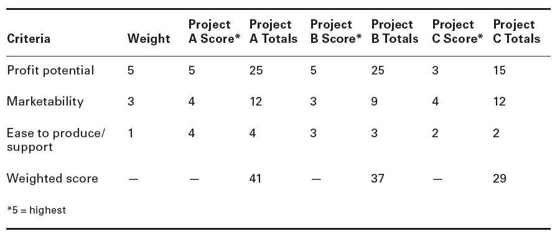
Scoring Models

Slide 7
Payback Period
Year | Project A | Project B
0 | -1,000 | -1,000
1 | 500 | 100
2 | 400 | 300
3 | 300 | 400
4 | 100 | 600
7

Slide 8
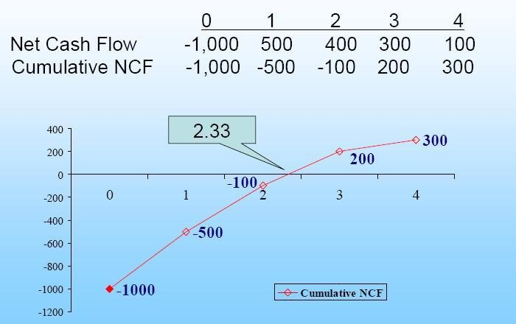
Project A

Slide 9
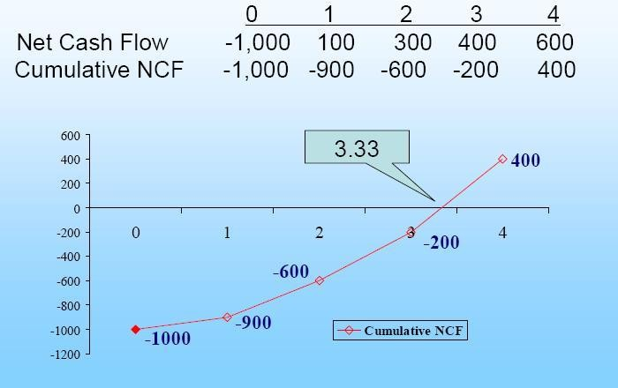
Project B

Slide 10
The Time Value of Money
A dollar received today is worth more than a
dollar received tomorrow
 This is because a dollar received today can be invested to earn interest
 The amount of interest earned depends on the rate of return that can be earned on the investment
Time value of money quantifies the value of a dollar through time

Slide 11
Example of PV Calculation
0
1
2
3
4
10%
100
300
300
-50
90.91
247.93
225.39
-34.15
530.08 = PV
10

Slide 12
4.1 Develop Project Charter
The process of developing a document that formally authorizes a project or a phase and documenting initial requirements
Issued by an initiator or a sponsor.
Projects are initiated as a result of the following:
Market demand
Business need
Customer request
Technological advance
Legal requirement
Social need

Slide 13
4.1 Develop Project Charter Inputs
Project Statement of Work
Business need
Product Scope Description
Strategic Plan
Business Case
Contract
Enterprise Environment Factors
Organization Process Assets

Slide 14
4.1 Develop Project Charter Tools &
Techniques
Expert Judgment
Other units within the organization
Consultants
Stakeholders, including customer or sponsor
Professional and technical associations
Industry groups
Subject matter experts
Project Management Office (PMO)

Slide 15
4.1 Develop Project Charter
Outputs
Project Charter
Project purpose or justification
Measurable Project Objectives
High-Level requirements
High-Level Project Description
High-Level Risks
Summary milestone Schedule
Summary Budget
Project Approval Requirements
Assigned Project Manager
Name and Authority of the Sponsor

Slide 16
Q: Integration is done by:
Project Manager
Team
Senior Management
Client
Answer A

Slide 17
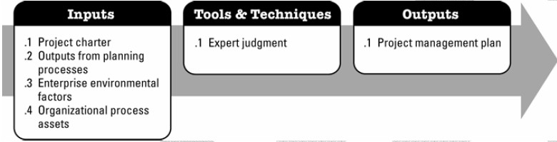
4.2 Develop Project Management
Plan
The process of documenting the actions necessary to define, prepare, integrate, and coordinate all subsidiary plans

Slide 18
4.2 Develop Project Management Plan
Inputs
Project Charter
Outputs From Planning Processes
Enterprise Environmental Factors
Organizational Process Assets

Slide 19
4.2 Develop Project Management Plan
Tools & Techniques
Expert Judgment
Tailor the process to meet the project needs
Develop technical and management details to be
included in the project management plan
Determine resources and skill levels needed to perform project work
Define the level of configuration management to apply on the project
Determine which project documents will be subject to the formal change control process.

Slide 20
4.2 Develop Project Management Plan Outputs
Project Management Plan
The management processes and level of implementation.
Tools & techniques.
How the work will be executed, monitored, controlled and closed.
Communication requirements among stakeholders.
Key management reviews.

Slide 21
4.3 Direct and Manage Project Execution
The process of performing the work defined in the project management plan to achieve the project's objectives.
It includes but are not limited to:
Activities to accomplish requirements
Create project deliverables
Staff, train & manage the team members assigned to the project
Establish and manage project communication channels
Generate project data, such as cost, schedule, technical and quality progress
Issue change requests
Manage risks
Manage sellers and suppliers
Collect and document lessons learned

Slide 22
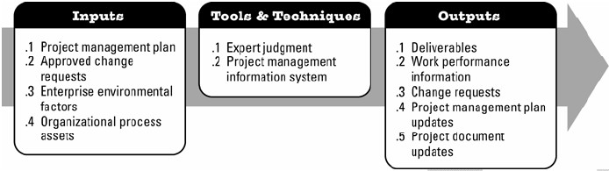
4.3 Direct and Manage Project Execution
Inputs, Tools & Techniques and Outputs

Slide 23
4.3 Direct and Manage Project
Execution Inputs
Project Management Plan
Approved Change Requests
Enterprise Environmental Factors
Organizational Process Assets

Slide 24
4.3 Direct and Manage Project Execution Tools and Techniques
Expert Judgment
Project management Information System

Slide 25
4.3 Direct and Manage Project
Execution Outputs
Deliverables
Work Performance Information
Deliverable status
Schedule Progress
Cost Incurred
Change Requests
Corrective action
Preventive action
Defect repair
Updates
Project Management Plan Updates
Project Document Updates

Slide 26
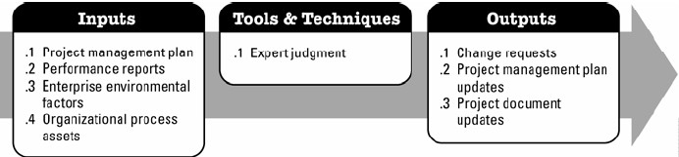
4.4 Monitor and Control Project Work
The process of tracking, reviewing and regulating the progress to meet the performance objectives defined in the project management plan.

Slide 27
4.4 Monitor and Control Project
Inputs
Project Management Plan
Performance Reports
Enterprise Environmental Factors
Organizational Process Assets

Slide 28
4.4 Monitor and Control Project Tools &
Techniques
Expert Judgment

Slide 29
4.4 Monitor and Control Project Outputs (1)
Change Requests
Corrective action
Work to bring expected future performance in line with plans.
Preventive action
Activity that can reduce the probability of negative
consequences.
Defect Repair
Identification of a defect in project component with a recommendation to either repair the defect or completely replace the component.

Slide 30
4.4 Monitor and Control Project Outputs (2)
Project Management Plan Updates
Project Document Updates

Slide 31
4.5 Perform Integrated Change Control
The process of reviewing all change requests, approving changes & managing changes to the deliverables, organizational process assets, project documents & the project management plan.
Change Control Board (CCB) is responsible for approving or rejecting change requests
Roles and responsibilities of CCB are defined within configuration control and change control procedure
30

Slide 32
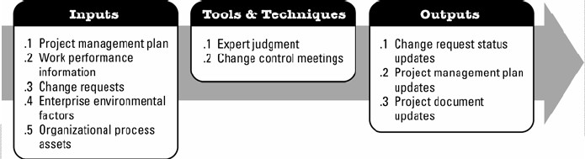
4.5 Perform Integrated Change Control
Inputs, Tools& Techniques and Outputs

Slide 33
Perform Integrated Change Control Inputs
Project Management Plan
Work Performance Information
Change Requests
Enterprise Environmental Factors
Organizational Process Assets

Slide 34
Perform Integrated Change Control Tools &
Techniques
Expert Judgment
Change Control Meetings

Slide 35
Perform Integrated Change Control Outputs
Change Requests Status Updates
Project Management Plan Updates
Project Document Updates

Slide 36
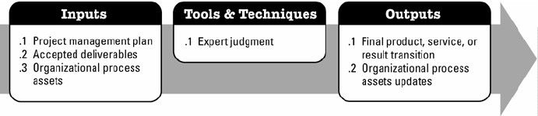
4.6 Close Project or Phase
The process of finalizing al activities across all of the project management process groups to formally close the project or phase

Slide 37
Close Project or Phase Inputs
Project management Plan
Accepted Deliverables
Organizational Process Assets

Slide 38
Close Project or Phase Tools &
Techniques
Expert Judgment

Slide 39
Close Project or Phase Outputs
Final Product, Service, or Result Transition
Organizational Process Assets Updates
Project file
Project or phase closure documents
Historical information

