Slide 1
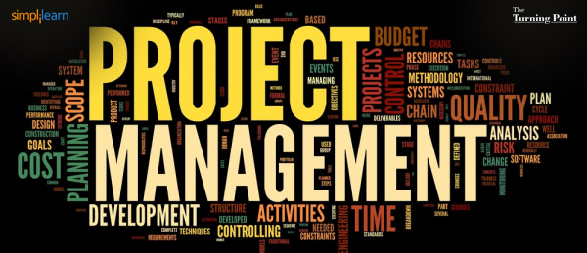
Instructor: NGUYEN ANH MINH, MSc, PMP

Slide 2
Project Scope Management

Slide 3
Ch.5 Project Scope Management
Project Scope Management
Processes that ensures the project includes all the work required, and only the work required
Product scope:
The features and functions that characterize a product, service, or result
Project scope:
The work that needs to be accomplished to deliver a product, service, or result with the specified features and functions.
Or the processes related to finding what is included and what is not included in the project

Slide 4
Project Scope Vs Product Scope
Project Scope | Product Scope
The work needed to create product of the project | Features and functions of the product of the project
Completion of a project is measured against the plan | Completion of product scope is measured against the requirements

Slide 5
Processes of Scope Management
1. Plan Scope Management
Developing a plan that documents how the scope of project will be defined, validated, and controlled
2. Collect Requirements
Documenting and managing the needs of stakeholders
3. Define Scope
Developing the detailed scope of the project and product

Slide 6
Processes of Scope Management
4. Create WBS
Subdividing the deliverables of the projects into smaller components
5. Validate Scope
Formalizing the acceptance of the deliverables
6. Control Scope
Monitoring the scope of project and product and controlling changes to the scope baseline

Slide 7
5.1 Plan Scope Management
The process of developing project scope management plan
2. Scope Management Plan documents how the project scope will be defined, validated, and controlled
3. It provide guidance on how the project scope will be managed throughout the project

Slide 8
5.1 Plan Scope Management
1. P.M plan
2. Project Charter
3. EEF
4. OPA
1. Expert Judgment
2. Meetings
1. Scope Management Plan
2. Requirements Management Plan
Input
Tools & Techniques
Output

Slide 9
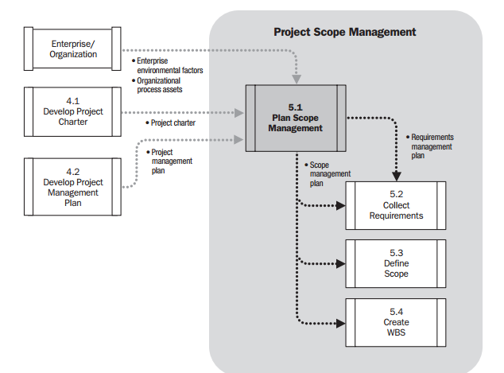
5.1 Plan Scope Management Data Flow Diagram

Slide 10
5.1 Plan Scope Management: Inputs
1. Project Management Plan
All the project plans that can influence project scope
2. Project Charter
It contains high level project and product scope
3. EEF/OPA
Organizational Culture (EEF)
Personnel administration (EEF)
Infrastructure (EEF)
Marketplace conditions (EEF)
Processes and procedures (OPA)
Historical information (OPA)

Slide 11
5.1 Plan Scope Management: T&T
1. Expert Judgment
Consulting those who are expert in the area
2. Meetings
Meetings attended by project teams, sponsor, stakeholders, etc

Slide 12
5.1 Plan Scope Management: Output
1. Scope Management Plan
It describes how the scope will be defined, developed, monitored, controlled, and verified.
Depending on the project scope management plan can be in detail or at high level
Scope Management Plan can include the following items:
Process for preparing a detailed project scope statement
Process for how to create WBS
Process that establishes how the WBS will be maintained and approved
Process for validating scope
Process for proper processing change request related project scope

Slide 13
5.1 Plan Scope Management: Output
2. Requirements Management Plan
The plan describes how requirements will be identified, analyzed, documented, and managed
Elements of Requirement Management Plan can as follow:
How requirements activities will be planned, tracked, and reported
Requirements prioritization process
Product metrics that will be used and the rationale for using them
Traceability structure to reflect which requirement attributes will be captured on the traceability matrix
How will the configuration management related to requirements work

Slide 14
5.2 Collect Requirements
The process of determining, and documenting stakeholder’s needs and requirements
2. Requirements provide the foundation for WBS or project scope
3. Project scope, cost, schedule, quality, and sometimes procurement are all based on the requirements

Slide 15
5.2 Collect Requirements
Requirements can be classified as follow:
Business requirements: These tells us why the project is undertaken or what is the product needed for or what aspect of business is needed to be changed or improved
Stakeholder requirements: Specific needs of some of the stakeholders
Solution or product requirements: This tell us about the functions and characteristic of the product, service, or results for which the project is undertaken
Transition requirement: Temporary capabilities, such data conversation or training to needed for transition from current state to the state where the customer wan to be
Project requirement: Process and conditions the project need to meet
Quality requirements: Condition or criteria which indicates the successful completion of the project or delivery of its product

Slide 16
5.2 Collect Requirements
1. Scope management plan
2. Requirements management plan
3. Stakeholder Management Plan
4. Project Charter
5. Stakeholder Register
1. Requirements documentation
2. Requirements traceability matrix
1. Interviews
2. Focus groups
3. Facilitated workshops
4. Group creativity techniques
5. Group decision making techniques
6. Questionnaires and surveys
7. Observations
8. Prototypes
9. Benchmarking
10. Context diagrams
11. Document Analysis
Input
Tools & Techniques
Output

Slide 17
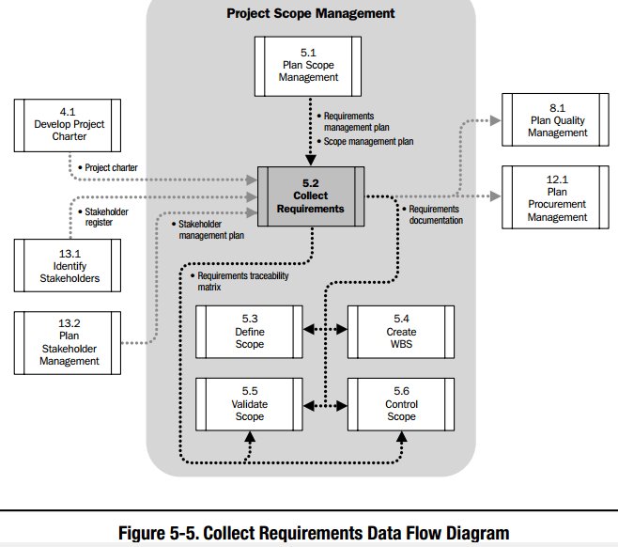
5.2 Collect Requirements: Data Flow Diagram

Slide 18
5.2 Collect Requirements: Inputs
5.2.1.1. Scope Management Plan
It tells us what type of requirements need to be collected
5.2.1.2 Requirements Management Plan
It tells us about the process that we will be using for collecting the requirement
5.2.1.3 Project Charter
This contains the high level description of the product, service or result
5.2.1.4 Stakeholder Register & Management Plan
Stakeholder register give us info on the identified stakeholders e. g contact No
Stakeholder management plan tell us about the communication requirements of teach stakeholders

Slide 19
5.2 Collect Requirements: T&T
5.2.2.1. Interviews
Best for receiving confidential information
5.2.2.2 Focus Group Discussion
Bringing together many experts at one place
More conversational than individual interviews
5.2.2.3 Facilitated workshops
Good for defining cross-functional requirements gathering
5.2.2.4 Group creativity technique
Good for reconciling between stakeholder differences
Best for detailed information
Several methods can be used to identify product/project requirement through group techniques

Slide 20

5.2.2.4 Group Creativity Techniques
Brainstorming………?
Generating and collecting multiple ideas
Used in conjunction with other techniques

Slide 21

5.2.2.4 Group Creativity Techniques
2. Nominal group technique
Ranking ideas for further brainstorming through voting

Slide 22
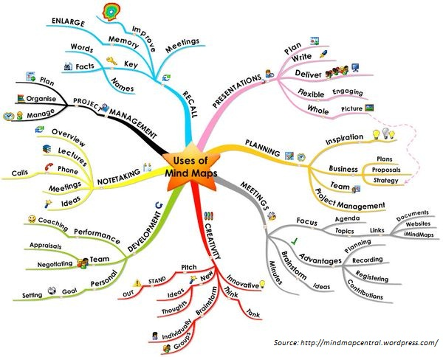
5.2.2.4 Group Creativity Techniques
3. Idea/Mind Mapping…..?
Mapping together ideas generated in individual brainstorming sessions
This allow for common understanding of ideas and help in generating new ideas

Slide 23
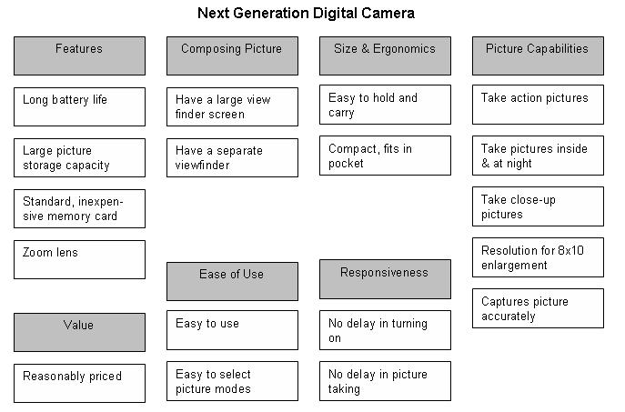
5.2.2.4 Group Creativity Techniques
4. Affinity Diagram……?
Classifying large number of ideas into groups

Slide 24
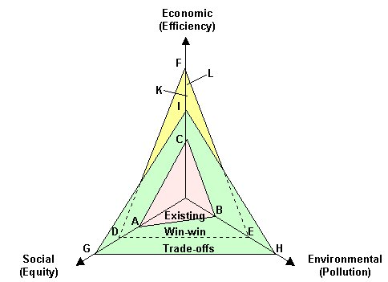
5.2.2.4 Group Creativity Techniques
5. Multi-criteria decision analysis…..?
Generating ideas or making decision based on different criteria, e. g time, quality, and cost

Slide 25
5.2 Collect Requirements: T&T
5.2.2.5 Group decision making technique
Decision making in a group for future actions
5.2.2.6 Questionnaires and surveys
Best when quick turn around from many stakeholders living in many different places is needed.
5.2.2.7 Observation
Observing the environment or job of the customer
The decisions can be reached through: 1. Unanimity, 2. Majority, 3. Plurality, 4. Dictatorship
The technique can be applied to group creativity technique
Practically performing job of a customer requiring a product

Slide 26
5.2 Collect Requirements: T&T
5.2.2.8 Prototypes
Obtaining feedback on requirements by providing a working model of the product
5.2.2.9 Benchmarking
Comparing the planned products to actual similar products.
5.2.2.10 Context Diagram
It visually shows the scope of the product by showing the business system (processes, equipments, computer system, etc).
5.2.2.11 Document Analysis
Analyzing existing documents such as market literature, business plans, proposals, process flow, etc to identify requirements.

Slide 27
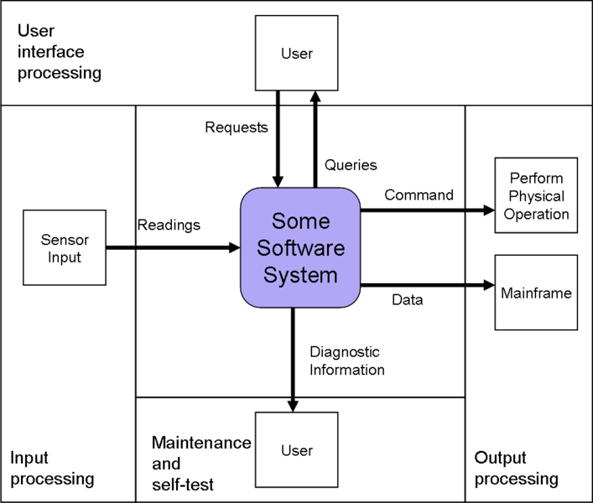
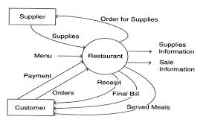
5.2.2.10 Context Diagram

Slide 28
5.2 Collect Requirements: Outputs
5.2.3.1 Requirements Documentation
It shows how each requirement will meet business need of the project
5.2.3.2 Requirements Traceability Matrix
This document links each requirement to the deliverable that fulfill the particularly requirement
Requirement needs to be clear, tangible, testable, traceable and measurable.
Requirements can be documented as a list or in much detail
It helps in tracing the requirement throughout the project
It helps in making changes to the project

Slide 29
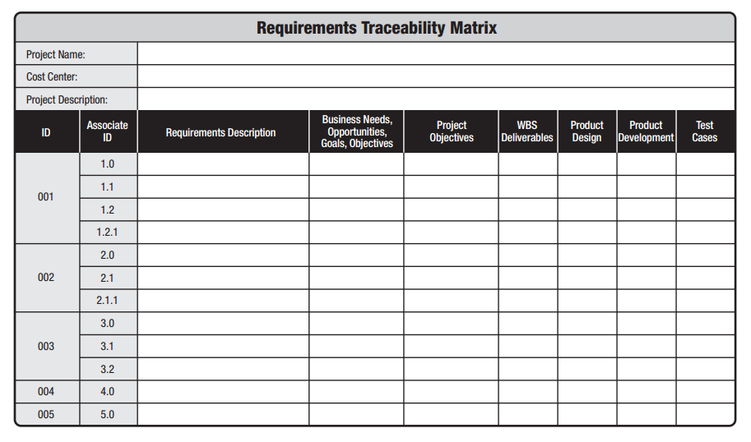
5.2.3.2 Requirements Traceability Matrix : Sample Doc

Slide 30
5.3 Define Scope
Developing the detailed description of the project and product
2. Specifying the boundaries of the project
3. Specifying the requirements that are included in the project scope.
The stakeholders may have lots of requirements but not all the requirements will be part of the project. Here you specify the requirements that will be part of the project.

Slide 31
5.2 Collect Requirements
1. Scope management plan
2. Project Charter
3. Requirements documentation
4. Organizational Process Assets
1. Project Scope Statement
2. Project document updates
1. Expert Judgment
2. Product analysis
3. Alternative generation
4. Facilitated Workshops
Input
Tools & Techniques
Output
What is completely new for you?
What is the importance of each input to this process?

Slide 32
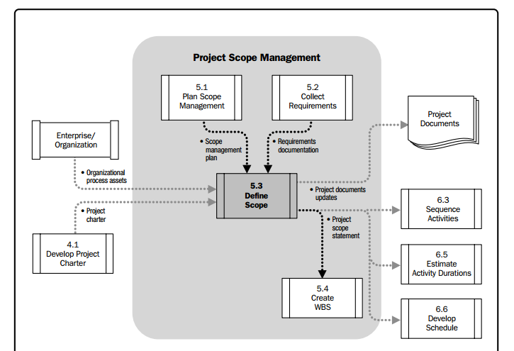
5.3 Define Scope Data Flow Diagram

Slide 33
5.3.1 Define Scope: Inputs
5.3.1.1 Scope Management Plan
It contains activities for defining, managing, and controlling the project scope.
5.3.1.2 Project charter
Contains high level project description
The requirements documentation is used to select the requirements that will be included in the project
Contains high level product scope
Describes high level deliverable acceptance criteria
5.3.1.3 Requirements documentation

Slide 34
5.3.2 Define Scope: T&T
5.3.2.1 Expert Judgment
Getting expert view from consultants, sponsors, industry experts, stakeholders, etc.
5.3.2.2 Product Analysis
Translating high level product description into tangible deliverables.
Identifying several options for executing the project work.
5.3.2.3 Alternative Generation
This can be done through product breakdown, system analysis, system engineering, value engineering, etc.

Slide 35
5.3.3 Define Scope: Outputs
5.3.3.1 Project Scope Statement
It describes project scope, deliverables, assumptions, and constraints and scope exclusions
5.3.3.2 Project Documents Update
Stakeholder register
Requirements documentation
Requirement traceability matrix
Scope statements create common understanding of the scope among the project team and stakeholders
Scope statement includes details about the project deliverable and the work needed to create these deliverables
The difference between scope statement and project charter is that the scope statement in much more details
Why are these documents updated?

Slide 36
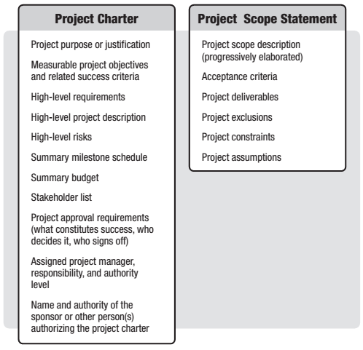
Project Scope Statement Vs Project Charter

Slide 37
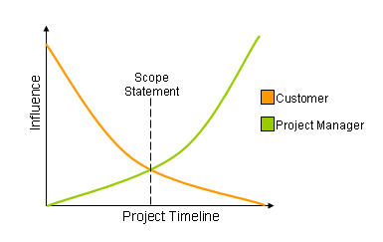
5.3.3.1 Project Scope Statement
Project Scope Statement includes the followings:
Product Scope: Describes the characteristics of the product, service or result
Project Exclusion: Identifying things that are outside the scope of the project. This helps in managing stakeholder expectations
Deliverable: Any verifiable product, service, or result. Deliverables can also be project reports and documentations.
Constraints. Constraints refers to limitations or restrictions. For example a predefined budget or deadline.
Acceptance Criteria: Conditions that are to be met before accepting the criteria
Assumptions: Something is considered to be true or certain without any proof. This is done for planning purpose. The scope statement also documents the affects of the assumed factors in case the proof to be false.
Project Scope Statement Template

Slide 38


Slide 39
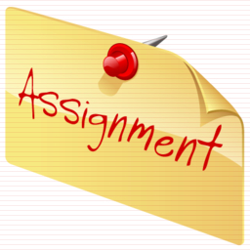
Read Pages 125-140 of the PMBOK Guide

