Slide 1
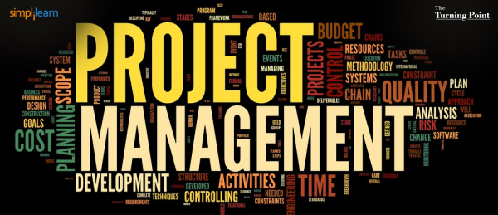
Instructor: NGUYEN ANH MINH, MSc, PMP

Slide 2
Project Scope Management

Slide 3


5. Project Scope Management
Processes included in Project Scope Management Knowledge Area
Plan Scope Management
Collect Requirements
Define Scope
Create WBS
Control Scope
Verify Scope

Slide 4



Processes of Scope Management
1. Plan Scope Management
Developing a plan that documents how the scope of project will be defined, validated, and controlled
2. Collect Requirements
Documenting and managing the needs of stakeholders
3. Define Scope
Developing the detailed scope of the project and product

Slide 5



Processes of Scope Management
4. Create WBS
Subdividing the deliverables of the projects into smaller components
5. Validate Scope
Formalizing the acceptance of the deliverables
6. Control Scope
Monitoring the scope of project and product and controlling changes to the scope baseline

Slide 6
5.4 Create WBS (Work Breakdown Structure)
WBS is a hierarchical decomposition of the total scope of work to be carried out by the project
Create WBS is the process of subdividing project work into smaller components
Input
Tools & Techniques
Output
Scope Management Plan
Project Scope Statement
Requirements Documentation
EEF &OPA
1.Decomposition
2. Expert Judgment
Scope Baseline
Project documents update

Slide 7
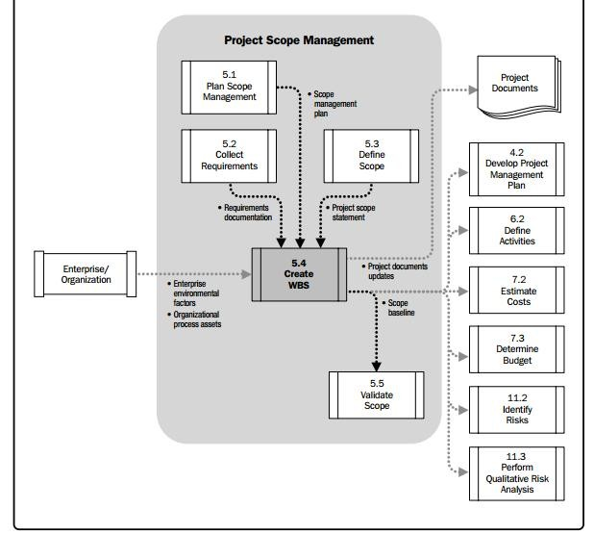
5.4 Create WBS Data Flow Diagram

Slide 8



5.4.1 Create WBS: Inputs
5.4.1.1 Scope Management Plan
It tells us how to create WBS
5.4.1.2 Project Scope Statement
It tell us about the work that is part of the project and the work that is not part of the project
5.4.1.3 Requirements Documentation
We need Req Docs to know what exactly needs to be done

Slide 9


5.4.1 Create WBS: Inputs
5.4.1.4 EEF
Industry specific WBS standard e. g ISO/IEC 15288 on System Engineering
5.4.1.5 OPA
Templates and Procedures
Lesson learned
Project files for previous similar projects

Slide 10


5.4.2 Create WBS: T&T
5.4.2.1 Decomposition
Identifying and analyzing the deliverables and related work;
Structuring and organizing the WBS;
Decomposing the upper WBS levels into lower-level detailed components;
Assigning identification codes to the WBS components; and
Verifying that the degree of decomposition of the deliverables is appropriate
5.4.2.2 Expert Judgment
Getting expert opinions on the technical details of the work during decomposition
EJ can also be in the form of industries specific templates designed to help in decomposition of project work

Slide 11
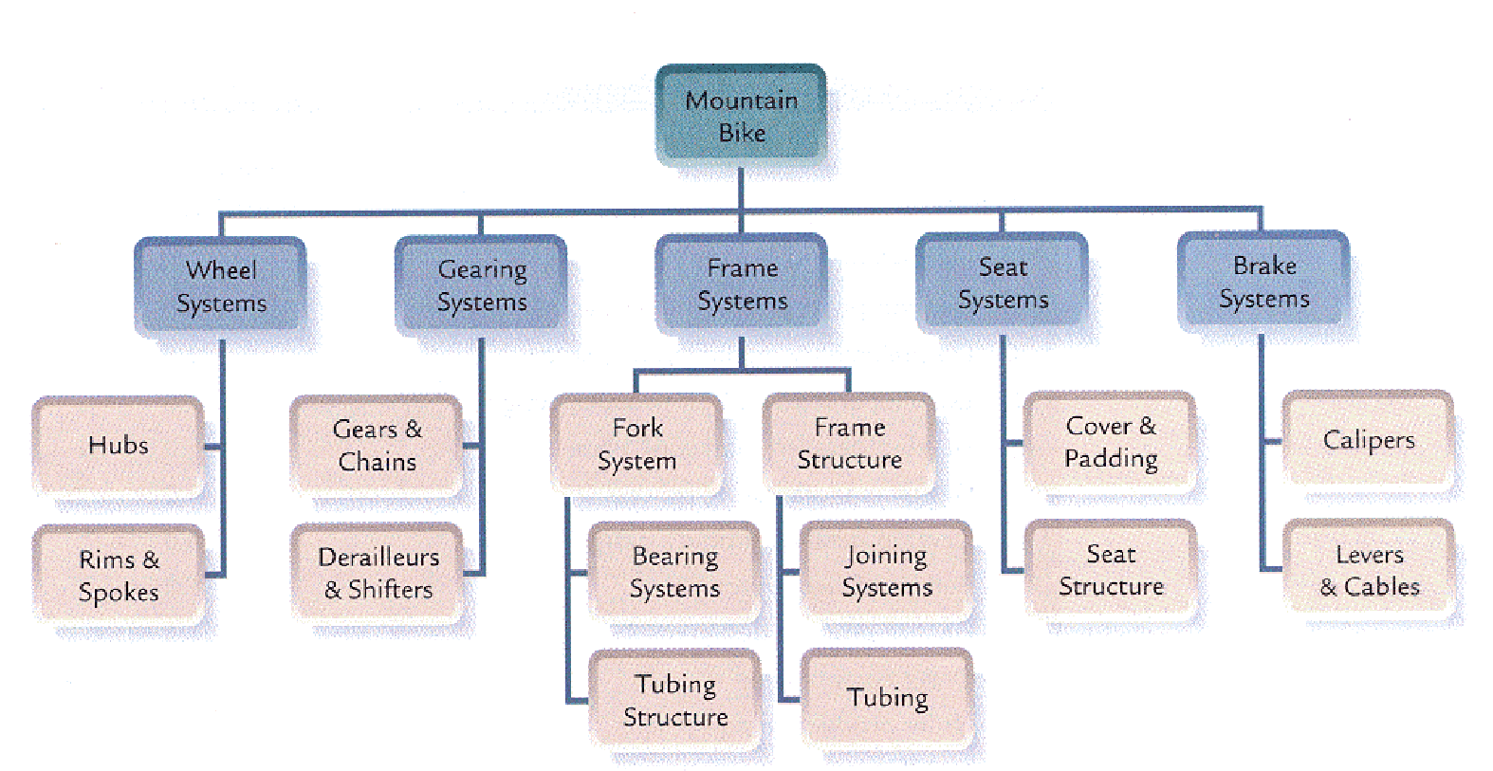

5.4.2 Create WBS: T&T
5 . 4 . 2 . 1 Decomposition
Decomposition is dividing and subdividing project work into smaller components.
The planned work is contained within the lowest level of WBS components called Work Package.
Work package is small enough to be estimated for time and cost.
Work Package
Work package can be subcontracted or assigned to one person.
It is possible that some deliverable that are schedule late are not decomposed at the early stage of the project.
Work package can not be further decomposed.
In the context of WBS, work refers to the deliverable or product of the activities not the activities themselves

Slide 12
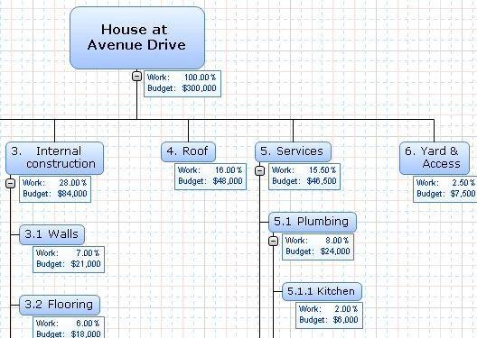
5.4.2.1 Create WBS: Decomposition
PMBOK advices to capture 100% of project work in the WBS. But most project managers can capture up to 95% of total project work in WBS
You can add duration too.

Slide 13
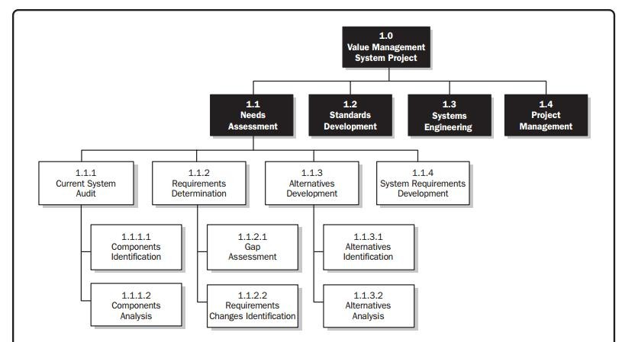
5.4.2.1 Create WBS: Decomposition
Decomposition allows for better management, control, and estimation of time and cost.
However subdividing into too much detail can lead to none productive management

Slide 14
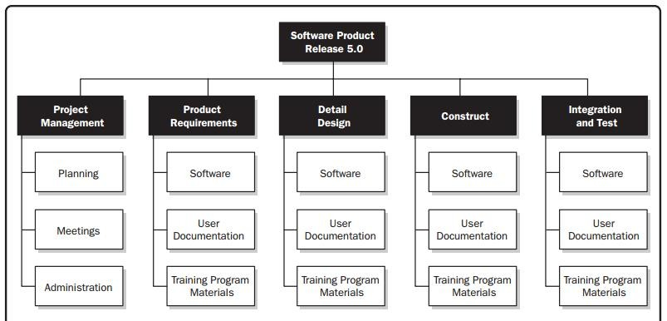
5.4.2.1 Create WBS: Decomposition
You can subdivide project work based on project phases.
Work packages include all the project work, including the work related to project management.

Slide 15
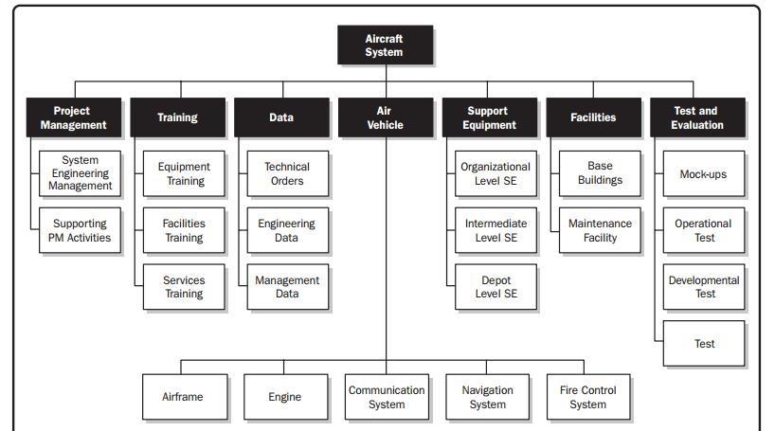
5.4.2.1 Create WBS: Decomposition
You can subdivide project work based on major deliverables

Slide 16
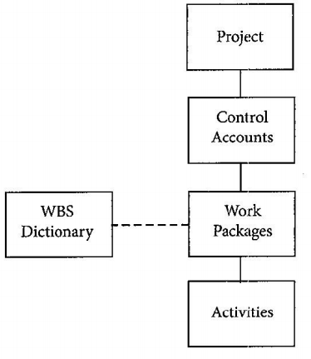
5.4.2.1 Create WBS: Decomposition
Many work packages are grouped into a control account.
All the work executed in the work packages are billed under their respective control account
Through control account we integrate budget, scope, schedule, and the actual cost and time.
Doing so help is in better performance measurement.

Slide 17


5.4.3 Create WBS: Output
5.4.3.1 Scope Baseline
Scope baseline is the approved version of scope statement, WBS, and WBS dictionary
Scope baseline can only be changed through formal Change Control procedure
Scope baseline is used as the base for comparing the actual work with the planned work.
5.4.3.2 Project Document updates
Requirements documentation may be updated

Slide 18

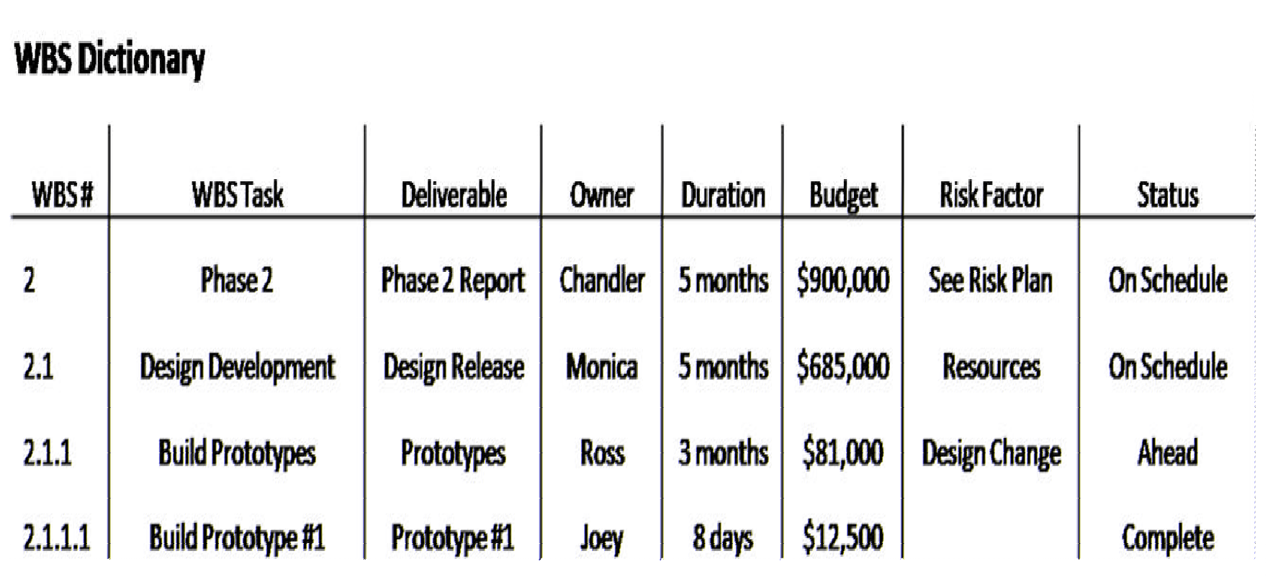
5.4.3 Create WBS: Output
5.4.3.1 Scope Baseline:
Scope baseline is the approved version of 1. Project Scope Statement, 2. WBS, and 3. WBS dictionary.
1. Project Scope Statement: Output to Define Scope process
2. WBS: Output to Create WBS Process
The WBS dictionary is a document that provides detailed deliverable, activity, and scheduling information about each component in WBS.
3. WBS Dictionary: Output to Create WBS Process
You can also include the following information:
•code of account identifier
•Assumptions and constraints
•Related schedule activities
•Acceptance criteria

Slide 19

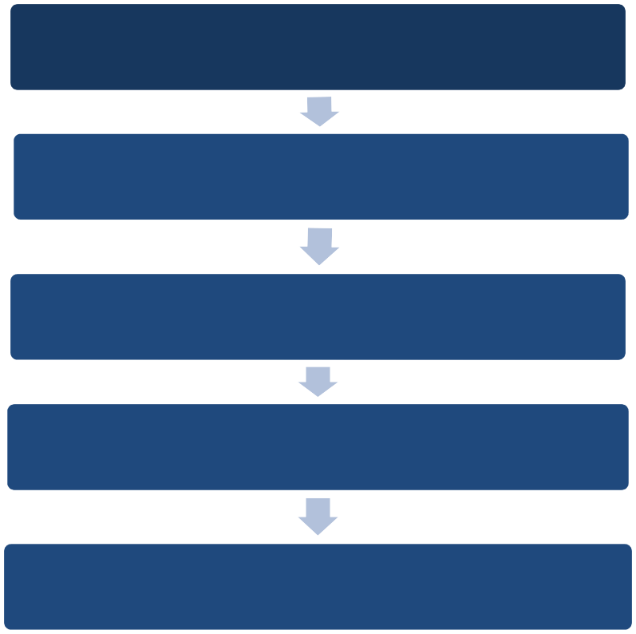
5.5 Validate Scope
Validate Scope is related to formal acceptance of the deliverables after completion.
Creating a product goes through the following process
Done internally, in Control Quality process product correctness and quality requirement of the product is verified.
Work planned in various planning processes
Work executed through execution processes
The verified deliverables obtained from Control Quality Process are reviewed with the customer to ensure they are satisfied and to get formal acceptance of the deliverables from the sponsor.
Product verified in Control Quality Process
Requirements documentations, scope baseline and execution data serves as the bases for validation or final acceptance of the product
Product formally accepted through Validate Scope process
Product formally handed over in Close Project Process

Slide 20
5.5 Validate Scope
Validate Scope is related to formal acceptance of the deliverables after completion.
Input
Tools & Techniques
Output
Project Management Plan
Requirements Documentation
Requirements traceability matrix
Verified deliverables
Performance data
1.Inspection
2. Group decision making technique
Accepted deliverables
Change requests
WPI
Project documents update

Slide 21
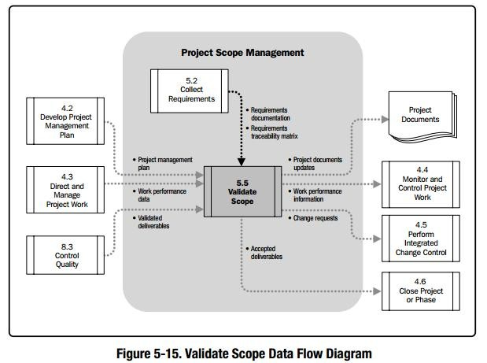
5.5 Validate Scope

Slide 22



5.5.1 Validate Scope: Inputs
5.5.1.1 Project Management Plan
Scope baseline of Project Management Plan is used.
5.5.1.2 Requirements Documentation
It contains products requirements and its acceptance criteria
5.5.1.3 Requirements Traceability Matrix
This document link each requirement to its origin and traces them throughout the project life cycle.

Slide 23

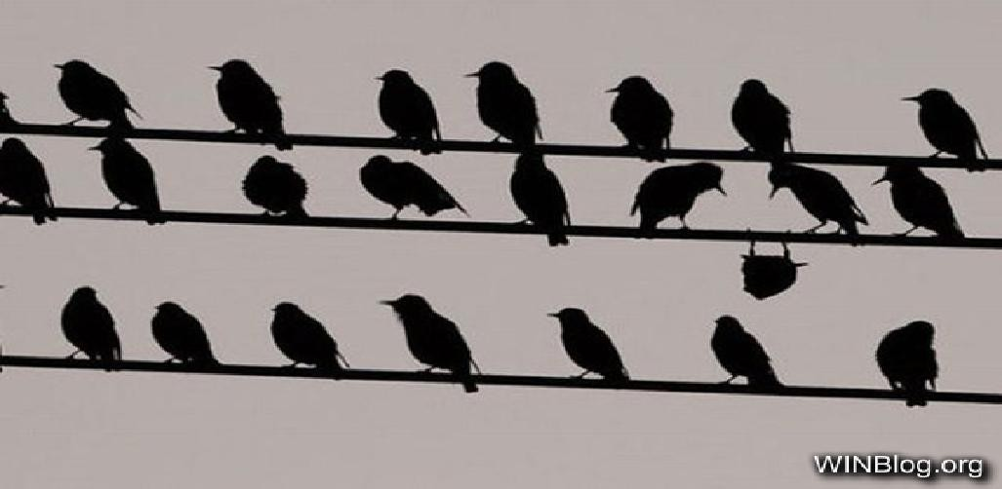
5.5.1 Validate Scope: Inputs
5.5.1.4 Verified Deliverables
Deliverables that are checked and verified in Control Quality Process
5.5.1.5 Work Performance Data
The data that provides information about the product’s degree of compliance to the requirements.
This can include the 1. number of validation cycles, 2. the number conformities,
3. the number of none nonconformities , and 4. the severity of nonconformities.
Work Performance Data is the collected during the actual work. Where the performed work is compared to the requirements.
Conformance: Being within the limits of possible variation.

Slide 24


5.5.2 Validate Scope: T&Ts
5.5.2.1 Inspection
Measuring, examining, and validating the work/product against the requirement and acceptance criteria
Inspections are sometimes called review, products reviews, audits, or walkthrough.
5.5.2.1 Group Discussion Making Technique
This technique is used to reach conclusion when the project team or other stakeholders are validating product or project work.

Slide 25


5.5.3 Validate Scope: Outputs
5.5.3.1 Accepted Deliverables
Deliverables formally signed off by the customer or sponsor
5.5.3.2 Change Request
If the deliverables are not formally accepted. The reason for none acceptance may be documented and change request is issued.
The change request is then processed through Perform Integrated Change Control Process.
5.5.3.3 Work Performance Information
This document includes information about project work progress, e.g the deliverable completed, accepted, etc.
Such information is then communicated to stakeholders.

Slide 26
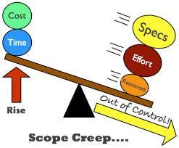
5.6 Control Scope
The process of monitoring the status of project/product scope and managing changes to scope baseline
Customers will have varying
ideas about what is inside scope and what is not.
Therefore Control Scope is important
Uncontrolled Scope Change, or changing scope without adjustment to cost, time and resources can result in scope creep.
Inputs
Tools & Techniques
Output
Requirement Management Plan
Requirement Doc
Req Trace Matrix
Work Performance Data
OPA
1. Variance Analysis
Work Performance Information
Change requests
PMP/PD updates
OPA updates

Slide 27
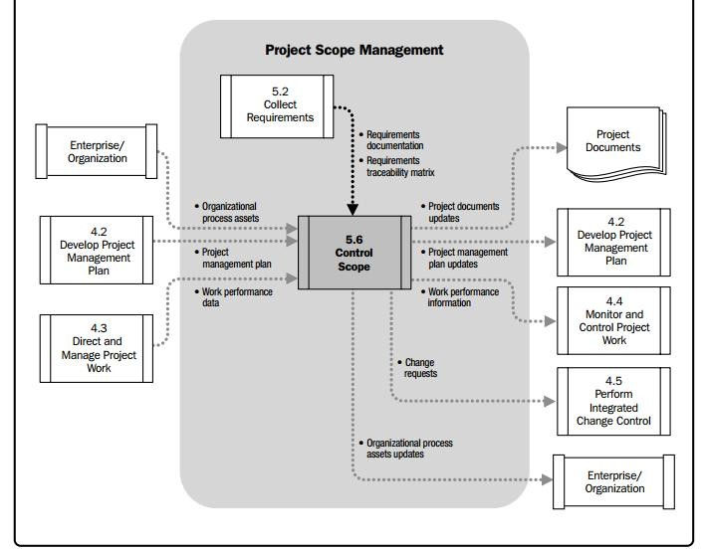
5.6 Control Scope

Slide 28



5.6.1 Control Scope: Inputs
Project Management Plan
• Scope Baseline
• Scope Management Plan
• Change Management Plan
• Requirements Management Plan
Requirement Documentation
• Containing all the requirements about the project deliverables
• Requirements are used as reference when change is requested
Requirements Traceability Matrix
• It helps in determining the impact of any change.
Work Performance Data
• It includes the number of changes requested, accepted, and rejected, also the number of deliverables completed.

Slide 29

5.6.2 Control Scope: T&Ts
5.6.2.1 Variance Analysis
Measuring the planned scope against the completed scope
Determining the cause and degree of difference between the baseline and actual work
Deciding whether corrective or preventive action is required

Slide 30



5.6.3 Control Scope: Outputs
5.6.3.1 Work Performance Information
Contextualized Information about project scope
It talks about changes made, their impacts, and scope variances
WPI works as the base for making decision related to project scope
5.6.3.2 Change Requests
Control Scope Process can result in changes to scope or any other component of the project management plan
The change can be related to preventive actions, corrective actions, or defect repairs
5.6.1.4-6 Updates
Updates to scope baseline, requirements documentation, requirements traceability matrix, and lessons learned are made.

Slide 31
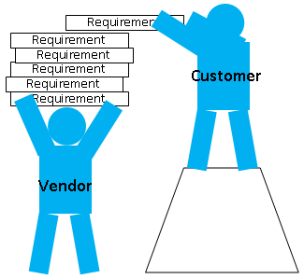
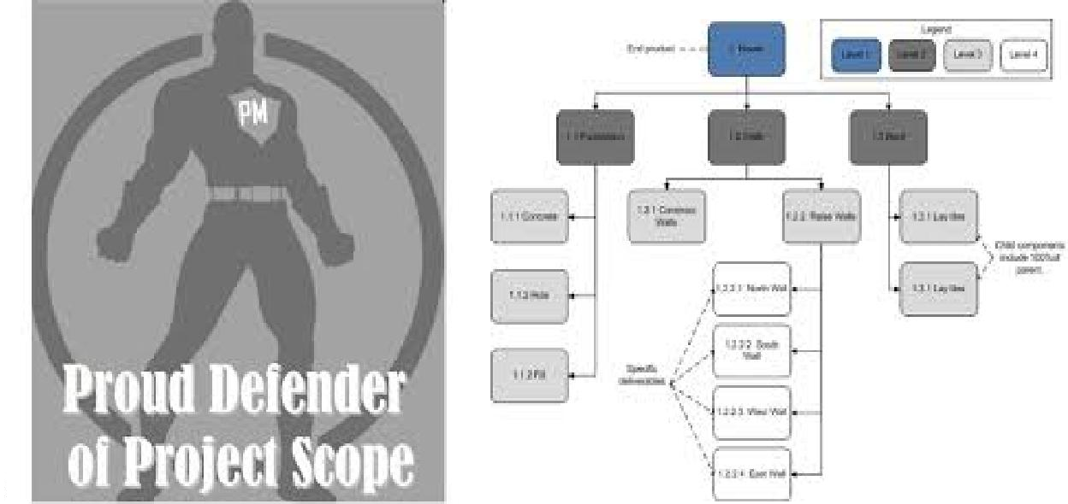
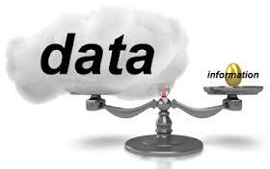
Lesson 6: Wrap Up
Create WBS
Decomposition
WBS Dictionary
Scope Baseline
Validate Scope
Verified Deliverables
Accepted Deliverables
Work Performance Data
Work Performance Information
Control Scope
Scope Creep
Variance Analysis
Change Requests

Slide 32


Slide 33

Read Pages 141 -192 of the PMBOK Guide

