Slide 1
Ch.7 Project Cost Management
Pages 193-226 of PMBOK Guide 5th Edition

Slide 2
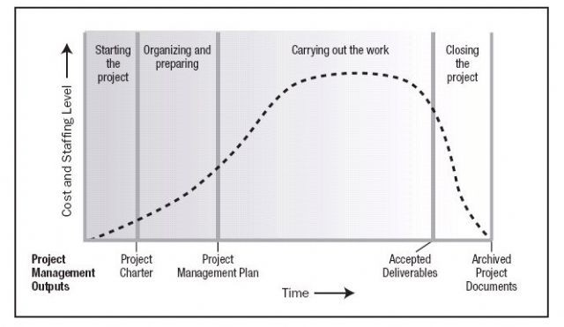
Ch.7 Project Cost Management
Here we study all those process that deal with planning, managing, and controlling the cost of the project.
In small project cost costing and budgeting are closely related processes and can be performed by a single person
The cost related decision can affect the future costs of maintaining the product of your project .
For example reducing the number of iteration for a software development project may reduce the cost of the project but increase the cost of maintaining the product.
Cost and staffing is highest at the execution stage
Budget is the approved cost and cost baseline the time phase budget
Sometimes you may be required to calculate the financial benefits of your product. In such a case Project Cost Management may include financial management techniques
e.g return on investment, discounted cash flow, etc.

Slide 3



Ch.7 Processes of Cost Management
7.1 Plan Cost Management
Here we establish the policies, procedures, and documentation for planning, managing, expending, and controlling project costs.
7.2 Estimate Costs
The process of estimating costs for project activities
7.3 Determine Budget
The process of aggregating individual activity or work package cost in order to establish the cost baseline.
7.4 Control Costs
The process of monitoring the status of the project to update the project costs and managing changes to the cost baseline.

Slide 4
7.1 Plan Cost Management: ITTOs
Here we develop policies and procedures as well as documentation for managing and controlling project cost.
Input
Tools & Techniques
Output
Project Management Plan
Project Charter
EEF
OPA
Expert Judgments
Analytical Techniques
Meetings
1. Cost Management Plan

Slide 5
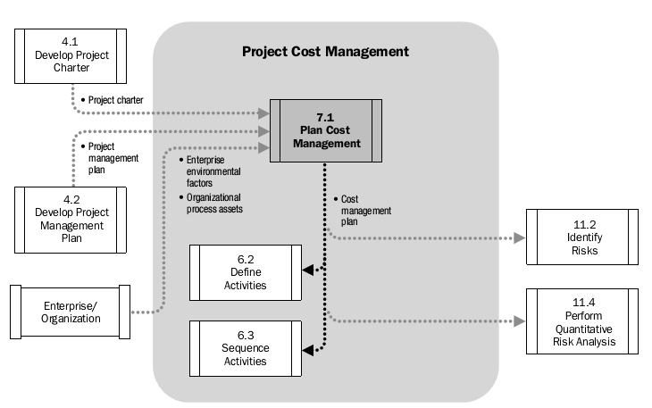
7.1 Plan Cost Management: Data Flow Diagram

Slide 6



7.1 Plan Cost Management: Inputs
7.1.1.1 Project Management Plan
Elements of PMP used are Scope Baseline, Schedule Baseline, and cost related risk and communication decisions.
7.1.1.2 Project Charter
Contains high level budget and project approval requirements
7.1.1.3 EEF/OPA
Currency exchange rates, market conditions, published commercial data,
Financial control procedures, financial database, lesson learned, exiting policies

Slide 7


7.2 Plan Cost Management: ITTOs
7.1.2.1 Expert Judgment
Experts in the area making use of their expertise and historical information
7.1.2.2 Analytical Technique
Using techniques such Payback period, Return on Investment, Net Present Value, Internal Rate of Return, and discounted Cash Flow
We use these techniques to choose between strategic options for acquiring resource need for project activates such as self funding, funding with equity, renting, leasing, buying, etc.
7.1.2.3 Meetings
Meetings that are attended by project manger, project team members involved with costing, sponsor, and other related stakeholders

Slide 8

7.3 Plan Cost Management: outputs
7.1.3.1 Cost Management Plan
The cost management plan describes how the project cost will be structure, planned, and managed
Cost Management Plan establishes the following
Unit of measure: E.g staff hours, staff days, liters, meters, tons, etc.
Organizational Procedure Link: As each work package in WBS is having unique account identifier, activity cost is directly linked through this account identifier to organizations accounting system.
Level of precision: the level of round up values e.g 10.51 to 11.00
Control thresholds: Specifying acceptable threshold for cost variance before action is needed. The threshold is usually shown in percentage of variance.
Level of accuracy: The acceptable range for accepting cost estimation e. g ± 10%
In the Cost Management Plan we also specify the frequency of reporting, and any other additional process needed for cost estimation
Rules of Performance Measurement: Rules for Earned Value Management (EVM) are set.
For example
At which point in the project measurements will be made
What techniques to be used for EVM
How to calculate EAC

Slide 9

7.2 Estimate Costs: ITTOs
The process of estimating monetary resources of the project activities.
Costs are estimated for all the resources that will be charged to the project
Input Tools & Techniques Output
Cost Management Plan
HR Magtm Plan
Scope Baseline
Project Schedule
Risk Register
EEF/OPA
Expert Judgments
Analogous estimating
Parametric estimating
Bottom-up estimating
Three-point estimating
Reserve Analysis
Cost of Quality
Project Magtm software
Vendor bid analysis
Group Decision Making
Activity cost estimates
Bases of estimates
Project document updates

Slide 10
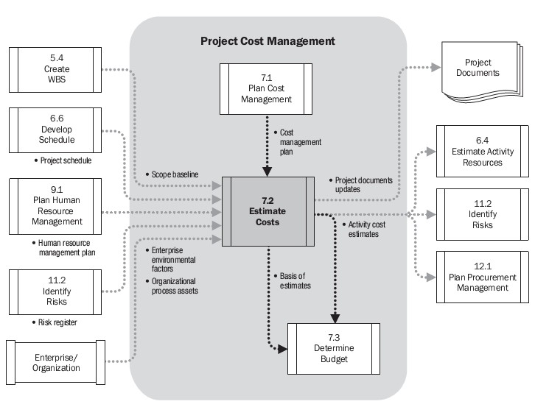
7.2 Estimate Costs: Data Flow Diagram
Cost estimating should be an iterative process and refined as activities become more clear with progress in work.
In some Orgs there might be guidelines about when to make such refinements
Cost estimation is usually measurement of some currency but can also be measured as a unit of staff hours, staff days, etc to eliminate the risk of currency fluctuation.
At the begging our estimates might be just a rough order of magnitude (ROM) which is -25%
to +75% of the real cost. Later on we can reach to definitive estimates which are -5% to +10

Slide 11


7.2 Estimate Costs: Inputs
7.2.1.1 Cost Management Plan
It tells us about how to estimate, manage, and control project cost
7.2.1.2 Human Resource Management Plan
It tells us about the skill level of the staff needed and the reward and recognition planned for the staff
7.2.1.3 Scope Baseline
Scope statement may tell us whether both direct and indirect costs or only direct costs are estimated
WBS and WBS dictionary will give us more info about the scope
There might be constraints documented in the scope baseline e. g regulations related to safety, security, environment, and health.

Slide 12



7.2 Estimate Costs: Inputs
7.2.1.4 Project Schedule
It tells us about the resources and duration of activities
Also some of the resources may be at higher or lower rate at some specific time of the year
7.2.1.5 Risk Register
It tells us about the future risks and their implication on the activity costs
During the project we should be sensitive about both positive and negative risks
7.2.1.6 EEF/OPA
Market condition: the availability of certain resource and products and who have it.
Published Data: Telling us about resource costs
Historical information, template, policies

Slide 13


7.2.2 Estimate Costs: T&Ts
7.2.2.1 Expert Judgment
Industry specific expertise together with using historical information
7.2.2.2 Analogues Estimating
Estimating activity duration, cost, based on historical information
In this technique we use the size, duration, budget, and complexity of an activity carried out in previous project as base for estimating cost and duration of new activities.
Analogues estimating is less costly and less time consuming than other techniques but also less accurate.

Slide 14


7.2.2 Estimate Costs: T&T
7.2.2.3 Parametric Estimating
In Parametric Estimating technique we use statistical relationship between historical data and other variables e. g square foot or labor hours per work unit.
7.2.2.4 Three point Estimation
To count for uncertainty in estimation and risk we use three point estimation
The estimation used are: Most likely (cM), Optimist (cO), and Pessimistic (cP)
Estimate time (cE) is achieved through the following two formulas:
Triangular Distribution: cE= (cO+cM+cP)/3
Beta Distribution: cE = (cO+4cM+cP)/6

Slide 15


7.2.2 Estimate Costs: T&Ts
7.2.2.5 Bottom up Estimating
Estimating costs at lower level for better estimation and then adding it up to the higher level for better reporting ad tracking
6.5.2.6 Reserve Analysis
Contingency Reserves uncertainty in estimating the activity cost
Contingency reserves are allocated to identified risk or “known unknowns”. For example we know that there will some rework (Known) but we do not know the amount of the rework (unknown)
Contingencies reserves can be a percentage of work, a fixed cost, or developed using quantitative analysis.
As the project progress contingency reserves may be increase or decreased
While contingency reserve is part of project baseline another type of reserves called Management reserves is associated with managerial control of the project work, unforeseen work that is included in the project scope, and unidentified risks or “unknown unknowns”
Originally the management reserve is not part of Cost Baseline but when we start using the reserves we do include them in the Cost Baseline through Change Control System

Slide 16

7.2.2 Estimate Costs: T&Ts
7.2.2.7 Cost of Quality
Assumption about the costs related to the quality of product should be included in the cost estimates
7.2.2.8 Project Management Software
Using software to estimate tools
7.2.2.9 Vendor Bid Analysis
Analyzing bids received from other successful bidders for the same project
7.2.2.10 Group Decision Making Technique
Group techniques such as brainstorming, Delphi Technique, and Nominal Group Techniques are used for better estimation and commitment to those estimations

Slide 17


7.2.3 Estimate Costs: Outputs
7.2.3.1 Activity Cost Estimates
Activity Cost Estimates are the quantitative assessments of the costs required to complete an activity
Cost estimates are related to all the activity resource such as direct labor, materials, equipment, services, IT, interest rates, inflation rate, exchange rates, contingency reserves etc.
7.2.3.2 Bases of Estimation
Here we document how we achieved the estimation about activity costs
For example the bases on which we developed the costs, the assumption we made, the constraint we had, the confidence level we have in our estimates, and the range of estimates (±10%)
7.2.3.3 Project Documents Updates
Risk register is updated

Slide 18
7.3 Determine Budget: ITTOs
In this process we aggregate all the costs and develop cost baseline for the project which is the approved project budget except for the management reserves
Input
Tools & Techniques
Output
Cost Management Plan
Scope Baseline
Activity cost estimation
Basis of estimates
Project Schedule
Resource Calendar
Risk Register
Agreements
OPA
Cost aggregation
Reserve Analysis
Expert Judgment
Historical Relationships
Funding limit reconciliations
Cost Baseline
Project Funding Requirements
Project Docs update

Slide 19
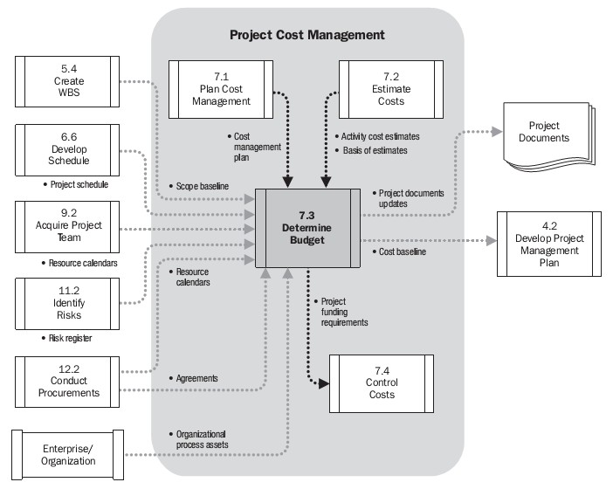
7.3 Determine Budget: Data Flow Diagram

Slide 20



7.3.1 Determine Budget: Inputs
7.3.1.1 Cost Management Plan
It tells us how the project cost will be managed and controlled
7.3.1.2 Project Scope Baseline
Scope Statement: Indicating the budget related constraints
WBS: indicating the relationship between various works of the project
WBS Dictionary: Gives details about the WBS components
7.3.1.3 Activity Cost Estimates
Giving us the cost estimates about each activity which will be aggregated to calculate estimated cost for each work package
7.3.1.4 Bases for estimation
This Doc will tell us about the assumptions for including or excluding the indirect or any other costs for a given activity

Slide 21



7.3.1 Determine Budget: Inputs
7.3.1.5 Project Schedule
The project schedule will tell us about start and finish dates of activities, information necessary for developing a budget
7.3.1.6 Resource Calendar
Resource calendar tells us about the resources used during a specific time for project activities.
As most of the costs will go to resources, having this info is critical
7.3.1.7 Risk Register
It tells us about all the risk and their expected time of occurrence
7.3.1.8 Agreements
Agreements related to the product that is going to be purchased is included when determining budget.
This may help us know how and when the seller is going to be paid

Slide 22



7.3.2 Determine Budget: T&Ts
7.3.2.1 Cost Aggregation
Costs are first aggregated by work packages and then higher components of the WBS. The estimates are ultimately aggregated for the whole project
7.3.2.2 Reserve Analysis
Here we establish both contingency reserves and the management reserves related to project budget
7.3.2.3 Expert Judgment
Experts in the subject area consisting of consultants, sponsor, stakeholder

Slide 23


7.3.2 Determine Budget: T&Ts
7.3.2.4 Historical Relationships
Using historical information to establish a mathematical model through analogous or parametric estimation
The mathematical model is then used to determine budget for the whole project
The model can be simple as (basing budget of a residential home construction based on square foot) or complex as (having a model where multiple factors can be adjusted
7.3.2.5 Funding limit reconciliation
The project expenditure should be reconciled with the funding limits.
If the planned expenditure is above the funding limits at any time, project work should be rescheduled

Slide 24

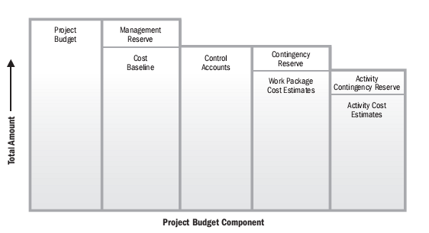
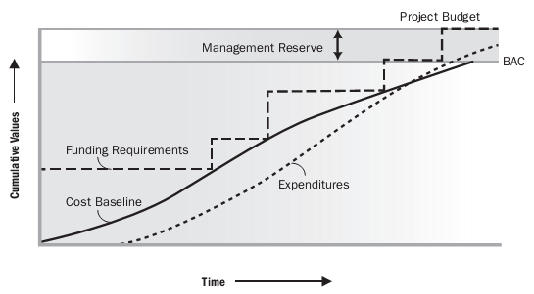
7.3.3 Determine Budget: Outputs
7.3.3.1 Cost Baseline
Cost Baseline is the approved time-phased project budget
The cost baseline can only be changed through proper change control system
Cost Baseline does not include management reserve
Project Budget is Cost Baseline +
Management Reserves
The summation of Control Accounts makes up the Cost Baseline
Many work packages coming together makes as single control account
When managements reserves are about to be used, they are included in the cost baseline

Slide 25


7.3.3 Determine Budget: Outputs
7.3.3.2 Project Documents Updates
Risk Register, Activity Cost Estimates, and Project Schedule may be updated
7.3.3.3 Funding Requirement
Funding requirements are derived from the cost baseline
Funding requirements also include the management reserves
The source of funding may also be identified in the funding requirement doc
Funding can not be provided on regular bases therefore funding requirements are asked on incremental bases

Slide 26

7.4 Control Costs: ITTOs
In this process we monitor the status of the project to update the project costs plus we manage changes to cost baseline.
Here we mainly compare the expenditure and the physical work completed.
Input
Tools & Techniques
Output
Project Management Plan
Project Funding Requirement
Work Performance Data
OPA
Earned Value Management
Forecasting
To-complete Performance Index (TCPI)
Performance reviews
Project Management Software
Reserve analysis
Work Performance Information
Cost forecasts
Change requests
Project management plan updates
Project Docs update
6.

Slide 27
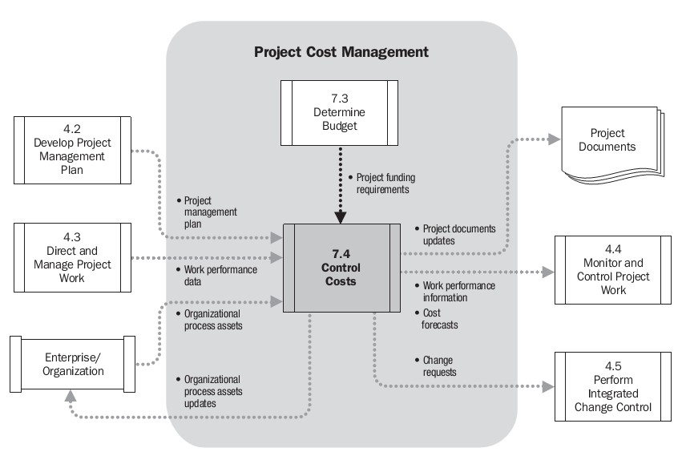
7.4 Control Cost: Data Flow Diagram
In the process we also:
Monitor work performance against funds expended;
Prevent unapproved changes from being included in the reported cost
Bring expected cost overruns within acceptable limits.

Slide 28



7.4.1 Control Costs: Inputs
7.4.1.1 Project Management Plan
Project Cost Mamgt Plan: Specifying how to manage & control the costs
Cost Baseline: The baseline is compared with the actual results
7.4.1.2 Project Funding Limits
It specifies the project cost plus the liabilities associated with securing the funds
7.4.1.3 Work Performance Information
WPI include all the information about work progress, e. g which activities have completed and which have started and the cost authorized or spent for these activities
7.4.1.4 OPA
Including policies, procedures, and cost control mechanism

Slide 29

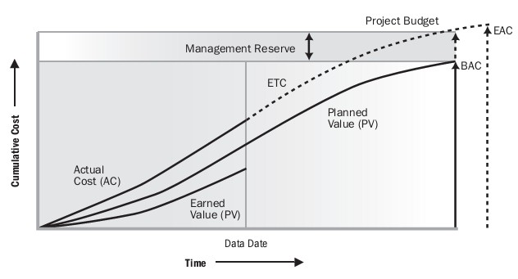
7.4.2 Control Costs: T&Ts
7.4.2.1 Earned Value Management
Earned Value Management (EVM) is a technique that combines scope, schedule and resource measurement in order to assess project performance
EVM measures project performance and progress through performance baseline
The performance baseline is formed through integrating project scope baseline, cost baseline, and schedule baseline
Using the Earned Value Management technique we develop and manage the three key dimensions for each work package or control account. The three dimensions are Planned Value, Earned Value, and the Actual Cost

Slide 30



7.4.2.1 Control Costs: EVM
Planned Value (PV)
PV is the value of physical work that should have been accomplished against the planned cost.
E. g you planned that for 10,000 USD you will complete 5% work
Earned Value (EV)
EV is the value of physical work that is actually completed against the planned cost.
E. g you have actually completed 4% of the work after spending the 10,000 USD that were planned to be spent for completing 5% work.
Actual Cost (AC)
AC is the amount of expenditure spent on completing a work during specific time period or percentage of work.
E. g to complete 5% of the planned work you spent 12,000 USD. The 12K spent is the AC.

Slide 31



7.4.2 Control Costs: T&Ts
Earned Value Management Continues….
Schedule Variance (SV)
SV is a measure of schedule performance
SV is measured by subtracting the PV from EV or SV= EV-PV
Cost Variance (CV)
CV is a measure of cost performance for a project
CV is measured by subtracting the AC from EV or CV = EV - AC
Schedule Performance Index (SPI)
SPI measures the efficiency of the time used by the project team or simply shows schedule efficiency
SPI is measured as a ratio of the EV to the PV, or SPI = EV/PV
If SPI is greater than 1 we are ahead of the schedule
If SPI is less than 1 we are behind the schedule

Slide 32

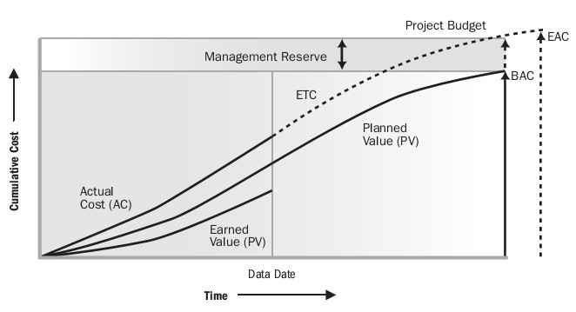
7.4.2 Control Costs: T&Ts
Earned Value Management Continues….
Cost Performance Index (CPI)
CPI measure the budget efficiency in a project
CPI is measured as the EV to AC or CPI = EV/AC
CPI greater than 1 indicates we are under budget
CPI less than 1 indicate we are over budget
So far, all the equations involve Earned Value (EV). When calculating SV, CV, SPI, or CPI, you always start with EV and find its relation to the required equation.
Estimate At Completion (EAC) means how much will the project cost if we continue as the current situation.
Budget At Completion (BAC) means how much budget we had planned for the whole project.
What is going on with this project?

Slide 33

7.4.2 Control Costs: T&Ts
7.4.2.2 Forecasting
Based on the project performance we may develop a forecast for the Estimate At Completion (EAC) for the cost.
To forecast EAC we consider the current performance and any information relate to the project’s future performance. Such information can be found in WPI
The basic formula for calculating for EAC is: EAC= AC+ bottom-up ETC (Estimate to completion)
Since (EAC = AC + bottom-up) involves manual estimation, the result may be compared with various results obtained from other equations used for calculating the EAC.
If the future work is performed the same as the budgeted rate or the way we had planned it at the very begging, we calculate EAC as: EAC = AC + (BAC – EV)
If we believe that the current performance will continue in the future we calculate EAC as: EAC = BAC/CPI
If want to take both the current cost and schedule performance into account then we calculate EAC as: EAC = AC + [(BAC – EV) / (CPI x SPI)] . The CPI and SPI can be counted as 80/20 or 50/50 or any other values as desired by the project manager.

Slide 34

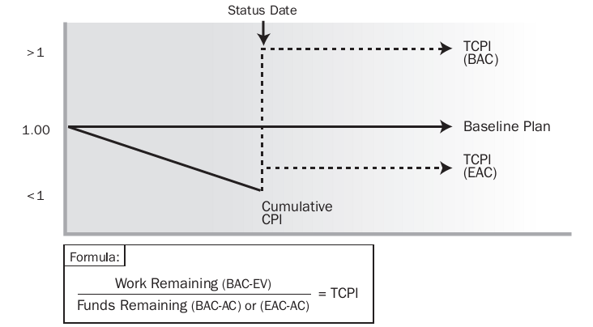
7.4.2 Control Costs: T&Ts
7.4.2.3 To Complete Performance Index (TCPI)
TCPI is used to calculate future Performance Index if we want to achieve some specific managerial goals, e. g completing the project within the planned budget (BAC) or within our new estimation (EAC).
To calculate TCPI we can use two different equations shown below
If we want to complete the project within the planned budget (BAC) then the formula is: TCPI = (BAC-EV) / (BAC – AC)
But if we think that it is no longer possible to complete the project in the planned budget (BAC) which might be the case in this example where the current performance index is below 1, then we calculate TCPI by using EAC: TCPI = (BAC-EV)/ (EAC – AC)

Slide 35

7.4.2 Control Costs: T&Ts
7.4.2.4. Performance Reviews
Through Performance Reviews we compare the cost performance, indentifying the activities or work packages that are over budget or under budget and estimated funds needed to complete the work.
If EVM is used the followings information is determined:
Variance Analysis: Cost Variance (CV = EV – AC), Schedule Variance (SV = EV – PV), and Variance At Completion (VAC = BAC – EAC) are determined.
And find the cause and degree for variance and decide whether corrective or preventive action is needed.
Trend Analysis: In Trend Analysis we analysis project performance over time to know the performance is improving or deteriorating.

Slide 36


7.4.2 Control Costs: T&Ts
7.4.2.5 Project Management Software
Project Management Software is used monitor the three dimensions of EVM (PV, AC, and EV).
The software is also used to show different forecast for the project completion.
7.4.2.6 Reserve Analysis
Analyzing contingency and management reserves
If the reserves are not used, we take them out of the project budget
We may possible allocate more reserves

Slide 37



7.4.3 Control Costs: Outputs
7.4.3.1 Work Performance Information
Calculated CV, SV, CPI, SPI, VAC, and TCPI for each control account and work package are documented and communicated to the stakeholders
7.4.3.2 Forecasts
EAC is documented and communicated to the stakeholders
7.4.3.3 Change Requests
As with most of Monitoring and Controlling process change request is made
Change request can be preventive or corrective action or changes into one of the three baselines

Slide 38



7.4.3 Control Costs: Outputs
7.4.3.4 Project Management Plan Updates
Cost Baseline: Changes to cost baseline is made due to variances or new estimates
Cost Management Plan: Some of the stakeholders may request changes to things like level of control thresholds, or level of accuracy.
7.4.3.5 Project Documents Updates
Cost Estimates and Bases of Estimation
7.4.3.6 OPA Updates
Causes of Variance, corrective action selected and the reason for them to be selected, financial database, and lesson learned are updated.

